Slide 1
Welcome to my class
Da Phuc Primary School
Teacher: Do Tra Giang
Class: 4a1

Slide 2
STARTER
A. HELLO AGAIN!

Slide 3
Warm-up
Let's meet new friends!
01

Slide 4
Let’s sing.
02

Slide 5
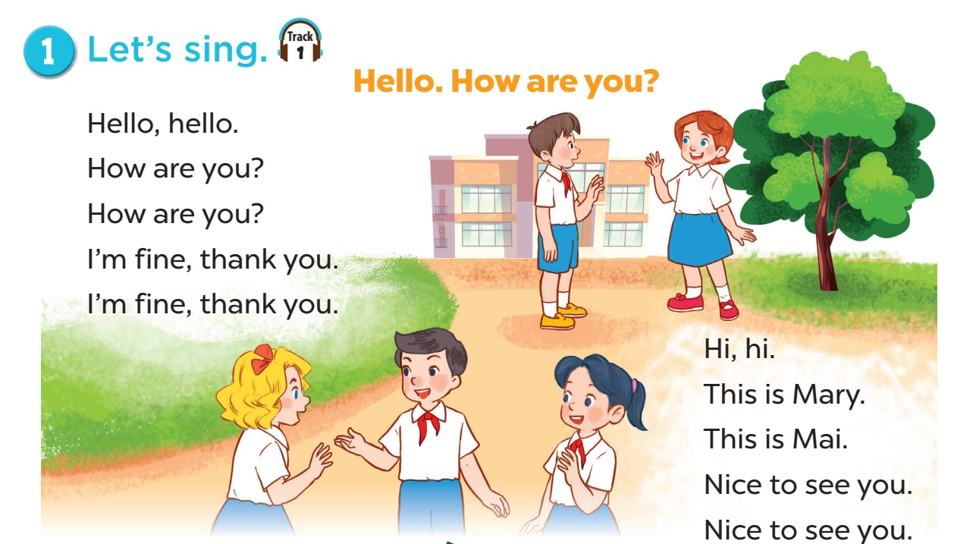

Minh
Lucy

Slide 6
Listen and tick.
03

Slide 7
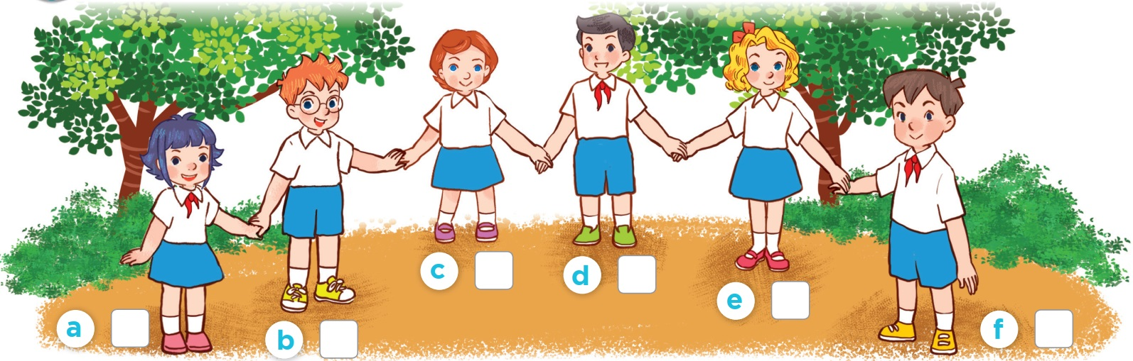
Who is she/ he?

Slide 8
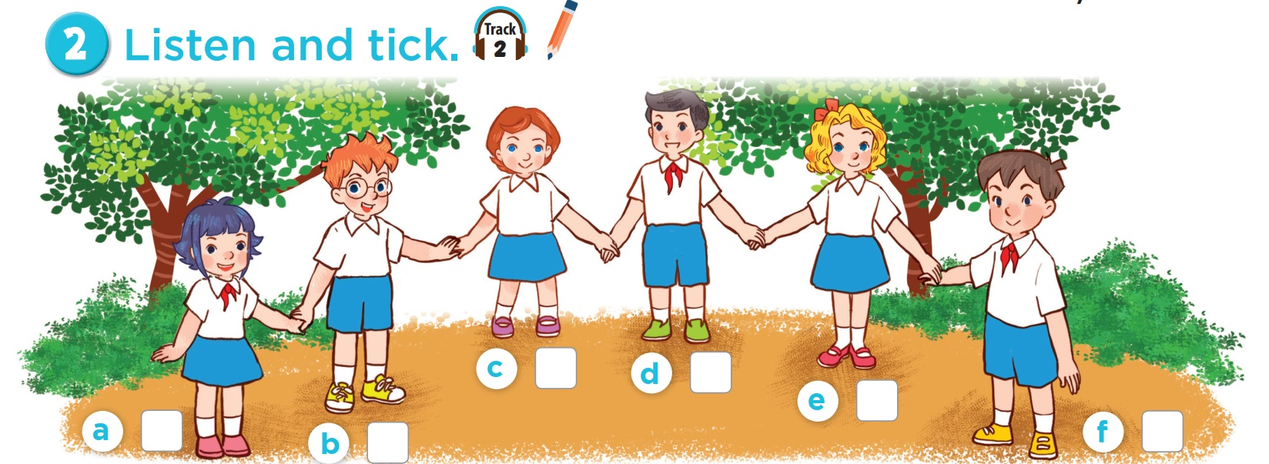


Slide 9
Let's play.
03

Slide 10
Review alphabets

Slide 11



A
B
C
D
E
F
G
H
I
J
K
L
M
N
Q
R
Notes:
Step 1: Divide the class into 2 or 4 groups
Step 2: Each group chooses a letter by reading its name
Step 3: Teachers clicks that letter to open the box and see how many stars pupils will get for the letter.
Repeat the procedure until the last letter.
Step 4: Groups having the most stars will win.

Slide 12
S
T
U
V
W
X
Y
Z
I
J
L
U
M
N
Q
R

Slide 13
Fun time
04

