Slide 1
Welcome to my class
Da Phuc Primary school
Teacher: Do Tra Giang class: 4a2

Slide 2


Time and daily routines
2
Lesson 2 (1,2,3)

Slide 3
01
Warm-up & review

Slide 4
02
Look, listen and repeat.

Slide 5
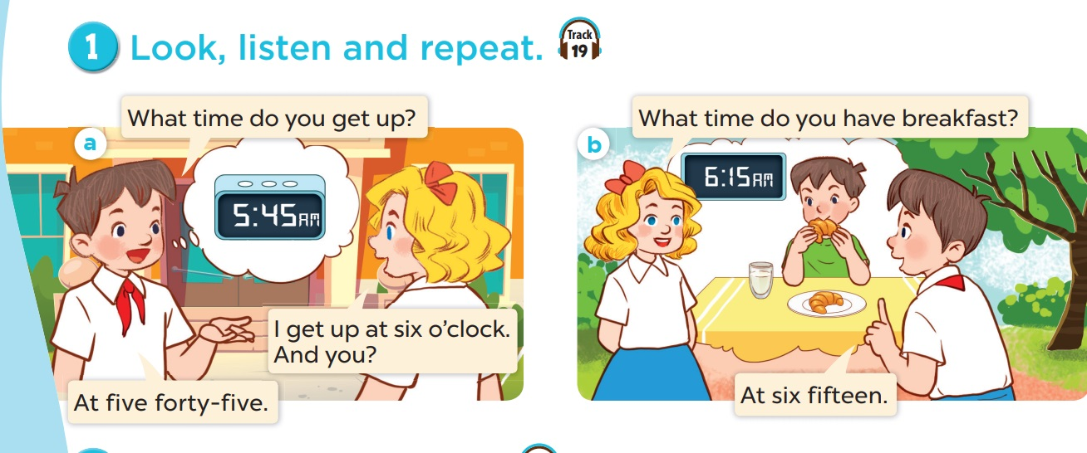

Slide 6
03
Listen, point and say.

Slide 7
vocabulary

Slide 8
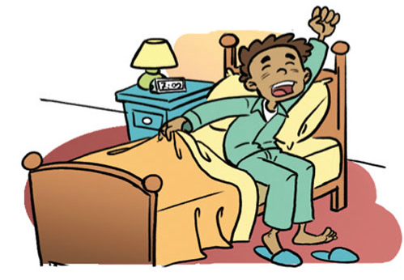
get up

Slide 9
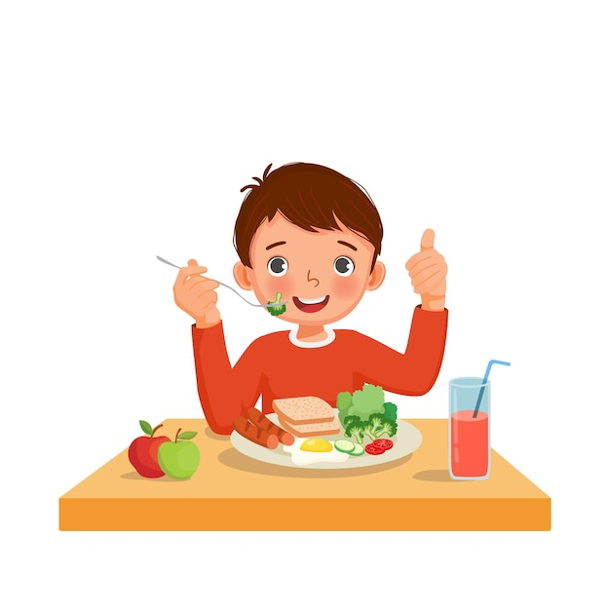
have breakfast

Slide 10

go to school

Slide 11
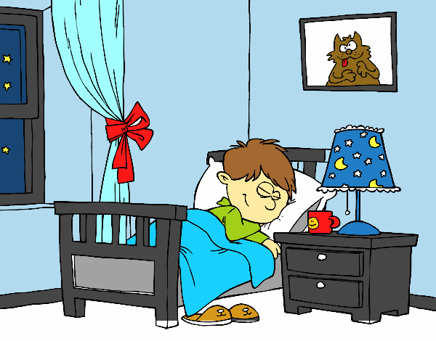
go to bed

Slide 12
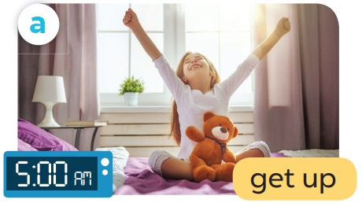
What time do you get up?
I get up at
5 o’clock.

Slide 13
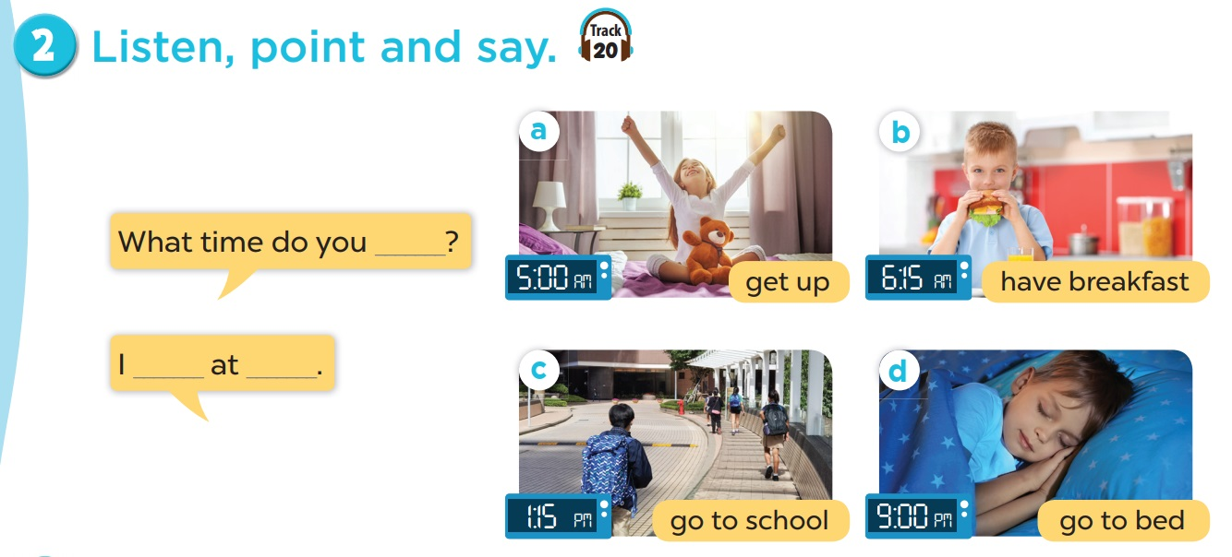

Slide 14
04
Let’s talk.

Slide 15
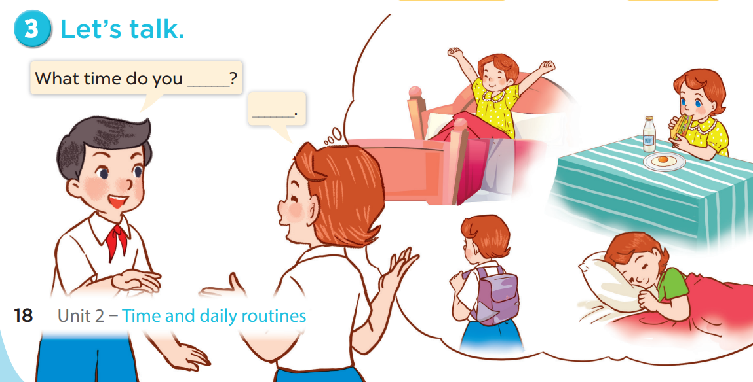

Slide 16
05
Fun corner & wrap-up

Slide 17


Magic wheel
50
10
20
30
10
20
30
40
Spin
PLAY
LUẬT CHƠI
Nhấn nút để quay.
Trả lời đúng câu hỏi sẽ được cộng số điểm tương ứng vị trí mũi tên dừng.
Kết thúc trò chơi đội cao điểm hơn sẽ chiến thắng.
Spin

Slide 18
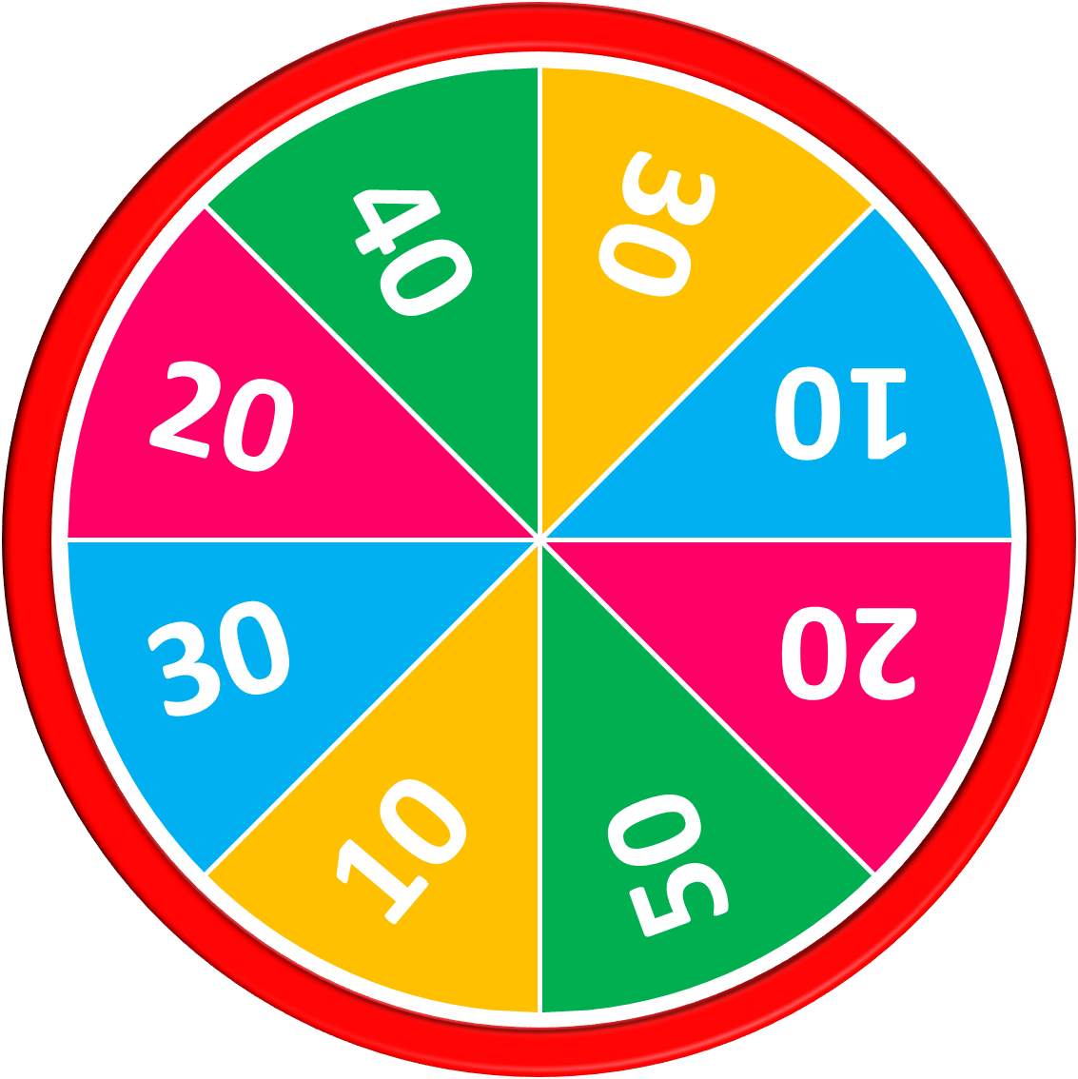
50
10
20
30
10
20
30
40
Answer
get up
Stop
Spin

Slide 19
50
10
20
30
10
20
30
40
Answer
have breakfast
Stop
Spin

Slide 20
50
10
20
30
10
20
30
40
Answer
A: What time do you get up?
B: I get up at five o’clock.
Stop
Spin

Slide 21
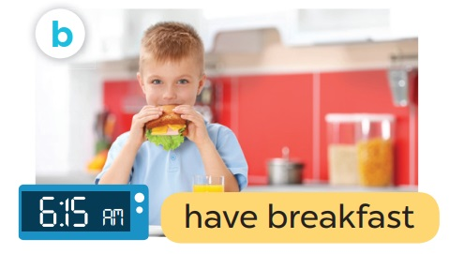
50
10
20
30
10
20
Answer
30
40
A: What time do you have breakfast?
B: I have breakfast at six fifteen.
Stop
Spin

Slide 22

50
10
20
30
10
20
30
40
Exit

Slide 23
Thank you
Goodbye

