Slide 1
Welcome to my class Da Phuc Primary School Teacher: Tran Phuong Linh Class: 3a1

Slide 2





4
Our bodies
LESSON 3
Period 5

Slide 3
Contents
1
2
3
Warm-up and review
Listen and repeat.
4
Fun corner and wrap-up
Listen and circle.
5
Let’s chant.

Slide 4
1
Warm-up and review

Slide 5
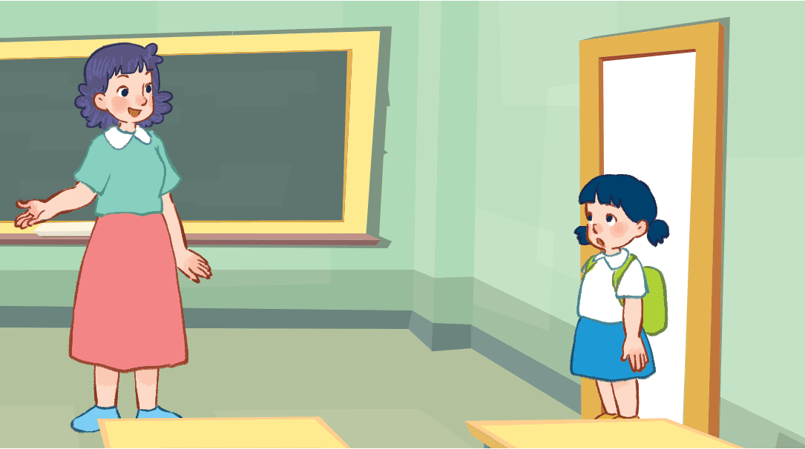

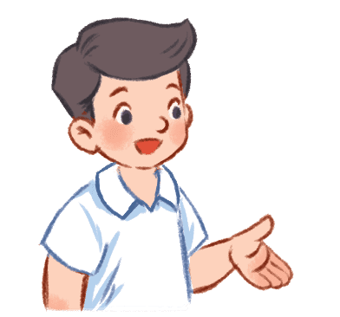

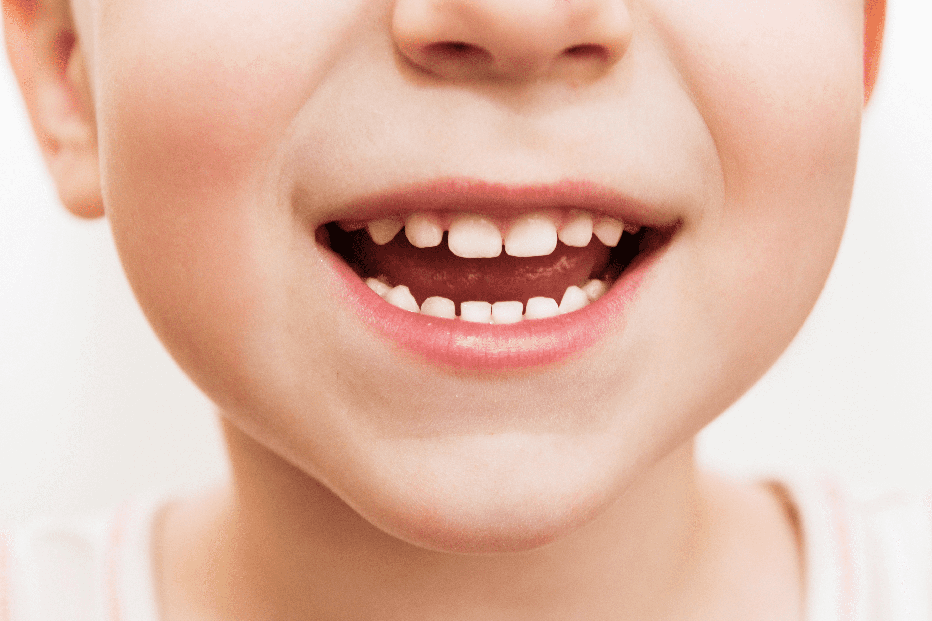
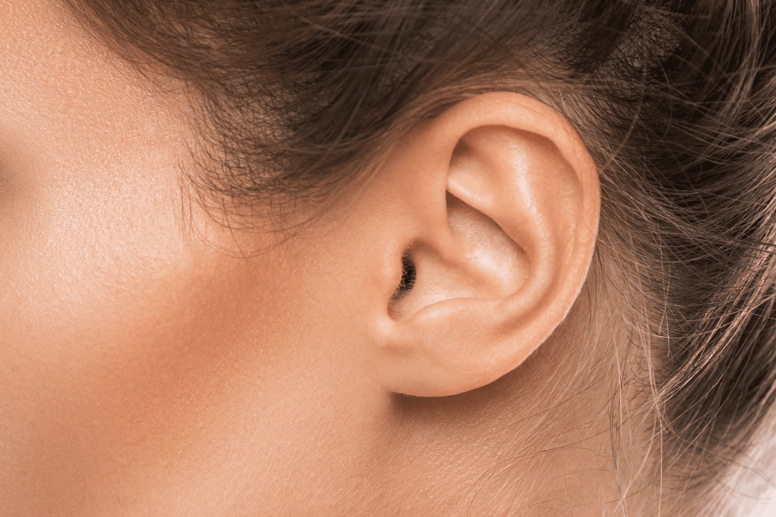
Jump and say.
Notes:
Option 1: Game: Jump and say
Step 1: Ask 5 – 6 pupils to join the game. Line them up. Each pupil holds a flashcard.
Step 2: If the pupils hear that teacher has said the word that matches their flashcard, they must jump and say out loud.

Slide 6

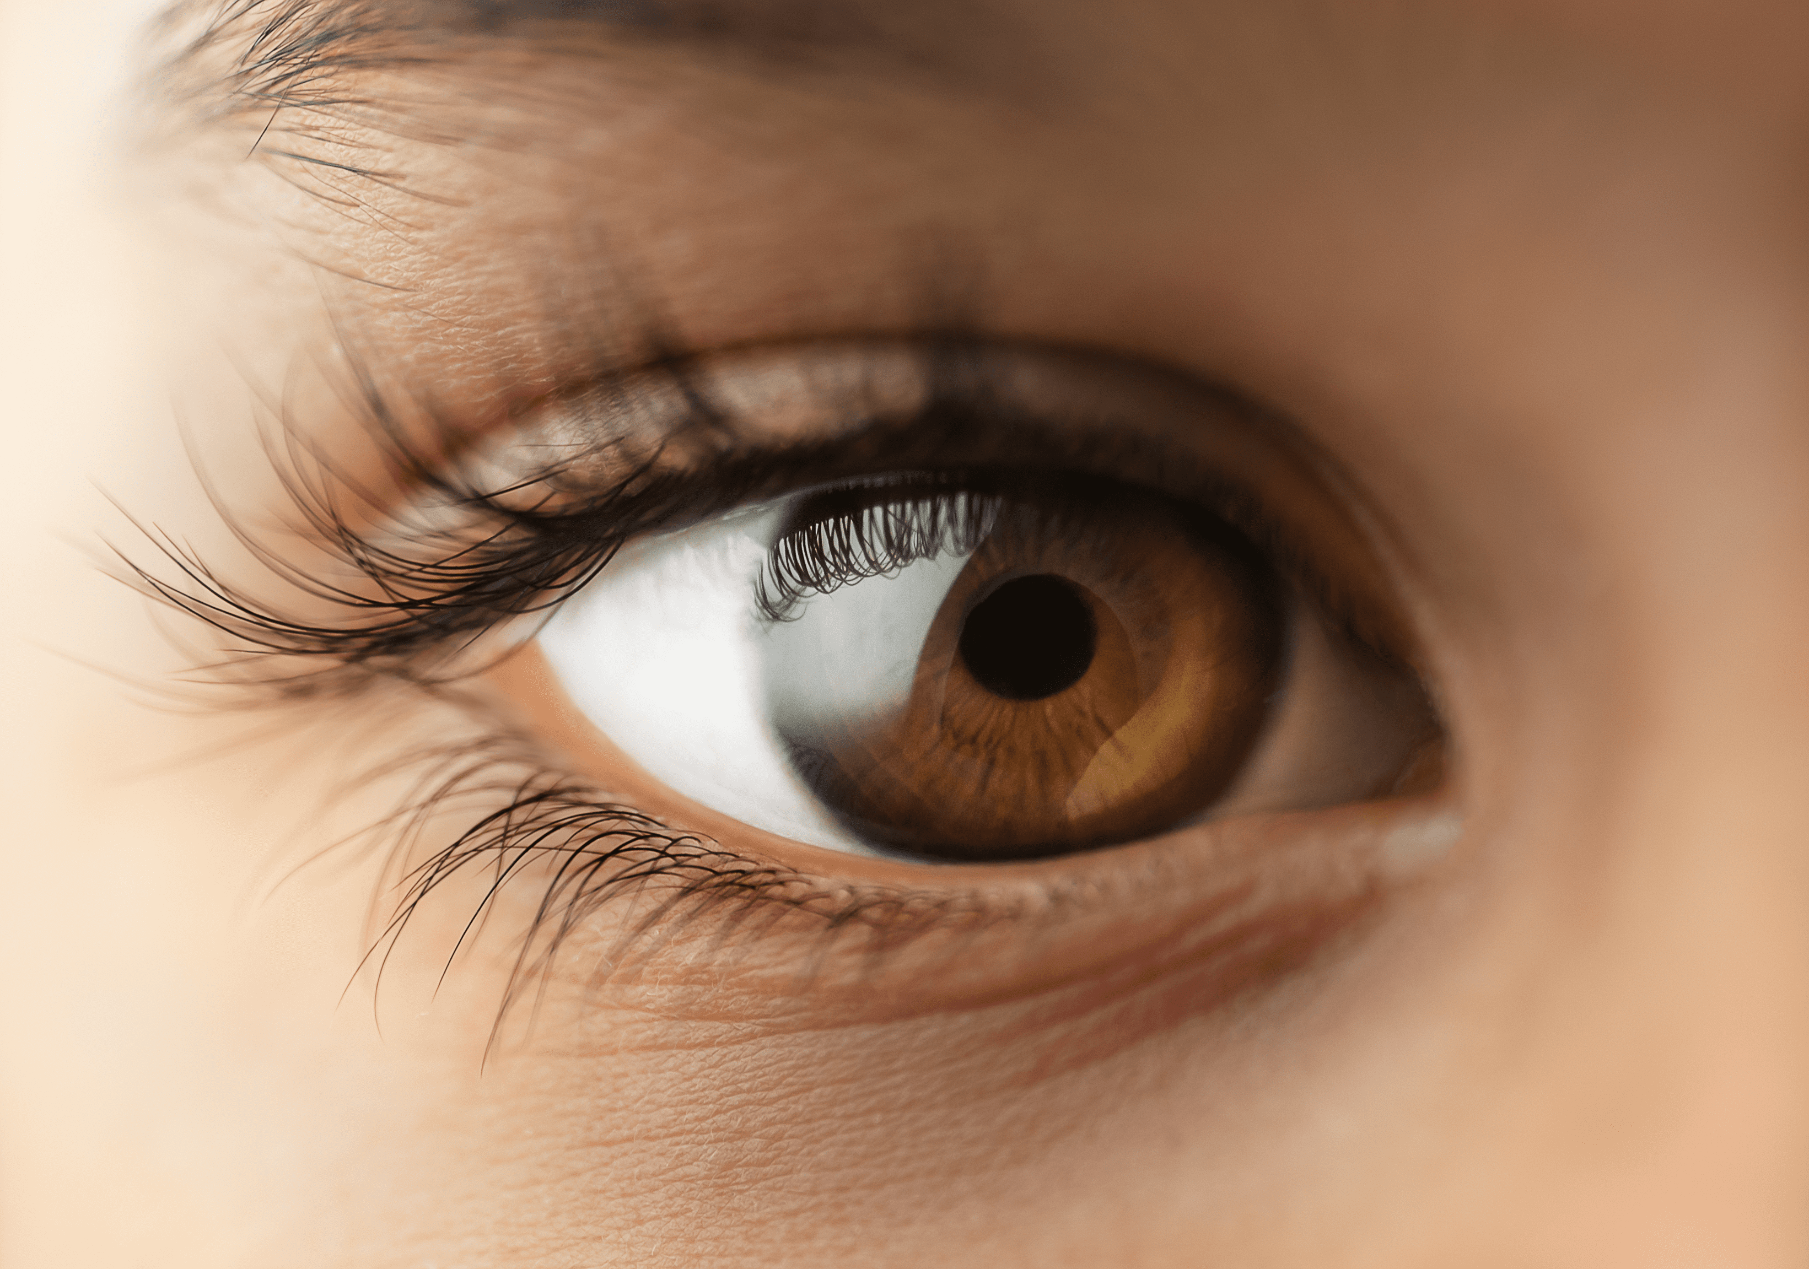
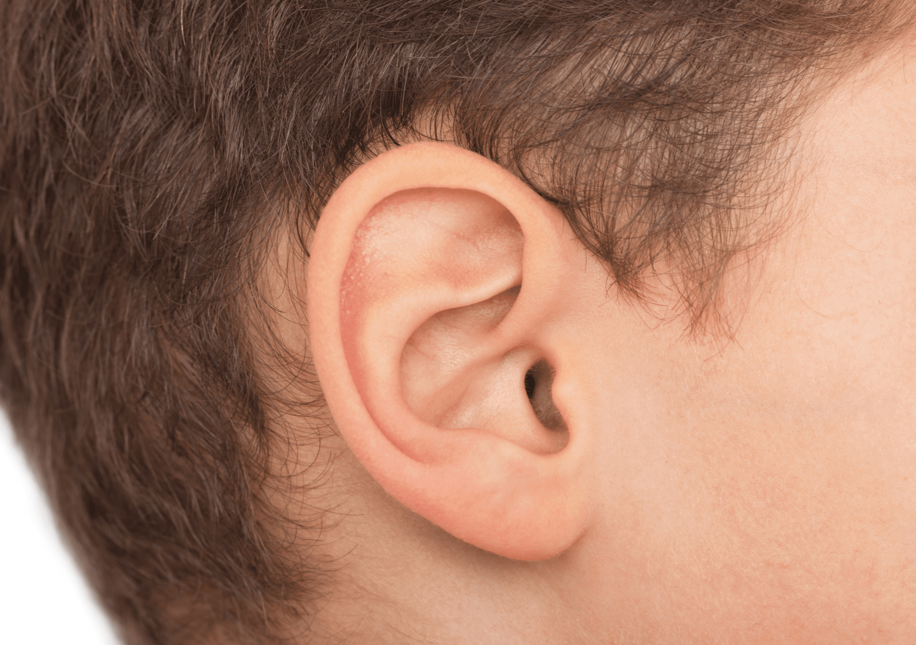

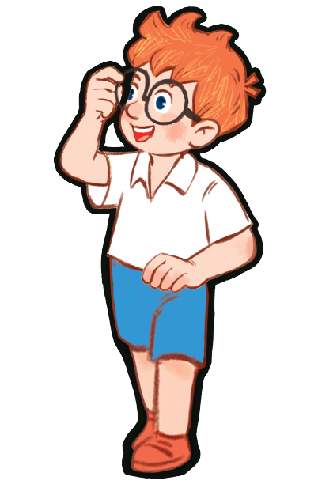
Which is missing?
Notes:
Option 2: Which is missing?
Step 1: Teacher puts four or five flashcards on a board and tells pupils to read out loud.
Step 2: Ask them to close their eyes. Teacher takes one (or two/three picture... depending on the level of your class) item away.
Step 3: Have pupils open their eyes, ask them to guess what item is missing and say that word out loud .

Slide 7
2
Listen and repeat.

Slide 8
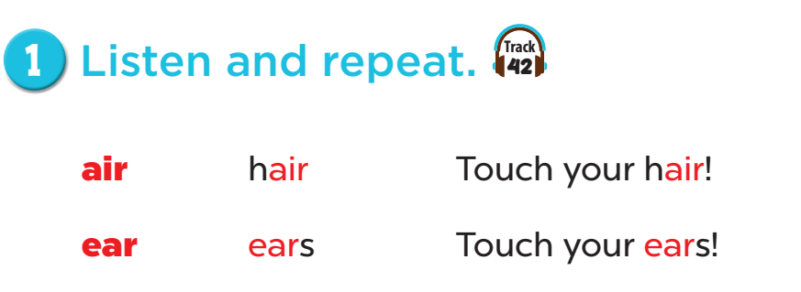


Slide 9
3
Listen and circle.

Slide 10
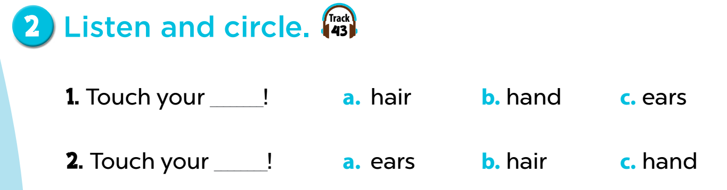
Notes:
Key: 1. c 2. b

Slide 11
4
Let’s chant.

Slide 12
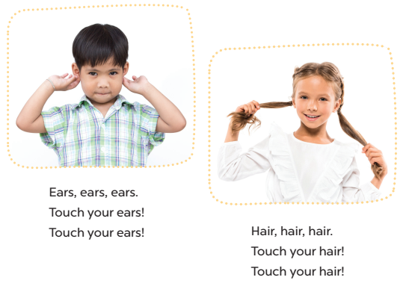

Slide 13
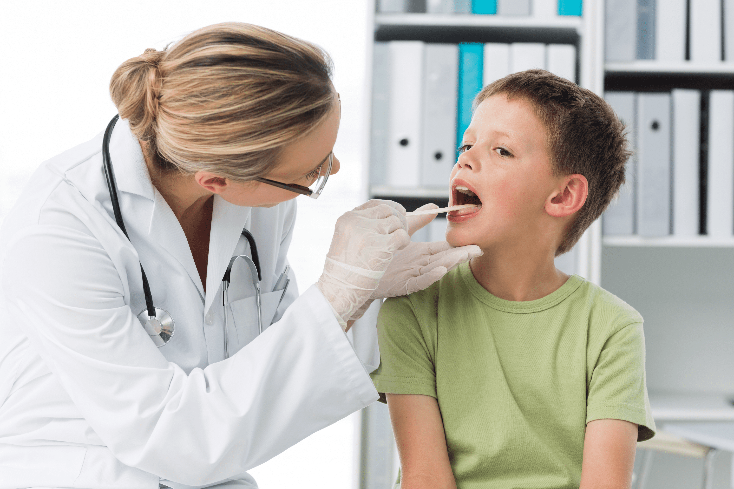

Mouth, mouth, mouth.
Open your mouth!
Open your mouth!
Face, face, face.
Touch your face!
Touch your face!

Slide 14
5
Fun corner and wrap-up

Slide 15
Thank you See you later

