Slide 1
Welcome to my class Da Phuc Primary school Teacher: Do Tra Giang Class: 4A3

Slide 2



Things we can do
5
LESSON 3 (4,5,6)

Slide 3
01
Warm-up

Slide 4
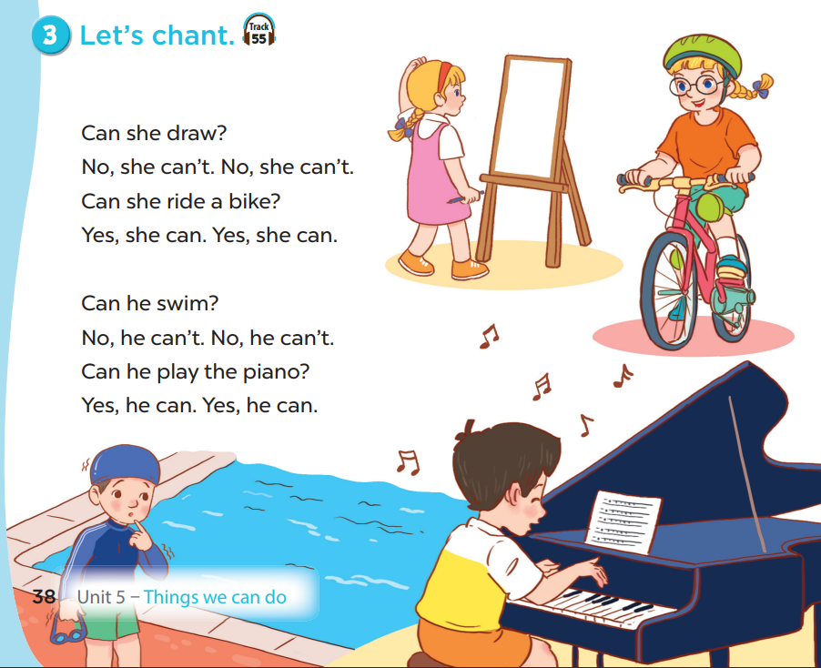


Slide 5
02
Activity 1 Read and tick.

Slide 6
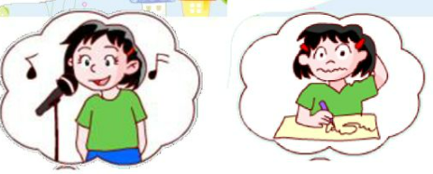


She can sing.
She can’t write.
She can sing but she can’t write.

Slide 7
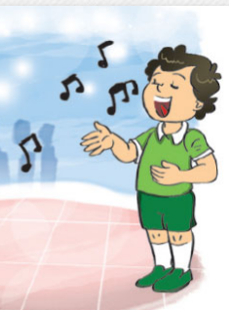
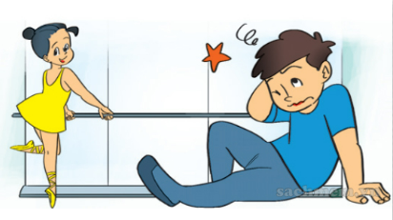
He can sing.
He can’t dance.
He can sing but he can’t dance.

Slide 8
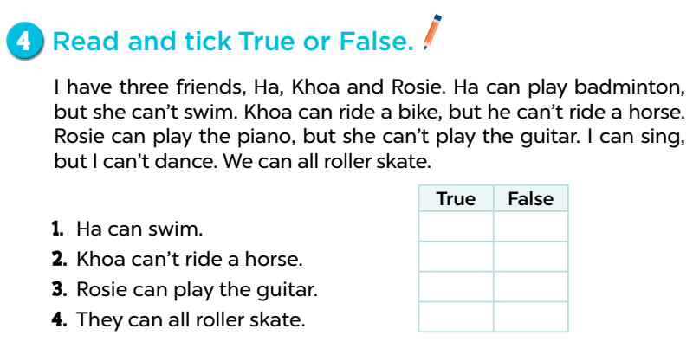








Slide 9
03
Activity 2 Let’s write.

Slide 10
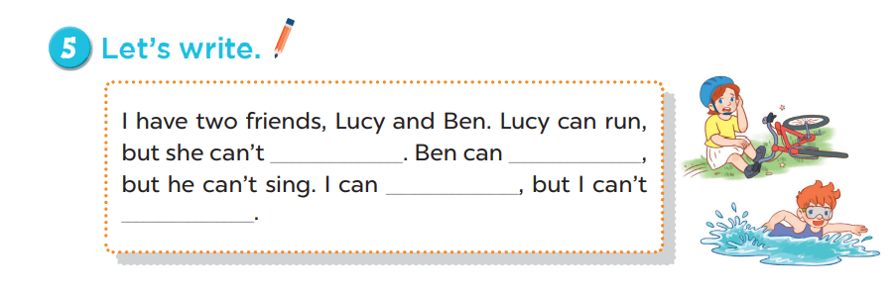
ride a bike
swim

Slide 11
04
Game

Slide 12








TEAM 1:
TEAM 2:
TEAM 3:

Slide 13



Point
+10
Lose all points

Slide 14
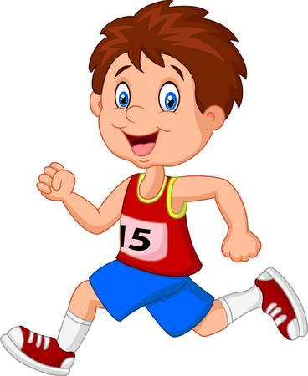
What can he do?.
He can run..

Slide 15

Can she play the piano?
No, she can’t..

Slide 16
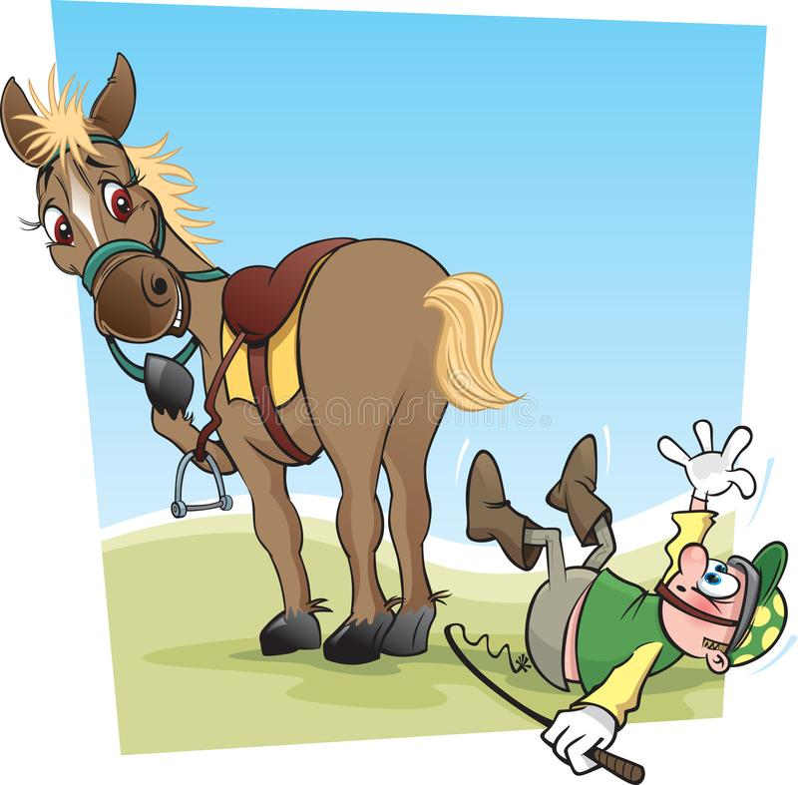
What can’t he do?
He can’t ride a horse..

Slide 17
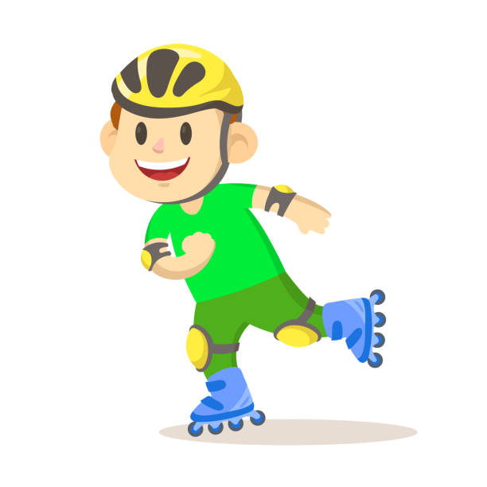
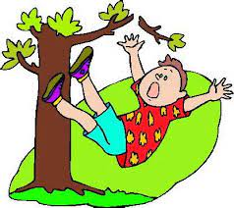
Make a sentence..
He can roller skate but
he can’t climb a tree.
…. but …

Slide 18
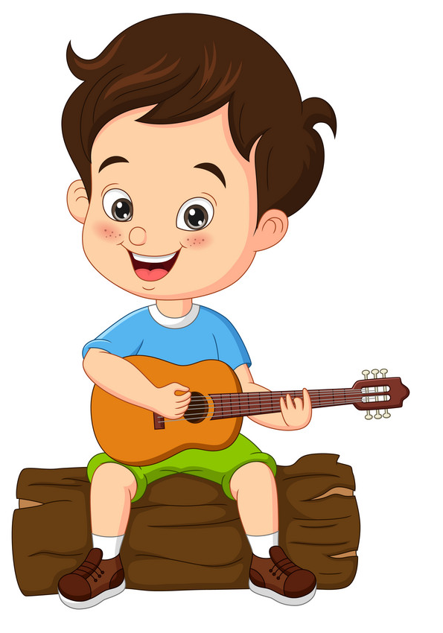
What can he do?
He can play the guitar..

Slide 19
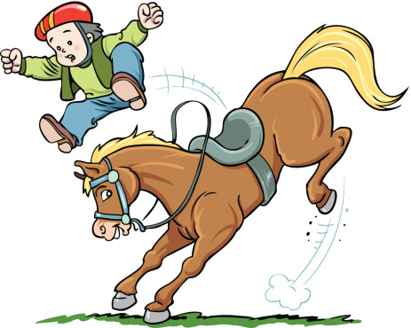
What can’t he do?.
He can’t ride a horse.

Slide 20
05
Project

Slide 21
Our school club | SPORT MUSIC | MUSIC
Names | Can you …………………? | Can you …………………?

Slide 22
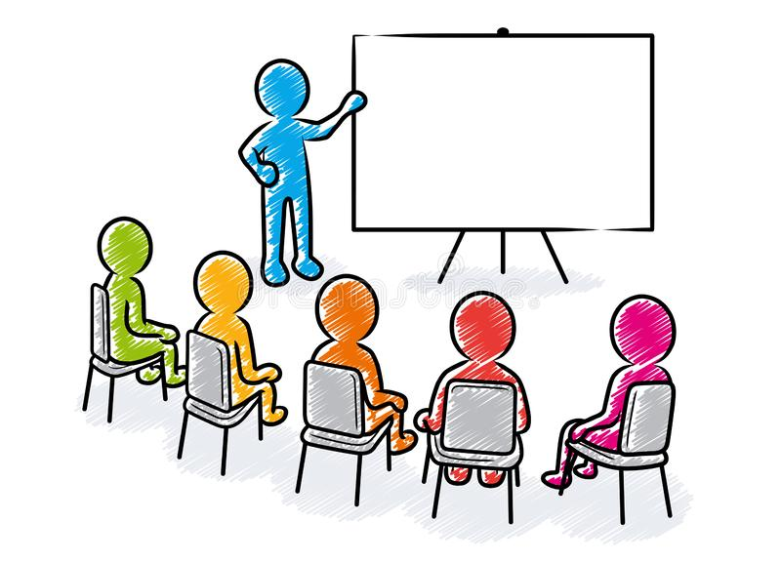
Presentation

Slide 23
Thank you Goodbye

