Slide 1
Welcome to my class
Da Phuc Primary school
Teacher: Do Tra Giang
Class: 4A4

Slide 2
Unit 7 Our timetables
Lesson 1 (4,5,6)

Slide 3
01
Warm-up
Let’s sing a song

Slide 4
02
Listen and tick or cross.

Slide 5
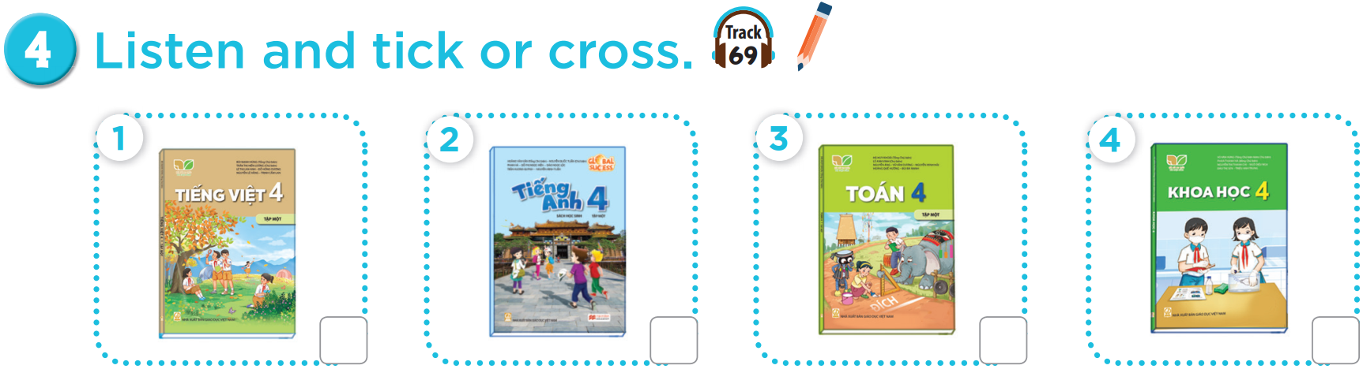


Slide 6
03
Look, complete and read.

Slide 7
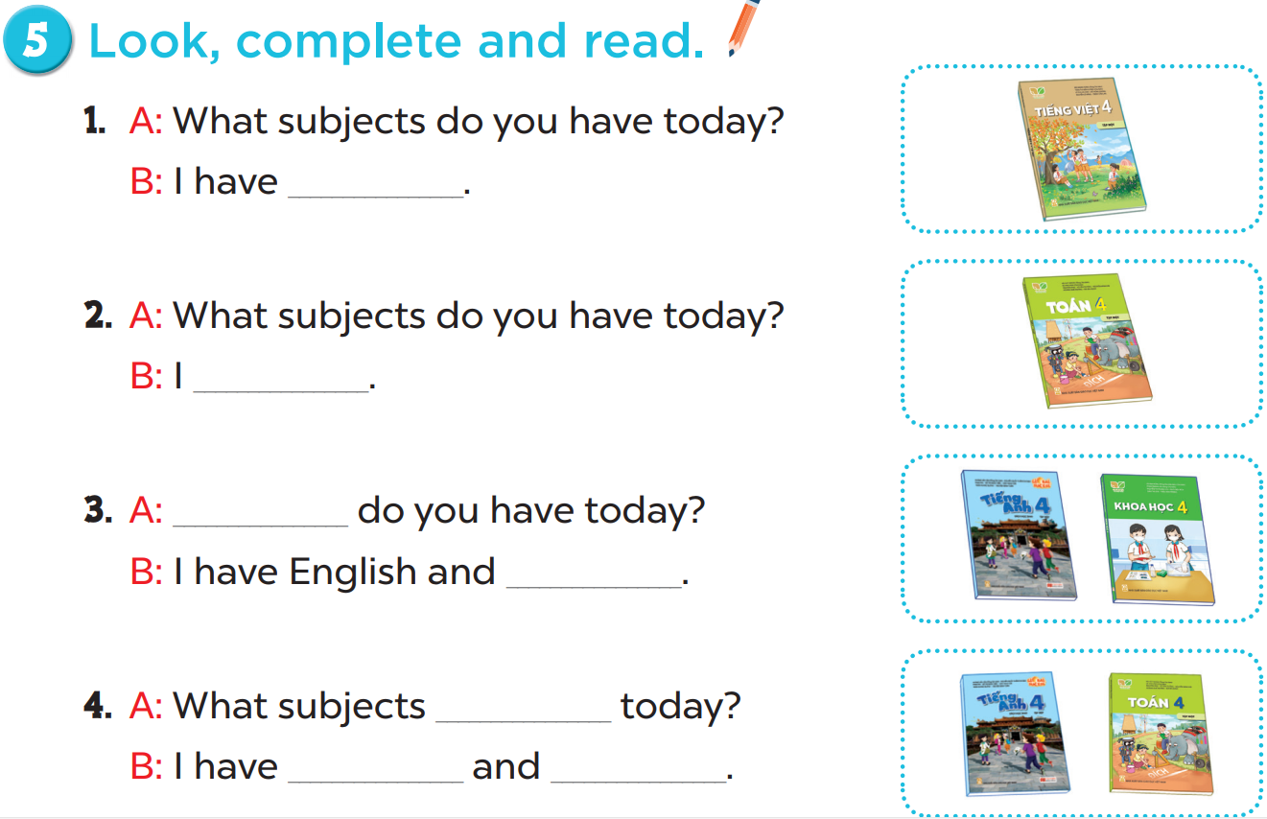
Vietnamese.
maths
What subjects
science
do you have
English
maths

Slide 8
04
Let’s play.

Slide 9
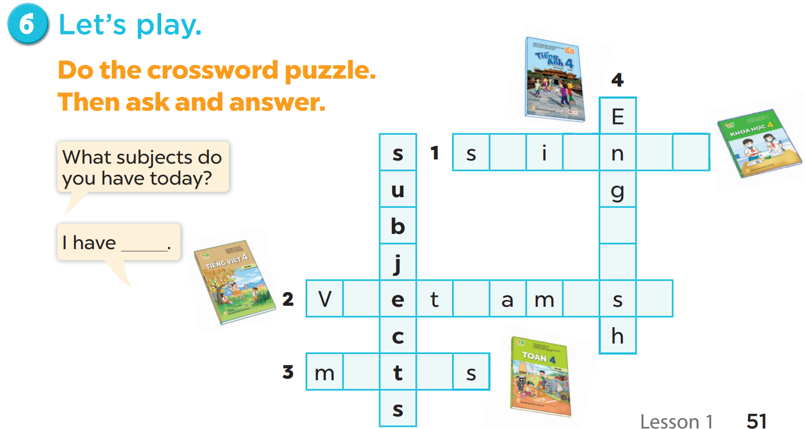
c
e
c
e
l
i
i
n
e
e
a
h

Slide 10
5
fun corner & wrap-up

Slide 11

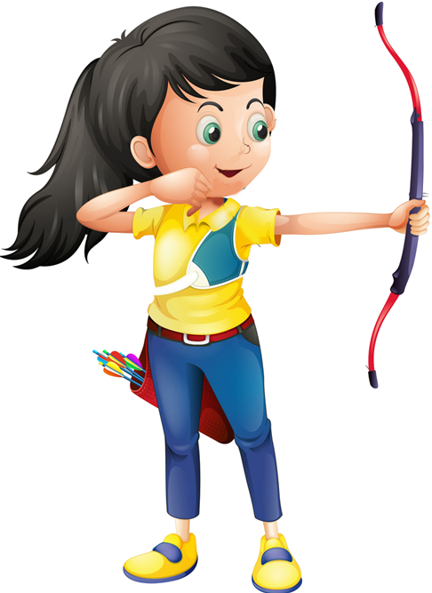





Slide 12


What ______do you have today?
subjects
subject
Ms Huyền Phạm
0936.082.789

Slide 13
_____subjects do you have today?
What
How
Ms Huyền Phạm
0936.082.789

Slide 14
I have________.
Viet Nam
Vietnamese
Ms Huyền Phạm
0936.082.789

Slide 15
I have________.
England
English
Ms Huyền Phạm
0936.082.789

Slide 16
I have Maths and ______.
scienec
science
Ms Huyền Phạm
0936.082.789

Slide 17
I have________.
matht
maths
Ms Huyền Phạm
0936.082.789

Slide 18
Thank you see you later

