Slide 1
Welcome to my class Da Phuc Primary School Teacher: Tran Phuong Linh Class: 3a1

Slide 2





8
Period 1

Slide 3


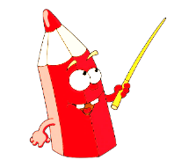
①
Warm-up and review
Contents
②
Look, listen and repeat.
③
Listen, point and say.
④
Let’s talk.
⑤
Fun corner and wrap-up

Slide 4




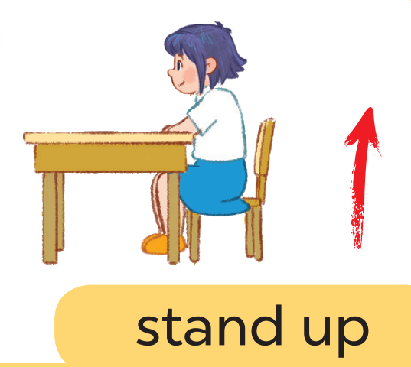


Game: Listen and choose

Slide 5
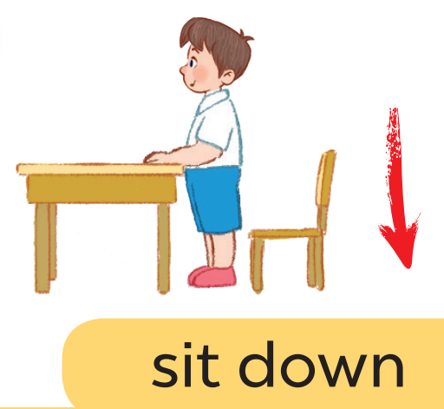
Game: Listen and choose

Slide 6
Game: Listen and choose

Slide 7
Game: Listen and choose

Slide 8
Game: Listen and choose

Slide 9
Game: Listen and choose

Slide 10
Game: Listen and choose

Slide 11

②
Look, listen and repeat.

Slide 12
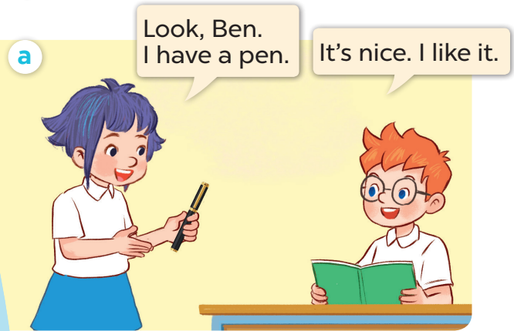
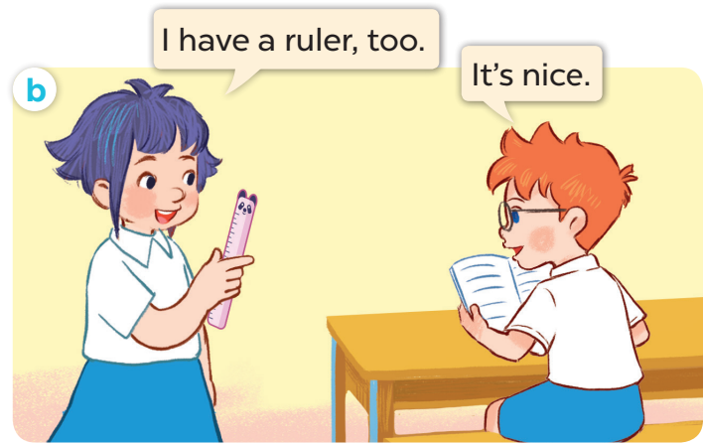

Slide 13
③
Listen, point and say.

Slide 14
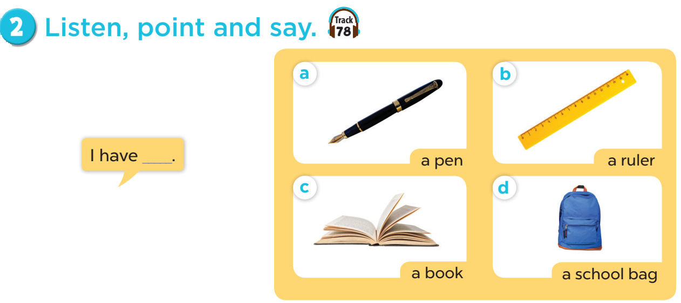


Slide 15


Game:
Notes:
Game: Slap the board.
- Divide the class into four teams.
- Stick the pictures of activities on the board.
- T says a sentence, a pupil from each team has to point/slap the right picture and says the sentence again. The faster pupil will get points for their team.

Slide 16
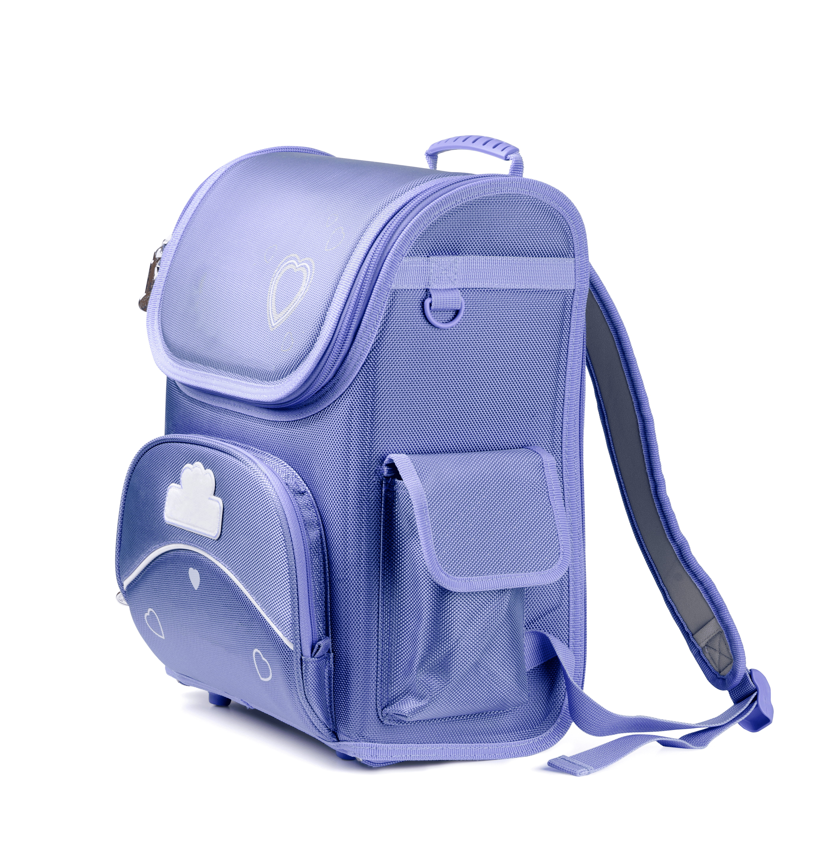

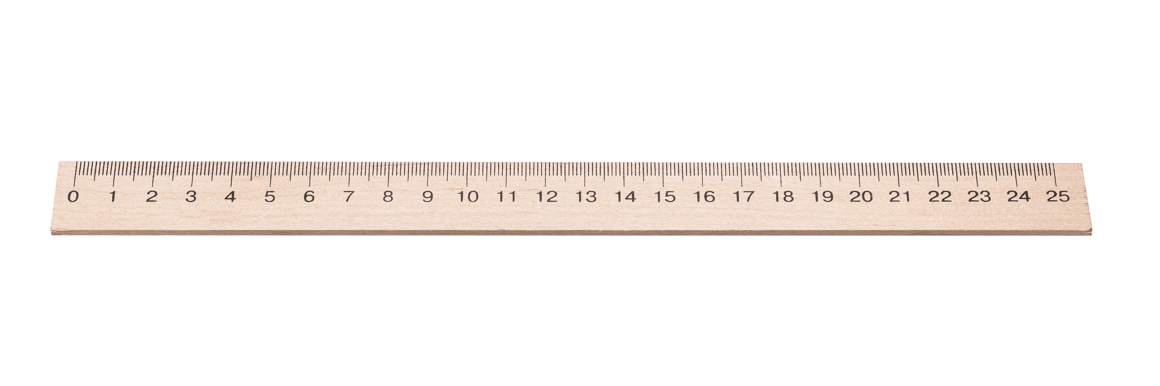
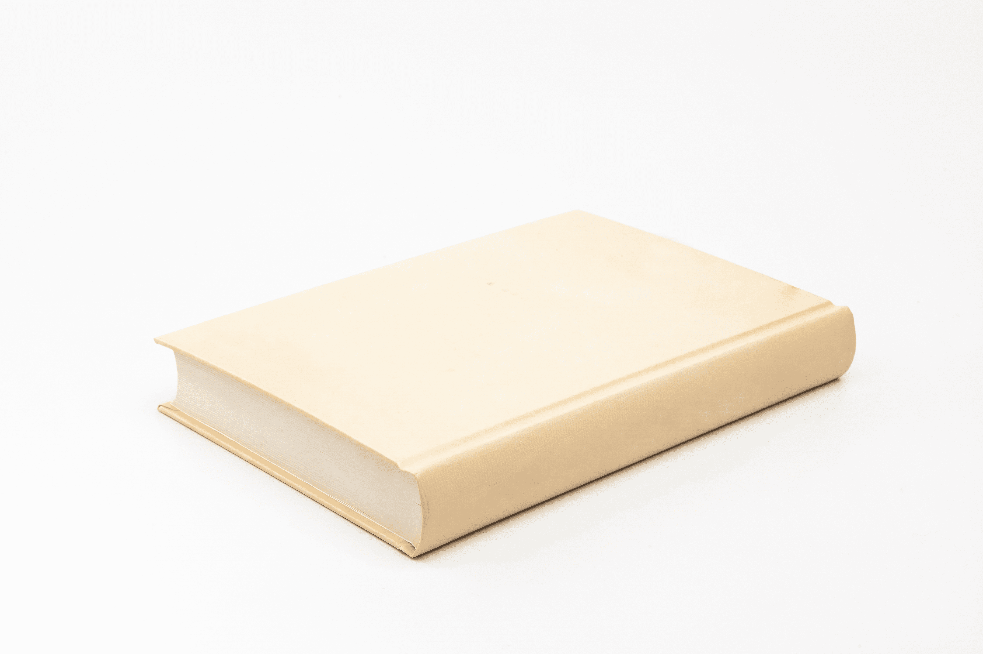
I have a ruler!
I have a ruler!
Notes:
Game: Slap the board.
- Divide the class into four teams.
- Stick the pictures of school things on the board.
- T says a sentence, a pupil from each team has to point/slap the right picture and says the sentence again. The faster pupil will get points for their team.

Slide 17
④
Let’s talk.

Slide 18
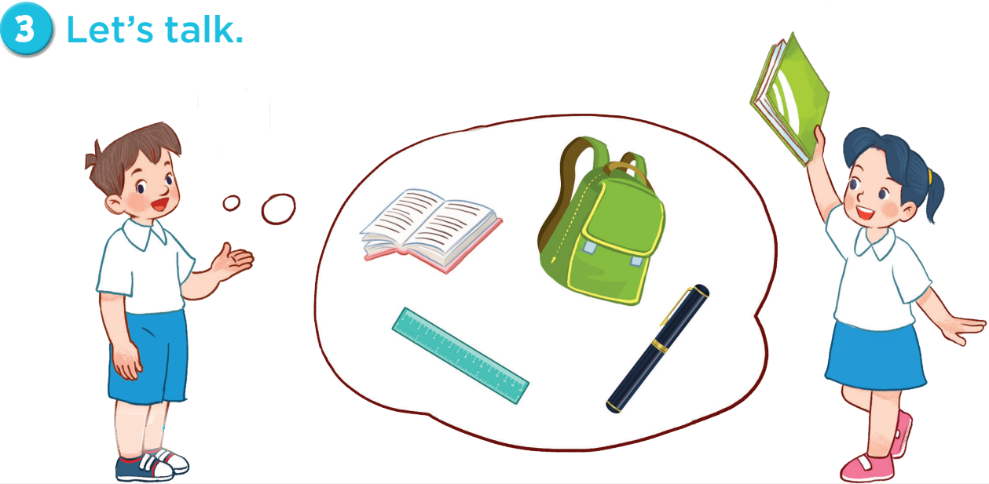
I have a school bag!
I have a book!

Slide 19
Game: Let’s move and say!

Slide 20
















I have a pencil!
Go back 1 space
Go back 1 space
Go forward 1 space
Back to
start!
Notes:
Let’s move and say!
- Get 2-3 pupils to play at the same time.
- Each pupil tosses a dice then moves accordingly.
- When he/she gets to the space, they have to do the requirements. Whoever gets to the last place first is the winner.

Slide 21
Thank you See you later

