Slide 1
Welcome to my class
Da Phuc Primary school
Teacher: Do Tra Giang
Class: 4A4

Slide 2


Our sports day
9
Lesson 3 (1,2,3)

Slide 3
01
Review

Slide 4









TEAM 1
TEAM 2

Slide 5
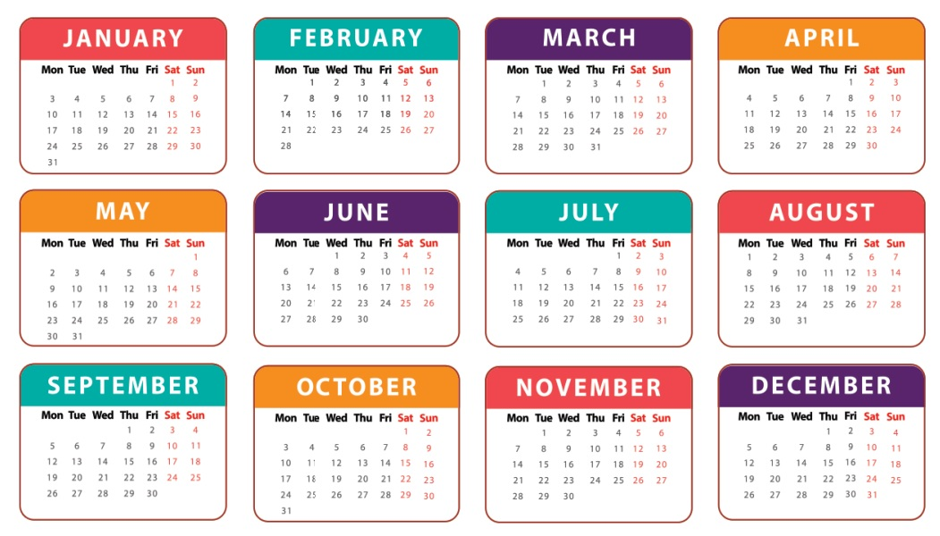
When’s your sports day?
It’s in June.

Slide 6
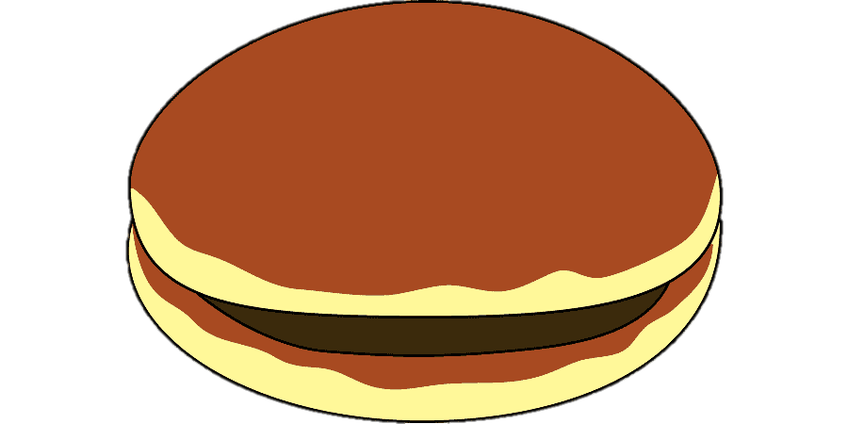
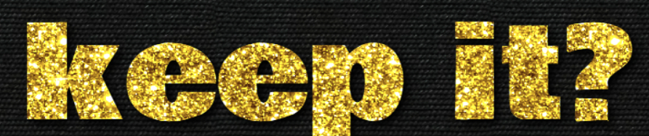
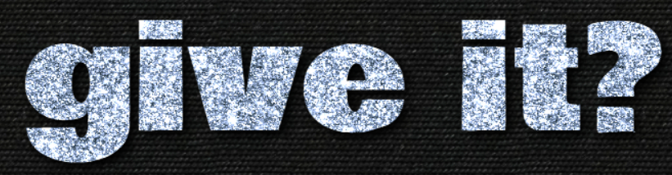
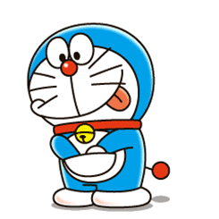

4 points
or

Slide 7
Is your sports day in February?
Yes, it is.

Slide 8
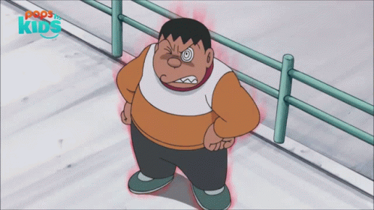


1 points
or

Slide 9
Is your sports day in July?
No, it isn’t.

Slide 10
3 points
or

Slide 11
When’s your birthday?
It’s in April.

Slide 12
2 points
or

Slide 13
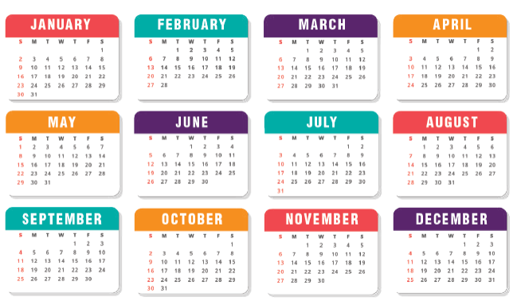
Is your sports day in October?
Yes, it is.

Slide 14
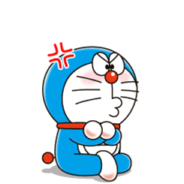
0 points
or

Slide 15
02
Listen and repeat.

Slide 16

1
Listen and repeat.
y February
Our sports day is in February.
y July
My birthday is in July.

Slide 17
03
Listen and circle.

Slide 18
2
Listen and circle.
1. Is your sports day in ___?
a. July b. February c. January
2. I like ___.
a. July b. January c. cycling

Slide 19
04
Let’s chant.

Slide 20


3
Let’s chant.
When’s your sports day?
In January, February or May?
In January, in January.
It’s in January.
When’s your sports day?
In May, June or July?
In July, in July.
It’s in July.

Slide 21
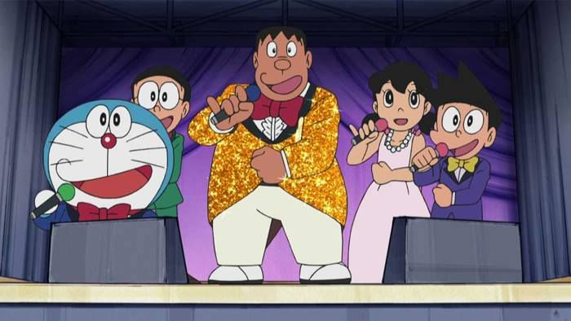
Let’s chant together!

Slide 22
Thank you
Goodbye. See you later

