Slide 1


DA PHUC PRIMARY SCHOL
Welcome to our class
GRADE 5
Hoang Thi Huong Giang

Slide 2
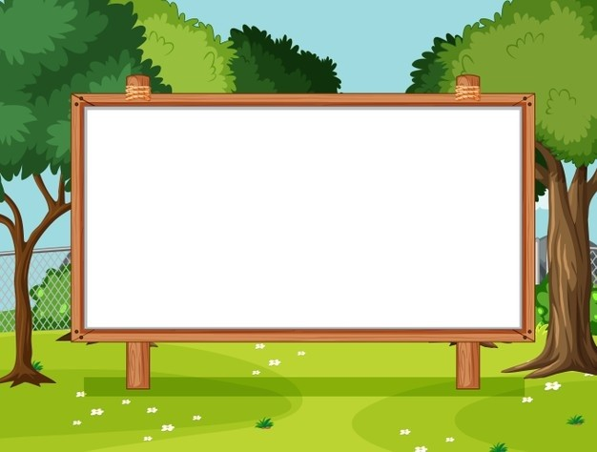
Unit 9
Our outdoor activities
Lesson 2 - Period 4

Slide 3

Table of contents
01
Warm-up and Review
02
Activity 4. Listen and circle.
03
Activity 5. Read and complete.
04
Activity 6. Let’s sing.
05
Fun corner and Wrap-up

Slide 4


01
Warm-up and Review

Slide 5



What did you do yesterday?
We ____.

Slide 6
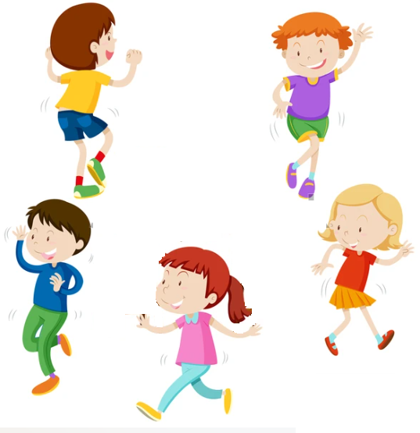
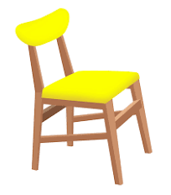
Hot Seat
Game

Slide 7
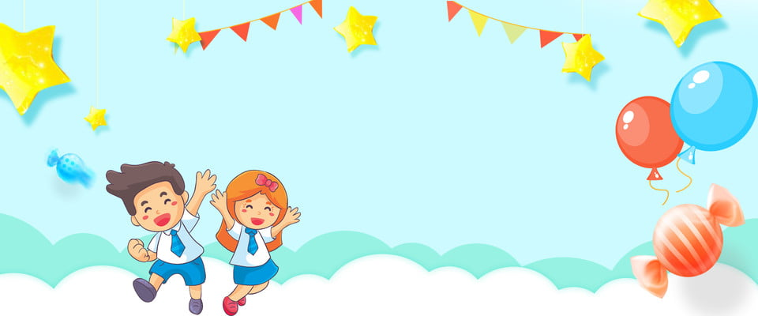

Very Good!

Slide 8
02
Activity 4. Listen and circle.

Slide 9

Listen and circle.
1. Where were you last Sunday? - We were at the ____.
a. campsite b. funfair
2. What did you do in the morning? - We ____ around the lake.
a. cycled b. walked
3. What did you do in the afternoon? - We visited the ____.
  a. farm b. zoo
4. What did you do in the evening? – I _____.
a. played the guitar b. danced around the campfire

Slide 10
Listen and circle.
1. Where were you last Sunday? - We were at the ____.
a. campsite b. funfair

Slide 11
Listen and circle.
2. What did you do in the morning? - We _______ around the lake.
a. cycled b. walked

Slide 12
Listen and circle.
3. What did you do in the afternoon? - We visited the ____.
  a. farm b. zoo

Slide 13
Listen and circle.
4. What did you do in the evening? – I _____.
a. played the guitar b. danced around the campfire

Slide 14
Listen and circle.
1. Where were you last Sunday? - We were at the ____.
a. campsite b. funfair
2. What did you do in the morning? - We ____ around the lake.
a. cycled b. walked
3. What did you do in the afternoon? - We visited the ____.
  a. farm b. zoo
4. What did you do in the evening? – I _____.
a. played the guitar b. danced around the campfire

Slide 15
03
Activity 5.
Read and complete.

Slide 16
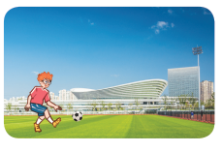
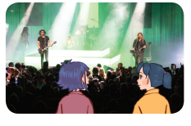
Read and complete.

Slide 17
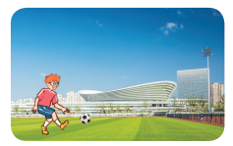
Read and complete.
1. A: Where were you last weekend?
B: I was at the ____________.
A: What did you do there?
B: I ____________.
sports centre
played football

Slide 18
Read and complete.
2. A: Were you and Mai at the theatre yesterday?
B: Yes, ________.
A: What did you ____ there?
B: We ________________.
we were
do
listened to music

Slide 19
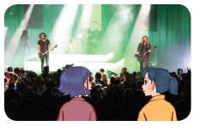
Read and complete.
1. A: Where were you last weekend?
B: I was at the ____________.
A: What did you do there?
B: I ____________.
2. A: Were you and Mai at the theatre yesterday?
B: Yes, _______.
A: What did you ___ there?
B: We ______________.
sports centre
played football
we were
do
listened to music

Slide 20
04
Activity 3. Let’s sing.

Slide 21
05
Fun corner and Wrap-up

Slide 22


MATCHING
GAME

Slide 23
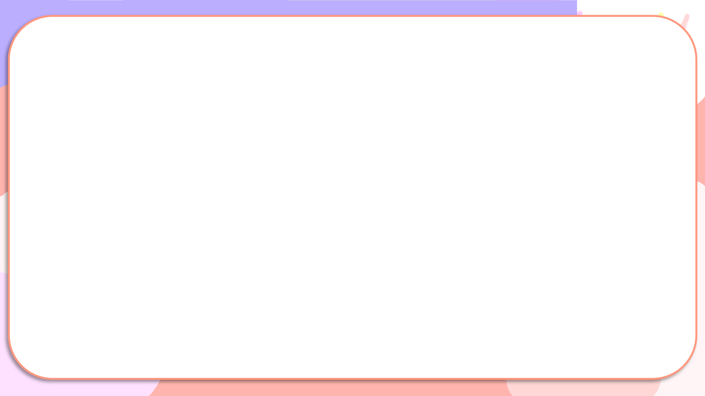
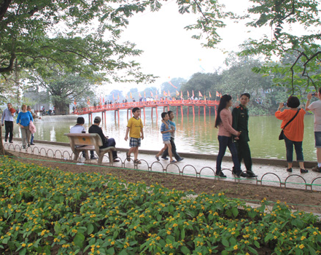
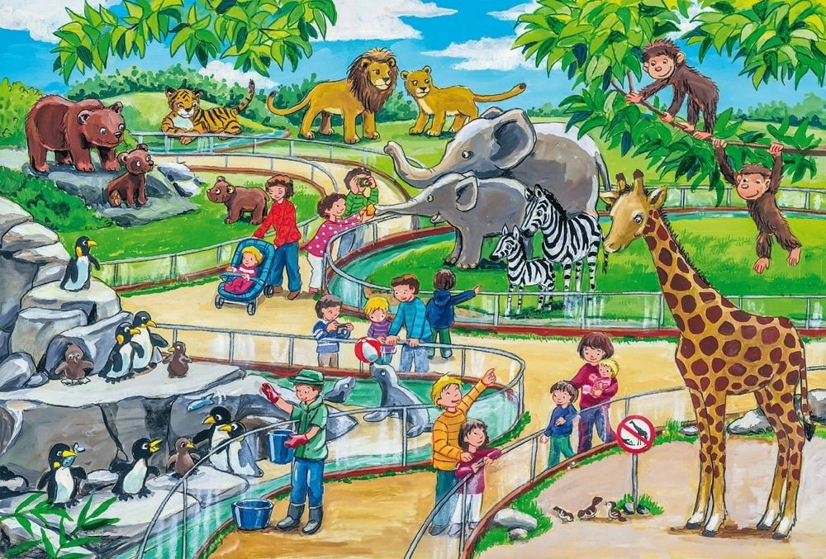
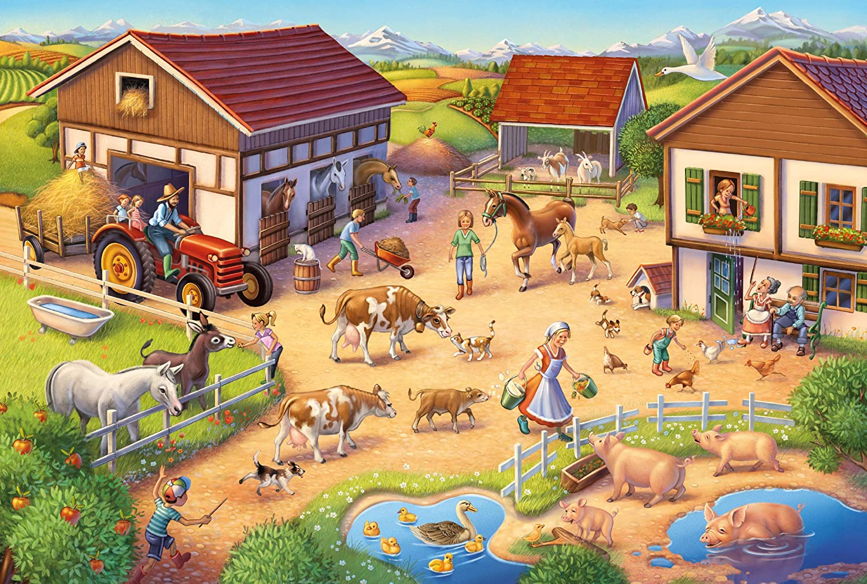
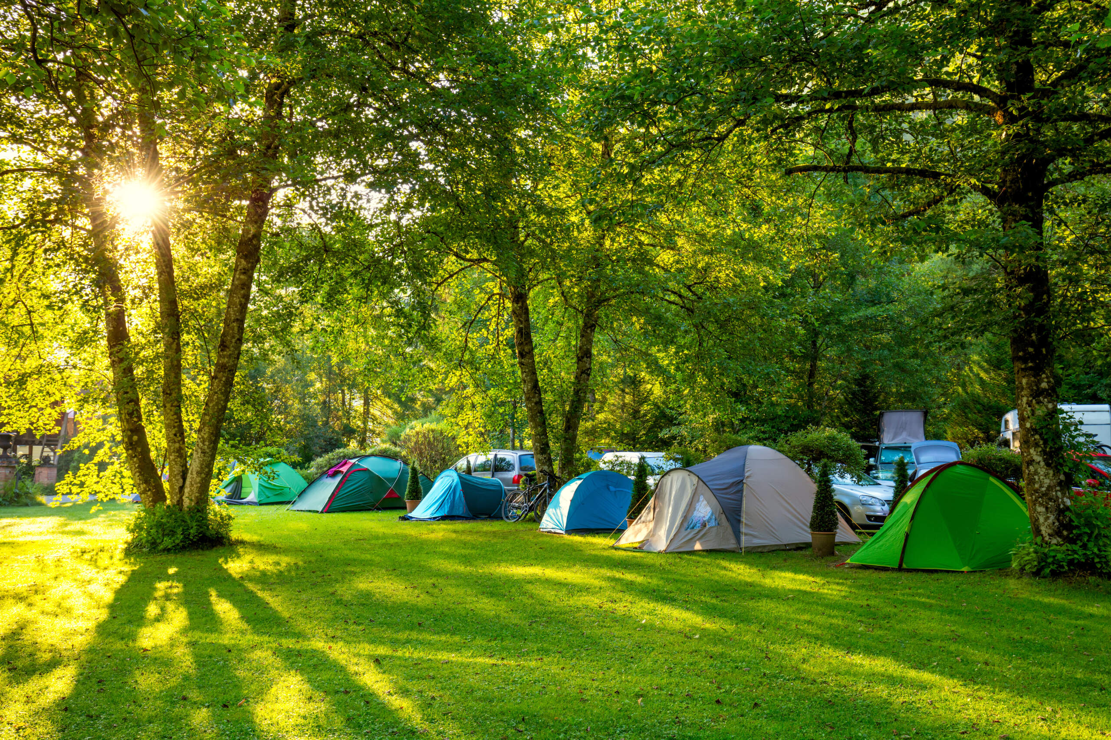
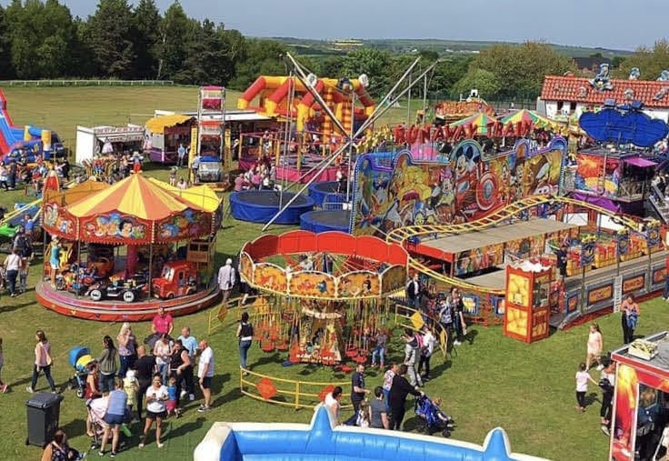
Matching
1
2
3
4
5
at the zoo
at the funfair
at the campsite
walked around the lake.
at the farm

Slide 24
Website: hoclieu.vn
Fanpage: https://www.facebook.com/tienganhglobalsuccess.vn/

