Slide 1


DA PHUC PRIMARY SCHOL
Welcome to our class
GRADE 5
Hoang Thi Huong Giang

Slide 2

Unit 1. All about me!
Lesson 3 - Period 5

Slide 3


01
Warm-up and review

Slide 4
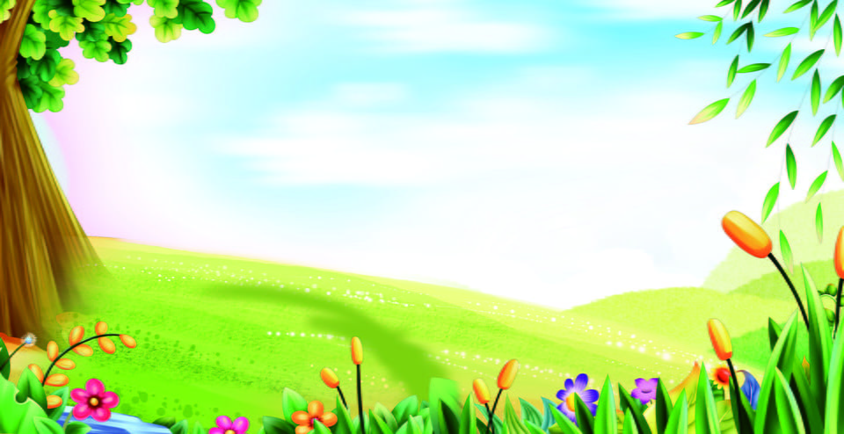
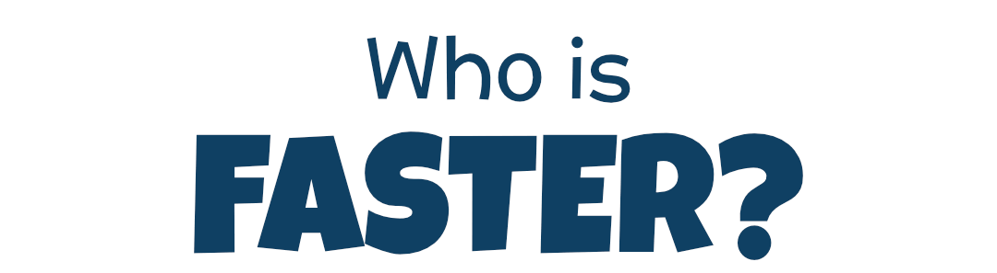
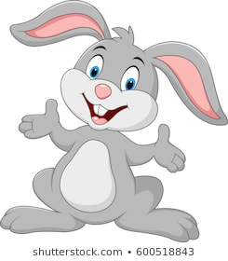
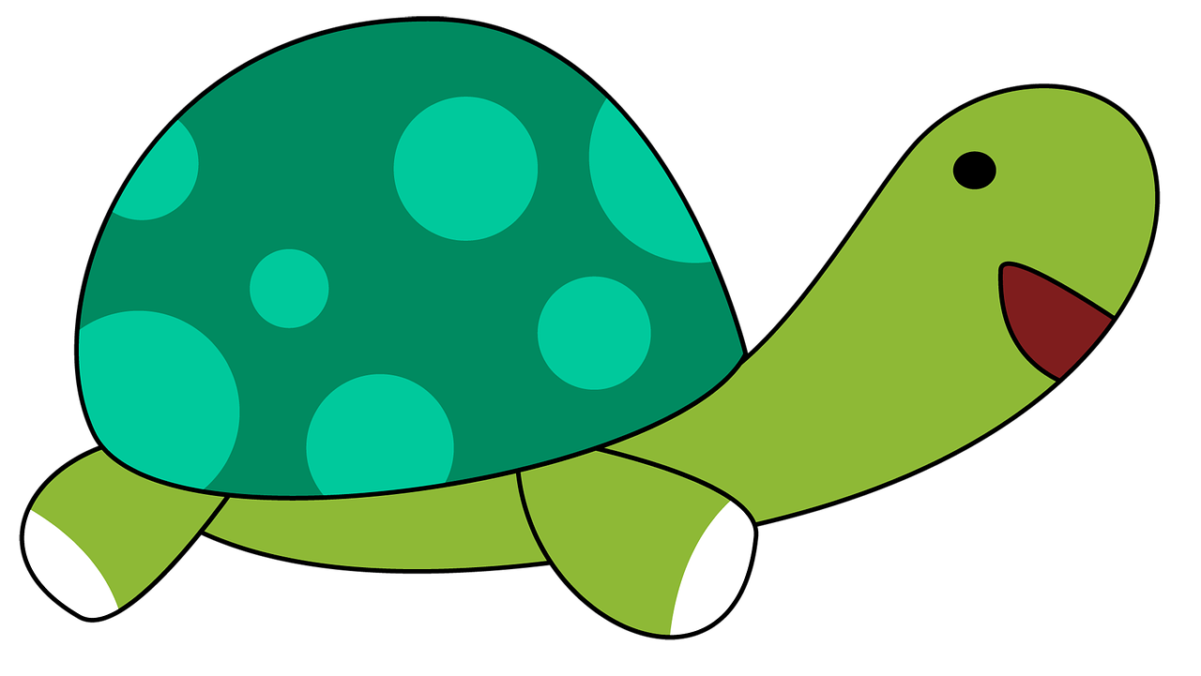
Team Turtle
Team Rabbit

Slide 5
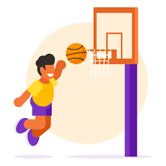
Choose the correct answer a,b or c.
A: What’s your favourite _______?
B: It’s basketball.
a
b
c
food
animal
sport

Slide 6
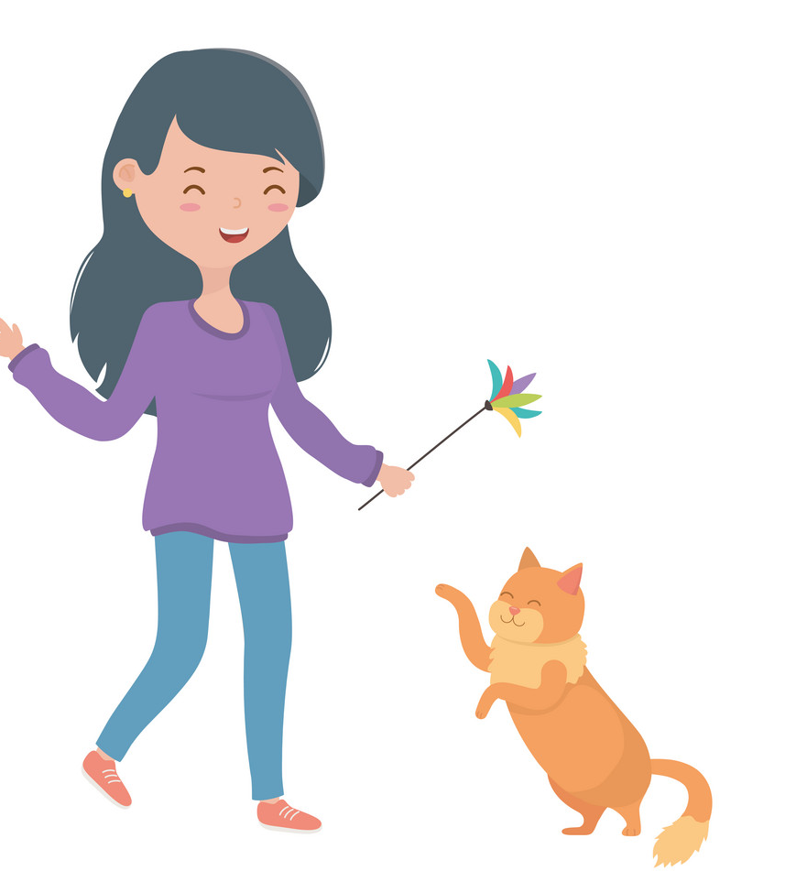
Choose the correct answer a,b or c.
A: What’s your favourite animal?
B: It’s _____.
a
b
c
cat
a cat
a dog

Slide 7

Choose the correct answer a,b or c.
A: What’s your favourite colour?
B: ___ red.
a
b
c
It
A
It’s

Slide 8
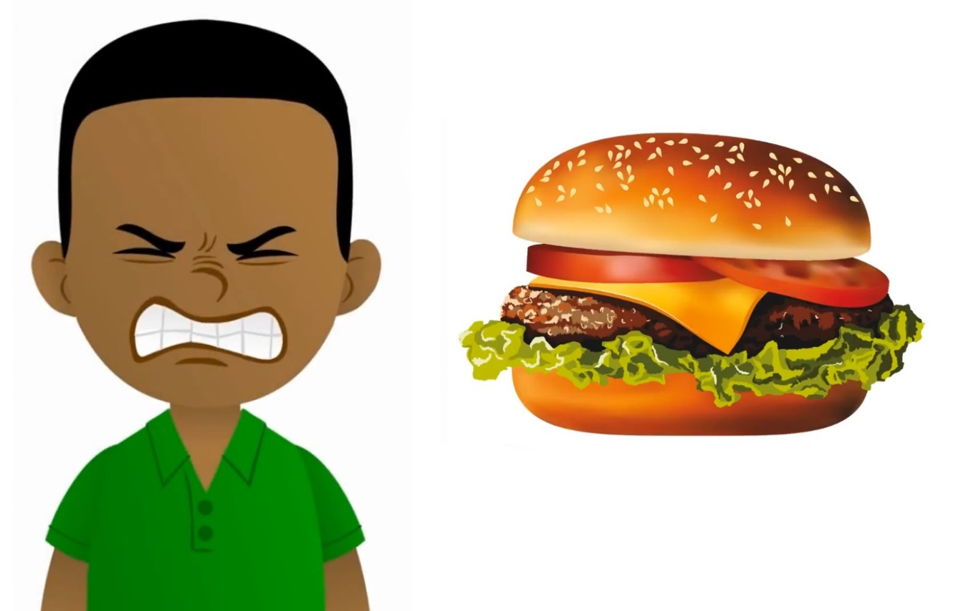
Choose the correct answer a,b or c.
A: My favourite food is hamburger.
Do you like hamburger, too?
B: No, I ____.
a
b
c
don’t
do
am

Slide 9

Summary
Notes:
GV nháy vào biểu tượng của đội chơi để tính điểm cho các đội. Mỗi lần nháy 1 ngôi sao xuất hiện.

Slide 10
02
Listen and repeat.

Slide 11

Listen and repeat.
'
'
dolphin
I like dolphins.
'
'
tennis
He plays tennis on Sundays.

Slide 12
03
Circle, listen and check.

Slide 13
Circle, listen and check.
1.
a. dolphin
b. giraffe
c. behind

Slide 14
Circle, listen and check.
2.
a. Japan
b. July
c. England

Slide 15
Circle, listen and check.
3.
a. tennis
b. hello
c. goodbye

Slide 16
Circle, listen and check.
1.
a. dolphin
b. giraffe
c. behind
2.
a. Japan
b. July
c. England
3.
a. tennis
b. hello
c. goodbye

Slide 17
04
Let’s chant.

Slide 18
05
Fun corner and wrap-up

Slide 19

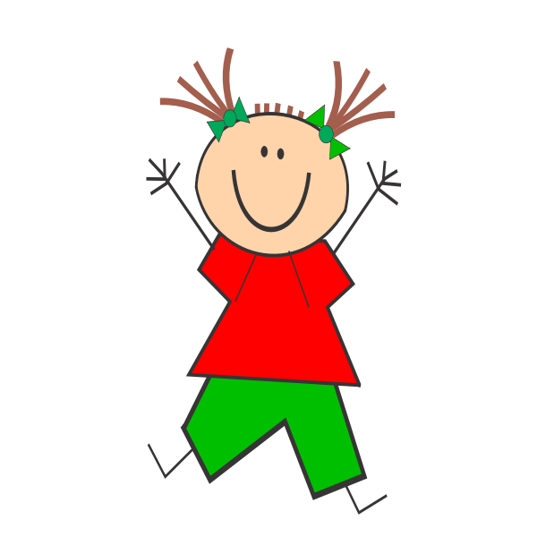
Jumping Games

Slide 20

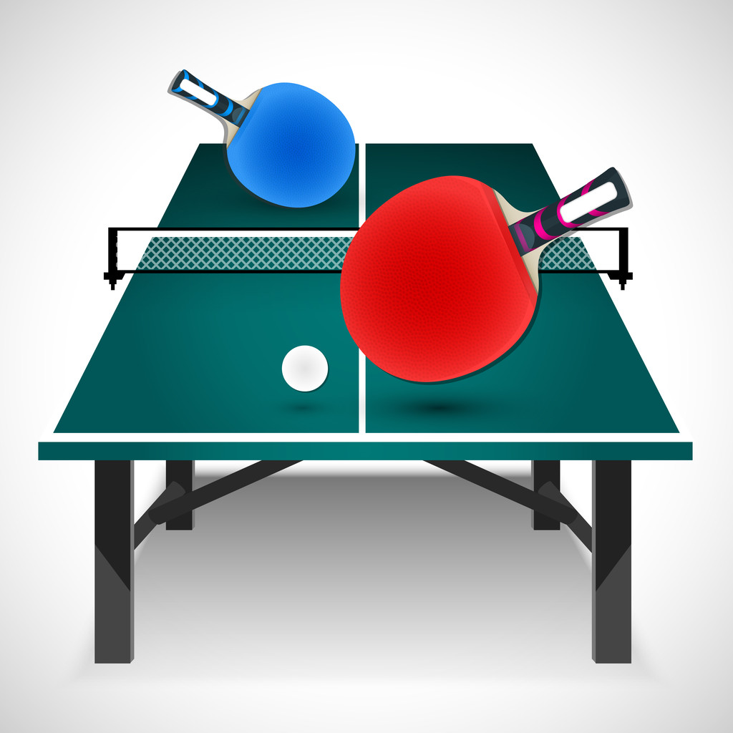
table tennis

Slide 21
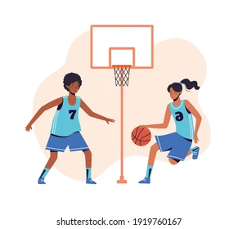
football

Slide 22

Japan

Slide 23
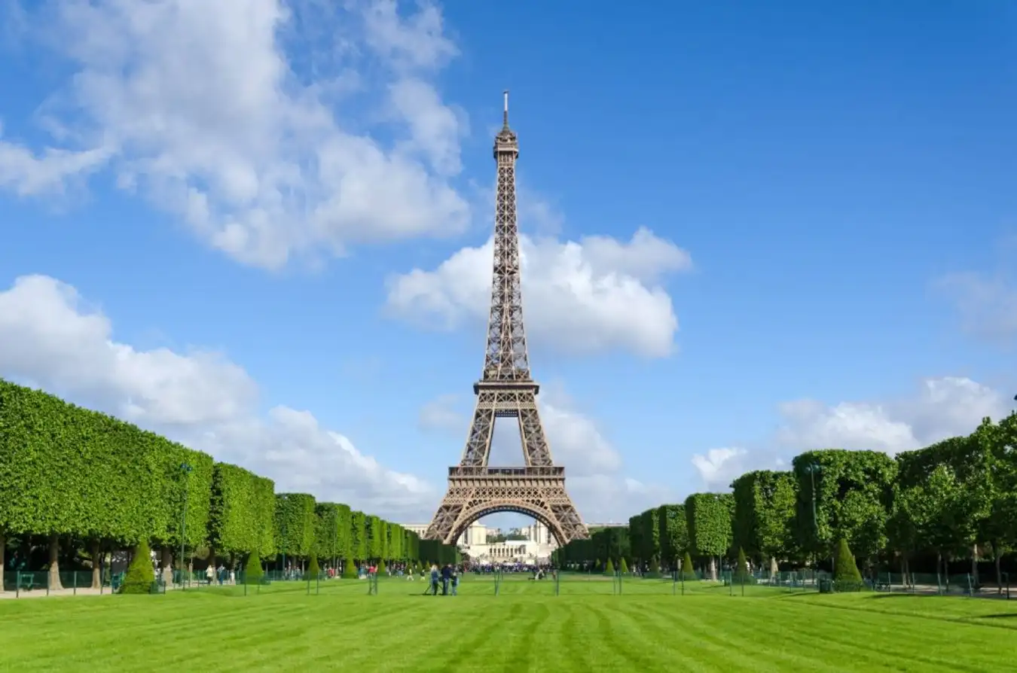
England

Slide 24
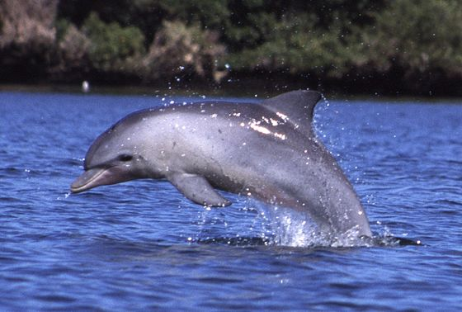
dolphin

Slide 25
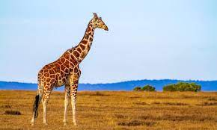
giraffe

