Slide 1


DA PHUC PRIMARY SCHOL
Welcome to our class
GRADE 5
Hoang Thi Huong Giang

Slide 2





My foreign friends
Unit 3
Lesson 1 – Period 2

Slide 3


01
Warm-up and Review

Slide 4

















Match the flags to the countries and tell the nationalities.
Australia
Singapore
Thailand
Malaysia
Viet Nam
Britain
Japan
America

Slide 5
Match the flags to the countries and tell the nationalities.
Britain
Australia
Viet Nam
Malaysia
Australia
Singapore
Thailand
Malaysia
Viet Nam
Britain
Japan
America
Thailand
Singapore
America
Japan

Slide 6







Let's play.
LUCKY STARS
GAME

Slide 7





1
2
3
4
5
6
7
8
FINISH
Notes:
Click the middle of the number to move to the Question slide.
Click the white circle to disappear the whole number card.
Click FINISH to end the game.

Slide 8









Look and Say.
He’s from Australia. He’s Australian.
Notes:
Click to show the answer sentences.
Click the sentences to show the lucky scores.
Click the yellow star to back to the Number Slide.

Slide 9


Look and Say.
He’s from America. He’s American.

Slide 10



Look and Say.
He’s from Britain. He’s British.

Slide 11


Look and Say.
She’s from Japan. She’s Japanese.

Slide 12
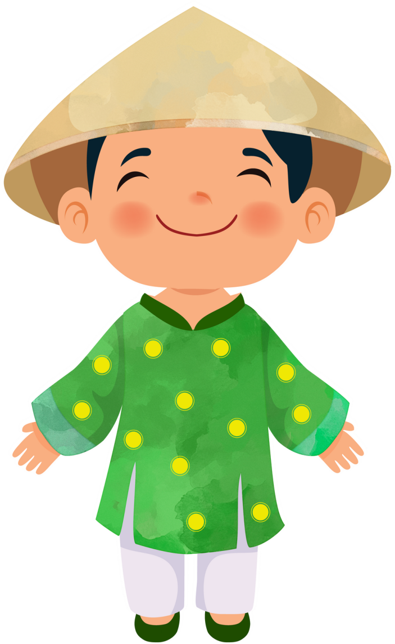

Look and Say.
He’s from Viet Nam. She’s Vietnamese.

Slide 13
02
Listen and tick.

Slide 14




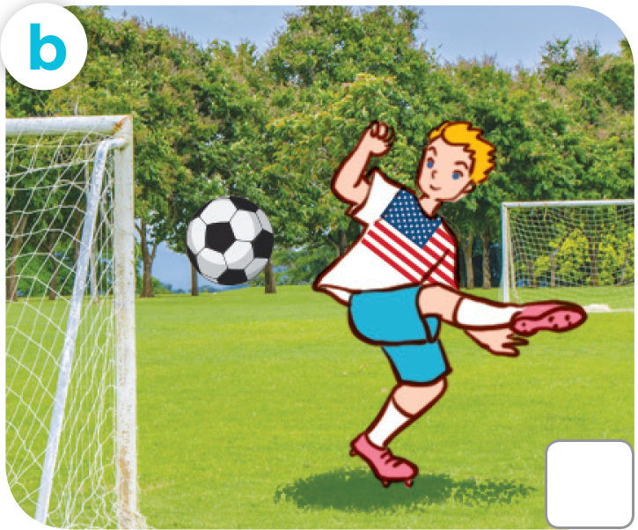
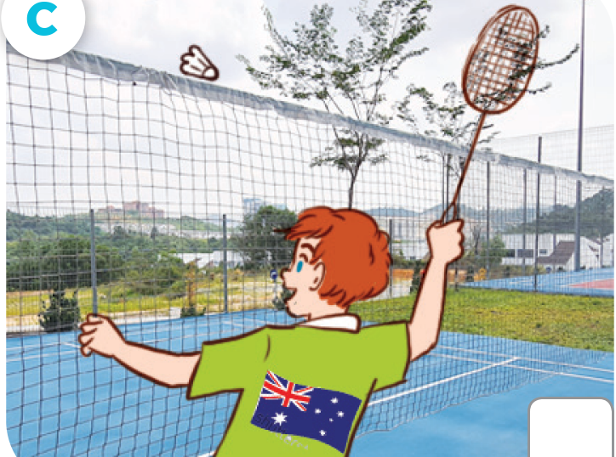


LOOK AND ANSWER.
Japanese
American
Australian

Slide 15




LOOK AND ANSWER.
British
Australian
Malaysian

Slide 16






LISTEN AND TICK.

Slide 17
03
Read and circle.

Slide 18



READ AND CIRCLE.
1. This is Sally. She’s from Britain / America.

Slide 19



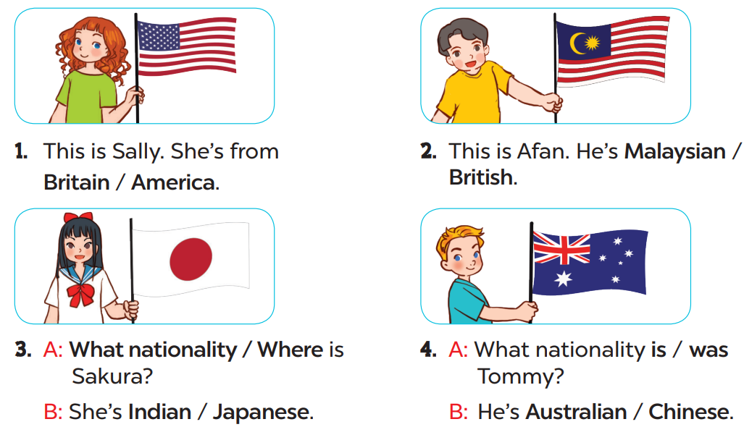


READ AND CIRCLE.
Page
23

Slide 20



LET’S CHECK YOUR ANSWERS.
2. This is Afen. He’s Malaysian / British.

Slide 21




LET’S CHECK YOUR ANSWERS.
3. A: What nationality / Where is Sakura?
B: She’s Indian / Japanese.

Slide 22



LET’S CHECK YOUR ANSWERS.
4. A: What nationality is / was Tommy?
B: He’s Australian / Chinese.

Slide 23
04
Let’s sing.

Slide 24
05
Fun corner
and wrap-up

Slide 25





Yes or No Game
Let’s play!

Slide 26





Question
Is he Japanese?
You have 15 seconds.

Slide 27



Answer
Yes

Slide 28

Question
Is she American?
You have 15 seconds.

Slide 29
Answer
No
She’s Thai.
She’s from Thailand.

Slide 30

Question
Are they Australian?
You have 15 seconds.

Slide 31
Answer
Yes

Slide 32





