Slide 1


DA PHUC PRIMARY SCHOL
Welcome to our class
GRADE 5
Hoang Thi Huong Giang

Slide 2









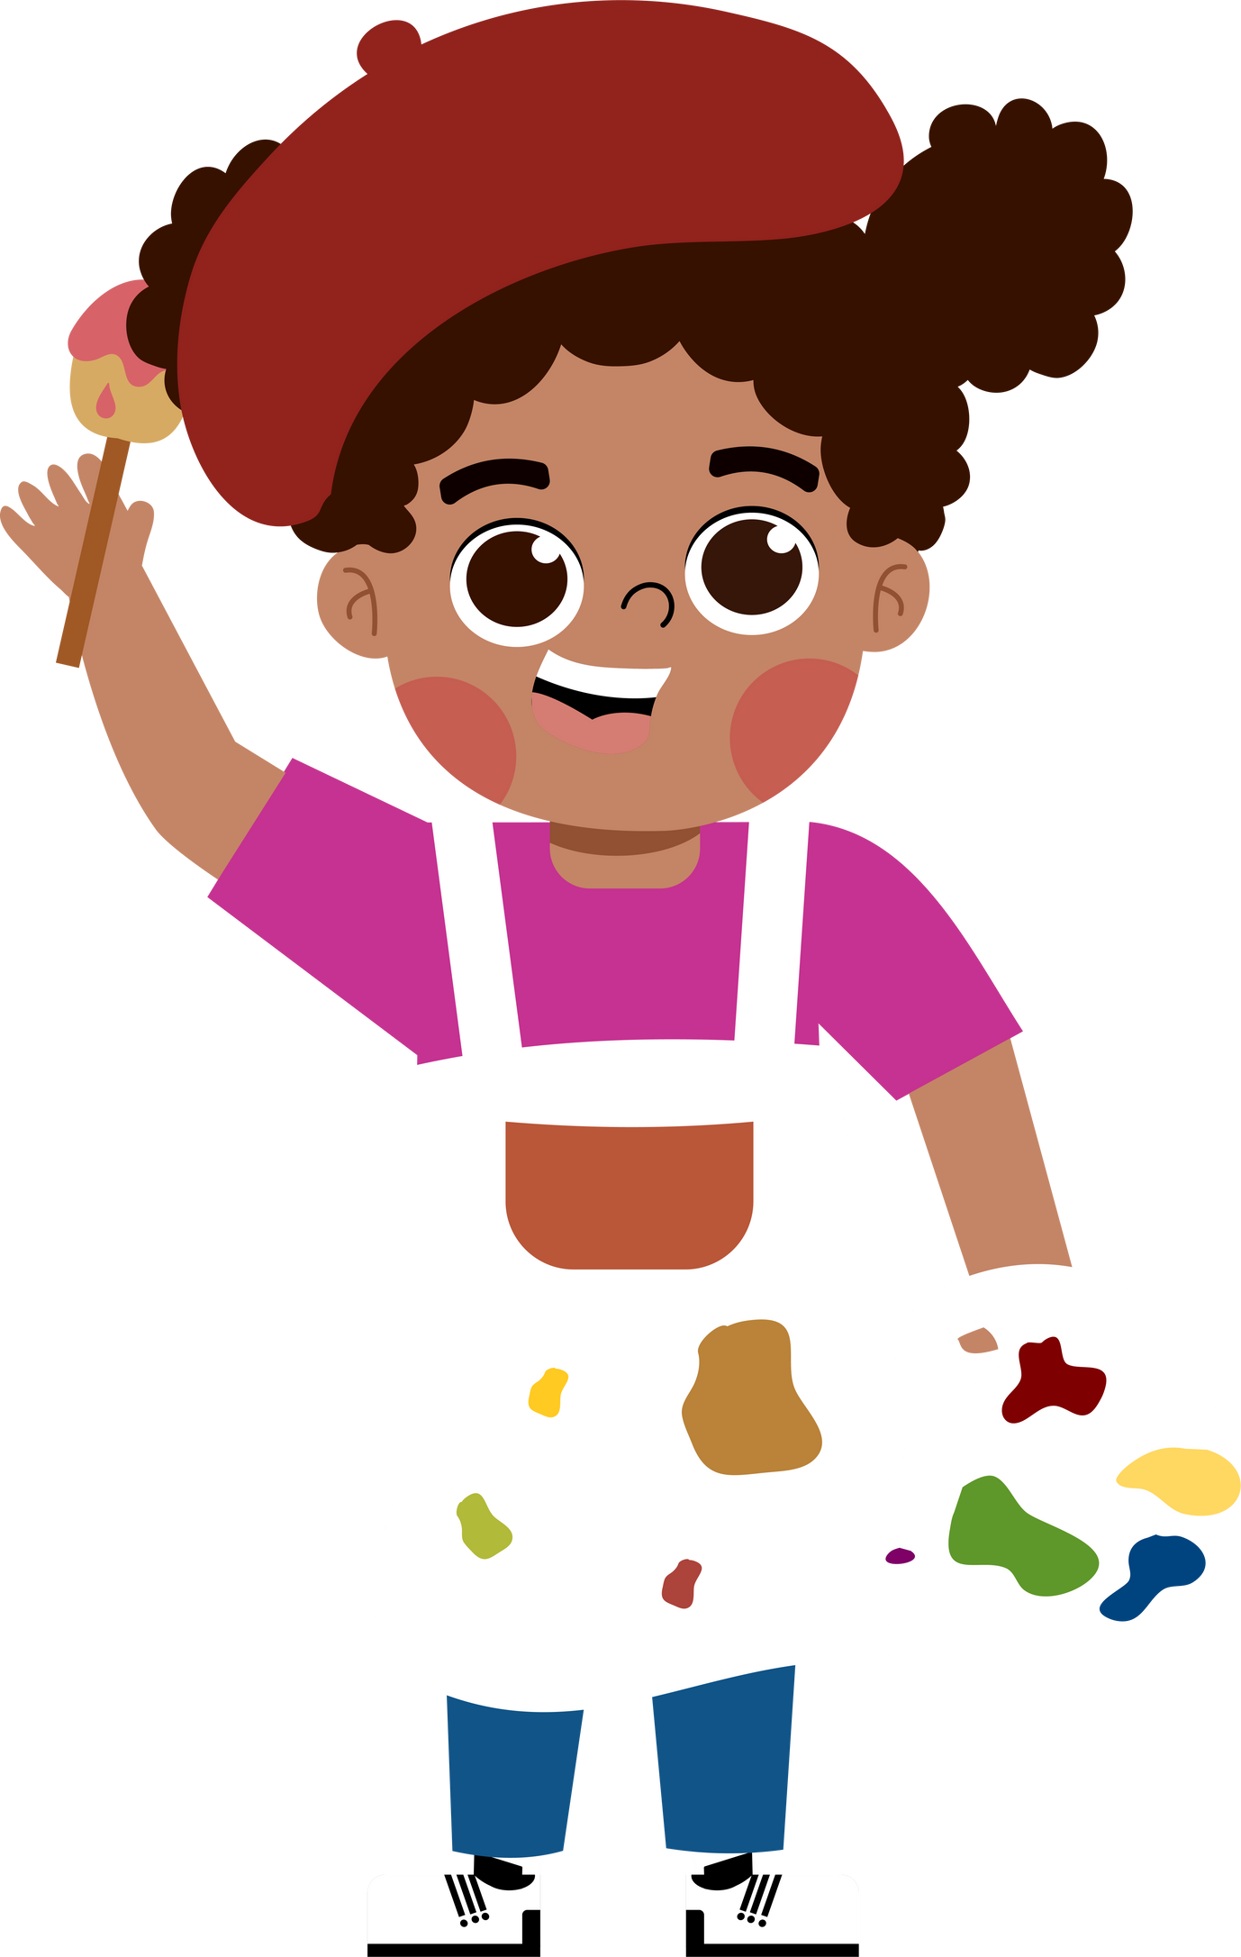
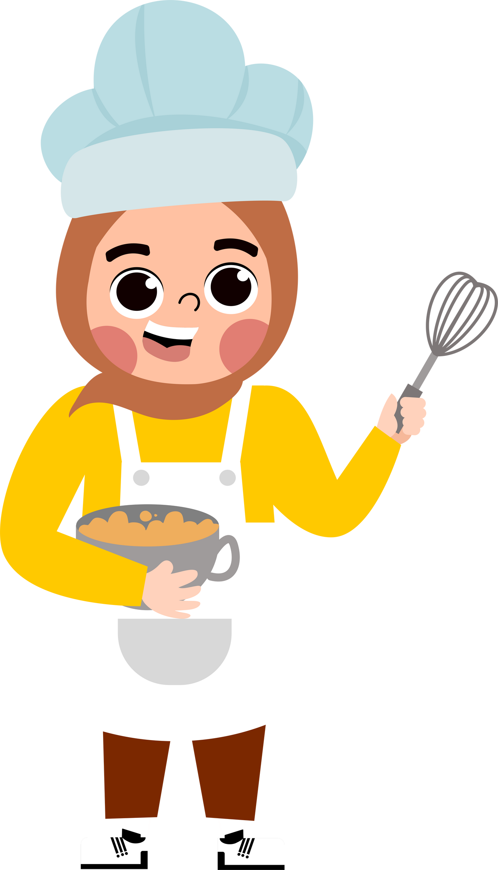


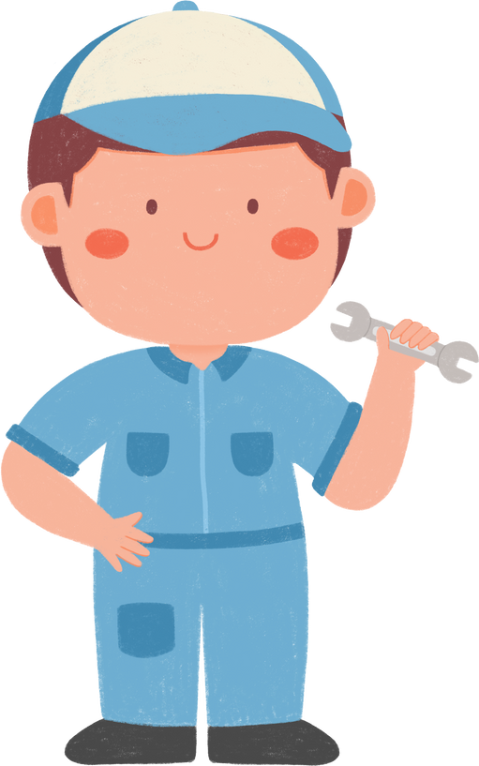




5
My future job
Lesson 2 - Period 4

Slide 3





TABLE OF CONTENTs
01. Warm-up and Review
02. Listen and tick.
03. Read and complete.
04. Let’s play.
05. Fun corner and Wrap-up

Slide 4




01.
Warm-up
and Review

Slide 5











Slide 6






Why would you like to be a teacher?
Because I’d like to …………………………………….
teach children
report the news

Slide 7

Why would you like to be a gardener?
Because I’d like to …………………………………….
grow flowers
put out fire

Slide 8

Why would you like to be a doctor?
Because I’d like to …………………………………….
help sick people
grow flowers

Slide 9

Why would you like to be a reporter?
Because I’d like to …………………………………….
write stories
report the news

Slide 10
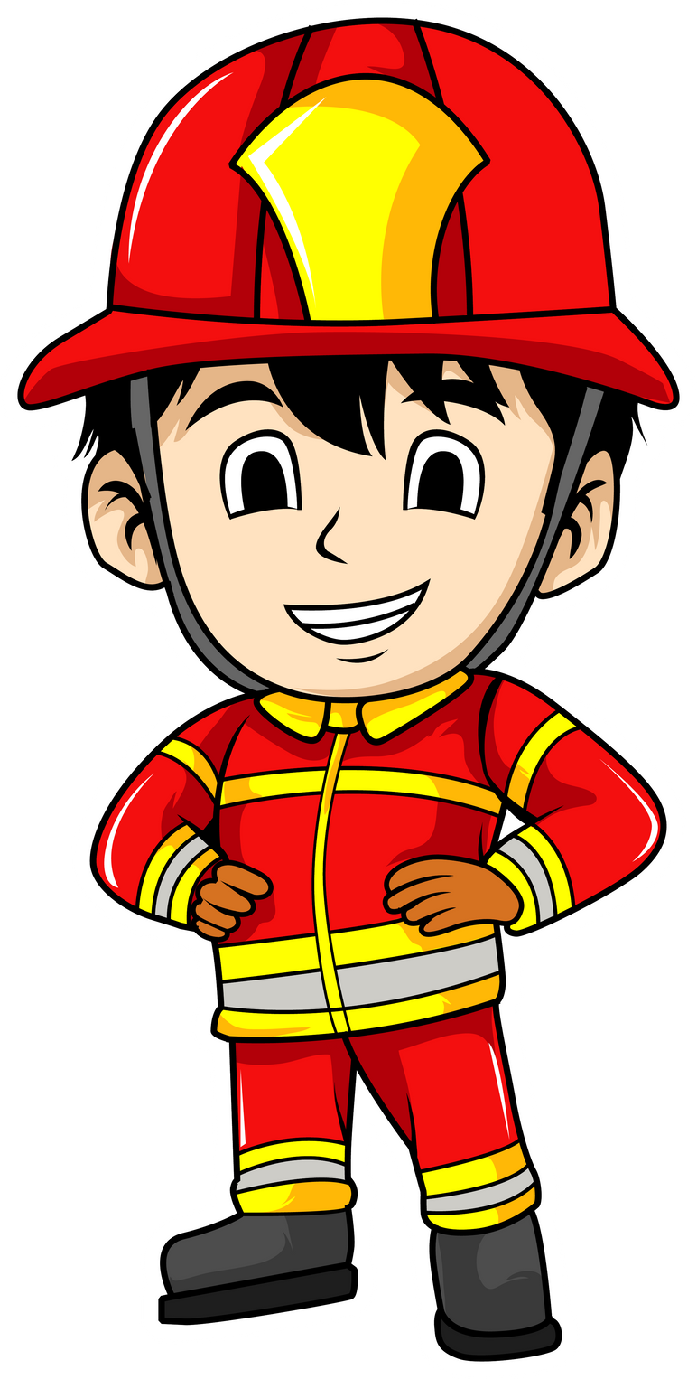
Why would you like to be a firefighter?
Because I’d like to …………………………………….
teach children
put out fire

Slide 11
02.
Listen and tick.

Slide 12

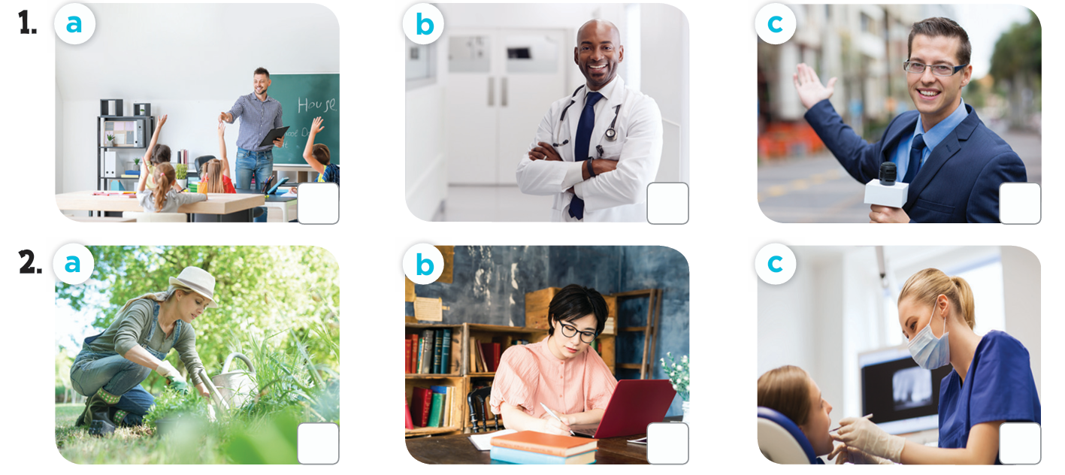

How many pictures are there?
What job can you see in each picture?

Slide 13
03.
Read and complete.

Slide 14
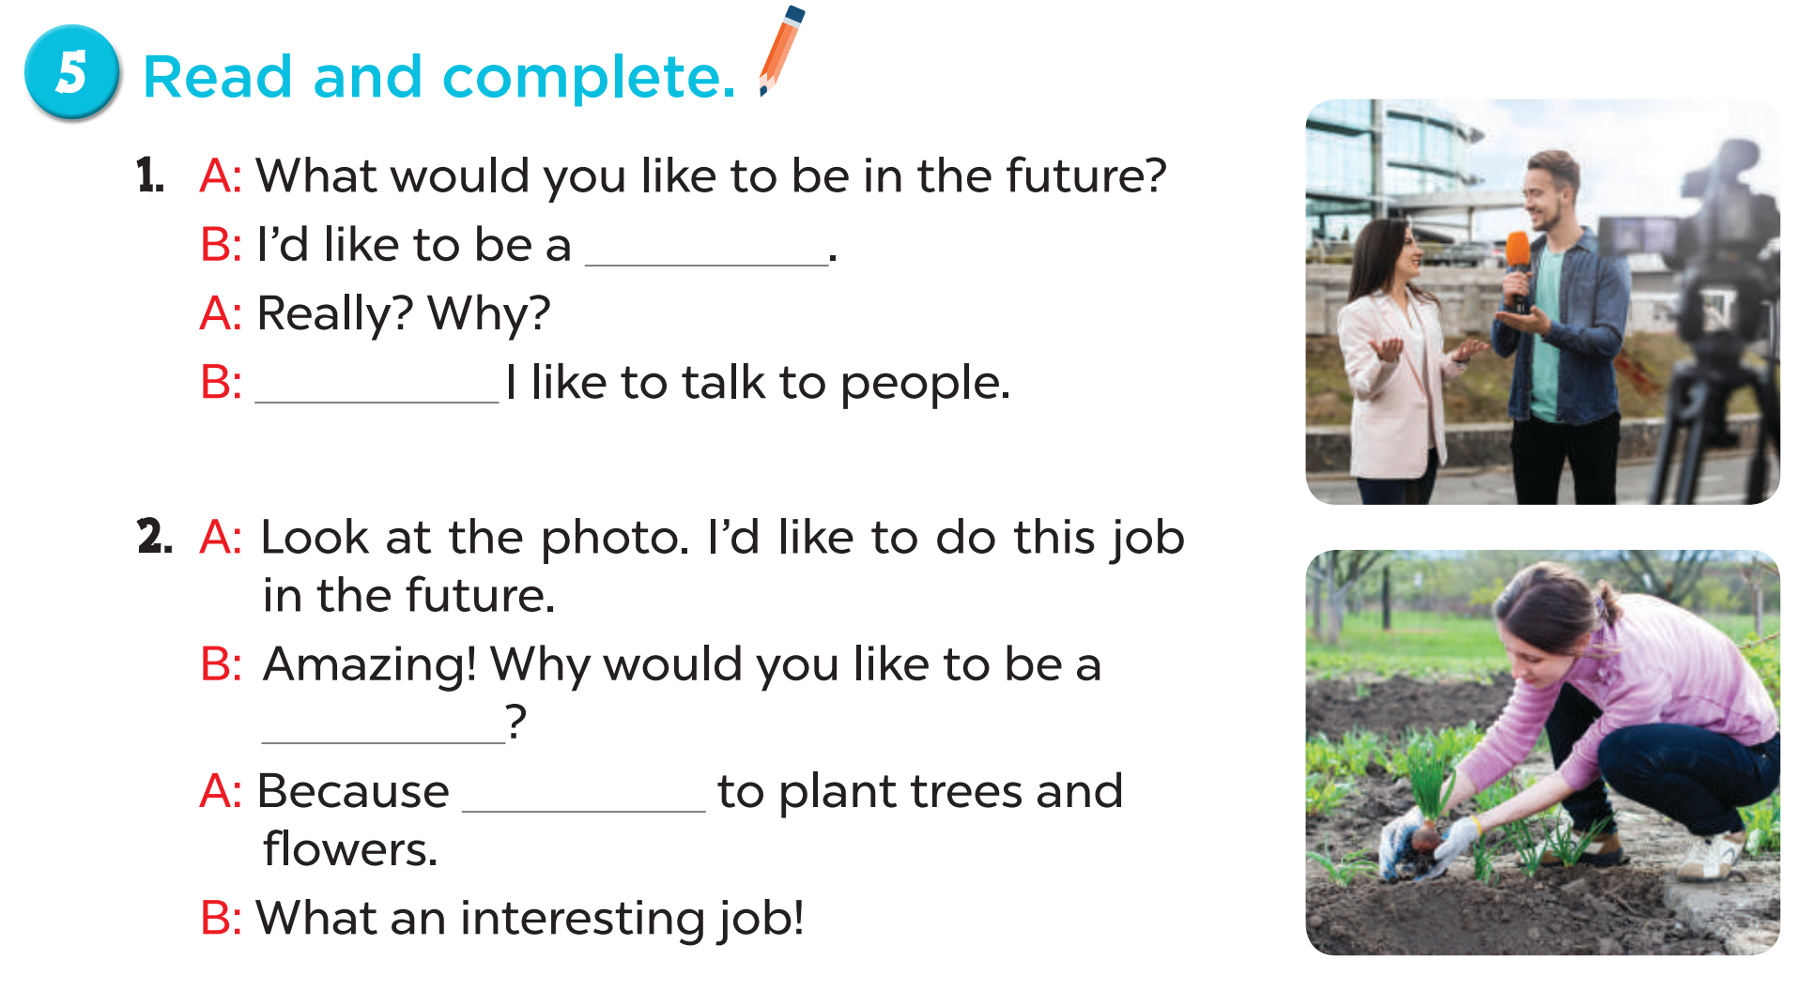
reporter
Because
gardener
I’d like

Slide 15
04.
Let’s play.

Slide 16

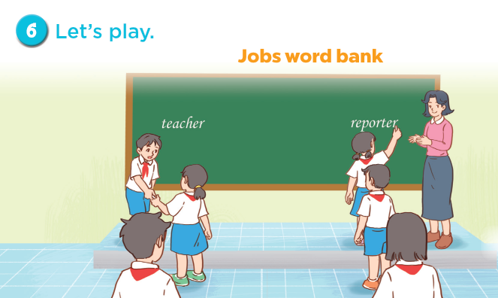


Slide 17
05.
Fun corner and Wrap-up

Slide 18

What would you like to be in the future?
doctor
gardener
teacher
reporter
firefighter
writer

Slide 19
I’d like to grow flowers.
doctor
firefighter
reporter
writer
teacher
gardener

Slide 20
I’d like to report the news.
doctor
firefighter
reporter
writer
teacher
gardener

Slide 21
I’d like to write stories.
doctor
firefighter
reporter
writer
teacher
gardener

Slide 22
I’d like to teach children.
doctor
firefighter
reporter
writer
teacher
gardener

Slide 23
Website: hoclieu.vn
Fanpage: https://www.facebook.com/tienganhglobalsuccess.vn/

