Slide 1
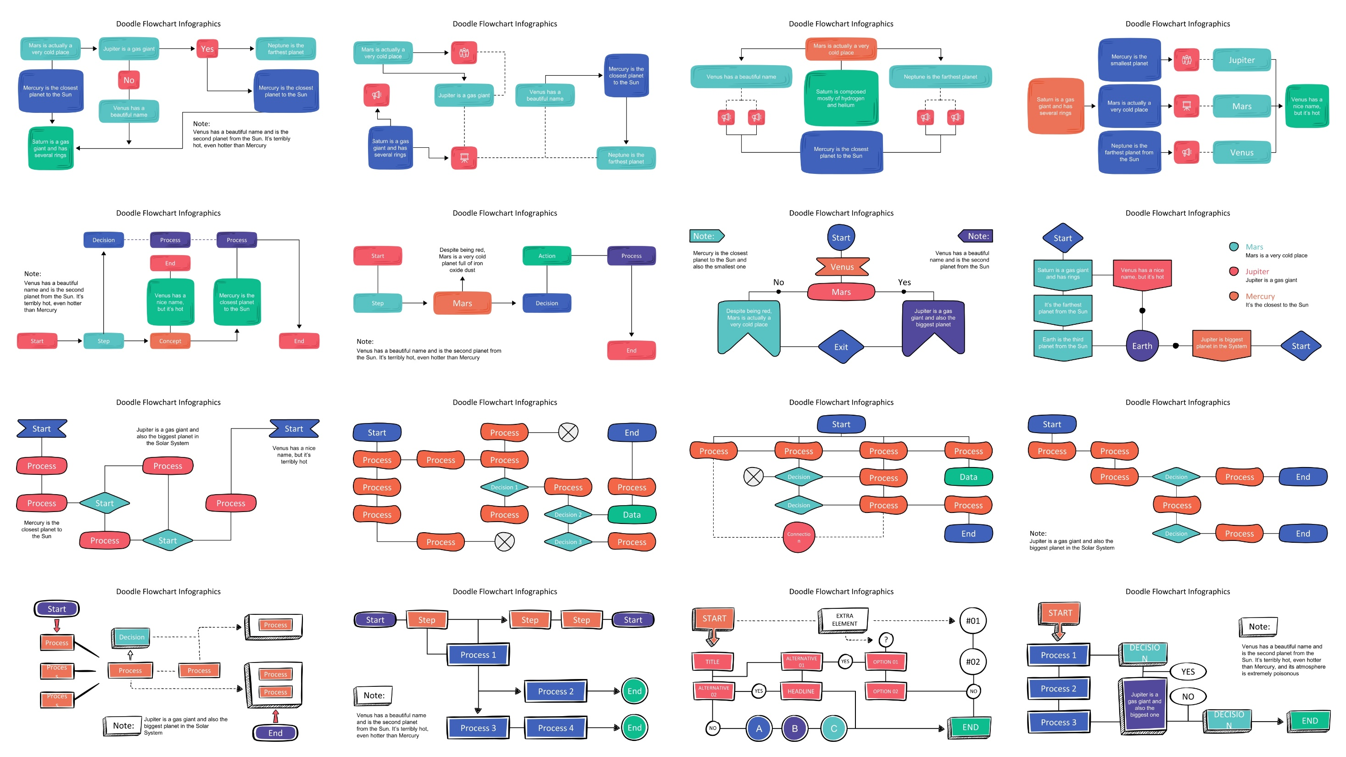
40
Mẫu sơ đồ tư duy

Slide 2
Doodle Flowchart Infographics
Mars is actually a very cold place
Jupiter is a gas giant
Yes
Neptune is the farthest planet
Mercury is the closest planet to the Sun
No
Mercury is the closest planet to the Sun
Venus has a beautiful name
Note:
Saturn is a gas giant and has several rings
Venus has a beautiful name and is the second planet from the Sun. It’s terribly hot, even hotter than Mercury

Slide 3
Doodle Flowchart Infographics
Mars is actually a very cold place
Mercury is the closest planet to the Sun
Jupiter is a gas giant
Venus has a beautiful name
Saturn is a gas giant and has several rings
Neptune is the farthest planet

Slide 4
Doodle Flowchart Infographics
Mars is actually a very cold place
Venus has a beautiful name
Neptune is the farthest planet
Saturn is composed mostly of hydrogen and helium
Mercury is the closest planet to the Sun

Slide 5
Doodle Flowchart Infographics
Mercury is the smallest planet
Jupiter
Saturn is a gas giant and has several rings
Mars is actually a very cold place
Venus has a nice name, but it’s hot
Mars
Neptune is the farthest planet from the Sun
Venus

Slide 6
Doodle Flowchart Infographics
Decision
Process
Process
End
Note:
Venus has a beautiful name and is the second planet from the Sun. It’s terribly hot, even hotter than Mercury
Venus has a nice name, but it’s hot
Mercury is the closest planet to the Sun
Start
Step
Concept
End

Slide 7
Doodle Flowchart Infographics
Start
Despite being red, Mars is a very cold planet full of iron oxide dust
Action
Process
Step
Mars
Decision
Note:
Venus has a beautiful name and is the second planet from the Sun. It’s terribly hot, even hotter than Mercury
End

Slide 8
Doodle Flowchart Infographics
Start
Note:
Note:
Mercury is the closest planet to the Sun and also the smallest one
Venus has a beautiful name and is the second planet from the Sun
Venus
No
Yes
Mars
Despite being red, Mars is actually a very cold place
Jupiter is a gas giant and also the biggest planet
Exit

Slide 9
Doodle Flowchart Infographics
Start
Mars
Mars is a very cold place
Saturn is a gas giant and has rings
Venus has a nice name, but it’s hot
Jupiter
Jupiter is a gas giant
Mercury
It’s the farthest planet from the Sun
It’s the closest to the Sun
Earth is the third planet from the Sun
Earth
Jupiter is biggest planet in the System
Start

Slide 10
Doodle Flowchart Infographics
Start
Start
Jupiter is a gas giant and also the biggest planet in the Solar System
Venus has a nice name, but it’s terribly hot
Process
Process
Process
Start
Process
Mercury is the closest planet to the Sun
Process
Start

Slide 11
Doodle Flowchart Infographics
Start
Process
End
Process
Process
Process
Process
Decision 1
Process
Process
Process
Process
Decision 2
Data
Process
Decision 3
Process

Slide 12
Doodle Flowchart Infographics
Start
Process
Process
Process
Process
Decision
Process
Data
Decision
Process
Process
Connection
End

Slide 13
Doodle Flowchart Infographics
Start
Process
Process
Process
Decision
Process
End
Process
Note:
Decision
Process
End
Jupiter is a gas giant and also the biggest planet in the Solar System

Slide 14
Doodle Flowchart Infographics
Start
Process
Decision
Process
Process
Process
Process
Process
Process
Process
Note:
Jupiter is a gas giant and also the biggest planet in the Solar System
End

Slide 15
Doodle Flowchart Infographics
Start
Step
Step
Step
Start
Process 1
Process 2
End
Note:
Venus has a beautiful name and is the second planet from the Sun. It’s terribly hot, even hotter than Mercury
Process 3
Process 4
End

Slide 16
Doodle Flowchart Infographics
START
EXTRA ELEMENT
#01
?
#02
TITLE
ALTERNATIVE 01
YES
OPTION 01
ALTERNATIVE 02
YES
HEADLINE
OPTION 02
NO
A
B
C
END
NO

Slide 17
Doodle Flowchart Infographics
START
Note:
Venus has a beautiful name and is the second planet from the Sun. It’s terribly hot, even hotter than Mercury, and its atmosphere is extremely poisonous
Process 1
DECISION
YES
Process 2
Jupiter is a gas giant and also the biggest one
NO
Process 3
DECISION
END

Slide 18
Doodle Flowchart Infographics
START
ACTION
Mercury is the closest planet to the Sun
Jupiter is a gas giant and also the biggest planet in the Solar System
NO
ACTION
STEP
DECISION
YES

Slide 19
Doodle Flowchart Infographics
START
YES
YES
STEP
DECISION
DECISION
STEP
NO
NO
STEP
DATA
Note:
END
Venus has a beautiful name and is the second planet from the Sun. It’s terribly hot, even hotter than Mercury

Slide 20
Doodle Flowchart Infographics
Mars is a cold place
Mercury is the closest to the Sun
End
Start
No
Jupiter is a gas giant
Venus has a beautiful name
Saturn is a gas giant planet
End
Yes
Note:
Jupiter is a gas giant and also the biggest planet in the Solar System
Mars
Venus
Jupiter

Slide 21
Doodle Flowchart Infographics
No
Earth is where we live on
Mars is actually a cold place
Jupiter is a gas giant
Venus has a beautiful name
Start
Yes
No
Yes
Mercury is a small planet
Note:
End
Jupiter is a gas giant and also the biggest planet in the Solar System
No
Yes
Mars
Jupiter
Mercury
Venus

Slide 22
Doodle Flowchart Infographics
Step 1
Yes
Jupiter is a gas giant and also the biggest
Venus has a nice name and is the second planet from the Sun
Start
Action
Step 2
No
Mercury is the closest planet to the Sun

Slide 23
Doodle Flowchart Infographics
Start
No
Jupiter is a gas giant
Saturn is the ringed one
Neptune is the farthest planet
Venus has a nice name and is the second planet from the Sun
Action
Yes
Mars is a very cold place
Mercury is a small planet
Action
No
Yes
End

Slide 24
Doodle Flowchart Infographics
Start
Jupiter
Mars
Data
Jupiter is a gas giant and also the biggest planet in the Solar System
Despite being red, Mars is actually a very cold place. It’s full of iron oxide dust
Decision
Jupiter is a gas giant and the biggest planet of them all
Despite being red, Mars is actually a very cold place
End

Slide 25
Doodle Flowchart Infographics
Start
Mars is a cold place
Neptune is the farthest
Venus has a beautiful name
Venus has a beautiful name and is the second planet from the Sun. It’s terribly hot, even hotter than Mercury
Jupiter is a gas giant
Saturn is the ringed one
Mercury is a small planet
End

Slide 26
Doodle Flowchart Infographics
Start
Venus has a beautiful name and is the second planet from the Sun. It’s terribly hot, even hotter than Mercury
Decision
Decision
Process
Process
Process
Process
Process

Slide 27
Doodle Flowchart Infographics
Process 01
Jupiter is a gas giant and also the biggest
Start
Decision
Process 02
Finish
Mercury is the closest planet to the Sun
Process 03
Despite being red, Mars is a cold place

Slide 28
Doodle Flowchart Infographics
Start
Neptune is the farthest planet
Yes
Jupiter is a gas giant
Venus has a beautiful name
Decision
Mars is actually a very cold place
Saturn is a gas giant and has rings
No
Note:
Jupiter is a gas giant and also the biggest planet in the Solar System
End

Slide 29
Doodle Flowchart Infographics
Start
Process 1
Process 2
Decision 2
Decision 1
Decision 3
Product
Product
Product
End

Slide 30
Doodle Flowchart Infographics
Start
Decision
Mars is a very cold place
Decision
Jupiter is the biggest of them all
Venus has a beautiful name
End
Note:
Jupiter is a gas giant and also the biggest planet in the Solar System
End
End

Slide 31
Doodle Flowchart Infographics
Start
Process 5
Note:
Yes
Venus has a beautiful name and is the second planet from the Sun. It’s terribly hot, even hotter than Mercury
Yes
No
Process 2
No
Process 6
Process 1
Yes
Process 7
Process 3
Process 9
Process 10
Yes
No
Process 8
No
Process 4
Yes
No

Slide 32
Doodle Banner Infographics
Mercury
Saturn
Mercury is the closest planet to the Sun and also is the smallest one
Saturn is the ringed planet. It is mostly composed of hydrogen and helium
Mars
Jupiter
Despite being red, planet Mars is a cold place full of iron oxide dust
Jupiter is a gas giant and the biggest object in the whole Solar System

Slide 33
Doodle Banner Infographics
Mercury
Mars
Mercury is the closest planet to the Sun and the smallest planet
Despite being red, planet Mars is actually a cold place
Venus
Jupiter
It has a beautiful name and is the second planet from the Sun
Jupiter is a gas giant and the biggest planet in the Solar System

Slide 34
Doodle Banner Infographics
Mercury
Mars
Mercury is the closest planet to the Sun and the smallest planet
Despite being red, planet Mars is actually a cold place
Venus
Jupiter
It has a beautiful name and is the second planet from the Sun
Jupiter is a gas giant and the biggest planet in the Solar System

Slide 35
Doodle Banner Infographics
Venus
Saturn
It has a beautiful name and it’s hot
Yes, Saturn is the ringed planet
Jupiter
Jupiter is the fifth planet from the Sun and the largest of them all
Mercury
Neptune
It’s the smallest and innermost planet
It’s the farthest planet from the Sun
Mars
Earth
Despite being red, is a cold place
Earth is the planet we all live on

Slide 36
Doodle Banner Infographics
Despite being red, Mars is actually a cold place
01
Mars
Mercury is the closest planet to the Sun
02
Mercury
Jupiter is a gas giant and the biggest planet
03
Jupiter
Yes, Saturn is the ringed one. It’s a gas giant
04
Saturn

Slide 37
Doodle Banner Infographics
Mercury
Jupiter
Mercury is the closest planet to the Sun
Jupiter is a gas giant and the biggest planet
01
02
03
04
Neptune
Venus
It’s the farthest planet from the Sun
Venus is the second planet from the Sun

Slide 38
Doodle Banner Infographics
Mercury
Jupiter
It’s the closest to the Sun and the smallest one. It was named after a Roman deity
Planet Jupiter is the biggest object in the Solar System and also a gas giant
Venus has a really beautiful name and is the second planet from the Sun
Despite being red, Mars is actually a cold place, and is full of iron oxide dust
Venus
Mars

Slide 39
Hand-Drawn Timeline Infographics
Neptune
Mars
Earth
Neptune is the farthest planet from the Sun
Despite being red, Mars is actually a cold place
Earth is the third planet. It is the planet we live on
Mercury
Saturn
Mercury is the closest planet to the Sun
Saturn is one of the biggest planets. It is a gas giant

Slide 40
Doodle Banner Infographics
Mercury
Mars
Saturn
Jupiter
Mercury is actually the closest planet to the Sun
Despite being red, Mars is actually a cold place
Yes, Saturn is the ringed planet and it’s a gas giant
Jupiter is a gas giant and bigger than the others

