Slide 1


Slide 2



Slide 3

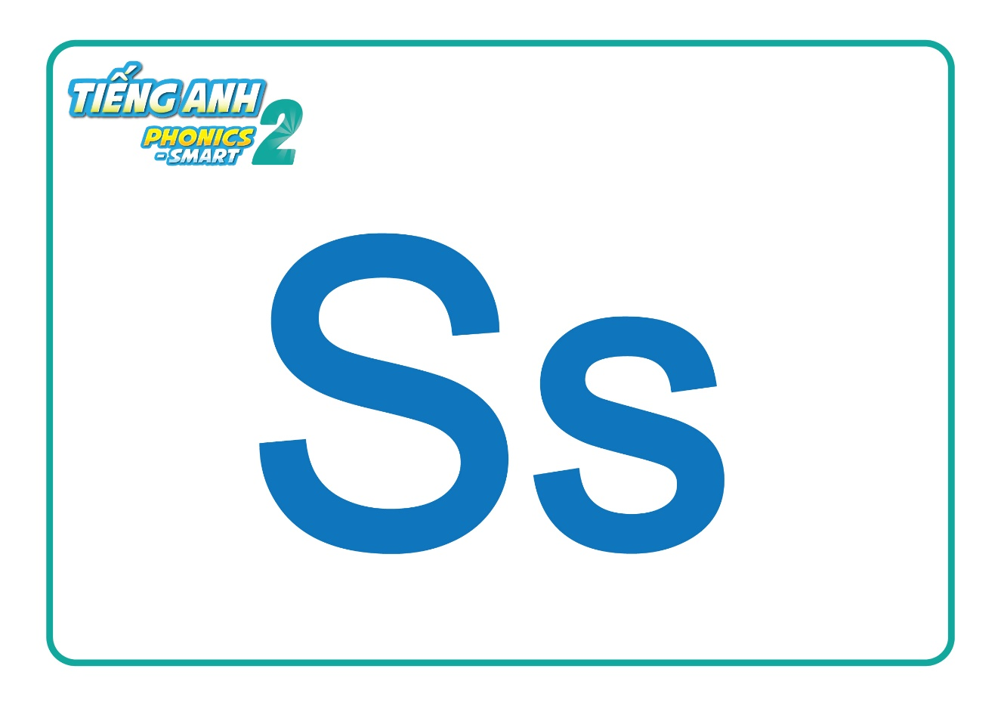
GUESSING GAME
Notes:
Hello children, How are you doing?
I hope that you are good.
Let’s play Guessing game.
Today, we will have 2 groups – group 1 and group 2. You are group 1, you are Group 2.

Slide 4
GUESSING GAME

Slide 5
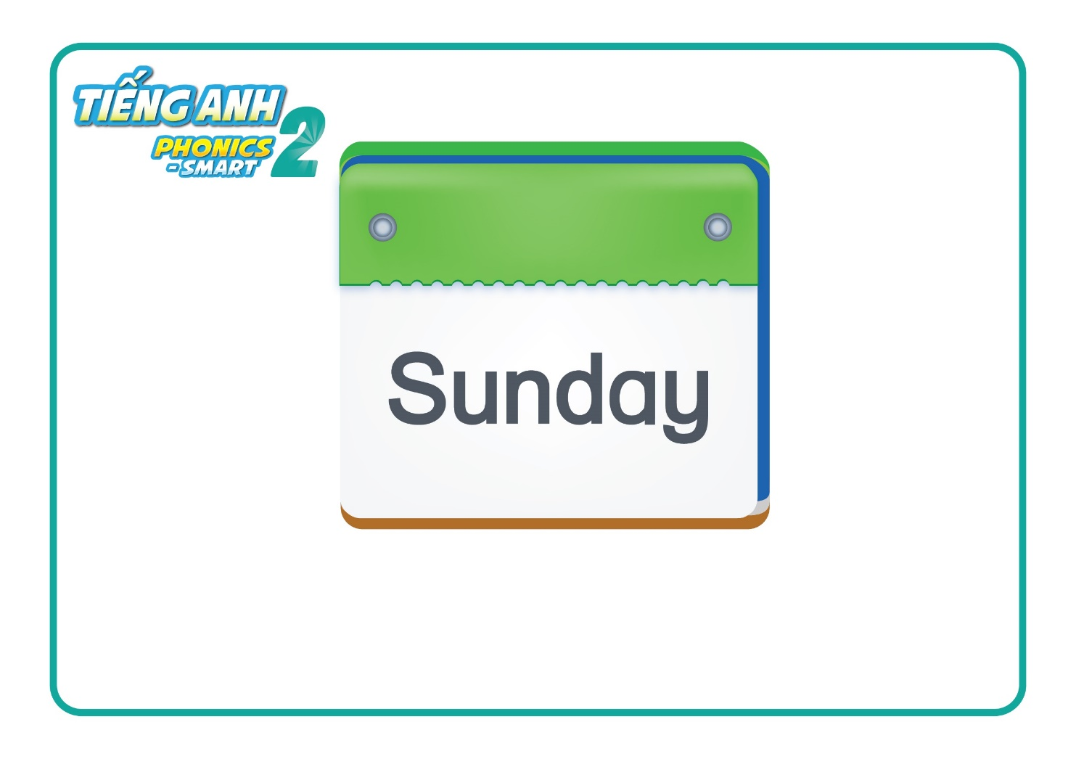
GUESSING GAME

Slide 6
GUESSING GAME

Slide 7
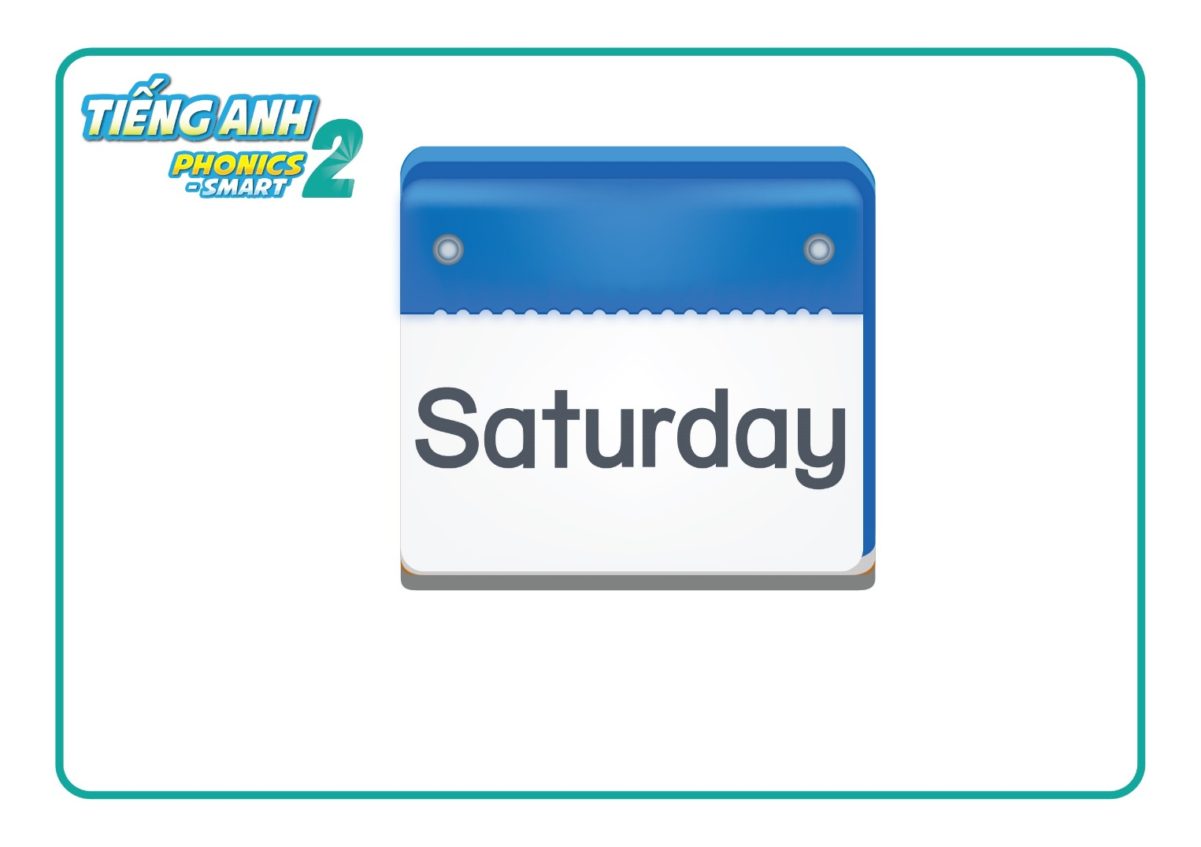
GUESSING GAME

Slide 8
GUESSING GAME

Slide 9
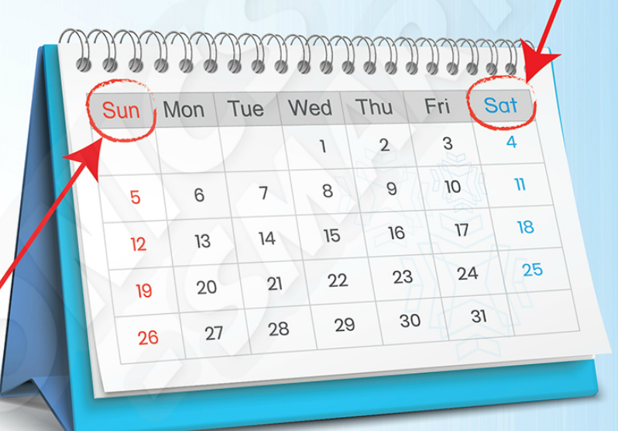

REVIEW
Notes:
Review letter Ss, sound s
Words: Sunday, Saturday

Slide 10

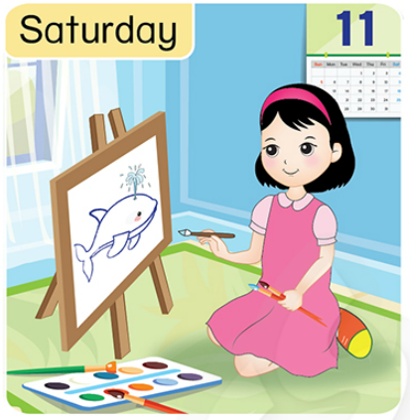
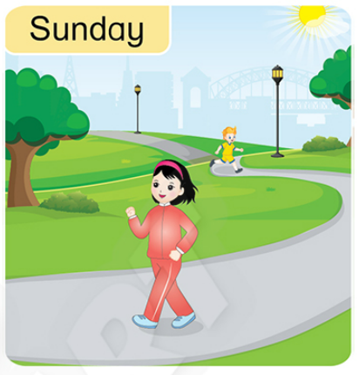
Unit 6 Lesson 2
Notes:
Now, we move to Lesson 2.

Slide 11


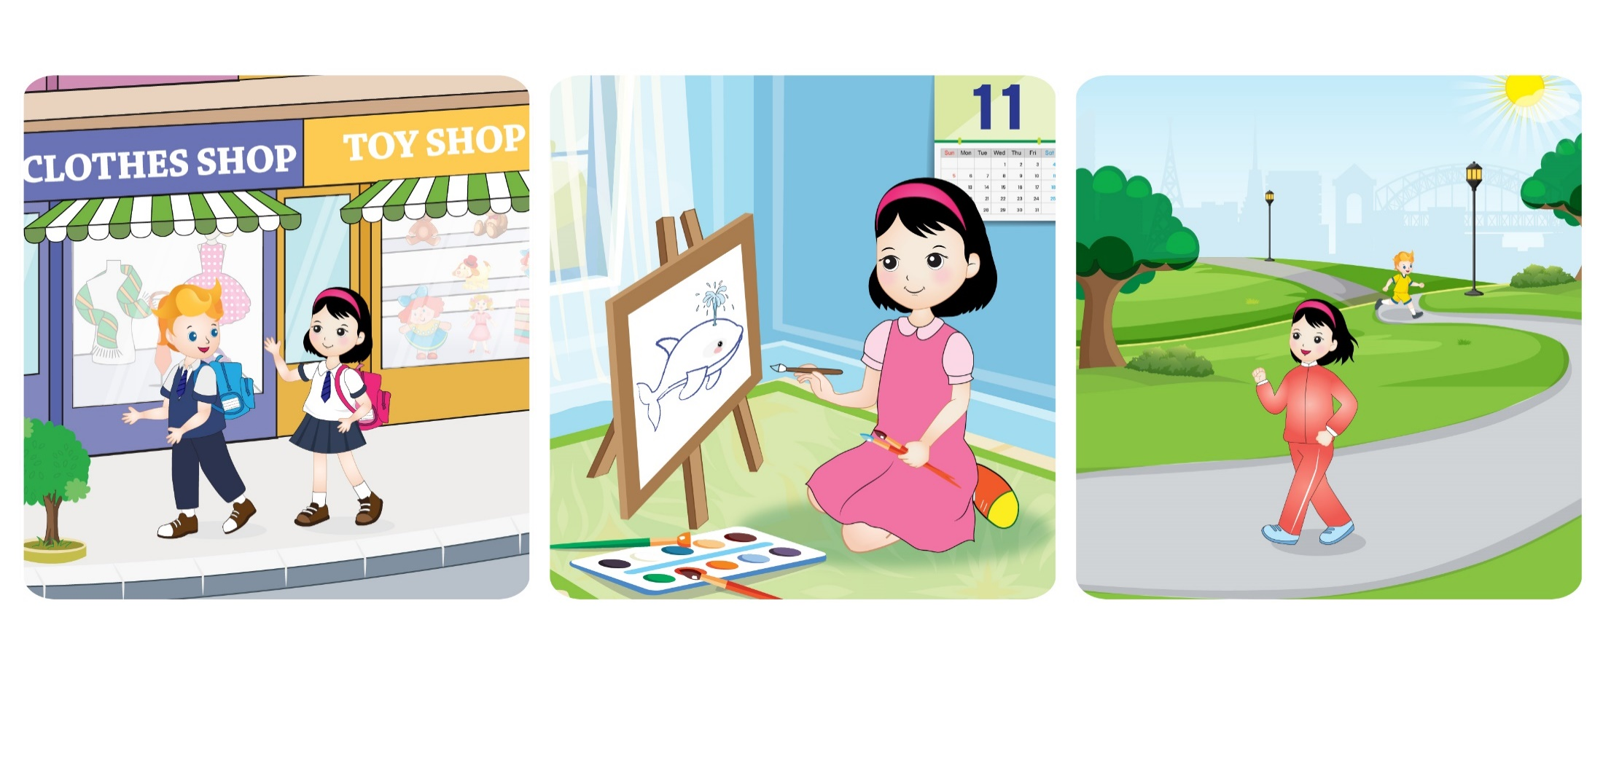
Unit 6
Lesson 2
1. Listen and repeat.
I love my weekend.
I draw on Saturday.
I walk on Sunday.

Slide 12
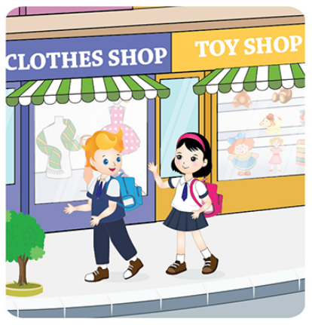
Unit 6
Lesson 2
1. Listen and repeat.
I love my weekend.

Slide 13
Unit 6
Lesson 2
1. Listen and repeat.
I draw on Saturday.
Notes:
Welcome to Unit 8 – Lesson 2.
Before we continue, Do you remember Lesson 1?
Let’s play a game to review Lesson 1.

Slide 14
Unit 6
Lesson 2
1. Listen and repeat.
I walk on Sunday.

Slide 15
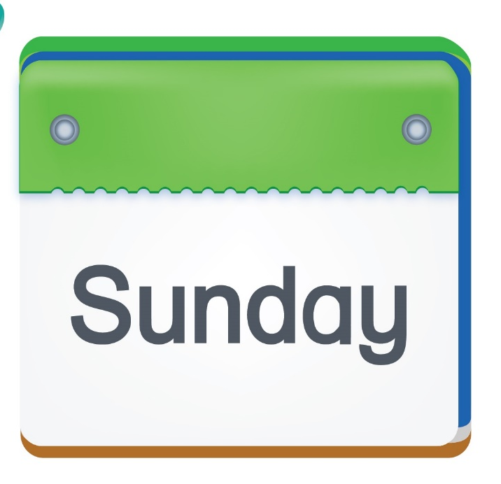
Unit 6
Lesson 2
Look and say.
I
on
Notes:
Now, look and say.

Slide 16

Unit 6
Lesson 2
Look and say.
I
on

Slide 17

Unit 6
Lesson 2
Look and say.
I
on

Slide 18

Unit 6
Lesson 2
Look and say.
I
on

Slide 19
Unit 6
Lesson 2
1. Listen and repeat.
I love my weekend.
I draw on Saturday.
I walk on Sunday.
Notes:
Open your book. Look, point and say.

Slide 20
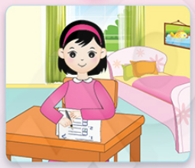
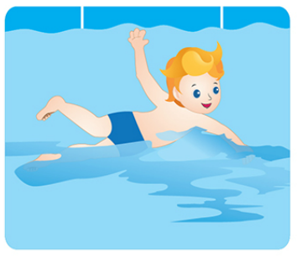


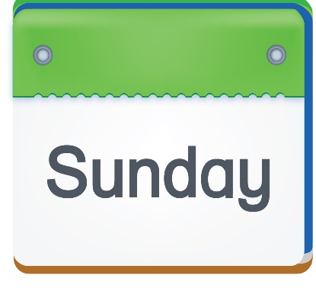

Unit 6
Lesson 2
2. Listen and tick (✓)
✓
✓
✓
✓

Slide 21

Unit 6
Lesson 2
REMEMBER GAME
Sunday
Notes:
Let’s play Remember Game.
Look at the pictures and tell me the activities.
These are the activities the children do on Sunday. Look and try to remember all of them.

Slide 22
Unit 6 Lesson 2
REMEMBER GAME
Sunday

Slide 23

Unit 6
Lesson 2
Sunday
Notes:
Ready?
Look and tell me the activities and circle.

Slide 24


Unit 6 Lesson 2
REMEMBER GAME
Saturday

Slide 25
Unit 6
Lesson 2
REMEMBER GAME
Saturday

Slide 26
Unit 6
Lesson 2
Saturday
Notes:
Look at the example. Look at the girl and listen.
What can you hear?
This is my bag. Good!
Yes or No?
Yes! So we put a tick on the circle.

Slide 27
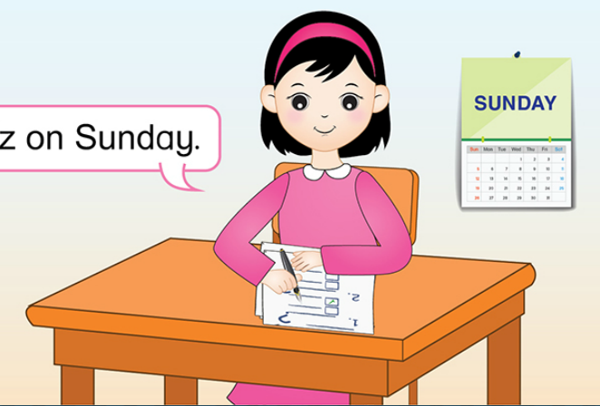
Unit 6
Lesson 2
3. Let’s talk
I do a quiz on Sunday

Slide 28

Unit 6
Lesson 2
3. Let’s talk
Look and say.
I
on
Notes:
Look and say the sentences.

Slide 29
Unit 6
Lesson 2
3. Let’s talk
Look and say.
I
on

Slide 30
Unit 6
Lesson 2
3. Let’s talk
Look and say.
I
on

Slide 31

Unit 6
Lesson 2
3. Let’s talk
Look and say.
I
on

Slide 32
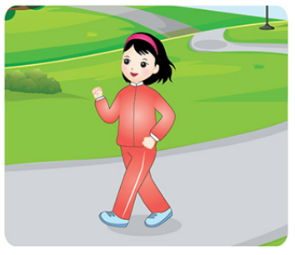
Unit 6
Lesson 2
Activity Book: Listen and tick (✓) or cross (✗)
I swim on Saturday.
✗
I read on Sunday.
✓
I sing on Sunday.
✗
I walk on Saturday.
✓
Notes:
Do the task in Activity Book.

Slide 33


CÔNG TY CỔ PHẦN PHÁT TRIỂN GIÁO DỤC
VIỆT NAM VPBOX
Hà Nội
Biệt thự G2&G28, Làng Quốc Tế Thăng Long,
Quận Cầu Giấy, Hà Nội.
ĐT: (024) 3 3793 2405
phonics.hanoi@vpbox.edu.vn
Thành Phố Hồ Chí Minh
Số 29 Mai Thị Lựu, Quận 1, TP. HCM.
ĐT: (028) 3 820 5934
phonics.hcm@vpbox.edu.vn
www.vpbox.edu.vn

