Slide 1











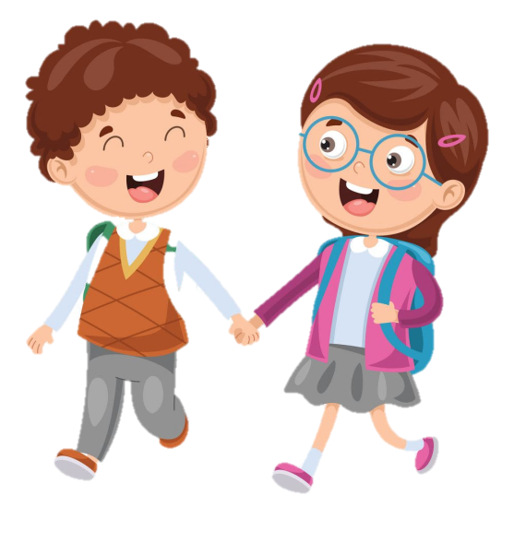



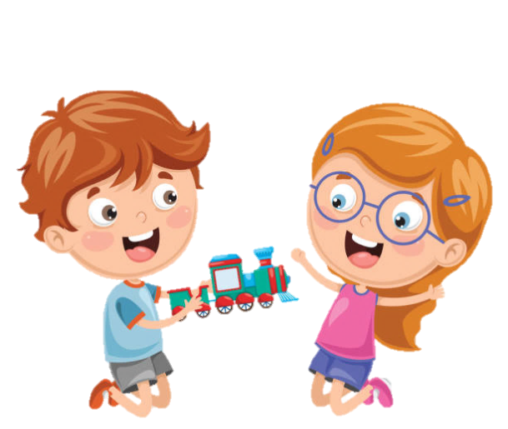






Slide 2







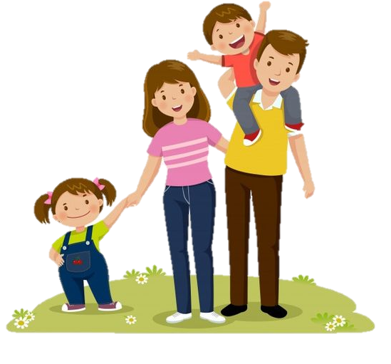
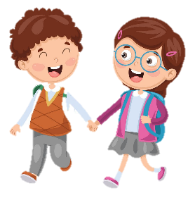
Review 3
Part 1

Slide 3
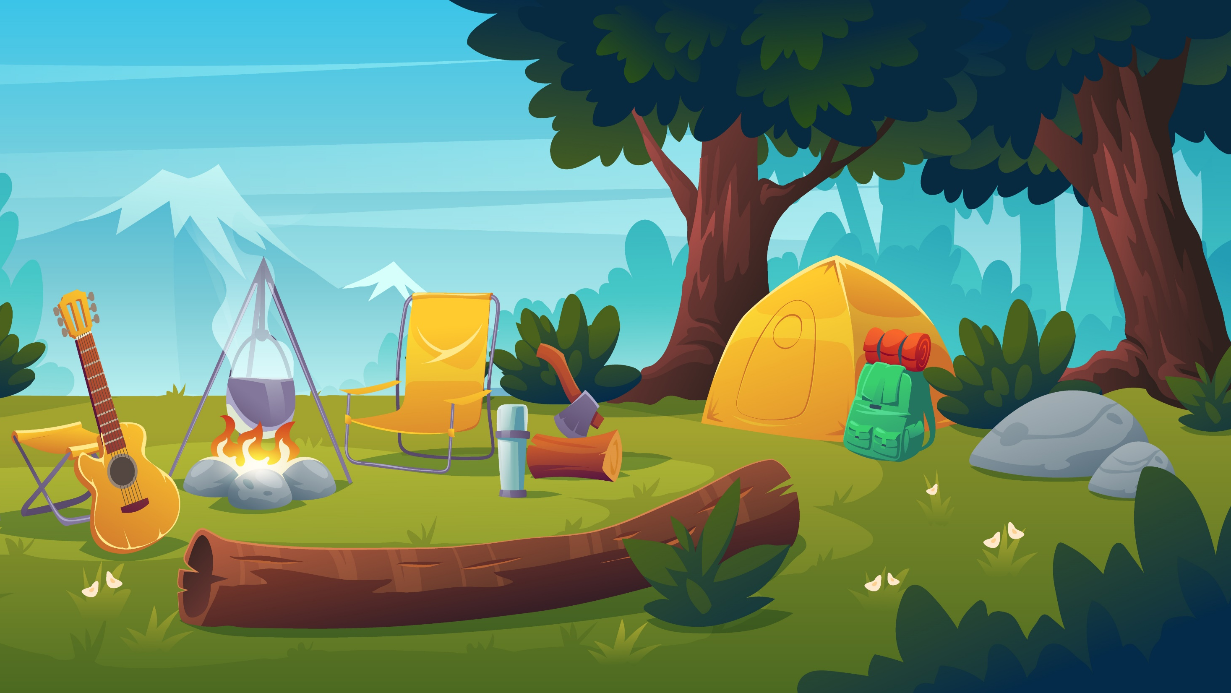
01
WARM-UP
Notes:
Bổ sung thêm bài hát sau slide warm up này

Slide 4
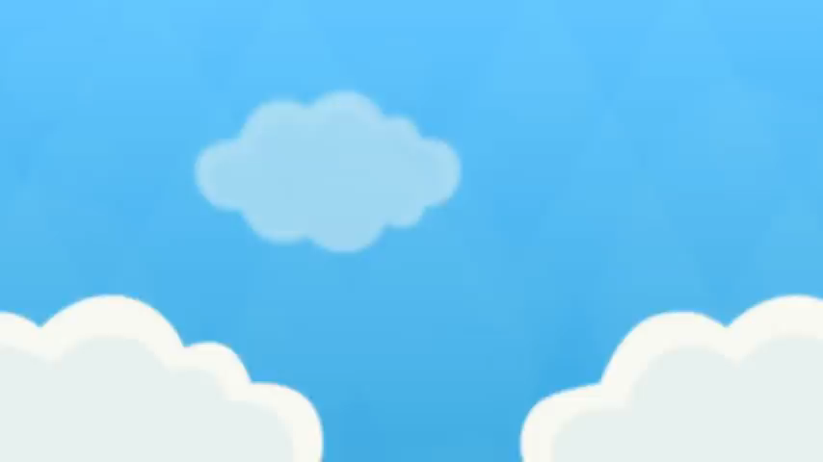
Listen and sing!

Slide 5
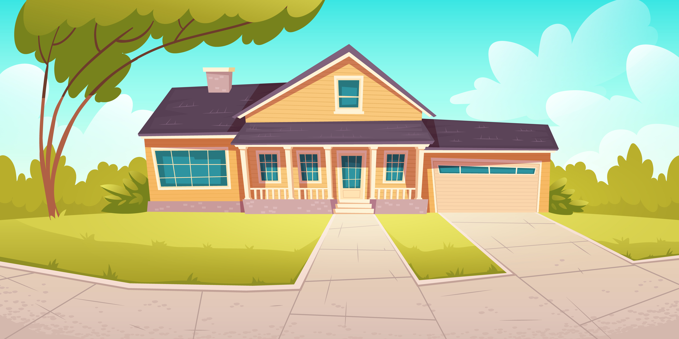
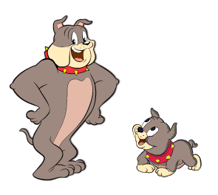
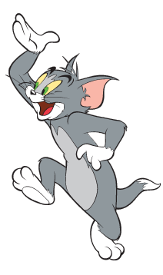
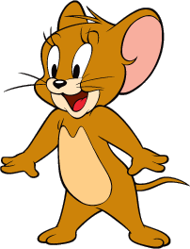
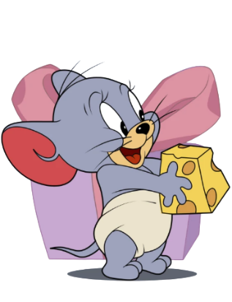
Tom and Jerry Puzzle!

Slide 6
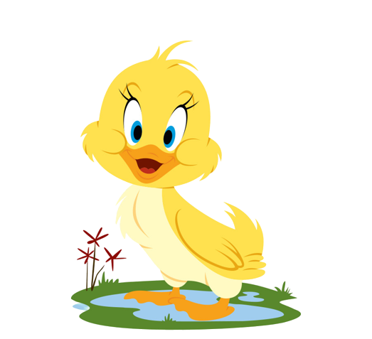
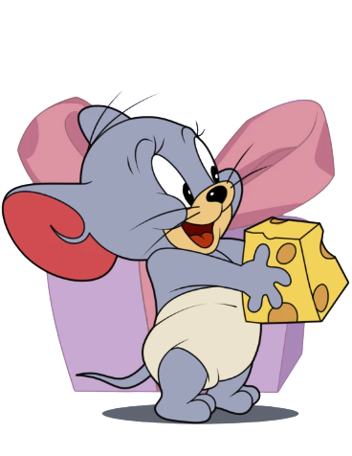
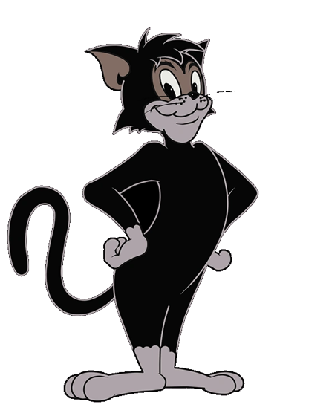
Pick A Character!
Next

Slide 7
What are they doing?
They are going fishing.
BACK

Slide 8
What are they doing?
They are making a campfire.
BACK

Slide 9
What is he doing?
He is playing ice hockey.
BACK

Slide 10
What are they doing?
They are going hiking.
BACK

Slide 11
What are they doing?
They are having a picnic.
BACK

Slide 12
What are they doing?
They are going swimming.
BACK

Slide 13
02
PRACTICE

Slide 14

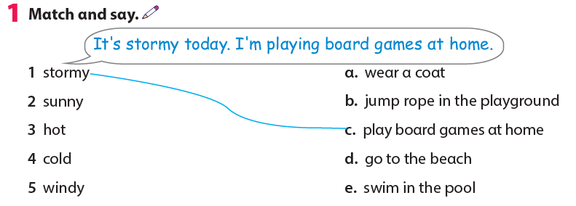

Slide 15
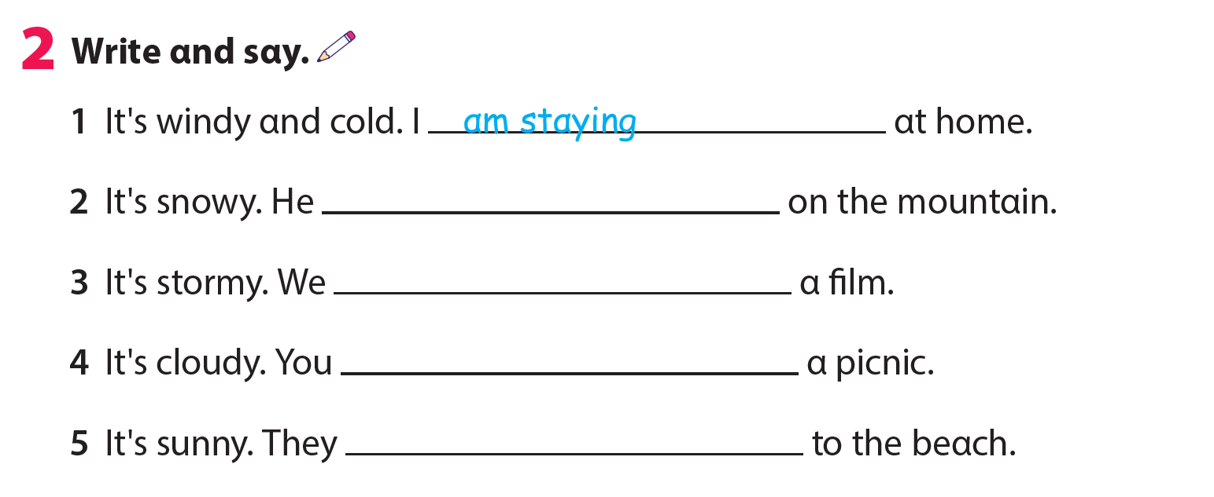
is skiing
are watching
are having
are going

Slide 16
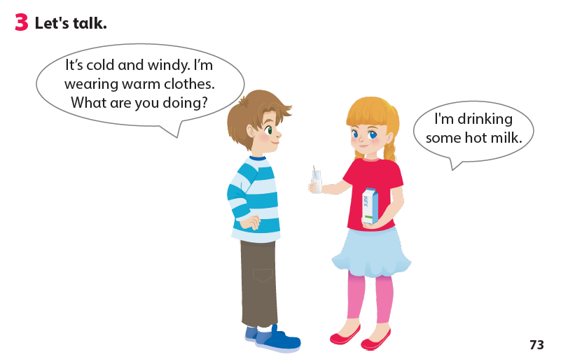
3. Let’s talk!

Slide 17
3. Let’s talk!
We can go to the beach today.
It’s cool.
Because it’s warm!
We can go hiking on the mountain.

Slide 18
03
ASSESSMENT

Slide 19




ASSESSMENT
TEAM 1
TEAM 2
TEAM 3
TEAM 4
Vận dụng xuất sắc những kiến thức đã học vào thực hành
Vận dụng tốt những kiến thức đã học vào thực hành
Biết cách vận dụng những kiến thức đã học vào thực hành

Slide 20


Reorder and write.
1 fishing / go / We / can/ today/ cool/ it’s/ because/.
2 I / sea/ swimming / am / the / in /.
3 do / What / we / park / in / can / the /?
We can go fishing today because it’s cool.
I am swimming in the sea.
What can we do in the park?

Slide 21




Thank you & goodbye!

