Slide 1




















Notes:
Để nguyên trang bìa như này, chỉ thay đổi tên bài trong quá trình làm. Logo của sách Wonderful World

Slide 2






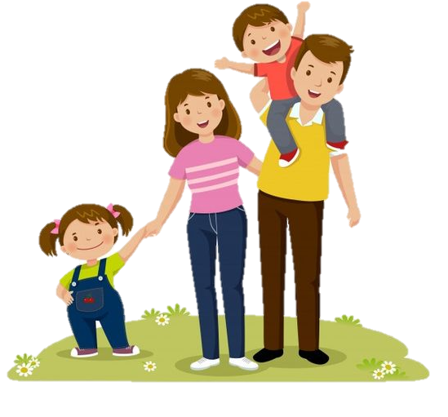
Review 3:
Part 4

Slide 3
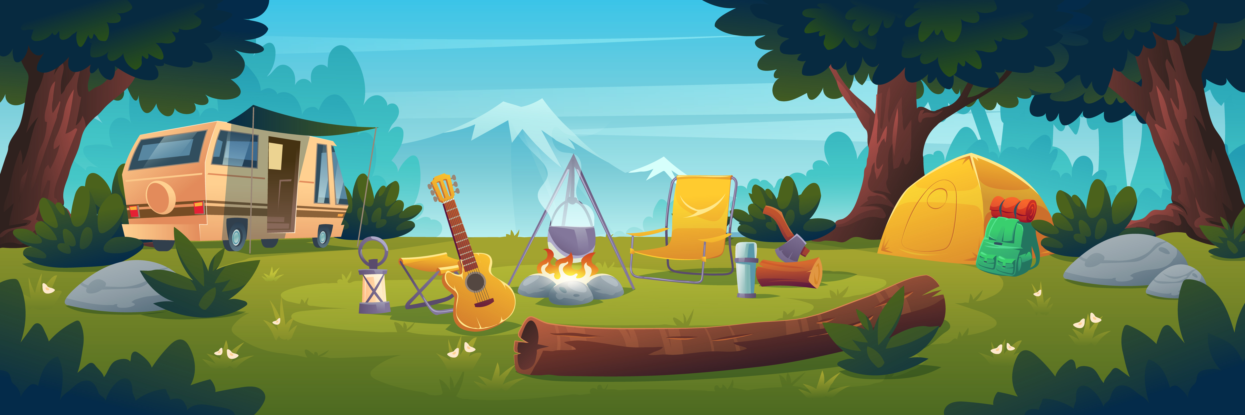
01
WARM-UP

Slide 4
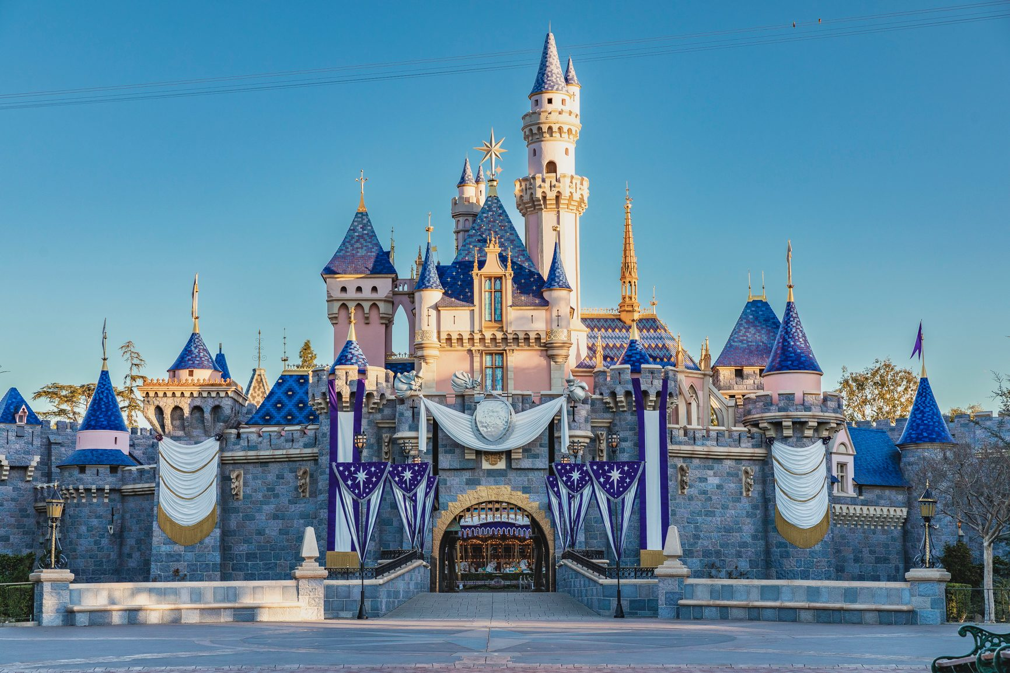
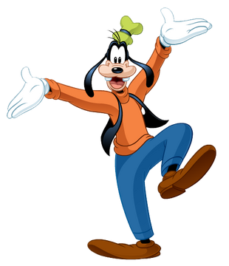
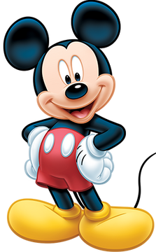
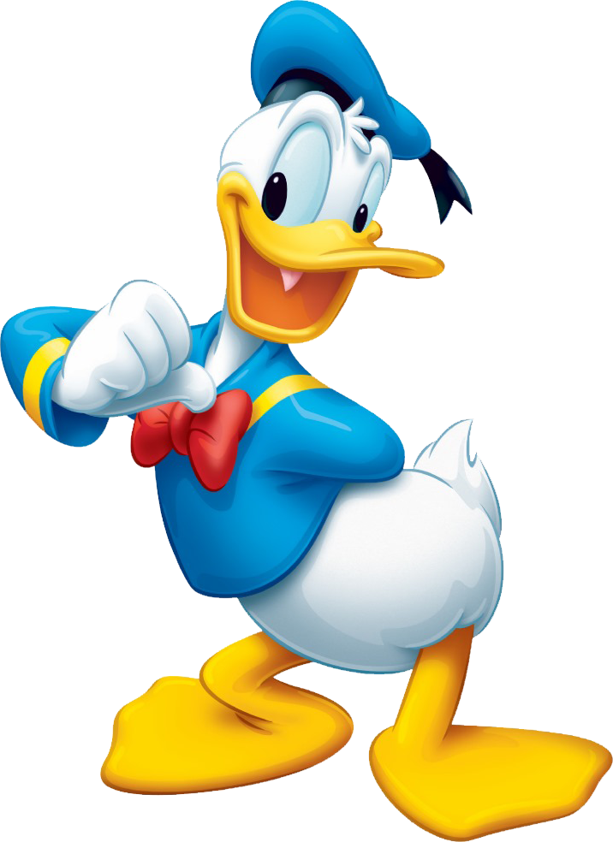
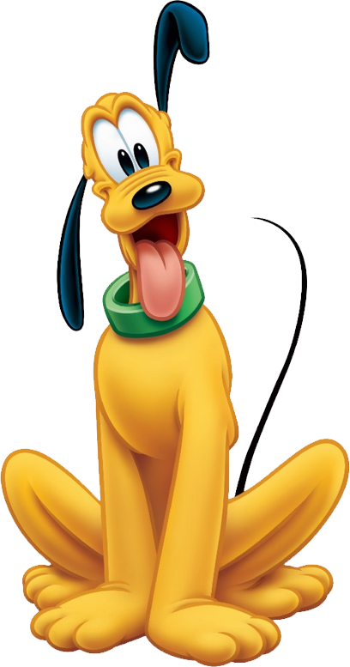
The Mickey Quiz!

Slide 5
Pick A Character!
Next

Slide 6
  garden
back

Slide 7
  beach
back

Slide 8
  forest
back

Slide 9
  mountain
back

Slide 10
02
PRACTICE

Slide 11
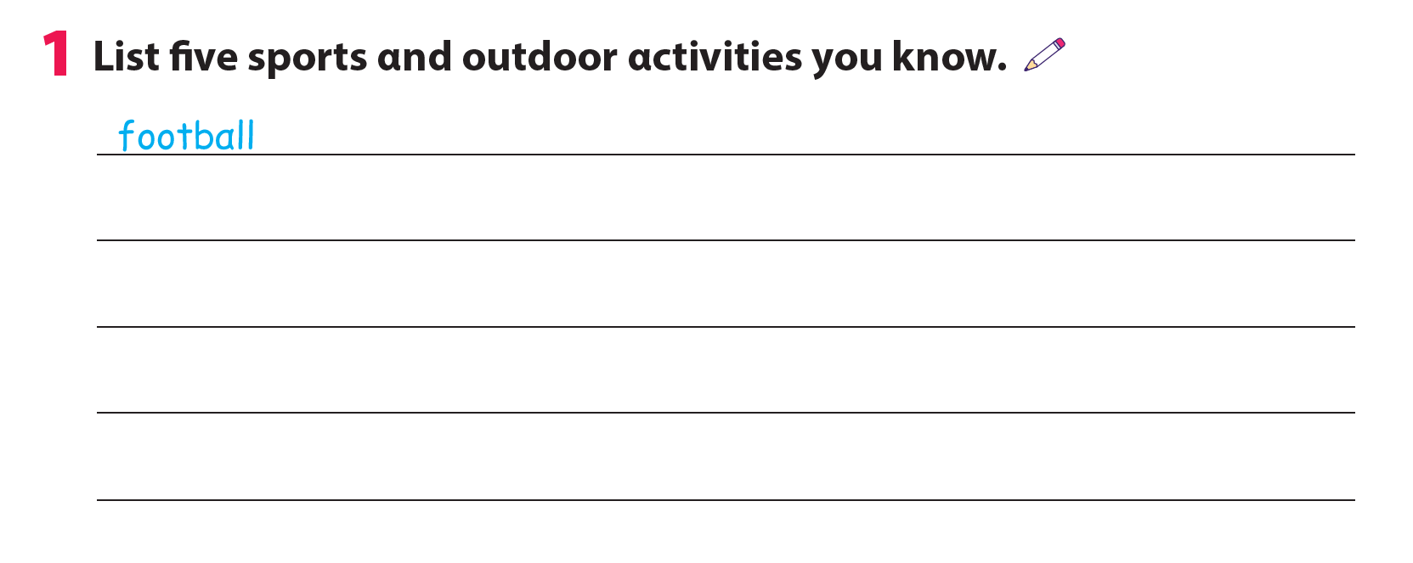
ice hockey
ride a bike
baseball
tennis
skiing

Slide 12
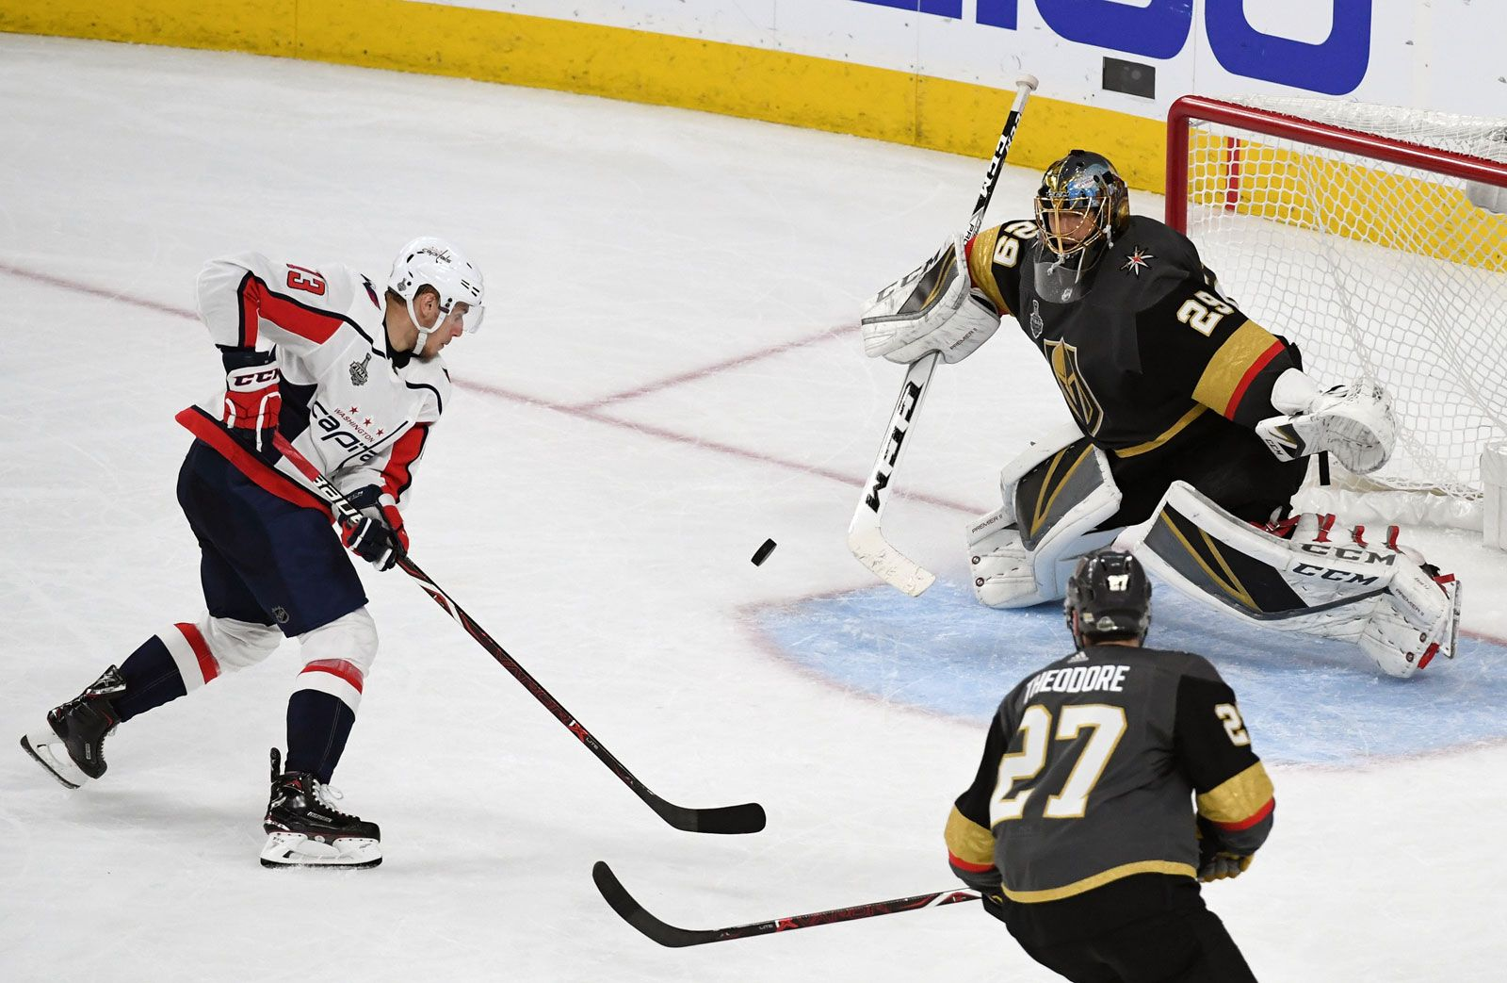
Ice hockey

Slide 13
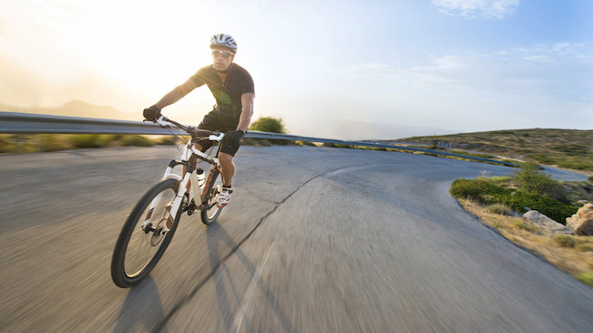
Ride a bike

Slide 14
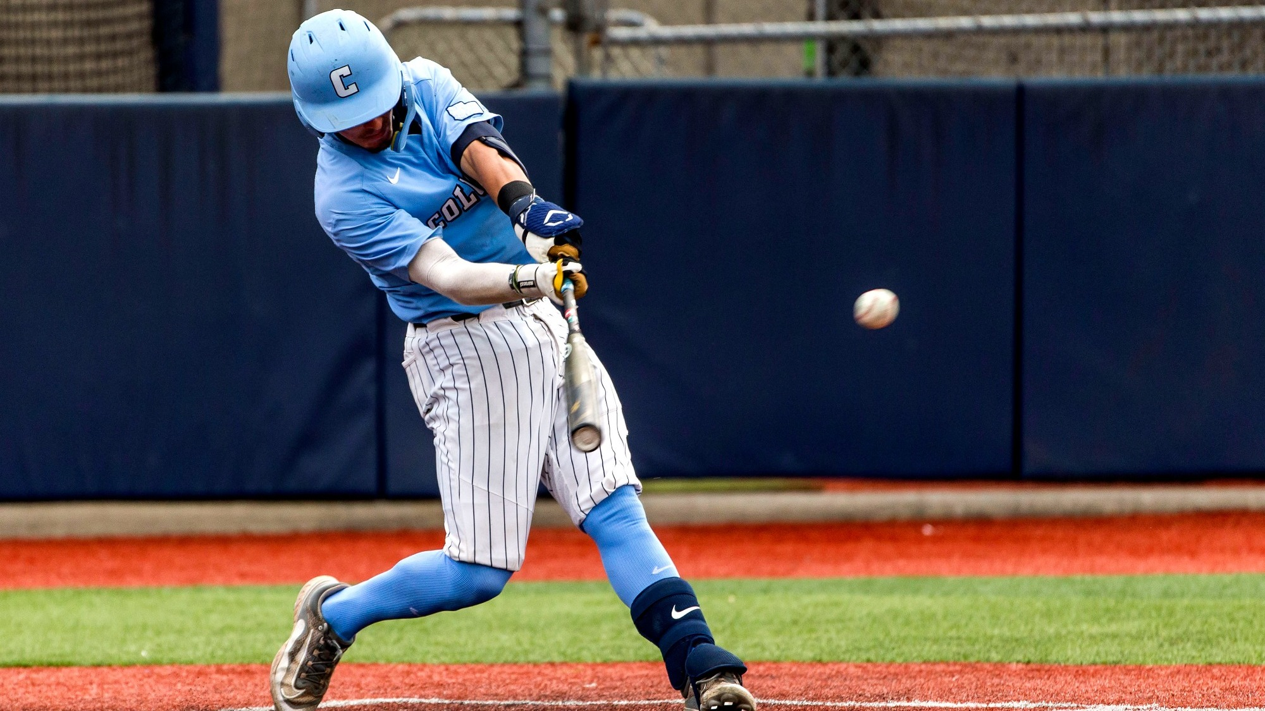
Baseball

Slide 15
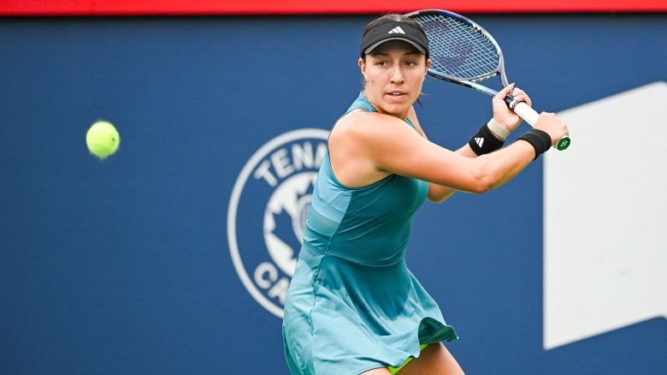
Tennis

Slide 16
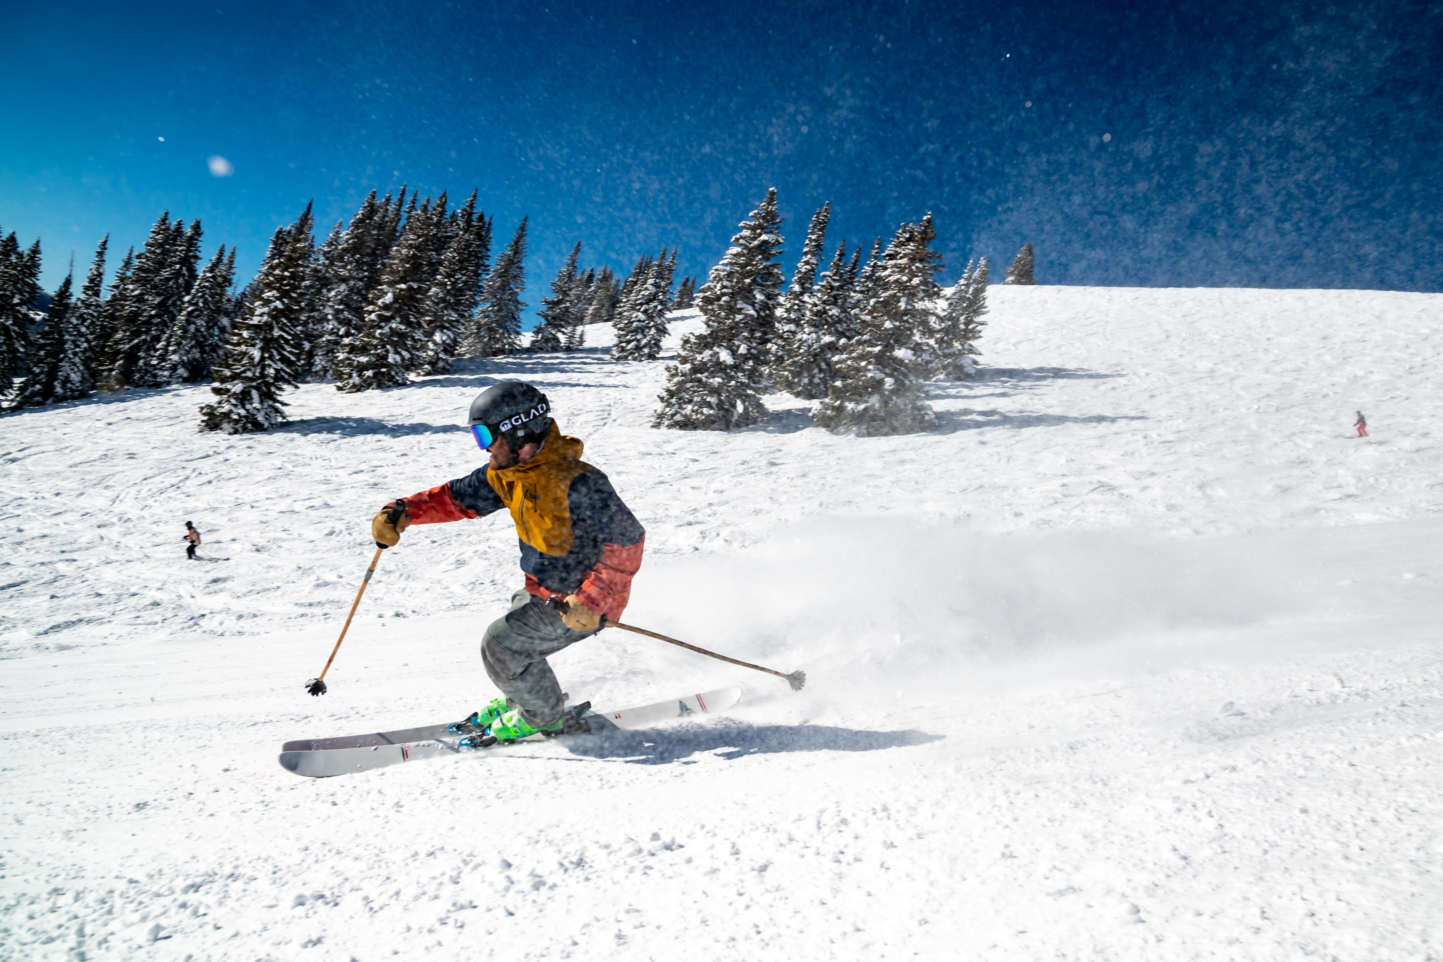
Skiing

Slide 17
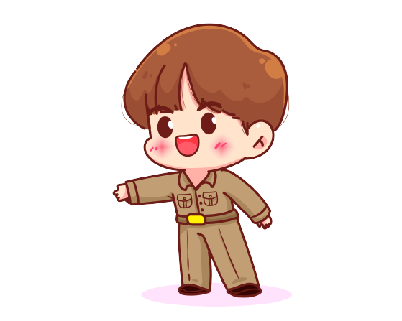

2. Talk about a place you want to visit and activities you want to do.
What cαn we do on the mountαin?
Let's go to the mountαin!

Slide 18
2. Talk about a place you want to visit and activities you want to do.
We cαn ski on the mountαin, but we can't go camping. It's very cold in winter.

Slide 19
2. Talk about a place you want to visit and activities you want to do.

Slide 20
03
ASSESSMENT

Slide 21
Circle the correct answer
It’s____. We can go swimming.
cold B. hot C. snowy
Can we have a picnic in the _____? Yes, we can.
park B. mountain C. pool
3. What can we do on the mountain? – We can ______.
go hiking B. go swimming C. play football
4. In ice hockey, there are _____ teams.
one B. two C. three

Slide 22


Thank you
& goodbye!

