Slide 1
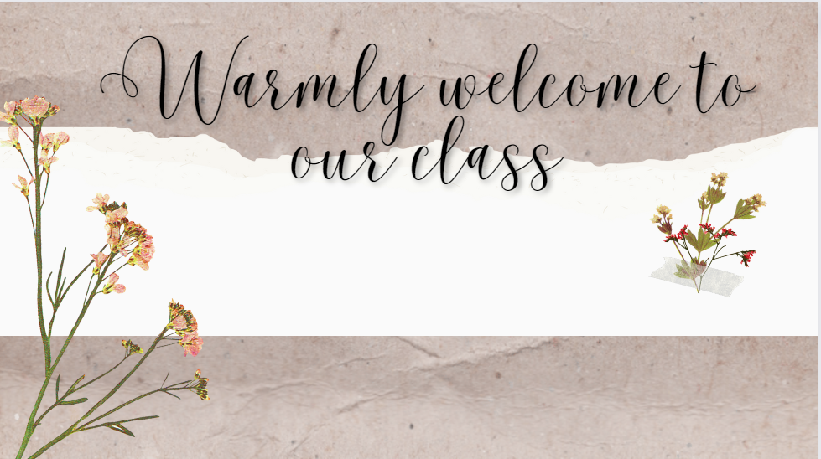
Unit 4 : I love my room
Lesson 1 Period 1

Slide 2
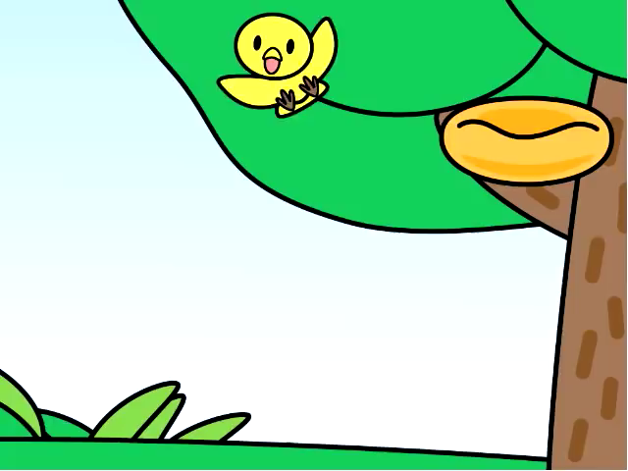

Slide 3
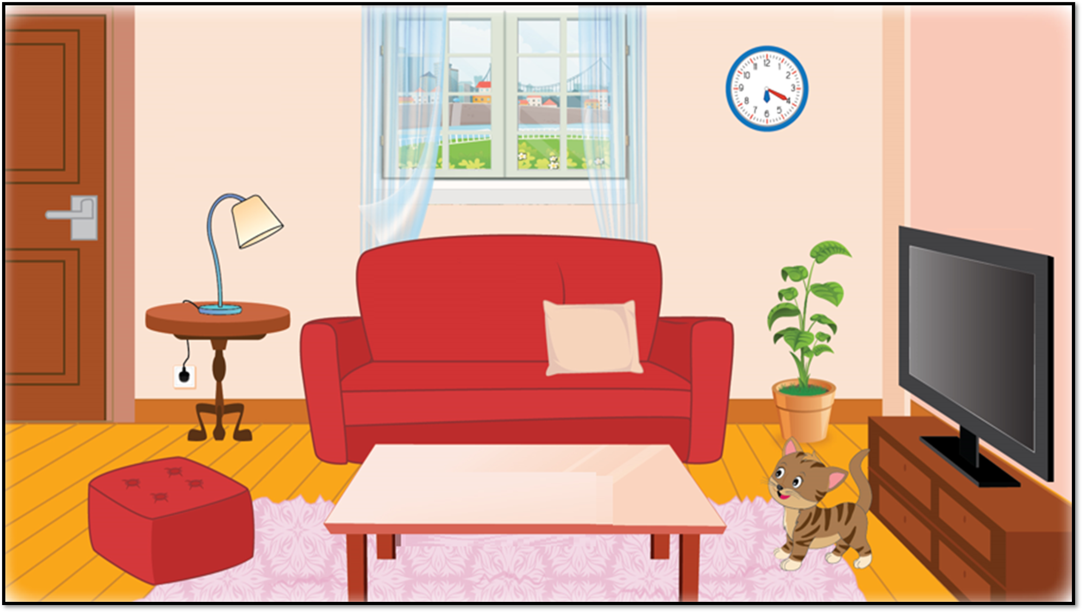



Slide 4
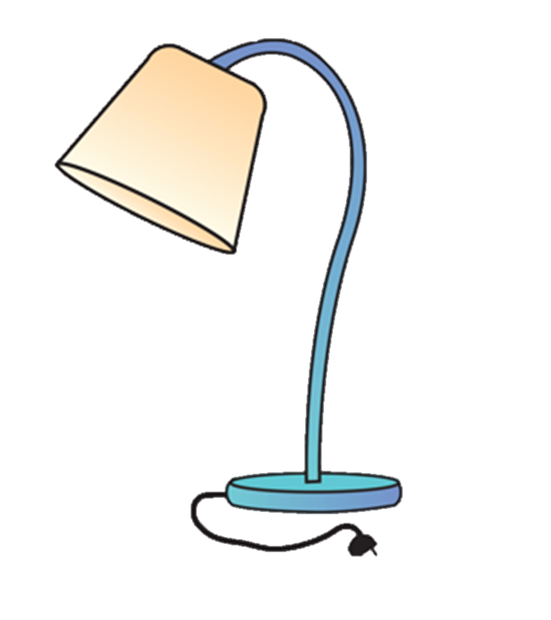
lamp

Slide 5

clock

Slide 6

sofa

Slide 7
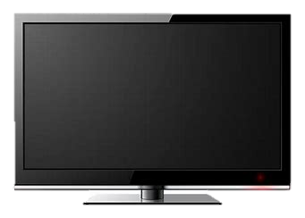
TV

Slide 8

table

Slide 9
clockp
lampp
sofap
TVp
tablep

Slide 10
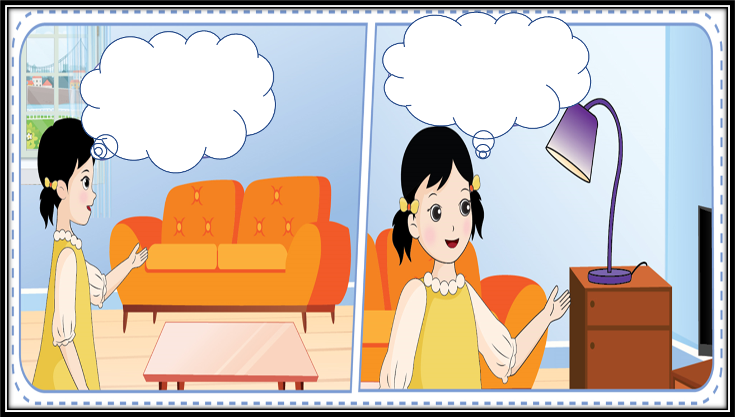
There is a lamp.
lamp.
There is a sofa.
sofa.
purple.
It’s purple.
It’s orange.
orange.

Slide 11
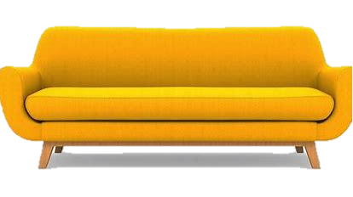

Sentence structure
There’s a sofa.
It’s orange.
Notes:
Introduce the sentence structure and explain for students.

Slide 12

table
brown
There is a ……….. . It’s …………
Notes:
Introduce the sentence structure and explain for students.

Slide 13

There is a ……….. . It’s …………
lamp
blue
Notes:
Introduce the sentence structure and explain for students.

Slide 14


Lucky star
4
2
6
3
5
1

Slide 15


There is a lamp. It’s orange.

Slide 16
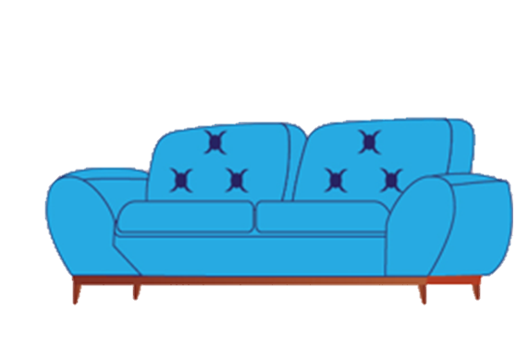
There is a sofa. It’s blue.

Slide 17

Lucky star

Slide 18

There is a lamp. It’s red.

Slide 19
Lucky star

Slide 20
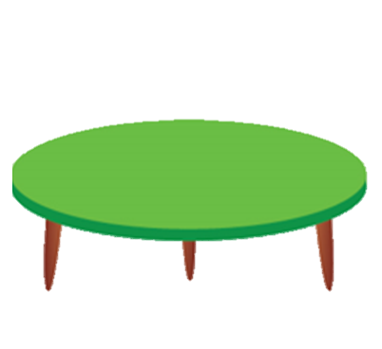
There is a table. It’s green.

Slide 21



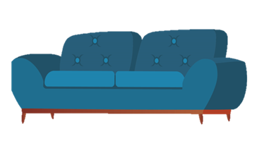

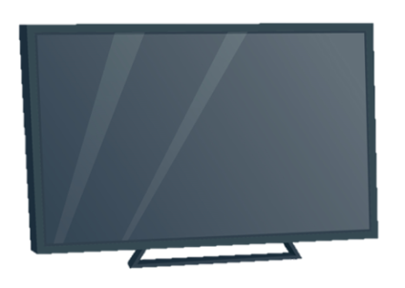
clock
There is …
It’s … .
lamp
table
sofa
TV

Slide 22
3. Homelink
Review learnt vocabulary and structures at home.
Practice with the partners in your free time.
Draw and decorate your room or your dream room.

Slide 23



Slide 24
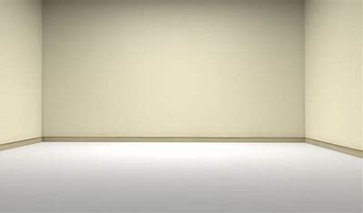

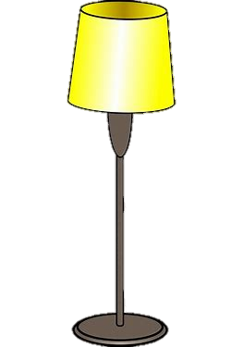
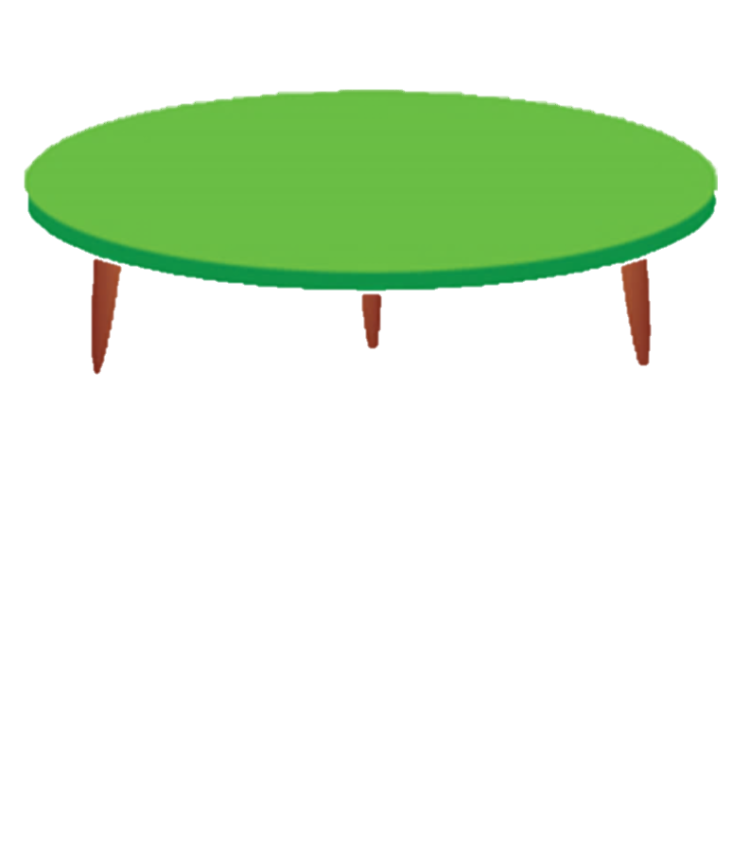

Slide 25
