Slide 1


Slide 2


Slide 3
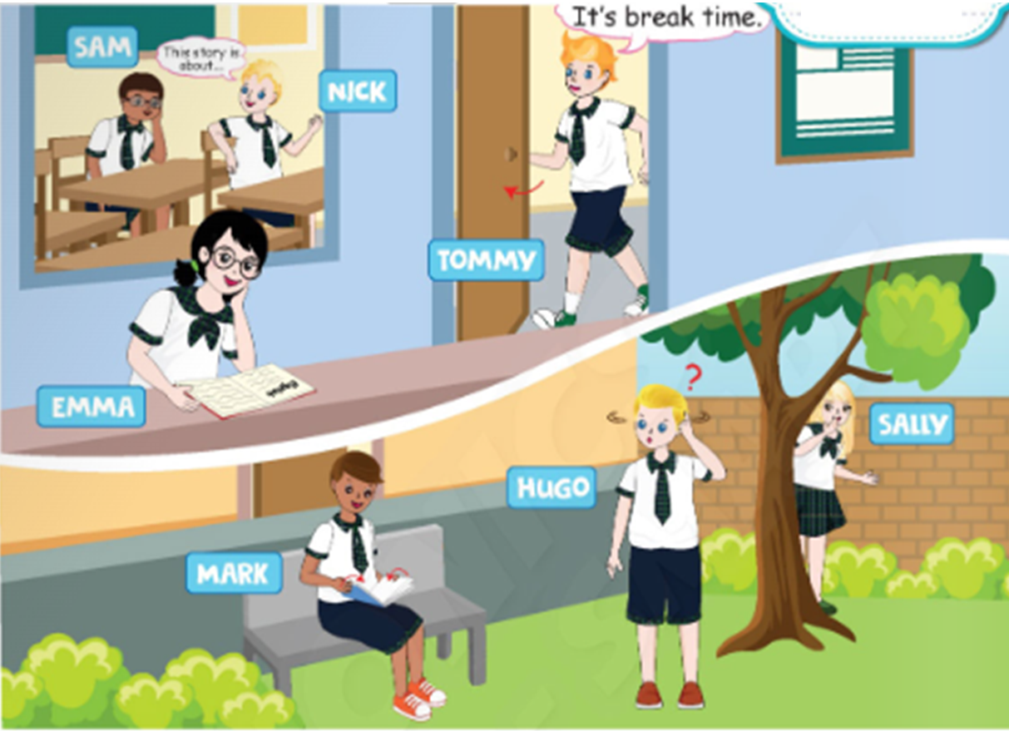
Unit 4
School activities
Lesson 2

Slide 5
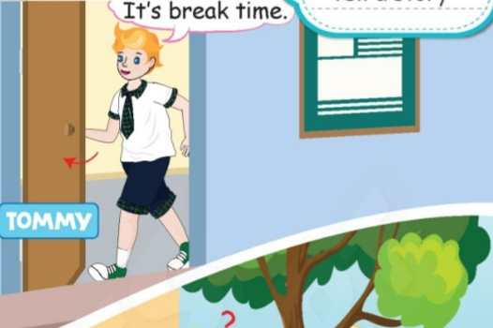
open

Slide 6
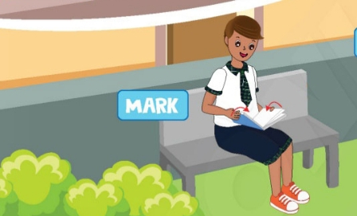
close

Slide 7
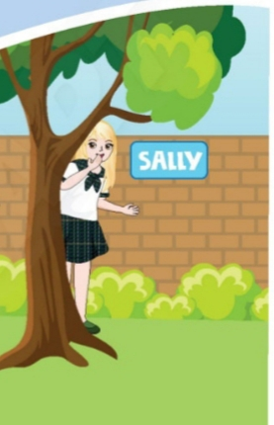
hide

Slide 8
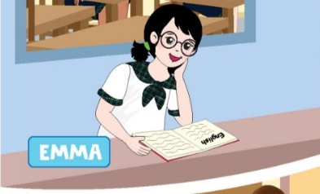
read an English book

Slide 9
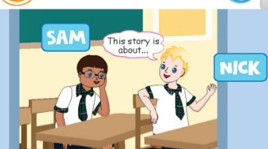
tell a story

Slide 10
I’m opening the door

Slide 11
open
opening
close
closing
hide
hiding
read
reading
tell
telling

Slide 12
I’m closing the book

Slide 13
I’m hiding

Slide 14
I’m reading an English book

Slide 15
I’m telling a story

Slide 18
I’m telling a story
I’m opening the door
I’m reading an English book
I’m hiding
I’m closing the book

Slide 19
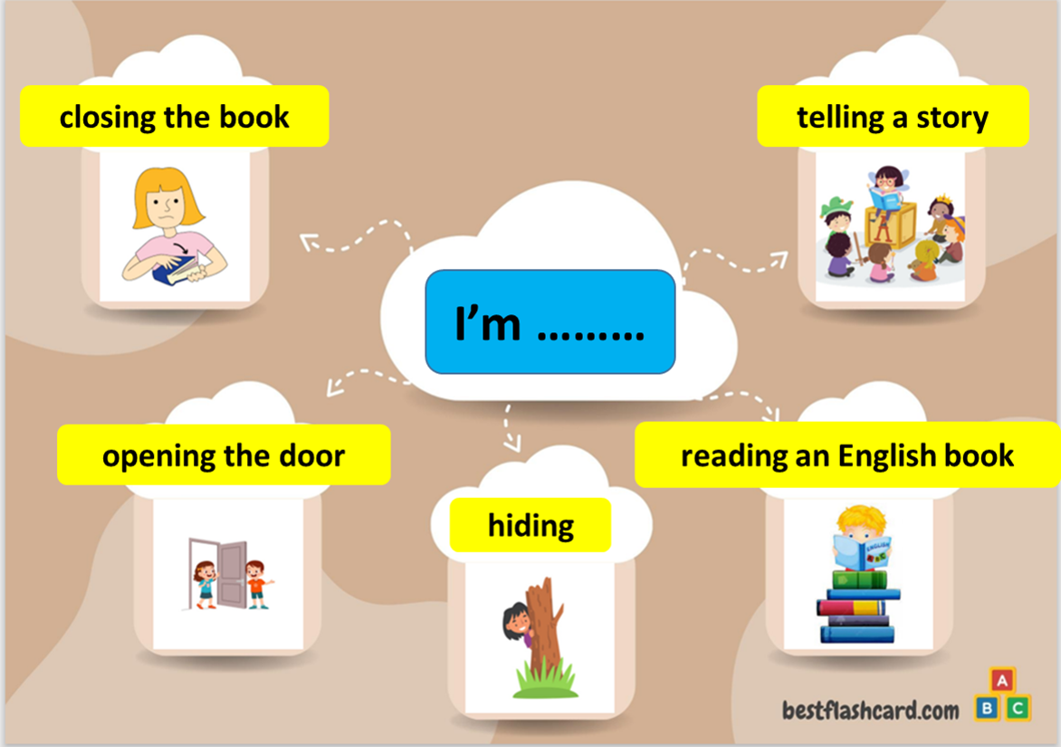

Slide 20


