Slide 1
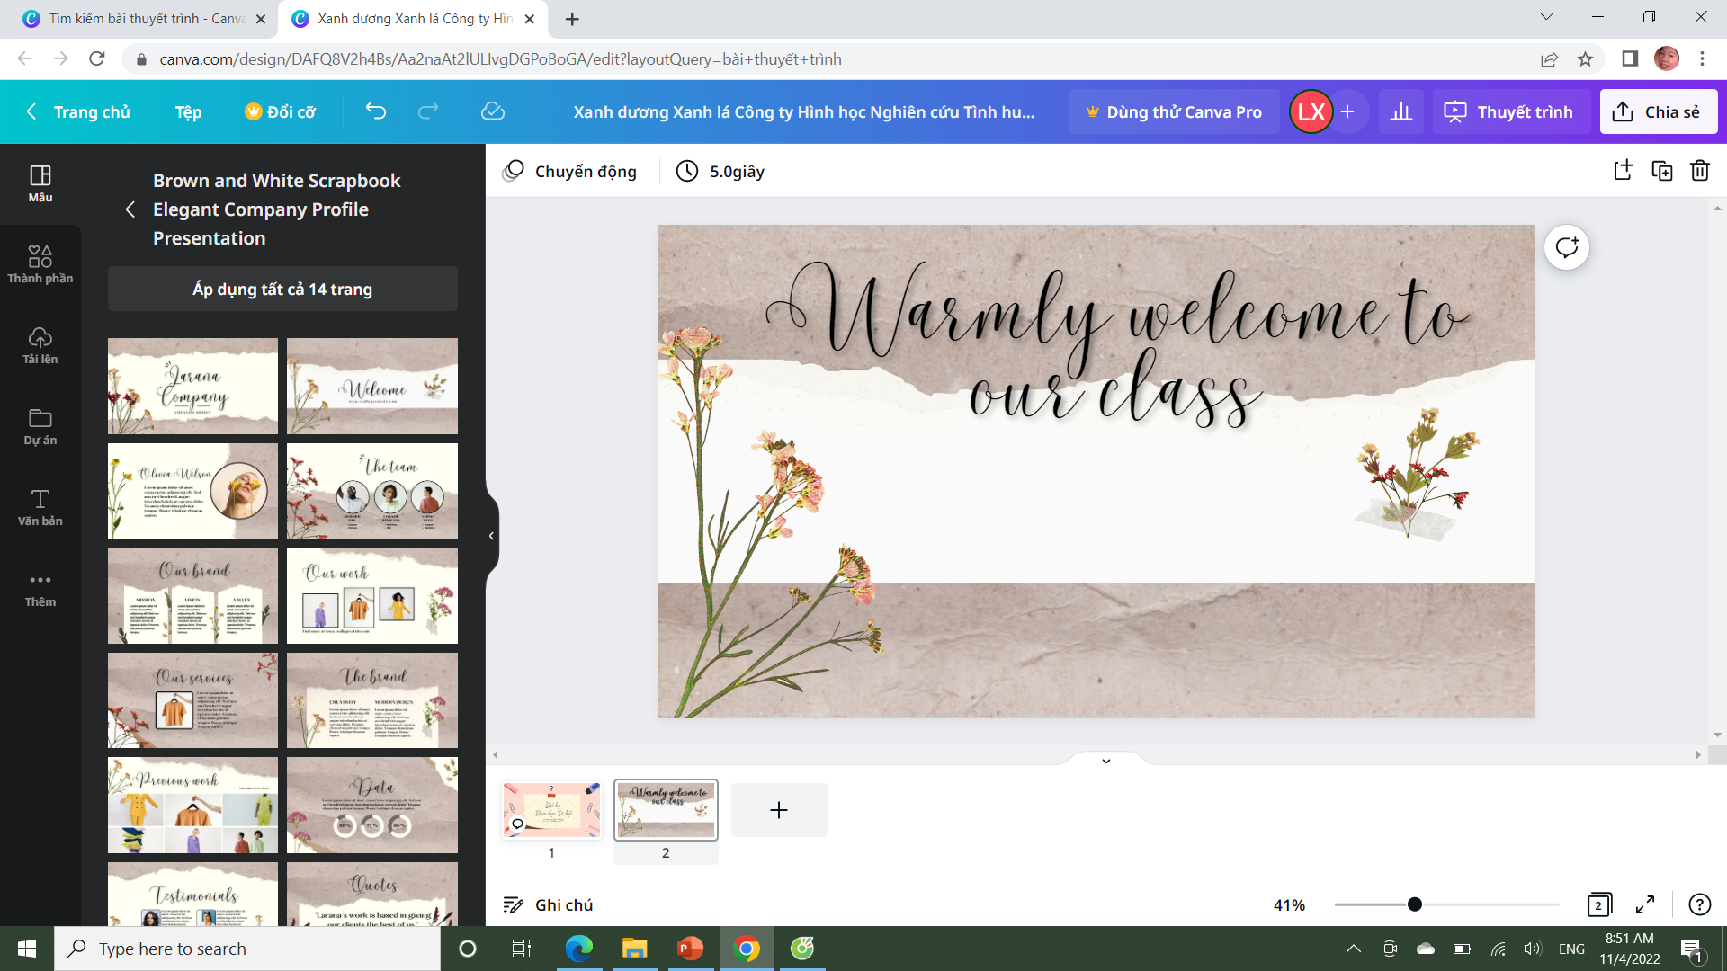

Slide 2


Slide 3


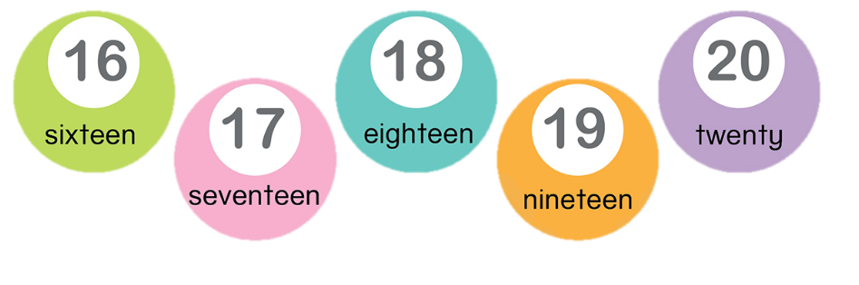
Unit 11:
Lesson 4
1. Listen and repeat

Slide 4
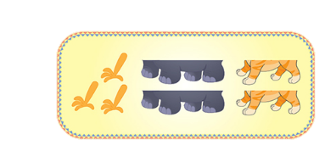
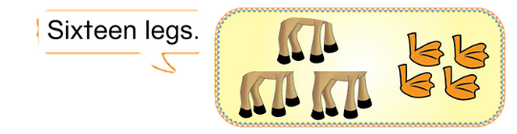
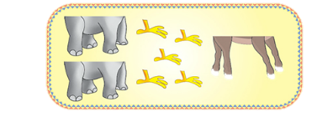
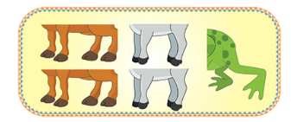
3. Count the legs and say
a.
b.
a.
c.
d.

Slide 5
Unit 11:
Lesson 4
3. Count the legs and say
a. Example
Sixteen legs

Slide 6
Unit 11:
Lesson 4
3. Count the legs and say
Nineteen legs
b.
CHECK

Slide 7
Unit 11:
Lesson 4
3. Count the legs and say
Seventeen legs
c.
CHECK

Slide 8
Unit 11:
Lesson 4
3. Count the legs and say
Eighteen legs
d.
CHECK

Slide 9
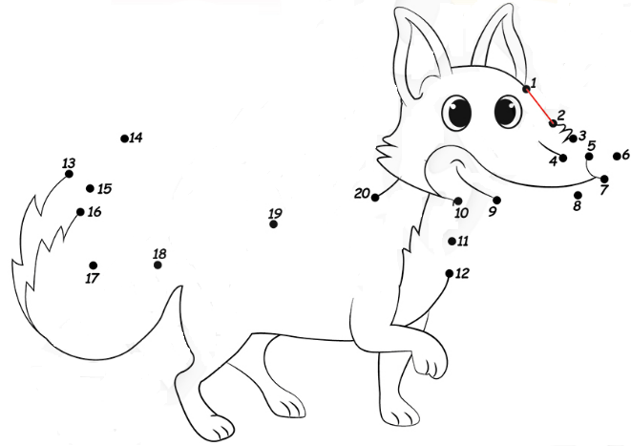

Unit 11:
Lesson 4
2. Match and say

Slide 10
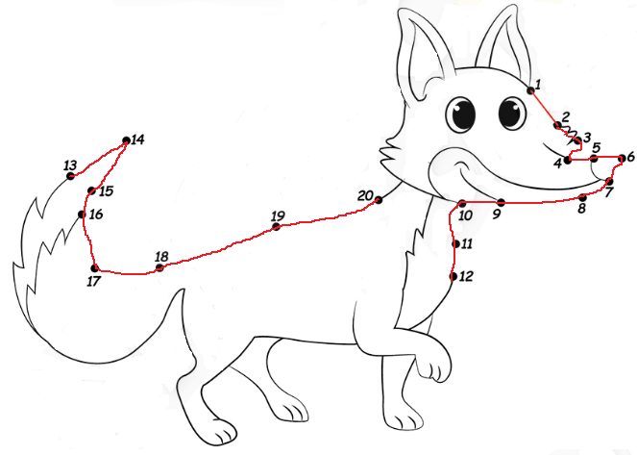
Unit 11:
Lesson 4
2. Match and say
It is a …
fox

Slide 11
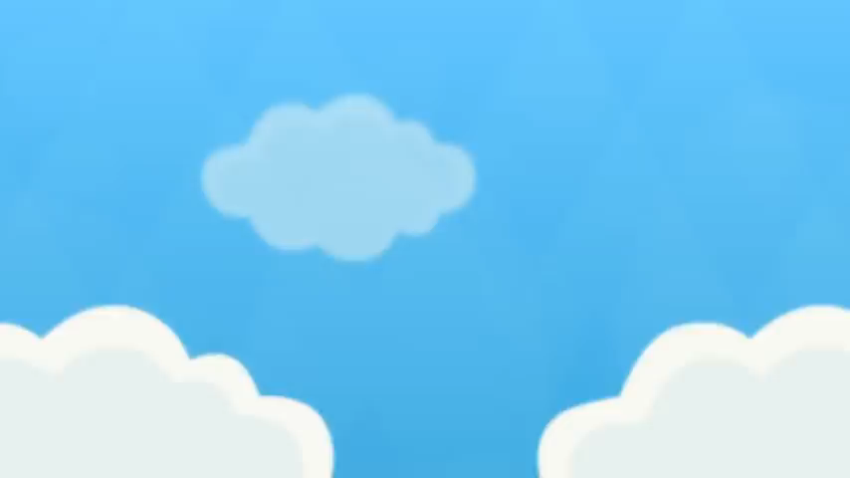

Slide 12


