Slide 1







Good afternoon

Slide 2


Dong Hai 1 primary school
29.10
2021
Welcome teachers to our English lesson
Teaching by: Hoang Thi Huyen- Class 5A1

Slide 3
Dong Hai 1 primary school
Welcome teachers to our English lesson
Teaching by: Hoang Thi Huyen- Class 5A1

Slide 4


Slide 5
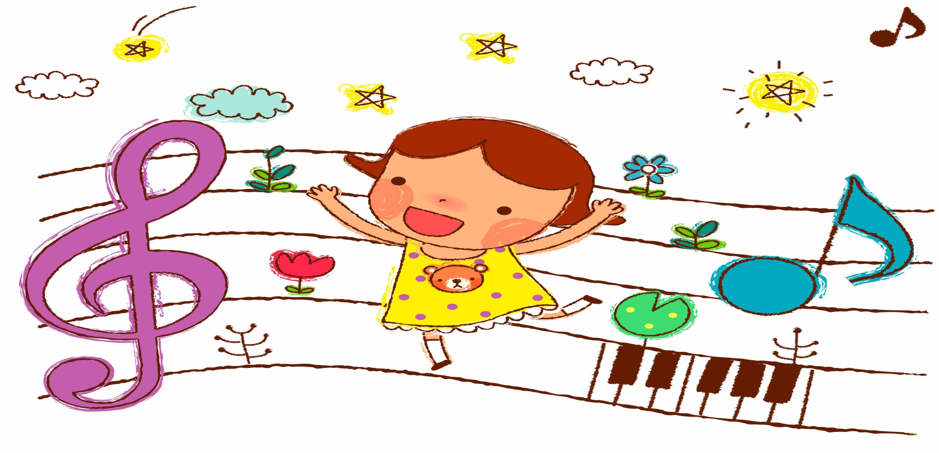

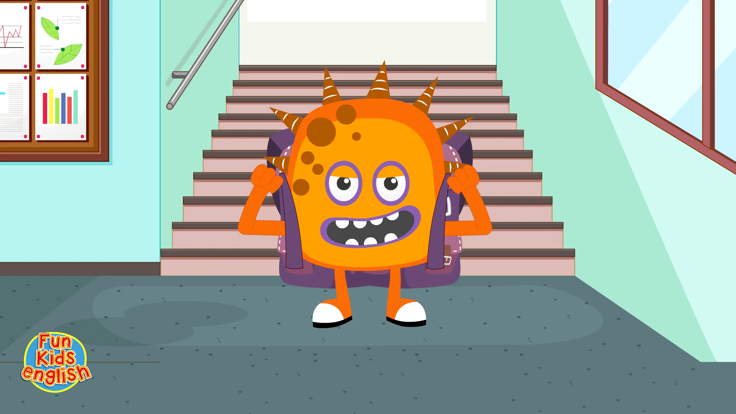
WARM UP

Slide 6
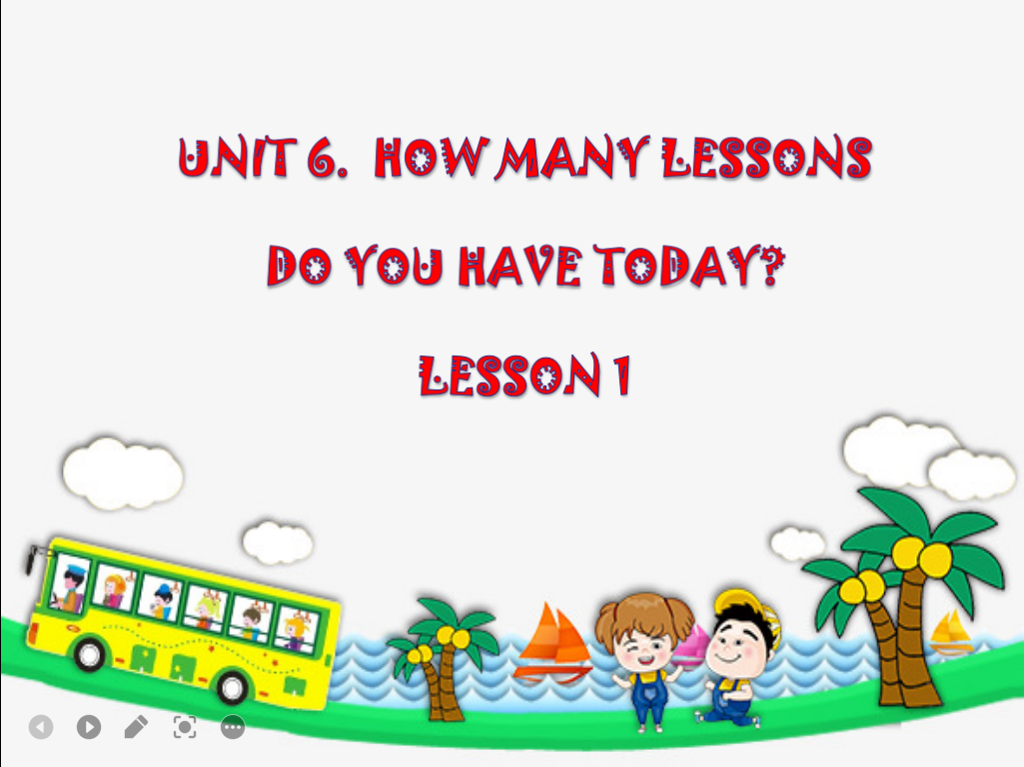

Slide 7
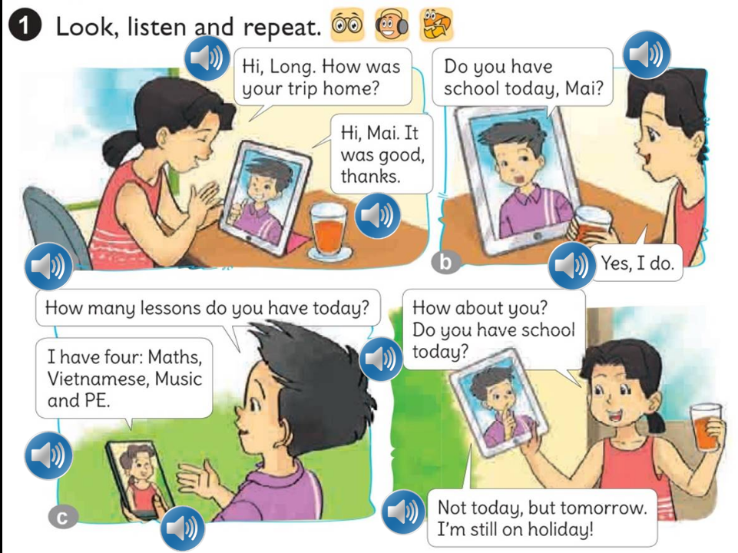




Slide 8



was

Slide 9
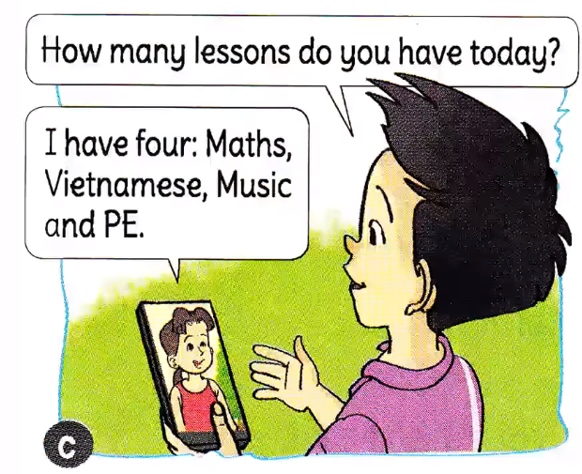
Model sentence:

Slide 10
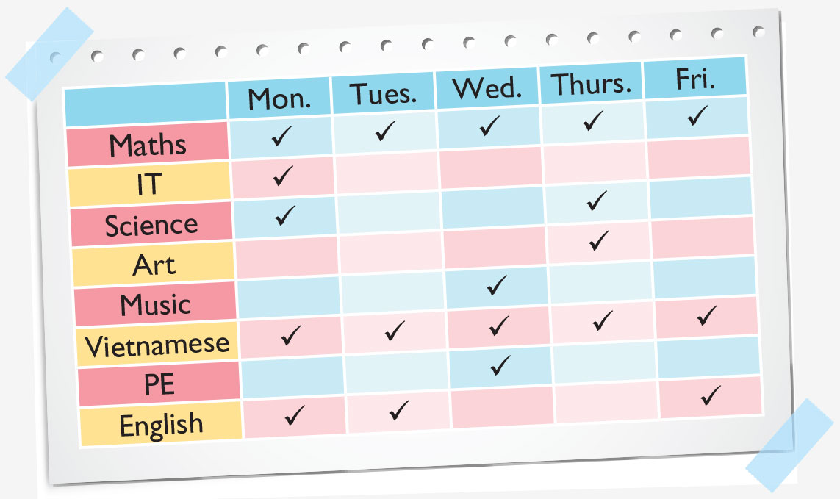
2. Model sentence
How many lessons do you have today?
I have four: Maths, Music, Vietnamese and PE.

Slide 11
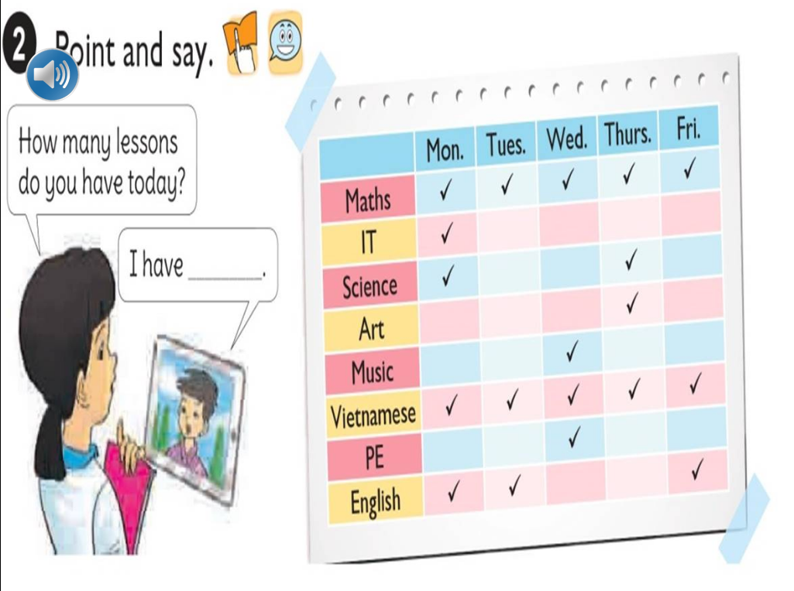

Slide 12

How many lessons do you have today?
I have
five: Maths, IT, Science,
Vietnamese and English.

Slide 13

How many lessons do you have today?
I have
three: Maths, Vietnamese
and English.

Slide 14

How many lessons do you have today?
I have
four: Maths, Music, Vietnamese
and PE.

Slide 15

How many lessons do you have today?
I have
four: Maths, Science, Music
and Vietnamese.

Slide 16

How many lessons do you have today?
I have
three: Maths, Vietnamese
and English.

Slide 17
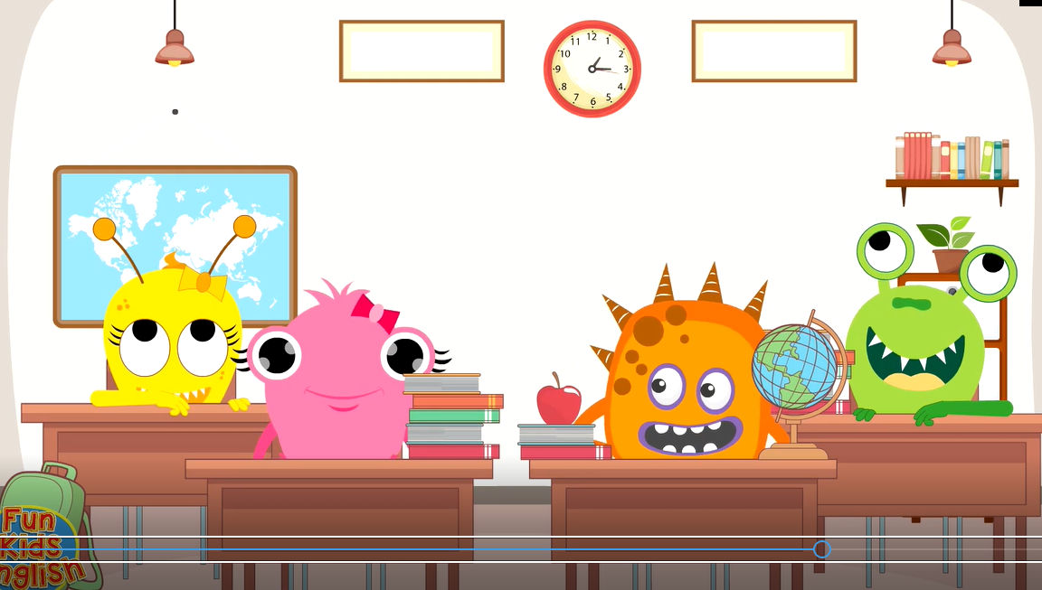
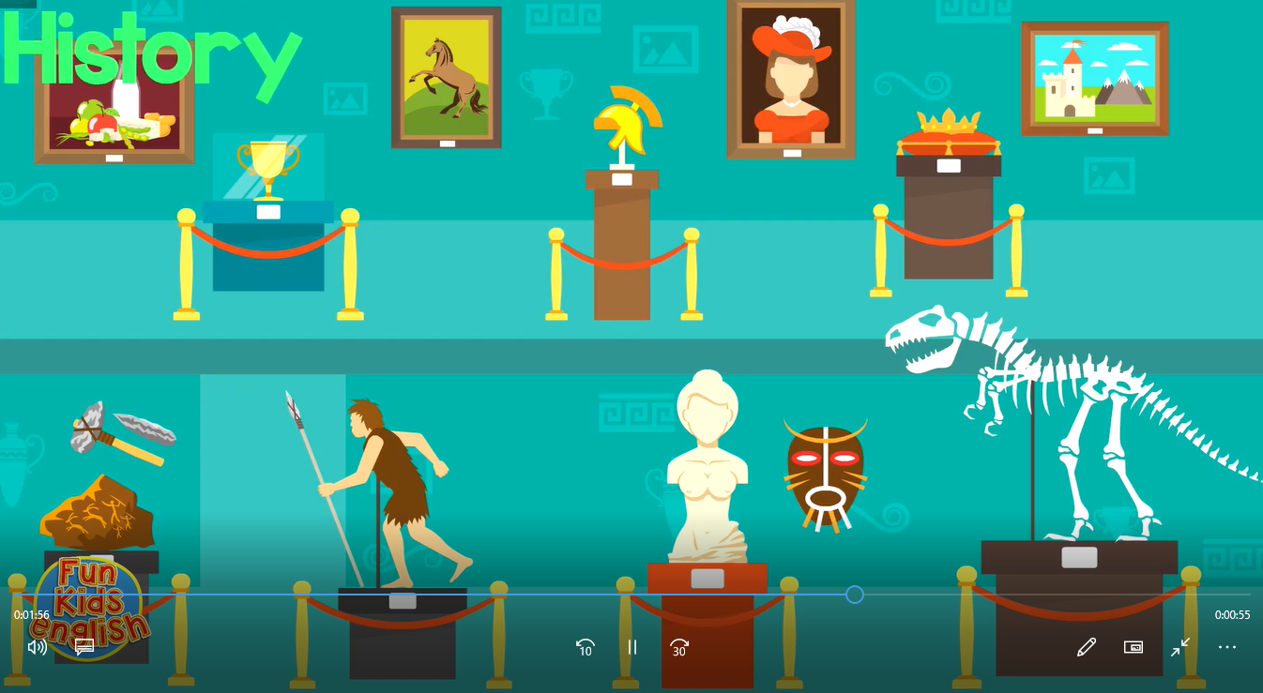
Geography

Slide 18

Moral

Slide 19
Free talk:
Build your school time table for your group then ask and answer:
How many lessons do you have today?
I have four: ........................and..............
How many lessons do you have on Tuesdays?
I have three: .............................and ........

