Slide 1


Welcome to our class
English 4
Teacher : HA QUYNH LIEN
Dong Hai 1 Primary School

Slide 2


My family’s weekend
15
Lesson 2 – Period 3

Slide 3
Table of contents
01
02
03
04
05
Warm-up
Look, listen
and repeat.
Listen, point and say.
Let’s talk.
Game

Slide 4

Game missing letters

Slide 5
Look, listen and repeat

Slide 6
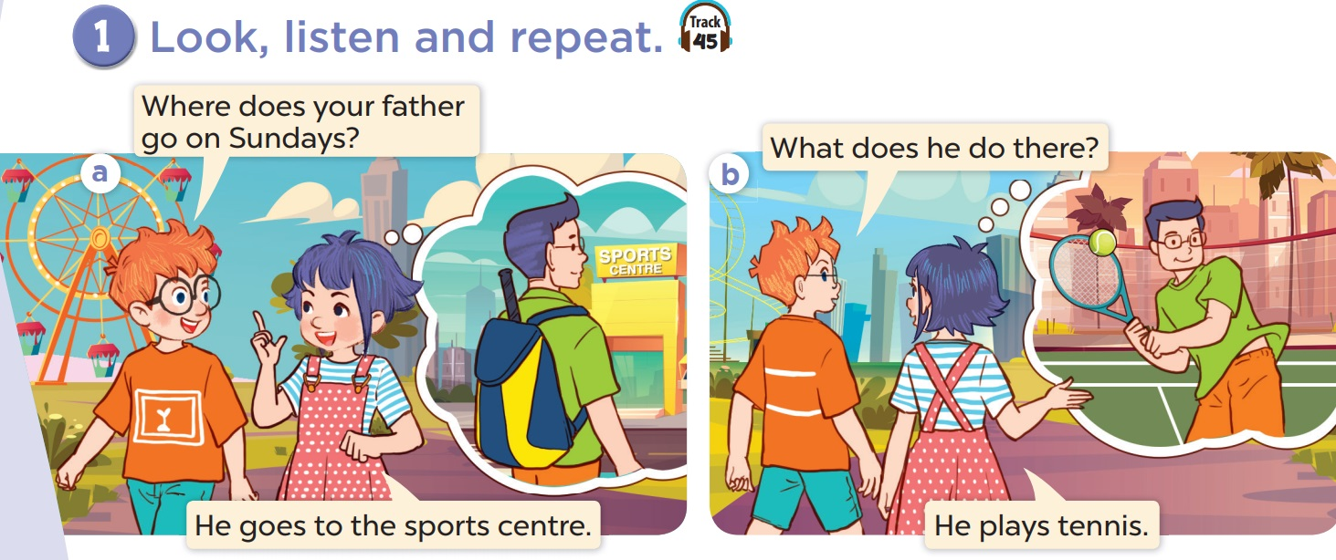


Slide 7
Listen, point
and say.

Slide 8
Vocabulary

Slide 9


Slide 10
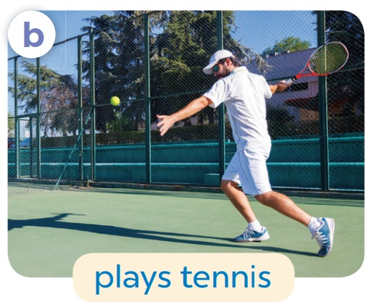

Slide 11


Slide 12


Slide 13
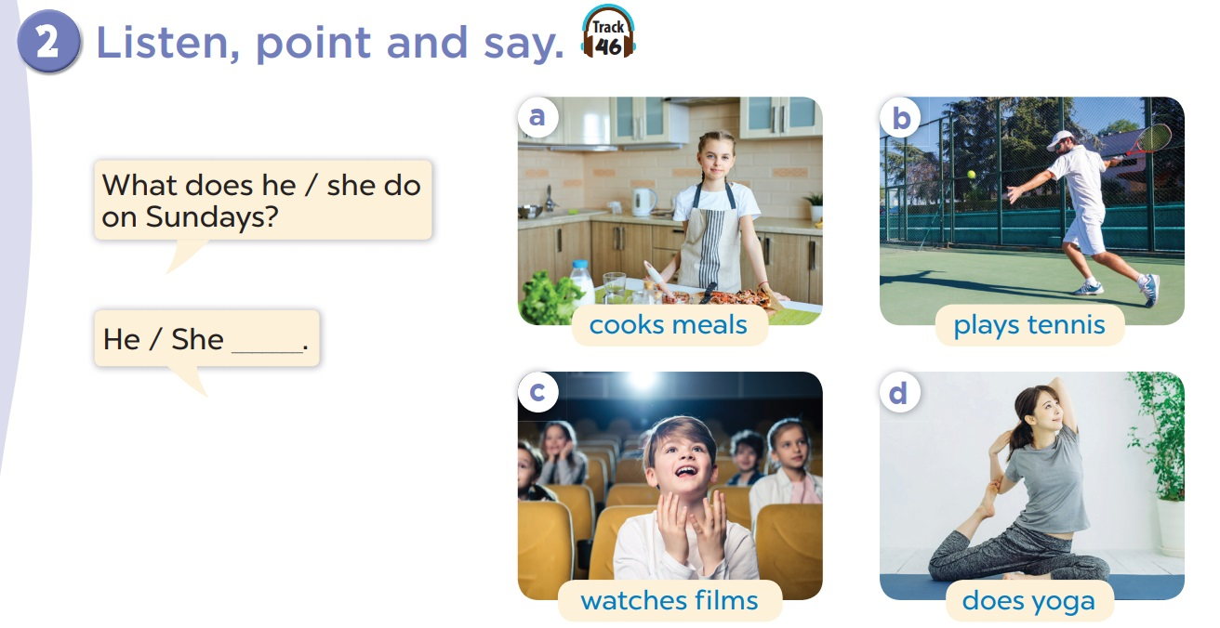

Slide 14
What does she do on Sundays?
She cooks meals.

Slide 15
What does he do on Sundays?
He plays tennis.

Slide 16
What does he do on Sundays?
He watches films.

Slide 17
What does she do on Sundays?
She does yoga.

Slide 18
REMEMBER!
I | She / He
cook meals
play tennis
watch films
do yoga
cooks meals
plays tennis
watches films
does yoga

Slide 19
Let’s talk.

Slide 20
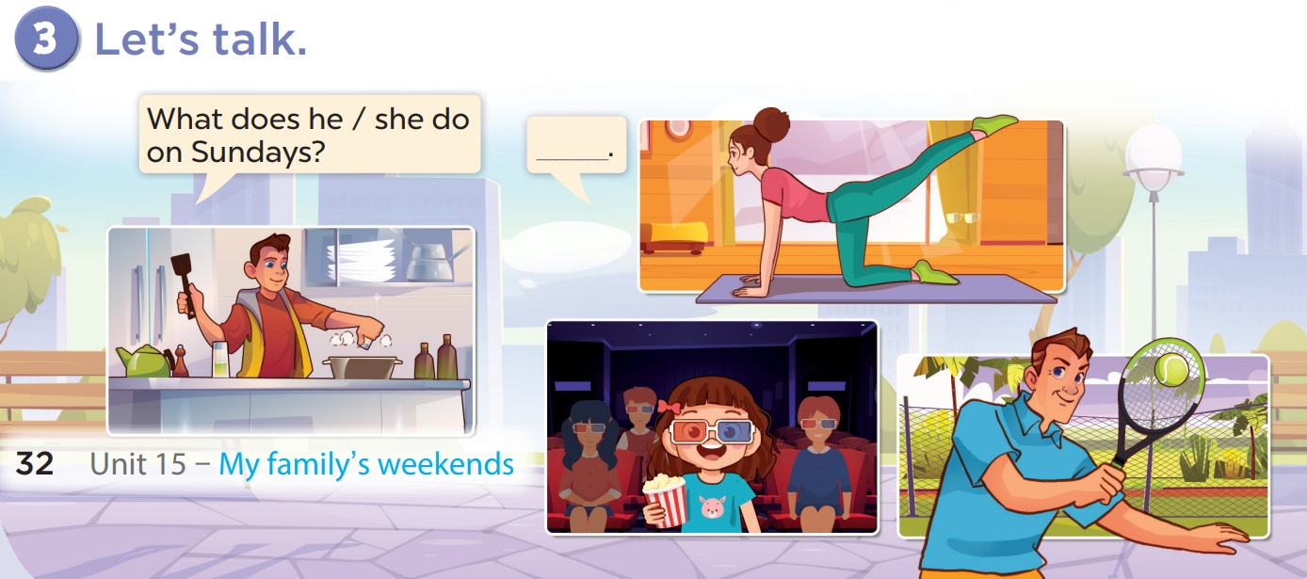

Slide 21
Game Tom & Jerry

Slide 22
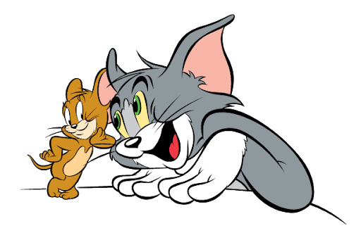
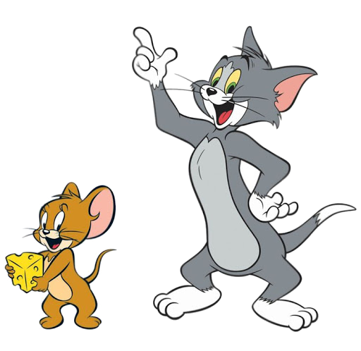

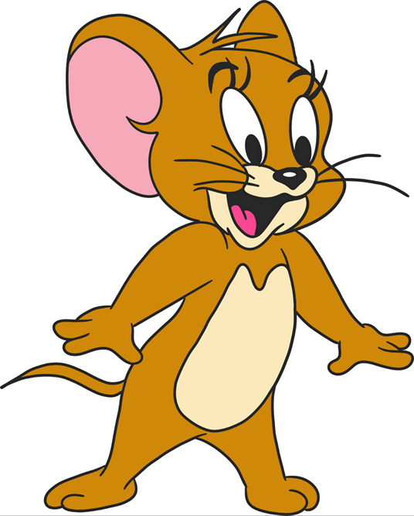
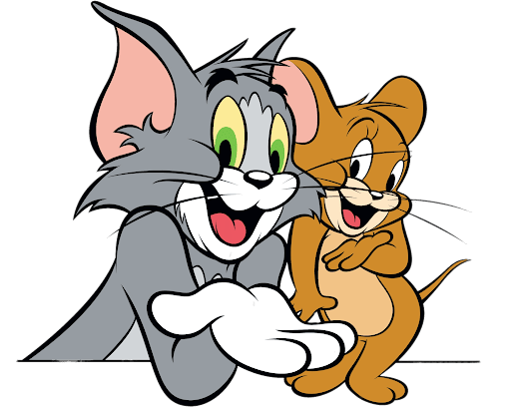

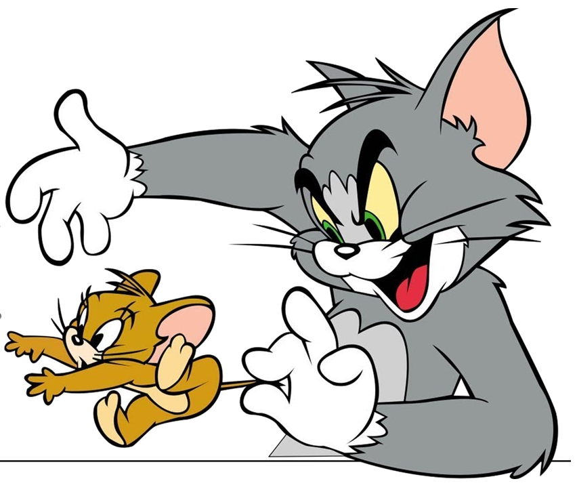
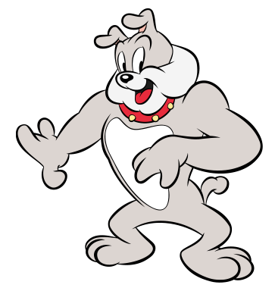
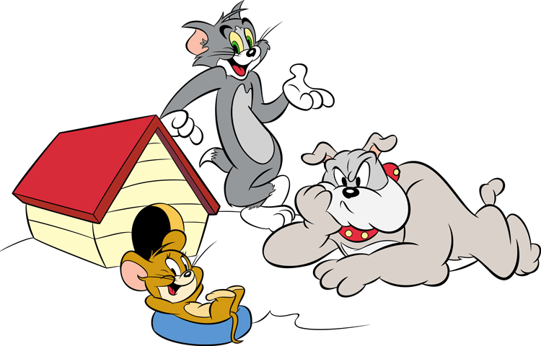
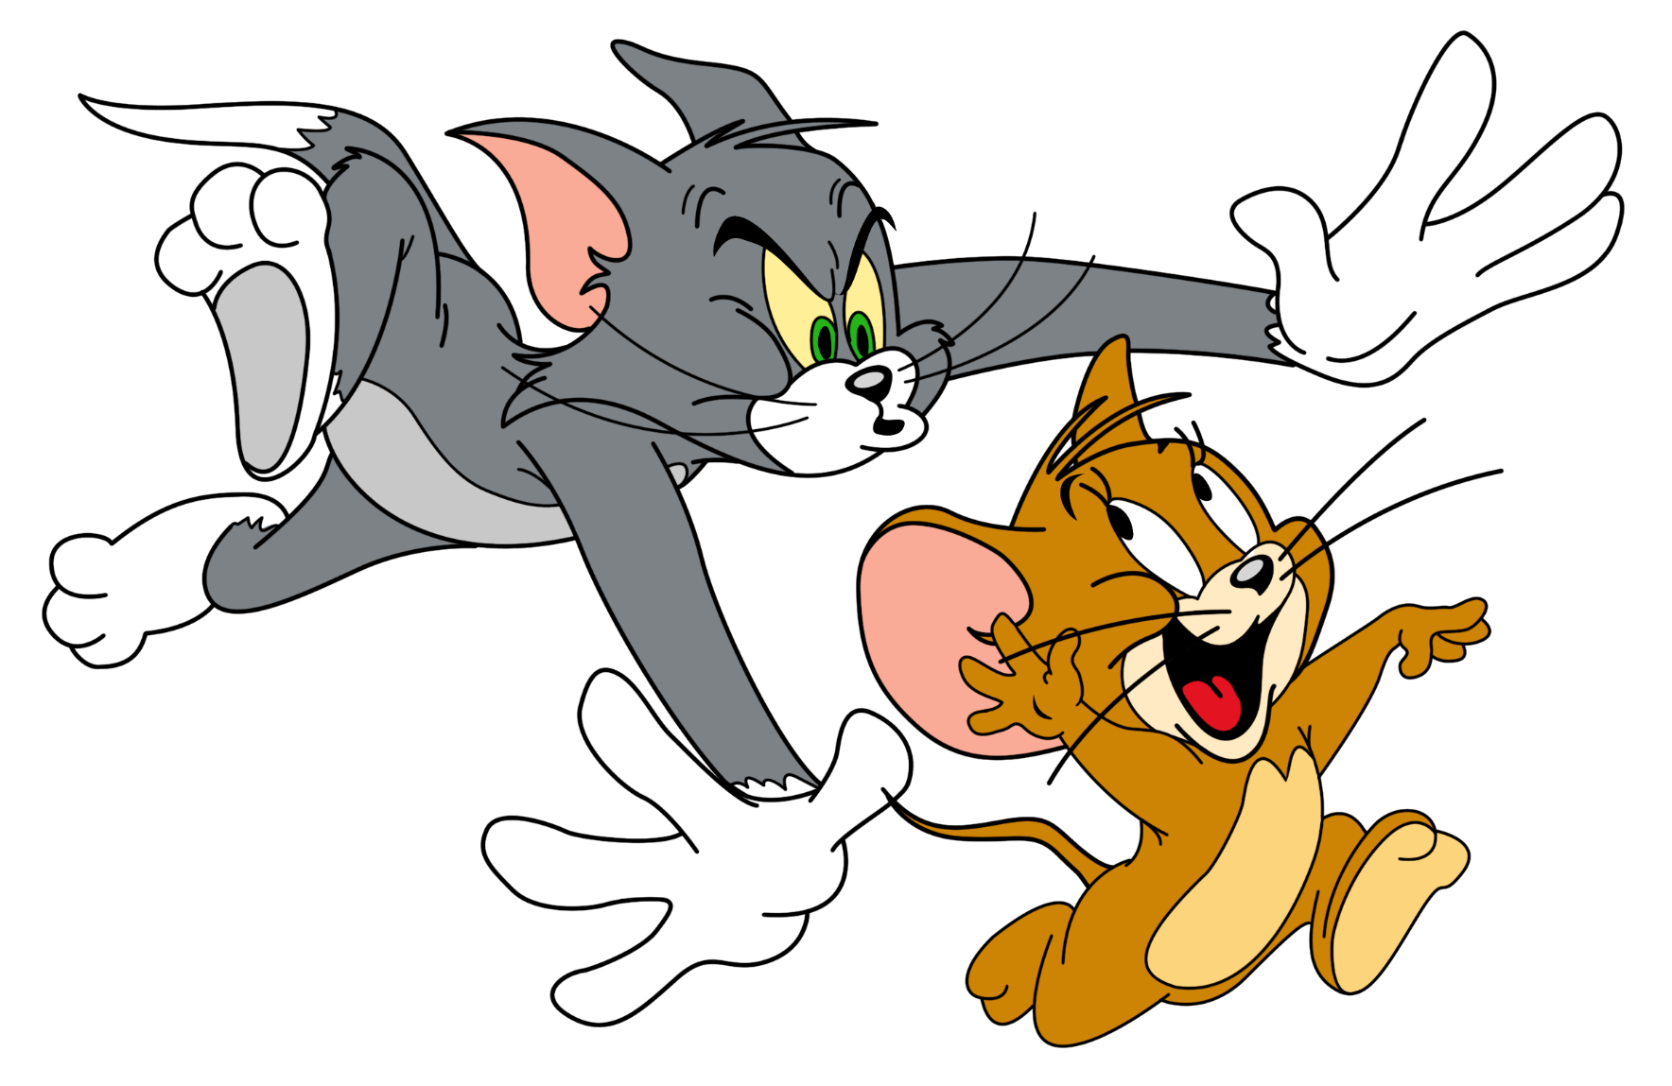

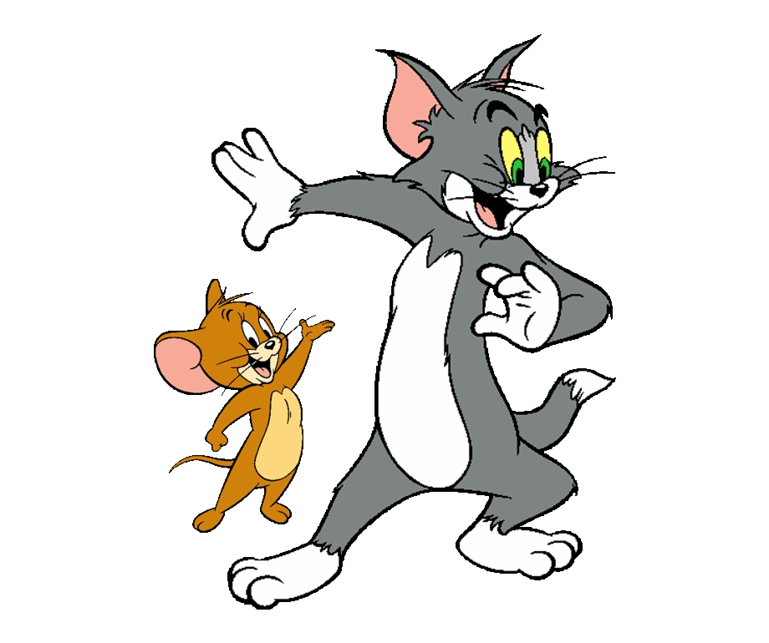

GAME
Notes:
Ms Huyền Phạm - 0936.082.789 – YOUTUBE: MsPham. Facebook: Dạy và học cùng công nghệ.

Slide 23



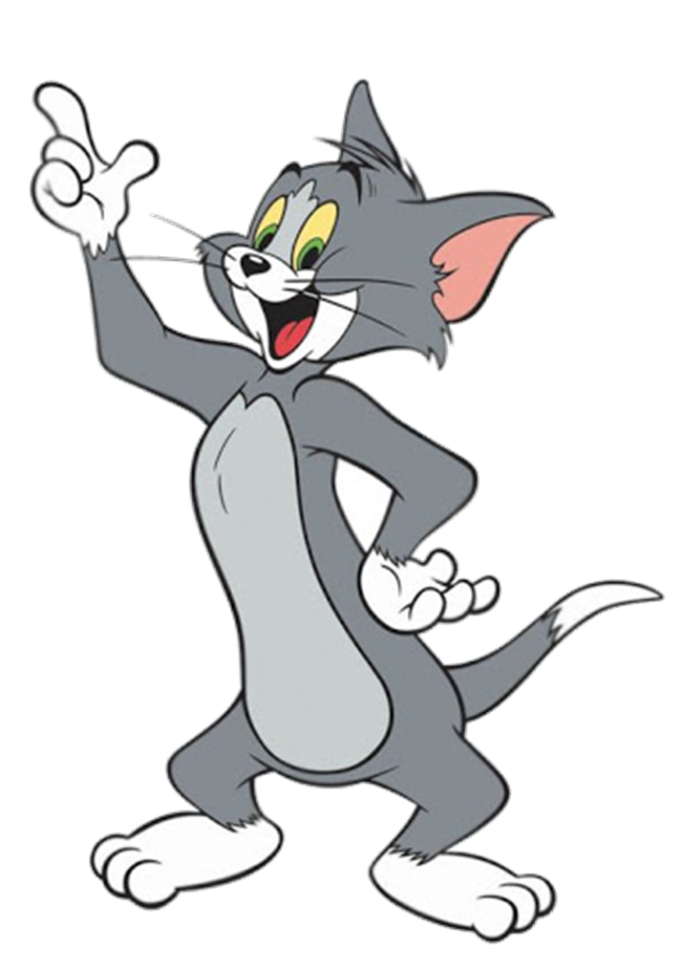
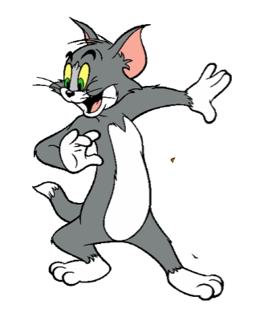







YOUTUBE: MsPham.
Facebook: Dạy và học cùng công nghệ.
gggg
He goes to the shopping centre.
He goes to the gym.
YOUTUBE: MsPham.
Facebook: Powerpoint thật dễ
YOUTUBE: MsPham.
Facebook: Dạy và học cùng công nghệ.
YOUTUBE: MsPham.
Facebook: Dạy và học cùng công nghệ.
YOUTUBE: MsPham.
Facebook: Dạy và học cùng công nghệ.
Notes:
Ms Huyền Phạm - 0936.082.789 – YOUTUBE: MsPham. Facebook: Dạy và học cùng công nghệ.

Slide 24
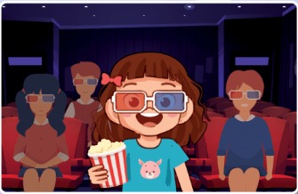
YOUTUBE: MsPham.
Facebook: Dạy và học cùng công nghệ.
gggg
She watches films.
She watches films.
YOUTUBE: MsPham.
Facebook: Powerpoint thật dễ
YOUTUBE: MsPham.
Facebook: Dạy và học cùng công nghệ.
YOUTUBE: MsPham.
Facebook: Dạy và học cùng công nghệ.
YOUTUBE: MsPham.
Facebook: Dạy và học cùng công nghệ.
Notes:
Ms Huyền Phạm - 0936.082.789 – YOUTUBE: MsPham. Facebook: Dạy và học cùng công nghệ.

Slide 25
YOUTUBE: MsPham.
Facebook: Dạy và học cùng công nghệ.
gggg
he/ go / Where/ on/ does / Saturdays?/
Where does he go on Saturdays?
YOUTUBE: MsPham.
Facebook: Powerpoint thật dễ
YOUTUBE: MsPham.
Facebook: Dạy và học cùng công nghệ.
YOUTUBE: MsPham.
Facebook: Dạy và học cùng công nghệ.
YOUTUBE: MsPham.
Facebook: Dạy và học cùng công nghệ.
Notes:
Ms Huyền Phạm - 0936.082.789 – YOUTUBE: MsPham. Facebook: Dạy và học cùng công nghệ.

Slide 26
YOUTUBE: MsPham.
Facebook: Dạy và học cùng công nghệ.
gggg
do/ she / does/ on/ What
/ Sundays?
What does she do on Sundays?
YOUTUBE: MsPham.
Facebook: Powerpoint thật dễ
YOUTUBE: MsPham.
Facebook: Dạy và học cùng công nghệ.
YOUTUBE: MsPham.
Facebook: Dạy và học cùng công nghệ.
YOUTUBE: MsPham.
Facebook: Dạy và học cùng công nghệ.
Notes:
Ms Huyền Phạm - 0936.082.789 – YOUTUBE: MsPham. Facebook: Dạy và học cùng công nghệ.

Slide 27
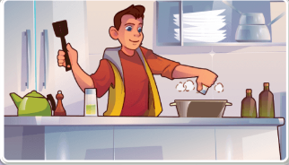
YOUTUBE: MsPham.
Facebook: Dạy và học cùng công nghệ.
gggg
What does he do on Sundays?
He cooks meals.
YOUTUBE: MsPham.
Facebook: Powerpoint thật dễ
YOUTUBE: MsPham.
Facebook: Dạy và học cùng công nghệ.
YOUTUBE: MsPham.
Facebook: Dạy và học cùng công nghệ.
YOUTUBE: MsPham.
Facebook: Dạy và học cùng công nghệ.
Notes:
Ms Huyền Phạm - 0936.082.789 – YOUTUBE: MsPham. Facebook: Dạy và học cùng công nghệ.

Slide 28
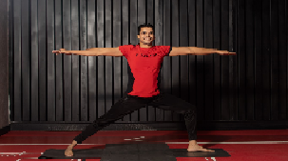
YOUTUBE: MsPham.
Facebook: Dạy và học cùng công nghệ.
gggg
What does he do on Sundays?
He does yoga.
YOUTUBE: MsPham.
Facebook: Powerpoint thật dễ
YOUTUBE: MsPham.
Facebook: Dạy và học cùng công nghệ.
YOUTUBE: MsPham.
Facebook: Dạy và học cùng công nghệ.
YOUTUBE: MsPham.
Facebook: Dạy và học cùng công nghệ.
Notes:
Ms Huyền Phạm - 0936.082.789 – YOUTUBE: MsPham. Facebook: Dạy và học cùng công nghệ.

Slide 29

YOUTUBE: MsPham.
Facebook: Dạy và học cùng công nghệ.
THANK YOU!
YOUTUBE: MsPham.
Facebook: Powerpoint thật dễ
YOUTUBE: MsPham.
Facebook: Dạy và học cùng công nghệ.
YOUTUBE: MsPham.
Facebook: Dạy và học cùng công nghệ.
YOUTUBE: MsPham.
Facebook: Dạy và học cùng công nghệ.
Notes:
Ms Huyền Phạm - 0936.082.789 – YOUTUBE: MsPham. Facebook: Dạy và học cùng công nghệ.

