Slide 1







Unit
6. Listen and repeat.
7. Let’s talk.
8. Let’s sing.

Slide 2
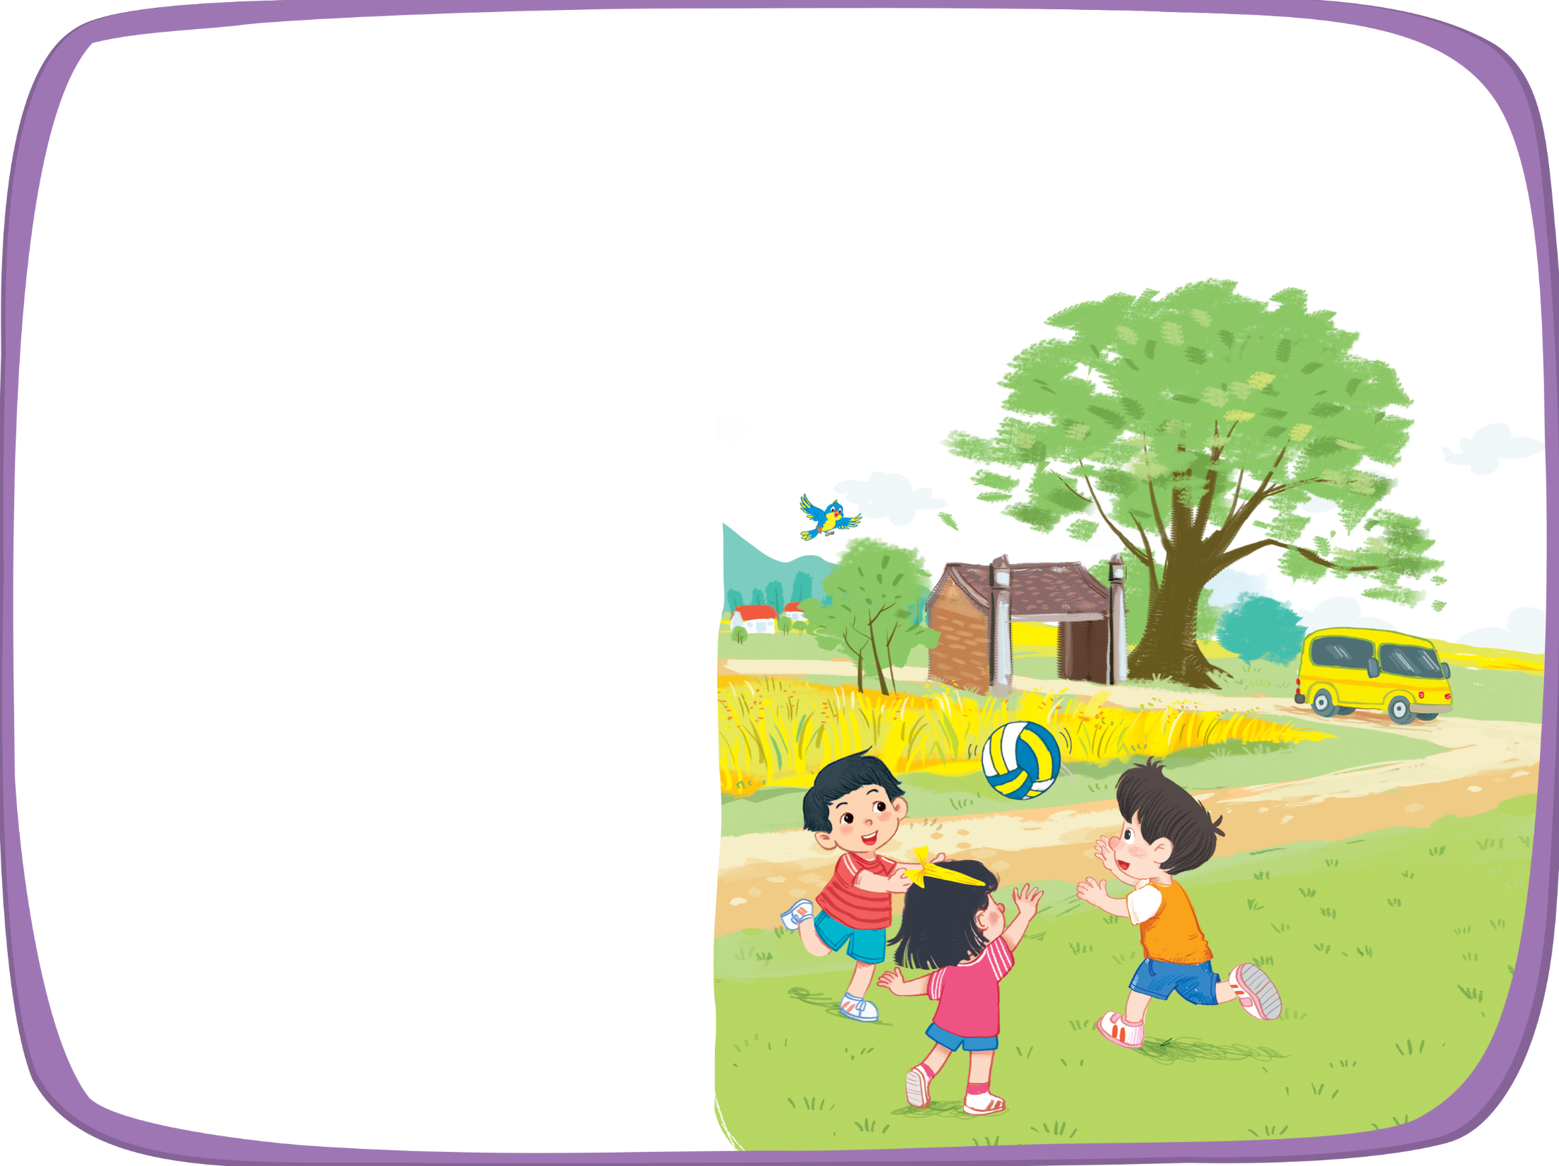




Listen and chant.
V, v, van.
V, v, van.
V, v, van.
V, v, van.
This is a van.
This is a van.
This is a van.
This is a van.
V, v, village.
V, v, village.
V, v, village.
V, v, village.
This is a village.
This is a village.
This is a village.
This is a village.
V, v, volleyball.
V, v, volleyball.
V, v, volleyball.
V, v, volleyball.
This is a volleyball.
This is a volleyball.
This is a volleyball.
This is a volleyball.

Slide 3



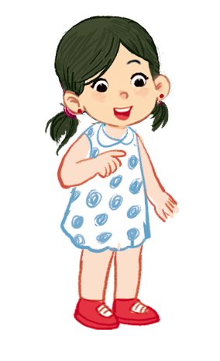

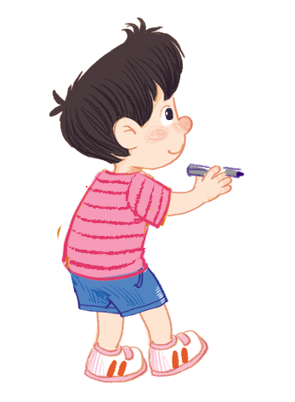
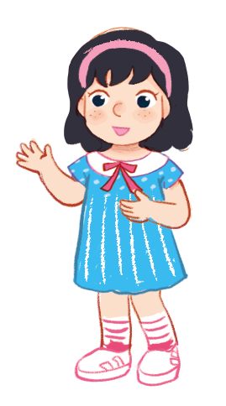
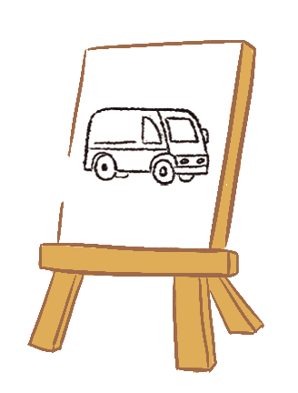

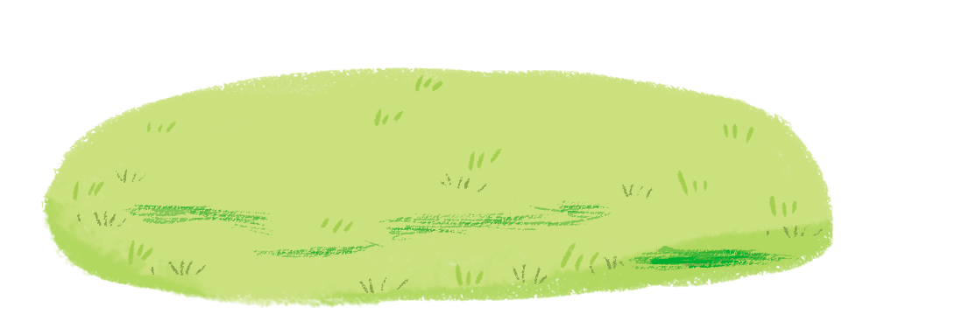
Listen and repeat.
Can you draw a van?
Can you draw a van?
Can you draw a van?
Can you draw a van?
No, I can’t.
No, I can’t.
No, I can’t.
No, I can’t.
Yes, I can.
Yes, I can.
Yes, I can.
Yes, I can.

Slide 4



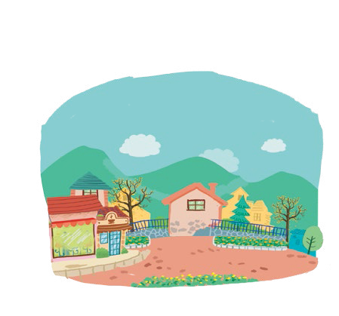
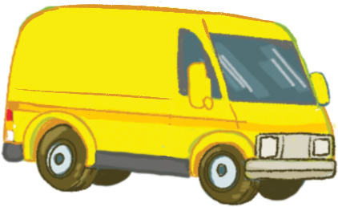


Let’s talk.
Can you draw a Van ?
Yes, I can .
No, I can’t .
Village
Van
Volleyball
Ball
a
b
c
d

Slide 5
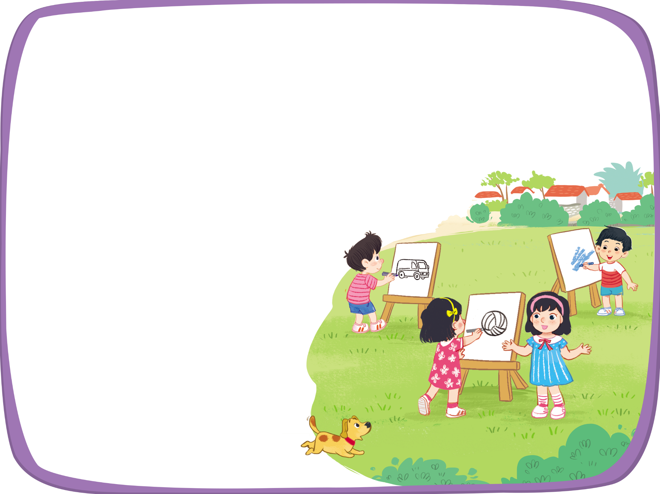


Let’s sing!
Can you draw a van?
Bạn có thể vẽ …….?
Can you draw a van?
Can you draw a van?
Can you draw a van?
Yes, I can.
Có. Tôi có thể.
Yes, I can.
Yes, I can.
Yes, I can.
Can you draw a volleyball?
Can you draw a volleyball?
Can you draw a volleyball?
Can you draw a volleyball?
Yes, I can.
Yes, I can.
Yes, I can.
Yes, I can.
Can you draw a village?
Can you draw a village?
Can you draw a village?
Can you draw a village?
No, I can’t.
Không . Tôi không thể.
No, I can’t.
No, I can’t.
No, I can’t.

