Slide 1


Our sports day
9
Lesson 3 - Period 6

Slide 2



Let’s chant.
When’s your sports day?
In January, February or May?
In January, in January.
It’s in January.
When’s your sports day?
In May, June or July?
In July, in July.
It’s in July.

Slide 3
Read the passage.
Our sports day is in November. It is in the school playground. There are many pupils and teachers. We play different sports and games. The boys play badminton. The girls play football. The teachers play basketball. It is a lot of fun!

Slide 4

True or False.
 | True | False
1. The sports day is in November.
2. The sports day is in the school gym.
3. The boys play badminton.
4. The girls play basketball.

Slide 5
5
Let’s write.
Our school sports day is in ________. We play sports and games in the school playground. The girls _________. The boys __________. The teachers _________. We all love our sports day.
October
play chess
play football
play volleyball

Slide 6
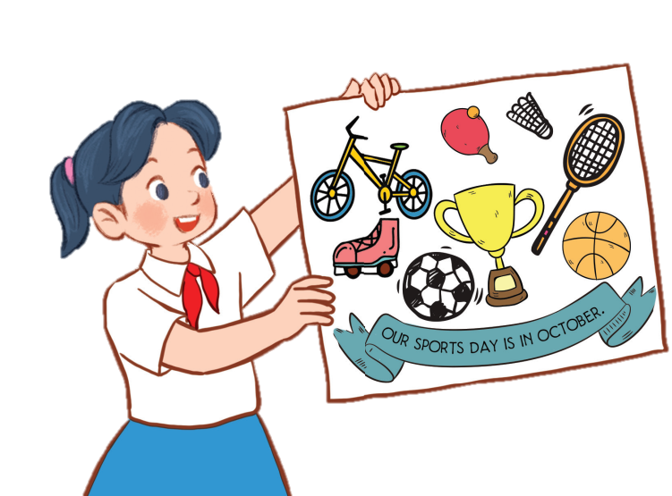
6
Project
Our sports day poster
Our sports day is in October. _______.

Slide 7
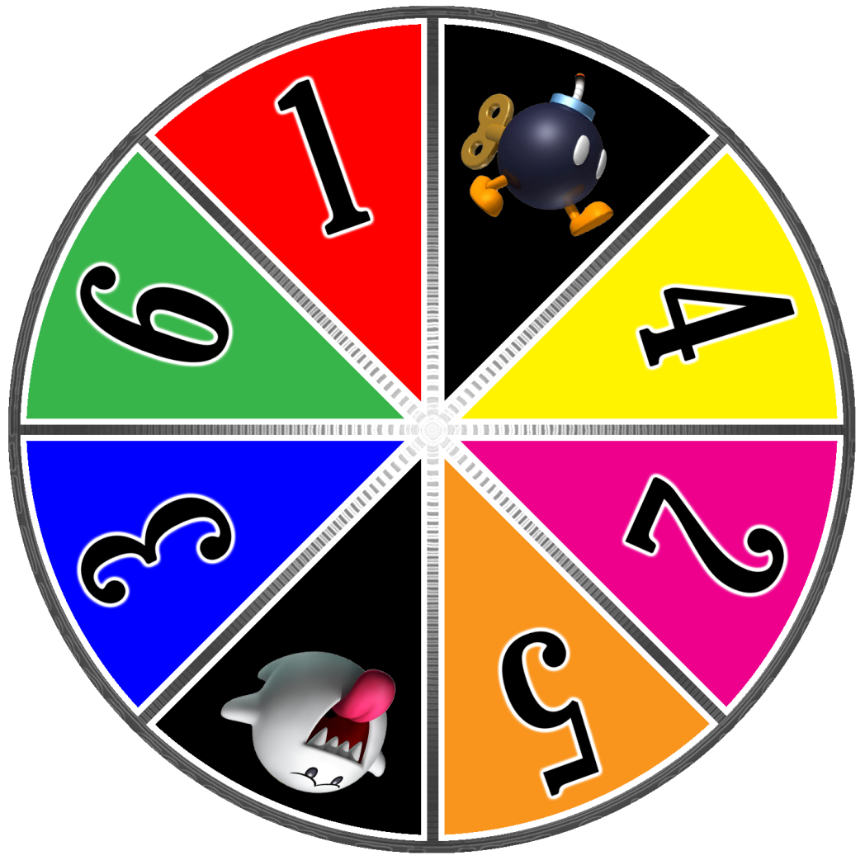




Slide 8

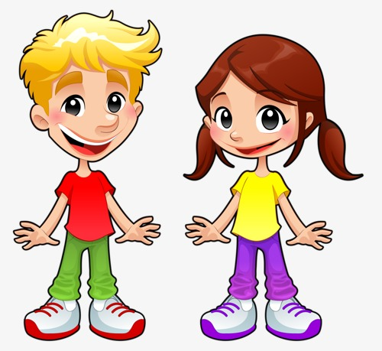

A
B
C
1
2
3
4
Notes:
24 Questions
Teacher says the first sentence. Student replies using the new structure. Click the rabbit to go back to question slide.

Slide 9
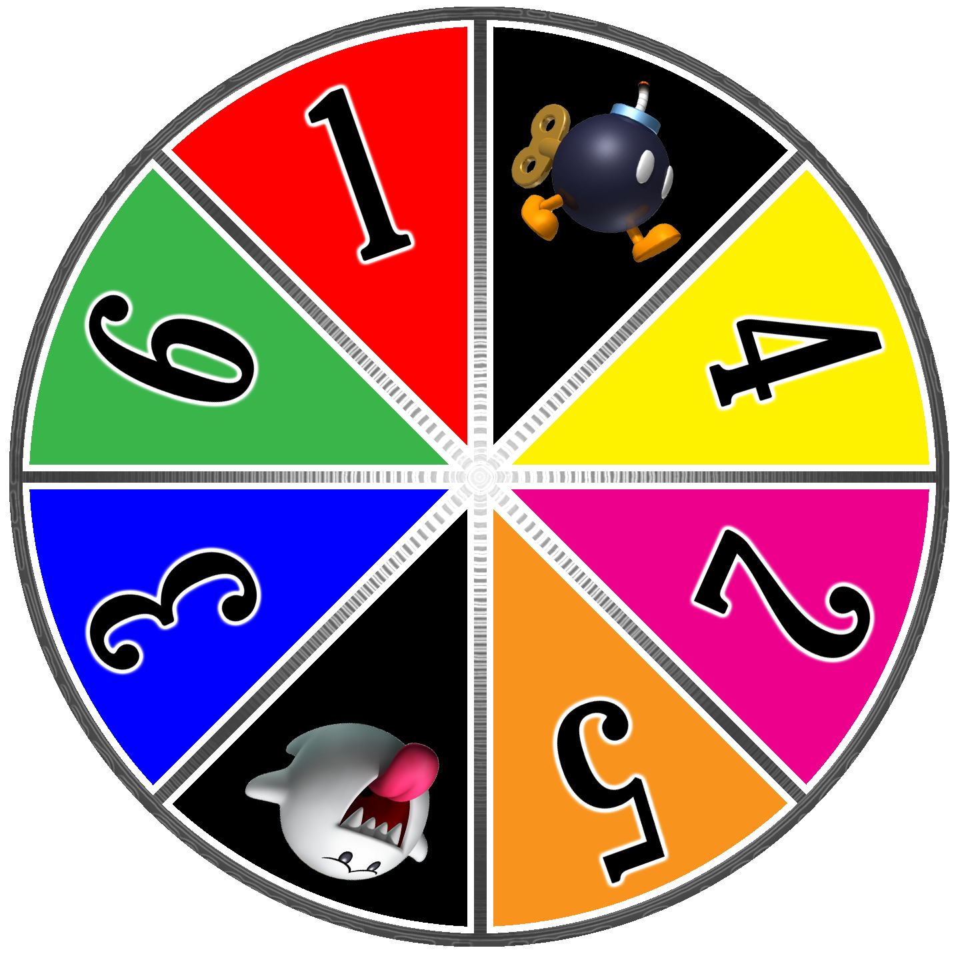

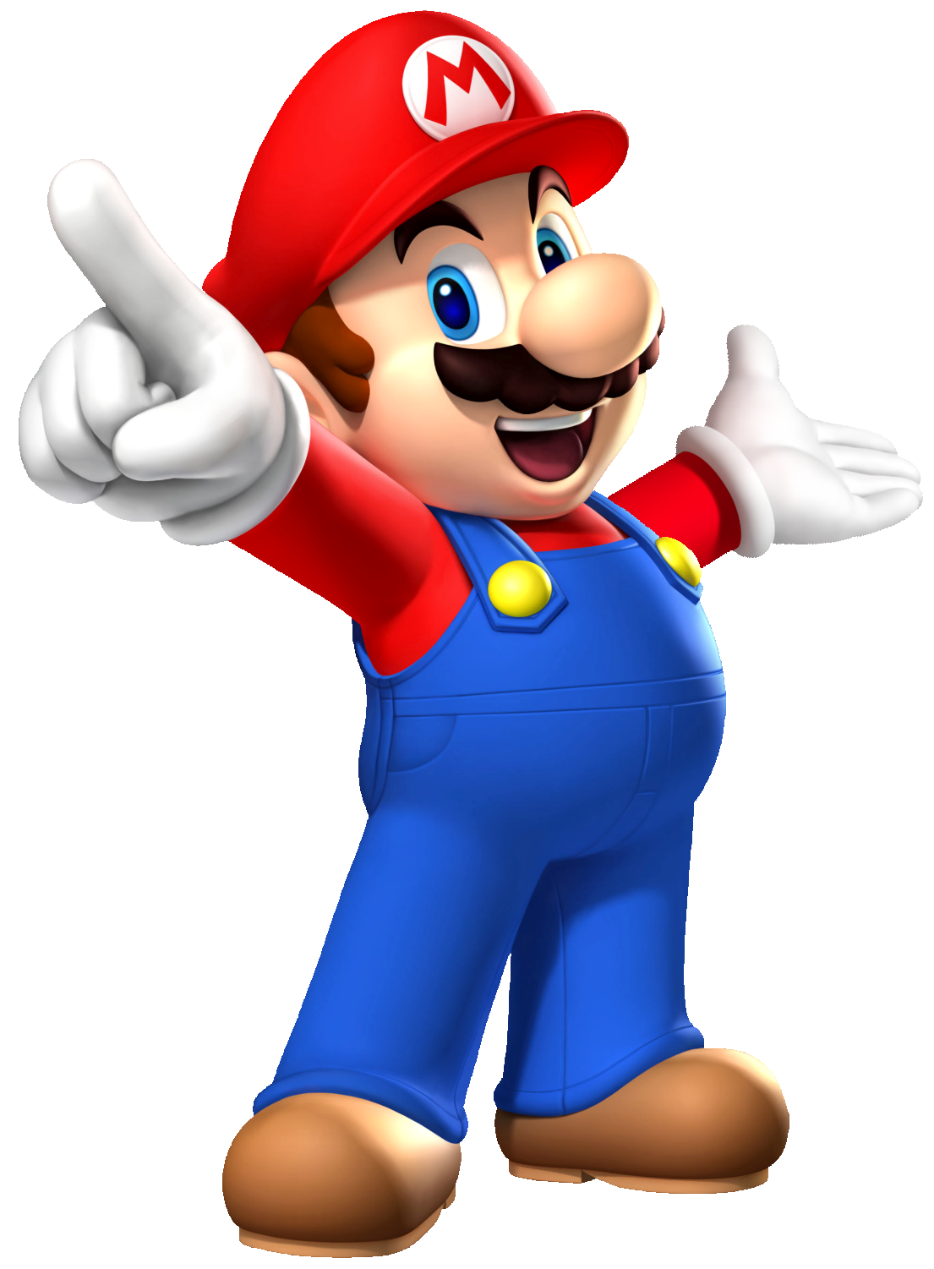


Slide 10
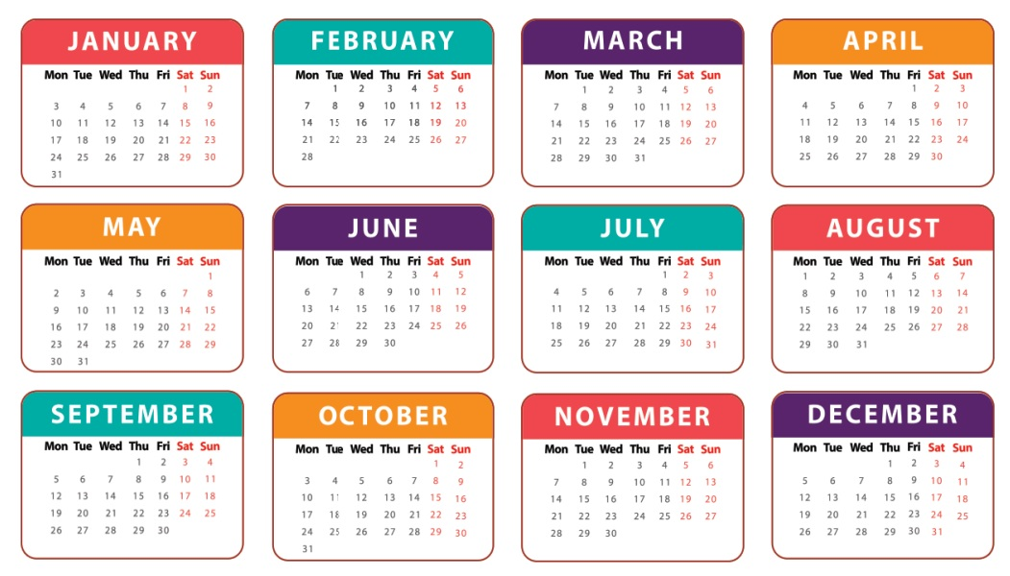

When’s your sports day?
It’s in August.

Slide 11
When’s your sports day?
It’s in September.

Slide 12
Is your sports day in June?
No, it isn’t. It’s in May.

Slide 13
When’s your sports day?
It’s in November.

Slide 14
Our …………..…… is in July.
sport days
sports day
Notes:
Students fill in the blank

Slide 15
My …………..…… is in December.
birth day
birthday
Notes:
Students fill in the blank

Slide 16
When’s your sports day?
It’s in April.

Slide 17
When’s your birthday?
It’s in …….
Notes:
Students fill in the blank

Slide 18
Our sports day is ……… March.
in
on

Slide 19
Our sports day is in November.
True
False

Slide 20
Our sports day is in ………...
July
August
Notes:
Students fill in the blank

Slide 21
Our sports day is in February.
True
False

