Slide 1
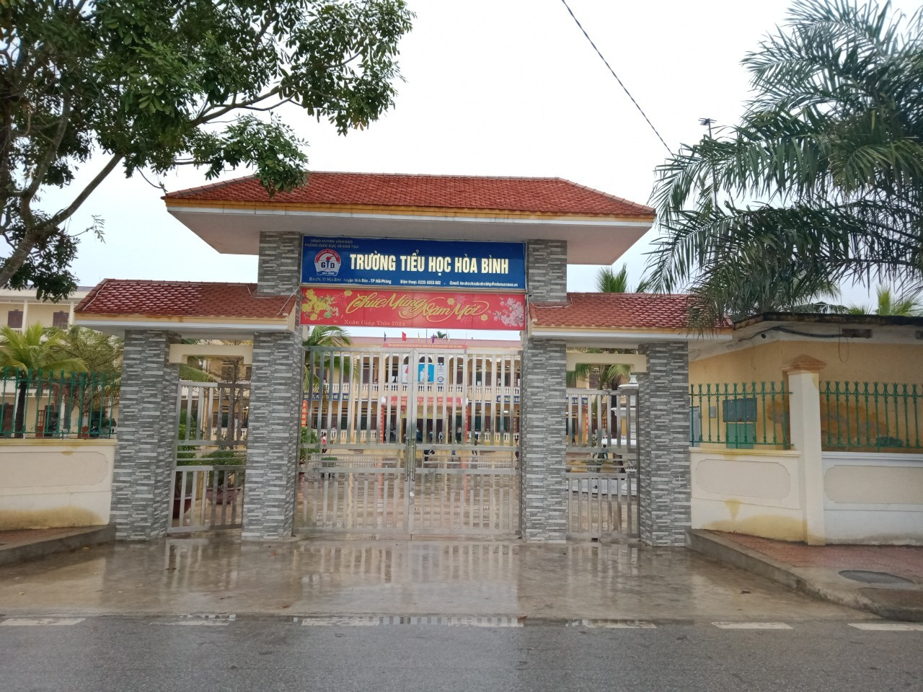

Cluster topics.- October 16th 2024
Welcome teachers to our class !

Slide 2

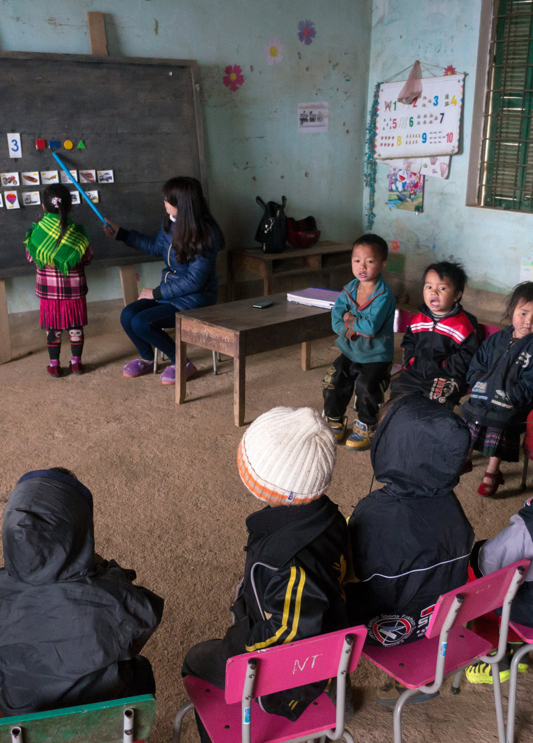
Look at the photo. Answer.
Where are these children?
They are in the classroom.
A primary school in the highland province of Ha Giang, Vietnam

Slide 3

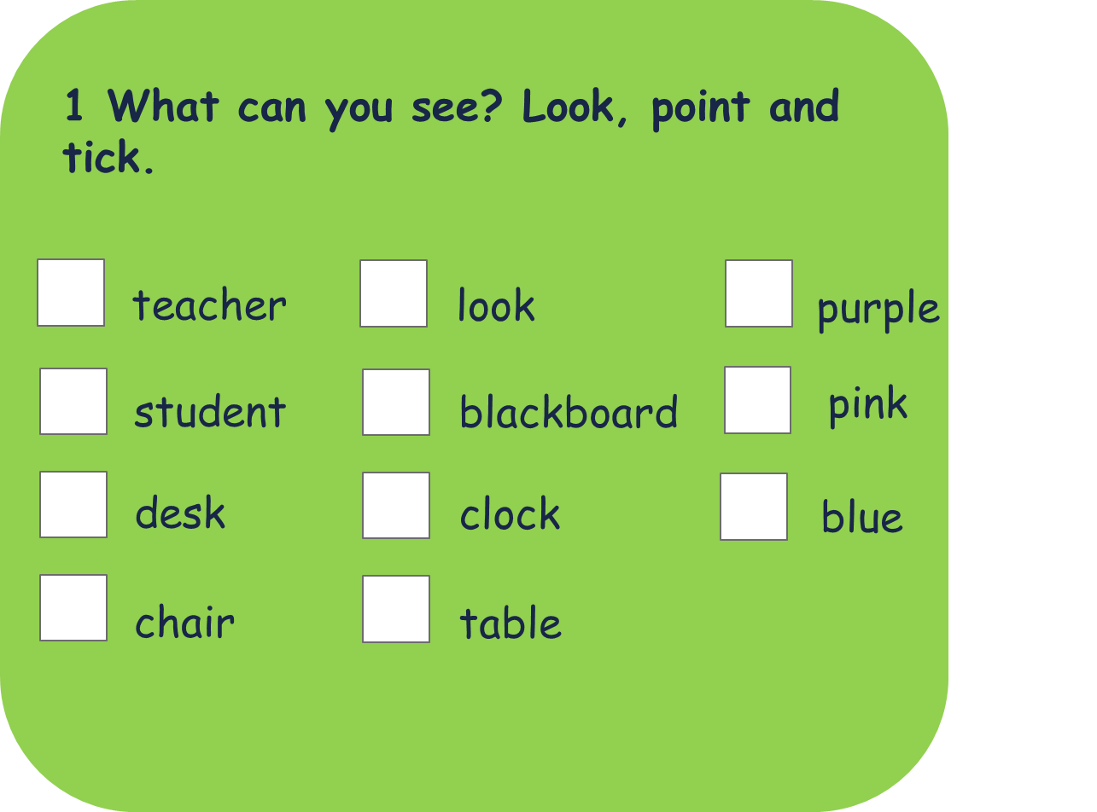
✓
✓
✓
book
✓
✓
✓
✓
✓
✓
A primary school in the highland province of Ha Giang, Vietnam

Slide 4




Unit 3:
SCHOOL LIFE
(Lesson 1 – p1,2,3)

Slide 5

Maggie MacDonnell is a teacher in Salluit in Canada.
It is very cold and windy in Salluit.
You cannot get to Salluit by car.
You have to fly.
Maggie’s students study maths, science and English.
Maggie teaches school subjects, but she does a lot more.
She finds solutions to her students’ problems.
It’s often too cold in Salluit for them to play outside.
So, Maggie opened a fitness centre.
Now, her students can exercise and practise sport all year.

Slide 6




Who is Maggie MacDonnell ?
A. Teacher
B. Doctor

Slide 7
Who is Maggie MacDonnell ?
A. Teacher
B. Doctor

Slide 8
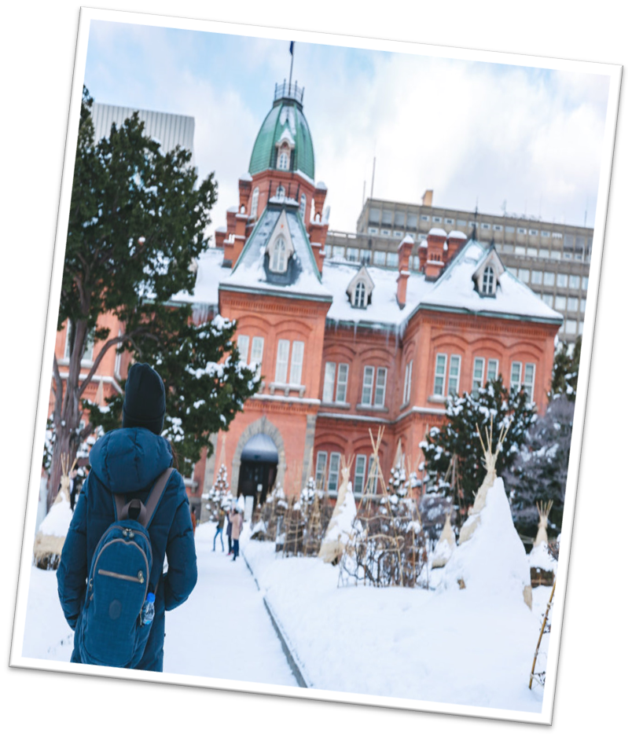
Where is Maggie’s school ?
A.Palluit
B.Salluit

Slide 9
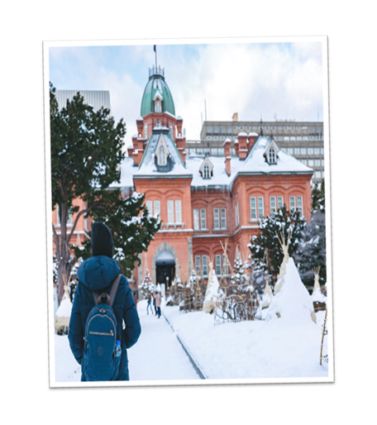
How’s the weather in Salluit?
A.Hot and windy
B. Cold and windy

Slide 10
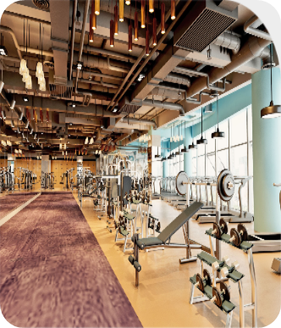
What did Mrs Maggie open ?
A. Fitness centre
B. Music club

Slide 11
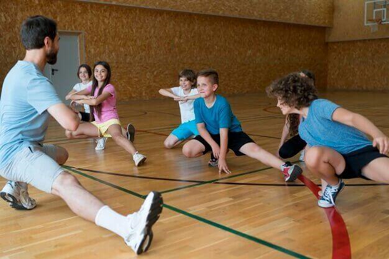

What can students do all year ?
A.Exercise and practice English
B.Exercise and practice sport

Slide 12
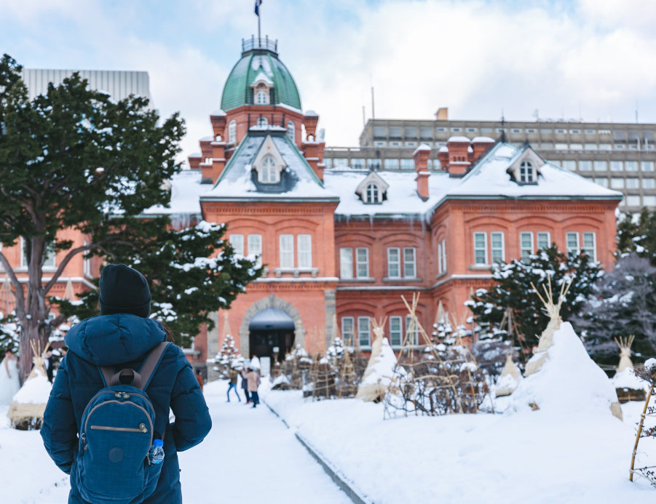
1/Listen and read.
Maggie MacDonnell is a teacher in Salluit
in Canada.
It is very cold and windy in
Salluit.
You cannot get to Salluit by car.
Maggie’s students study maths, science and English .
You have to fly.
Maggie
teaches school subjects, but she does a
lot more.
She finds solutions to her students’ problems.
It’s often too cold in Salluit for them to play outside.
So, Maggie opened a fitness centre.
Now, her students can exercise and practise sport all year.

Slide 13
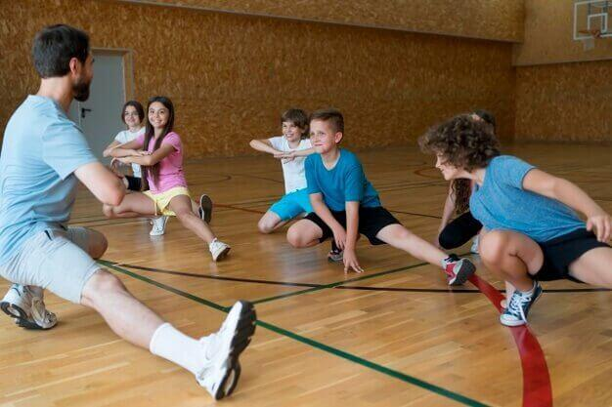
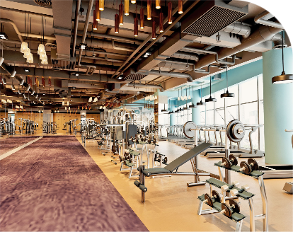
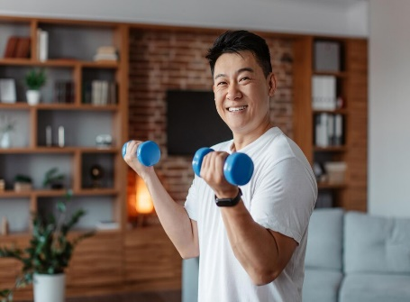


2/ Listen, point and repeat.
exercise fitness centre practise problem solution

Slide 14


exercise
fitness centre
practise
problem/
solution

Slide 15
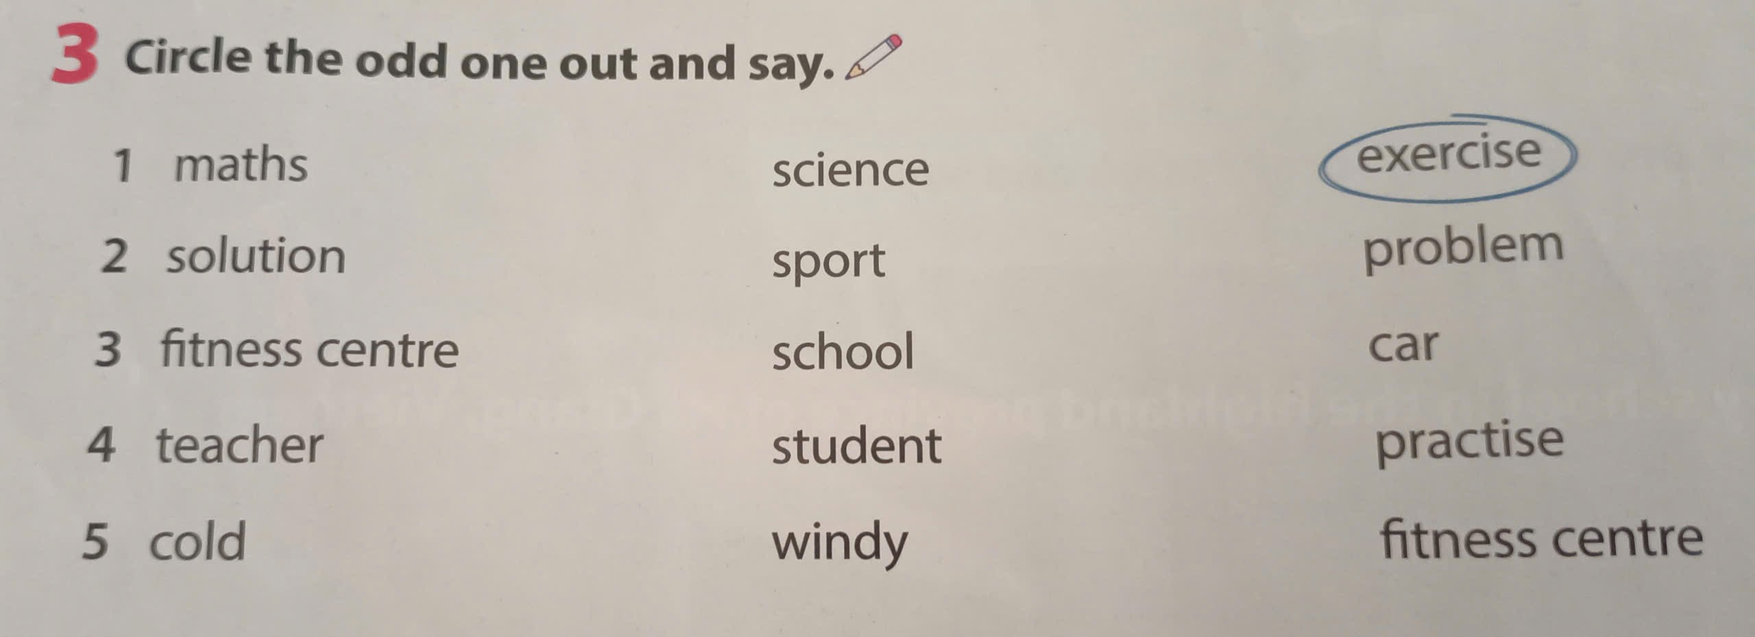
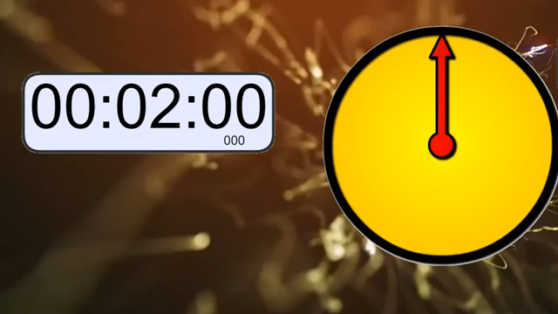

Slide 16

3/The odd-one-out and say
PLAY

Slide 17

2/15
maths
Science
exercise
NEXT

Slide 18
2/15
solution
sport
problem
NEXT

Slide 19
2/15
school
car
fitness centre
NEXT

Slide 20
2/15
student
practise
teacher
NEXT

Slide 21
2/15
cold
windy
fitness centre
NEXT

Slide 23
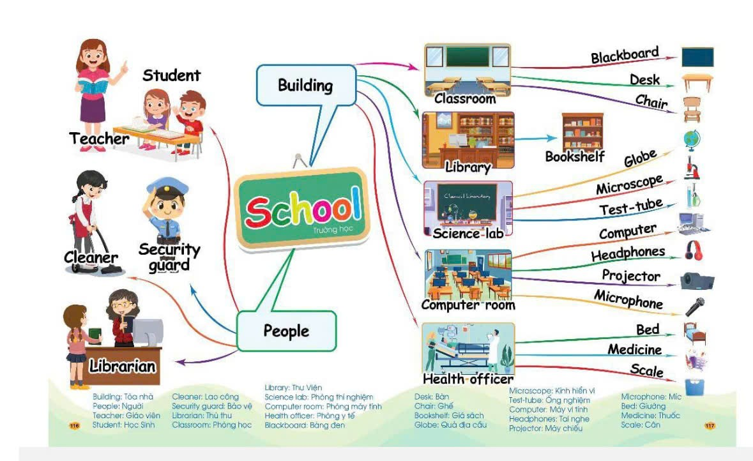
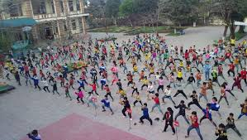
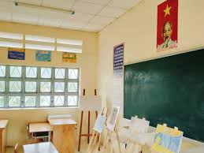
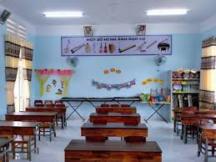
English classroom
Art room
Music room

