Slide 1


Class 5
Unit: 4
FREE TIME
Lesson 1: Task 1, 2, 3

Slide 2
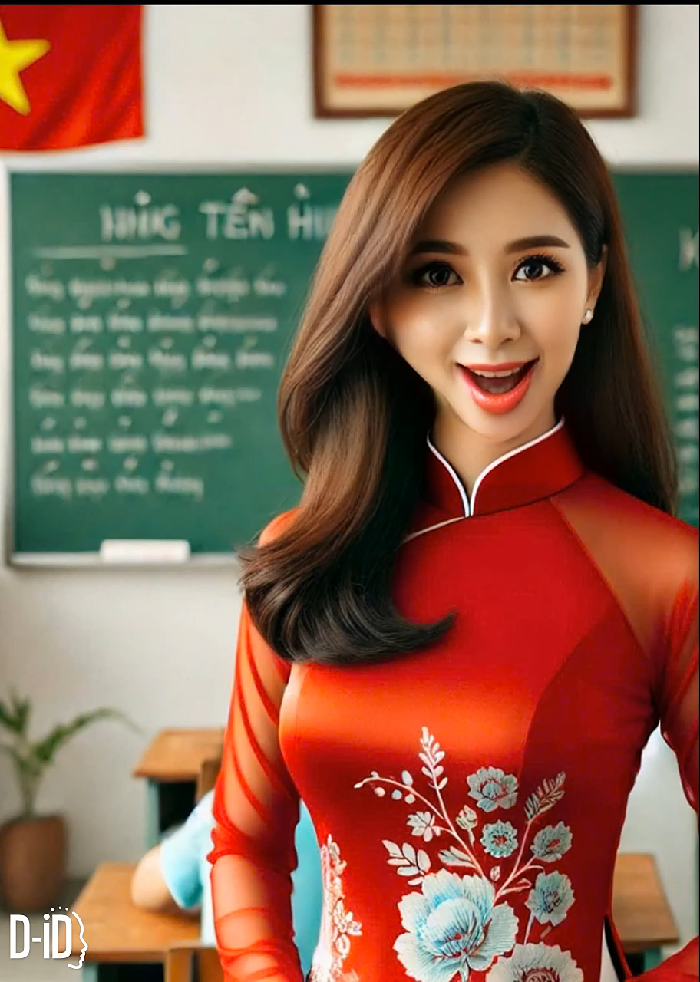
Ms Linh

Slide 3






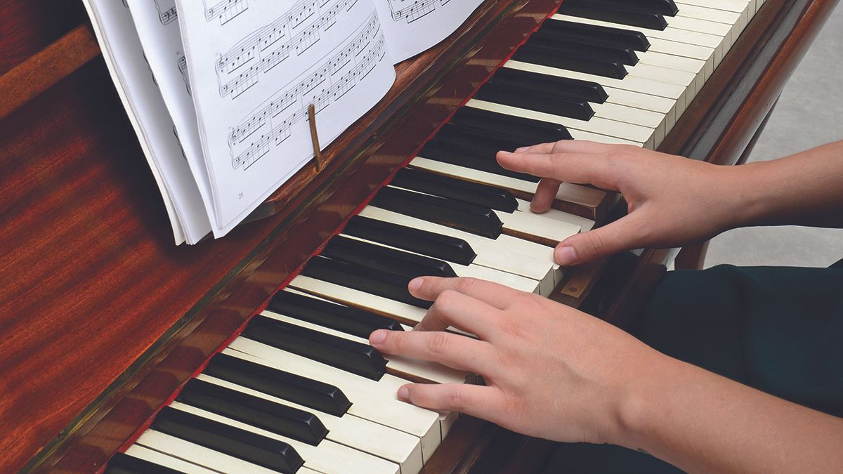

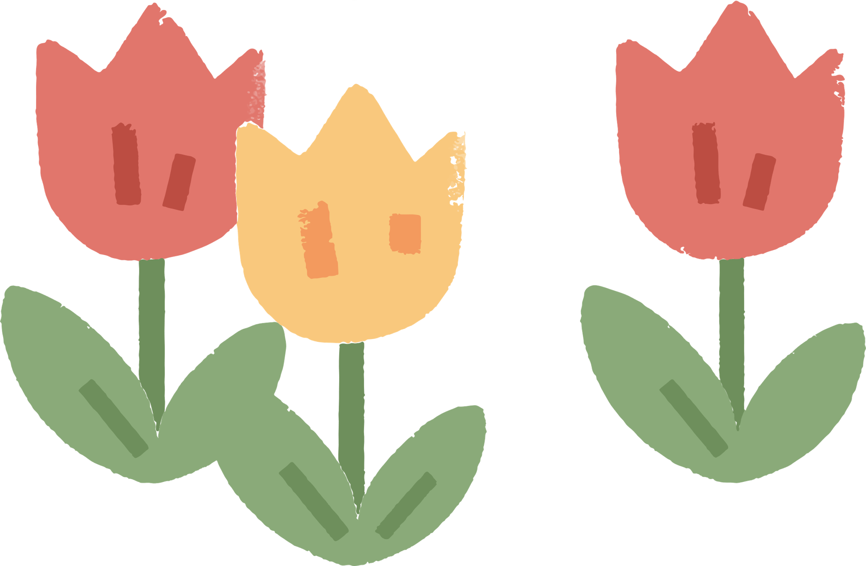
play the piano

Slide 4


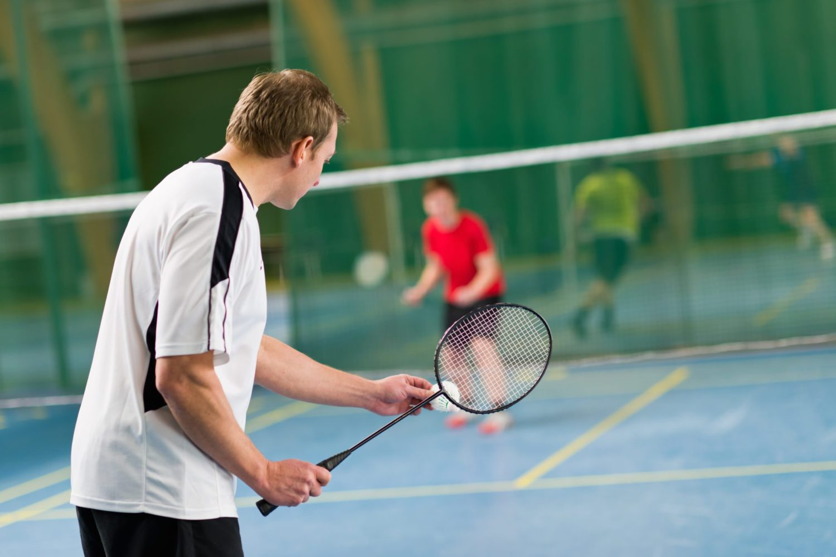
play badminton

Slide 5
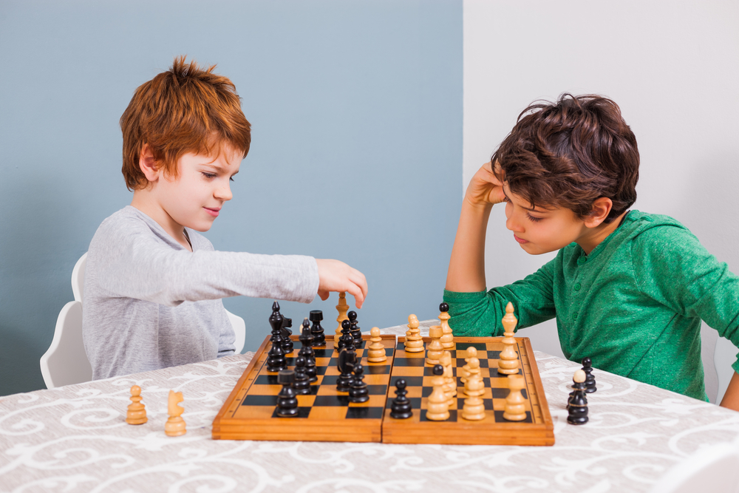

play chess

Slide 6
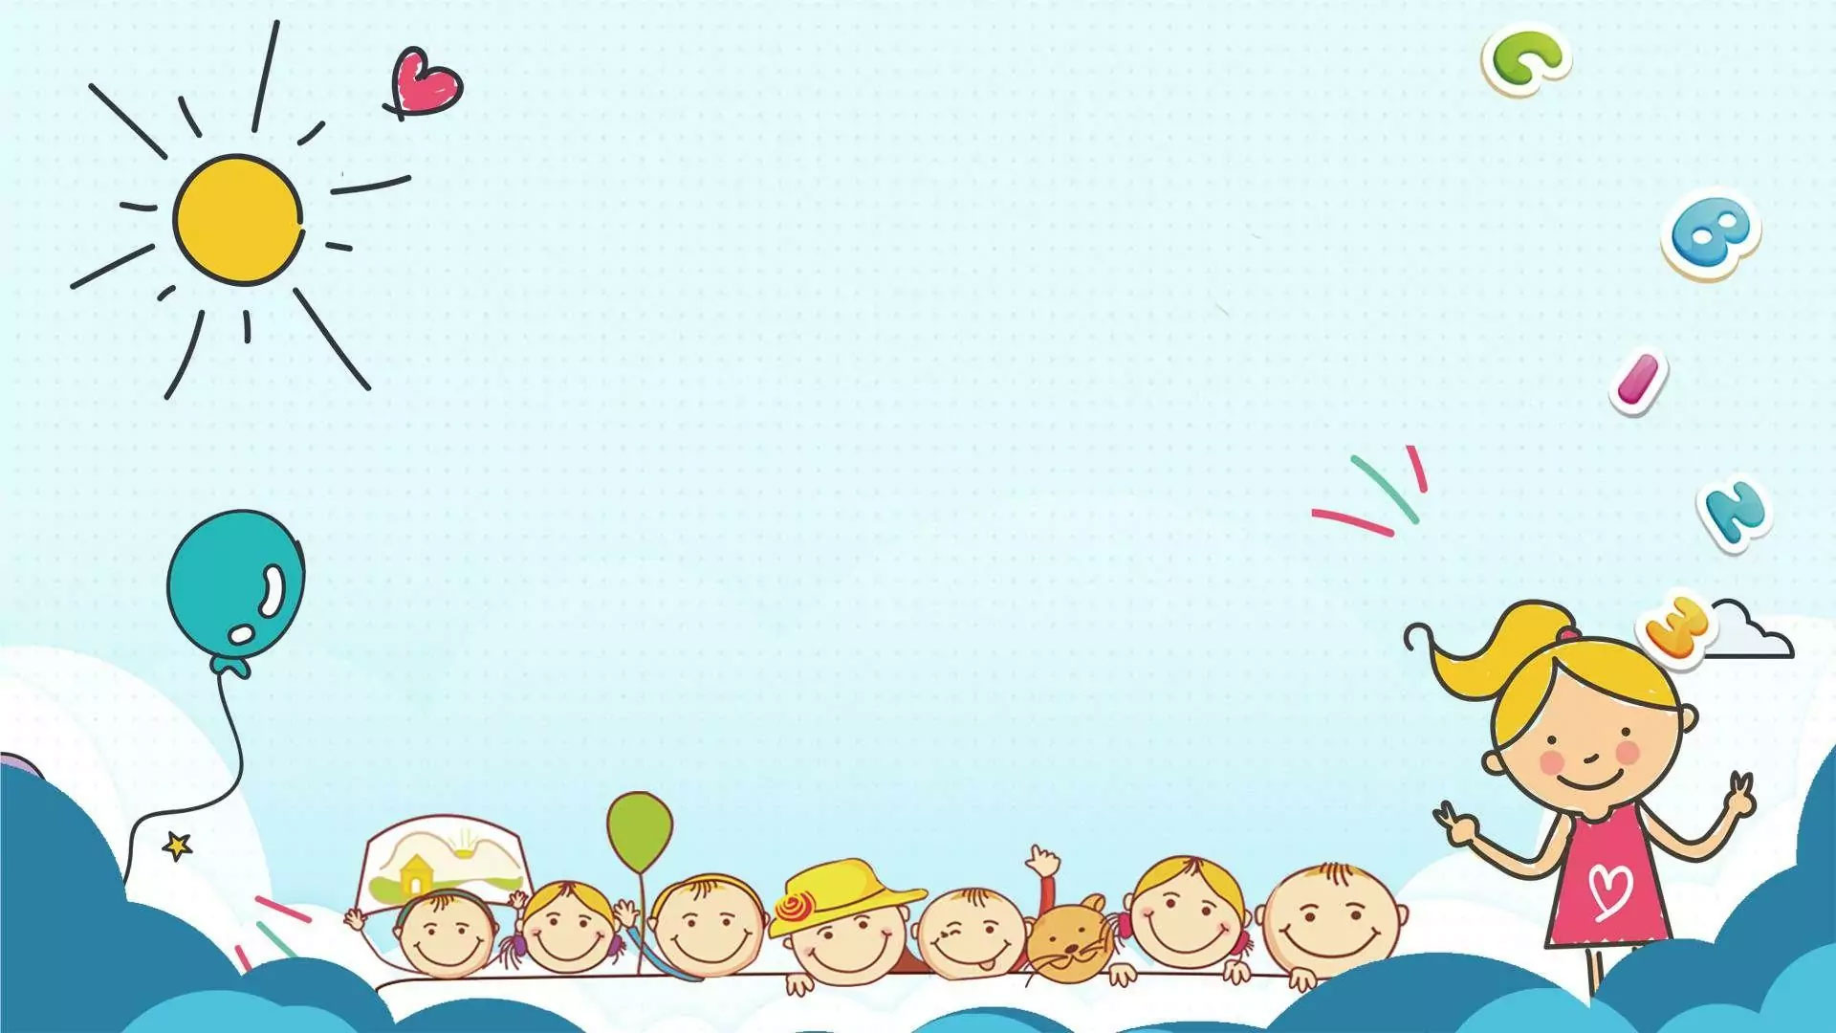
Unit: 4
FREE TIME
Lesson 1: Task 1, 2, 3

Slide 7
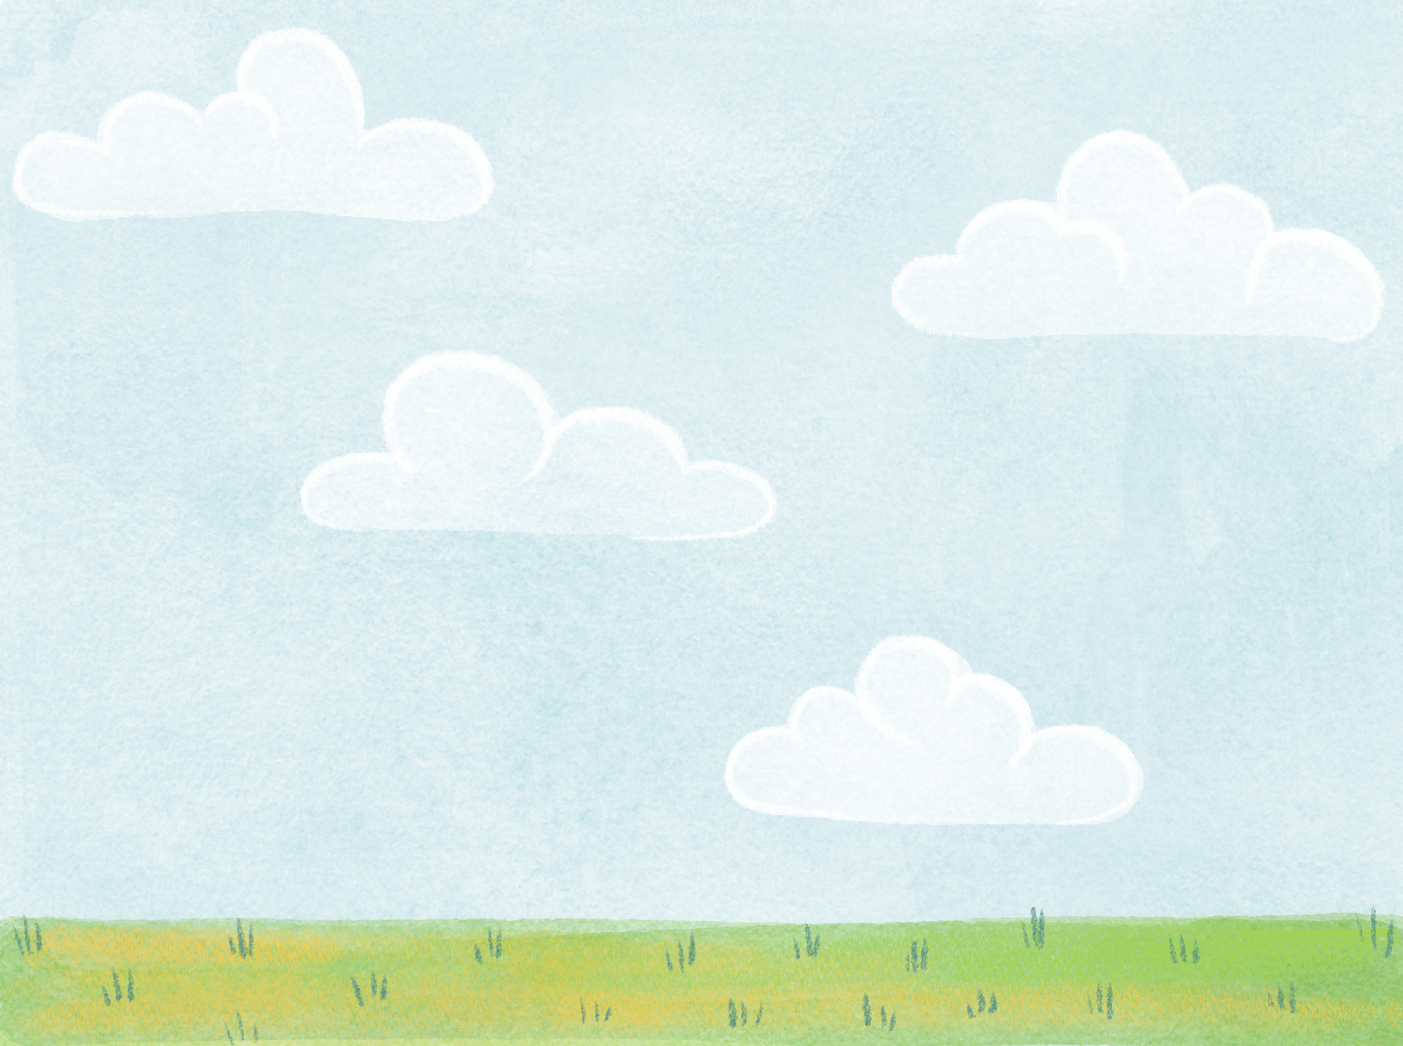
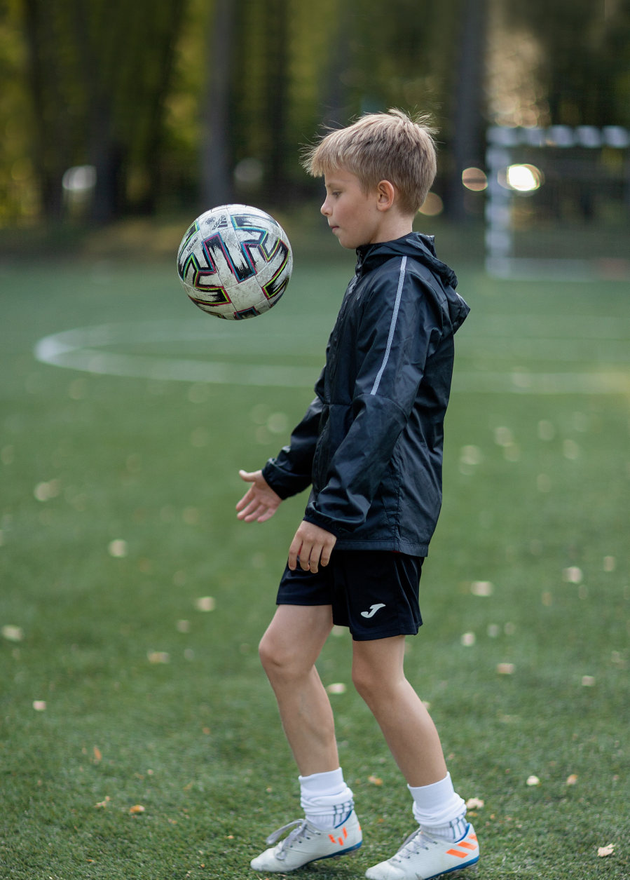
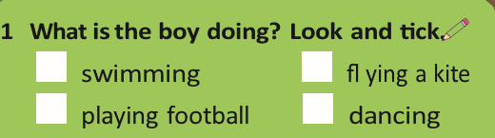
✓
2 What do you like doing in your free time ?

Slide 8
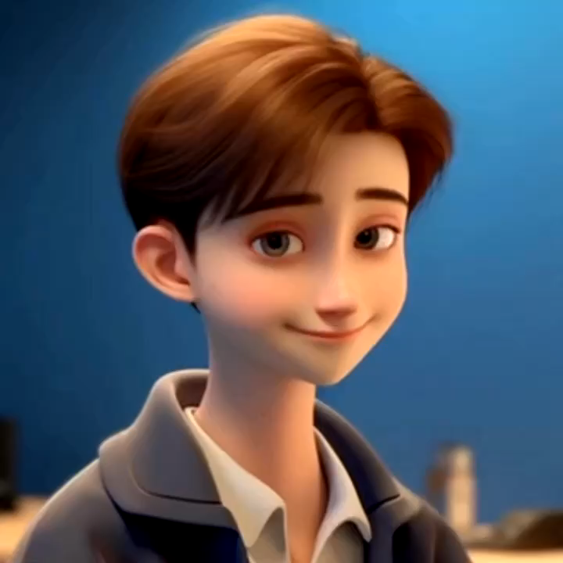

Slide 9
Video (web)

Slide 10

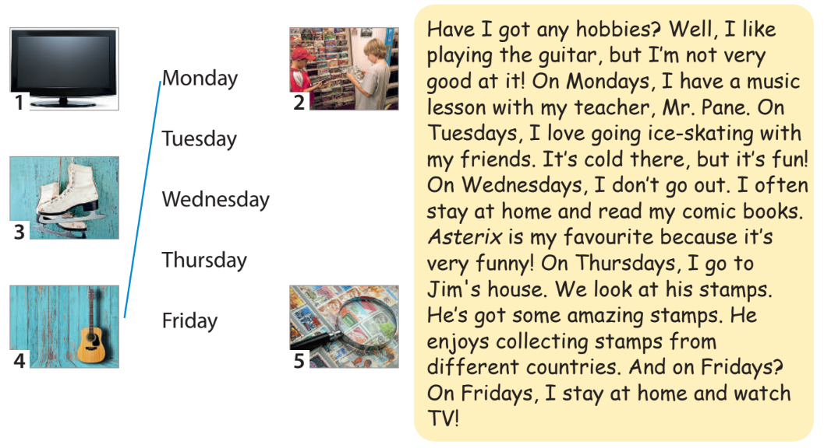
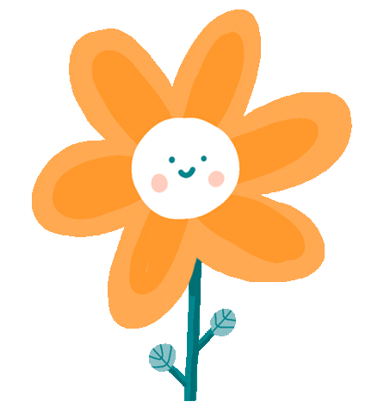
1 Listen and read about Adam’s hobbies. Match the pictures to the correct days. Track 4.1/web)

Slide 11
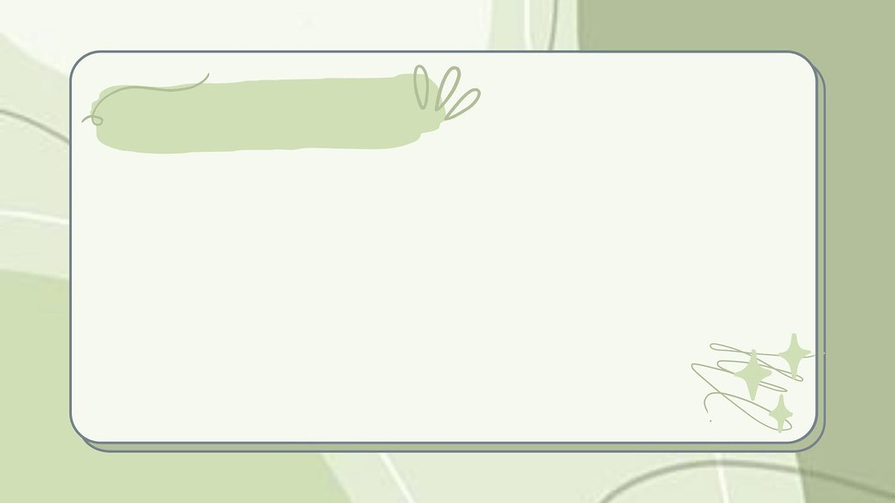

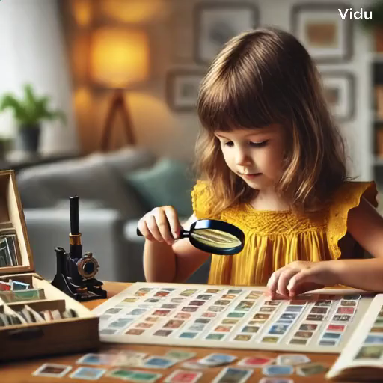
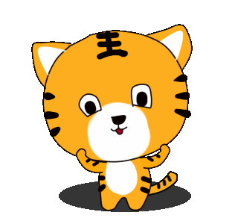
collect stamps
/kəˈlekt stæmps/

Slide 12

go ice-skating
/ɡəʊ ˈaɪs ˌskeɪ.tɪŋ/

Slide 13
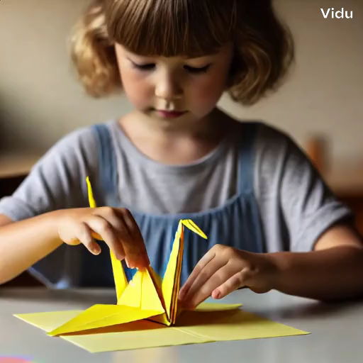
make a paper bird
/meɪk ə ˈpeɪ.pər bɜːd/

Slide 14
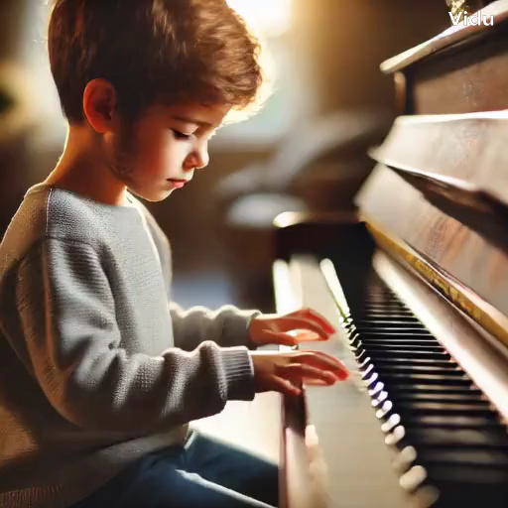
play the piano
/pleɪ ðə piˈæn.əʊ/

Slide 15
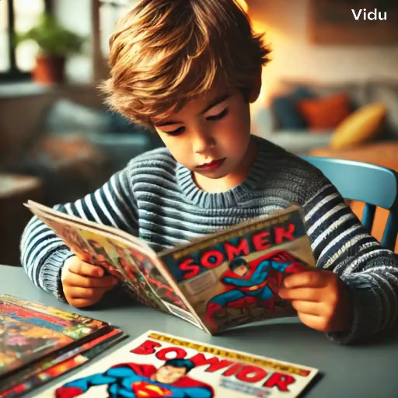
read comic books
/riːd ˈkɑm.ɪkˌbʊks/

Slide 16
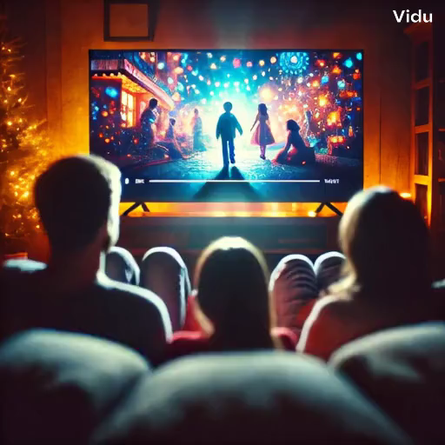
watch movies
/wɒtʃ ˈmu.viz/

Slide 17




3 Circle the word that does NOT belong
1 watch ____
a TV b a story c a film
2 go ____
a coins b swimming c ice-skating
3 read ____
a a story b the guitar c a comic book
4 collect ____
a coins b stamps c the piano
5 play ____
a the flute b a film c the drums

Slide 18
