Slide 1
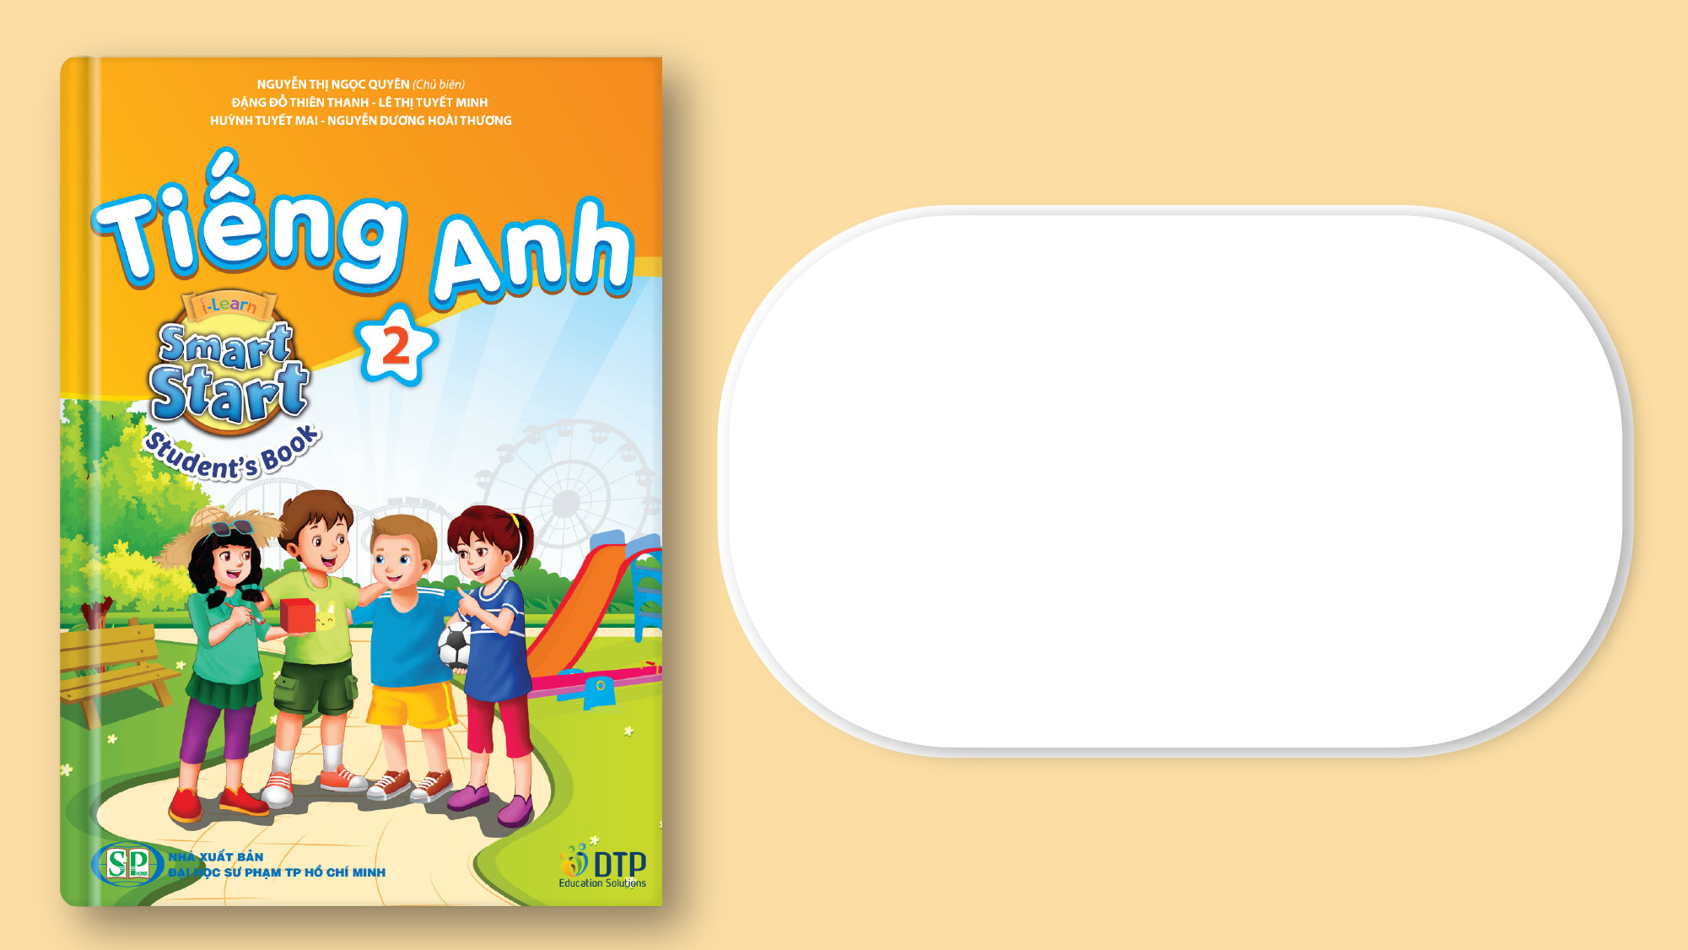
Wednesday, November 27th 2024
Unit 3
Numbers
Lesson 1 – Task A,B

Slide 2
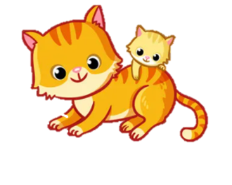
1.Warm Up ___ Let’s sing
(You tobe)

Slide 3
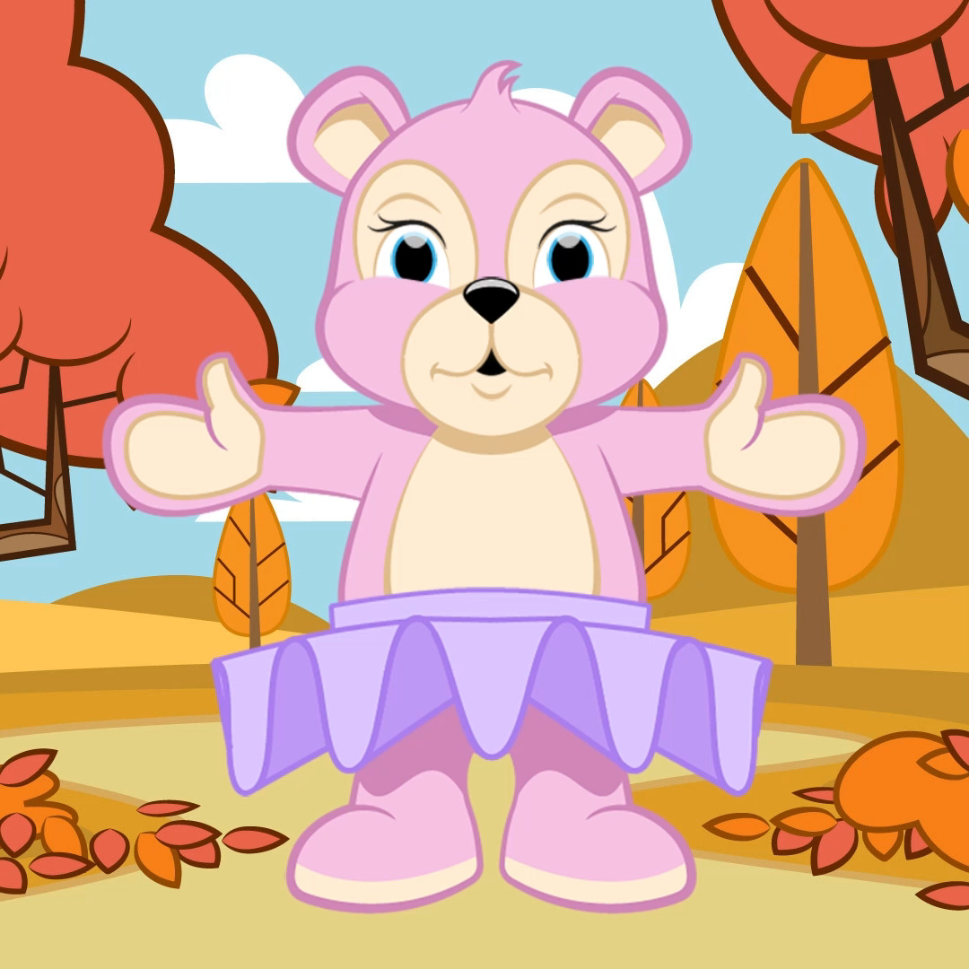
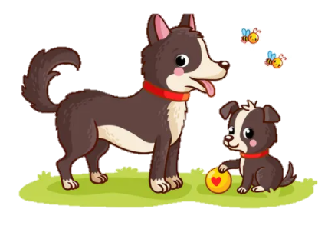
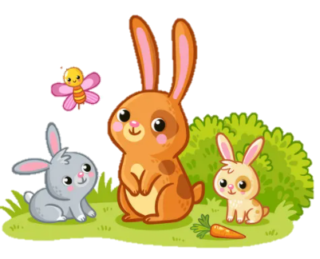

1. Warm up __*"Magic finger" game

Slide 4


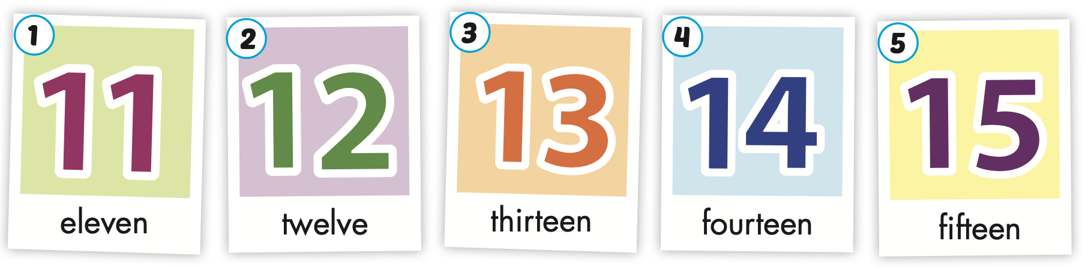

Slide 5
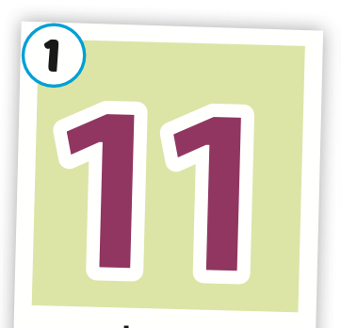
eleven

Slide 6
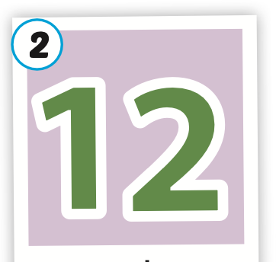
twelve

Slide 7
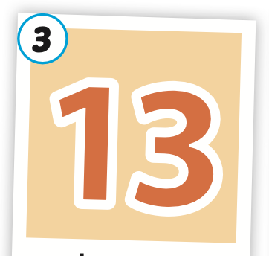
thirteen

Slide 8
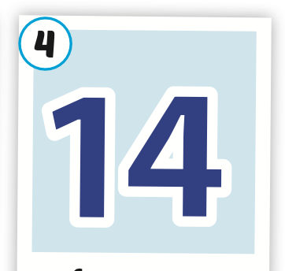
fourteen

Slide 9
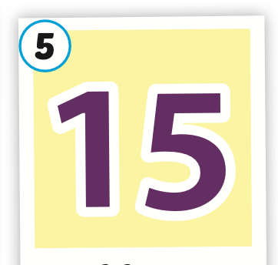
fifteen

Slide 10

Filling a letter.
12
Tw_lve
11
El_ven
13
Thirtee_
Numbers
15
F_fteen
14
Fo_rteen

Slide 11
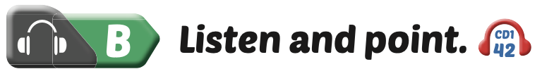
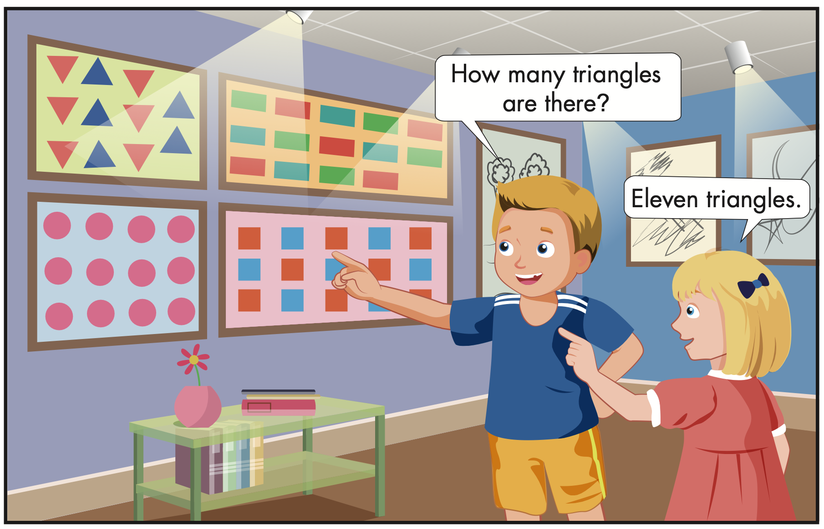

Slide 12
How many triangles are there ?
eleven triangles

Slide 13
How many rectangles are there ?
fourteen rectangles

Slide 14
How many circles are there ?
twelve circles

Slide 15
How many squares are there ?
fifteen squares

Slide 16
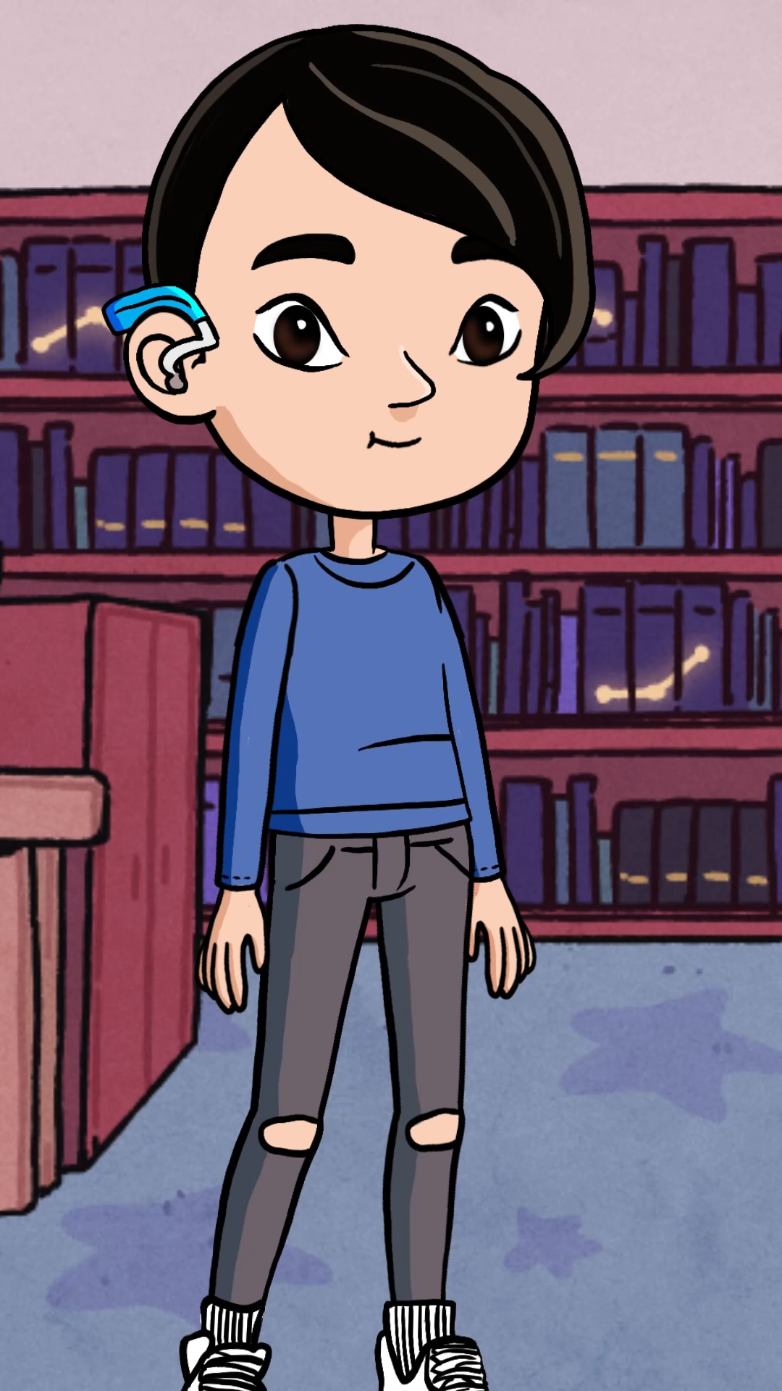
*"Flashcard walk" game

Slide 17
C/ Sing
How many triangles are there ?
Eleven triangles.
(you tobe/ web)

