Slide 1







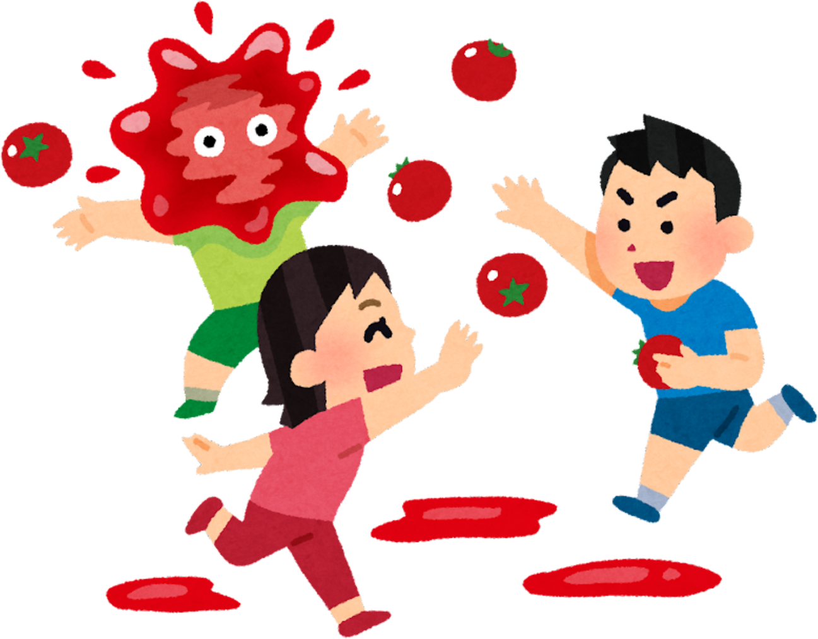
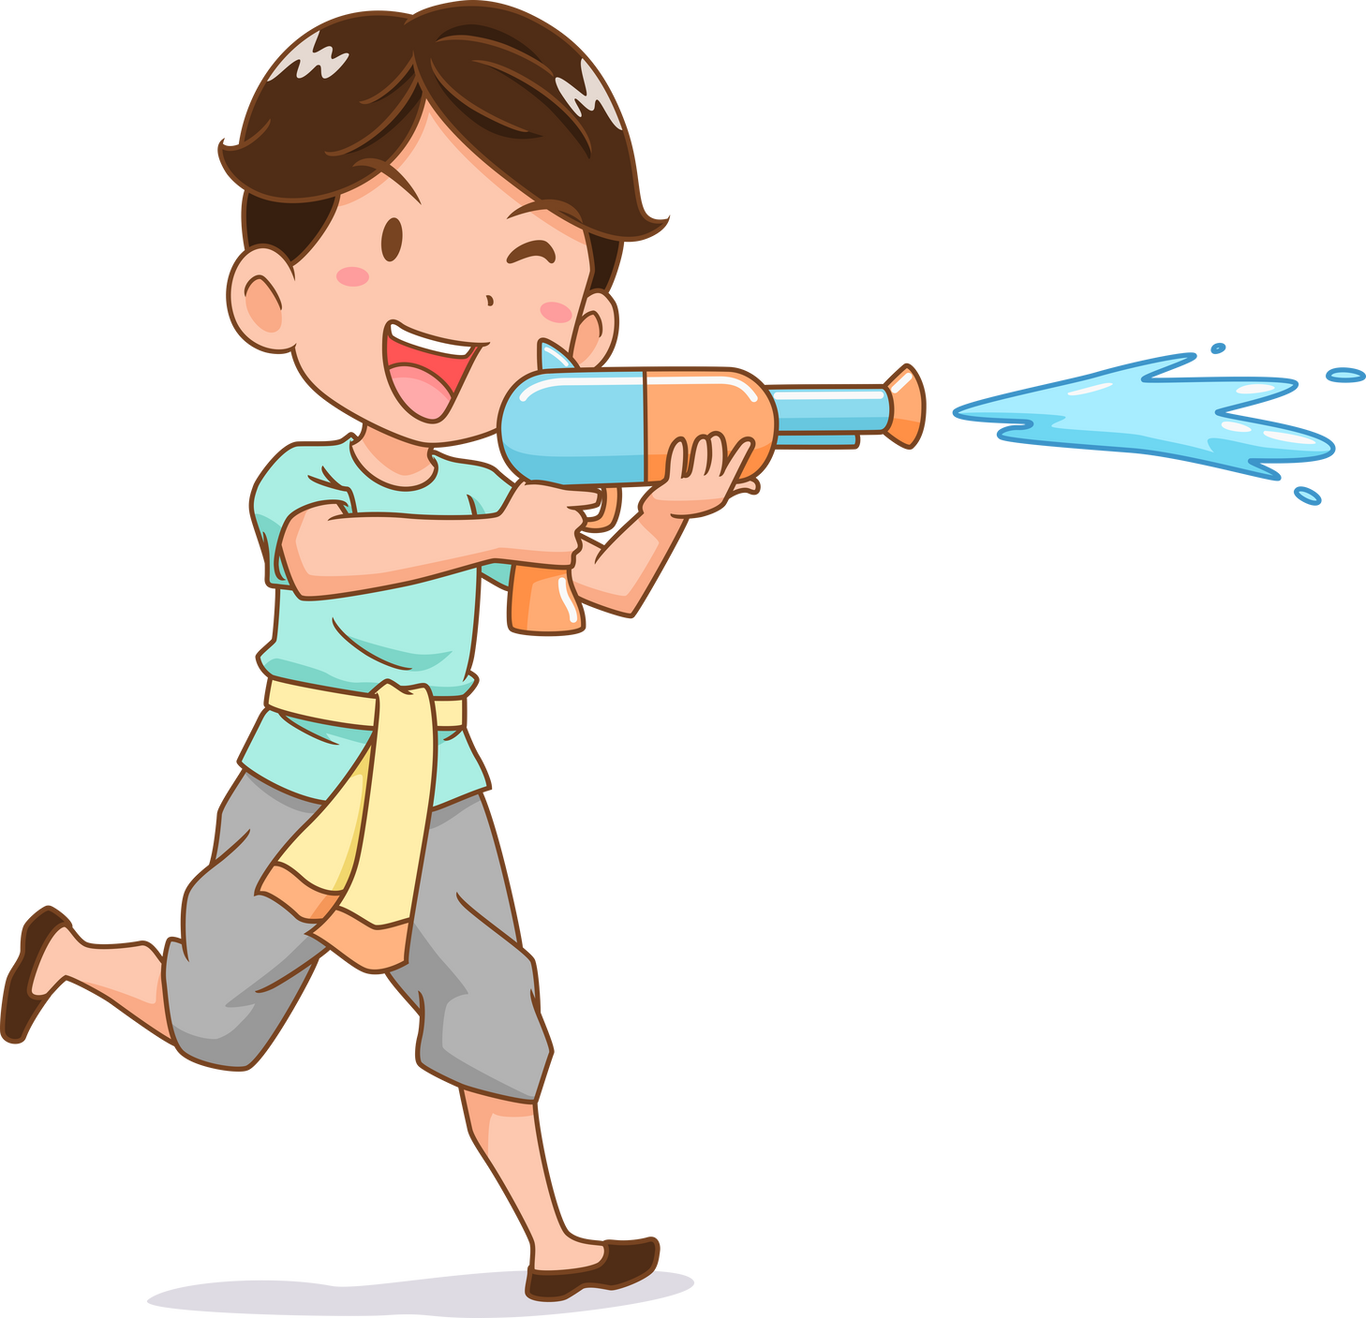
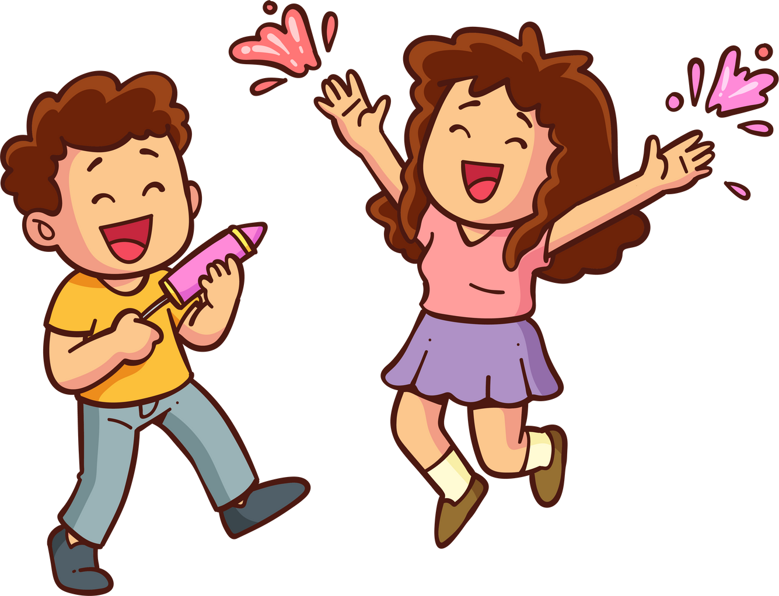
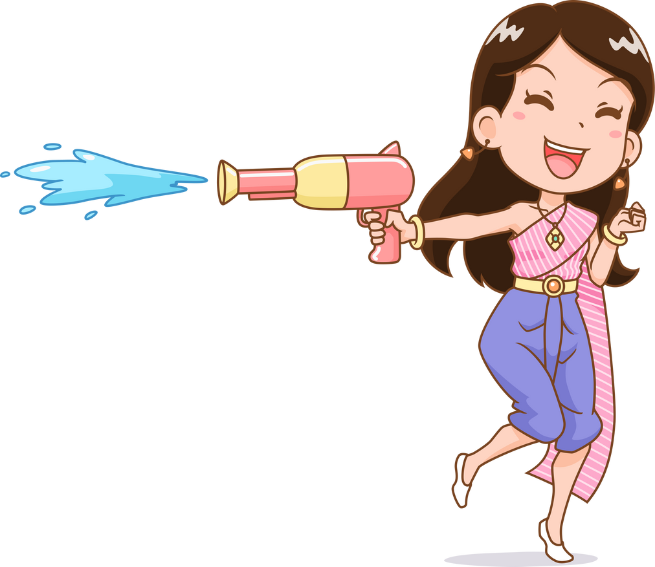
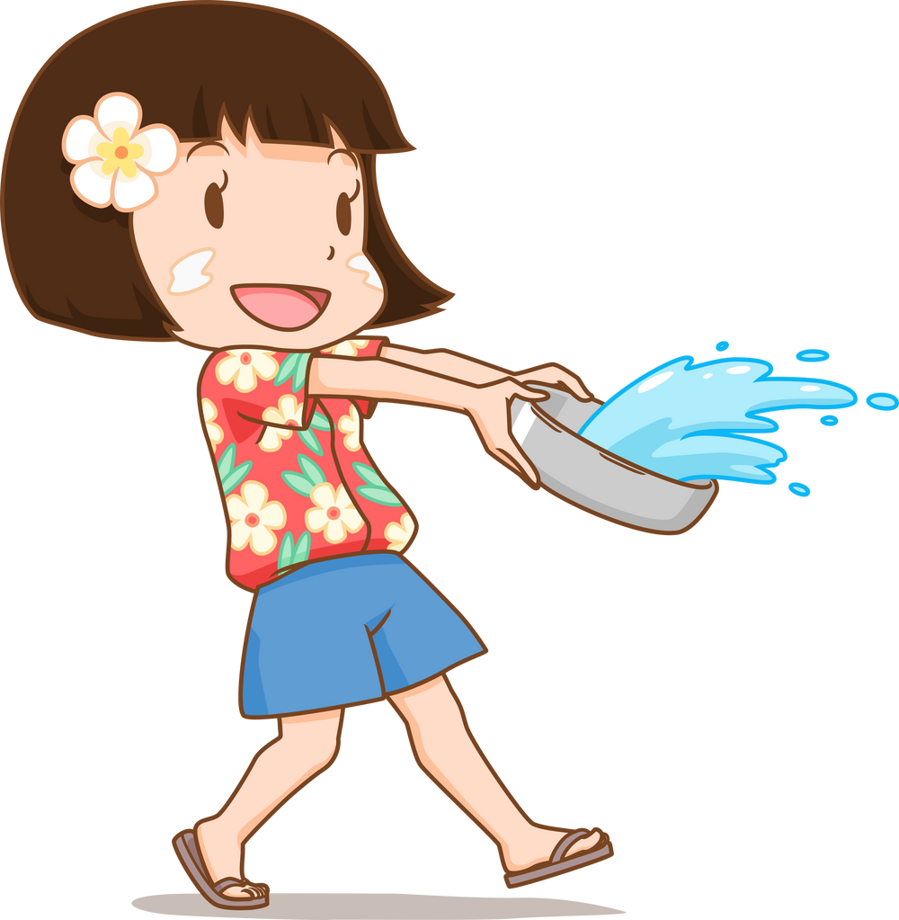

Unit 5
Celebrations
LESSON 3
TASK 1, 2, 3

Slide 2



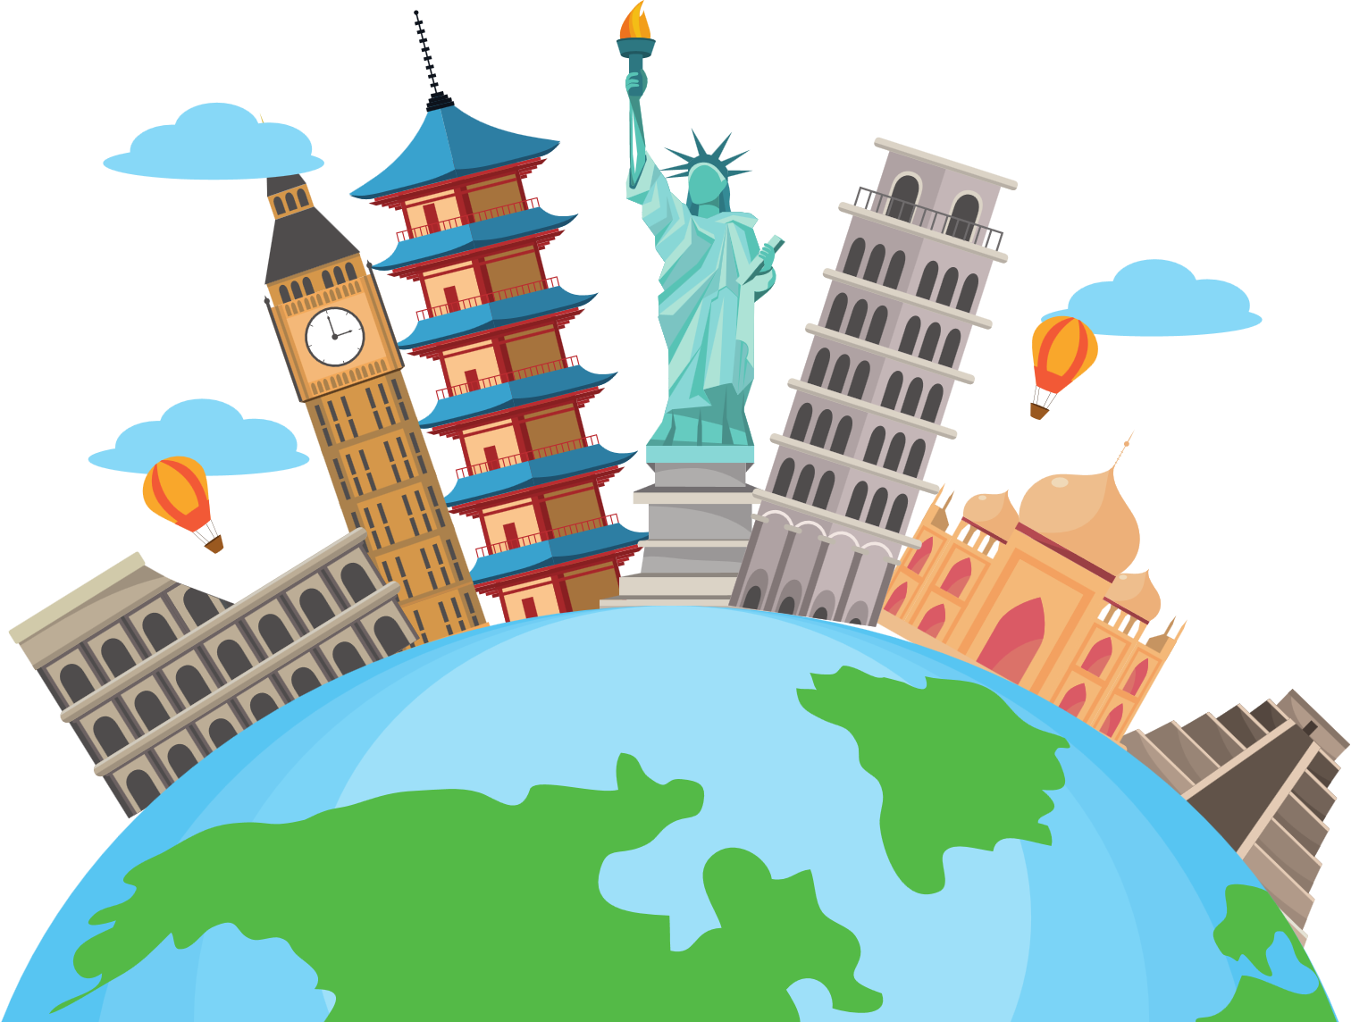



Slide 3

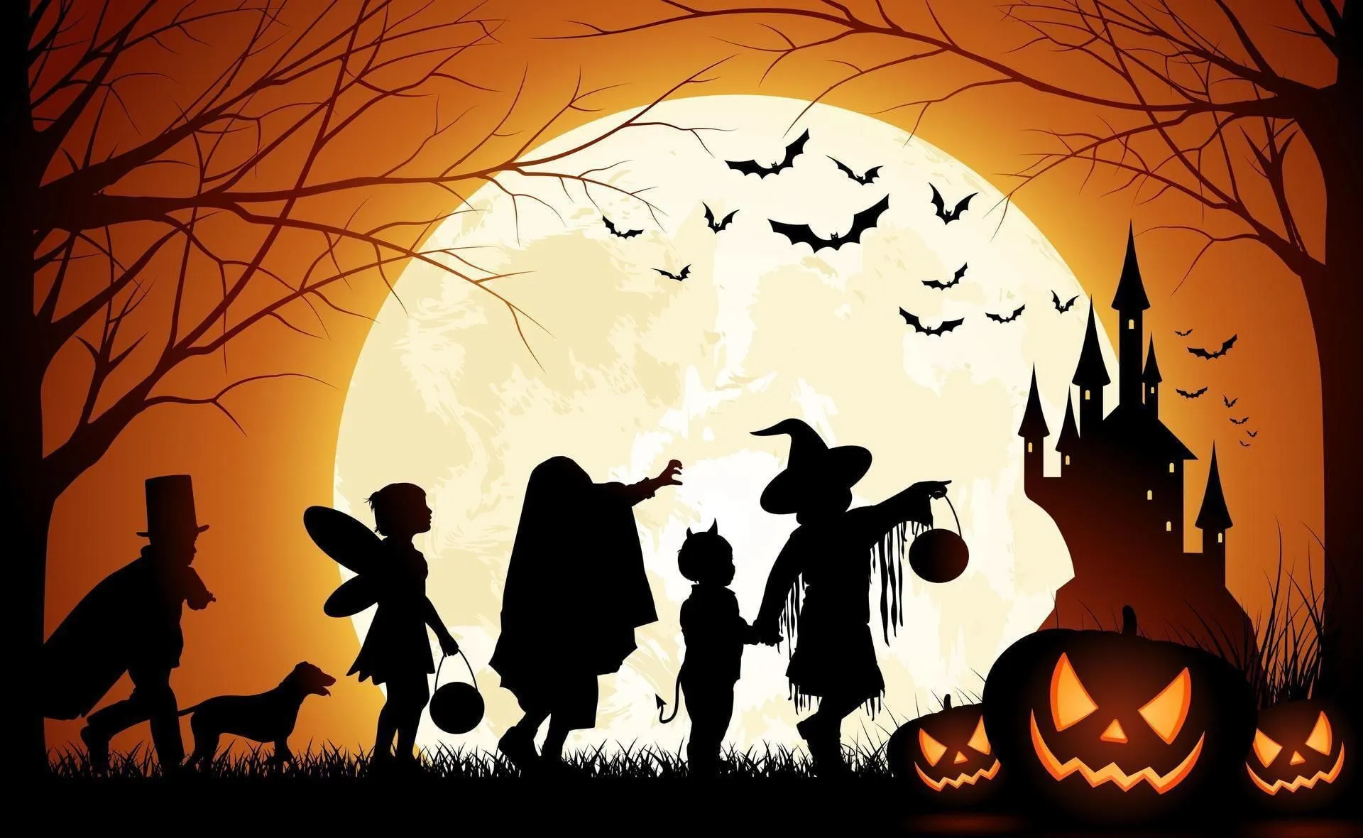
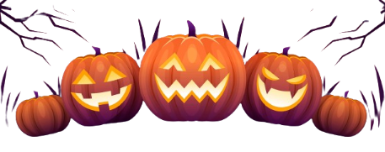

Slide 4
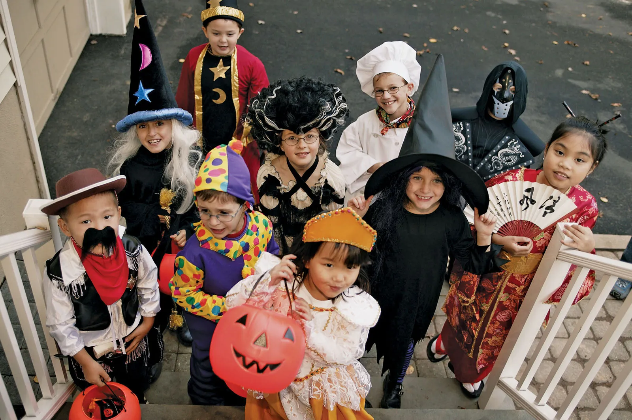


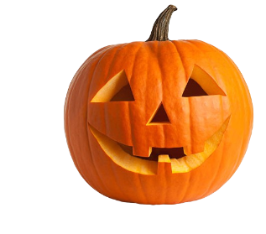
From the ancient Celtic festival Samhain,
now, Halloween is officially celebrated in European countries.
The mascot of Halloween is Jack O’Lantern – the lantern made from a pumpkin.

Slide 5

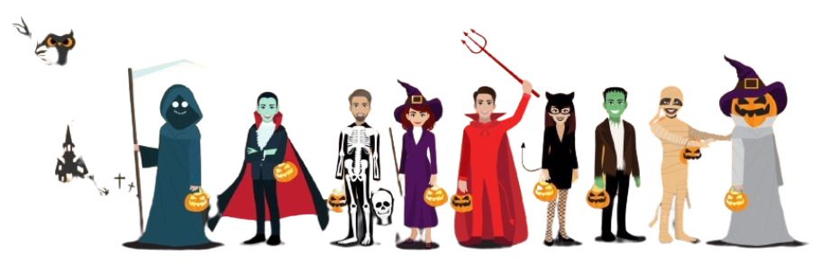
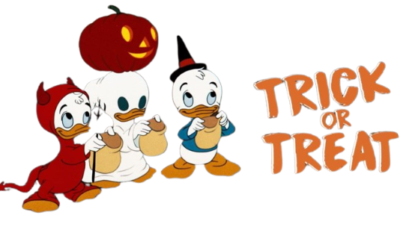
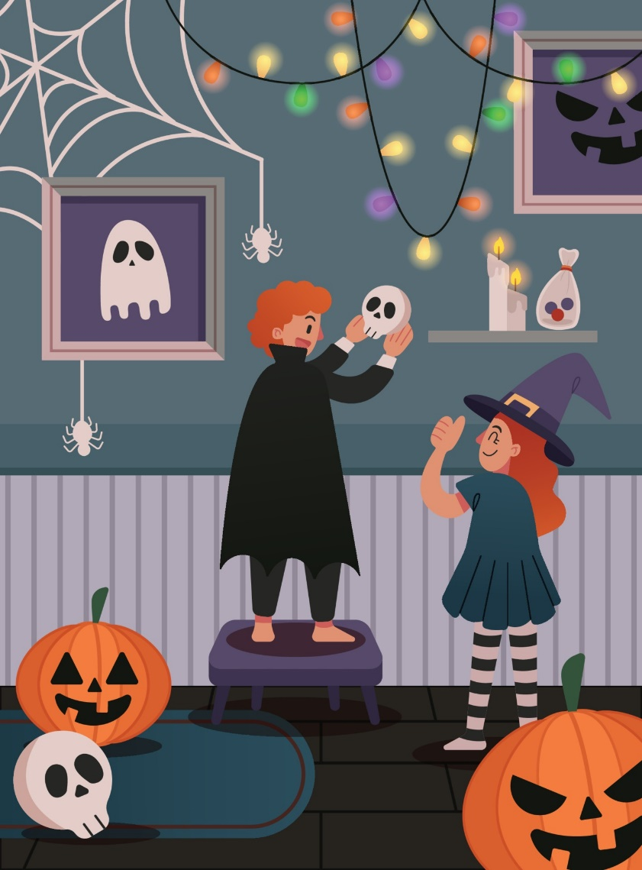

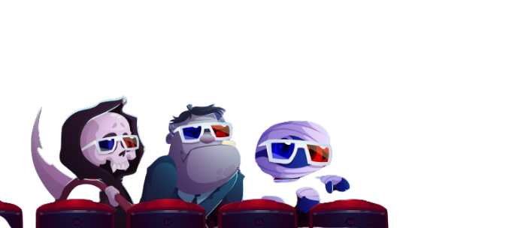
What do people do during Halloween?
HOUSE DECORATION

Slide 6
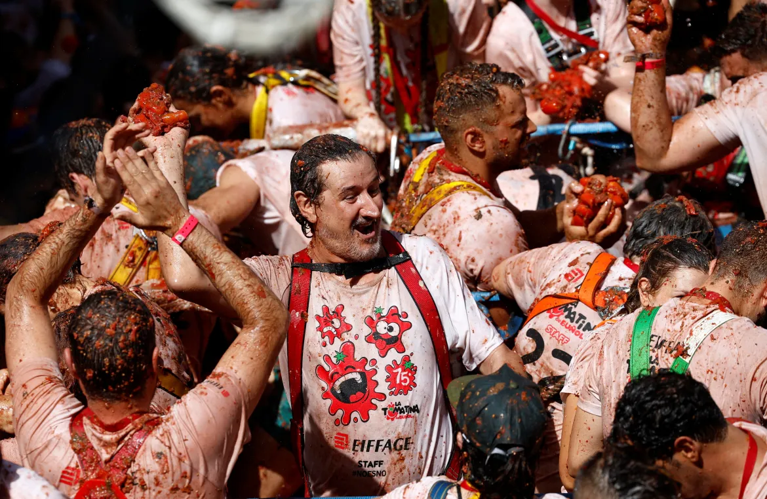
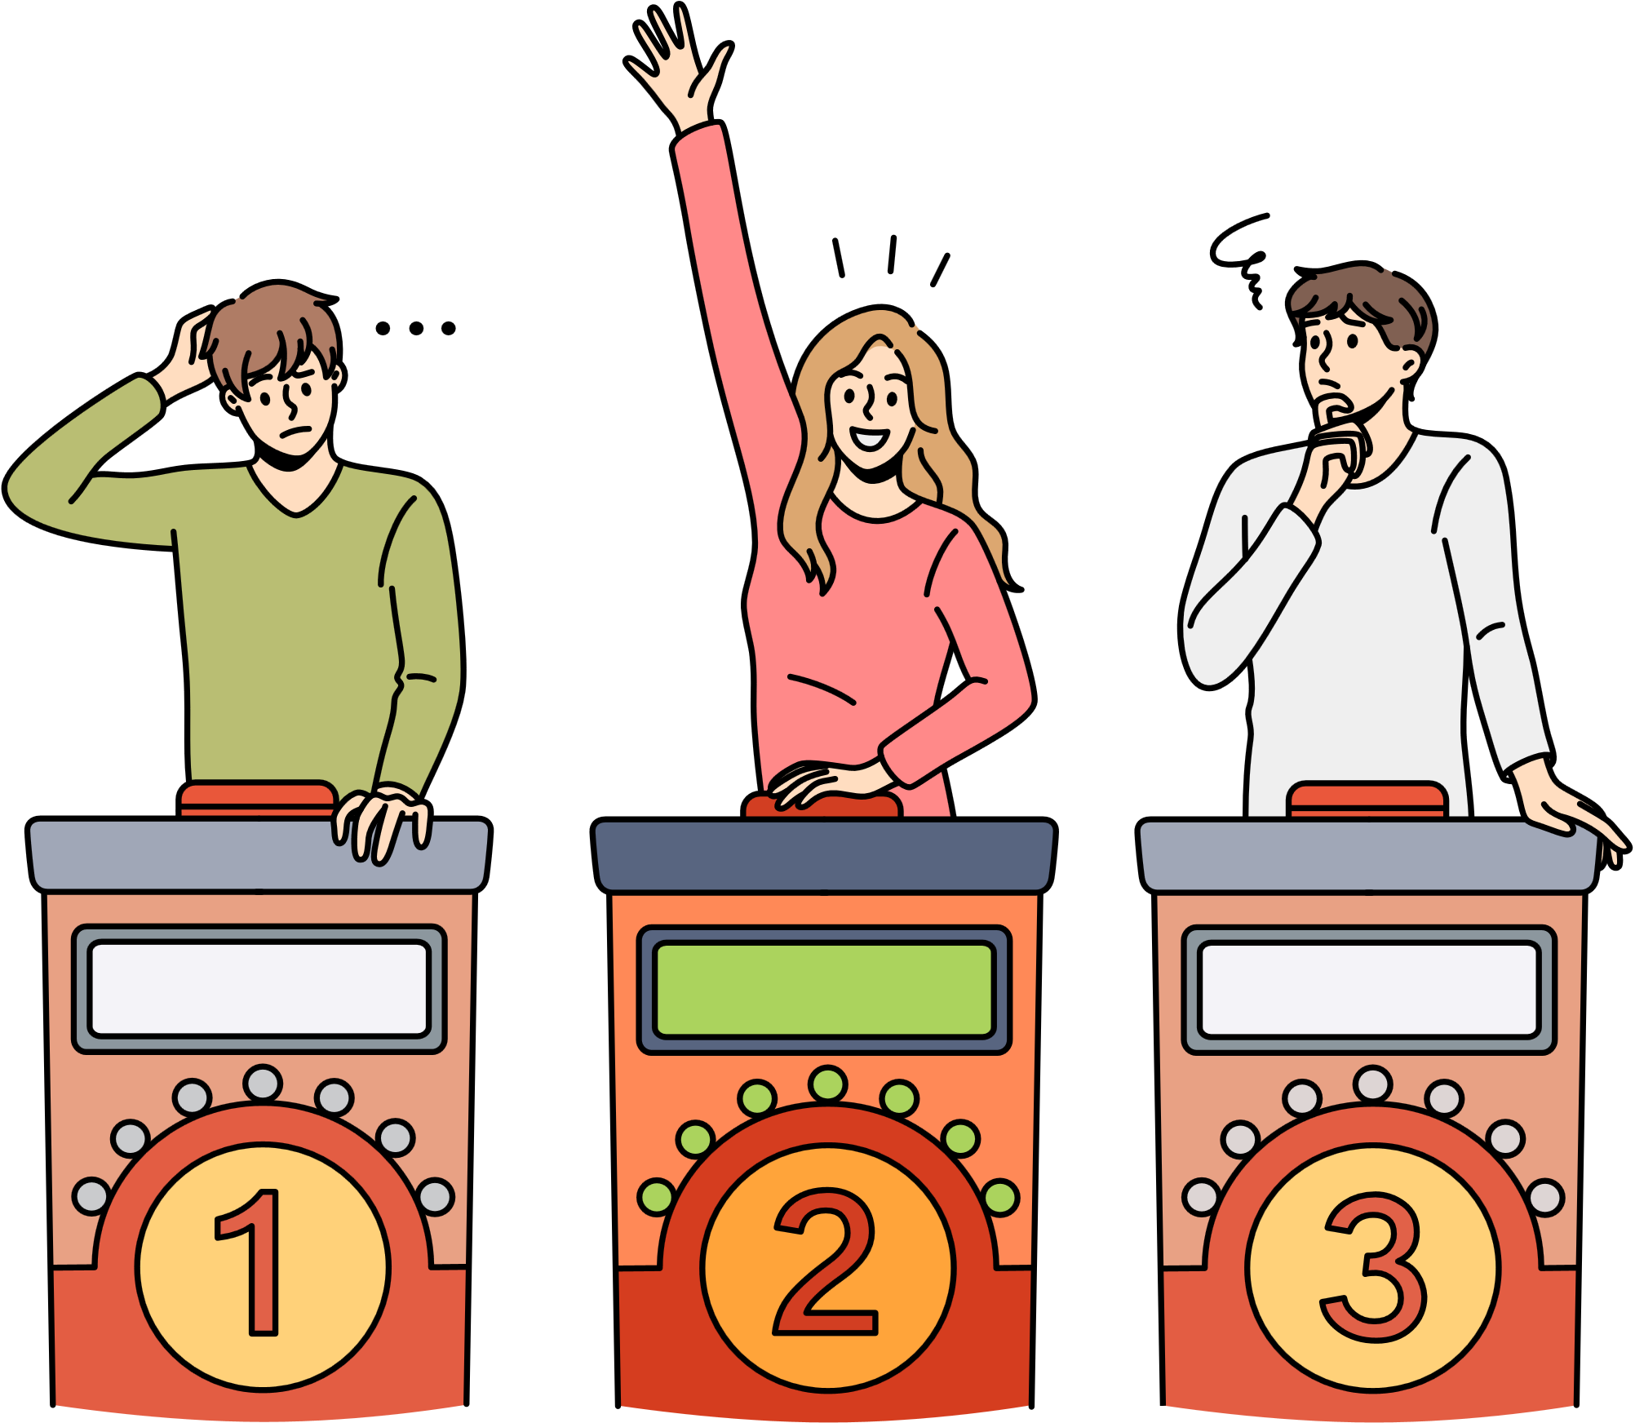

Slide 7
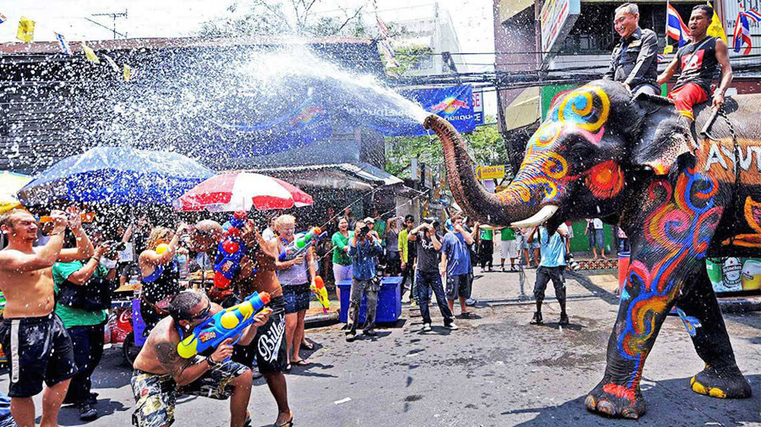

Slide 8
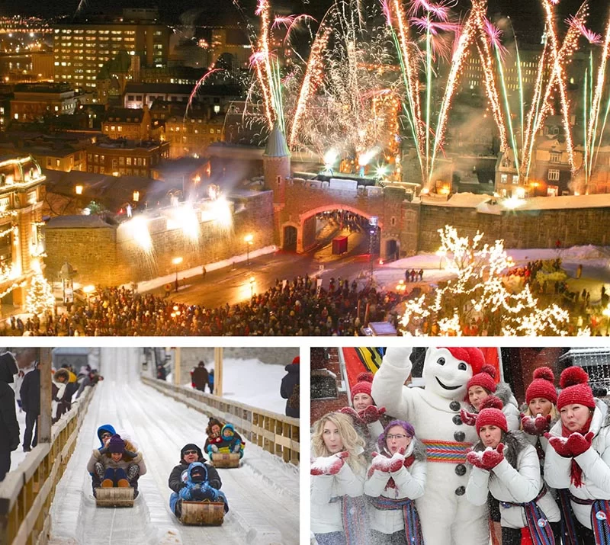

Slide 9


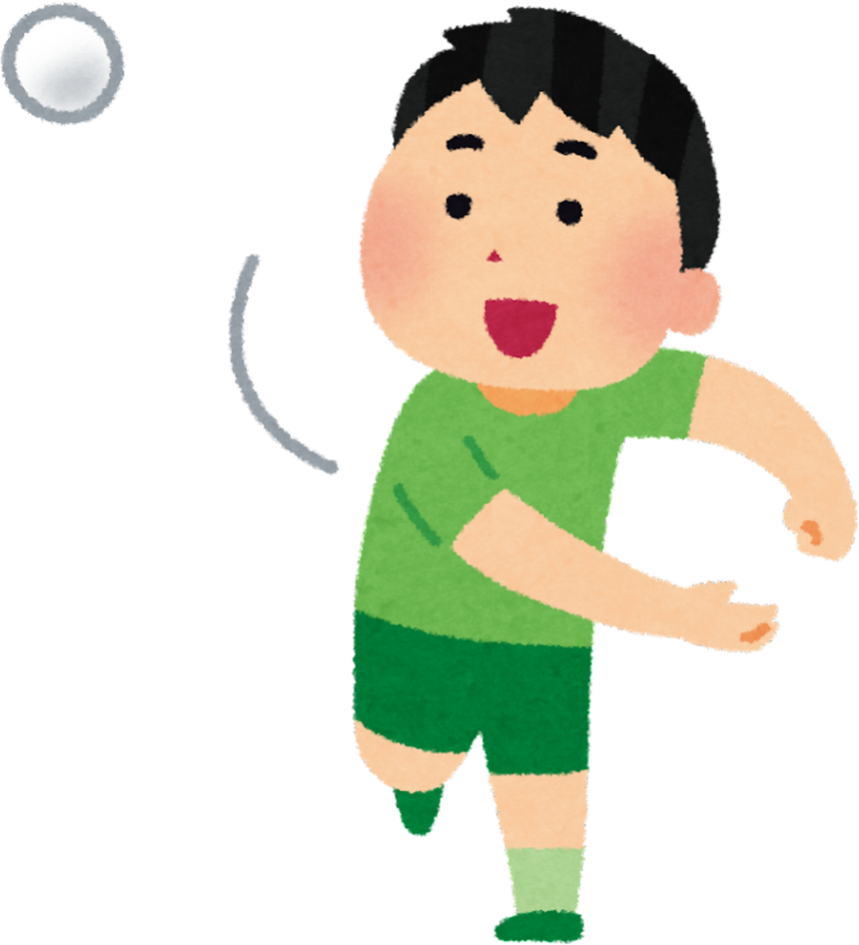
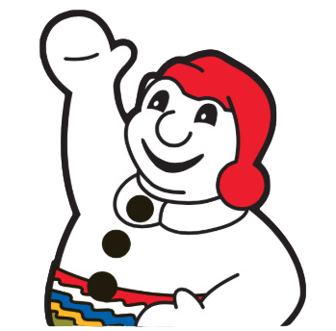
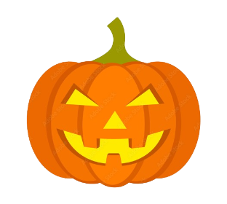
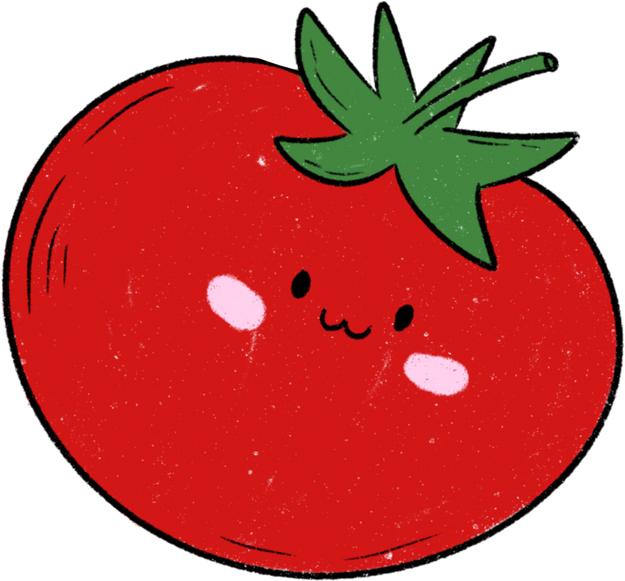

tomato
pumpkin
snow
water

Slide 10

2. mooncakes
5. lanterns
7. balloons
Countable or Uncountable?
Put the words into the correct columns
  1. pumpkin
2. skeleton
3. juice
4. uniform
5. snow
6. water
7. memory
8. homework
Countable nouns
Uncountable nouns
pumpkin
skeleton
4. uniform
7. memory
3. juice
5. snow
6. water
8. homework

Slide 11




2
Listen and write short answers.
1 When was his birthday?
yesterday
2 Where did he go first?
a supermarket
3 Who did he go with?
with his close friends
4 Where did he eat?
in a Japanese restaurant

Slide 12



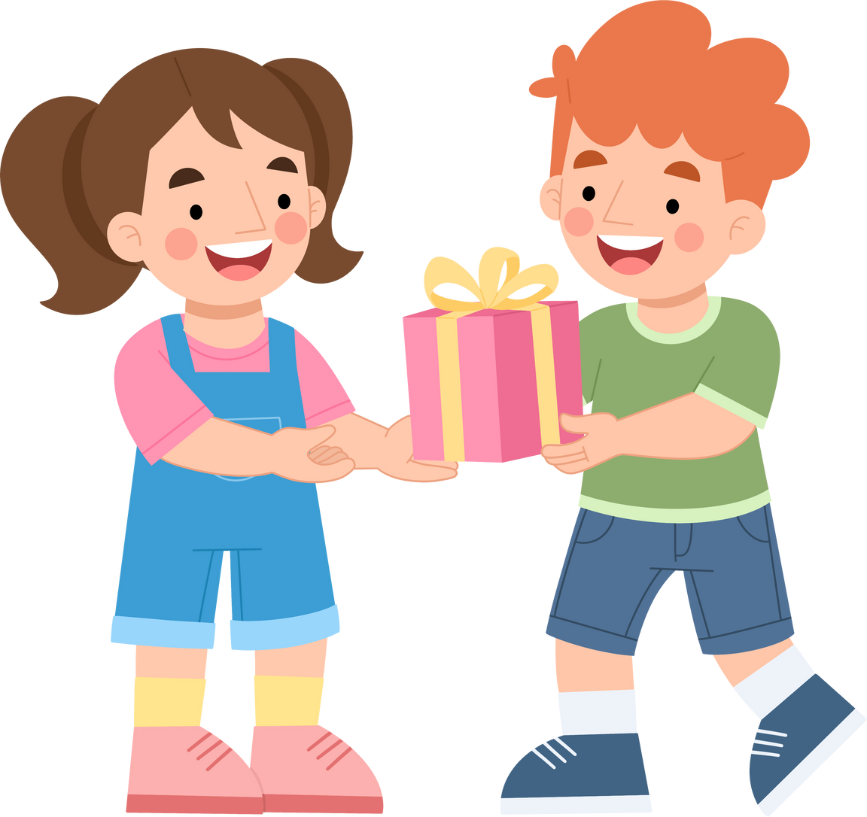

your gift

Slide 13
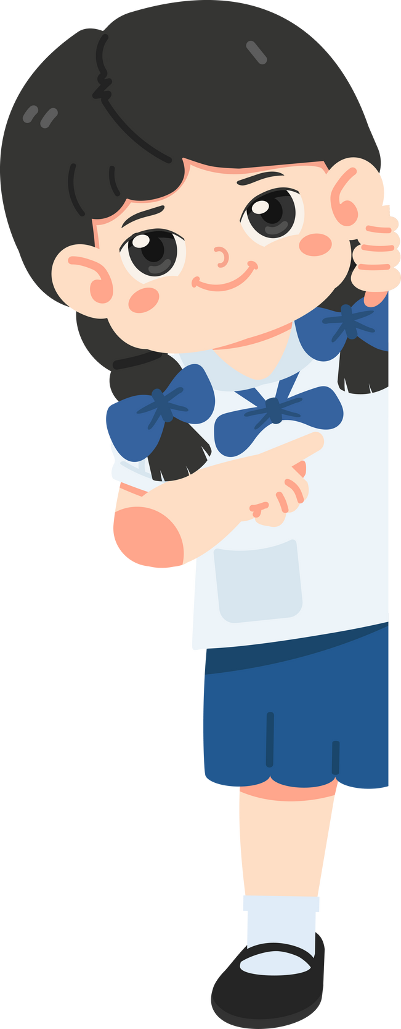
Use prompts to write four sentences about
your last birthday party.
birthday / last Saturday
My birthday was last Saturday.

Slide 14




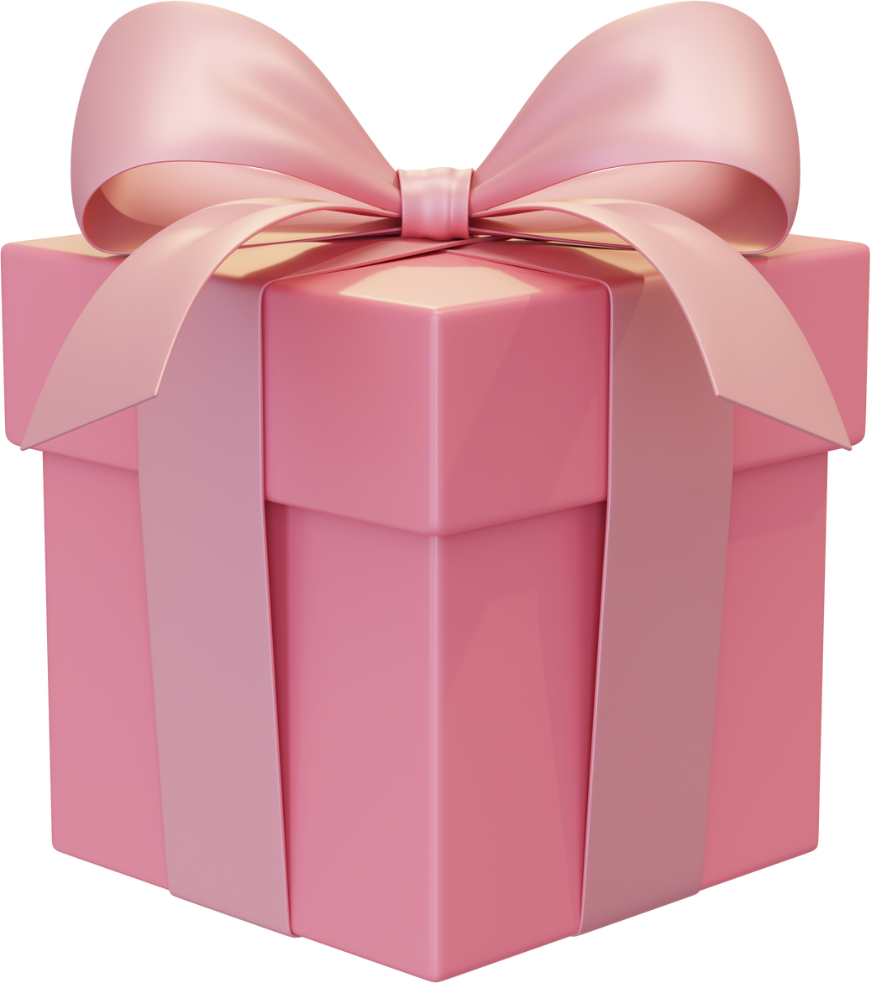

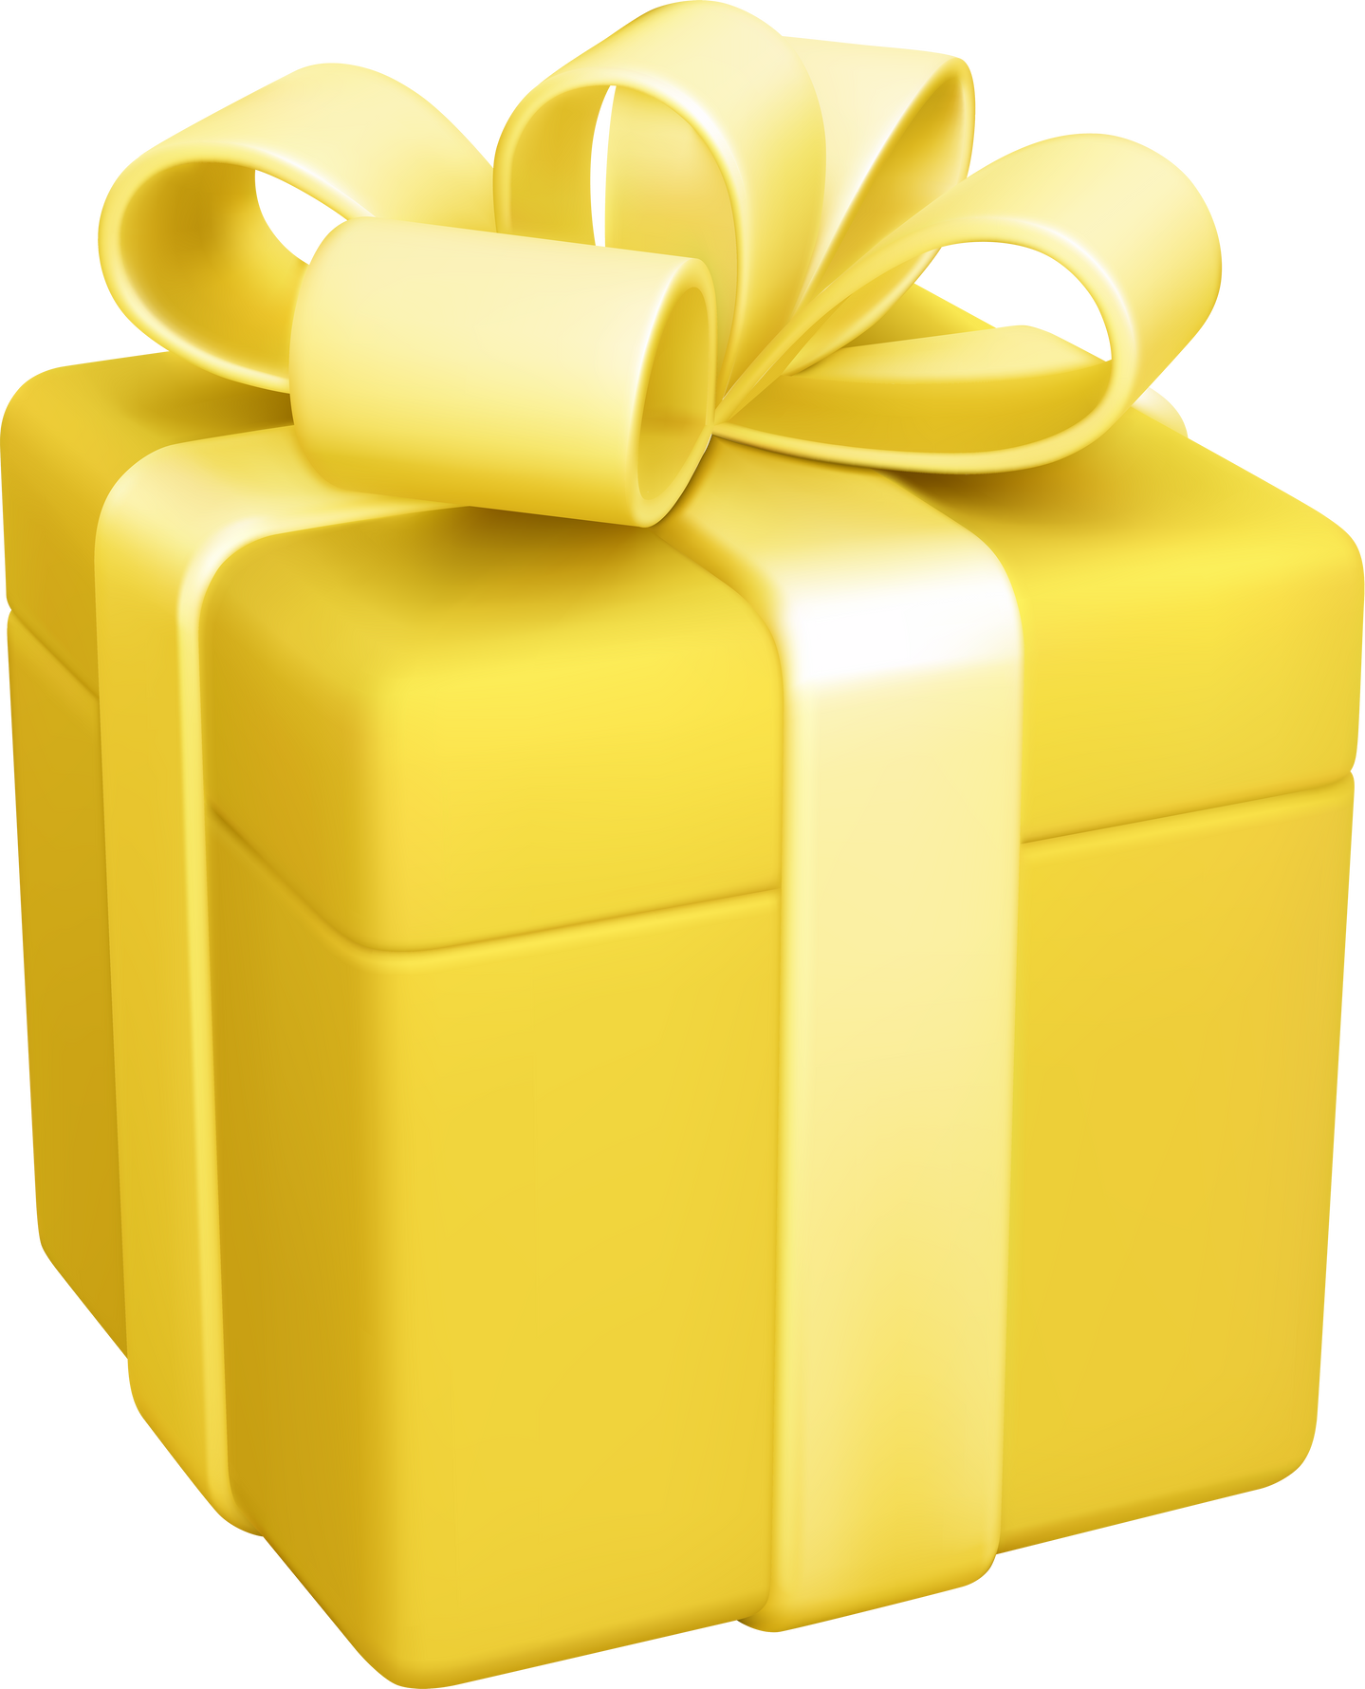
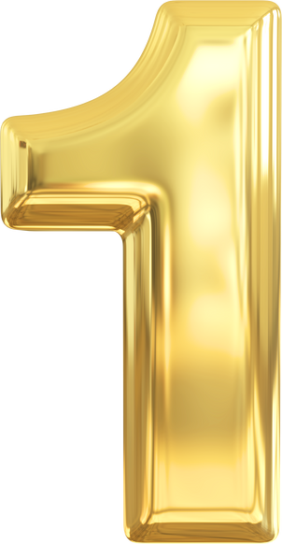



Slide 15
Use prompts to write four sentences about
your last birthday party.
went / bookshop / friends
I went to the bookshop with my friends.

Slide 16




Slide 17

Use prompts to write four sentences about
your last birthday party.
had / big / birthday cake
I had a big birthday cake.
________________________

Slide 19

Use prompts to write four sentences about
your last birthday party.
had / fun
______________________________
We had a lot of fun together.

Slide 20


Slide 21

Use prompts to write four sentences about
your last birthday party.
great / birthday / nice / memories
It was a great birthday party with many
nice memories.
___________________________________
___________________________________

Slide 23
It was a great birthday party with many
nice memories.
My birthday was last Saturday.
I went to the bookshop with my friends.
We had a lot of fun together.

Slide 24

Choose the correct answer
1. How many ___ are there in the basket?
a) tomato b) tomatoes
2. We ____some beer for the party last weekend.
a) buys b) bought
3. There is a lot of ___ on the mountain.
a) snow b) snows
4. She always carries a bottle of ___ with her.
a) waters b) water

