Slide 1
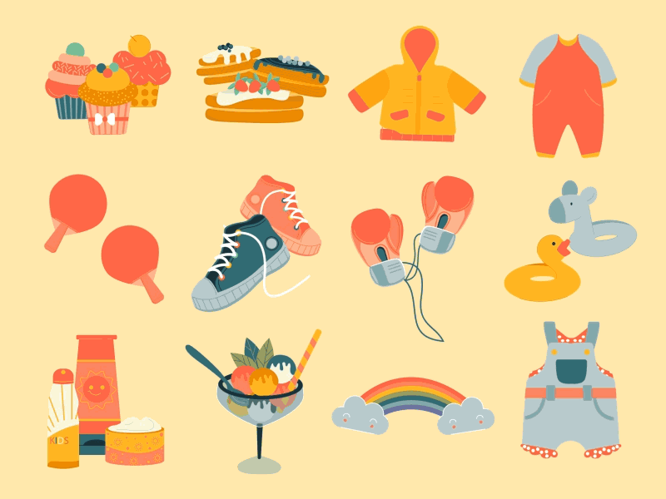


Unit 5 My clothes Lesson 1 – Task 1,2,3

Slide 2


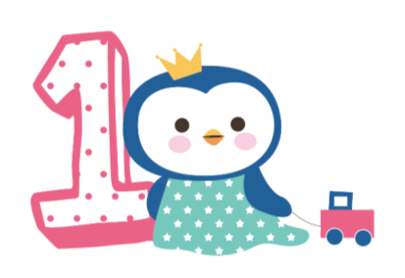



Warm up
Song: Hello song
( You tobe)

Slide 3
1
2
3
GUESSING GAME
4
5
6

Slide 4
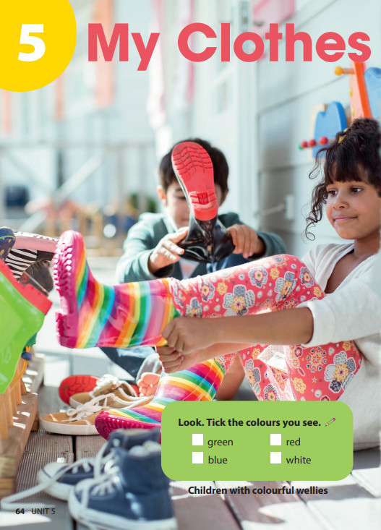
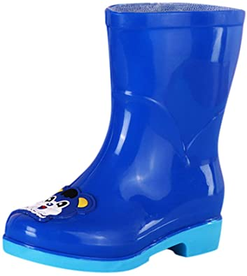
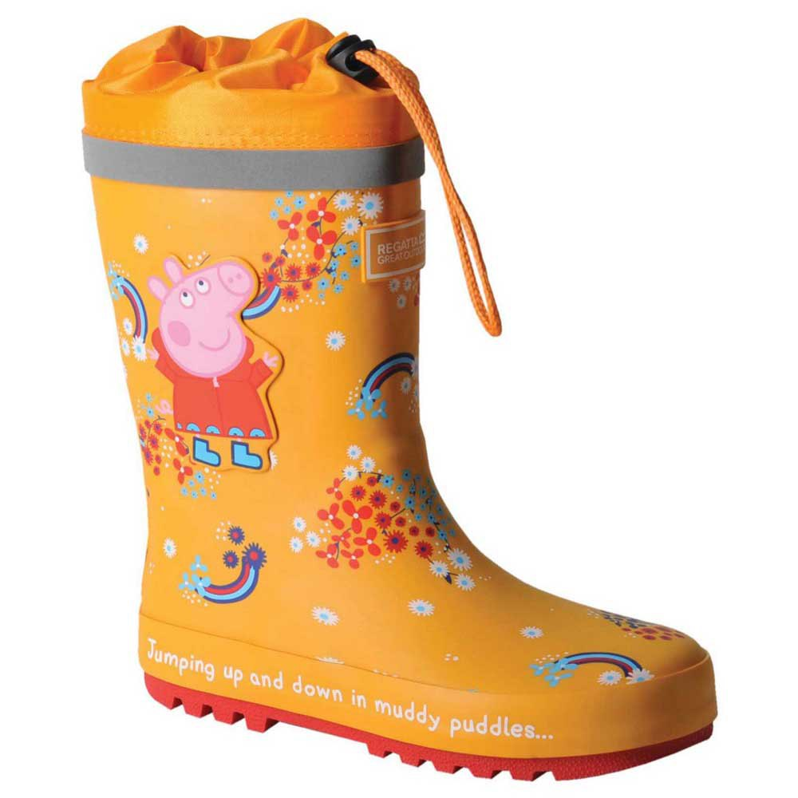
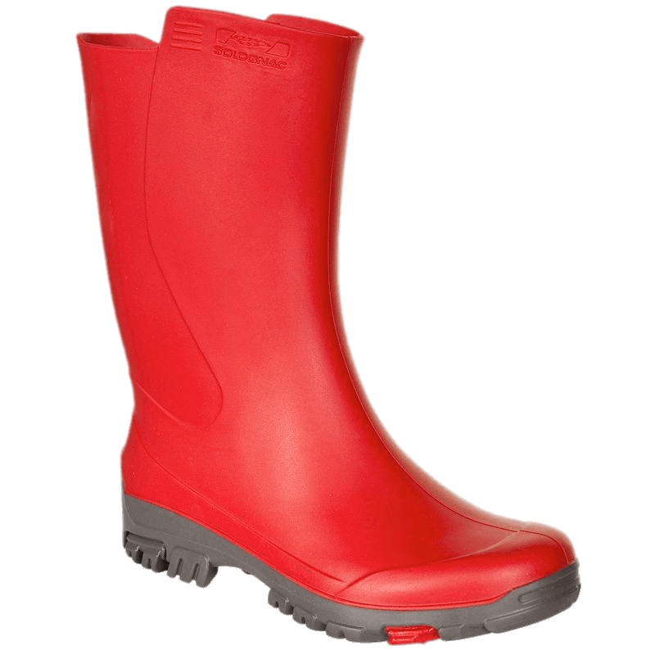
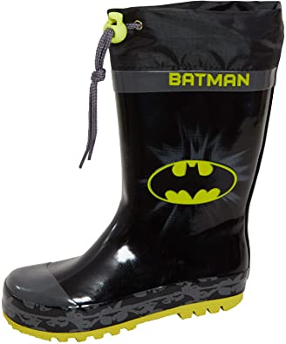
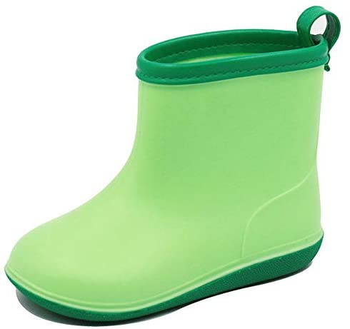
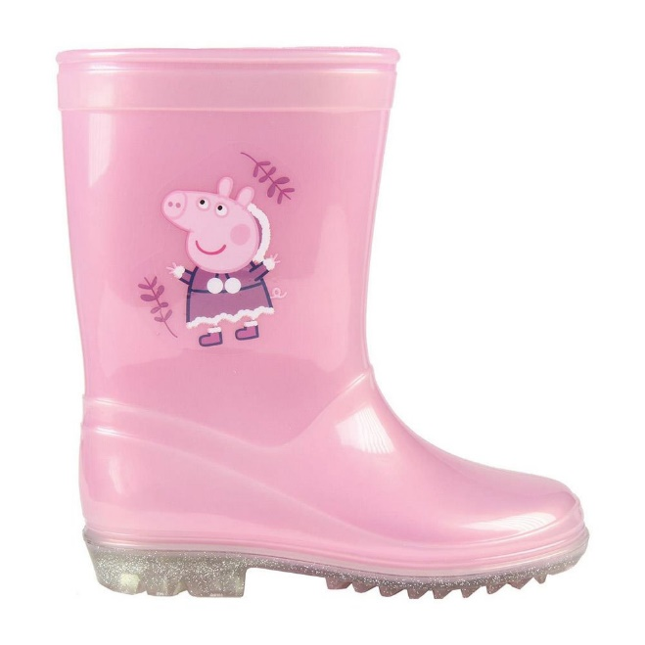
1
2
3
What colour is it?
What colour is it?
What colour is it?
4
5
6
What colour is it?
What colour is it?
What colour is it?
Notes:
Lead in: Use the opener picture to lead in the topic (My clothes) then teacher introduces the new unit “My chothes”

Slide 5


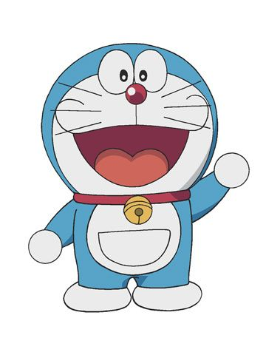

Hi! I’m Doraemon. I’m in Japan.
This is my magic bag.
What’s in my bag?

Slide 6
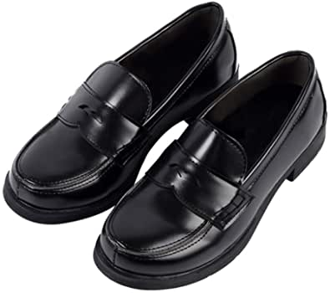
What’s in my bag?
shoes

Slide 7
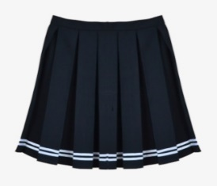
What’s in my bag?
skirt

Slide 8
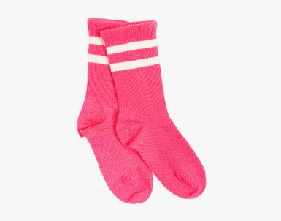
What’s in my bag?
socks

Slide 9
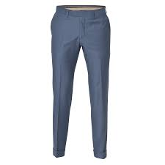
What’s in my bag?
trousers

Slide 10
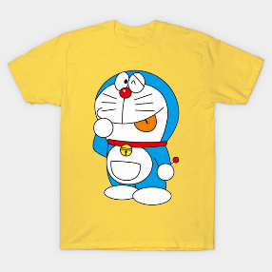
What’s in my bag?
T-shirt

Slide 11

tT
tT
tT
tT
tT
tT
tT
1.
There are
skirts
uniforms.
in
their
blue.
They
are
There are skirts in their uniforms. They are blue.
tT
tT
tT
tT
tT
2.
There aren’t
trousers
uniforms.
in
their
There aren’t trousers in their uniforms.
tT
tT
tT
tT
tT
white.
tT
tT
3.
There are
their
uniforms.
in
socks
They
are
There are socks in their uniforms. They are white.
tT
tT
tT
tT
tT
tT
tT
4.
There are
shoes
uniforms.
are
their
They
black.
in
There are shoes in their uniforms. They are black.
Notes:
THIẾT KẾ HOẠT ĐỘNG TƯƠNG TÁC CHO 4 CÂU NÀY

