Slide 2
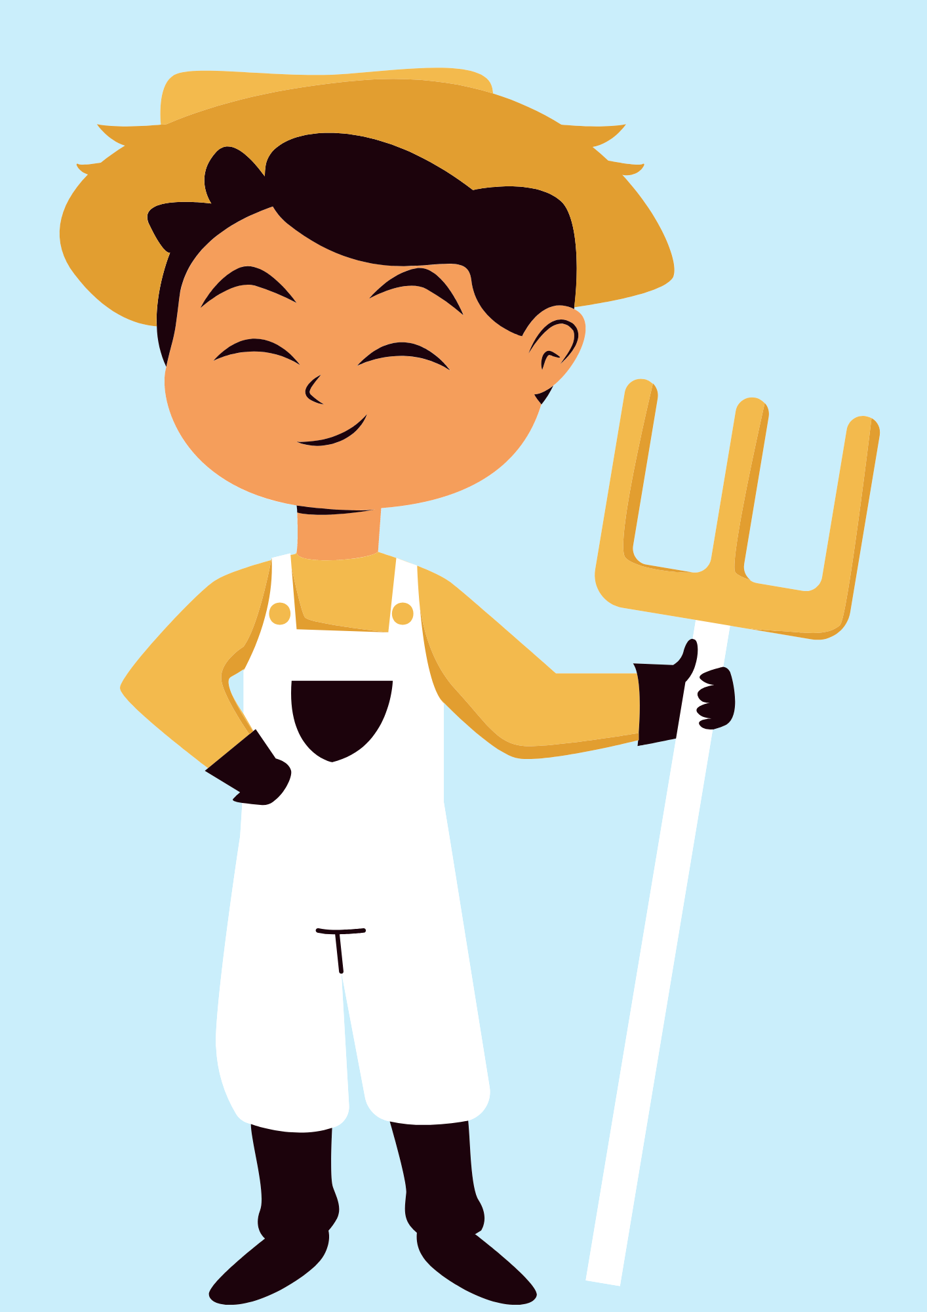
GUESS THE JOB!
a farmer

Slide 3
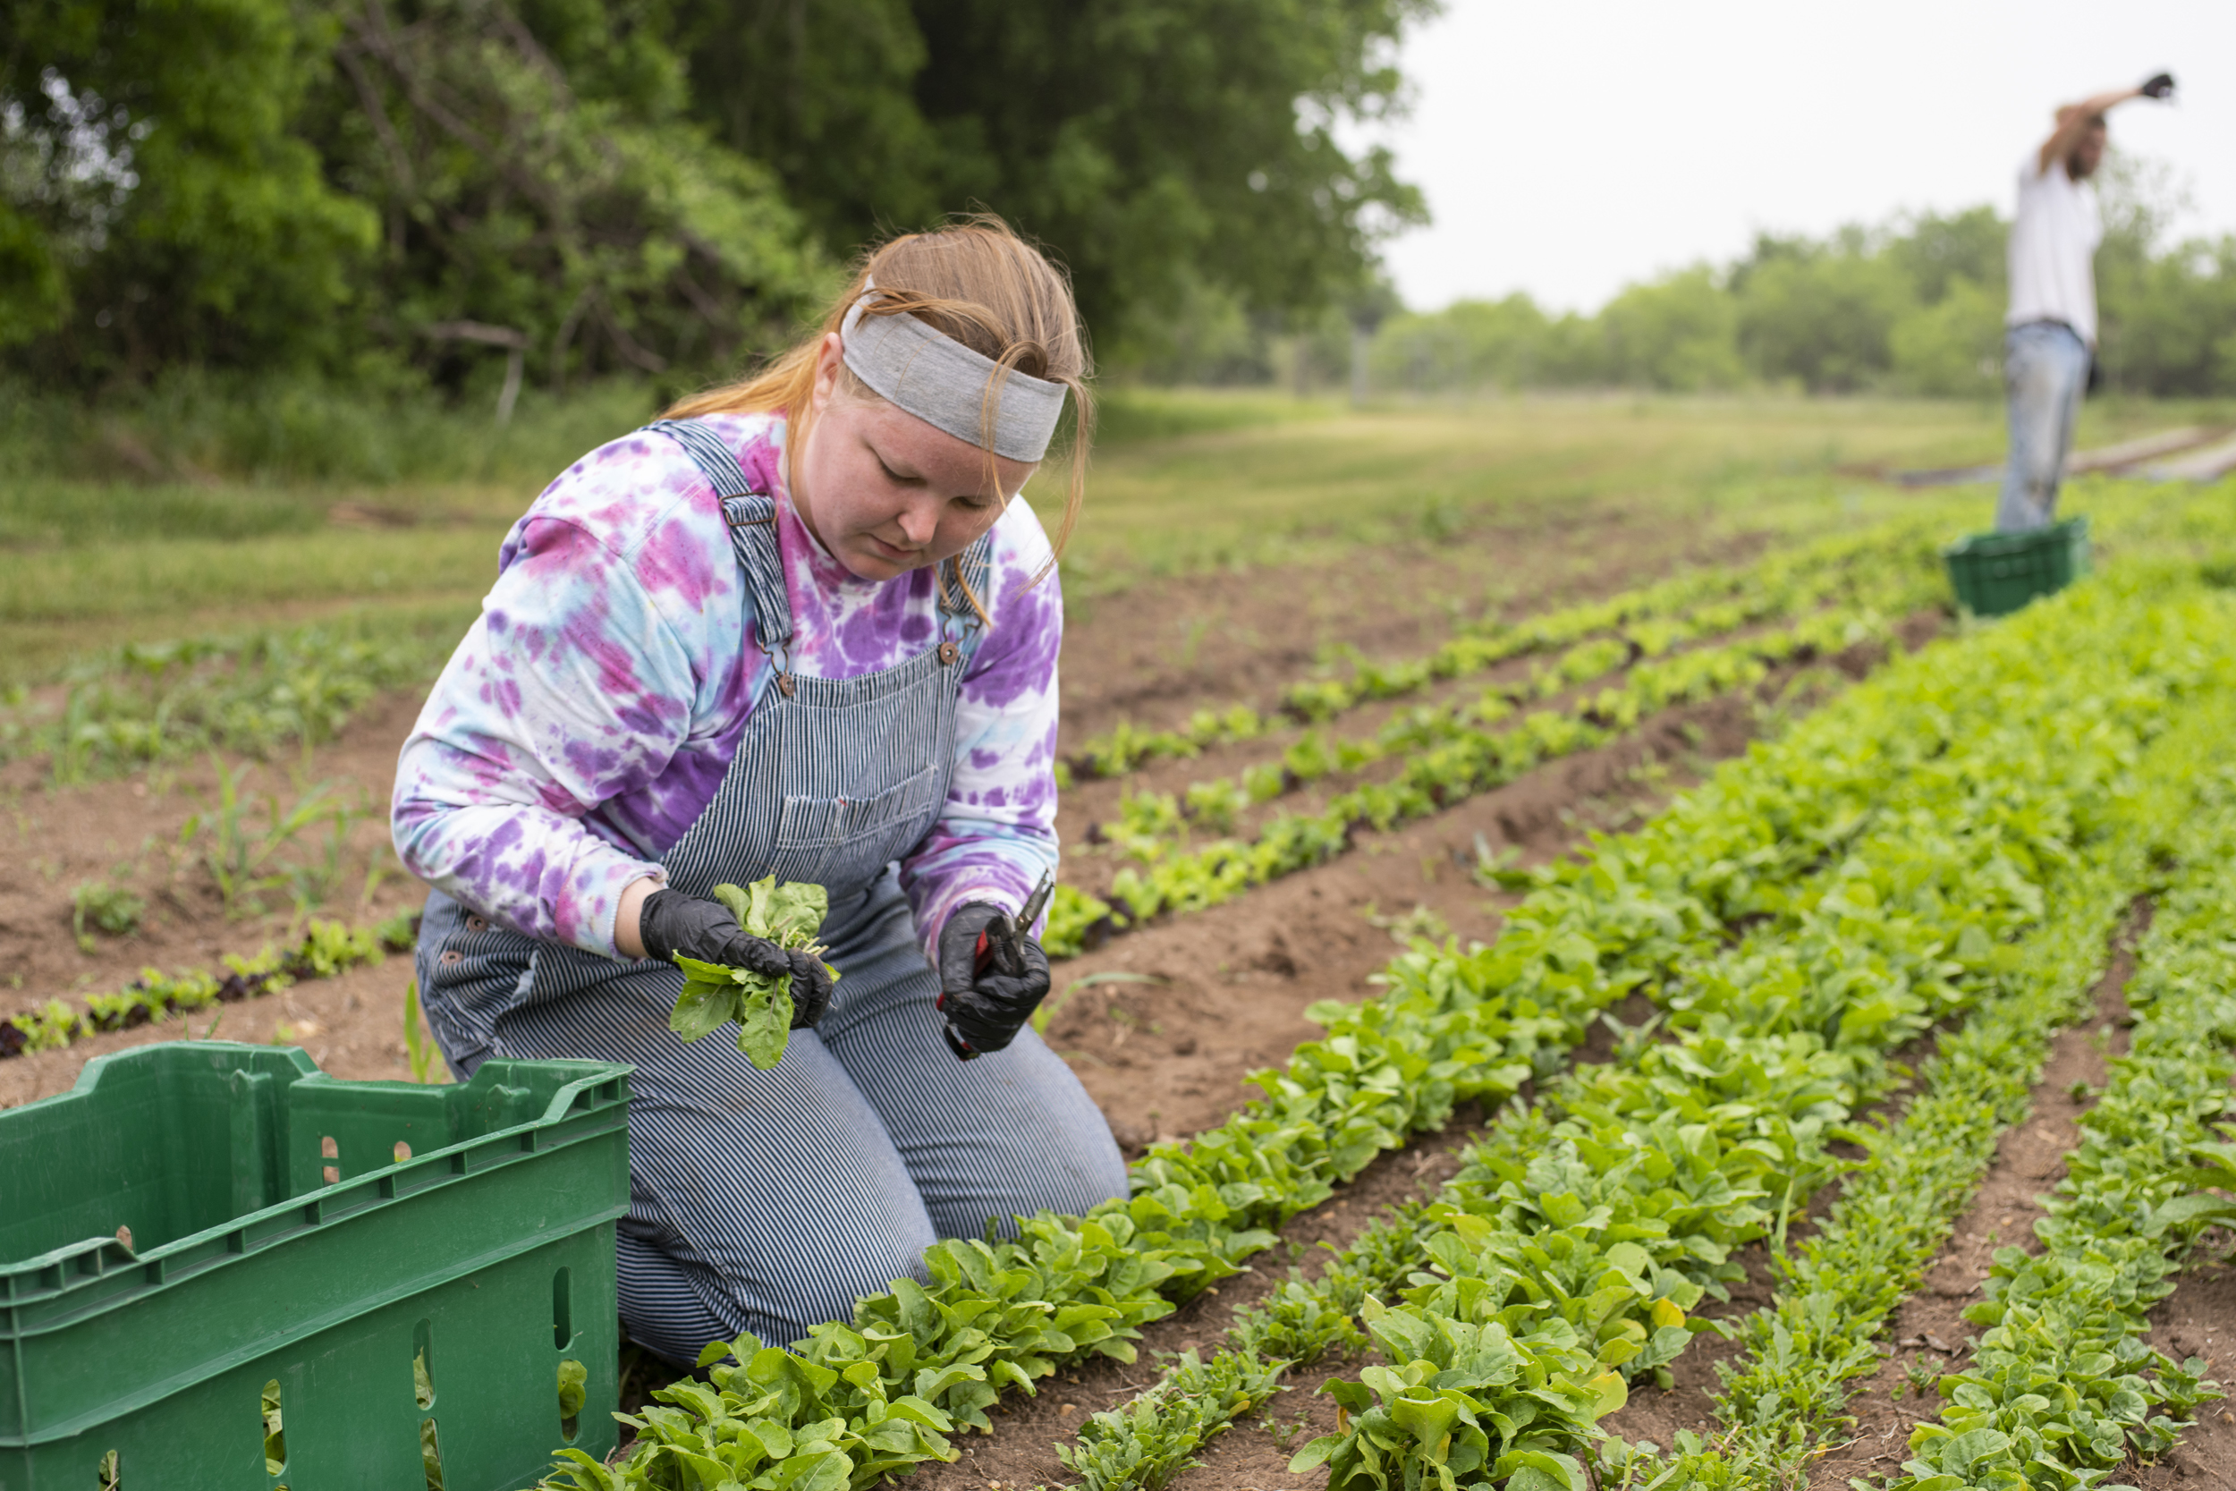
What does she do?
She’s a farmer.

Slide 4

GUESS THE JOB!
an office worker

Slide 5

What does she do?
She is an office worker.

Slide 6
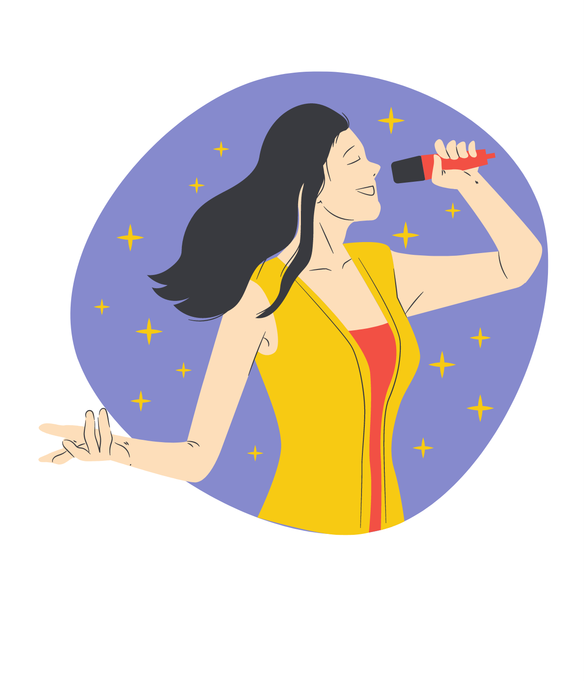
GUESS THE JOB!
a singer

Slide 7
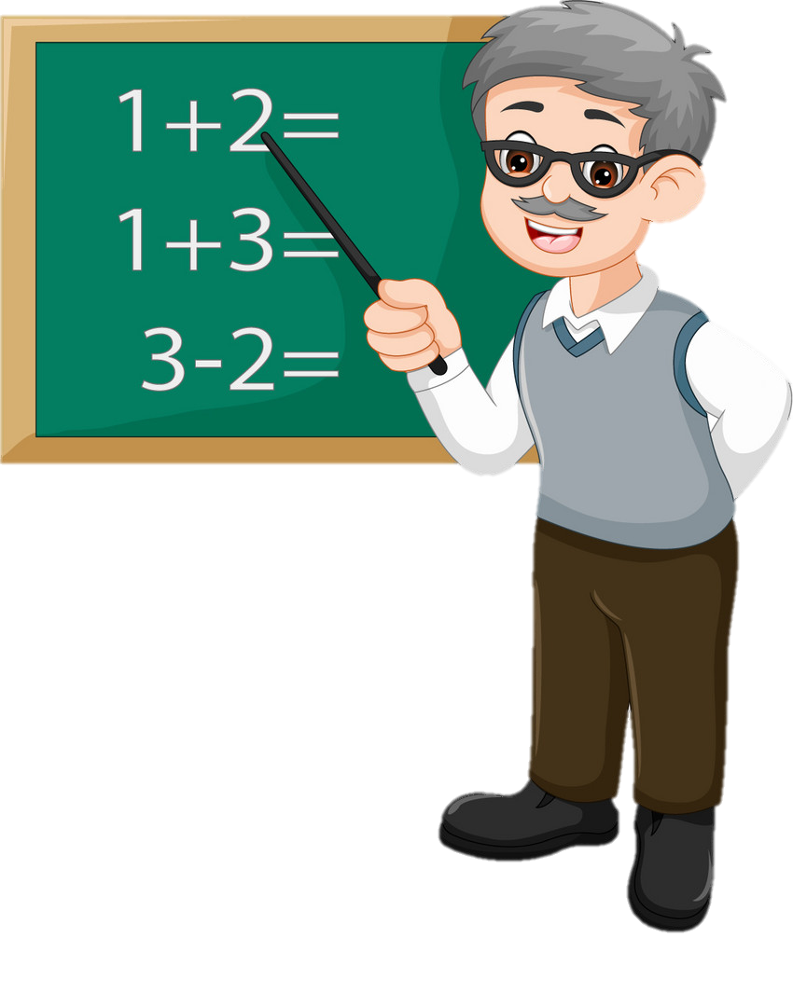
GUESS THE JOB!
a teacher

Slide 8

What does he do?
He is a teacher.

Slide 9

GUESS THE JOB!
a nurse

Slide 10
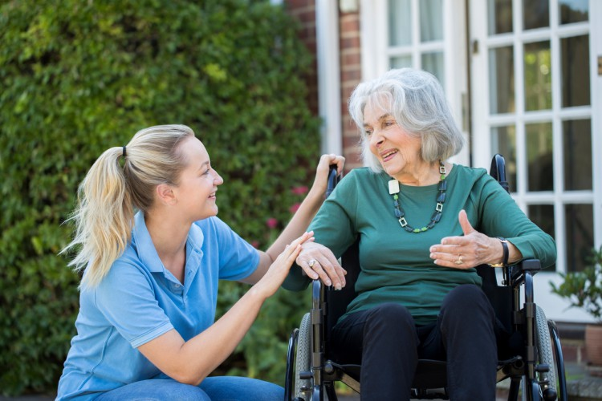
What does she do?
She is a nurse.

Slide 11
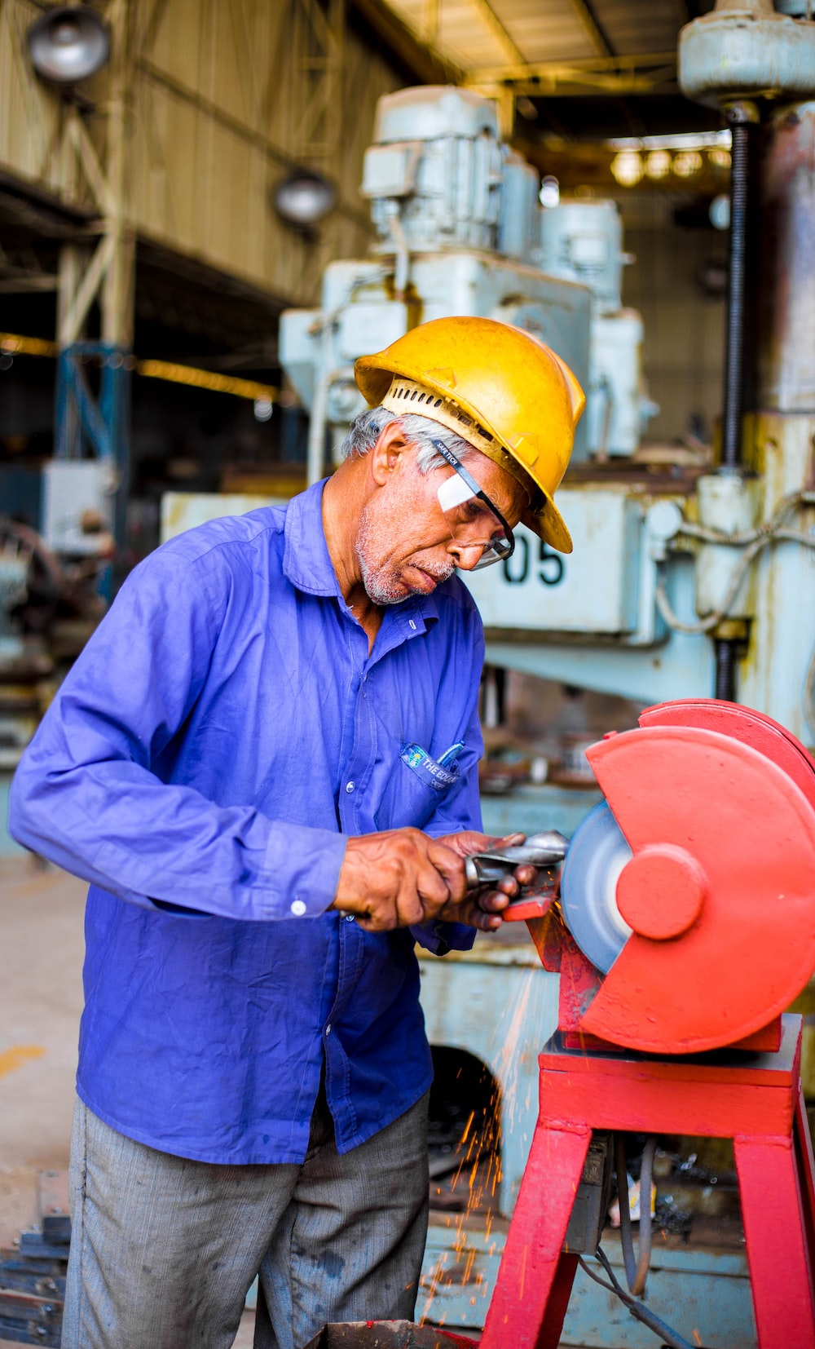
What does he do?
He’s a worker.

Slide 12
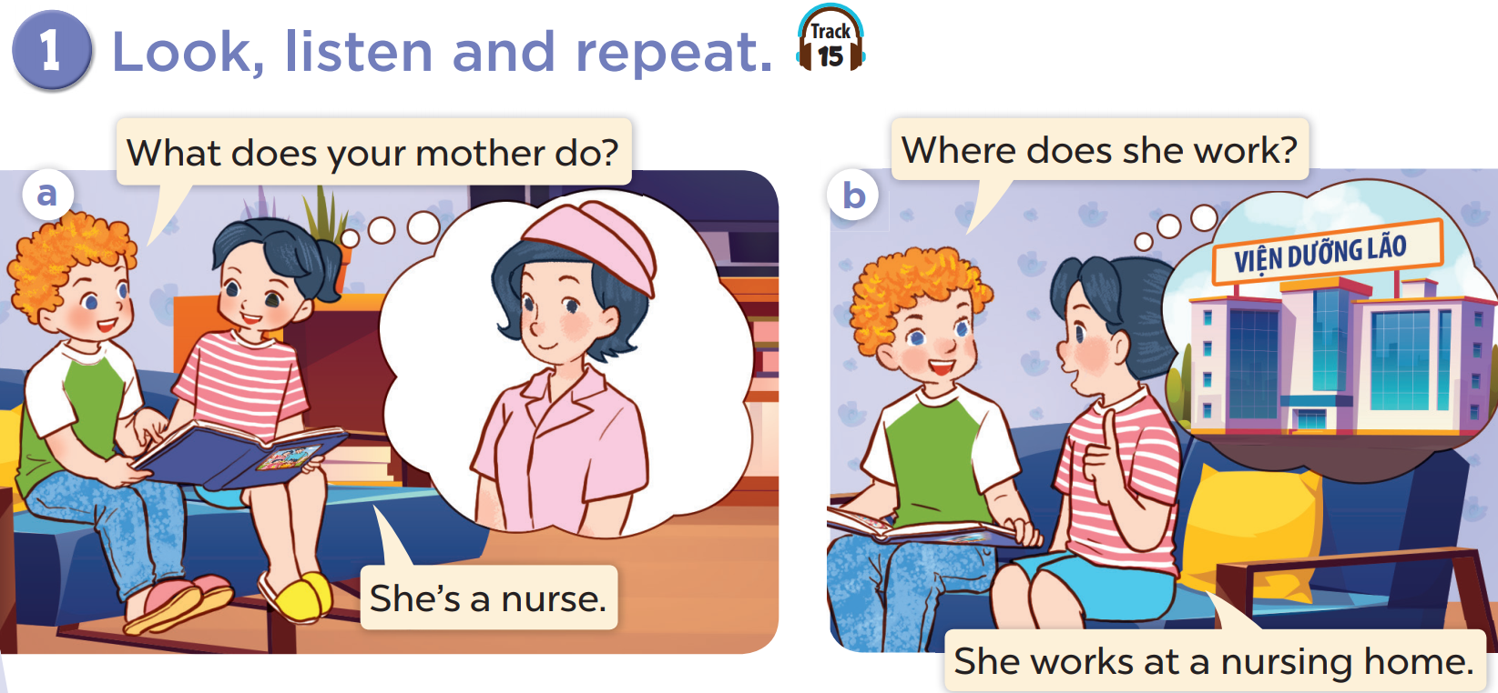


Slide 13

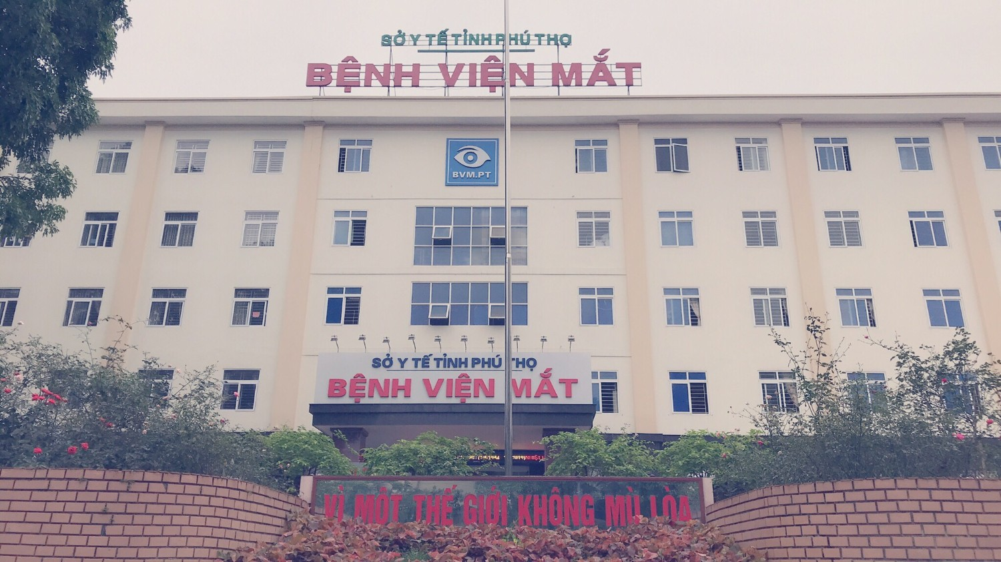

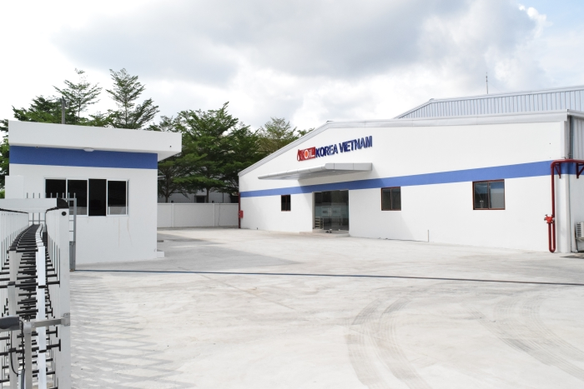
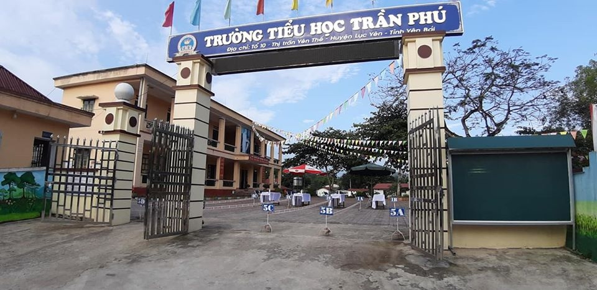
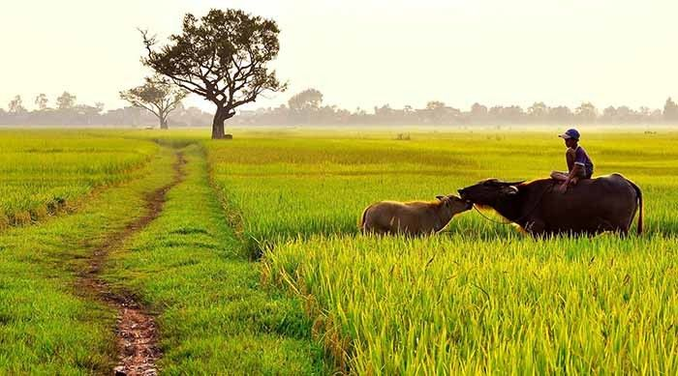
an office worker / In an Office
A doctor /
In a hospital
hospital
a nurse /
at a nursing home
Office
nursing home
A worker / In a factory
A farmer /
On a farm
A teacher /
At a school
farm
factory
school

Slide 14
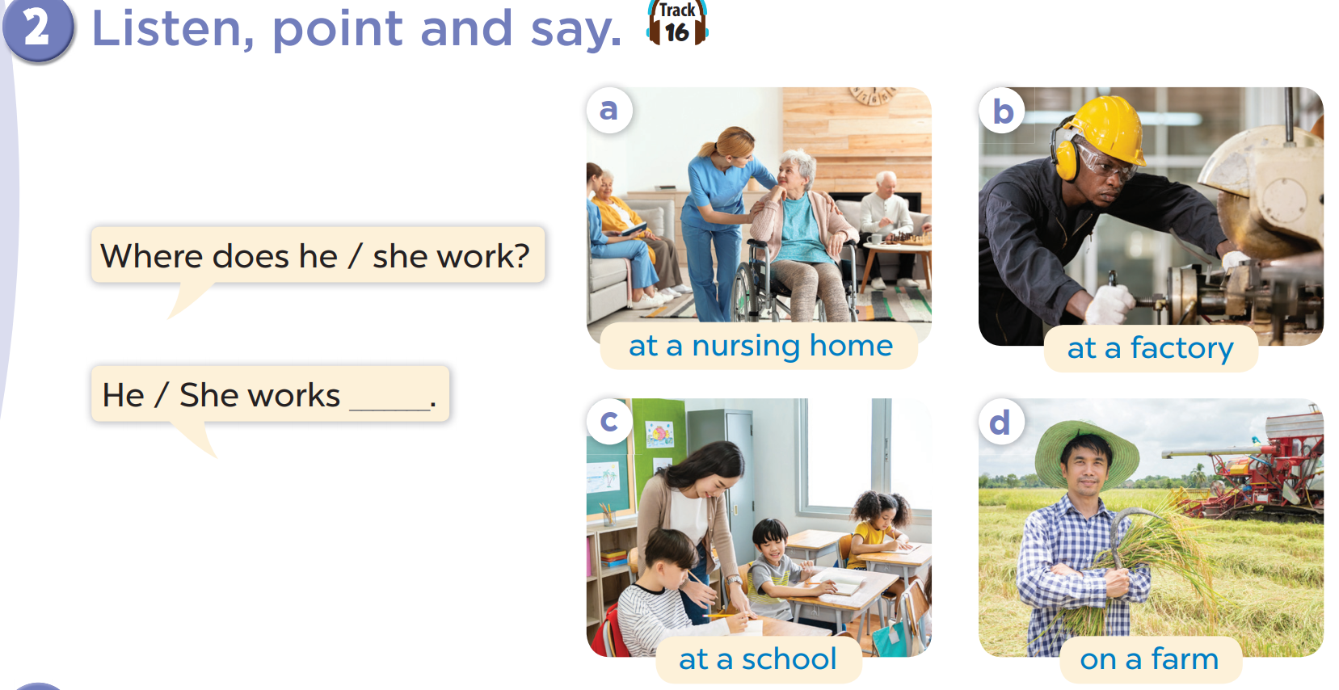

Slide 17
Where does she work?
She works at a nursing home.

Slide 18
Where does he work?
He works at a factory.

Slide 19
Where does he work?
He works at a school.

Slide 20
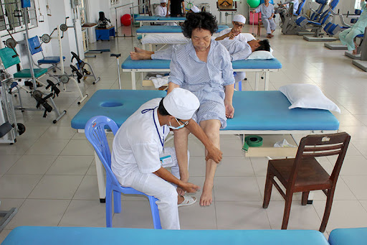
Where does he work?
He works in a hospital.

Slide 21
Where does she work?
She works in an office..

Slide 22
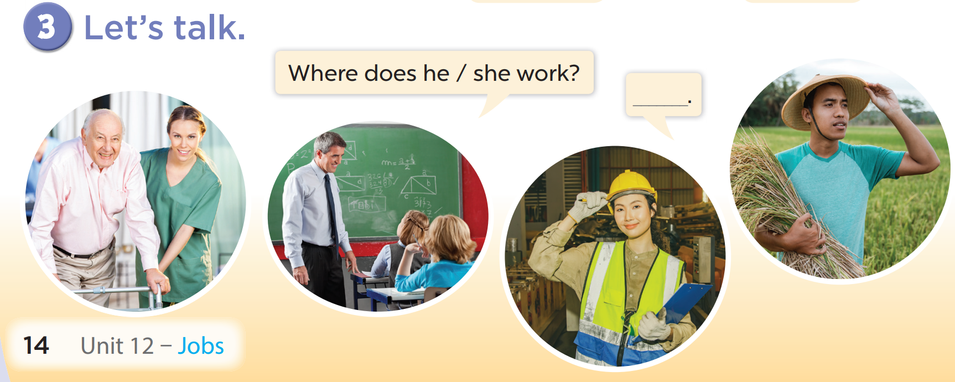

Slide 23
What does she do ?
She is a nurse.
Where does she work?
She works at a nursing home.

Slide 24
What does he do?
He’s a worker.
Where does he work?
He works at a factory.

Slide 25
What does he do?
He is a teacher.
Where does he work?
He works at a school.

Slide 26
What does he do?
He is a doctor.
Where does he work?
He works in a hospital.

Slide 27
What does she do?
She is an office worker.
Where does she work?
She works in an office..

Slide 28
What does she do?
She’s a farmer.
Where does she work?
She works on a farm.

Slide 29
What does your father do?
He’s a farmer.
Where does your father work?
He works on a farm.

Slide 30
What does your mother do ? ________ She’s a……..……
Where does your mother work ? ________ She works…..
an office worker / In an Office
A doctor /
In a hospital
hospital
a nurse /
at a nursing home
Office
nursing home
A worker / In a factory
A farmer /
On a farm
A teacher /
At a school
farm
factory
school

