Slide 1
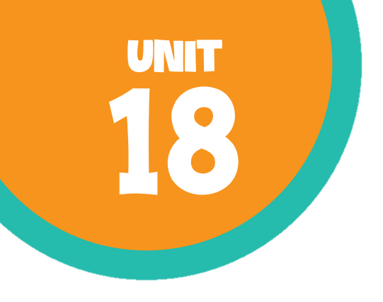
At the shopping centre Lesson 3 - Period 5

Slide 2
Table of contents
01
Warm-up and review
02
Listen and repeat.
03
04
Listen and circle.
Let’s chant.

Slide 3
Gift shop
Sports shop
Shoe
shop
Clothes shop
Bookshop
Bakery
Supermarket
Food shop
Look and remember.

Slide 4
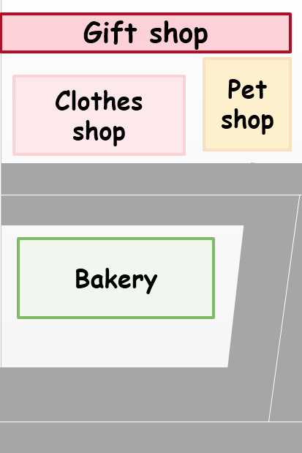

The clothes shop is …………….. the bakery.
A. opposite
B. behind
C. between
D. near

Slide 5
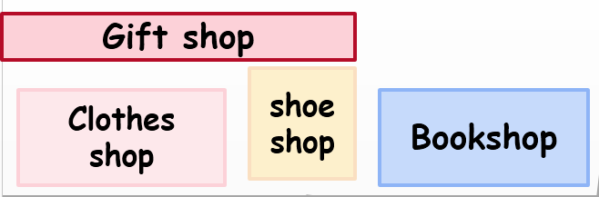
The gift shop is …………….. the clothes shop and the shoe shop.
A. opposite
B. behind
C. between
D. near

Slide 6
The shoe shop is …………….. the clothes shop and the bookshop.
A. opposite
B. behind
C. between
D. near

Slide 7
The bookshop is …………….. the shoe shop.
A. opposite
B. behind
C. between
D. near

Slide 8

Listen and clap. Which syllable is stressed?

Slide 9


campsite
‘campsite

Slide 10
shopping
‘shopping

Slide 11
‘bookshop
bookshop

Slide 12
centre
‘centre

Slide 13
be’hind
behind

Slide 14
between
be’tween

Slide 15
The stress is on the second syllable
be’hind
be’tween

Slide 16
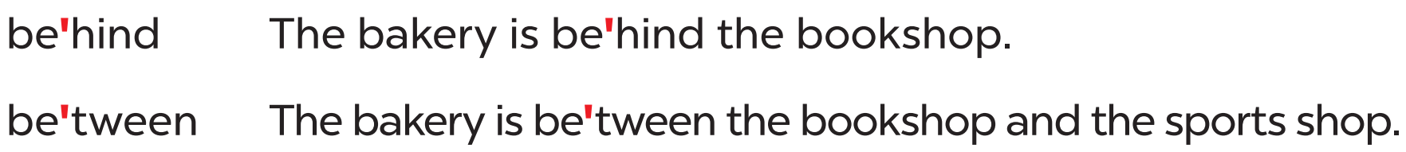
Listen and repeat.

Slide 17
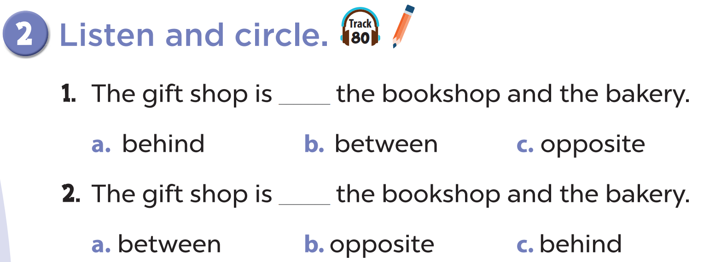

Listen and circle.
Look and read.

Slide 18


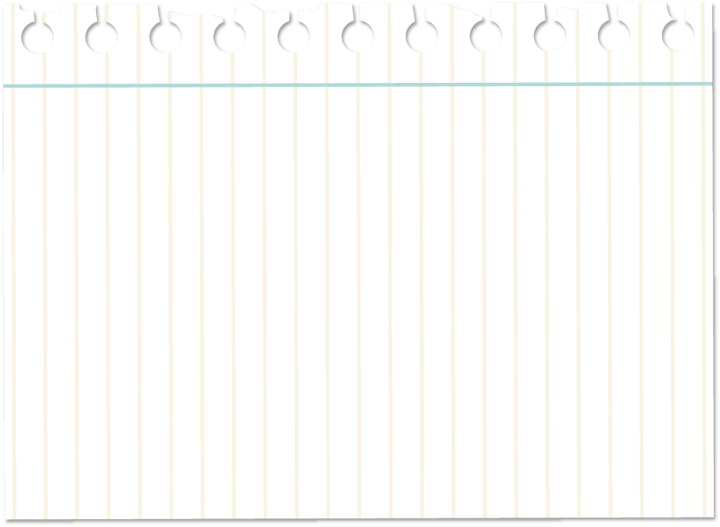
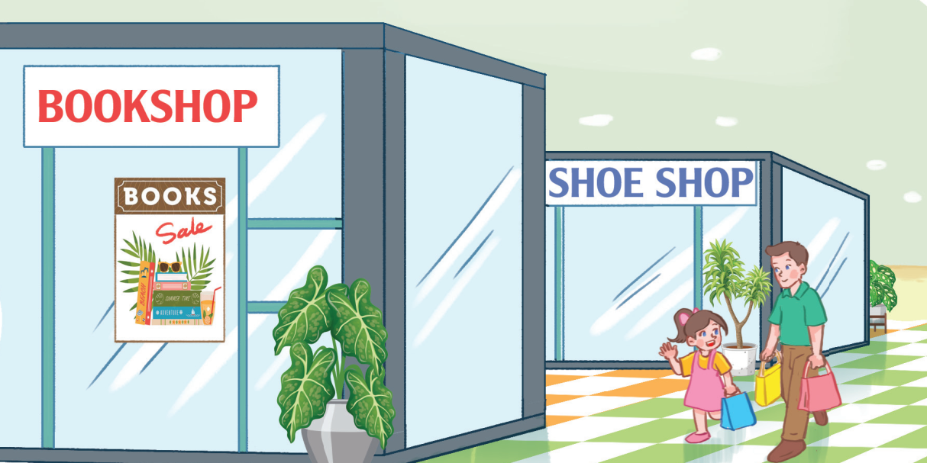
Where is the shoe shop?
It’s behind the bookshop.

Slide 19
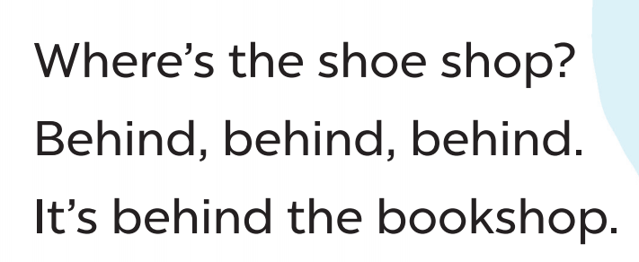

Clap and chant
Listen and repeat
Look and read

Slide 20
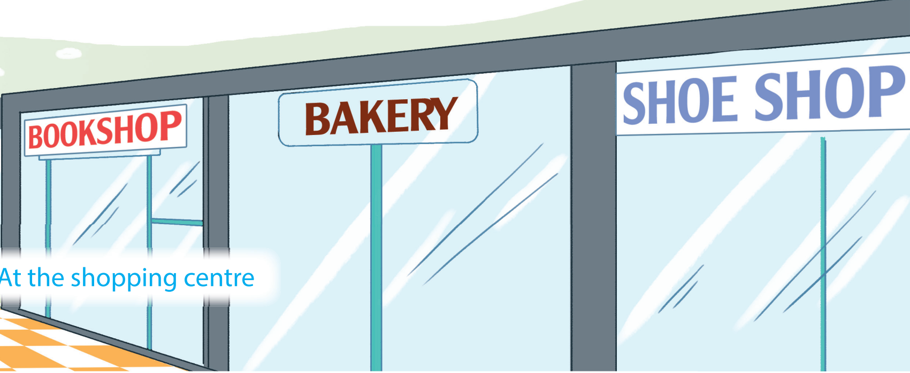
Where is the bakery?
It’s between the bookshop and the shoe shop.

Slide 21
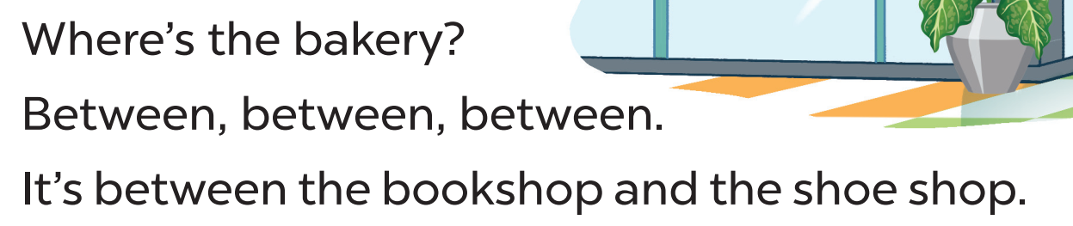
Clap and chant
Listen and repeat
Look and read

Slide 22
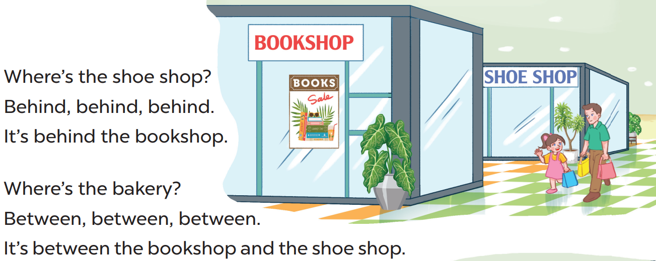
Let’s chant!

