Slide 1



19
The animal world
LESSON 2 - PERIOD 3

Slide 2
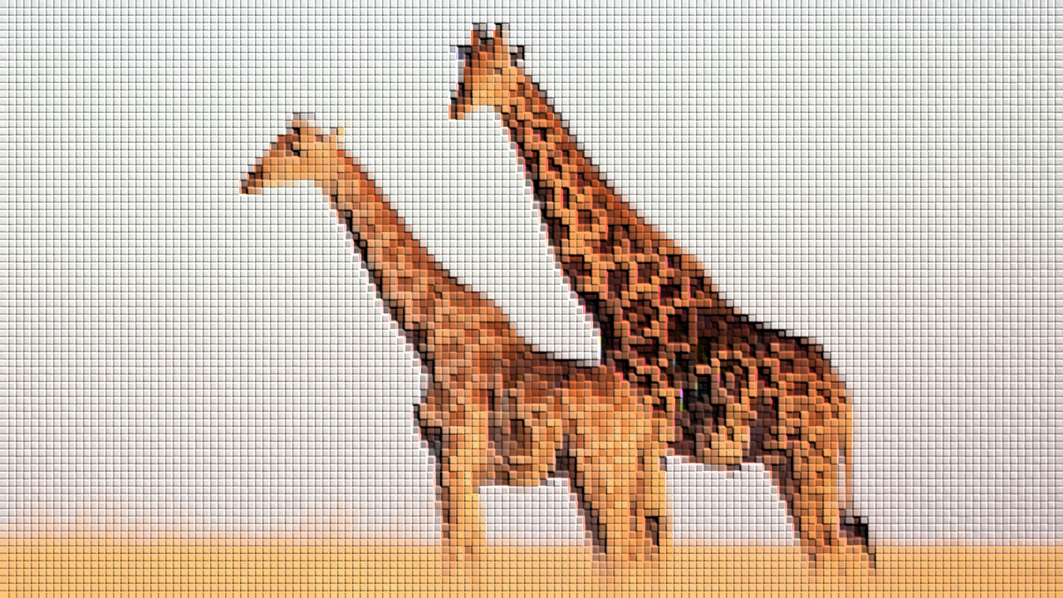
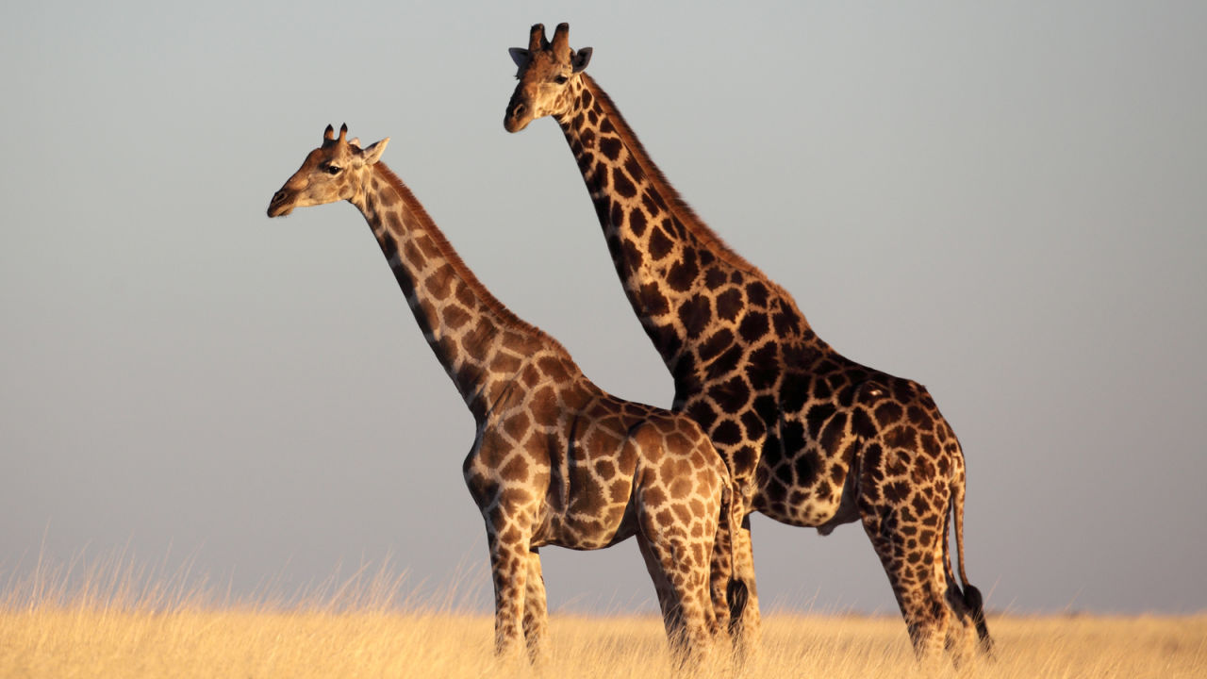
giraffes

Slide 3
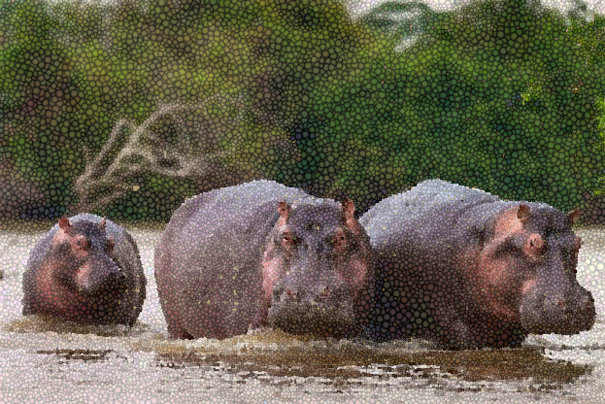
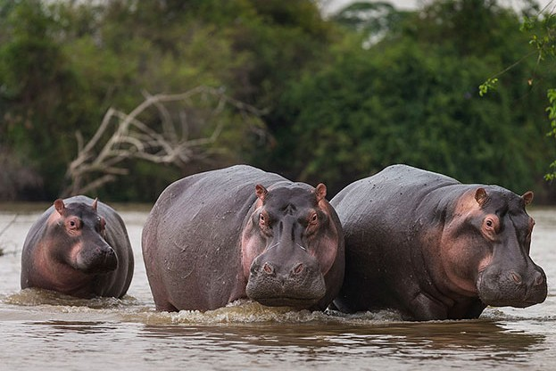
hippos

Slide 4
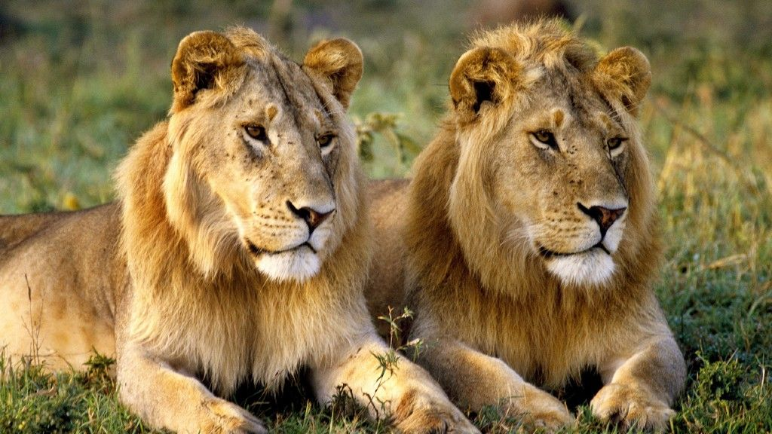
lions

Slide 5
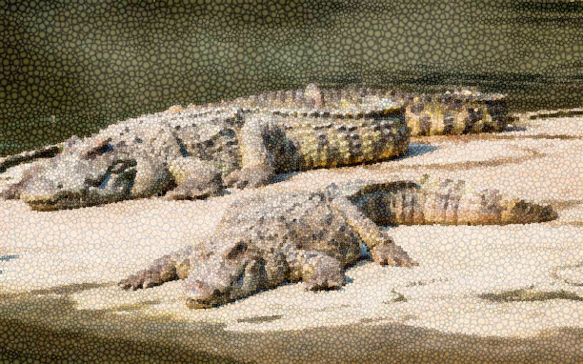
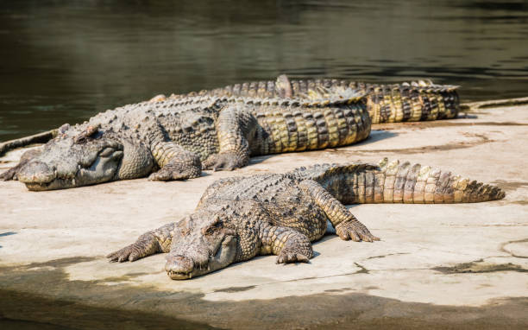
crocodiles

Slide 6
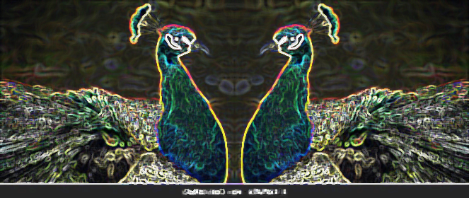
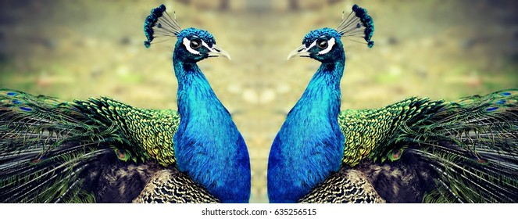
peacocks

Slide 7
Look, listen and repeat.
2

Slide 8

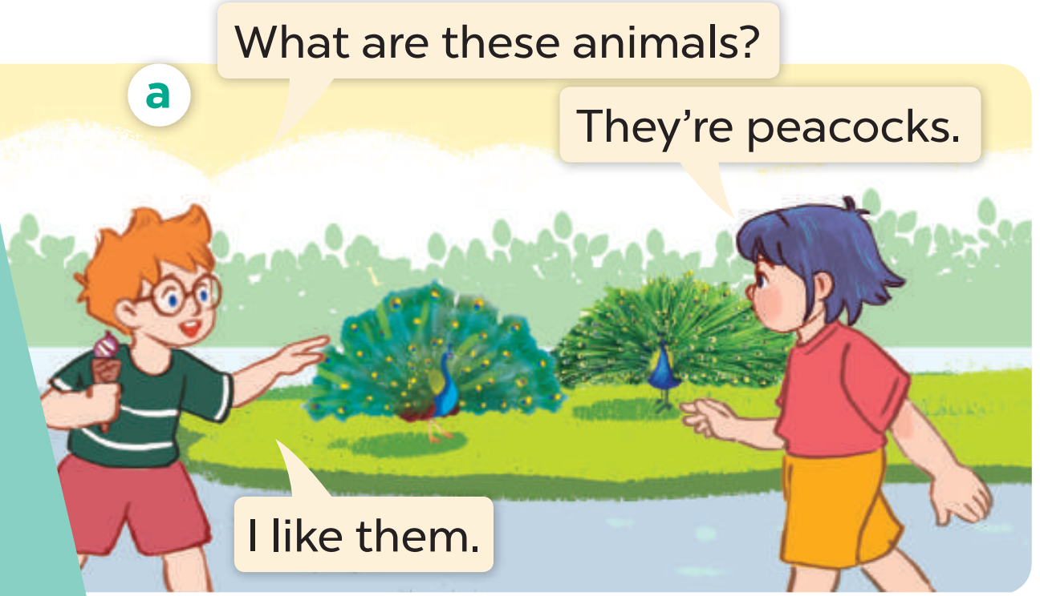
Look, listen and repeat.

Slide 9
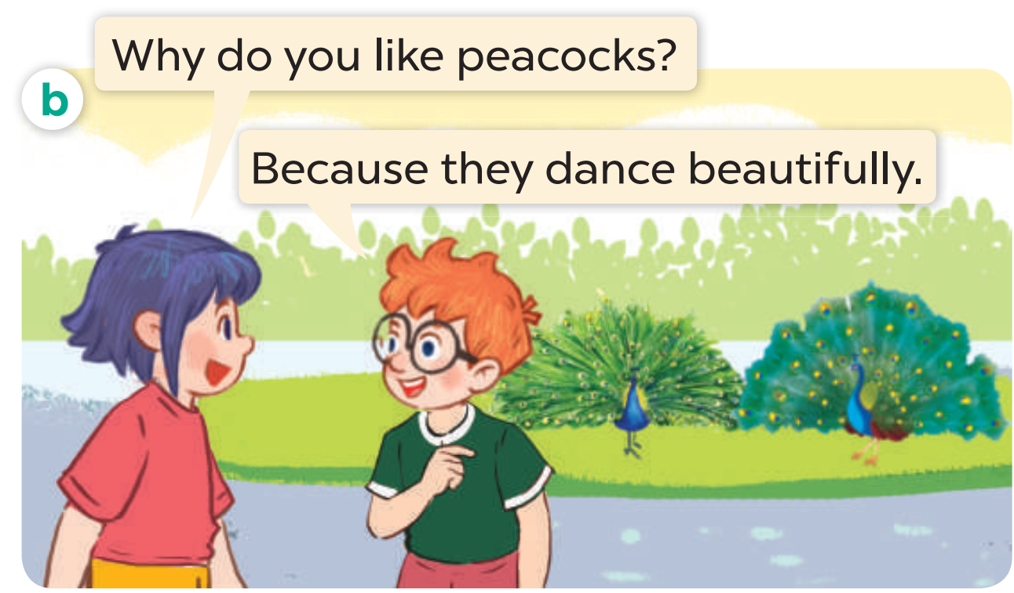
Look, listen and repeat.

Slide 10
Look, listen and repeat.

Slide 11
Listen, point and say.
3

Slide 12
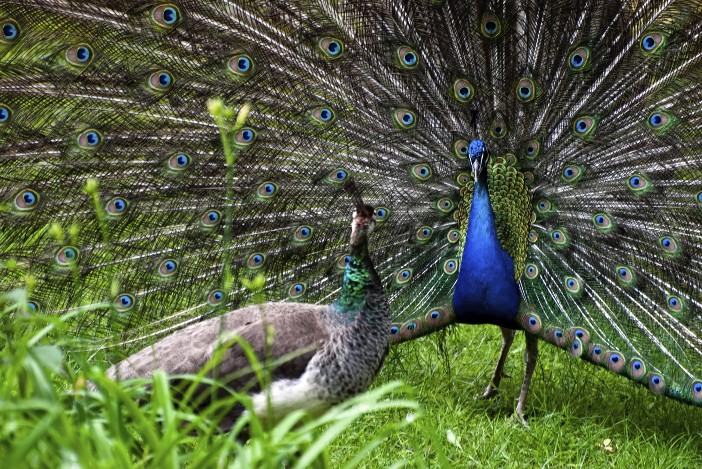
dance beautifully

Slide 13
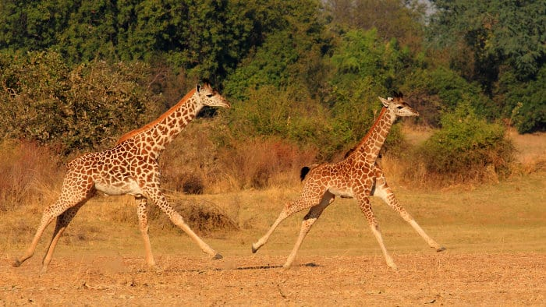
run quickly

Slide 14
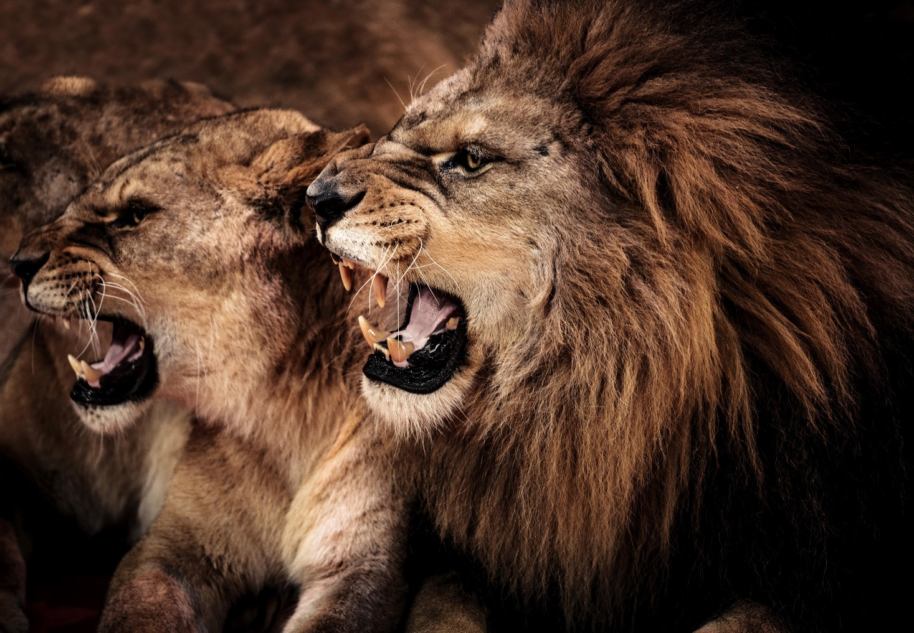
roar loudly

Slide 15
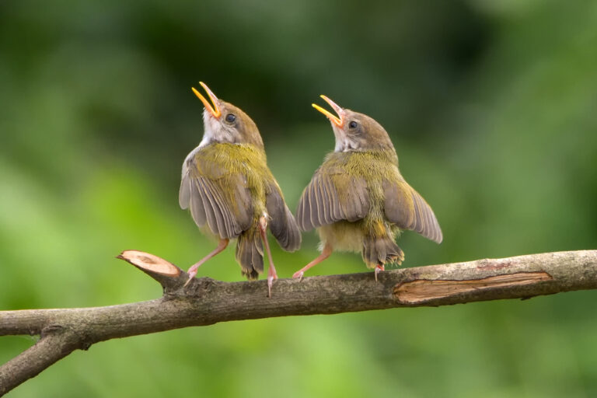
sing merrily

Slide 16
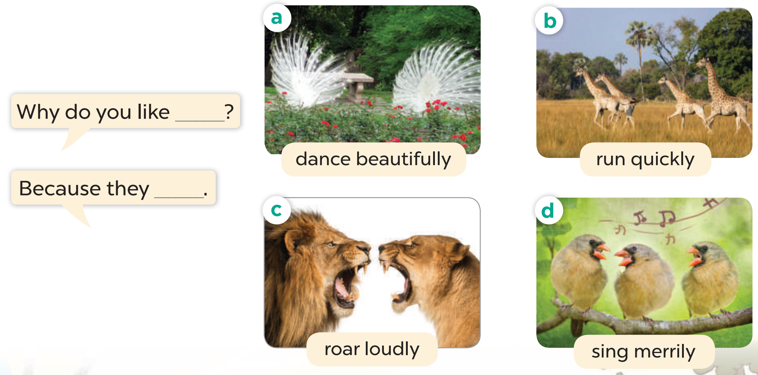
Listen, point and say.

Slide 17
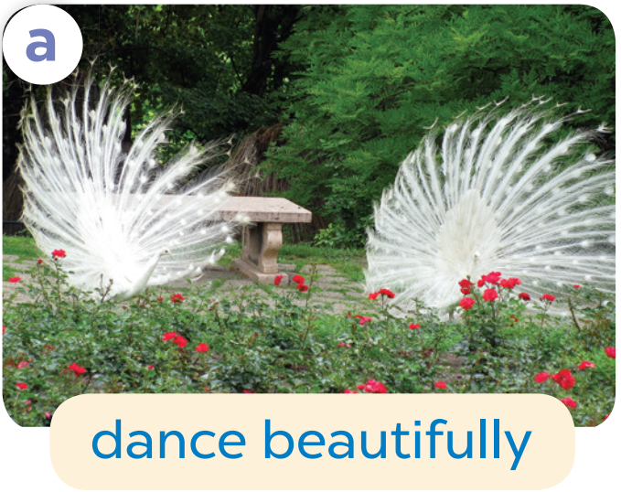
Why do you like ______?
Because they________.

Slide 18
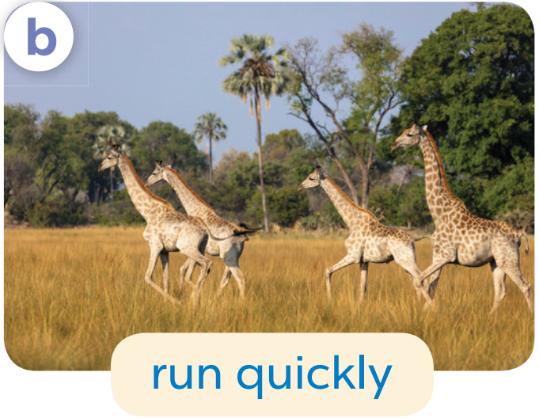
Why do you like ______?
Because they________.

Slide 19
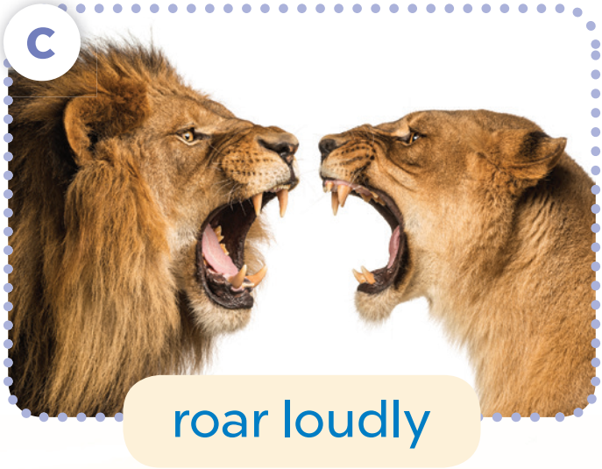
Why do you like ______?
Because they________.

Slide 20
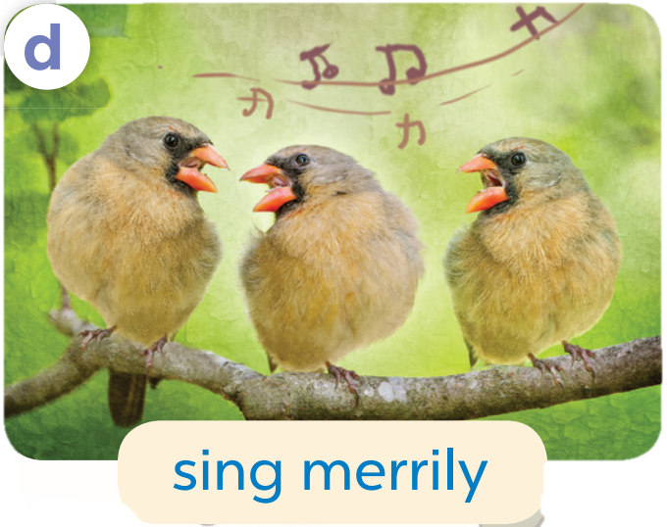
Why do you like ______?
Because they________.

Slide 21
4
Let’s talk.

Slide 22
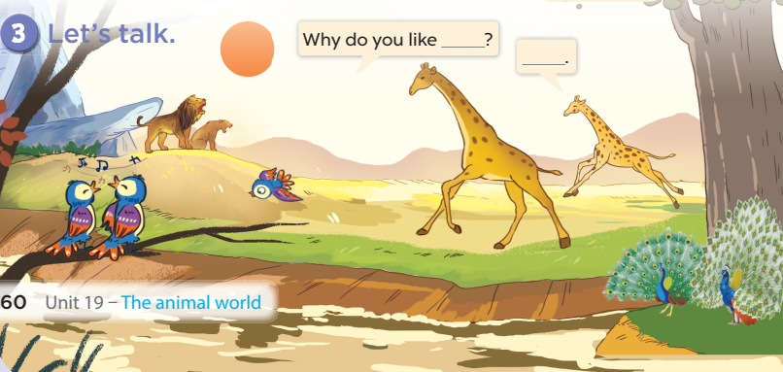

Slide 23
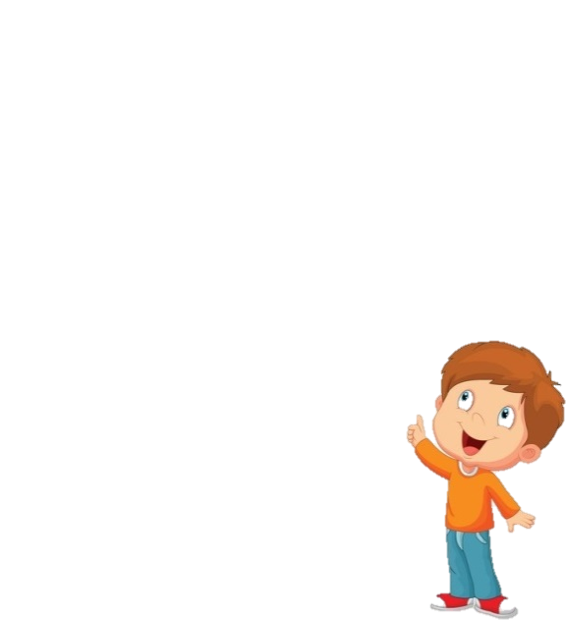

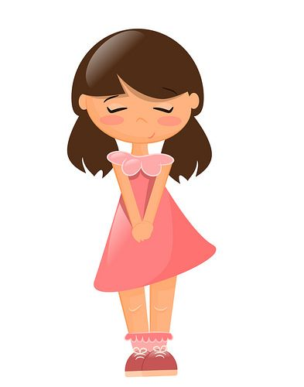
What are these animals?
They’re peacocks.

Slide 24
Why do you like peacocks?
Because they dance beautifully.

Slide 25

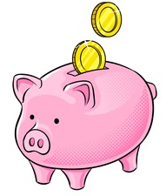
Piggy Bank

Slide 26
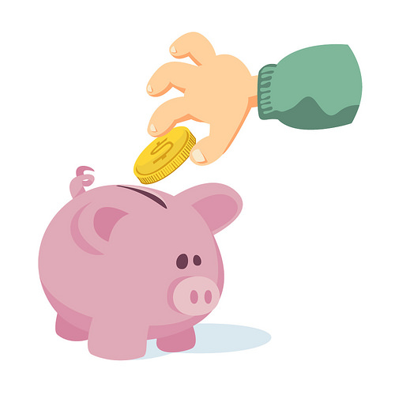


TEAM 1
TEAM 2
TEAM 3
Notes:
Click the piggy bank to show questions.
Click team names to give pupils the number of coins they get for each correct answer.

Slide 27
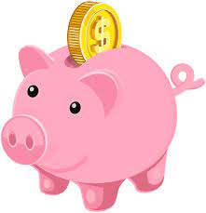
Choose the pig!
1
2
3
4
5
6
7
8

Slide 28
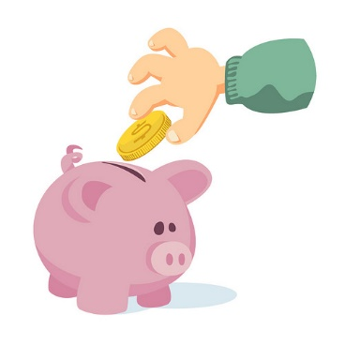
What are these animals?
They’re peacocks.

Slide 29
Why do you like peacocks?
Because they dance beautifully.

Slide 30
What are these animals?
They’re giraffes.

Slide 31
Why do you like giraffes?
Because they run quickly.

Slide 32

What are these animals?
They’re lions.

Slide 33
Why do you like lions?
Because they roar loudly.

Slide 34
What are these animals?
They’re birds.

Slide 35
Why do you like birds?
Because they sing merrily.

