Slide 1







Unit
6. Listen and repeat.
7. Let’s talk.
8. Let’s sing.

Slide 2

Warm-up

Slide 3


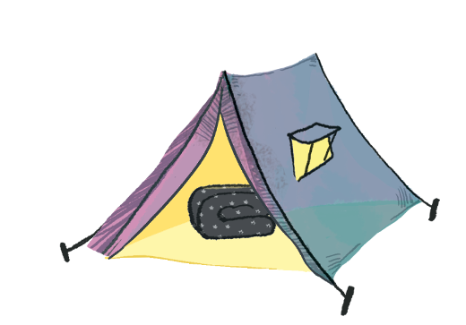

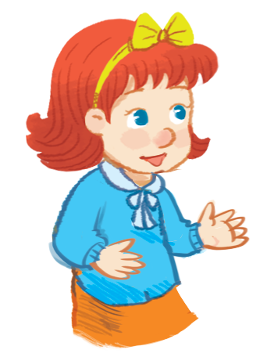
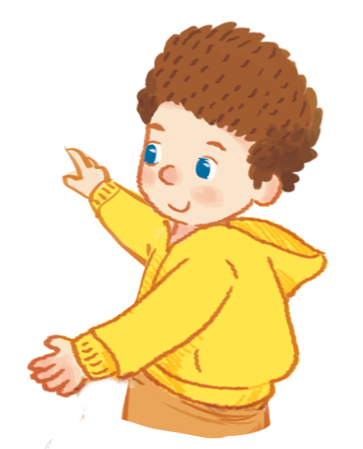
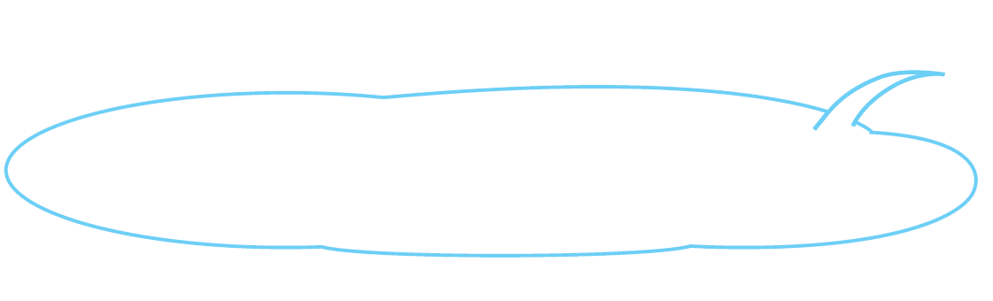
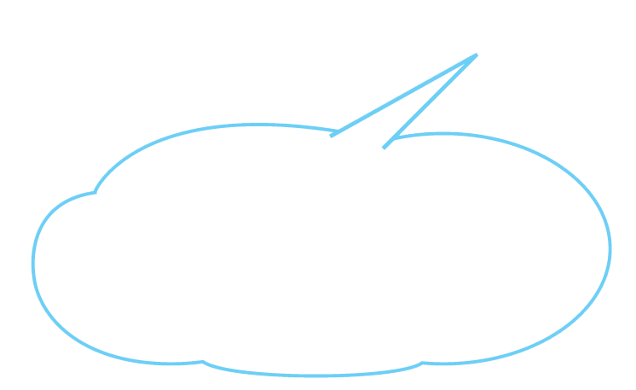
Listen and repeat.
Is the blanket near the tent?
Is the blanket near the tent?
Is the blanket near the tent?
Is the blanket near the tent?
No, it isn’t.
It’s in the tent.
No, it isn’t.
It’s in the tent.
No, it isn’t.
It’s in the tent.
No, it isn’t.
It’s in the tent.

Slide 4



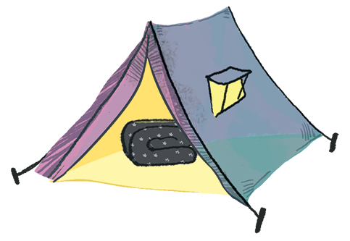
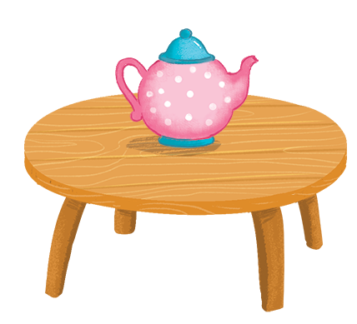
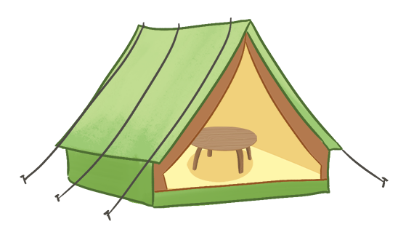
Let’s talk.
The is .
The are .
a
b
c

Slide 5
The is .
The are .
a

Slide 6
The is .
The are .
b

Slide 7
The is .
The are .
c

Slide 8
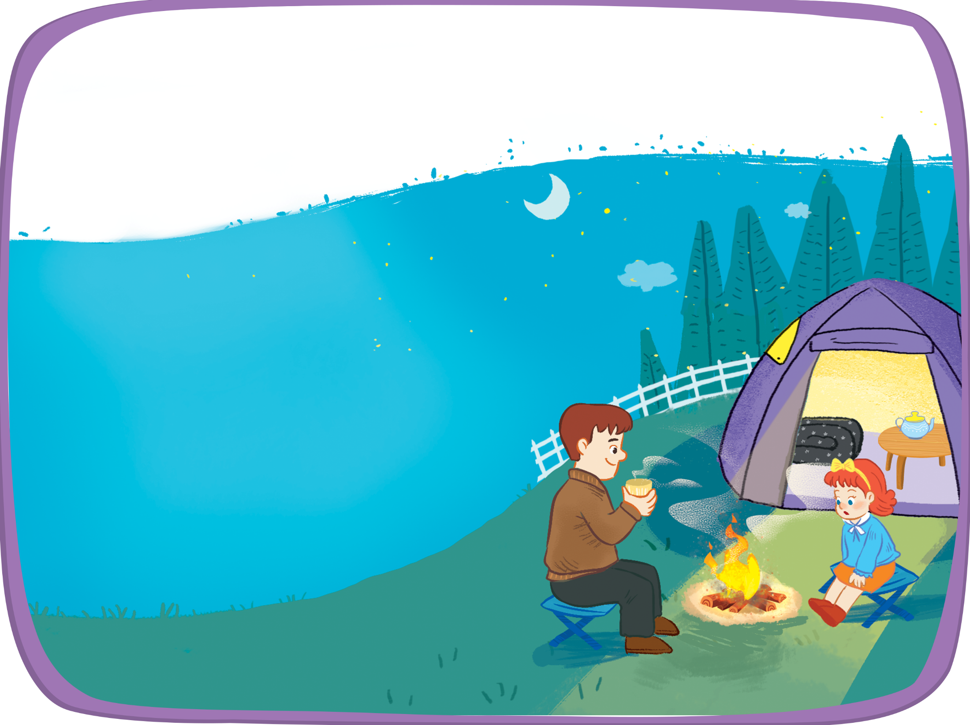


Let’s sing!
Is the blanket near the tent?
Is the blanket near the tent?
Is the blanket near the tent?
Is the blanket near the tent?
No, it isn’t. It’s in the tent.
No, it isn’t. It’s in the tent.
No, it isn’t. It’s in the tent.
No, it isn’t. It’s in the tent.
Is the table near the tent?
Is the table near the tent?
Is the table near the tent?
Is the table near the tent?
No, it isn’t. It’s in the tent.
No, it isn’t. It’s in the tent.
No, it isn’t. It’s in the tent.
No, it isn’t. It’s in the tent.
Is the teapot near the table?
Is the teapot near the table?
Is the teapot near the table?
Is the teapot near the table?
No, it isn’t. It’s on the table.
No, it isn’t. It’s on the table.
No, it isn’t. It’s on the table.
No, it isn’t. It’s on the table.

