Slide 1
MINDMAP
ENGLISH GRADE 5

Slide 2
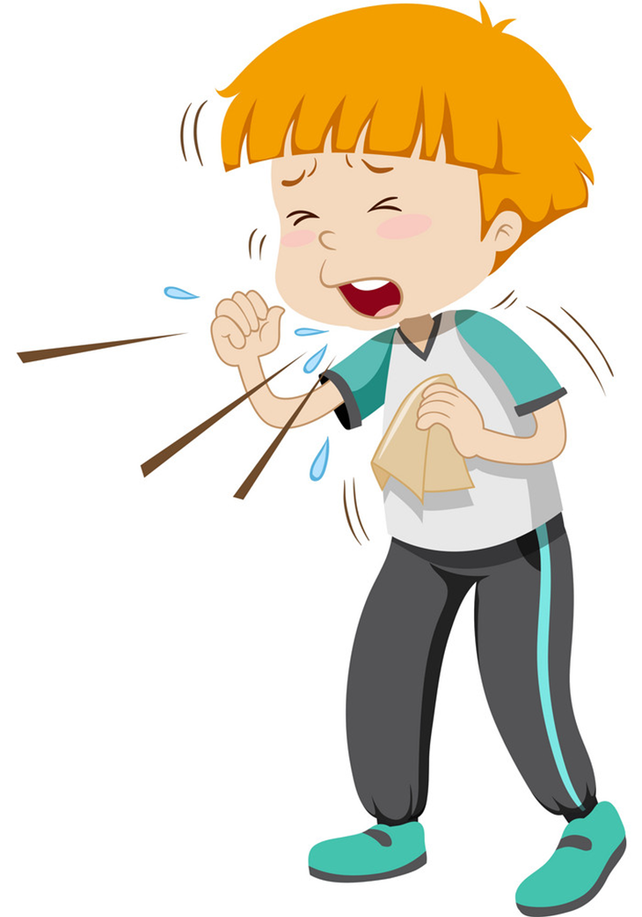
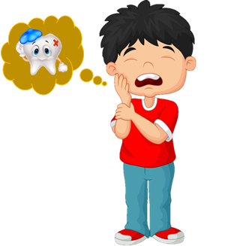
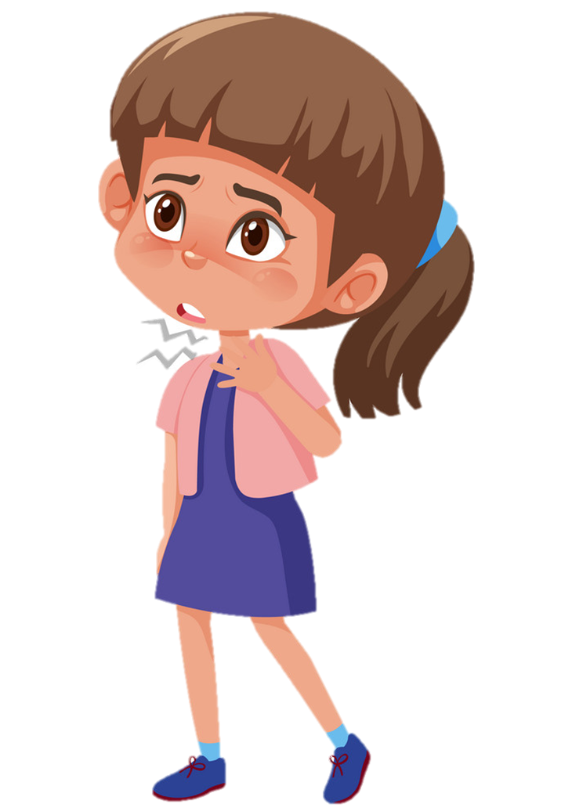
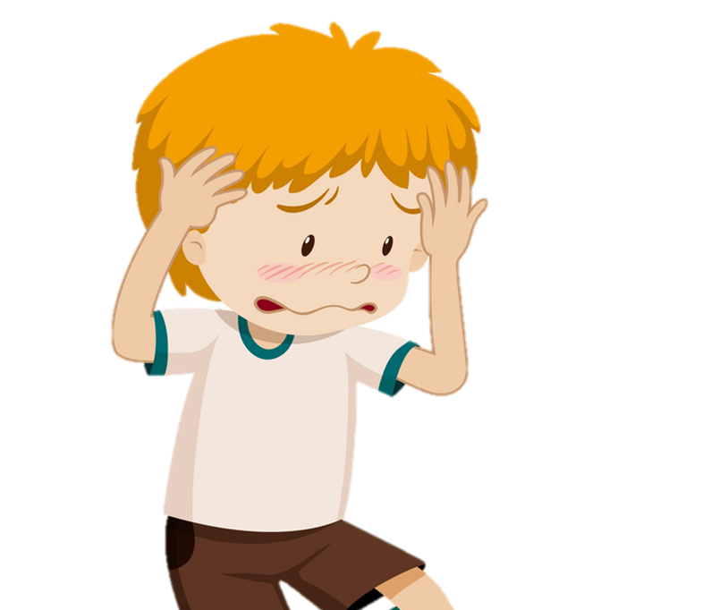
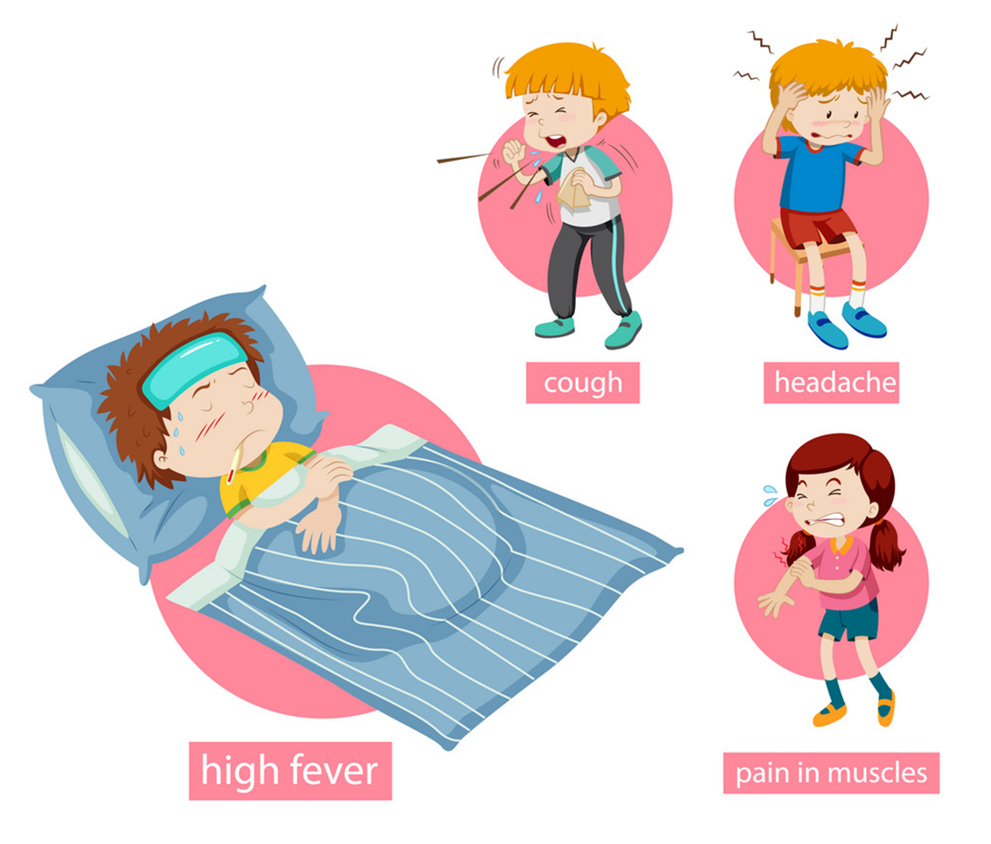
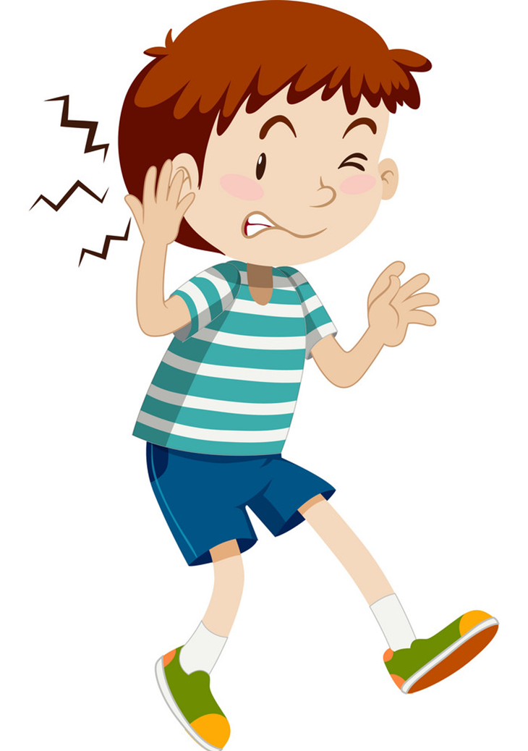
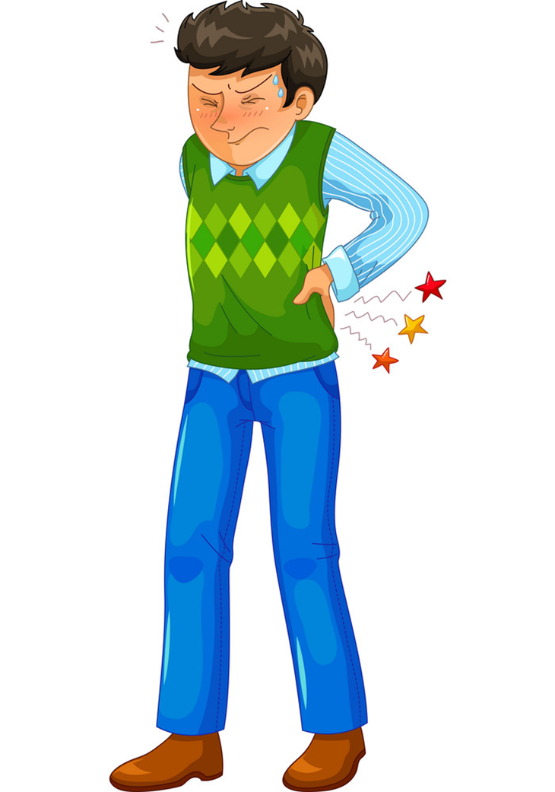
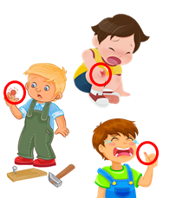
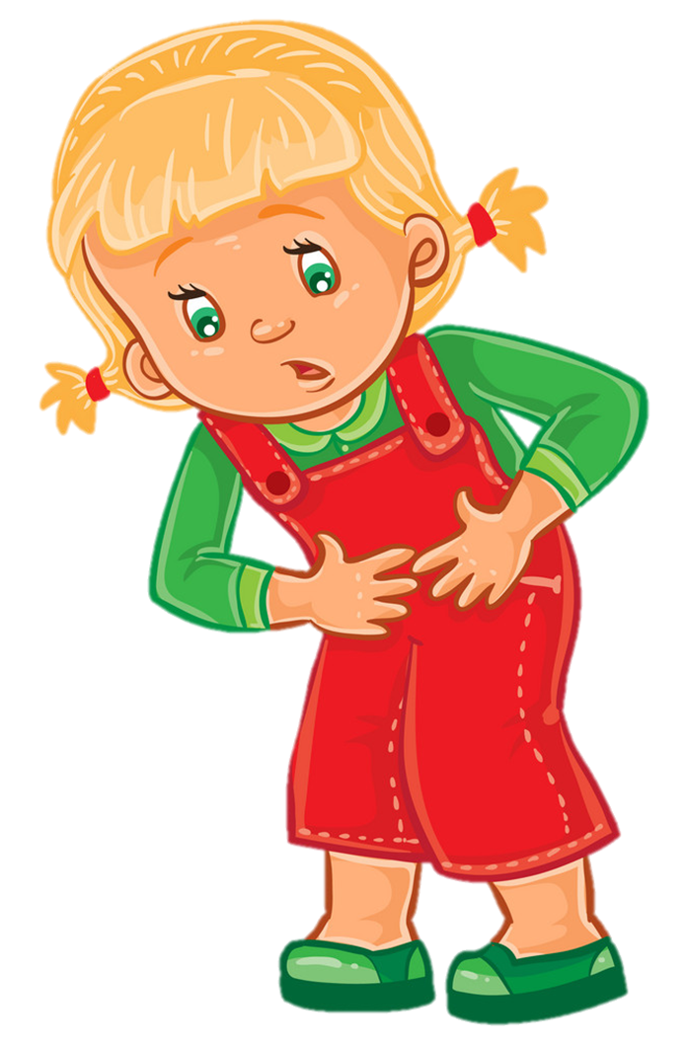
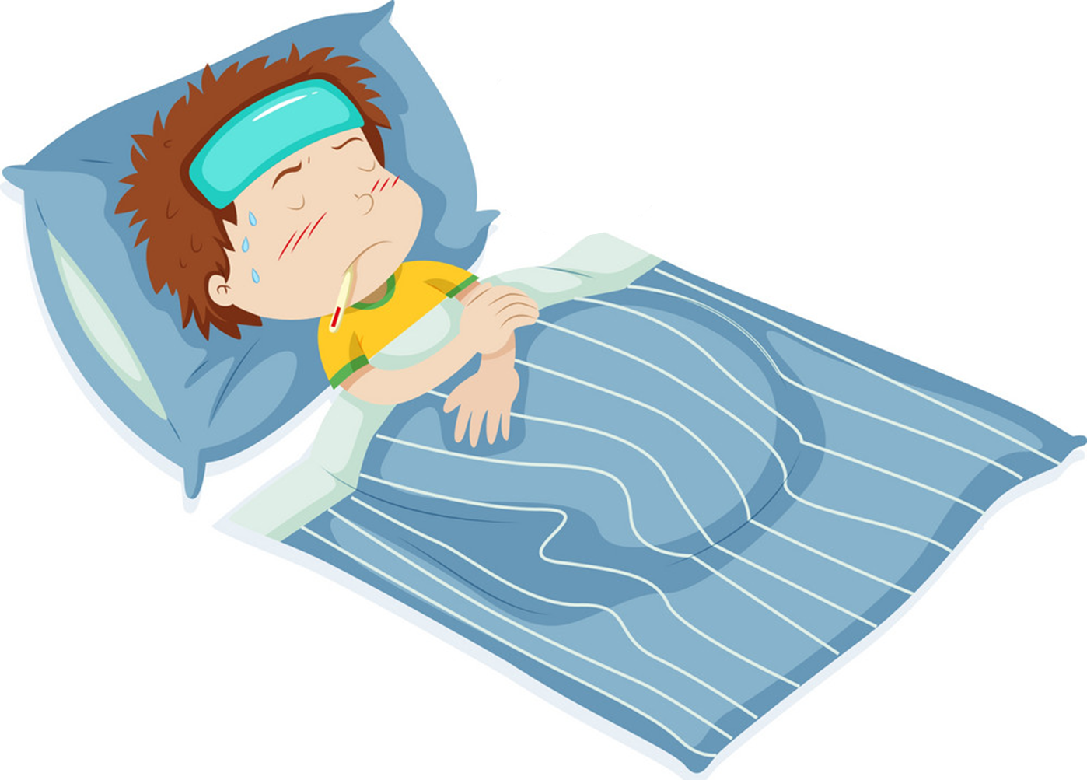
Temperature
/ˈtemprətʃər/
Unit 11
cough
toothache
sore throat
headache
flu
What's the matter with you?
I have a/an ______________.
earache
backache
pain
stomach ache
fever
Ms.Phạm English
Earache
/ˈɪəreɪk/

Slide 3
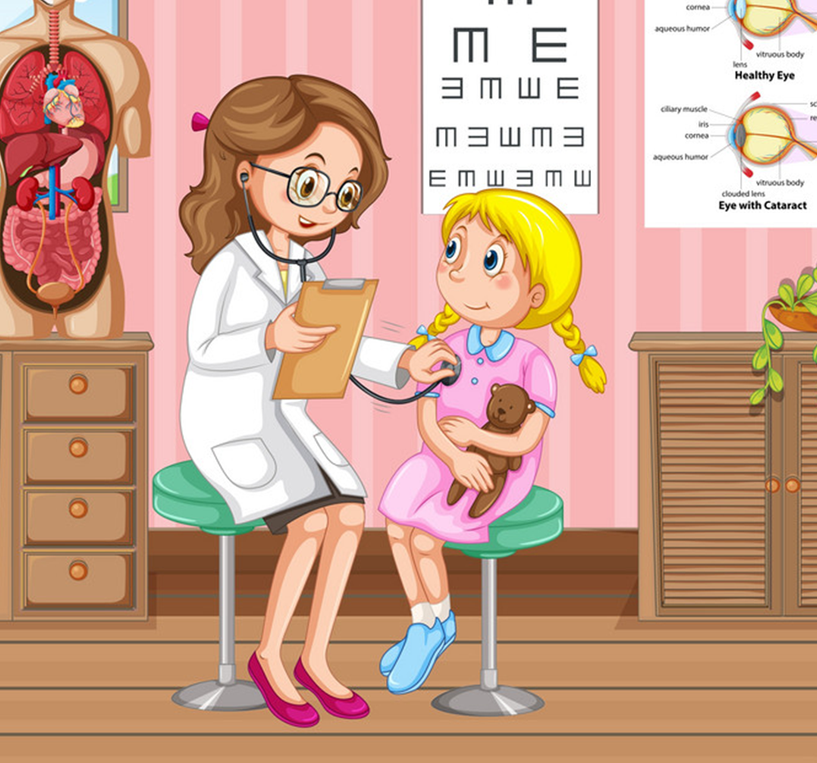
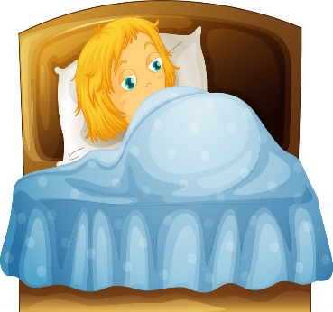
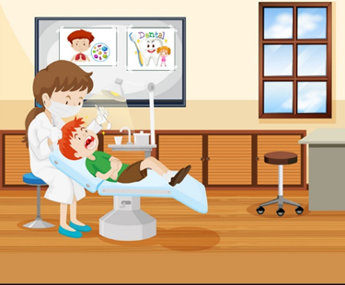
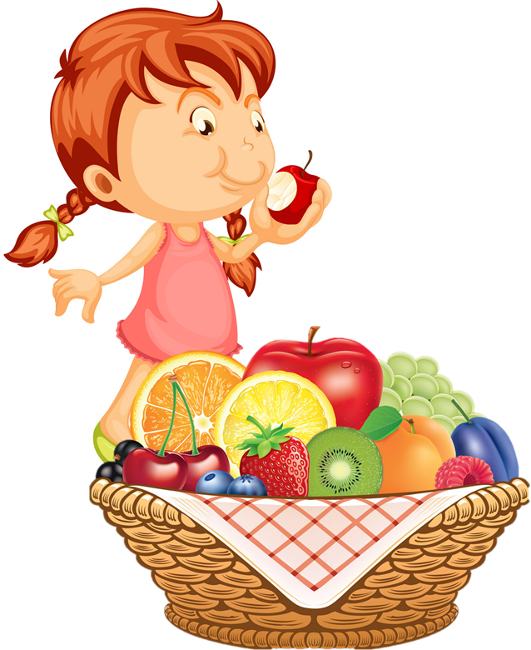
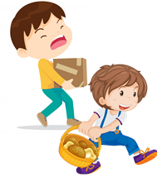
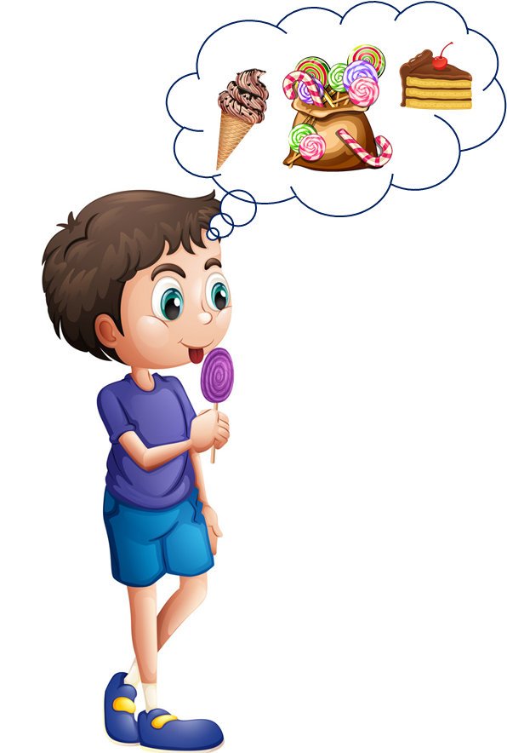
Temperature
/ˈtemprətʃər/
Unit 11
You should/shouldn’t _____________.
Yes, I will. Thanks.
OK, I won't. Thanks
go to the
doctor
take a rest
carry
heavy things
eat a lot of
sweets
go to the
dentist
eat a lot
of fruit
Ms.Phạm English
Earache
/ˈɪəreɪk/

Slide 4



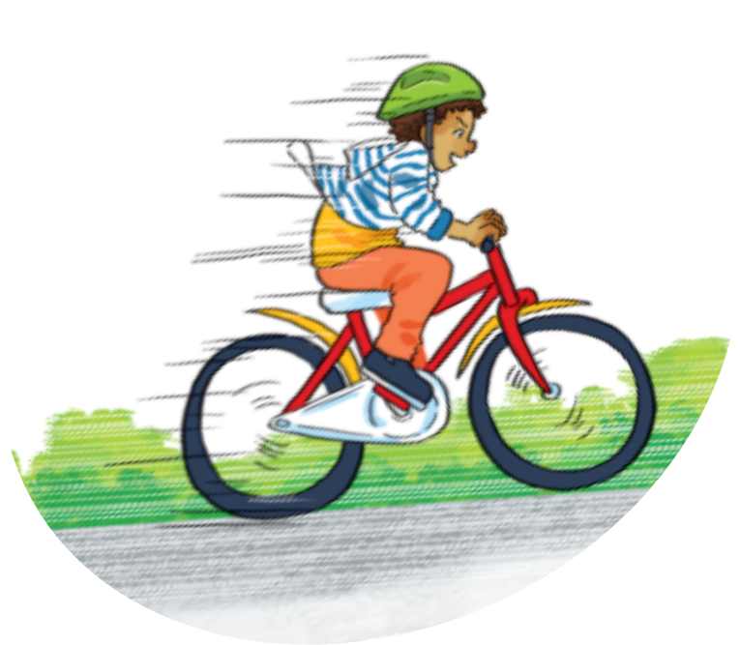
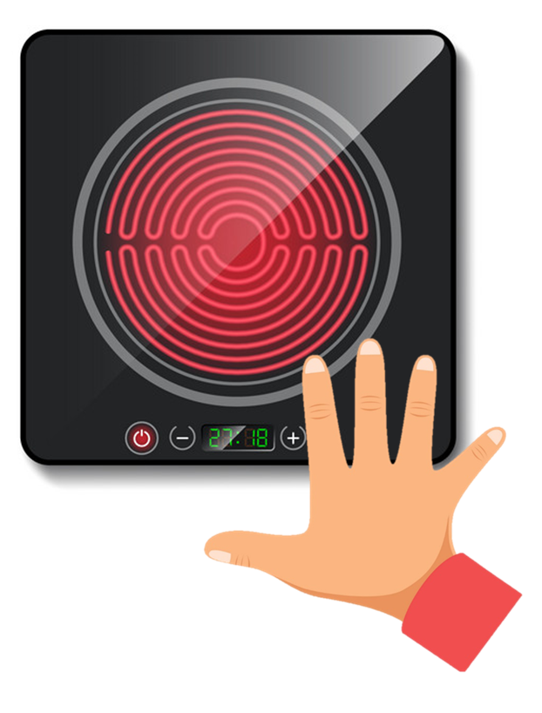
Unit 12
Don’t _____________.
Ok. I won’t.
climb the tree
run down
the stairs
play with matches
touch the stove
ride your bike too fast
Ms.Phạm English

Slide 5



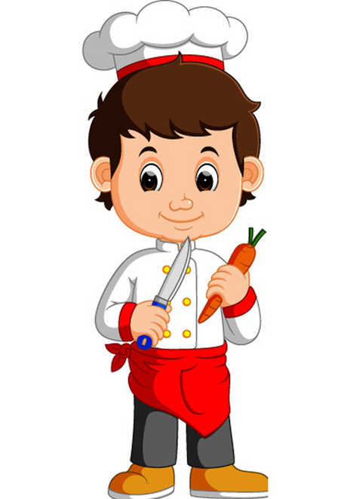
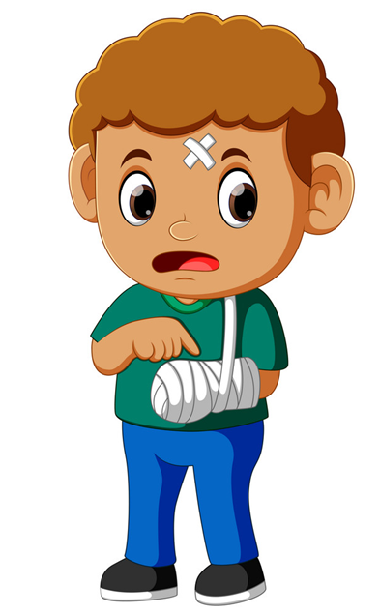
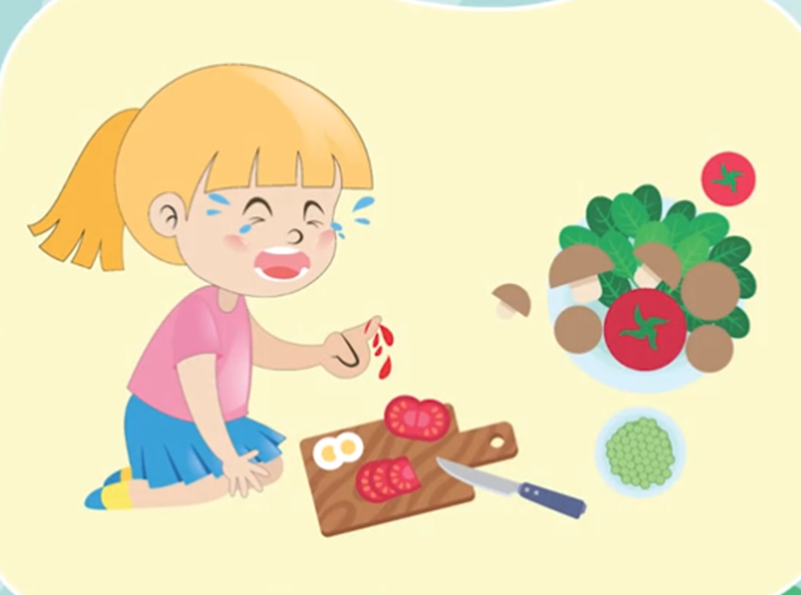
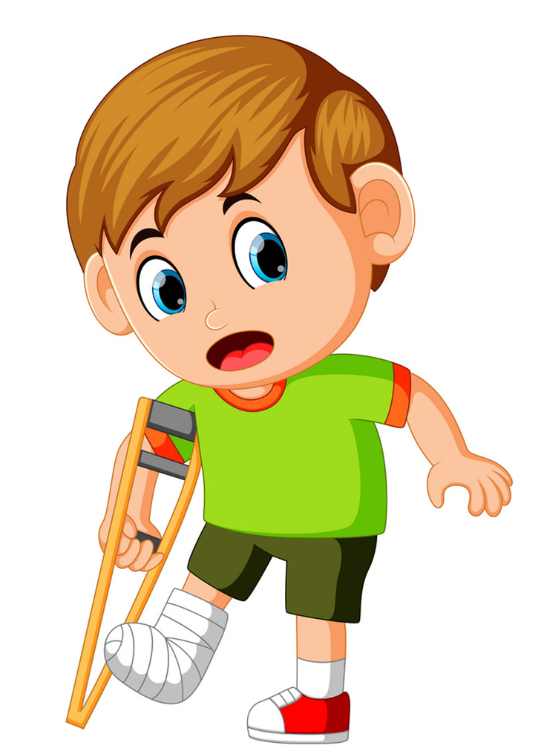

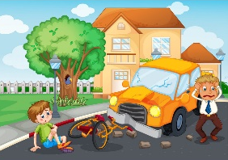
Unit 12
Touch the stove
Run down the stairs
Play with matches
Ride your bike
too fast
Climb a tree
Why I shouldn’t _____________?
Because you _____________.
Play with
the knife
Cut yourself
Break your arm
Break your leg
Have an accident
Get a burn
Ms.Phạm English

Slide 6
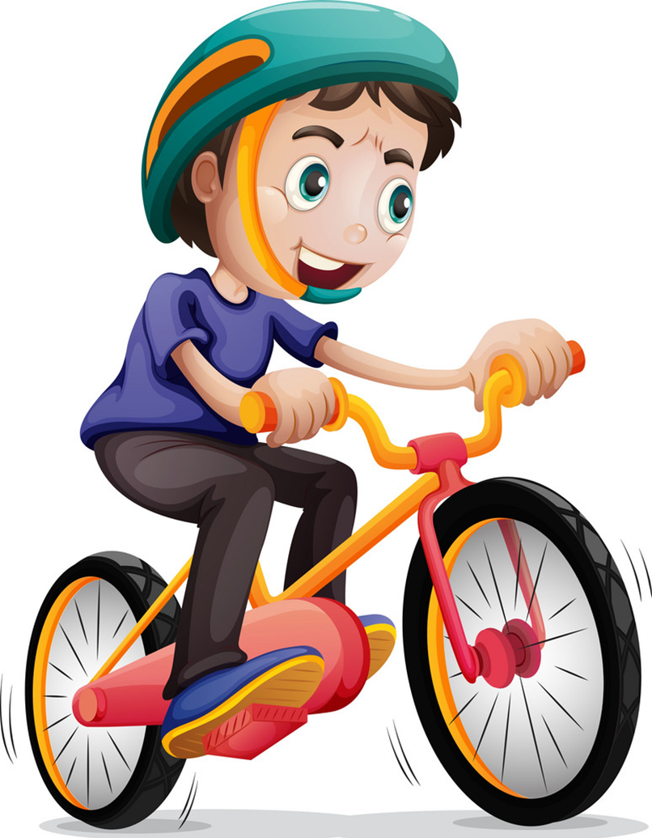

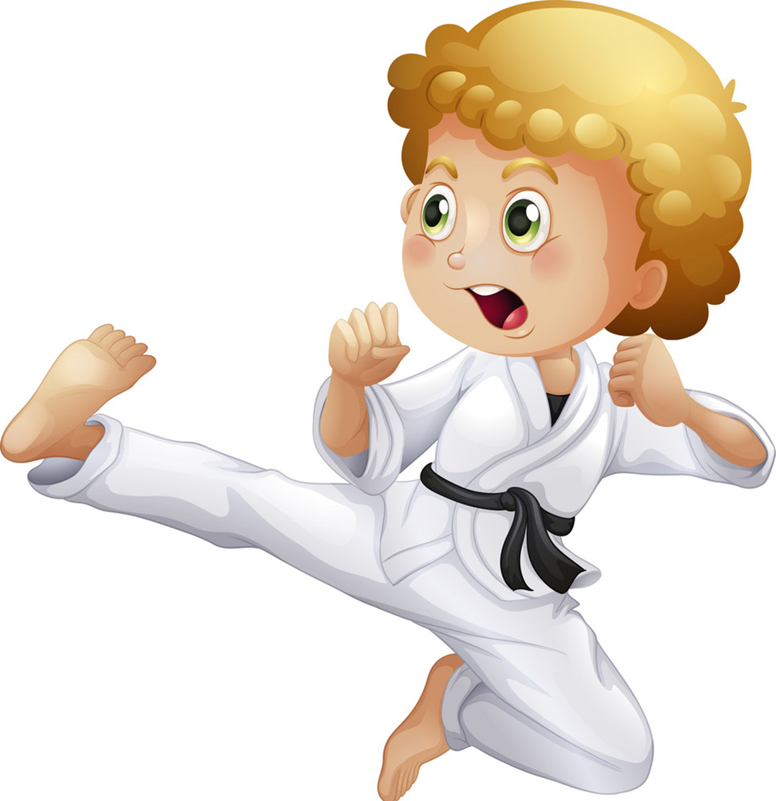
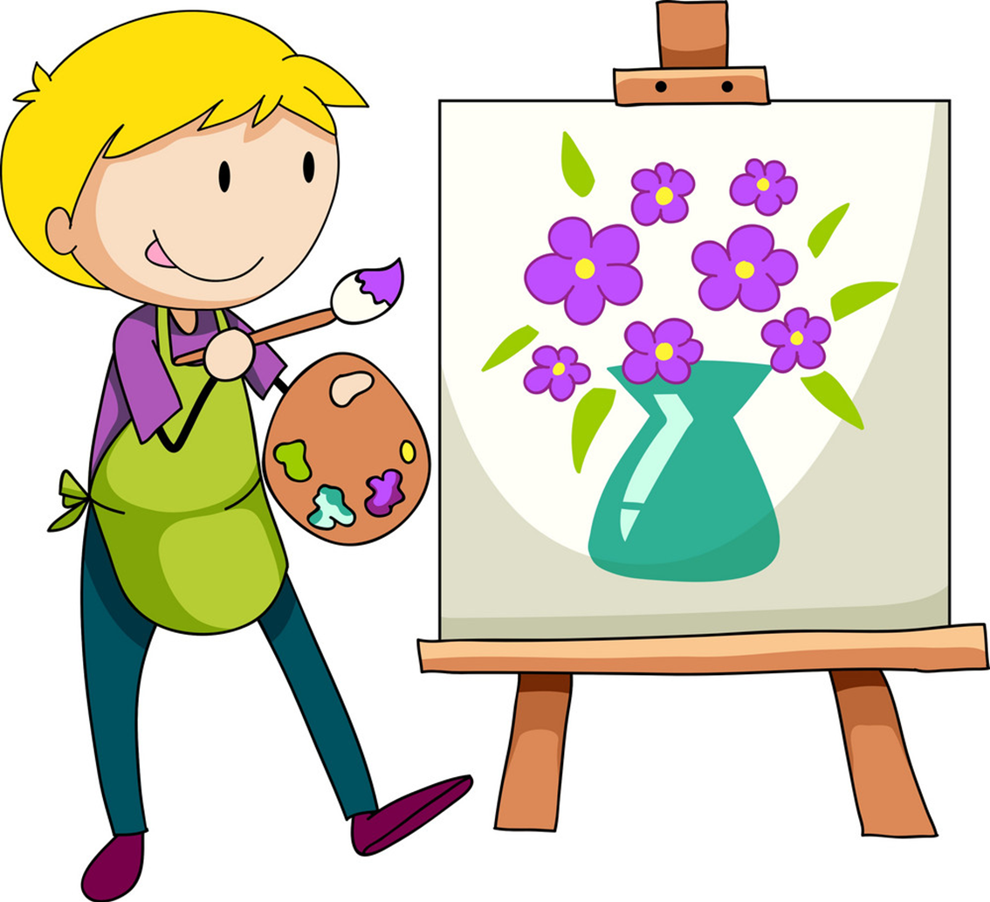

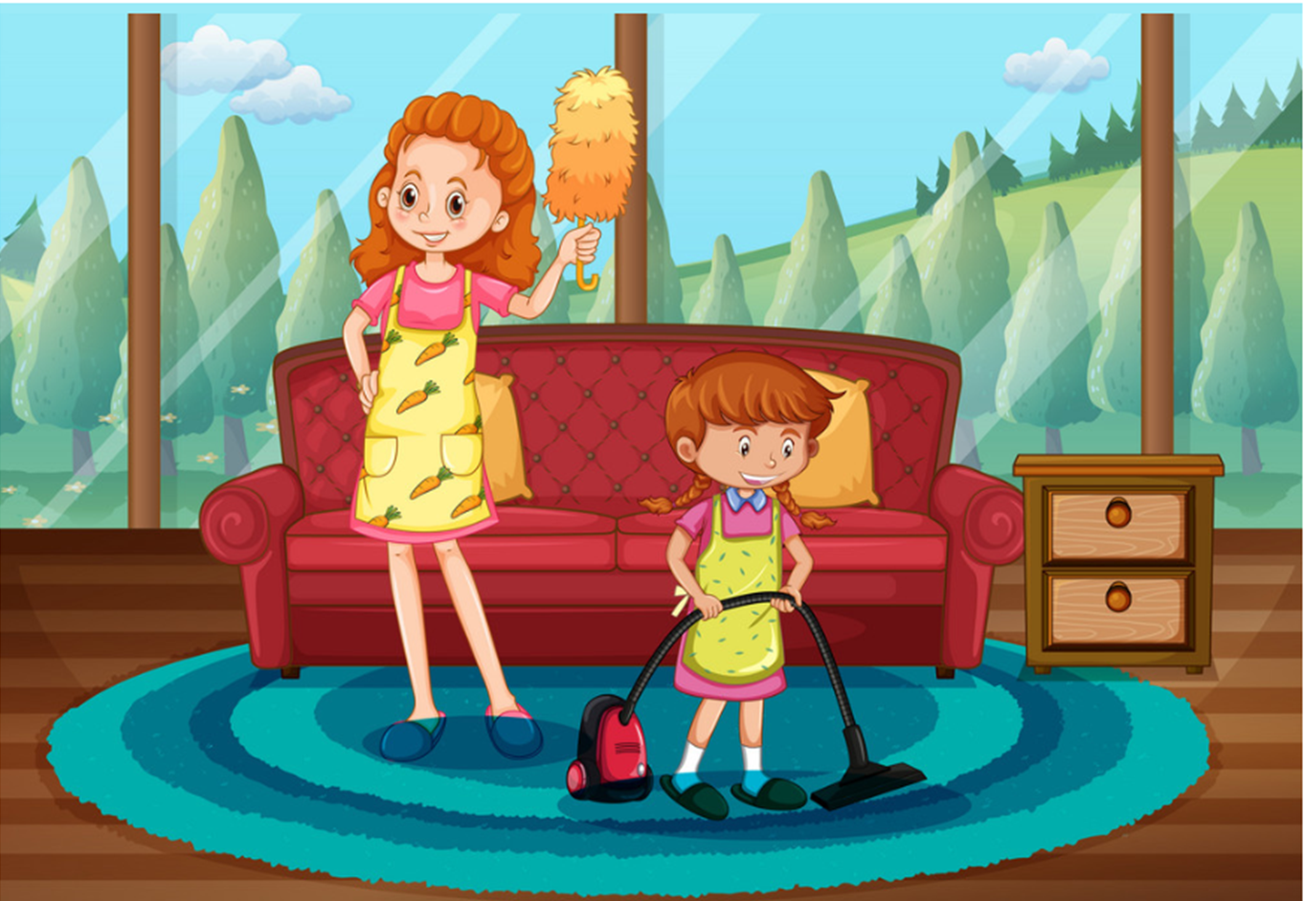
Unit 13
What do you do in your free time?
I ______________________.
ride my bike
surf the Internet
do karate
draw pictures
clean the house
go to the cinema
Ms.Phạm English

Slide 7
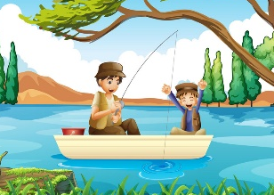
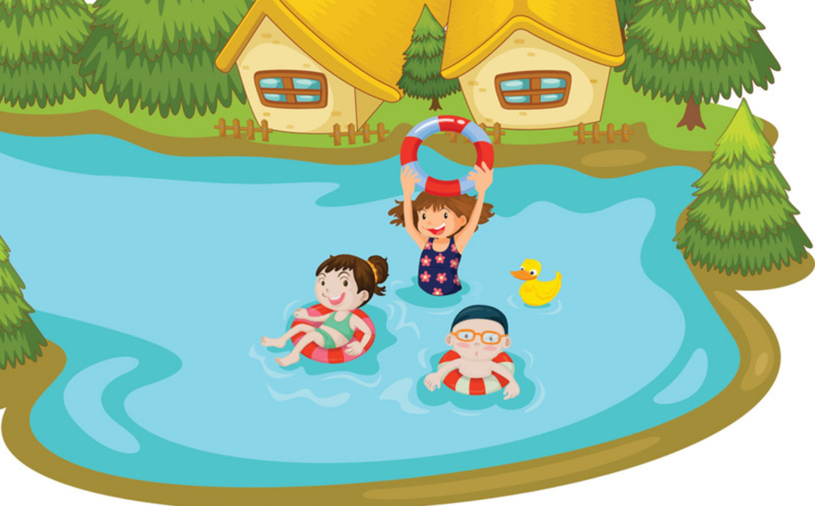
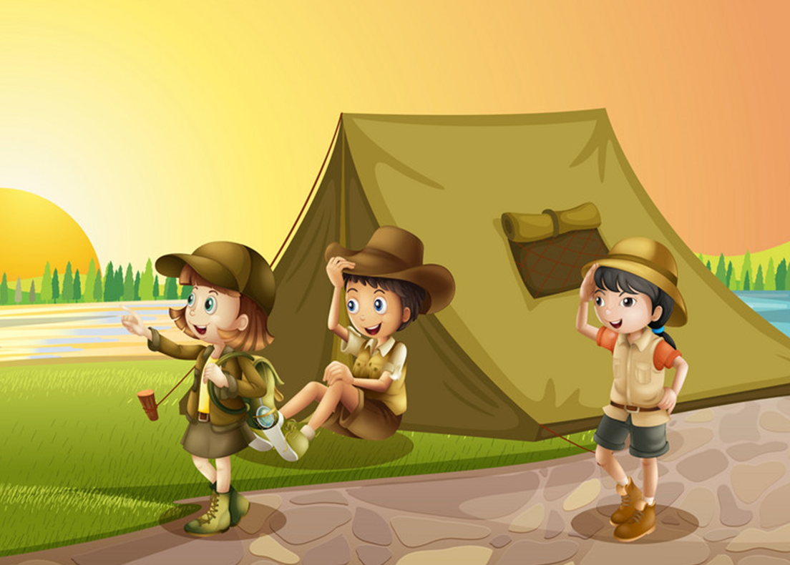
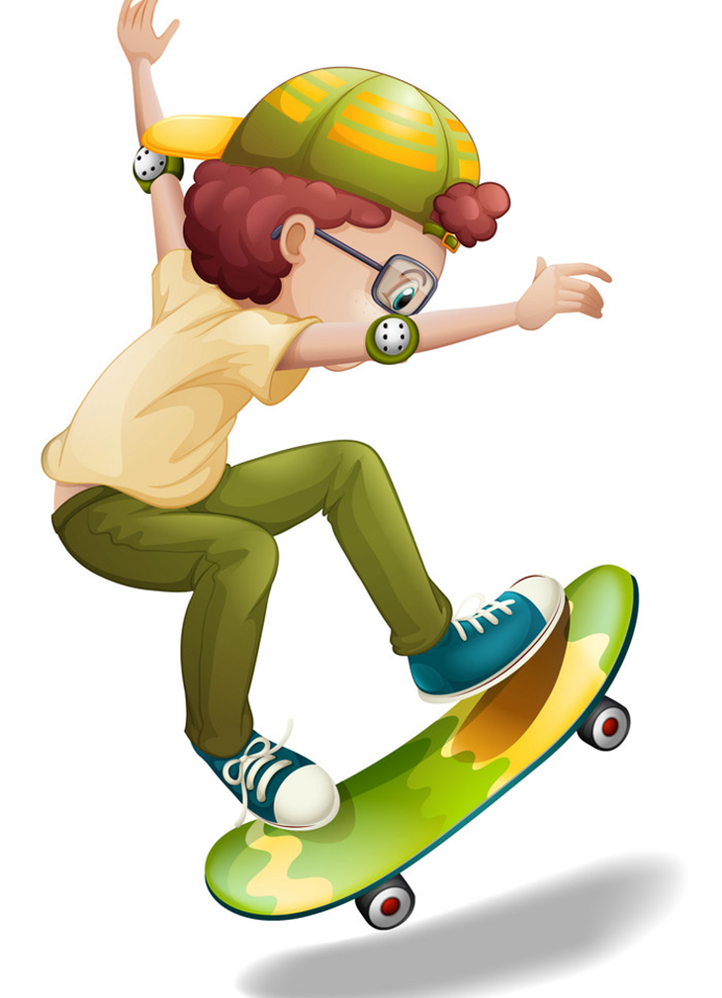
Unit 13
What does your ________ do in ____ free time?
She/he ______________________.
surfs the Internet
goes fishing
goes swimming
cleans the house
goes to the cinema
goes camping
does karate
goes skating
Ms.Phạm English

Slide 8
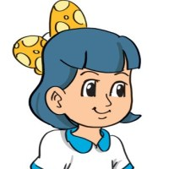

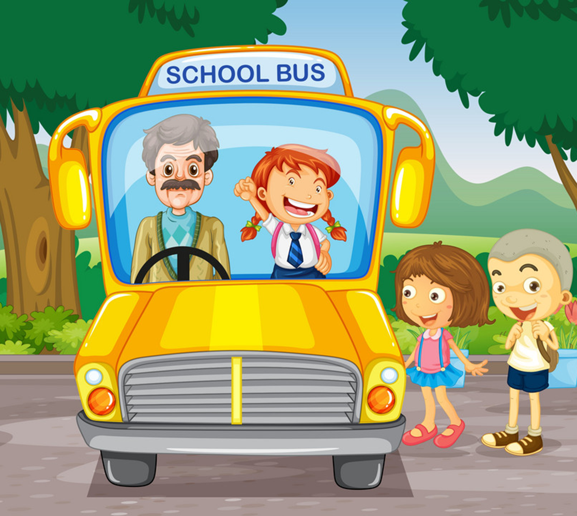
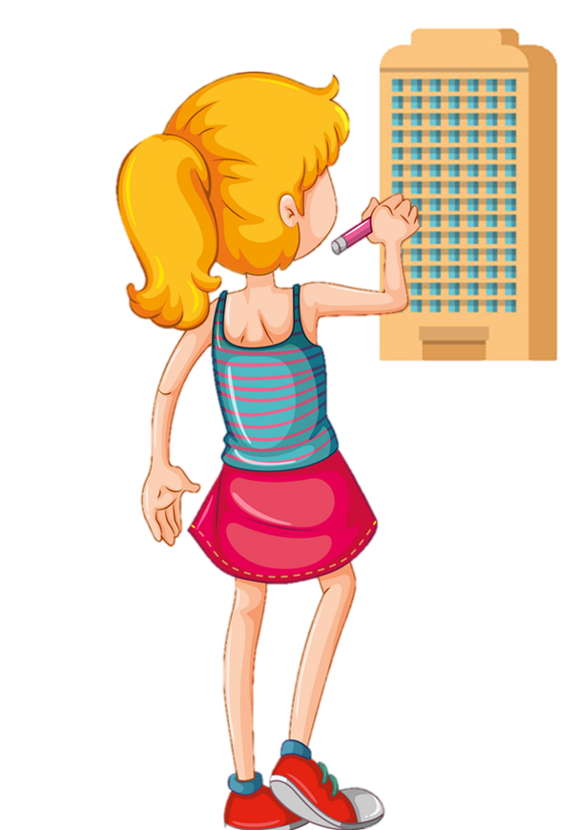

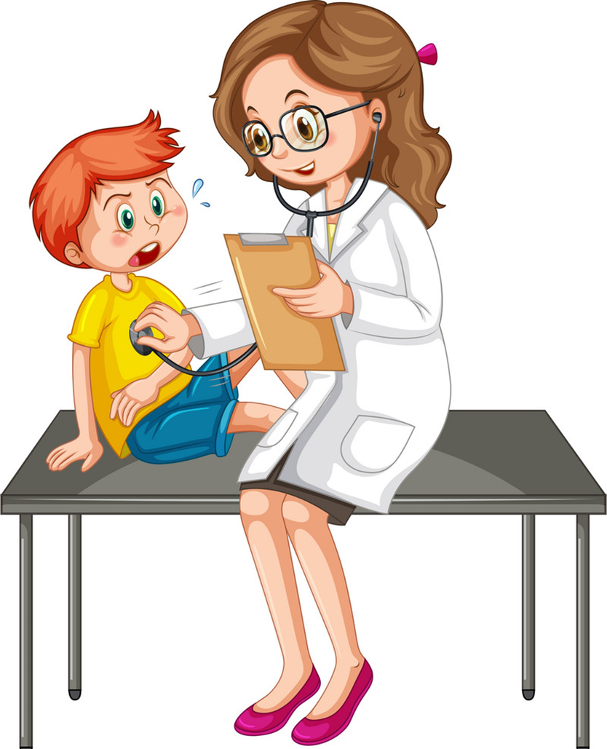
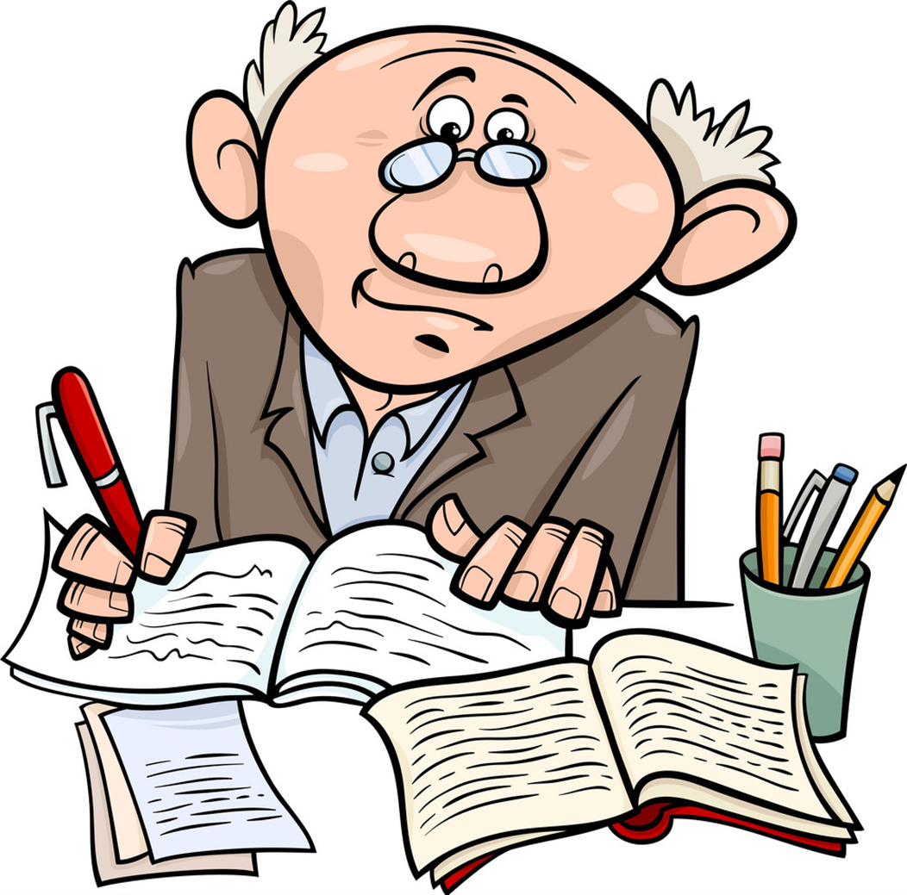
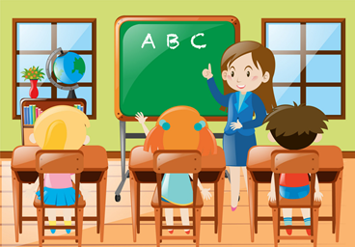
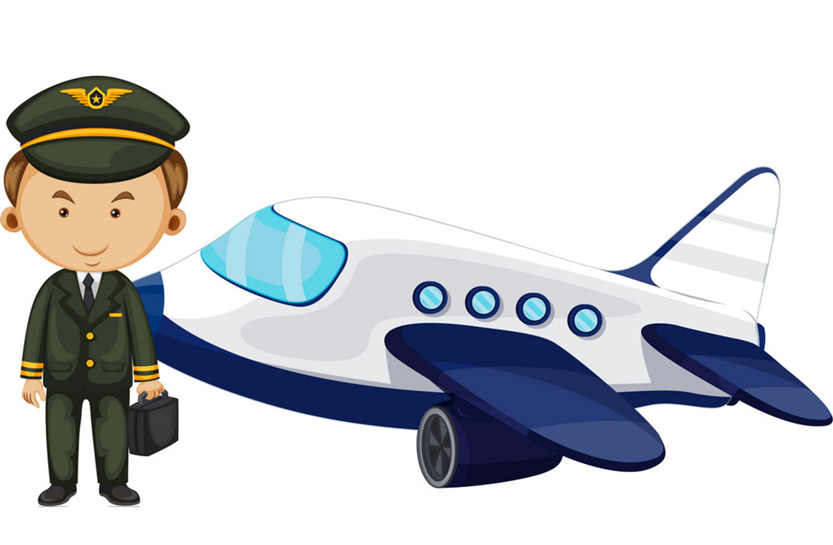


Unit 15
What would you like to be in the future?
I’d like to be a/an __________.
driver
architect
farmer
doctor
writer
teacher
pilot
worker
nurse
Ms.Phạm English

Slide 9
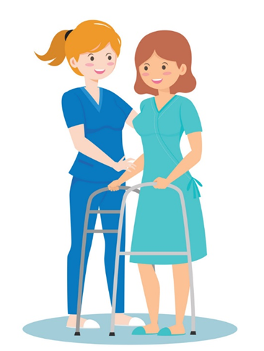
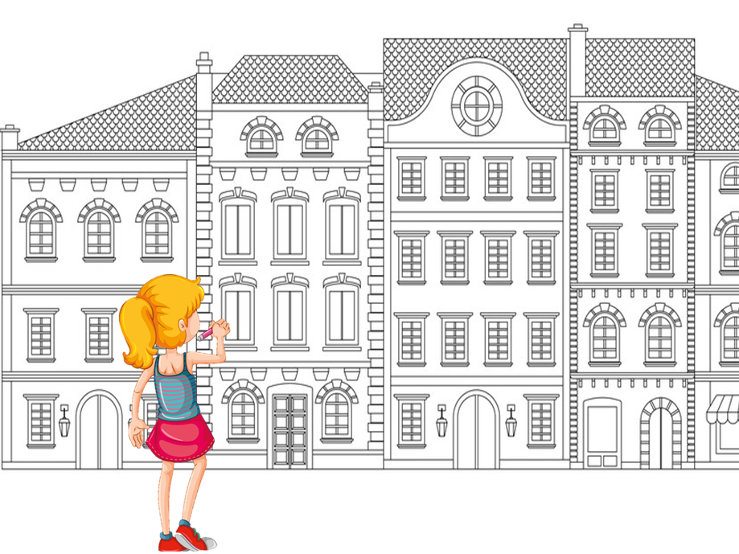
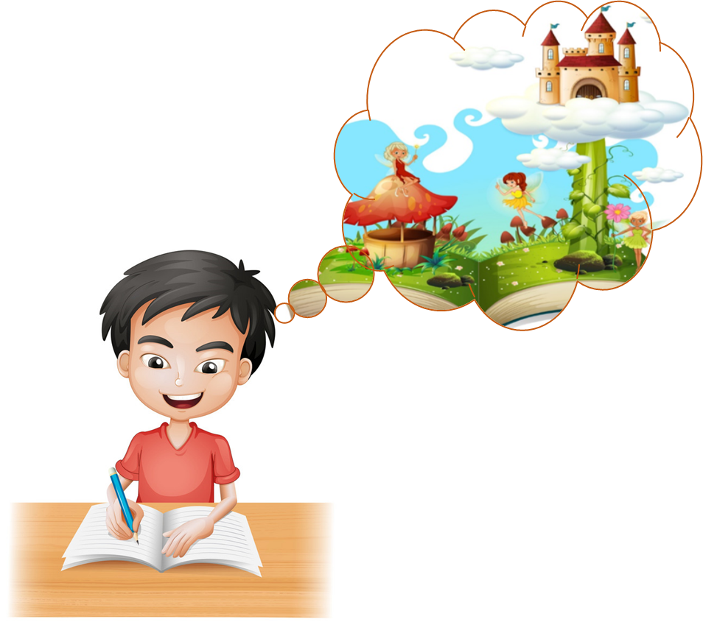

Unit 15
Why would you like to be _________?
Because I'd like to _____________.
look after patients
design buildings
write stories for children
fly a plane
Ms.Phạm English

Slide 10
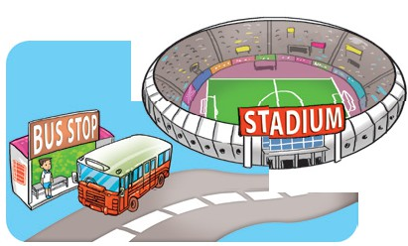
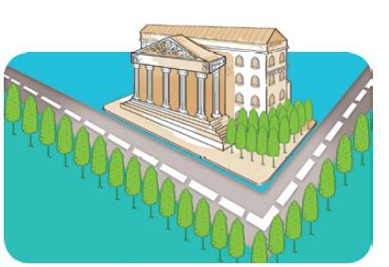
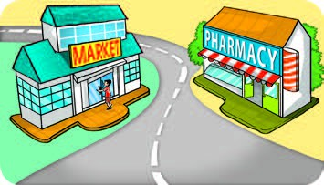
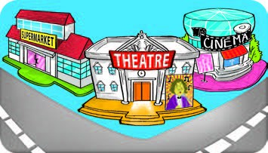
Unit 16
Excuse me, where's the _______?
It's ____________.
next to
on the corner of
the street
opposite
between
Ms.Phạm English

Slide 11
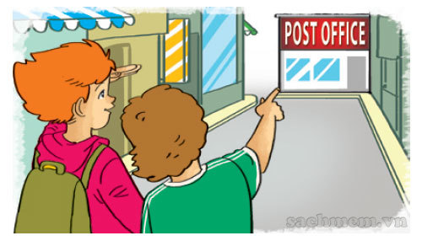
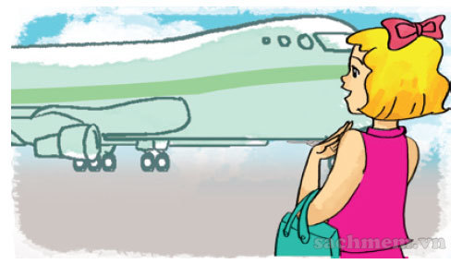
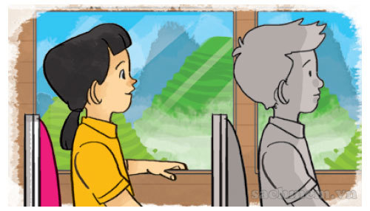
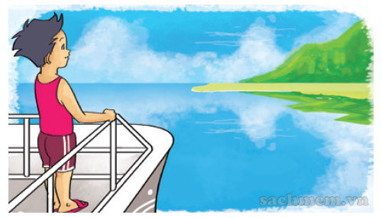
Unit 16
How can I get to ______________?
It's ____________.
the post office
Ho Chi Minh City
walk for five minutes
go by plane
Sa Pa
Phu Quoc Island
take a coach
take a boat
Ms.Phạm English

Slide 12

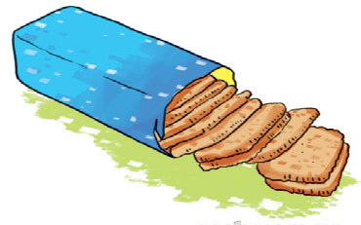


Unit 17
What would you like to eat/drink?
I'd like__________, please.
a packet of biscuits
a carton of lemonade
a bar of
chocolate
a glass of
orange juice
Ms.Phạm English

Slide 13




Unit 17
How many/much _______ do you eat every day?
I eat ______________________.
bananas
water
sausages
rice
three bottles
three bananas
two sausages
four bowls
Ms.Phạm English

Slide 14




Unit 18
What will the weather be like tomorrow?
It will be ______ and _________.
cold, snowy
cool, cloudy
hot, sunny
warm, stormy
Ms.Phạm English

Slide 15




Unit 18
What's ________ like in your country?
It's ______. There is/are ______.
spring
winter
summer
autunm
cold, wind
very cold, snow
hot, flowers
cool, rain
Ms.Phạm English

Slide 16






Unit 19
Which place would you like to visit,
_________ or ___________?
I'd like to visit _________.
Ms.Phạm English

Slide 17





Unit 19
What do you think of _______?
It's more___ than I expected.
Ha Long Bay
Phu Quoc Island
Thu Le Zoo
Dam Sen Park
attractive
beautiful
exciting
interesting
Ms.Phạm English

Slide 18




Unit 20
Which one is ____, ____ or ____?
I think ____________ is.
Hoan Kiem Lake
/ West Lake
life in the city
/life in the mountains
life in the city
/life in the countryside
smaller
Ben Thanh Market
/Dong Xuan Market
busier
noisier
larger
Ms.Phạm English

Slide 19



Unit 20
Which one is more ____, ____ or ____?
I think ____________ is.
life in the city/
life in the countryside
Ha Long City/ Nha Trang
life in Da Nang
/ life in Ho Chi Minh City
exciting
beautiful
expensive
Ms.Phạm English

