Slide 1
Unit 3
Where did you go
on holiday?
Lesson 2

Slide 2
Vocabulary

Slide 3
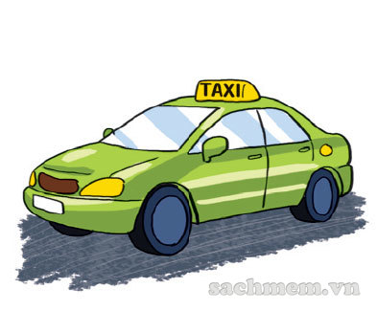
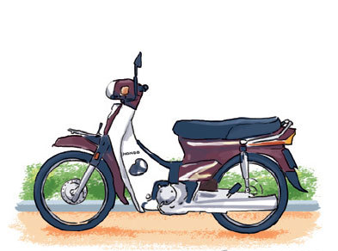
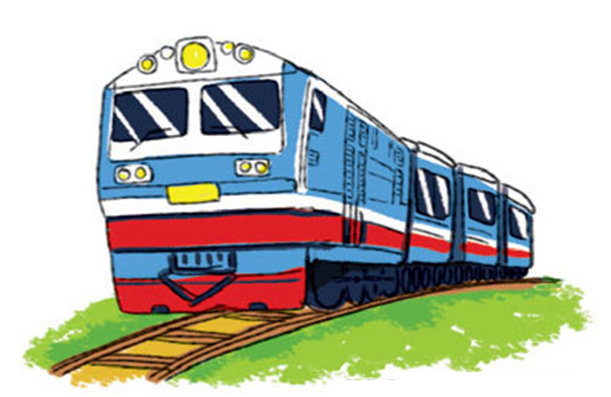
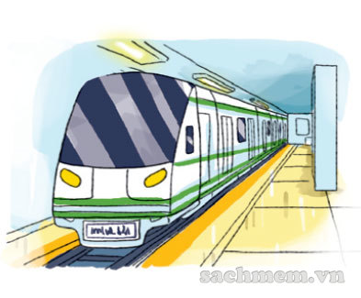
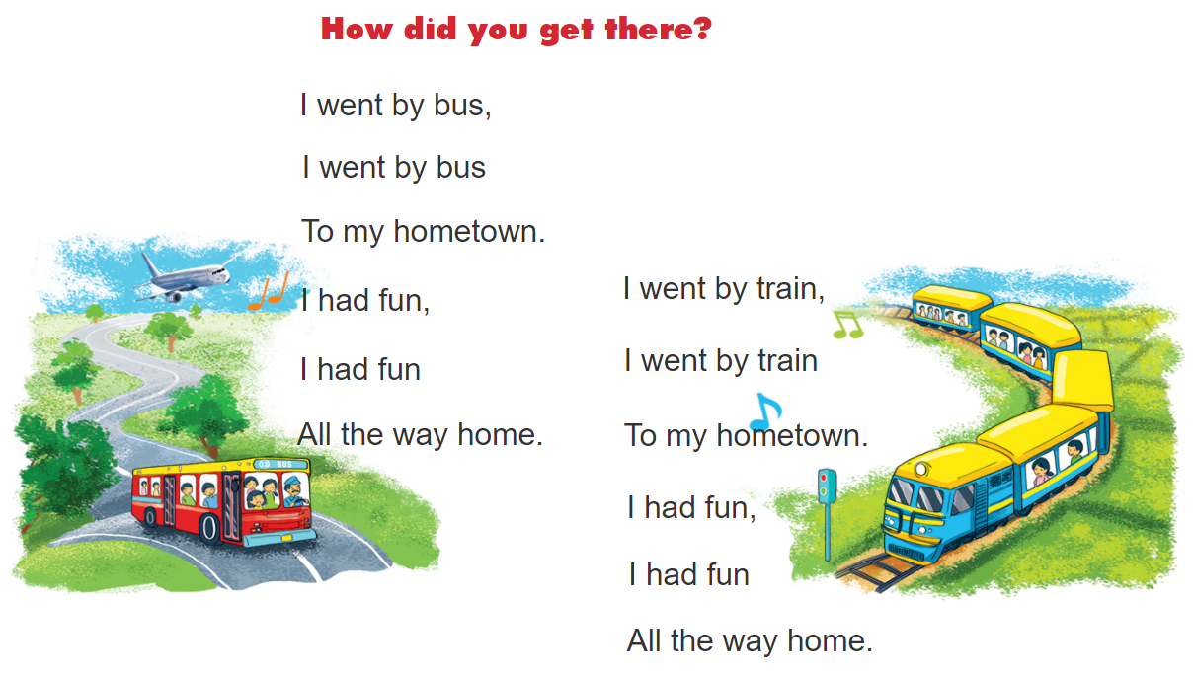
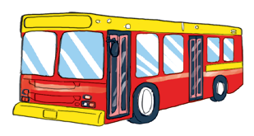
Vocabulary
train
taxi
motorbike
Tàu hỏa
Xe ta-xi
Xe máy
underground
bus
coach
Tàu điện ngầm
Xe buýt
Xe khách

Slide 4
Look read and circle
train
taxi
bicycle
bus
coach
motorbike
underground
taxi
train
plane
bus
coach

Slide 5
Grammar

Slide 6









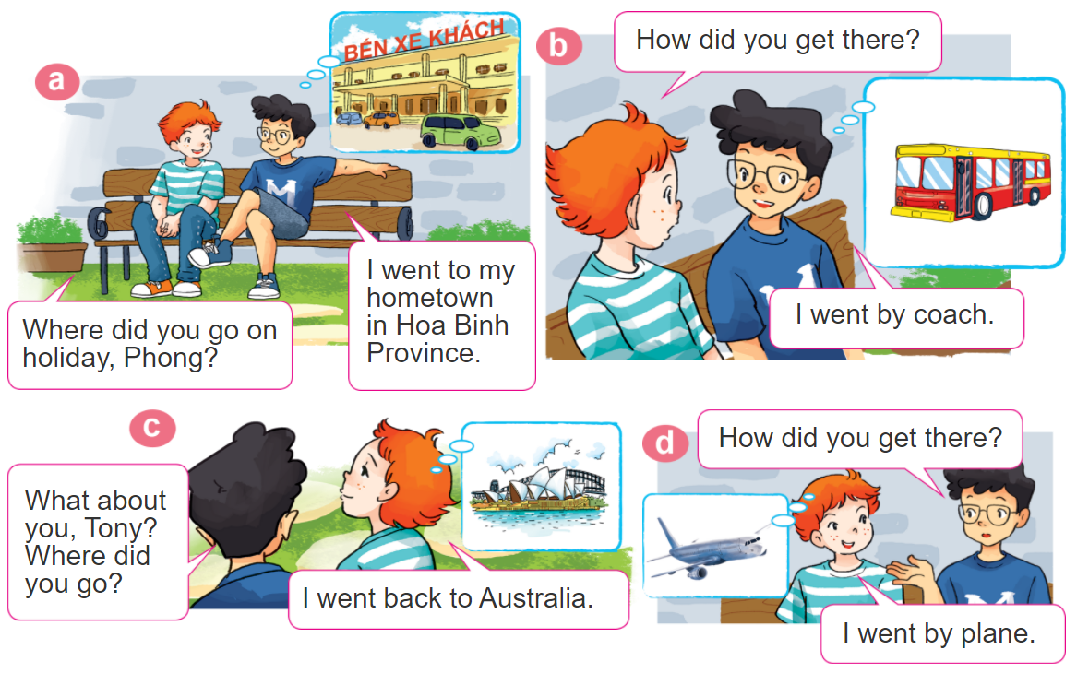

1. Look, listen and repeat

Slide 7




2. Point and say
How did you get there?
I went by____________.
train
underground
motorbike
taxi

Slide 8
Grammar
Hỏi và đáp bạn đã đi bằng phương tiện gì?
How did you get _______?
+ place
(Bạn đã đến ____ bằng gì?)
I went by ___________.
+ phương tiện
(Tớ đã đi bằng _____)

Slide 9


3. Let’s talk.
Where were you
on holiday?
I were ________.
I went to ________.
Where did you go?
I went by ________.
How did you get there?

Slide 10
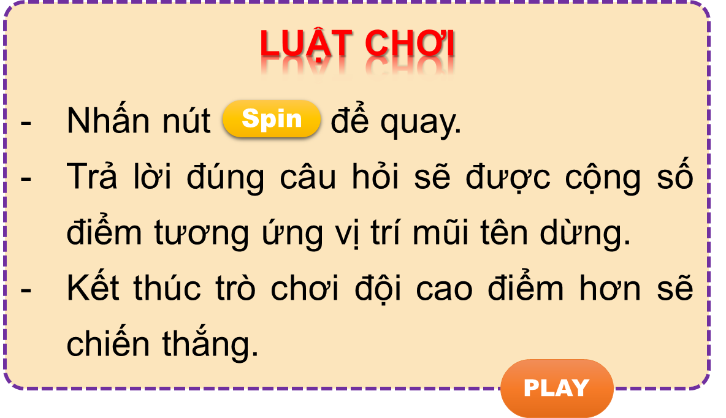

Vòng quay kì diệu
50
10
20
30
10
20
30
40
Spin
PLAY
LUẬT CHƠI
Nhấn nút để quay.
Trả lời đúng câu hỏi sẽ được cộng số điểm tương ứng vị trí mũi tên dừng.
Kết thúc trò chơi đội cao điểm hơn sẽ chiến thắng.
Spin
Notes:
Ms Huyền Phạm - 0936.082.789 – YOUTUBE: MsPham. Facebook: Dạy và học cùng công nghệ.

Slide 11
How did you get there?
50
10
20
30
10
20
30
40
I went by motorbike.
Xem đáp án
Spin
Notes:
Ms Huyền Phạm - 0936.082.789 – YOUTUBE: MsPham. Facebook: Dạy và học cùng công nghệ.

Slide 12
How did you get there?
50
10
20
30
10
20
30
04
I went by coach.
Xem đáp án
Spin
Notes:
Ms Huyền Phạm - 0936.082.789 – YOUTUBE: MsPham. Facebook: Dạy và học cùng công nghệ.

Slide 13
50
How did you get there?
10
20
30
10
20
30
04
I went by bus.
Xem đáp án
Spin
Notes:
Ms Huyền Phạm - 0936.082.789 – YOUTUBE: MsPham. Facebook: Dạy và học cùng công nghệ.

Slide 14

50
How did you get there?
10
20
30
10
20
30
40
I went by train.
Xem đáp án
Spin
Notes:
Ms Huyền Phạm - 0936.082.789 – YOUTUBE: MsPham. Facebook: Dạy và học cùng công nghệ.

Slide 15
How did you get there?
50
10
20
30
10
20
30
40
I went by taxi.
Xem đáp án
Spin
Notes:
Ms Huyền Phạm - 0936.082.789 – YOUTUBE: MsPham. Facebook: Dạy và học cùng công nghệ.

Slide 16
50
How did you get there?
10
20
30
10
20
30
40
I went by underground.
Xem đáp án
Spin
Notes:
Ms Huyền Phạm - 0936.082.789 – YOUTUBE: MsPham. Facebook: Dạy và học cùng công nghệ.

Slide 17
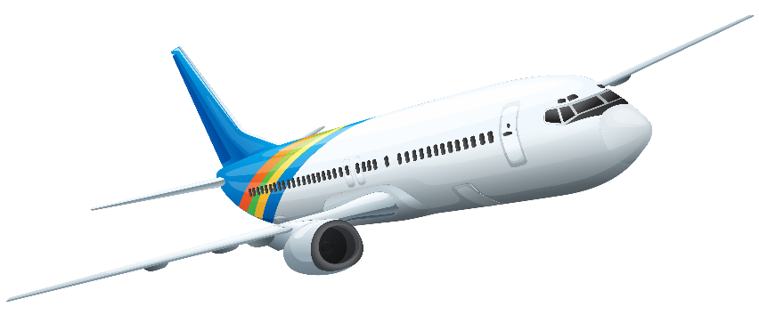
50
10
How did you get there?
20
30
10
20
30
40
I went by plane.
Xem đáp án
Spin
Notes:
Ms Huyền Phạm - 0936.082.789 – YOUTUBE: MsPham. Facebook: Dạy và học cùng công nghệ.

Slide 18



50
10
20
30
10
20
30
40
EXIT
Notes:
Ms Huyền Phạm - 0936.082.789 – YOUTUBE: MsPham. Facebook: Dạy và học cùng công nghệ.

Slide 19
4.
Listen and write one word in each blank
1. Mai went to see her grandparents by ___________.
2. Linda went to her hometown by ___________.
3. Nam went to the seaside by ___________.
4. Trung went to Da Nang by ___________.
motorbike
train
taxi
plane

Slide 20
5.
Write about your last holiday.
1. Where did you go last holiday?
2. How did you get there?
3. What did you do there?
4. Did you enjoy the trip?

Slide 21


6. Let’s sing.

