Slide 1
VOCABULARY

Slide 2















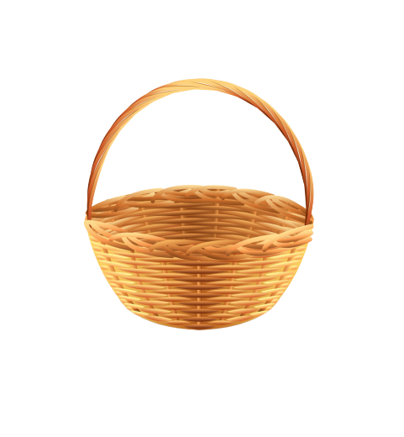
Trò chơi
HÁI TÁO
Notes:
Ms Huyền Phạm - 0936.082.789 – YOUTUBE: MsPham. Facebook: Dạy và học cùng công nghệ.

Slide 3

Play
hide-and-seek.
A
What did you do at the party?
We __________.
Played
hide-and-seek.
B
Plays
hide-and-seek.
C
Notes:
Ms Huyền Phạm - 0936.082.789 – YOUTUBE: MsPham. Facebook: Dạy và học cùng công nghệ.

Slide 4
Sang together
A
What did you do at the party?
We __________.
Singed together
B
Singes together
C
Notes:
Ms Huyền Phạm - 0936.082.789 – YOUTUBE: MsPham. Facebook: Dạy và học cùng công nghệ.

Slide 5
Chat
with my friends
A
What did you do at the party?
We __________.
Chattes
with my friends
B
Chatted
with my friends
C
Notes:
Ms Huyền Phạm - 0936.082.789 – YOUTUBE: MsPham. Facebook: Dạy và học cùng công nghệ.

Slide 6
Where did you do
A
What did you do
________ at the party?
We dance happily.
B
How did you do
C
Notes:
Ms Huyền Phạm - 0936.082.789 – YOUTUBE: MsPham. Facebook: Dạy và học cùng công nghệ.

Slide 7
what
A
____ was the party?
It was happily.
What like
B
How
C
Notes:
Ms Huyền Phạm - 0936.082.789 – YOUTUBE: MsPham. Facebook: Dạy và học cùng công nghệ.

Slide 8
____ was the party?
It is great.
A
It’s great.
B
It was great.
C
Notes:
Ms Huyền Phạm - 0936.082.789 – YOUTUBE: MsPham. Facebook: Dạy và học cùng công nghệ.

Slide 9
What was it
A
It was happily.
How was it?
B
What like was it?
C
Notes:
Ms Huyền Phạm - 0936.082.789 – YOUTUBE: MsPham. Facebook: Dạy và học cùng công nghệ.

Slide 10
Yes, I am.
A
Did you watch cartoon?
Yes, I do.
B
Yes, I did.
C
Notes:
Ms Huyền Phạm - 0936.082.789 – YOUTUBE: MsPham. Facebook: Dạy và học cùng công nghệ.

Slide 11
No, I didn’t.
A
No, I don’t.
Did you play hide-and-seek?
B
No, I am not.
C
Notes:
Ms Huyền Phạm - 0936.082.789 – YOUTUBE: MsPham. Facebook: Dạy và học cùng công nghệ.

Slide 12
PRONUNCIATION

Slide 13
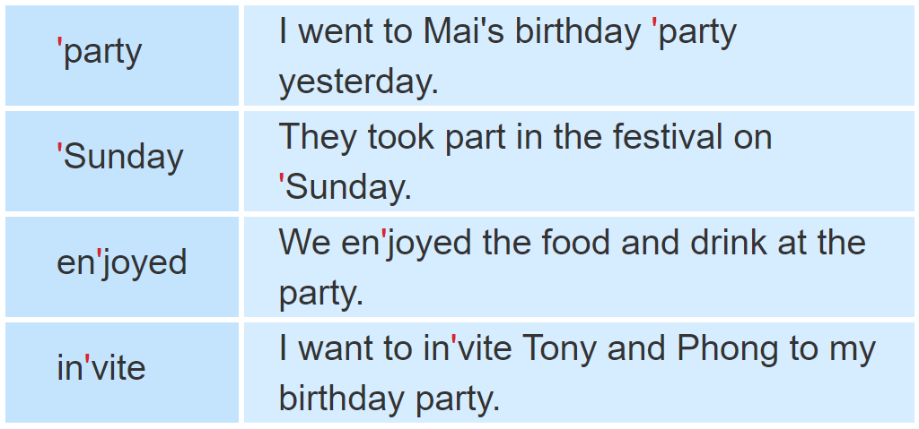

1. Listen and repeat.

Slide 14
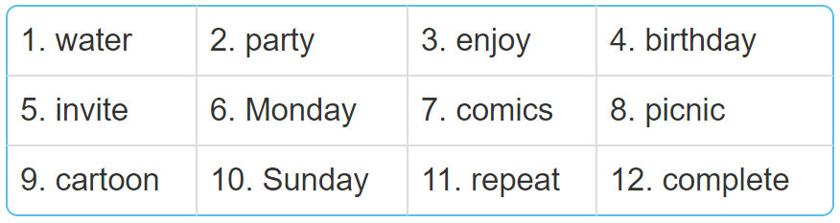
2. Mark the word stress. Then say the words aloud.
'water
'party
en'joy
'birthday
in'vite
'Monday
'comics
'picnic
car'toon
'Sunday
re'peat
com'plete

Slide 15
PRACTISE

Slide 16
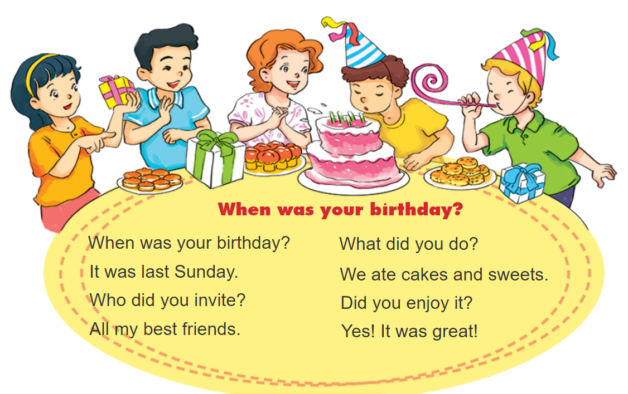
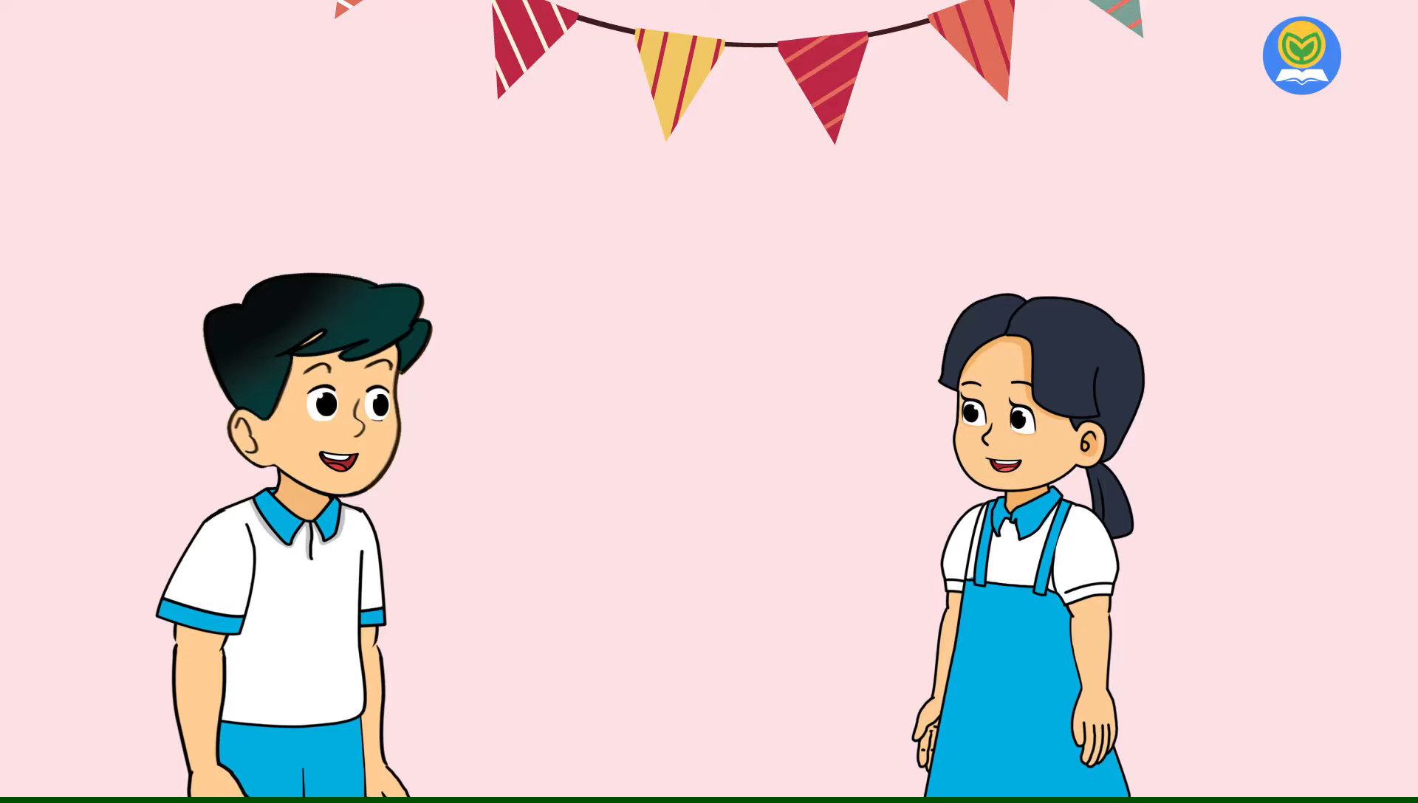

3. Let’s chant

Slide 17
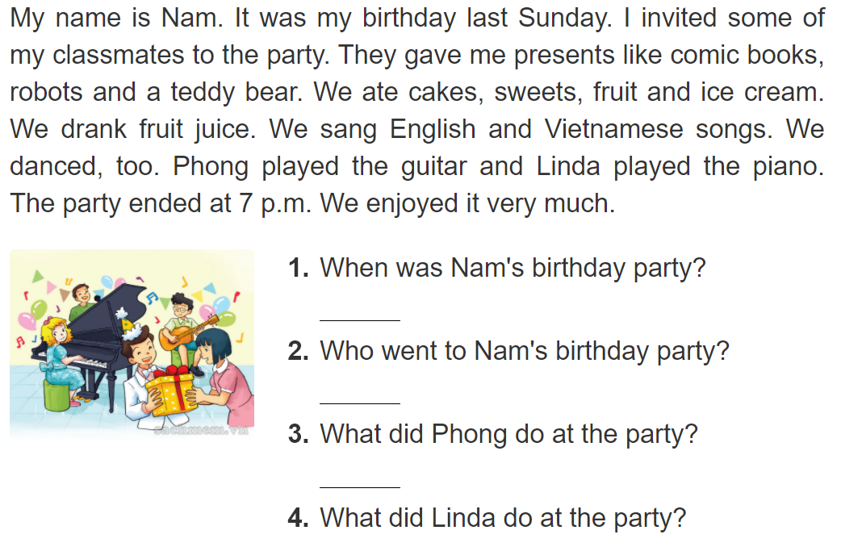
4. Read and answer.
It was last Sunday.
Some of his classmates went to the birthday party.
He played the guitar.
She played the piano.

Slide 18
5. Write about your friend.
When was your last birthday party?
____________________________________________.
2. Who went to your party?
____________________________________________.
3. What did you and your friends do at the party?
____________________________________________.

Slide 19
6. Write about your birthday party.

