Slide 1
Unit 5
What will you bethis weekend?
Lesson 1

Slide 2
Vocabulary

Slide 3
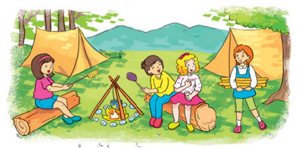
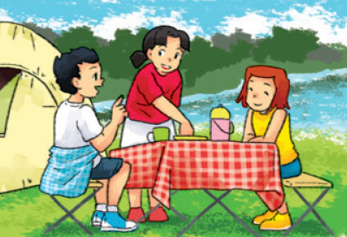
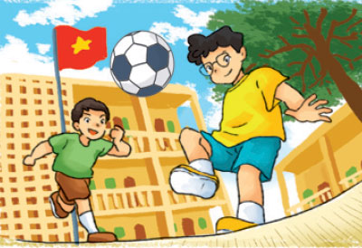
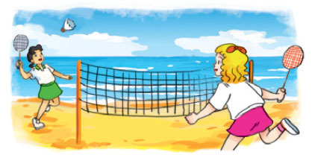
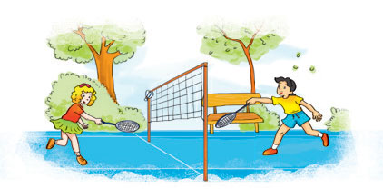
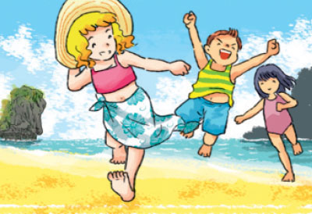
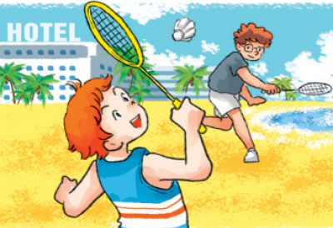
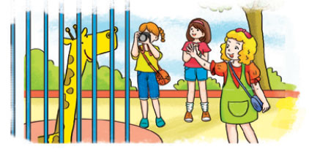
A. Vocabulary
in the moutain
in the countryside
at school
at the seaside
Ở trên núi
Ở nông thôn
Ở trường
Ở trên bờ biển
in the park
on the beach
by the sea
at the zoo
Ở công viên
Ở trên bãi biển
Ở gần biển
Ở sở thú

Slide 4

Look, read and tick
at the seaside

Slide 5
Look, read and tick
in the countryside

Slide 6
Look, read and tick
in the moutain

Slide 7
Look, read and tick
on the beach

Slide 8
Look, read and tick
at the zoo

Slide 9
Look, read and tick
at school

Slide 10
Look, read and tick
by the sea

Slide 11
GRAMMAR

Slide 12
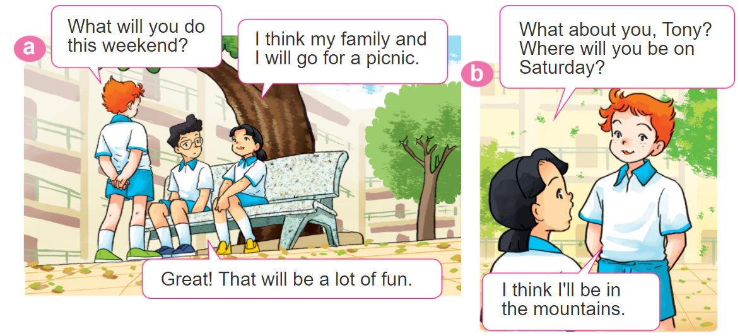

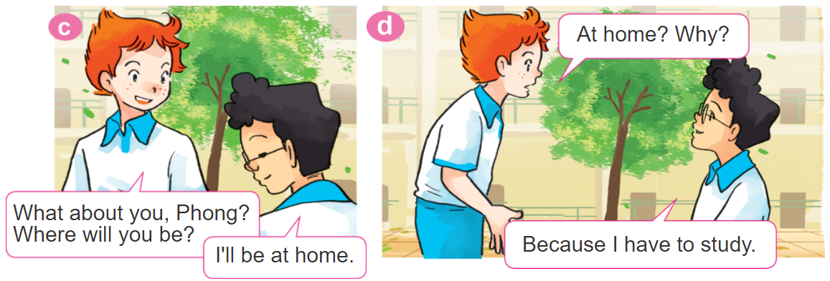
1. Look, listen and repeat

Slide 13
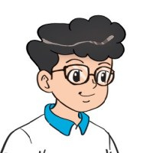
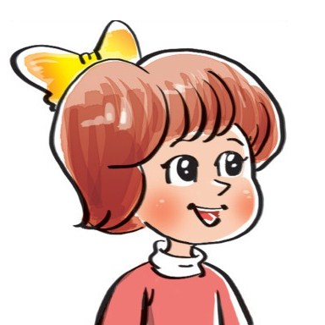
2. Point and say
Where will you be this weekend?
I think I'll be ____________.
in the
countryside
by the sea
on the beach
at school

Slide 14
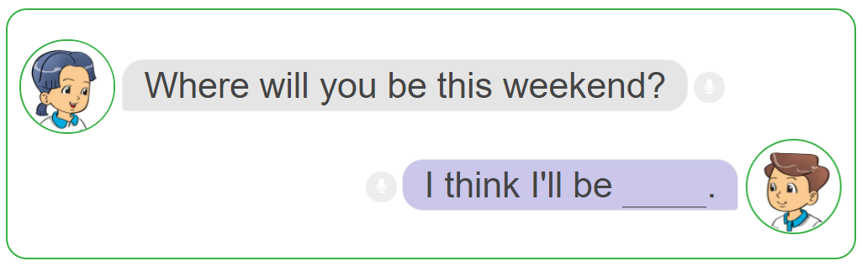
3. Let’s talk.

Slide 15
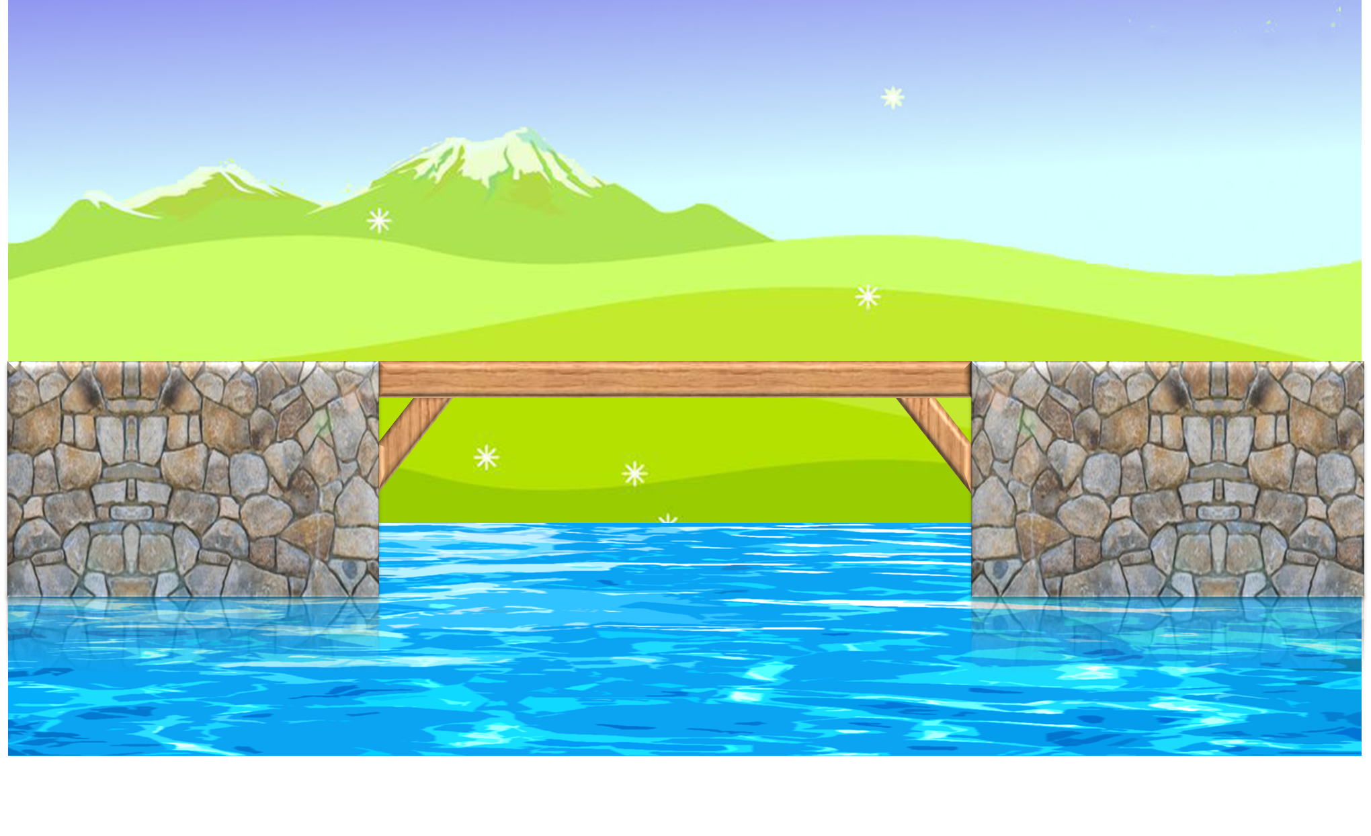
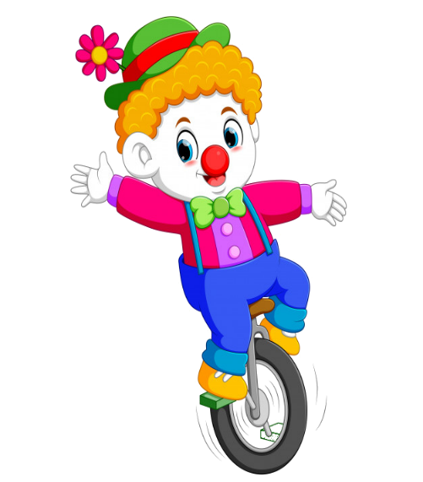



PLAY

Slide 16



Where will you be this weekend?
I think I'll be at the seaside.
I think I'll be at the zoo.
I think I'll be in the park.
I think I'll be at school.

Slide 17
Where will you be this weekend?
I think I'll be at the seaside.
I think I'll be on the beach.
I think I'll be at the zoo.
I think I'll be in the mountain.

Slide 18
Where will you be this weekend?
I think I'll be in the mountain.
I think I'll be at the zoo.
I think I'll be by the sea.
I think I'll be at the seaside.

Slide 19
Where will you be this weekend?
I think I'll be in the mountain.
I think I'll be in the countryside.
I think I'll be in the park.
I think I'll be by the sea.

Slide 20
Where will you be this weekend?
I think I'll be by the sea.
I think I'll be at school.
I think I'll be in the mountain.
I think I'll be in the countryside.

Slide 21
Where will you be this weekend?
I think I'll be at the zoo.
I think I'll be in the mountain.
I think I'll be by the sea.
I think I'll be at school.

Slide 22
Where will you be this weekend?
I think I'll be in the countryside.
I think I'll be at the zoo.
I think I'll be in the park.
I think I'll be on the beach.

Slide 23
Where will you be this weekend?
I think I'll be at school.
I think I'll be by the sea.
I think I'll be in the countryside.
I think I'll be on the beach.

Slide 24

End

Slide 25
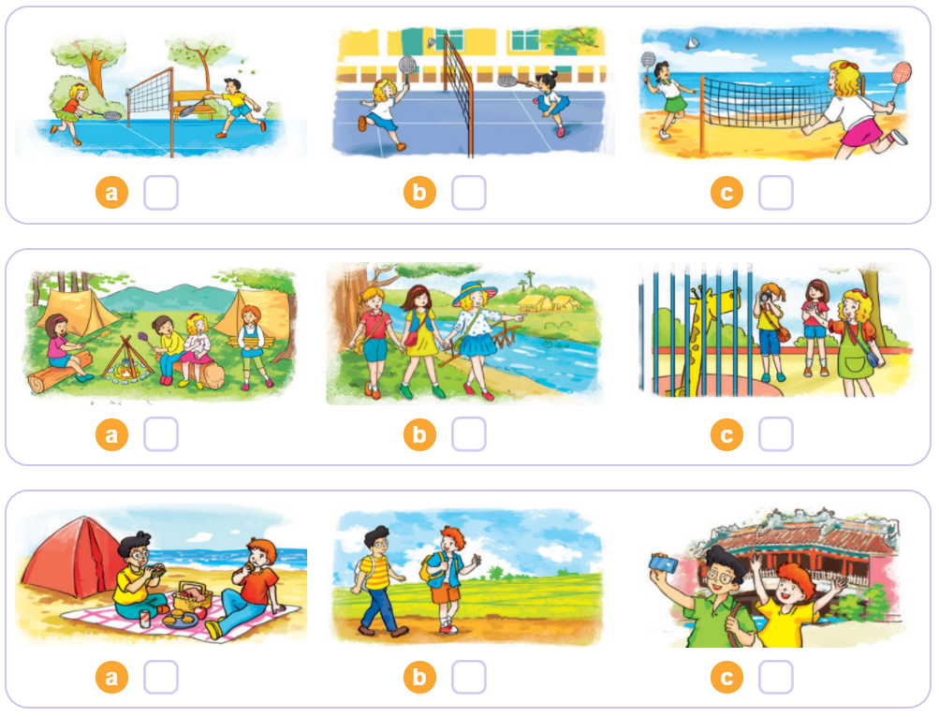

4. Listen and tick
1
2
3

Slide 26
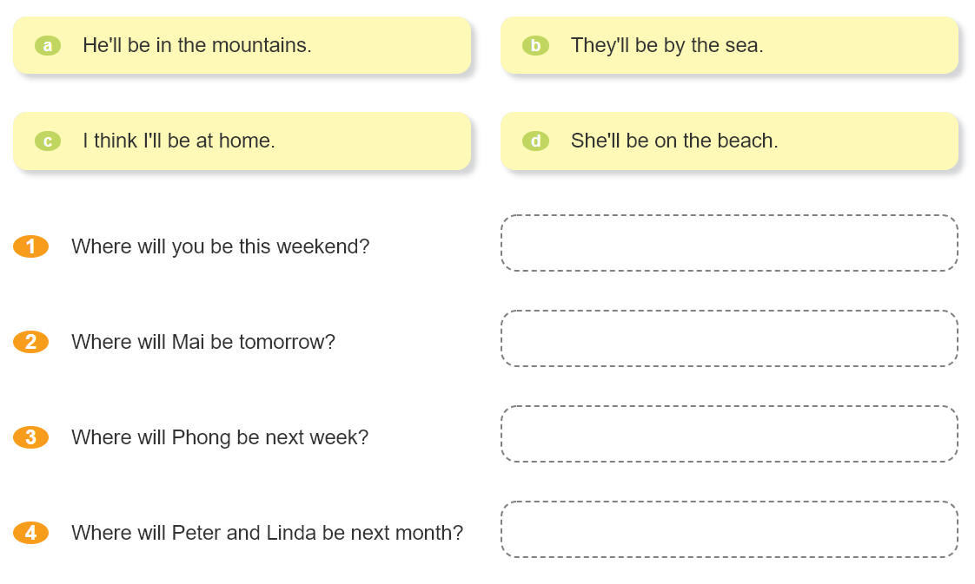

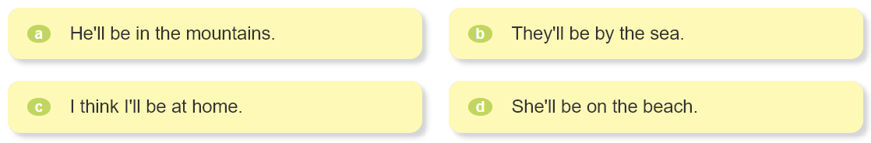
5. Read and match.

Slide 27
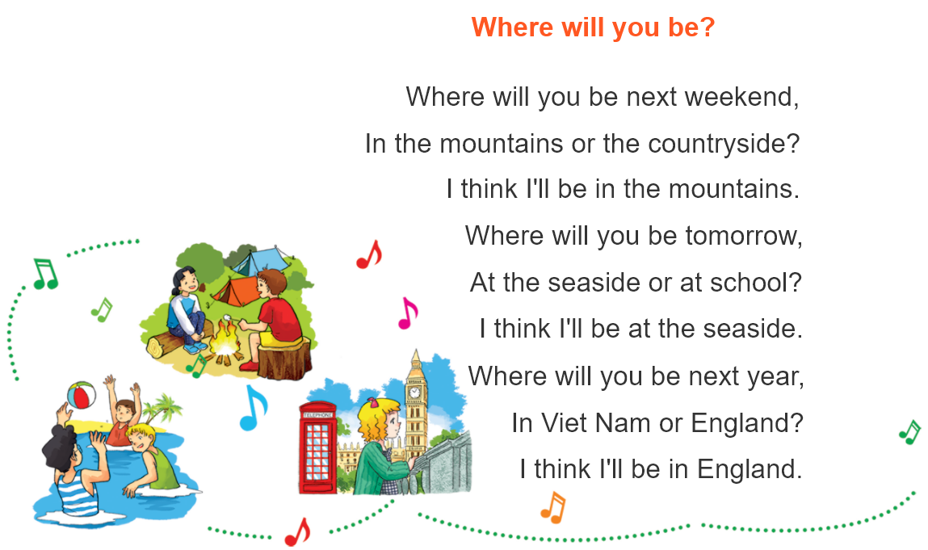


6. Let’s sing.

