Slide 1


My birthday party
4
Lesson 2 – Period 3

Slide 2


Table of contents
Warm-up
Activity 1
Activity 2
01
02
03
Look, listen and repeat.
Listen, point and say.
Let’s sing.
04
Activity 3
05
Game
Let’s talk.

Slide 3
01
Warm-up
Let’s sing.

Slide 4
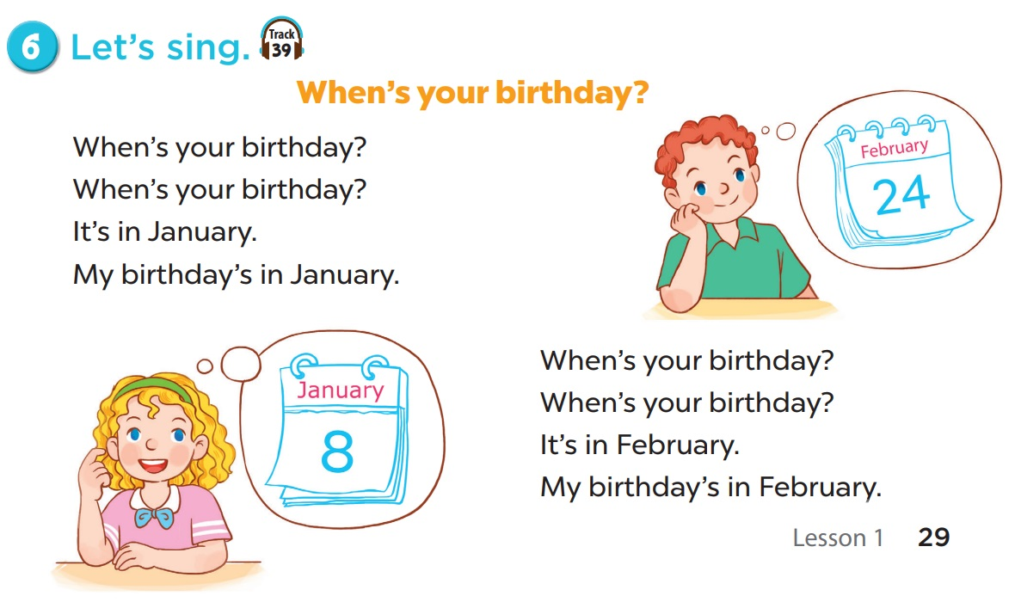


Slide 5
02
Activity 1
Look, listen and repeat.

Slide 6
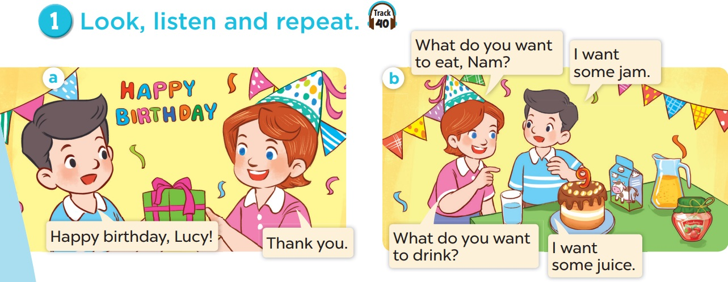
Look and listen.

Slide 7
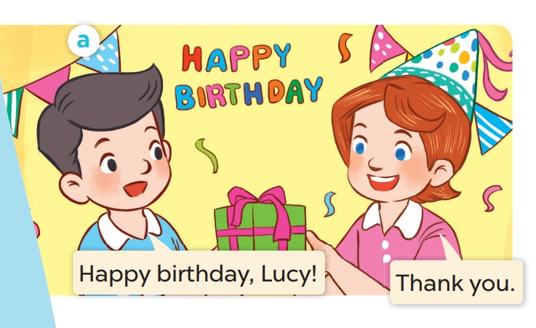
Listen and repeat.

Slide 8
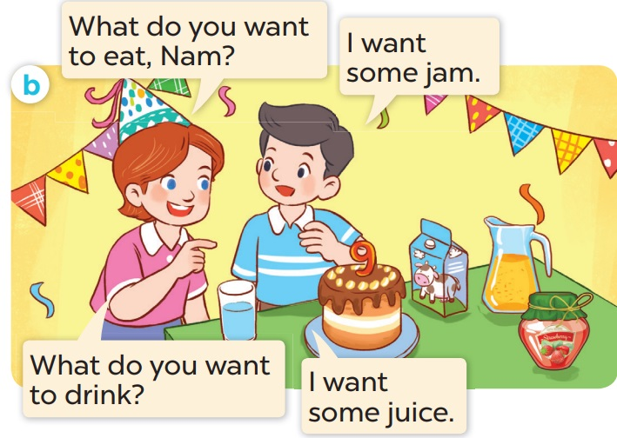
Listen and repeat.

Slide 9
03
Activity 2
Listen, point and say.

Slide 10

chips

Slide 11

grapes

Slide 12

jam

Slide 13

lemonade

Slide 14
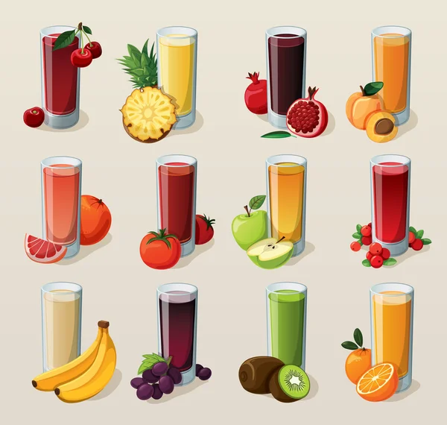
juice

Slide 15
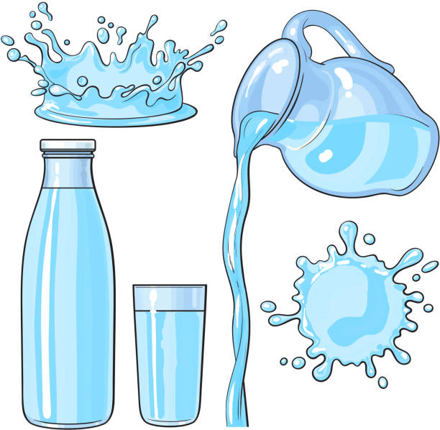
water

Slide 16
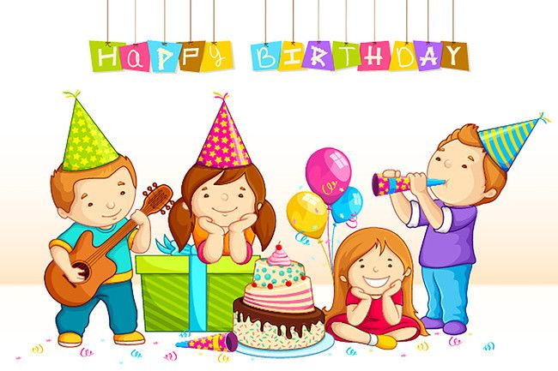
party

Slide 17
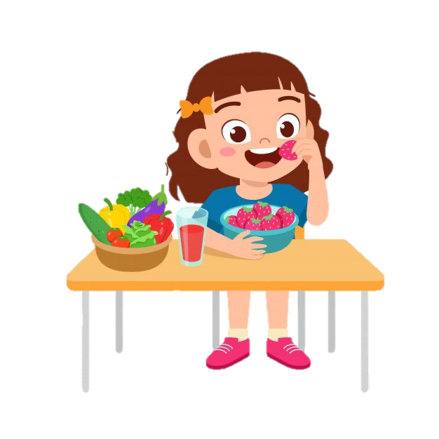
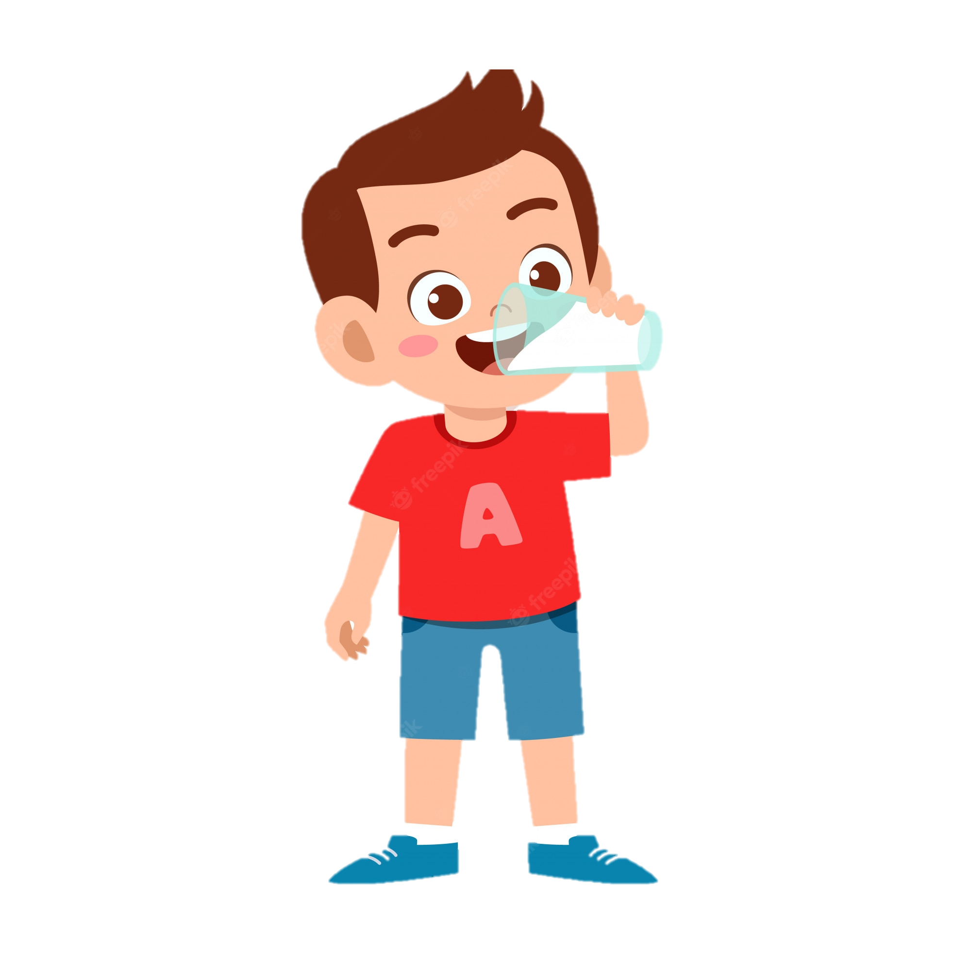
eat
drink

Slide 18
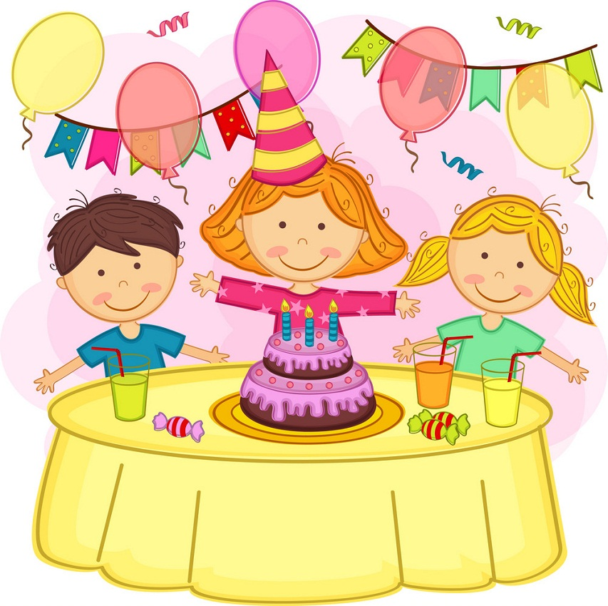
juice
birthday
grapes
chips
jam
party
water
lemonade

Slide 19
What is missing?

Slide 20

chips

Slide 21
party

Slide 22
jam

Slide 23
juice

Slide 24
lemonade

Slide 25
grapes

Slide 26
birthday

Slide 27
water

Slide 28
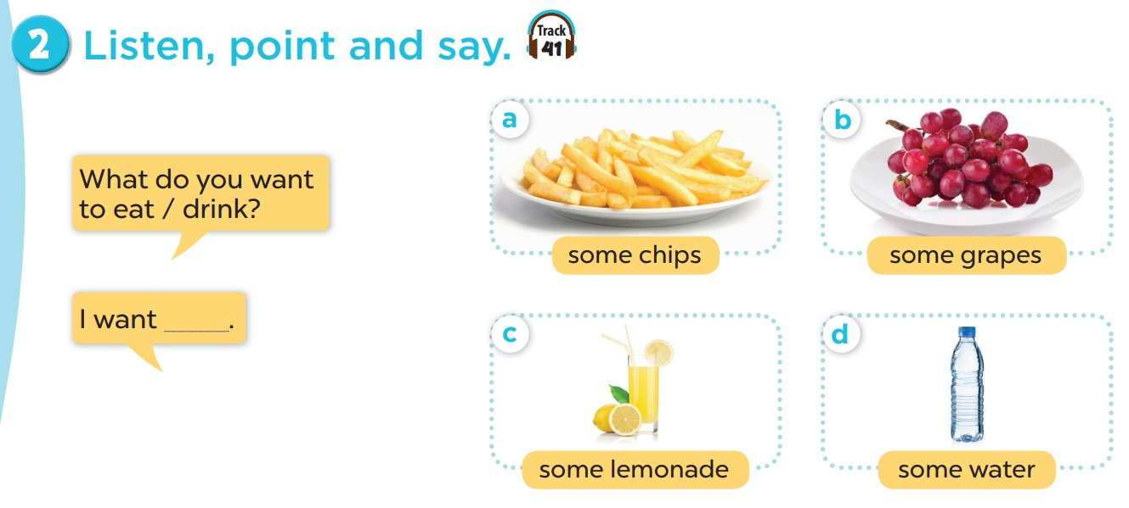
Listen and repeat.

Slide 29
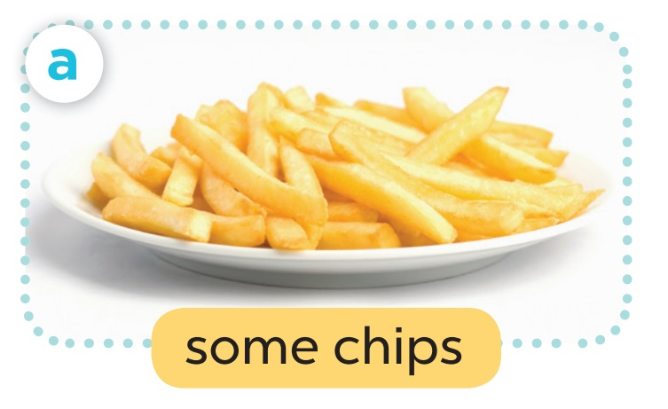
- What do you want to eat?
- I want some chips.

Slide 30
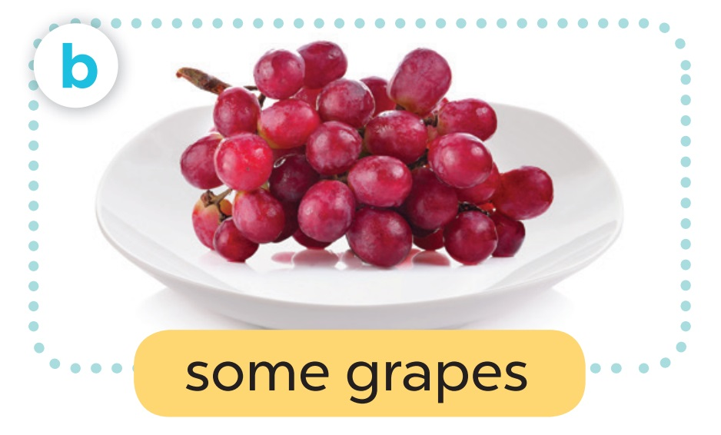
- What do you want to eat?
- I want some grapes.

Slide 31
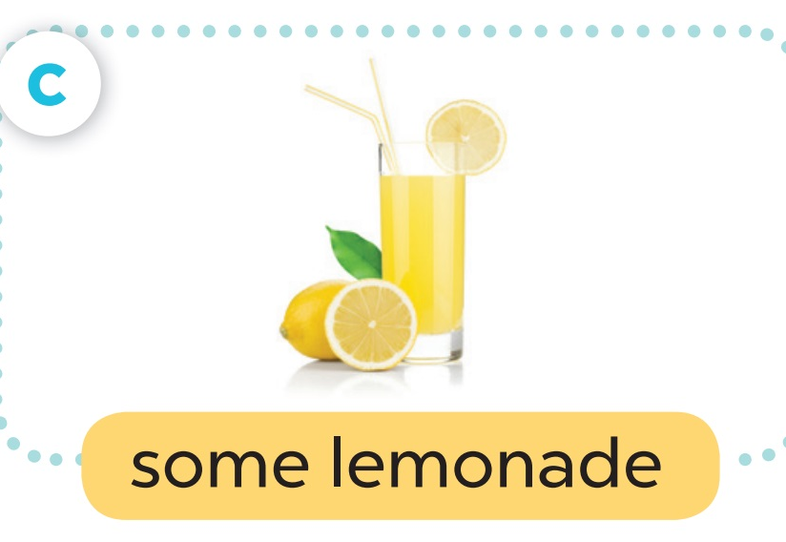
- What do you want to drink?
- I want some lemonade.

Slide 32
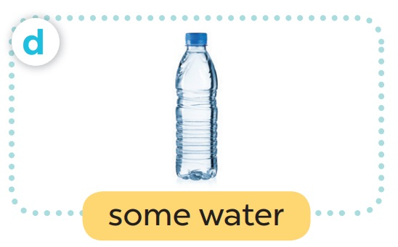
- What do you want to drink?
- I want some water.

Slide 33
04
Activity 3
Let’s talk.

Slide 34
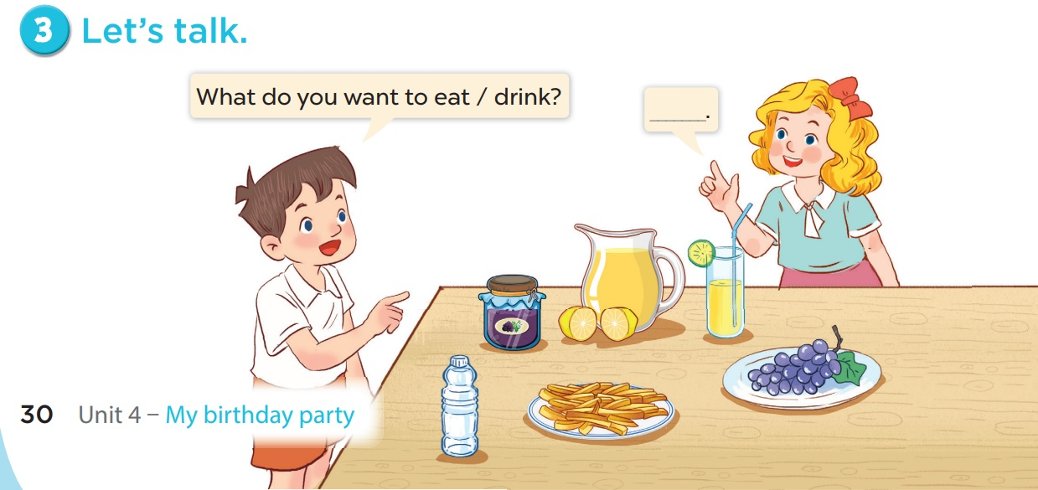

Slide 35
06
Game

Slide 36






BOMB STAR GAME
Choose one number to open the question.
Answer the question.
Lose the turn.
Write (A – B – C) on your white board to answer the questions.
Correct – get points behind the star.
Incorrect – no points.

Slide 37














BOMB STAR
+2
+2
+5
+3
+5
+2
+4
+1
+3
+1

Slide 38
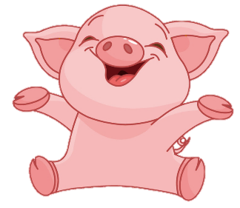


I want to eat some ____.
Back
A
B
C
juice
jam
grapes

Slide 39
I want to eat some ____.
Back
A
B
C
chips
grapes
jam

Slide 40
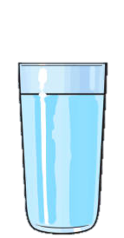
I want to drink some ____.
Back
A
B
C
lemonade
juice
water

Slide 41
I want to drink some ____.
Back
A
B
C
lemonade
juice
water

Slide 42
I want to ___ some juice.
Back
A
B
C
eat
drink
want

Slide 43
I want to ___ some chips.
Back
A
B
C
eat
drink
want

Slide 44
It’s a birthday ___.
Back
A
B
C
happy
party
music

Slide 45
Happy _____!
Back
A
B
C
school
party
birthday

