Slide 1









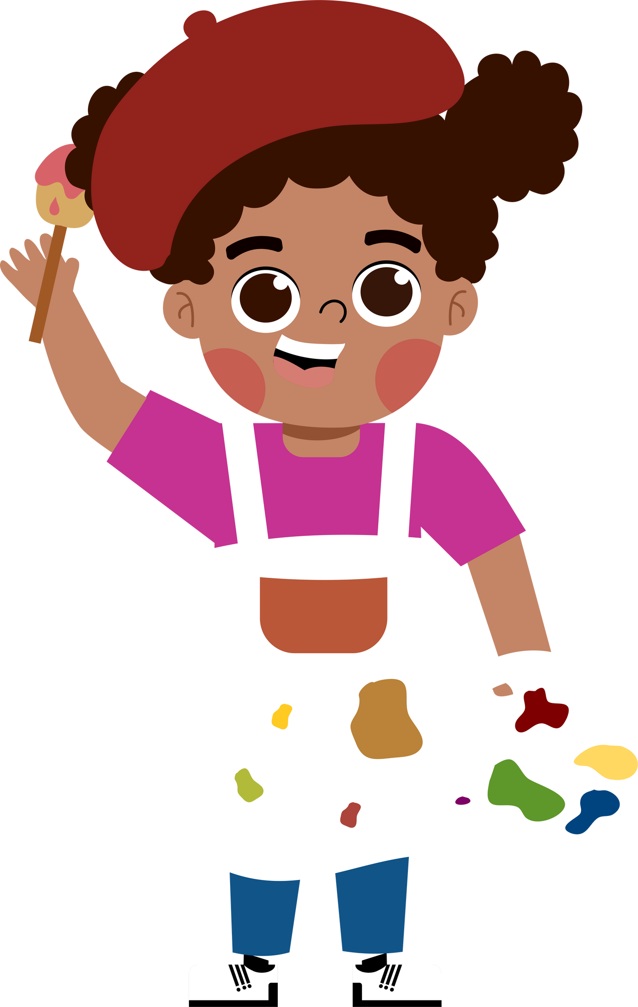








5
My future job
  Lesson 3 - Period 5

Slide 2





TABLE OF CONTENTs
  01. Warm-up and Review
  02. Listen and repeat.
  03. Circle, listen and check.
  04. Let's chant.
  05. Fun corner and Wrap-up

Slide 3




01.
Warm-up and Review
  Unscramble the letters.

Slide 4


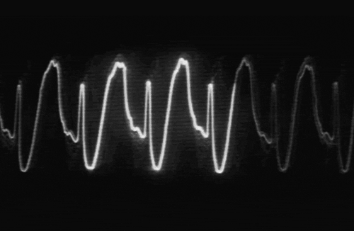


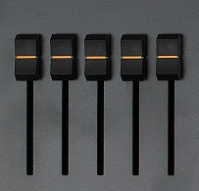




T R D C O O
DOCTOR
Notes:
Click on the red button to reveal the answer.

Slide 5
T I E R W R
WRITER
Notes:
Click on the red button to reveal the answer.

Slide 6
C H T R E A E
TEACHER
Notes:
Click on the red button to reveal the answer.

Slide 7
I S N T E D T
DENTIST
Notes:
Click on the red button to reveal the answer.

Slide 8
R I F E G T R E F H I
FIREFIGHTER
Notes:
Click on the red button to reveal the answer.

Slide 9
N E R D E R G A
GARDENER
Notes:
Click on the red button to reveal the answer.

Slide 10
R O R P E R E T
REPORTER
Notes:
Click on the red button to reveal the answer.

Slide 11




More jobs
  Guess the job.

Slide 12

artist

Slide 13
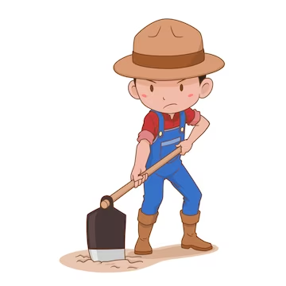
farmer

Slide 14
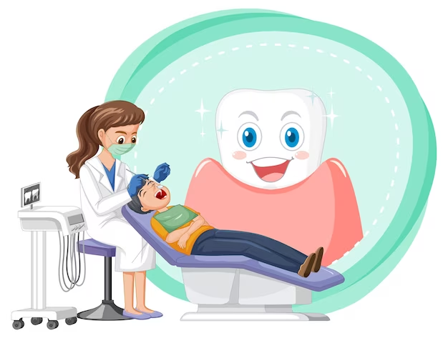
dentist

Slide 15

actor

Slide 16

pilot

Slide 17
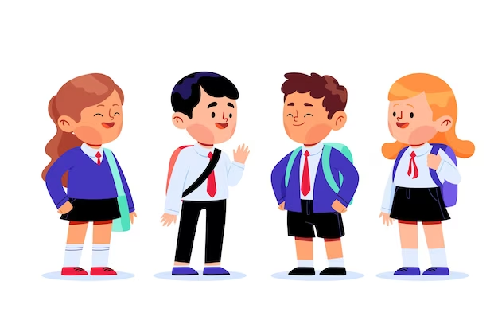
student

Slide 18
02.
Listen and repeat.

Slide 19



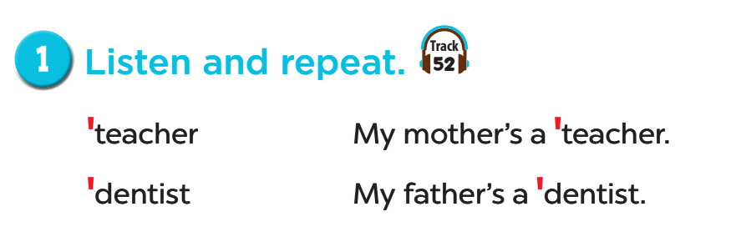


Listen and repeat.

Slide 20
03.
Circle, listen and check.

Slide 21
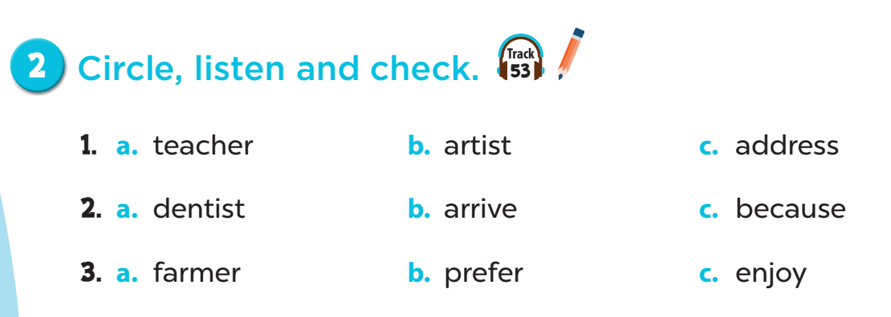
Listen and check.

Slide 22
04.
Let's chant!

Slide 23
1. Close your book.
2. Listen to the chant.
3. Listen again:
- Clap your hands on the stress.

Slide 24
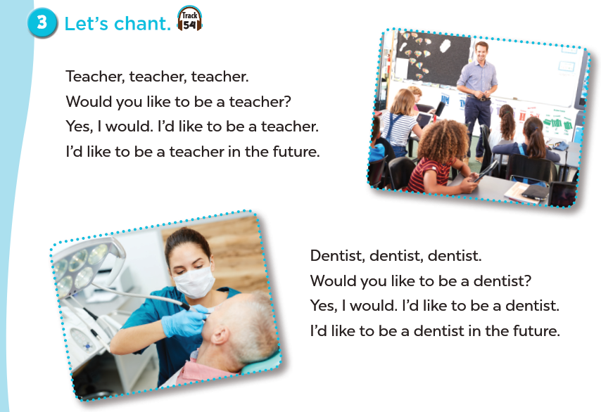

Slide 25
05.
Fun corner and Wrap-up

Slide 26
Game: Pictionary

