Slide 1




Slide 2



6
Our school
LESSON 1 PERIOD 1

Slide 3
Warm-up

Slide 4


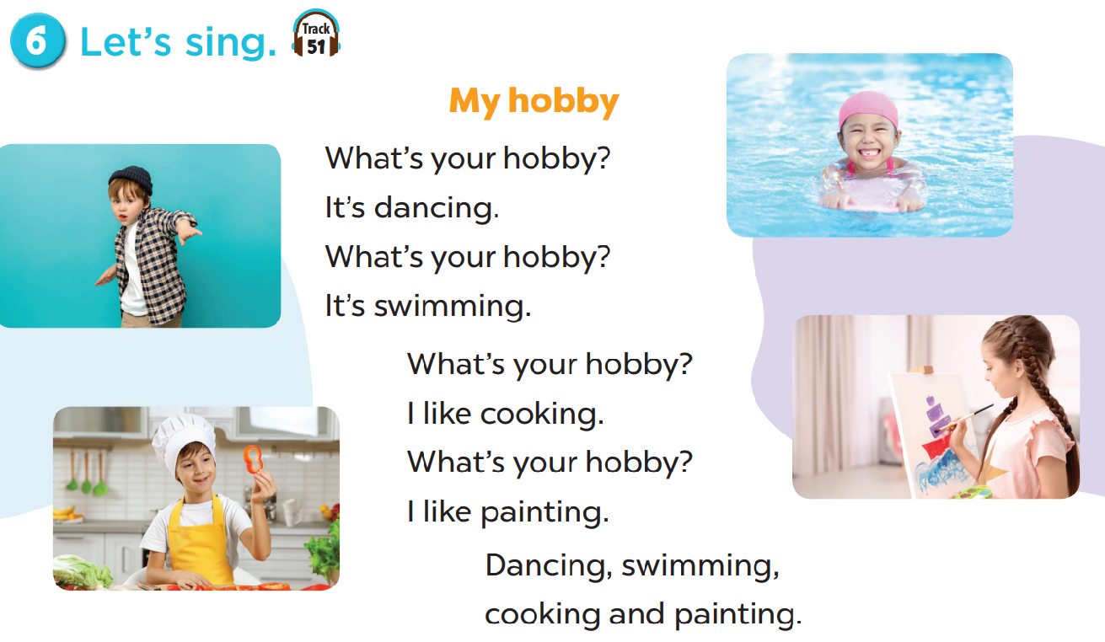

Slide 5

Look, listen and repeat.

Slide 6
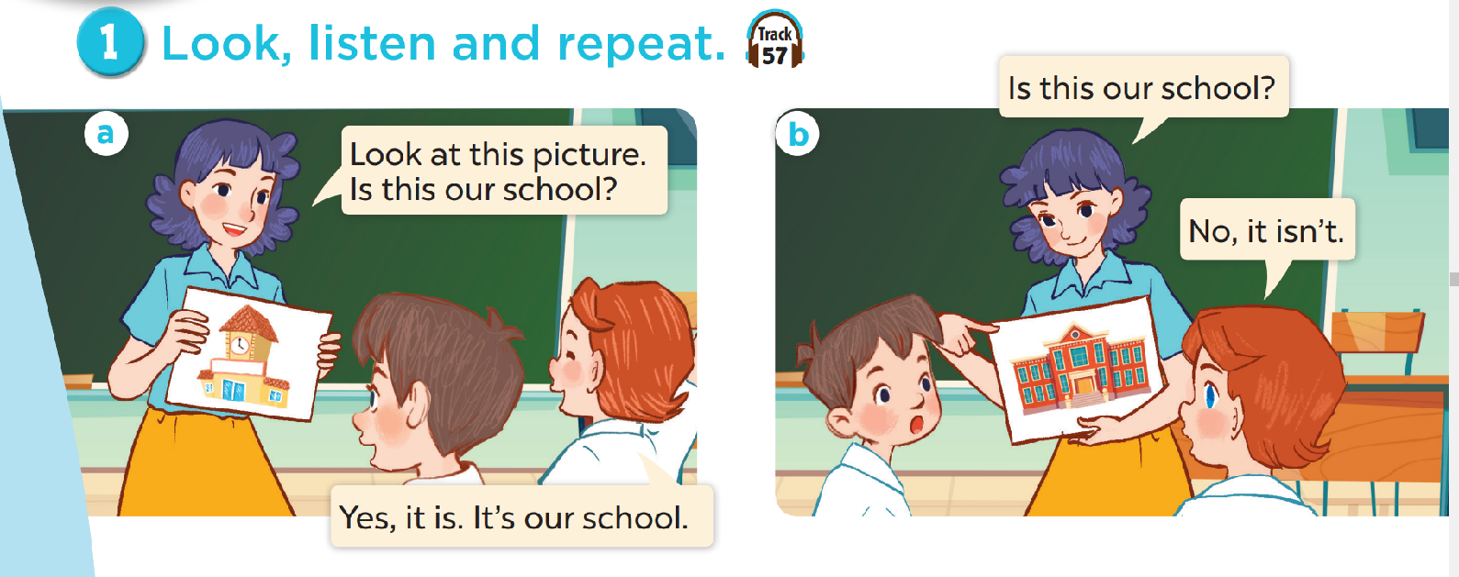
Look and answer the questions.
Where are they?
Who are they?
What are they doing?

Slide 7
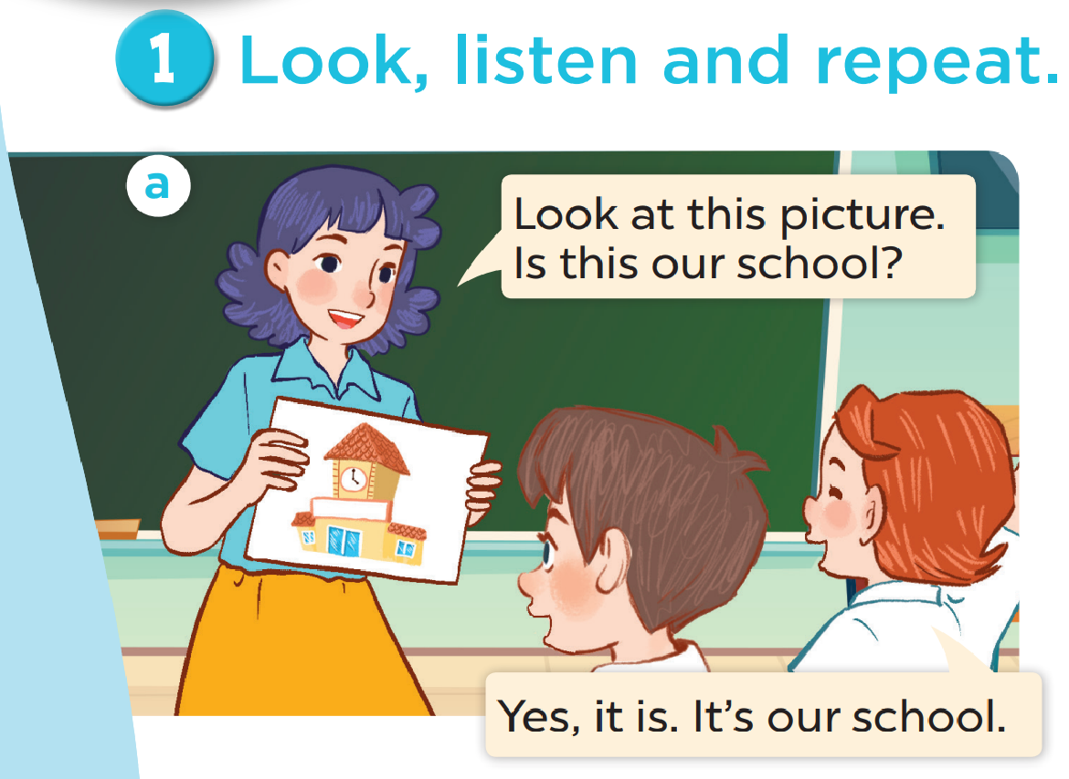

Slide 8
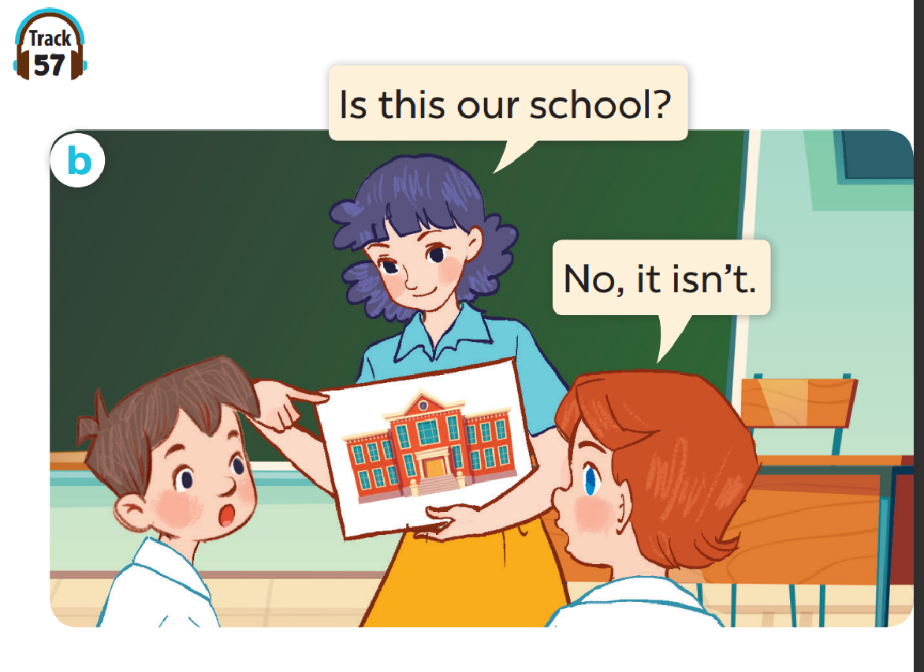

Slide 9
Work in pairs. Practise.
Listen and repeat.

Slide 10

Listen, point and say.

Slide 11
New words

Slide 12
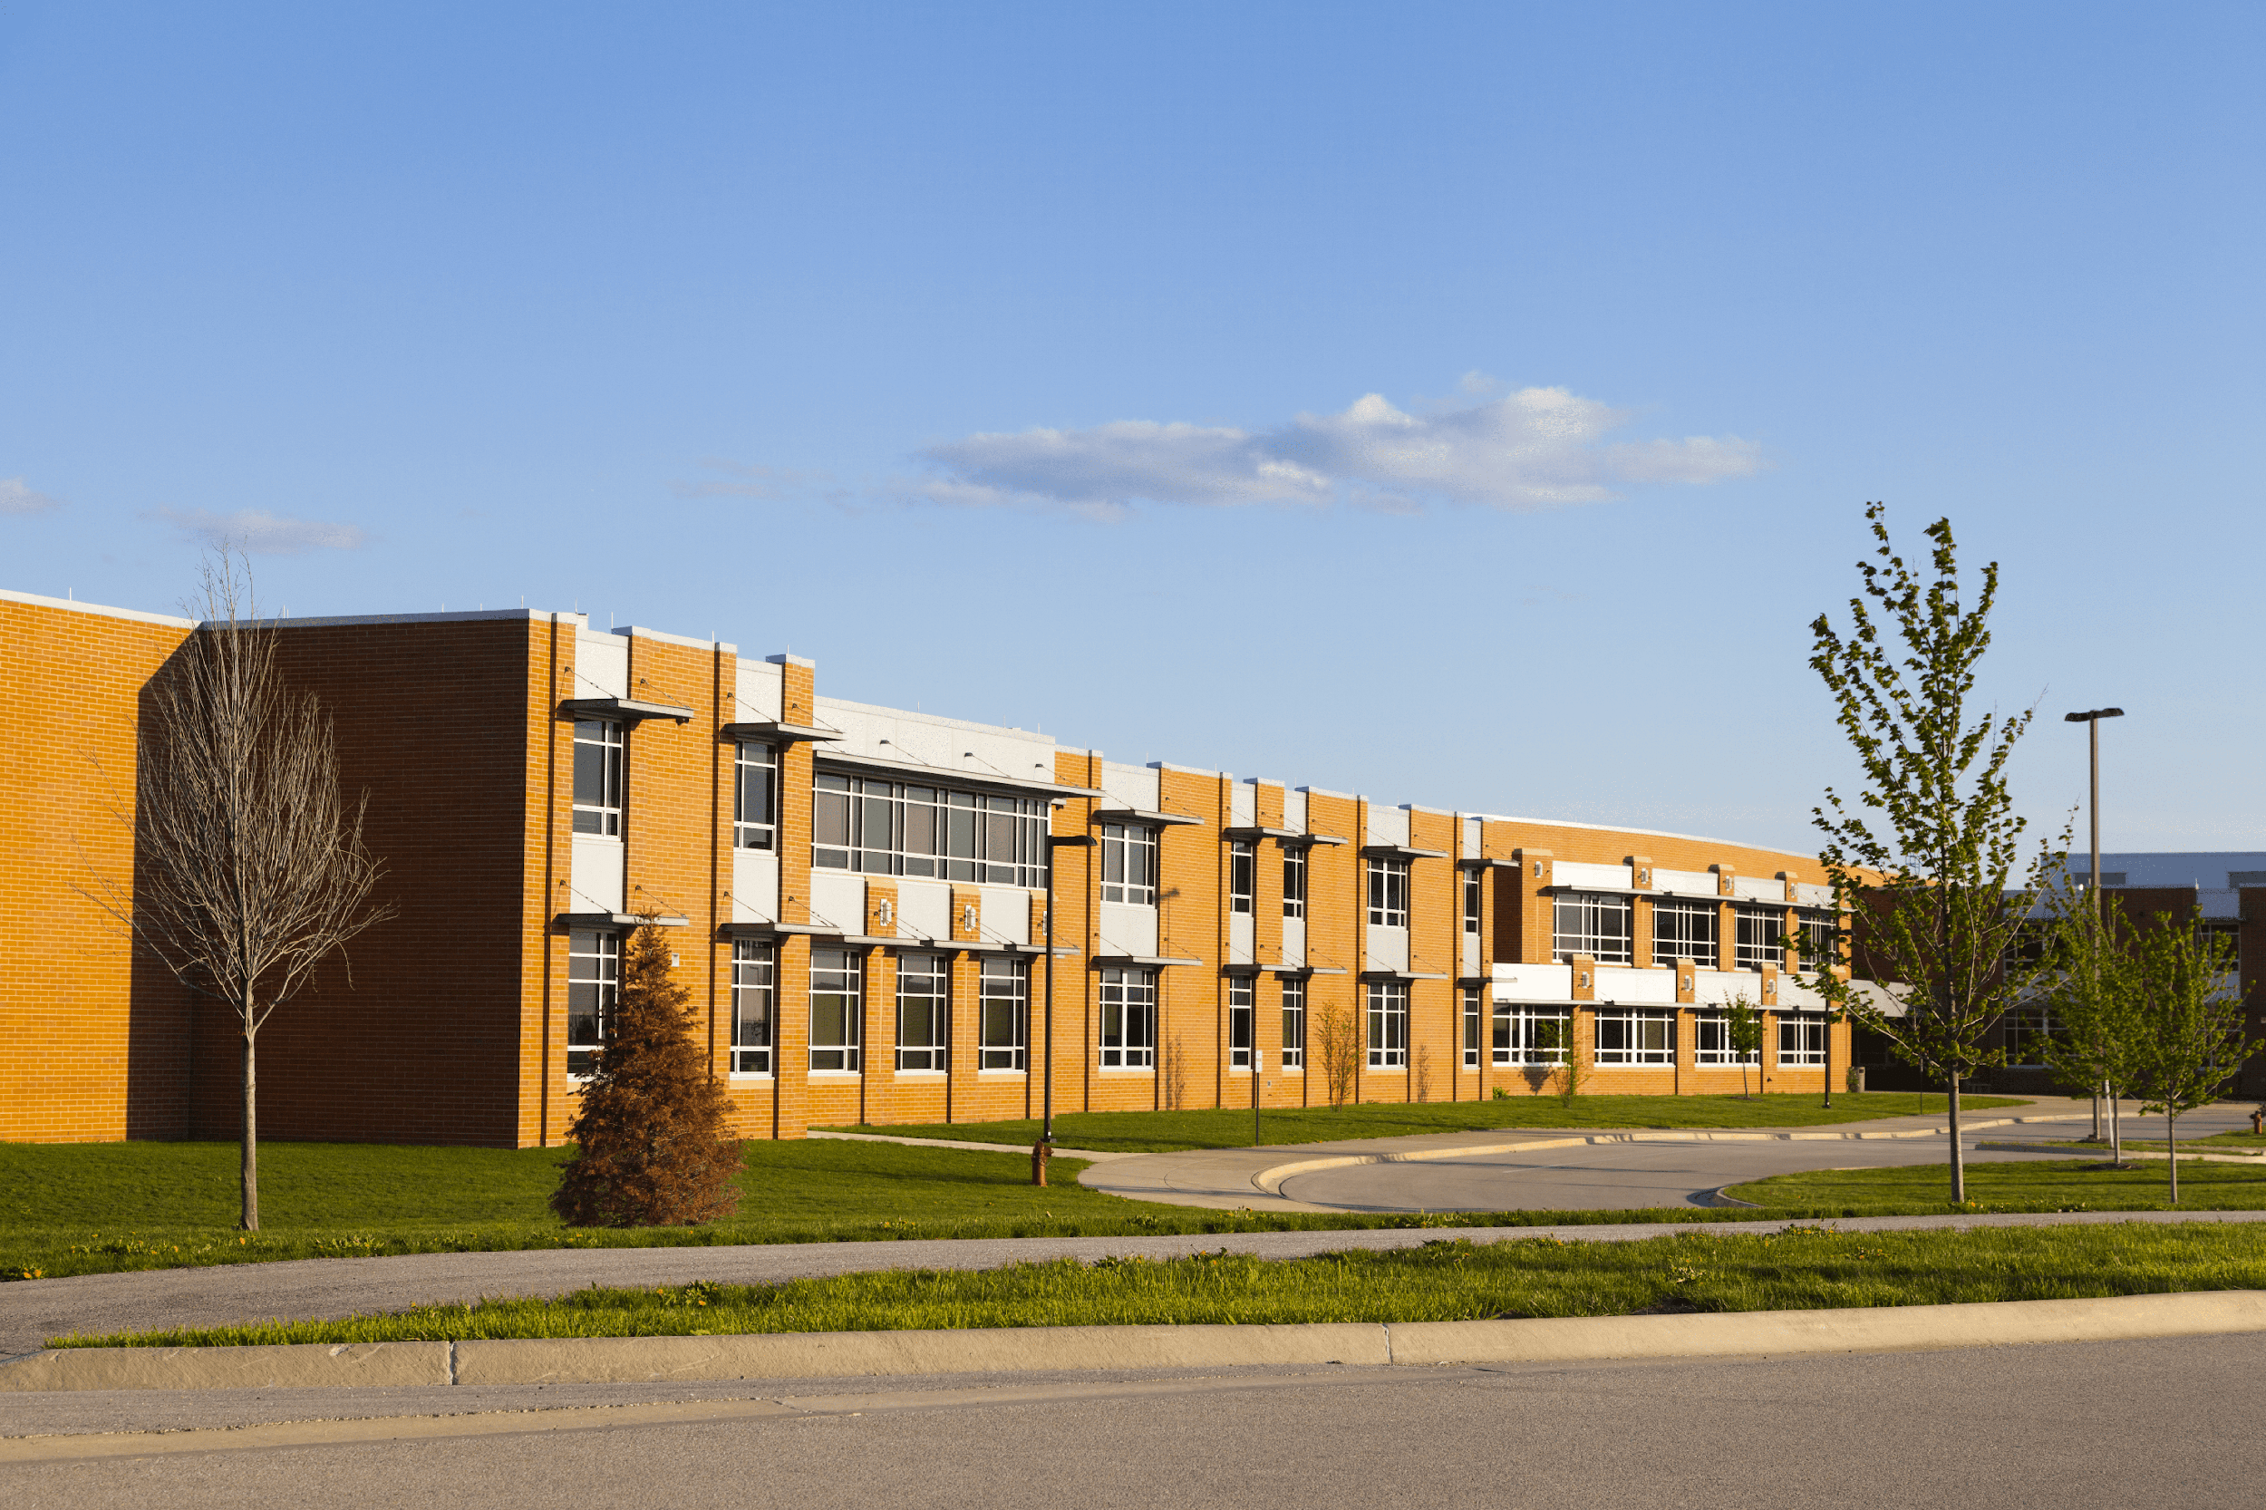
school

Slide 13
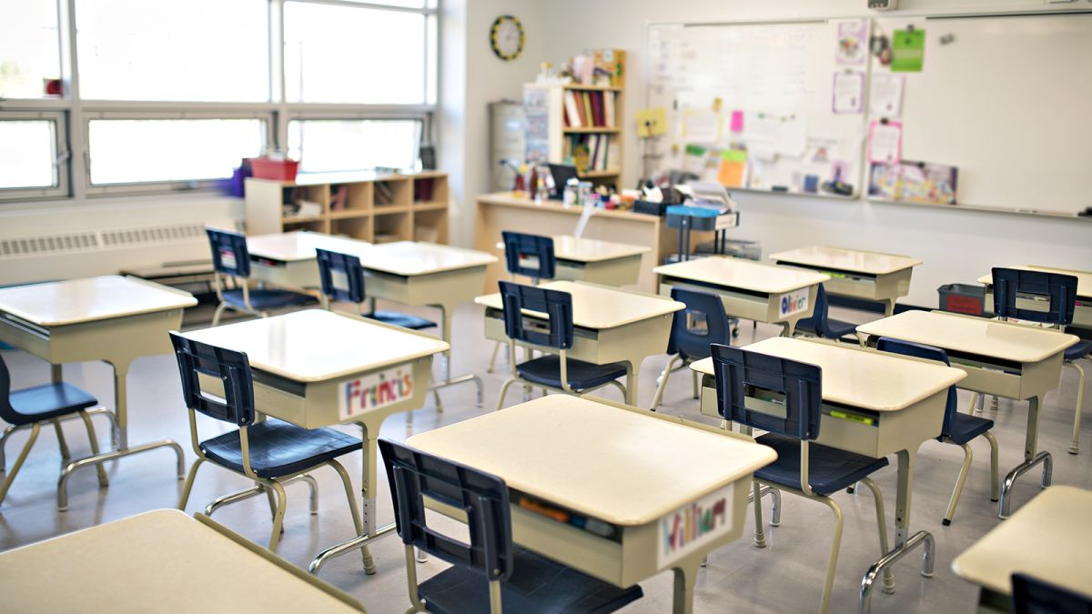
classroom

Slide 14
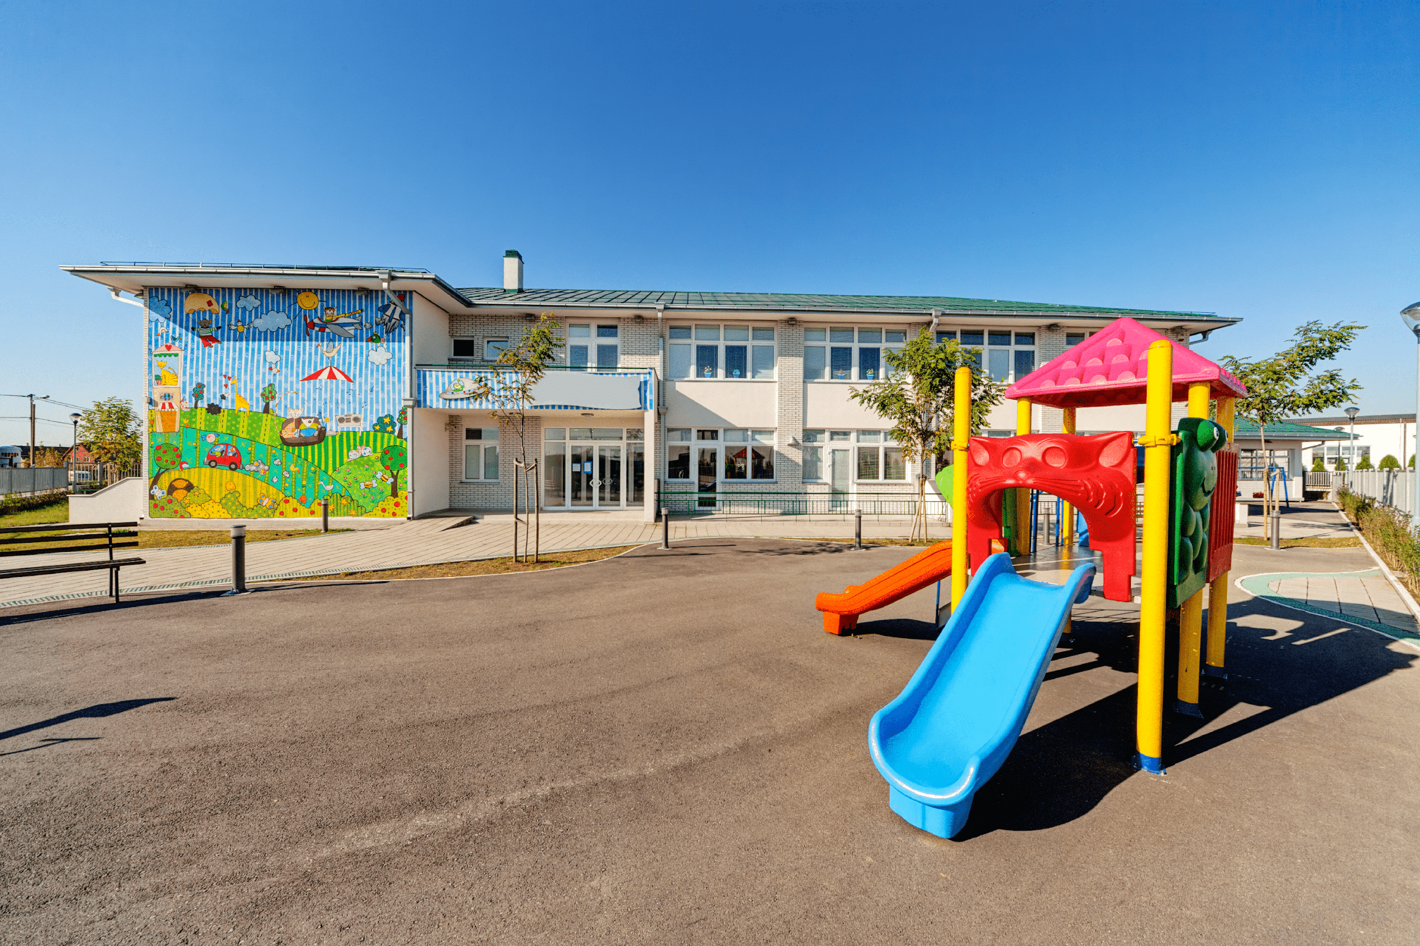
playground

Slide 15
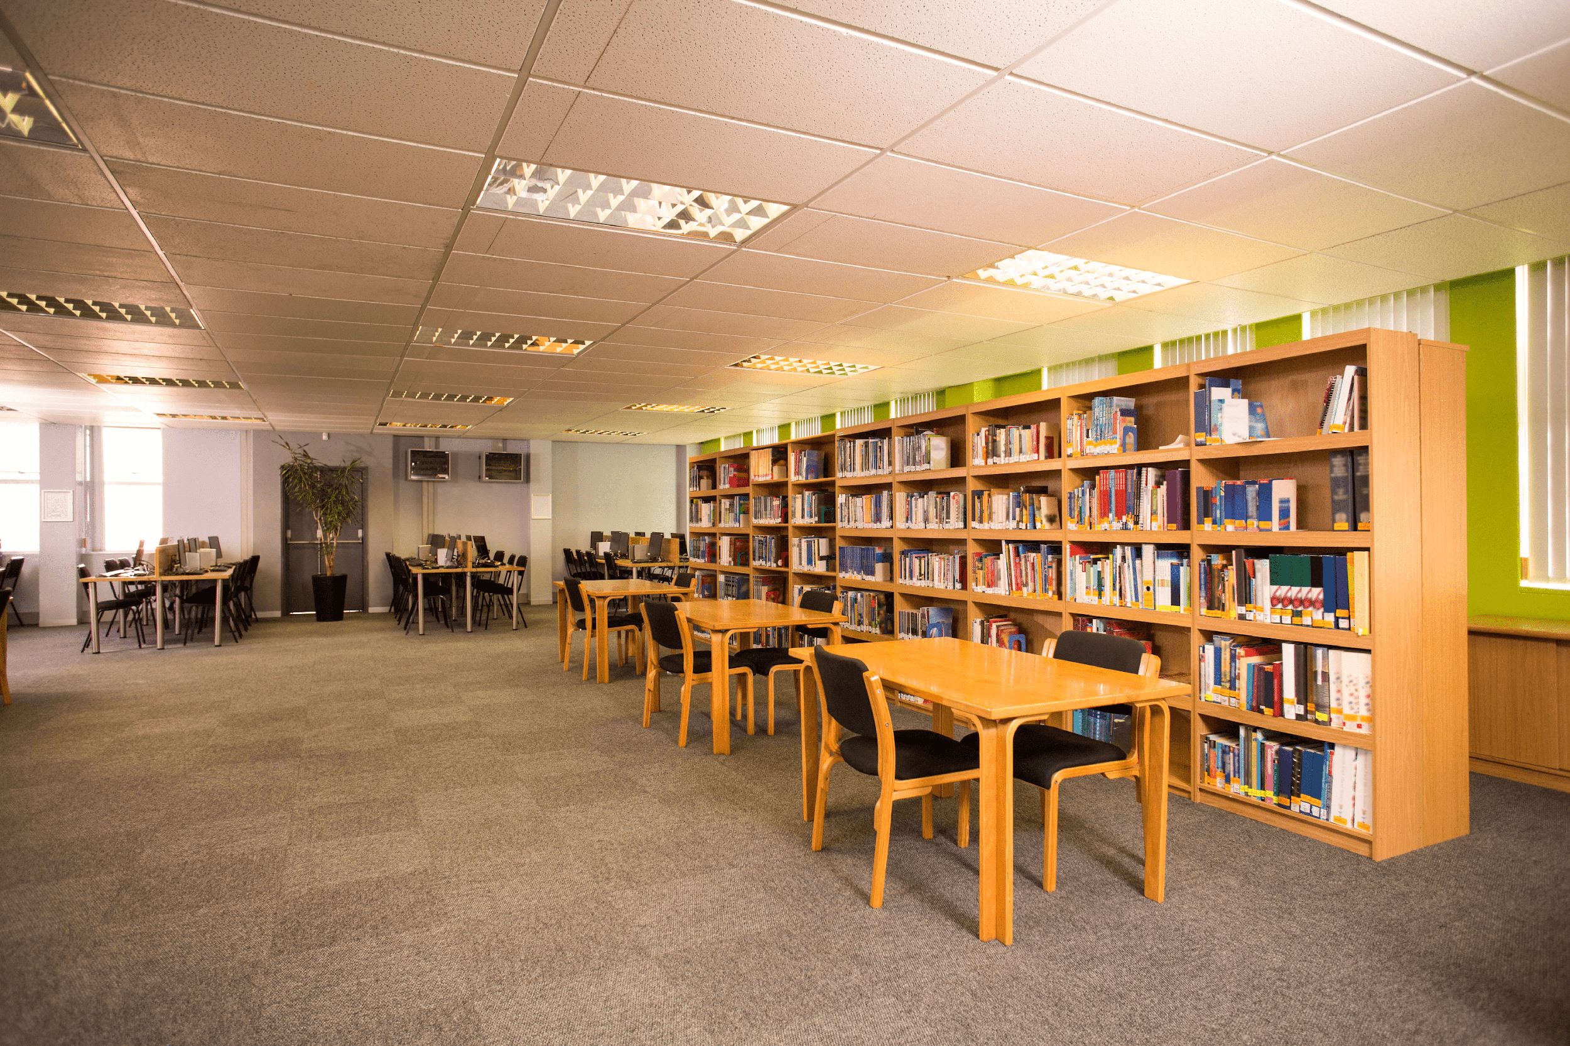
library

Slide 16
Look and guess.

Slide 17


Is this our classroom?
No, it isn’t.
Yes, it is.

Slide 18
Is this our library?
Yes, it is.
No, it isn’t.

Slide 19
Is this our playground?
Yes, it is.
No, it isn’t.

Slide 20
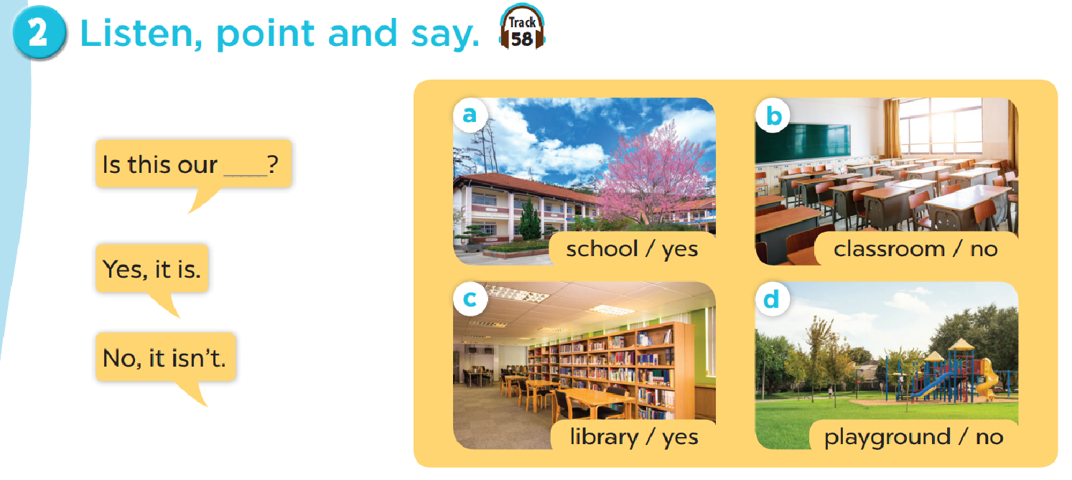
Work in pairs. Practise.

Slide 21

Let’s talk.

