Slide 1

WARM-UP AND REVIEW

Slide 2

Is this your classroom?
Yes, it is.

Slide 3
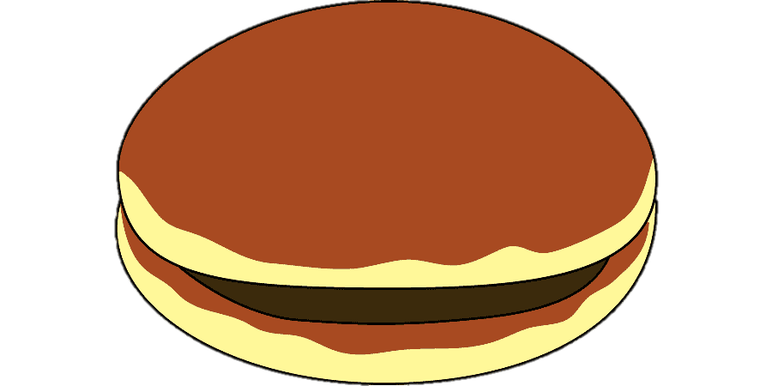
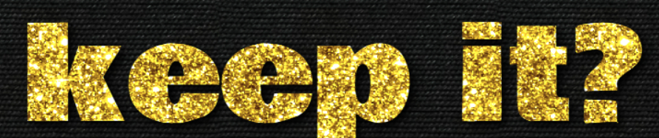
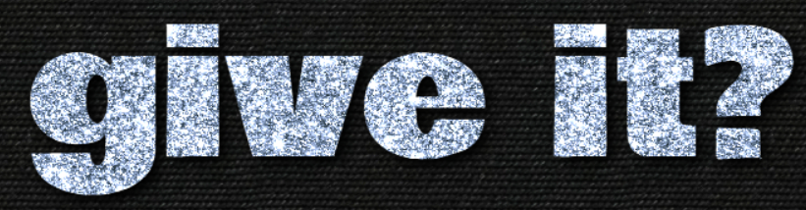
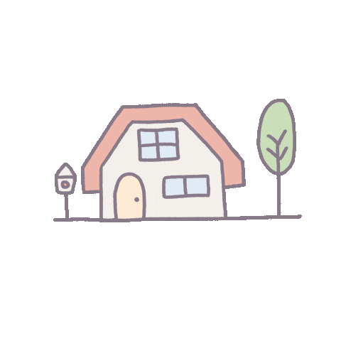
2 points
or

Slide 4
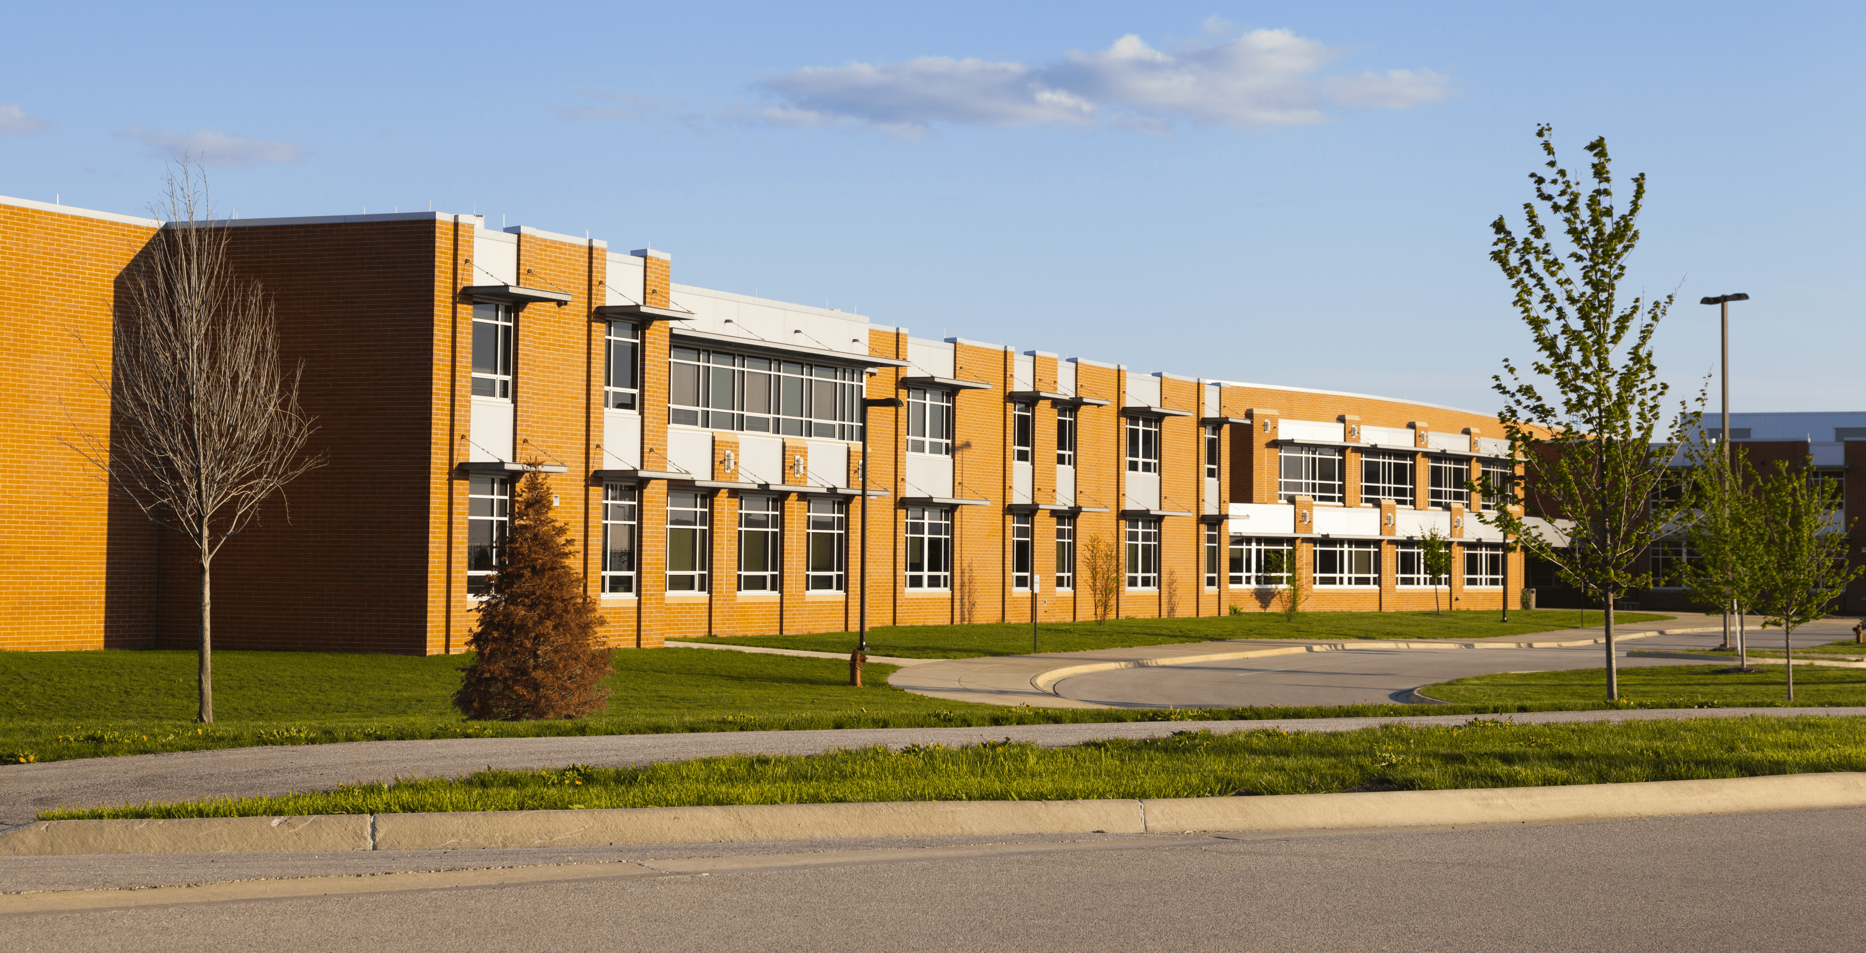
Is this your school?
Yes, it is.

Slide 5
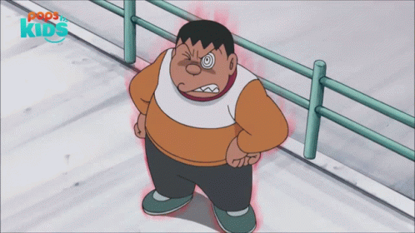

- 1 point
or

Slide 6
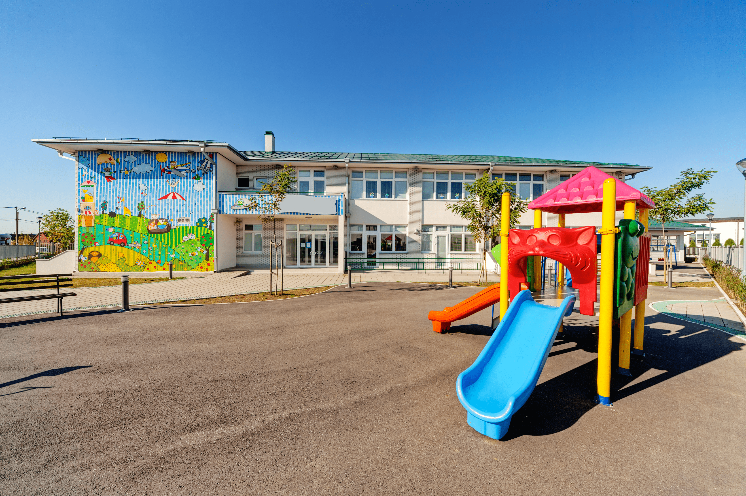

Is that our playground?
Yes, it is.

Slide 7
3 points
or

Slide 8
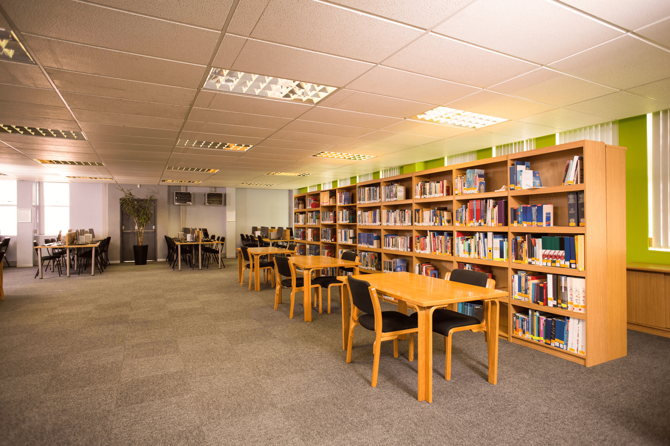
We like reading books.
Let’s go to the library.

Slide 9
- 2 points
or

Slide 10
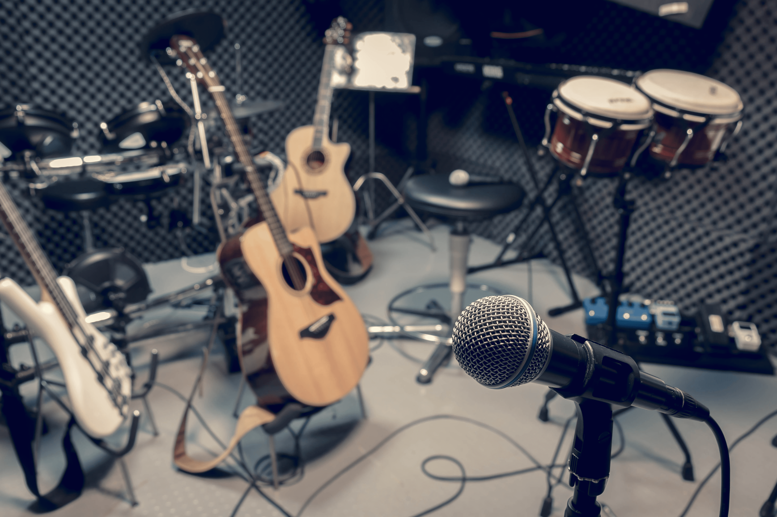
I like playing the piano.
Let’s go to the music room.

Slide 11
4 points
or

Slide 12
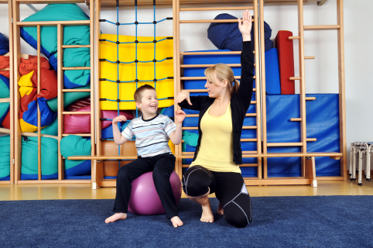
We like playing sports.
Let’s go to the gym.

Slide 13
3 points
or

Slide 14

I like computers.
Let’s go to the computer room.

Slide 15
6 points
or

Slide 16
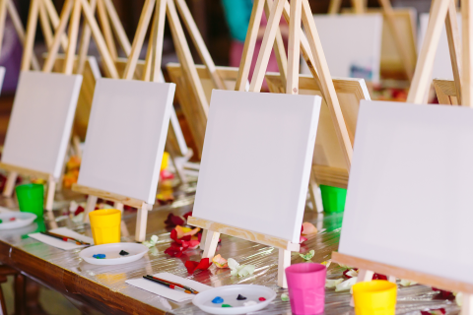
I like drawing pictures.
Let’s go to the art room.

Slide 17
0 point
or

Slide 18
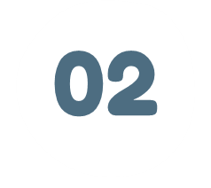
LISTEN AND REPEAT.

Slide 19


ayground
pl

Slide 20
assroom
cl

Slide 22

LISTEN AND CIRCLE.

Slide 24

LET’S CHANT.

Slide 25


