Slide 1



Things we can do
5
LESSON 1 PERIOD 2

Slide 2
Contents
Warm up Review vocabulary
01
04
02
Activity 2 Listen and tick.
Activity 3
Look, complete and read.
05
Activity 4 Let’s play.
06
Games

Slide 3
01
Warm-up

Slide 4

Look and guess.
Then say for you.
I can ....... .
I can’t …………..
Notes:
- Divide the class into 3 teams.
- Pupils take turn to answer the questions.
- They look at the hidden pictures and guess what activity is
- If they have the correct answers they get the points for their teams. If the answer is not correct, the other team answers.
- Review models:
Draw pupil’s attention to the picture.
They answer the questions.
Can he play badminton?
Yes, he can. / No, he can't.
Can she swim?
Yes, she can. / No, she can't.

Slide 5

ride a bike

Slide 6

ride a horse

Slide 7

play the piano

Slide 8

fly a kite

Slide 9
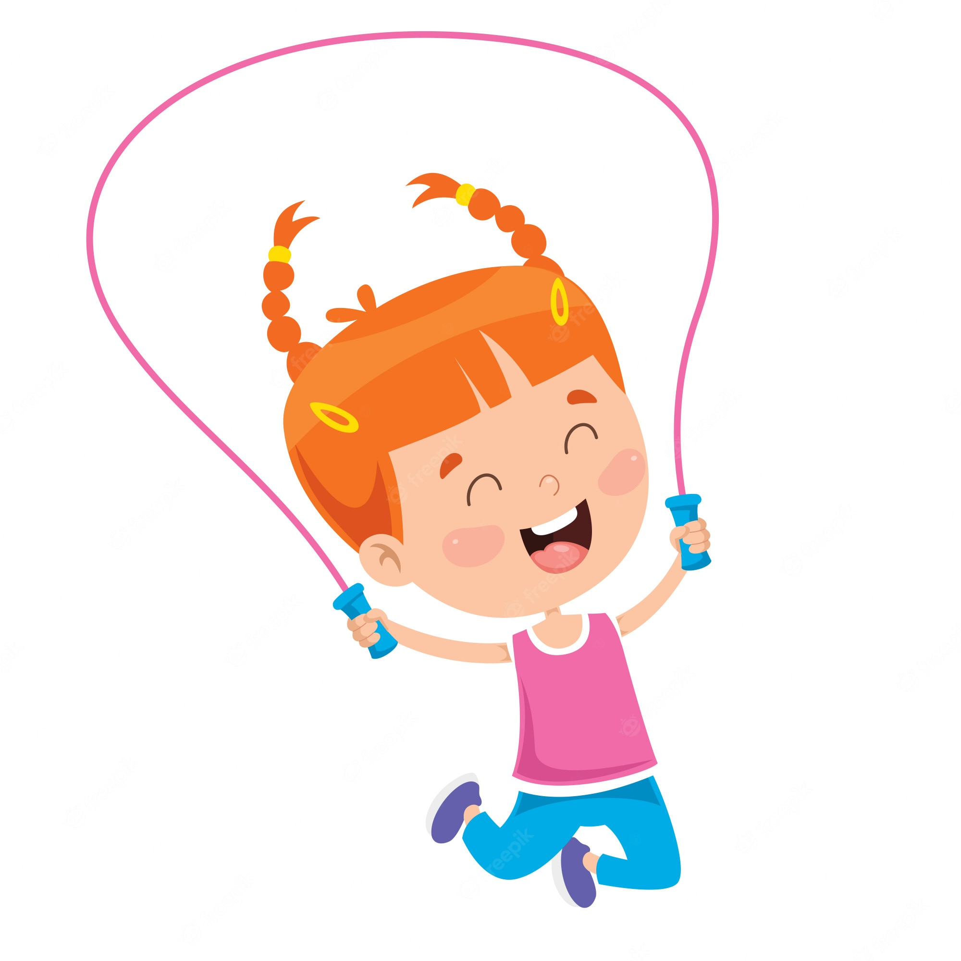
skip

Slide 10

play the guitar

Slide 11
02
Activity 4 Listen and tick.

Slide 12
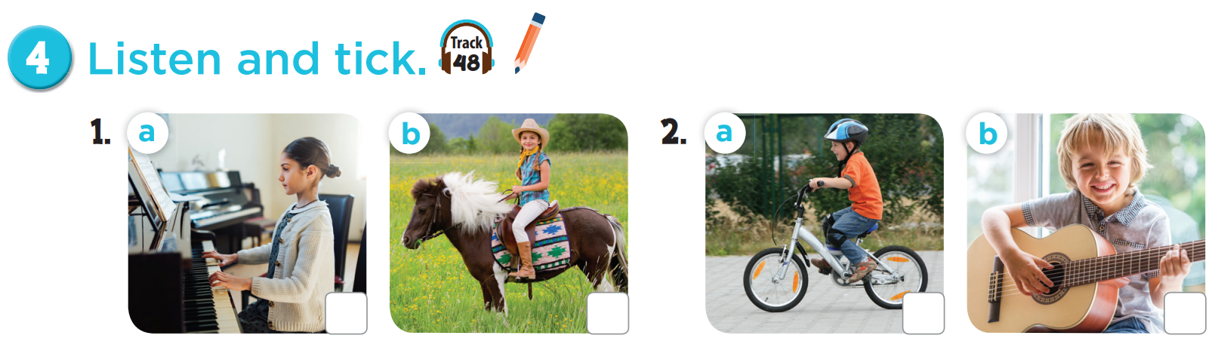


Listen and tick.

Slide 13
03
Activity 5 Look, complete and read.

Slide 14
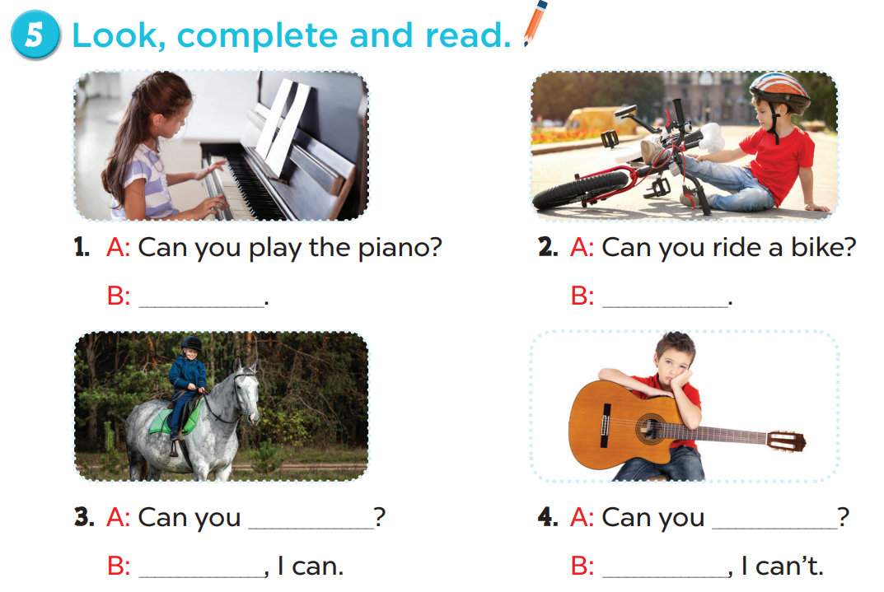
Work in pairs. Practise.
Yes, I can.
No, I can’t
play the guitar
ride a horse
Yes
No

Slide 15
05
Activity 6 Let’s play.

Slide 16
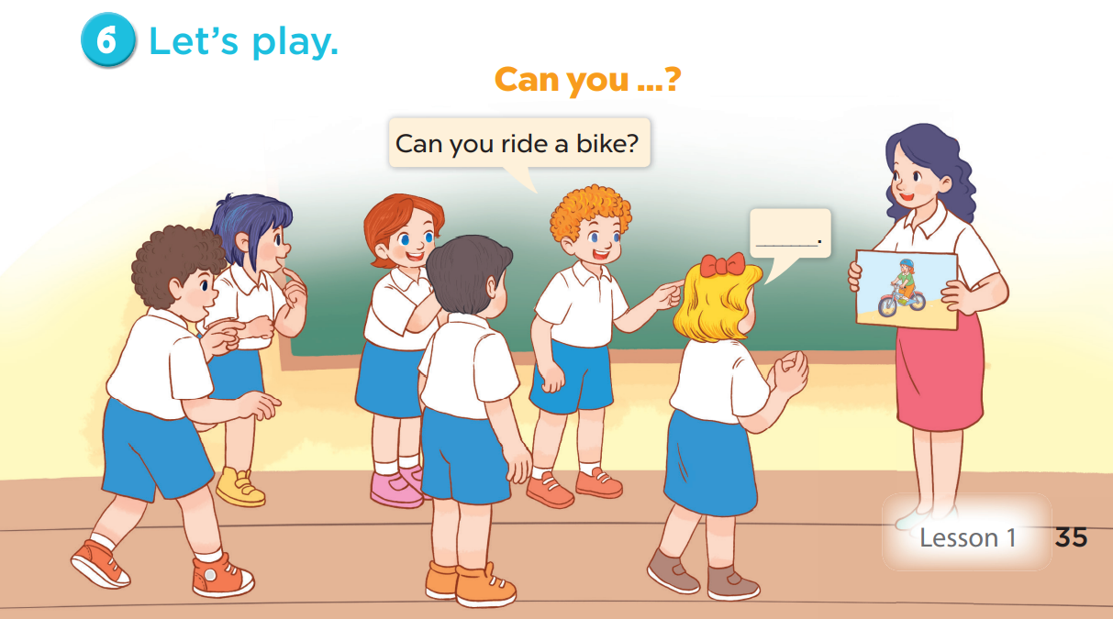

Slide 17
06
Games

Slide 18

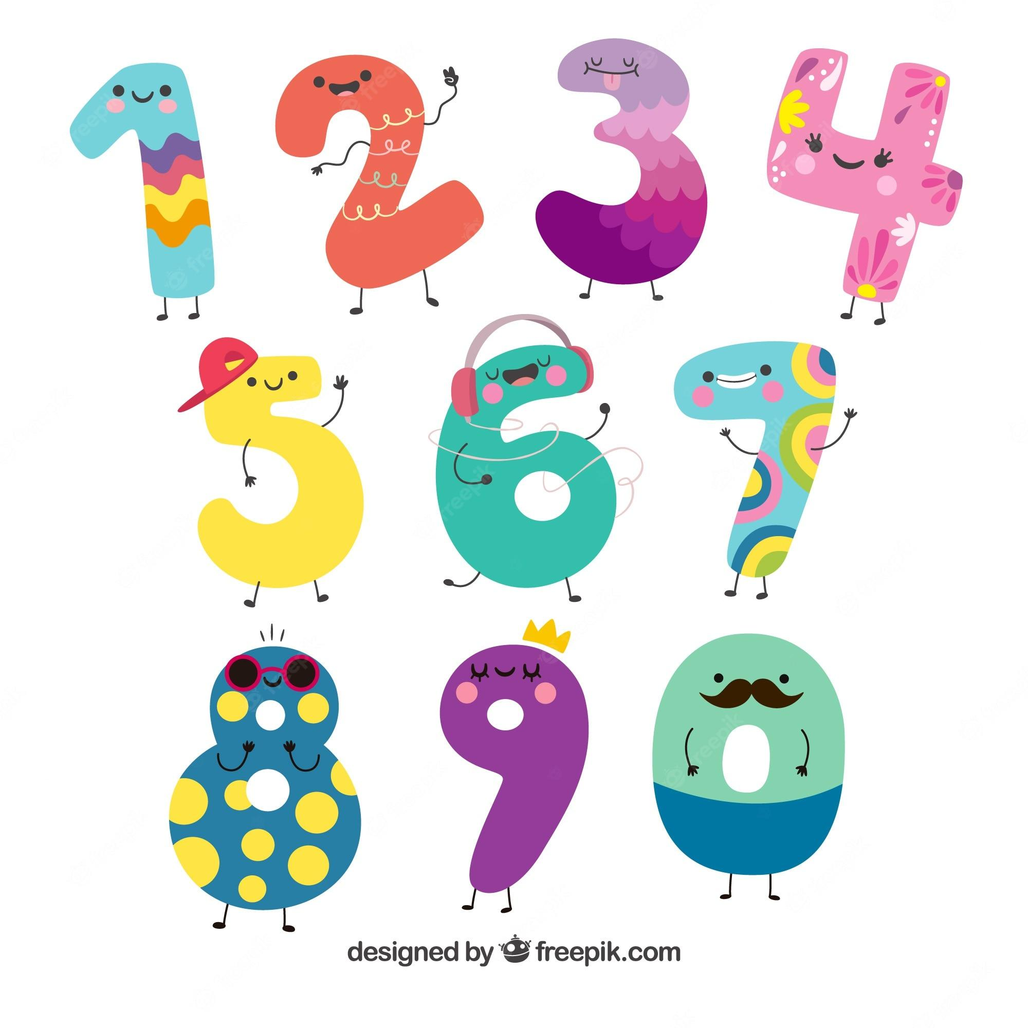
Lucky number!

Slide 19
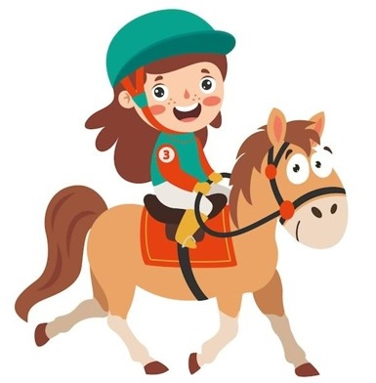

Can you ….………………….?
ride a horse
….., I can’t.
Back
No
Notes:
DICE ROLL GAME

Slide 20
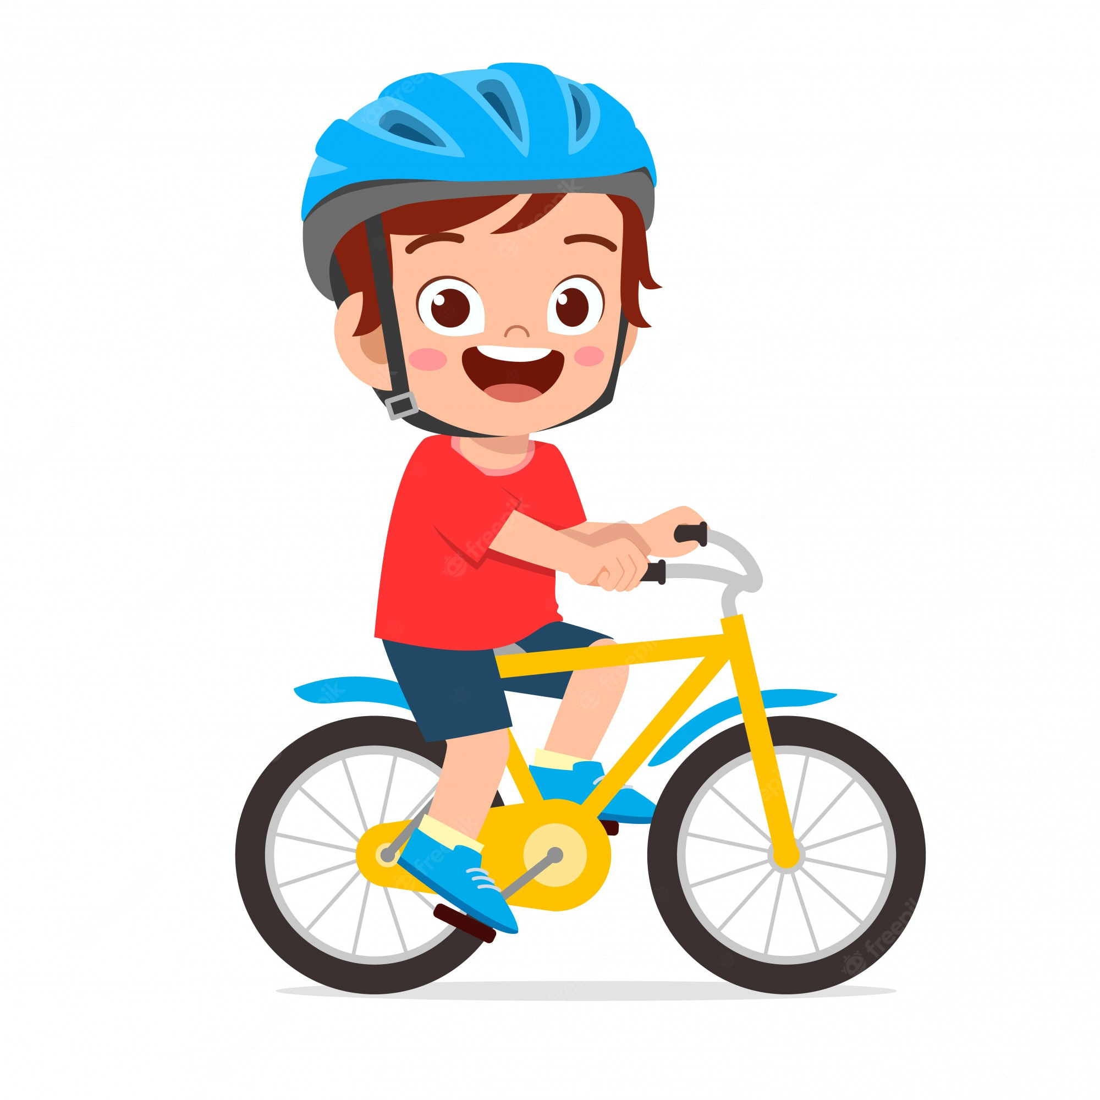
Can you ………………….?
ride a bike
….., I can’t.
Back
No

Slide 21
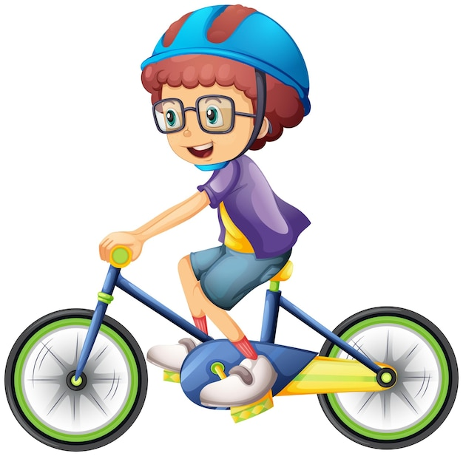

Can you ………………….?
ride a bike
Yes, …………..
I can
Back

Slide 22
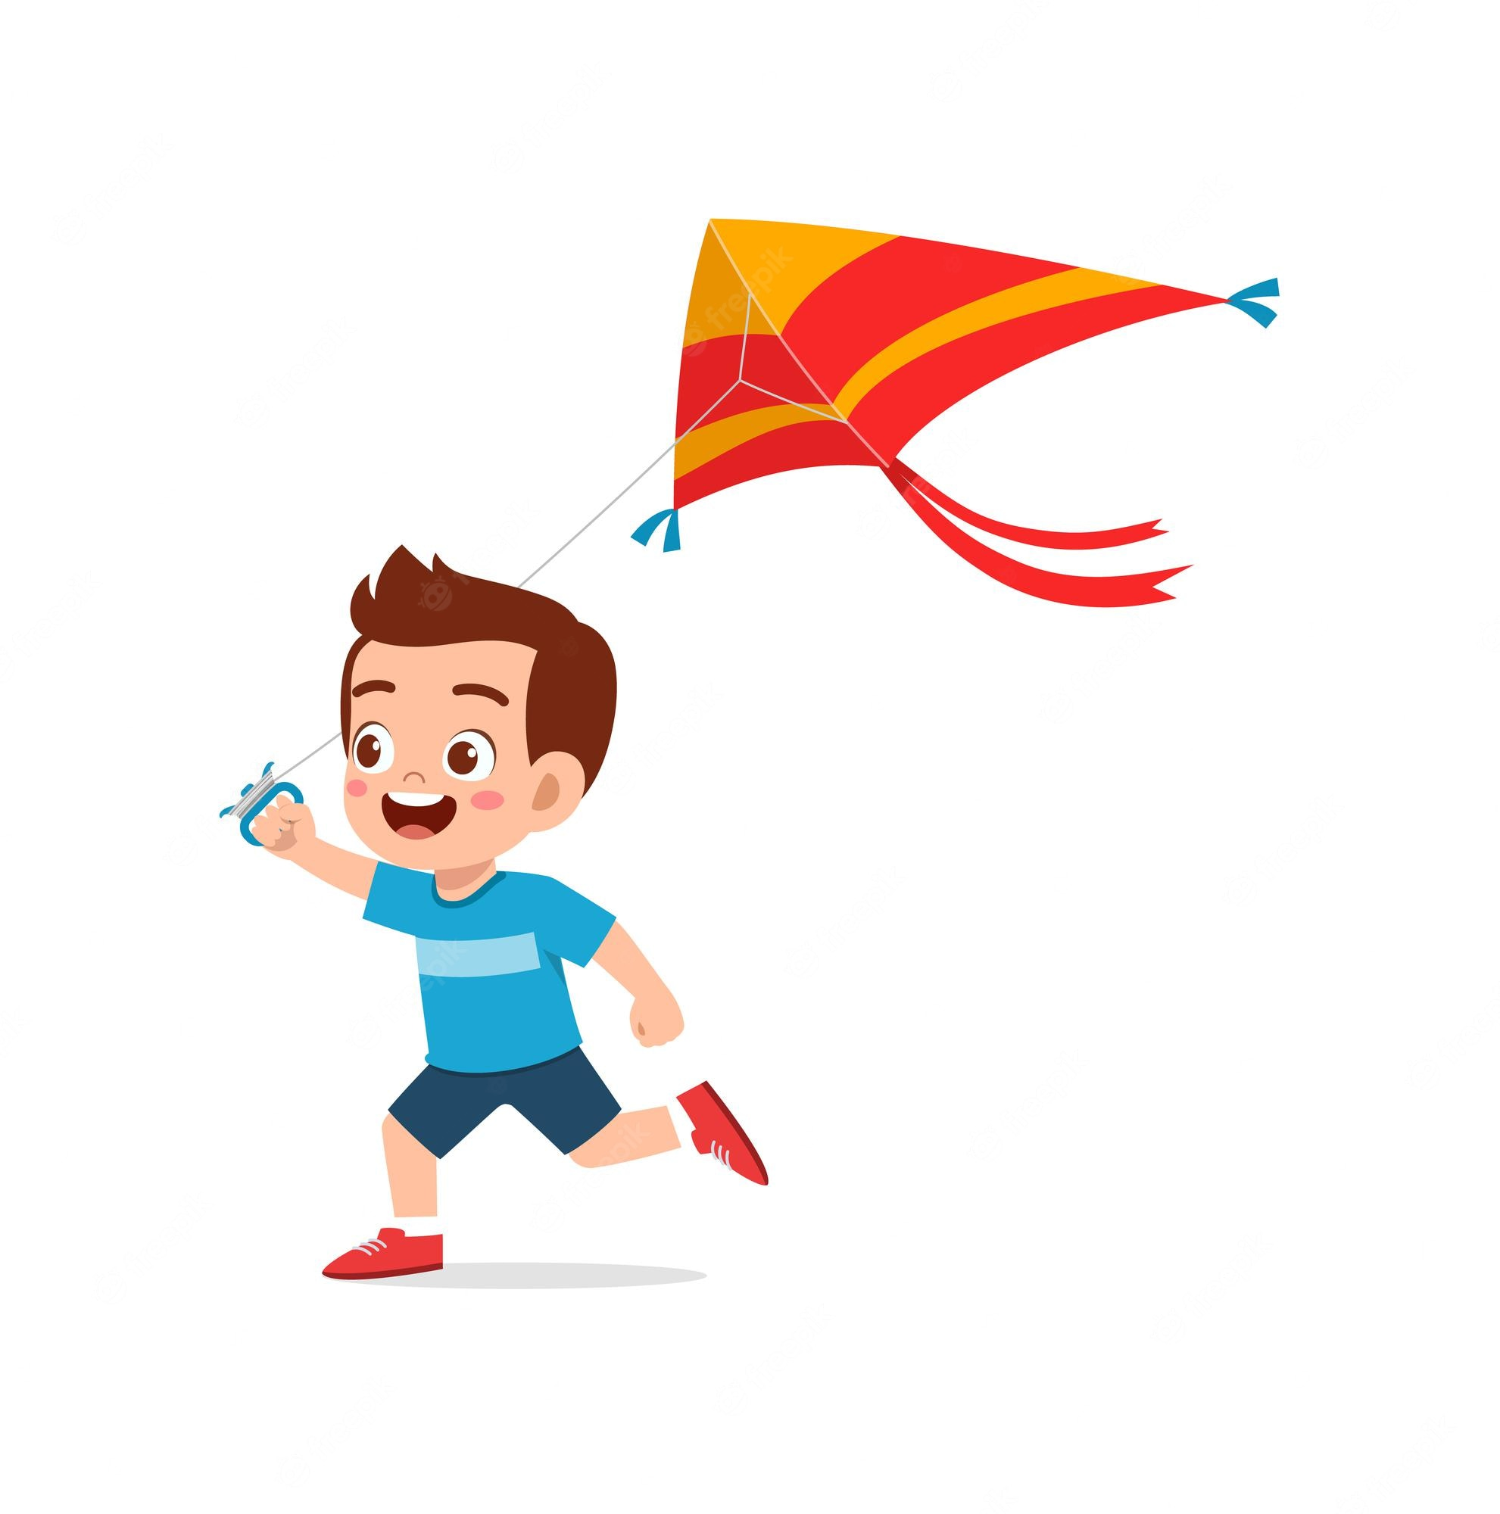
Can you ………………….?
fly a kite
….., I can.
Back
Yes

Slide 23
Can you ………………..………….?
play the piano
No, ……………….
I can’t
Back

Slide 24
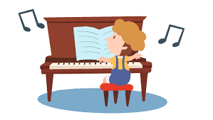
Can you ………….…………….?
play the piano
….., I can.
Back
Yes

Slide 25
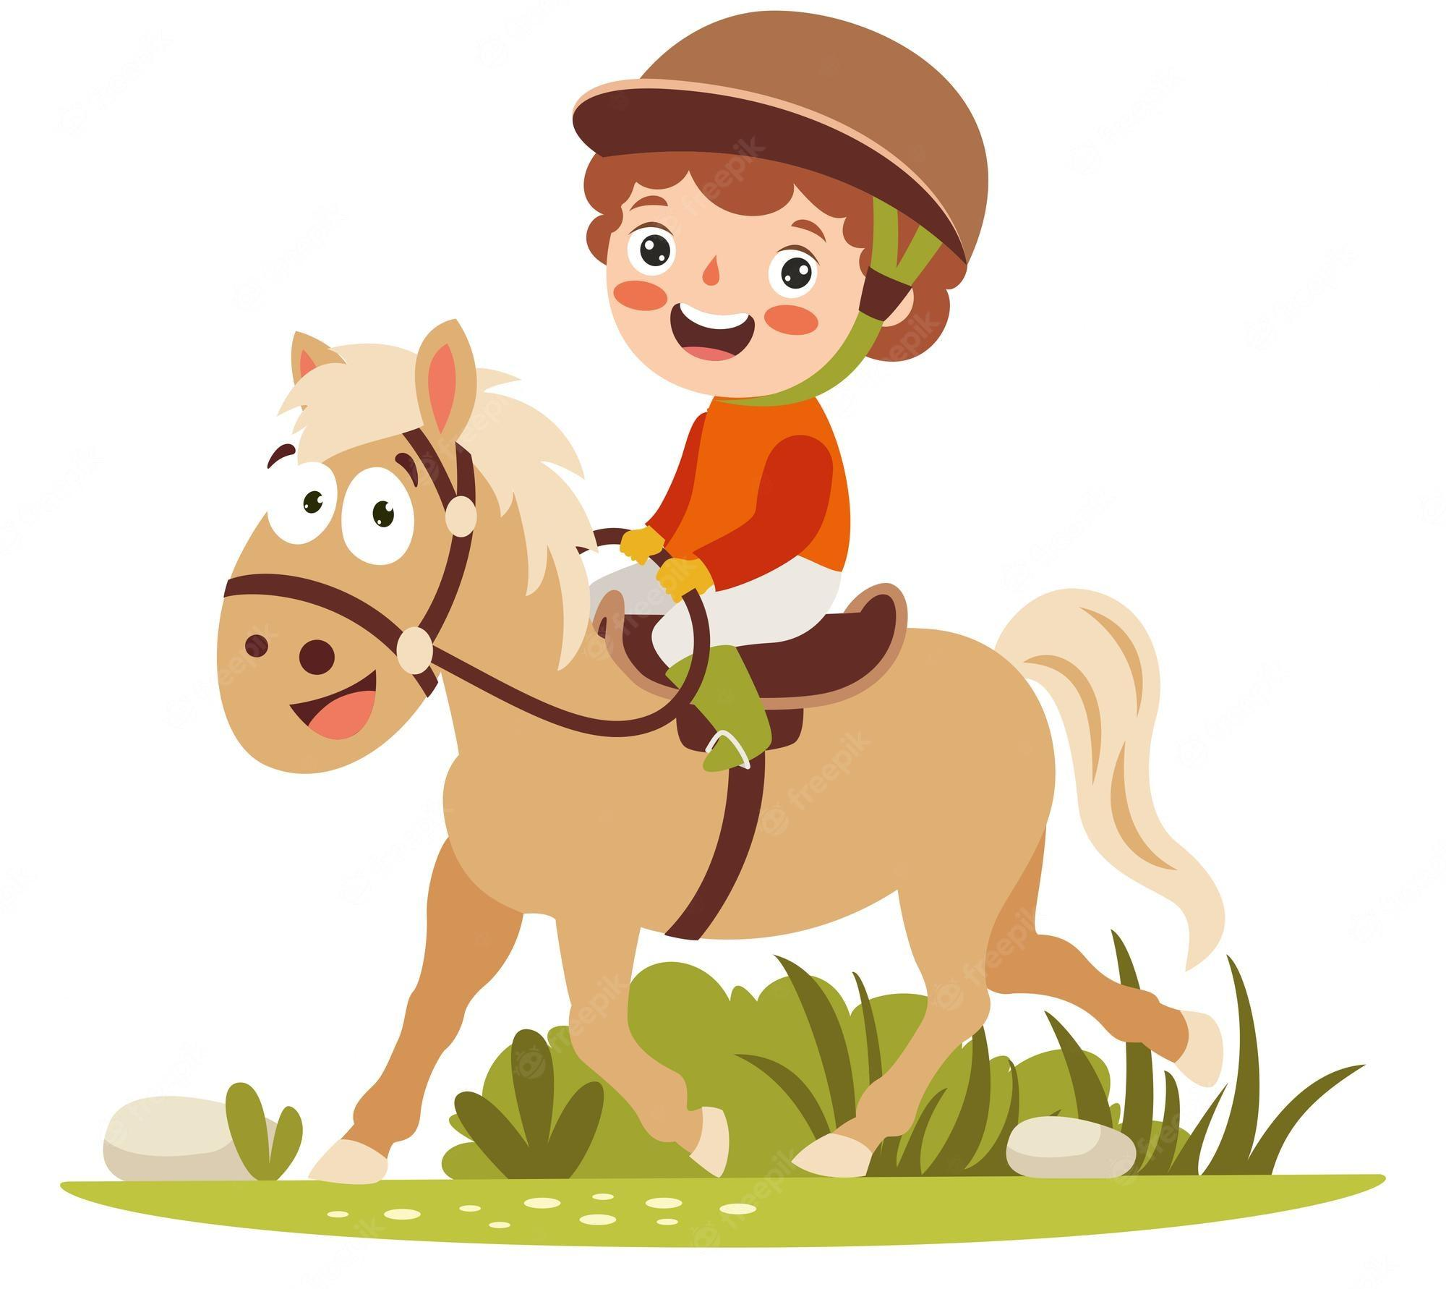
Can you ……………………….?
ride a horse
Yes, …………..
I can
Back

Slide 26
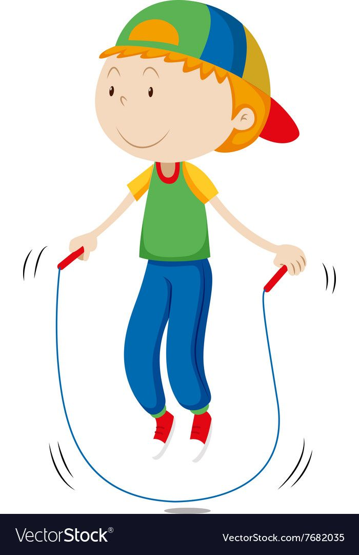
Can you ………………….?
skip
No, ………………..
I can’t
Back

