Slide 2
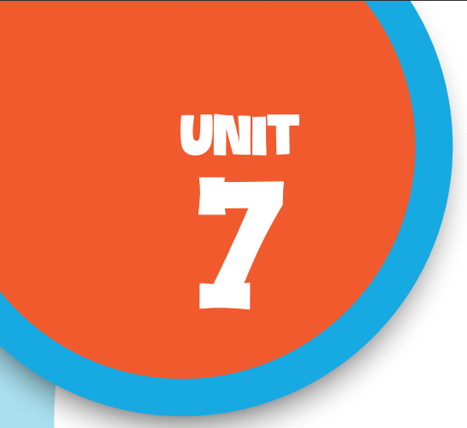

Our favourite
school activities
Lesson 1 - Period 2

Slide 3

Table of contents
Warm-up & Review
01
02
Listen and number.
Read and complete.
03
04
Listen, complete and sing.
05
Fun corner & Wrap-up

Slide 4


01
Warm-up
& Review

Slide 5
Lucky
number

Slide 6

Choose a number!
1
2
3
4
5
6

Slide 7

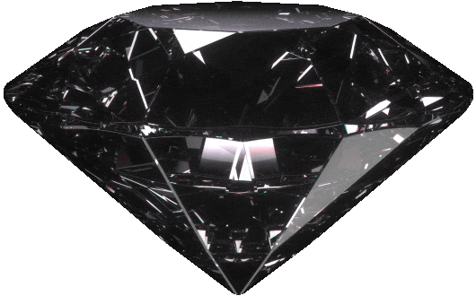
What school activities do they like?
1
They like doing projects.

Slide 8
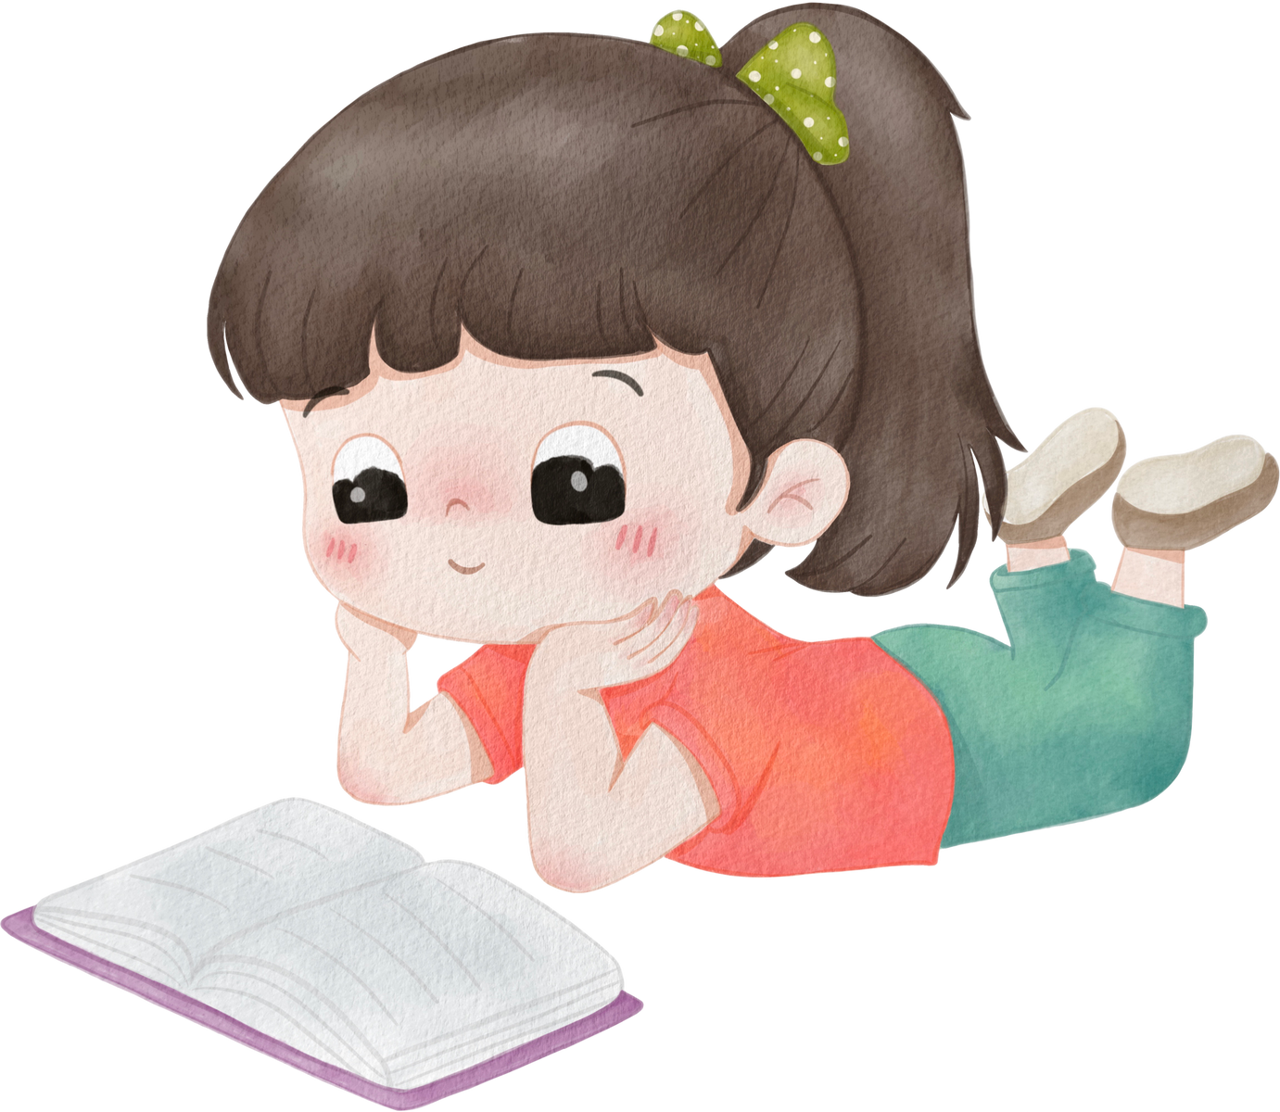

What school activities does she like?
2
She likes reading books.

Slide 9
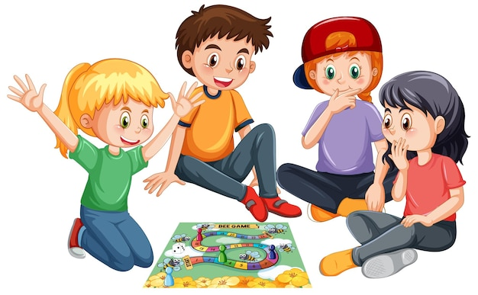
What school activities do they like?
.
3
They like playing games.
.

Slide 10
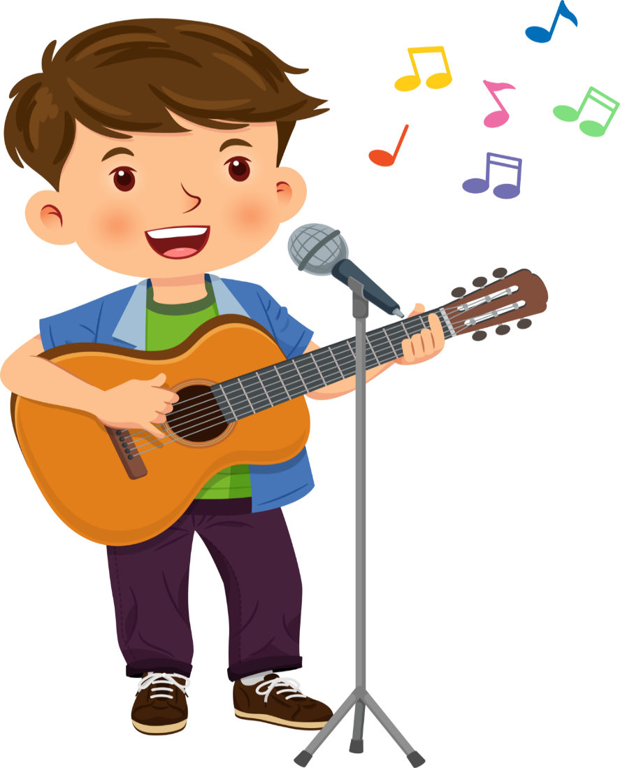
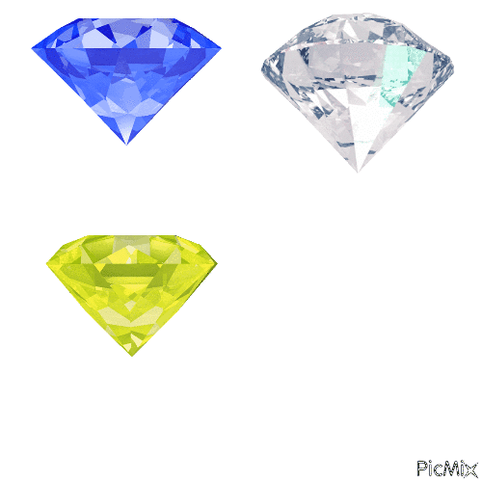
What school activities does he like?
4
He likes playing the guitar.

Slide 11
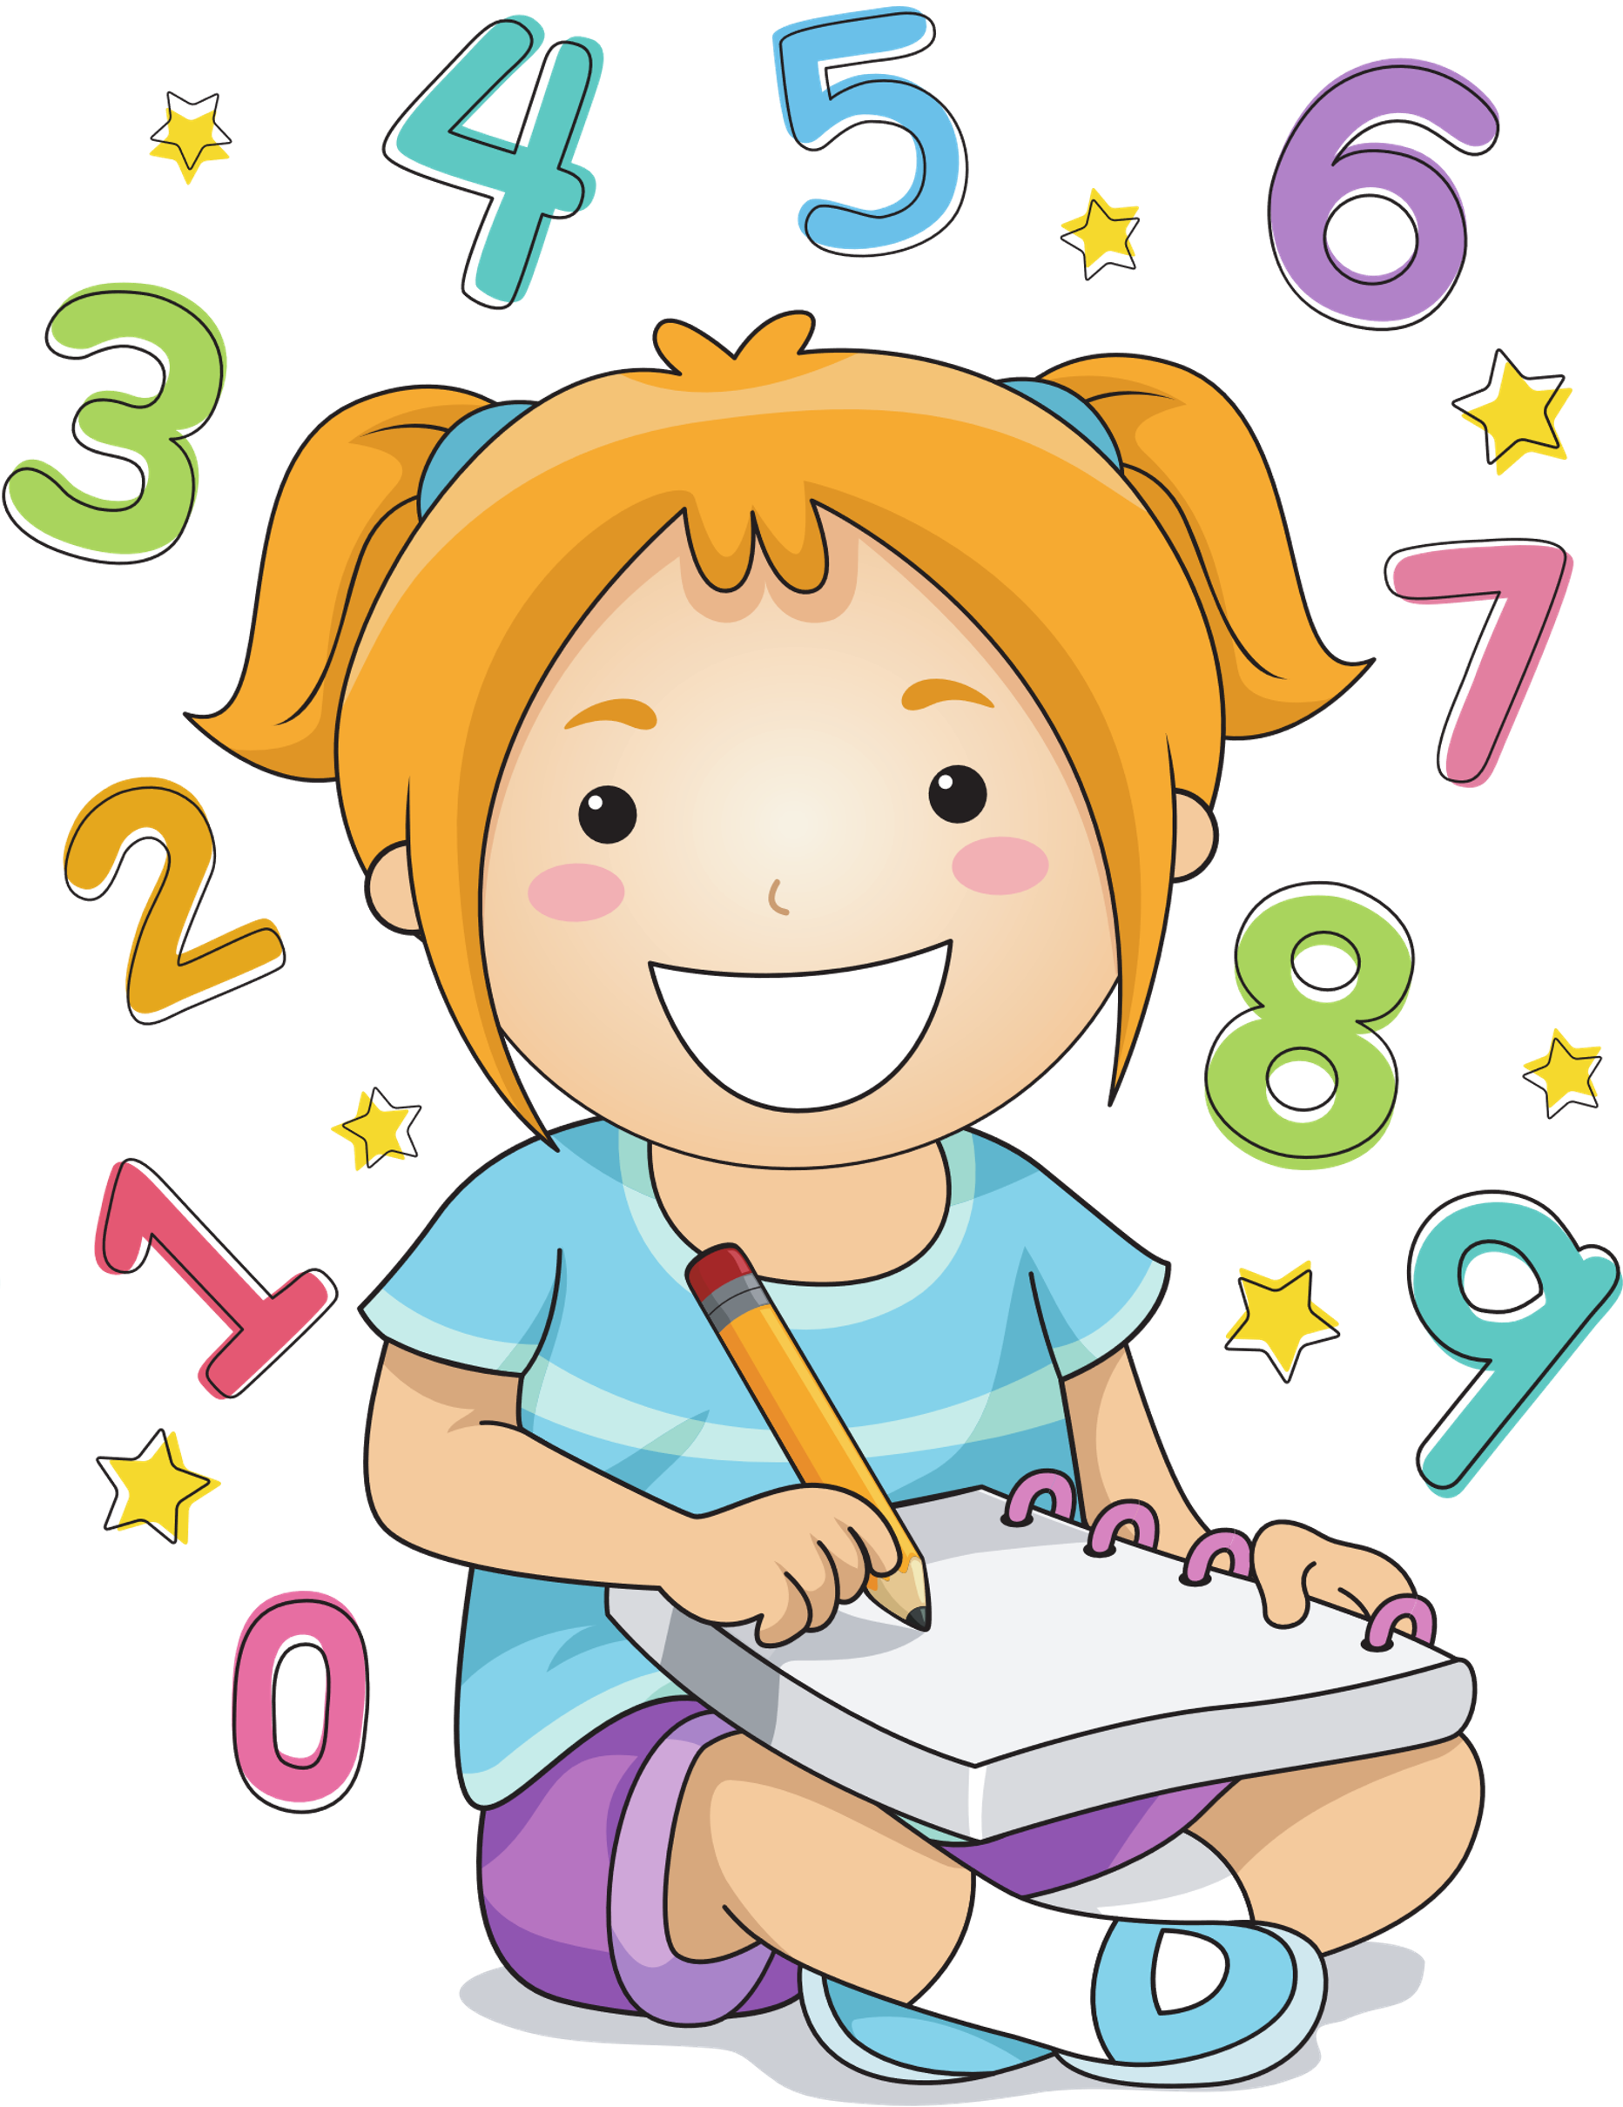
What school activities does she like?
5
She likes solving maths problems.

Slide 12
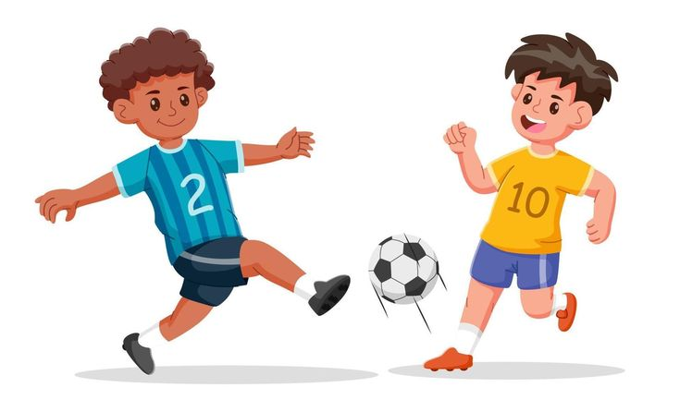
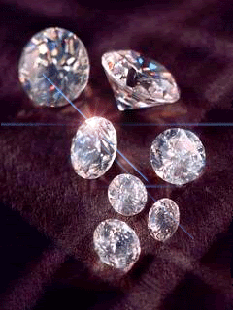
What school activities do they like?
6
They like playing football.

Slide 13
02
Listen
and number.

Slide 14
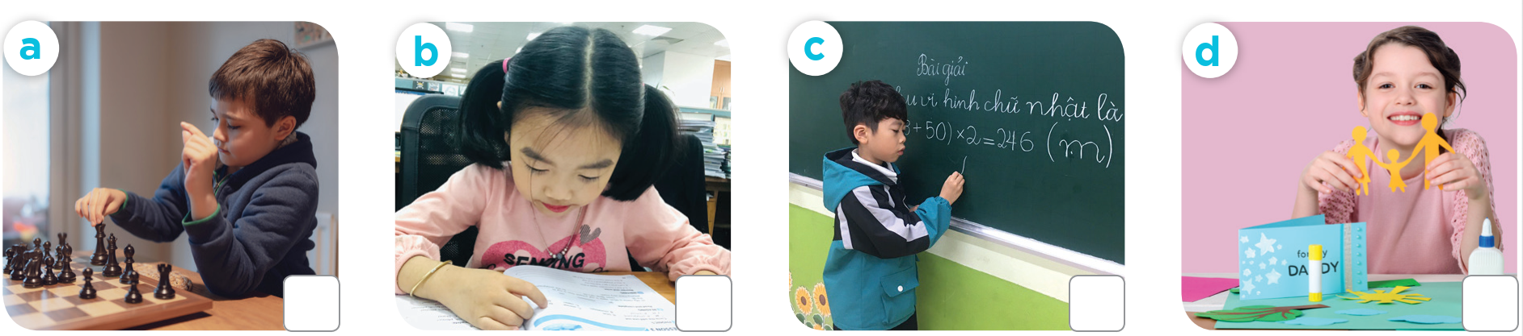
What school activities does he / she like?
“
”

Slide 15
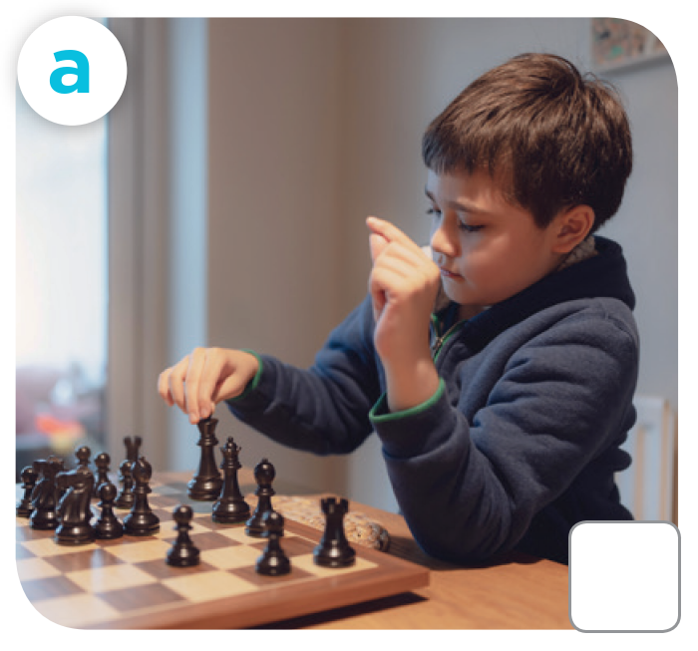
What school activities does he she like?
“
”

Slide 16
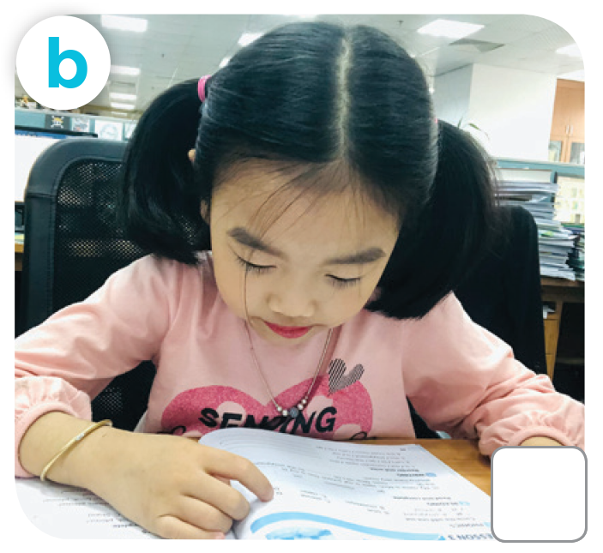
What school activities does she like?
“
”

Slide 17
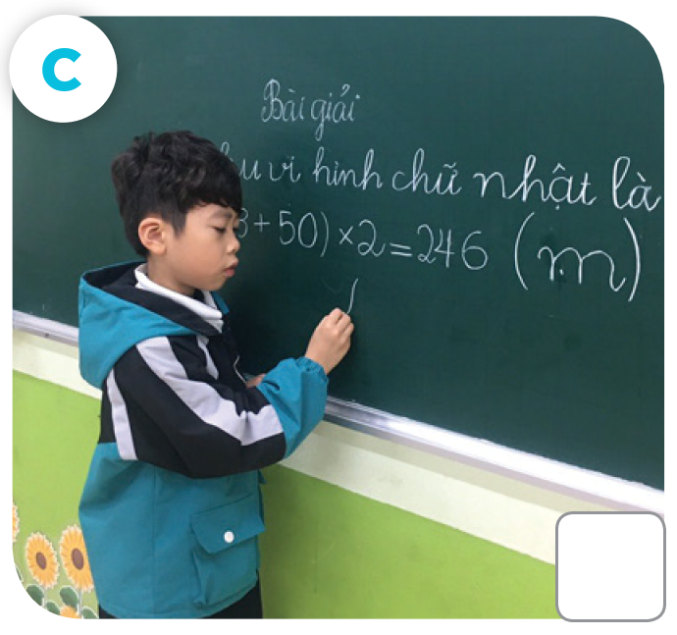
What school activities does he like?
”

Slide 18
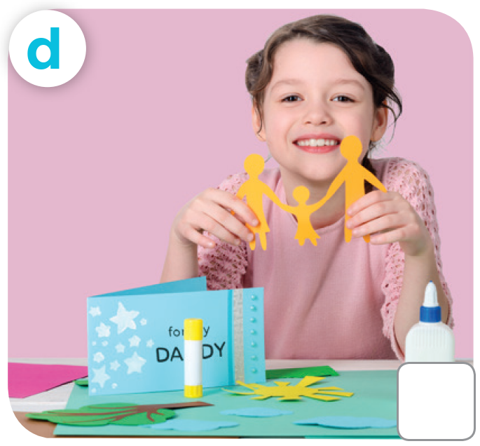
What school activities does she like?
”

Slide 19

Listen and number.
3
1
2
4

Slide 20
03
Read and
complete.

Slide 21

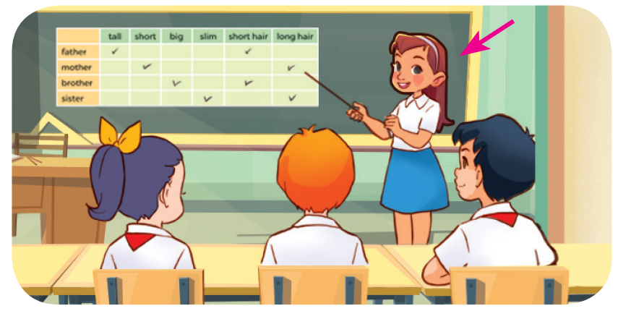
A: What school activity does
your sister like?
B: She likes _______________.
doing projects

Slide 22
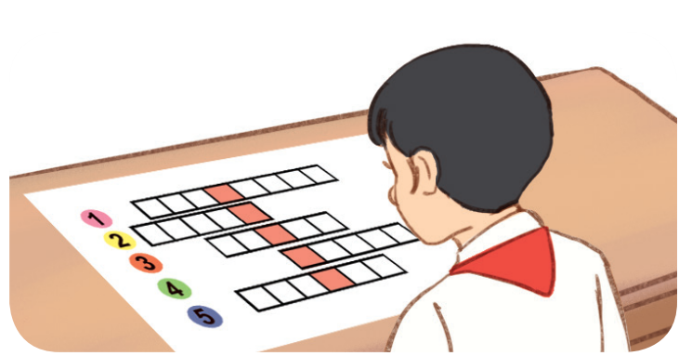
2. A: Does you brother like reading?
B: No he doesn’t. He likes ___________________.
It’s his favourite school activity.
doing word puzzles

Slide 23
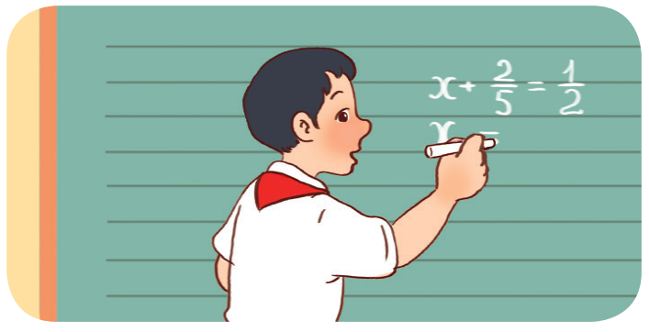
3. A: What’s he doing?
B: He’s _______________________. It’s his favourite school activity.
solving a maths problem

Slide 24
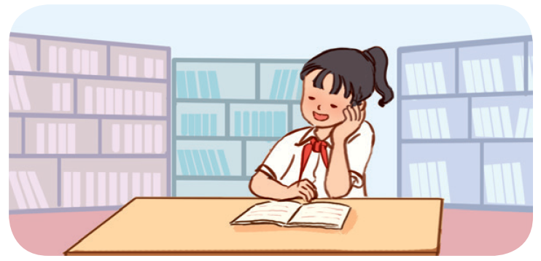
4. A: Does you sister like dancing?
B: No she doesn’t. She likes
_______________. It’s her favourite school activity.
reading books

Slide 25
Listen,
complete
and sing.
04

Slide 26
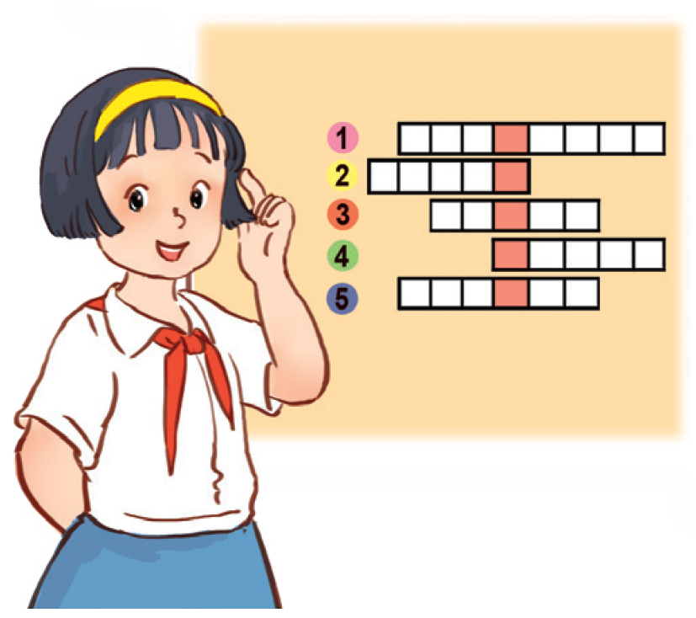
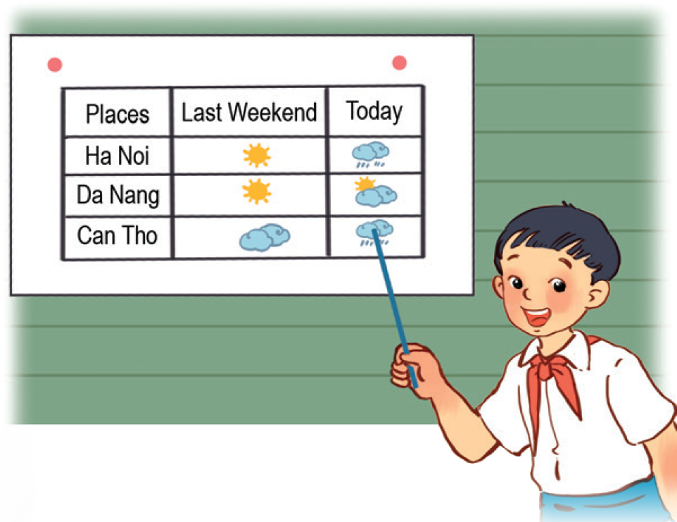
What school activities does she like?
What school activities does she like?
She likes (1) _____________________.
She likes playing the violin.
She likes reading stories.
What school activities does (2) ___ like?
He likes playing football.
He likes playing the guitar.
He likes (3) ______________.

Slide 27

What school activities does she like?
She likes (1) _____________________.
She likes playing the violin.
She likes reading stories.
What school activities does (2) ___ like?
He likes playing football.
He likes playing the guitar.
He likes (3) ______________.
playing word puzzles
he
doing projects

Slide 28
Your turns:
What school activities does she like?
She likes (1) _____________________.
She likes playing the violin.
She likes reading stories.
What school activities does (2) ___ like?
He likes playing football.
He likes playing the guitar.
He likes (3) ______________.
playing word puzzles
he
doing projects

Slide 29
05
Fun corner & Wrap-up

Slide 30

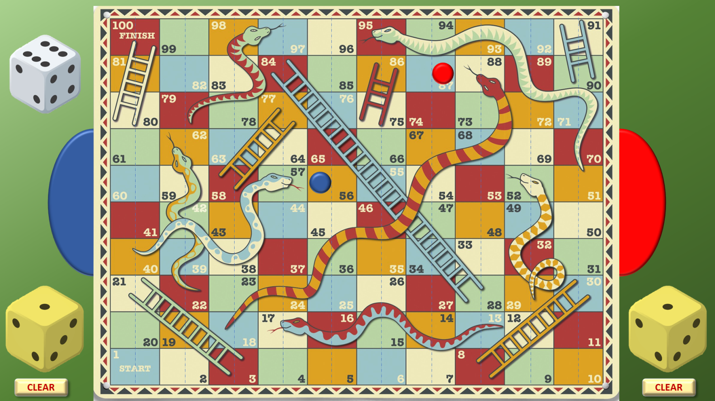

Play to the standard rules of Snakes & Ladders
Click here to roll your dice
Once you have clicked to reveal the position of your new counter,
click on the previous counter to remove it
Count along the number of boxes according to your dice throw –
and click on that box
Click here to clear the throw
Blue player clicks on the Left side of the dotted line
Red player clicks on the Right side of the dotted line

Slide 31
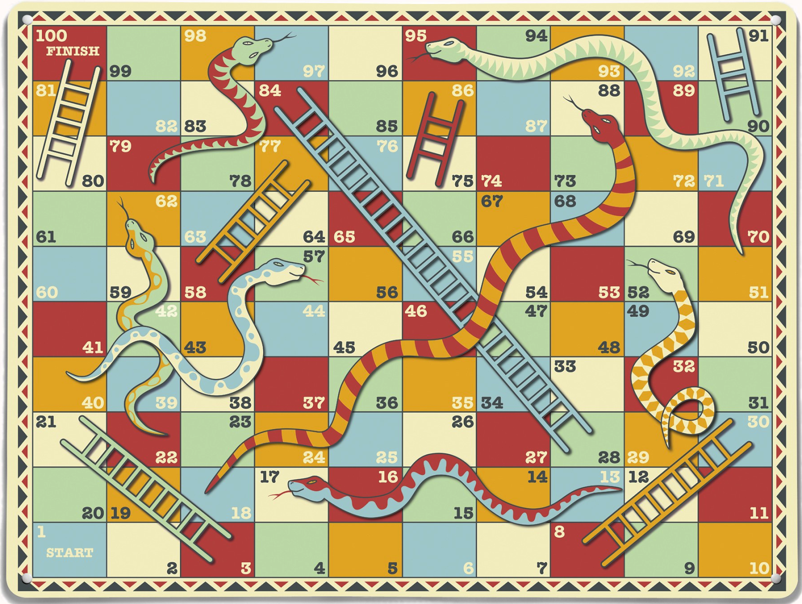
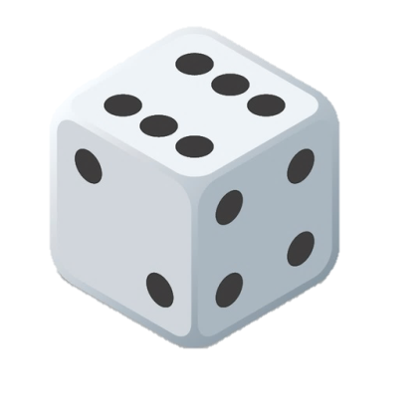
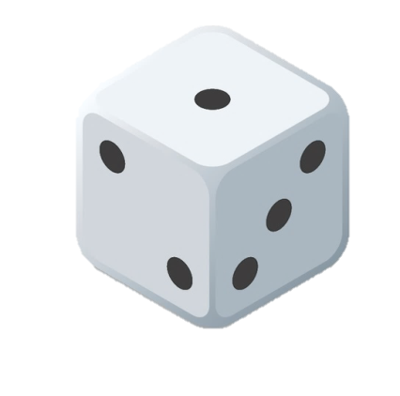
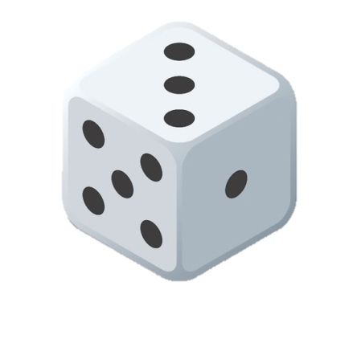
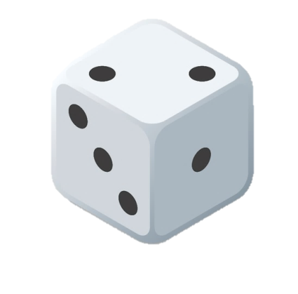
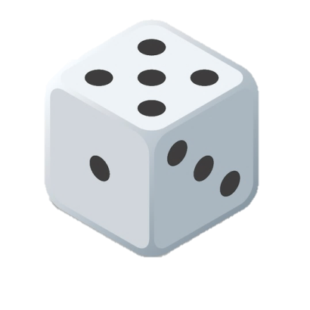


CLEAR
CLEAR

