Slide 1





8
2
Period 4

Slide 2


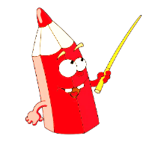
①
Warm-up and review
Contents
②
Listen and number.
③
Read and match.
④
Let’s play.
⑤
Fun corner and wrap-up

Slide 3
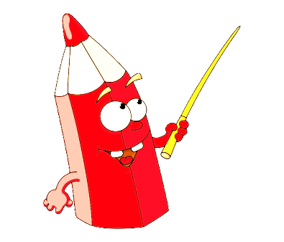

①
Warm-up and review

Slide 4
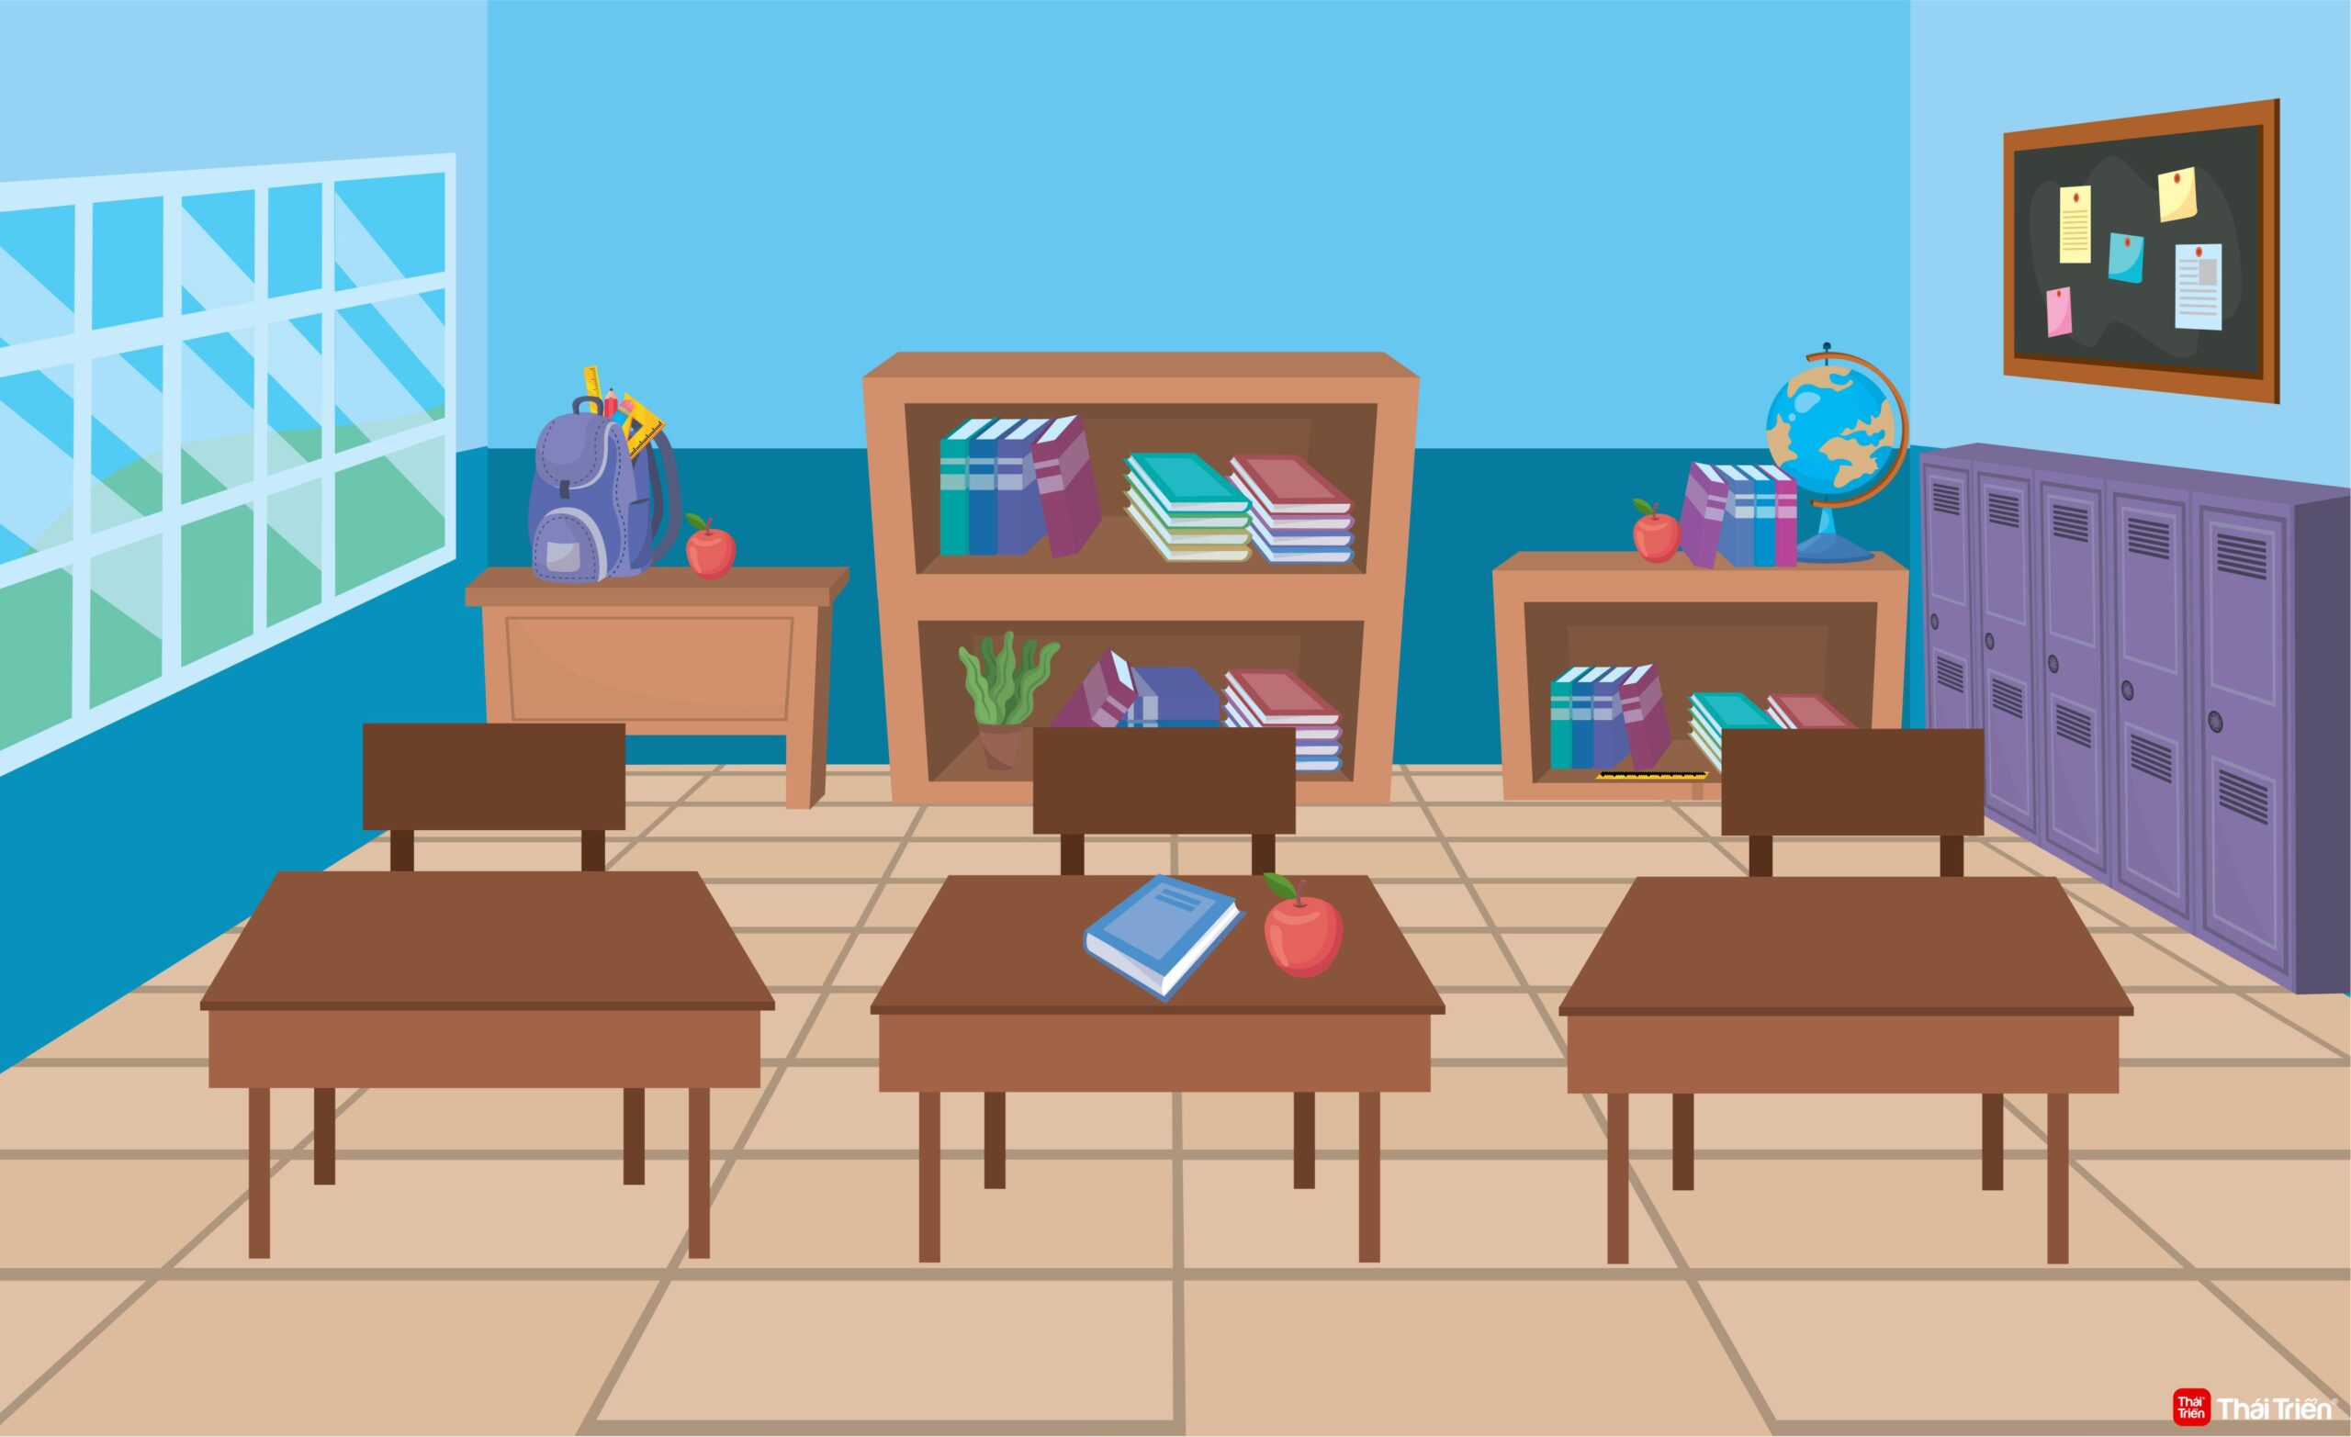
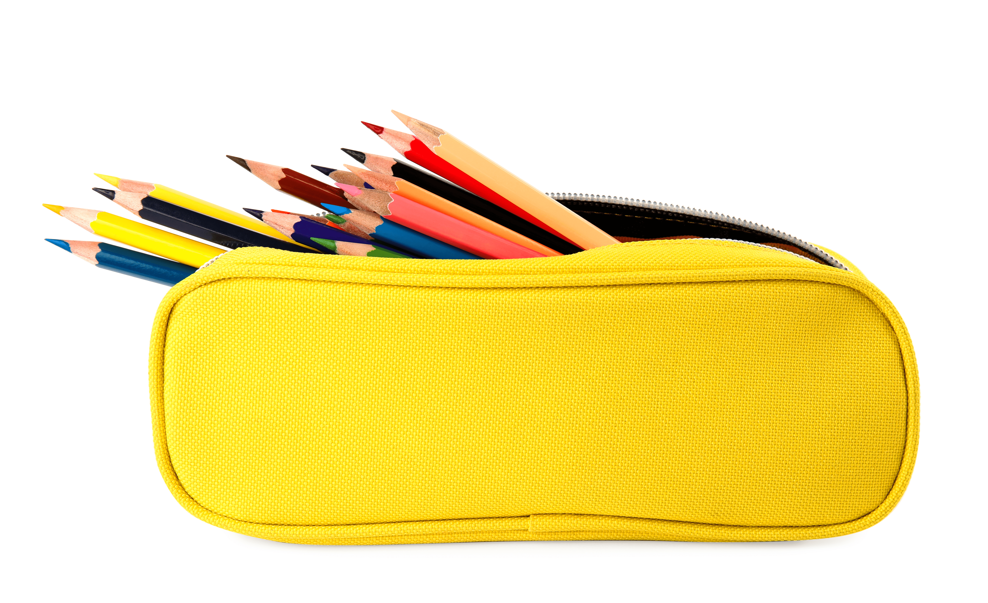



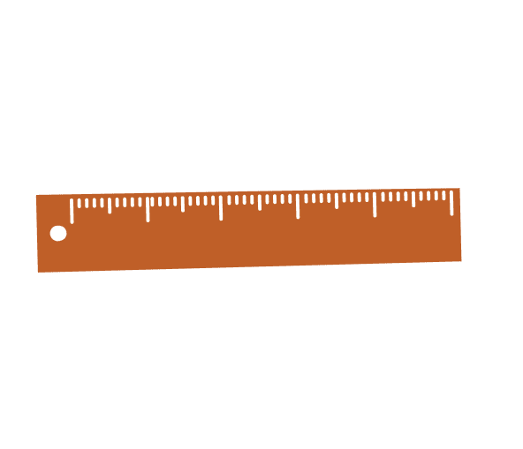


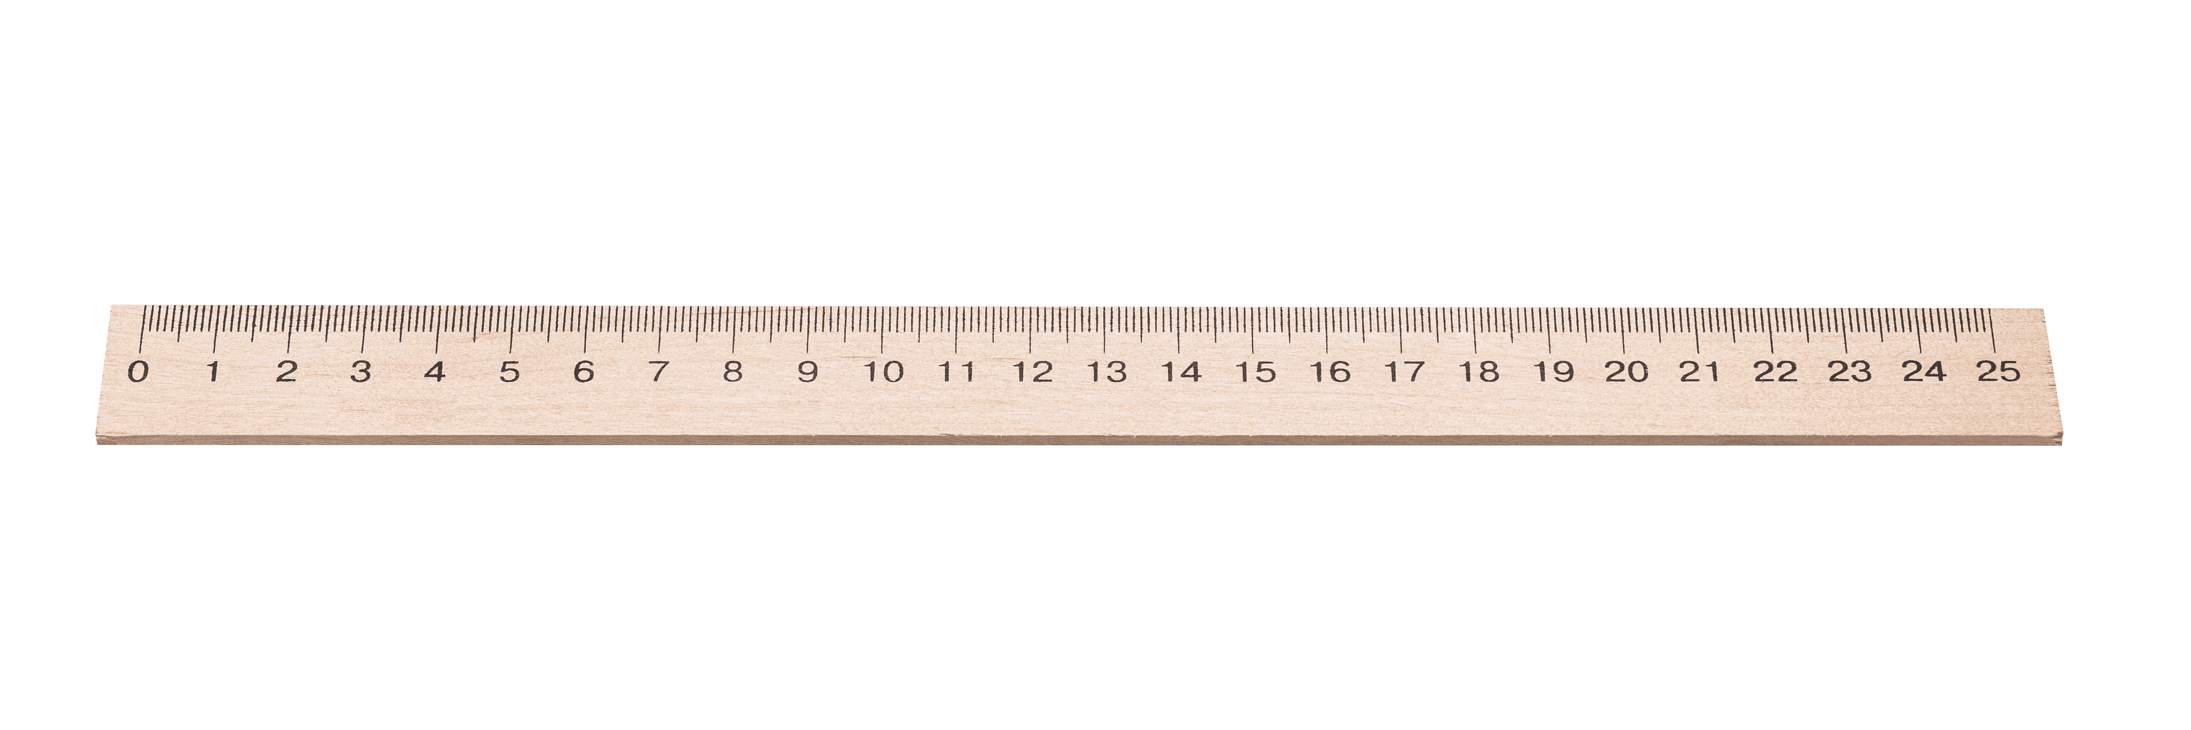


What school things do you see?
Notes:
There’s a classroom with school things everywhere. Ask pupils to look at the pictures carefully and find the school things. Let pupils count the items they find to make it more interesting.

Slide 5
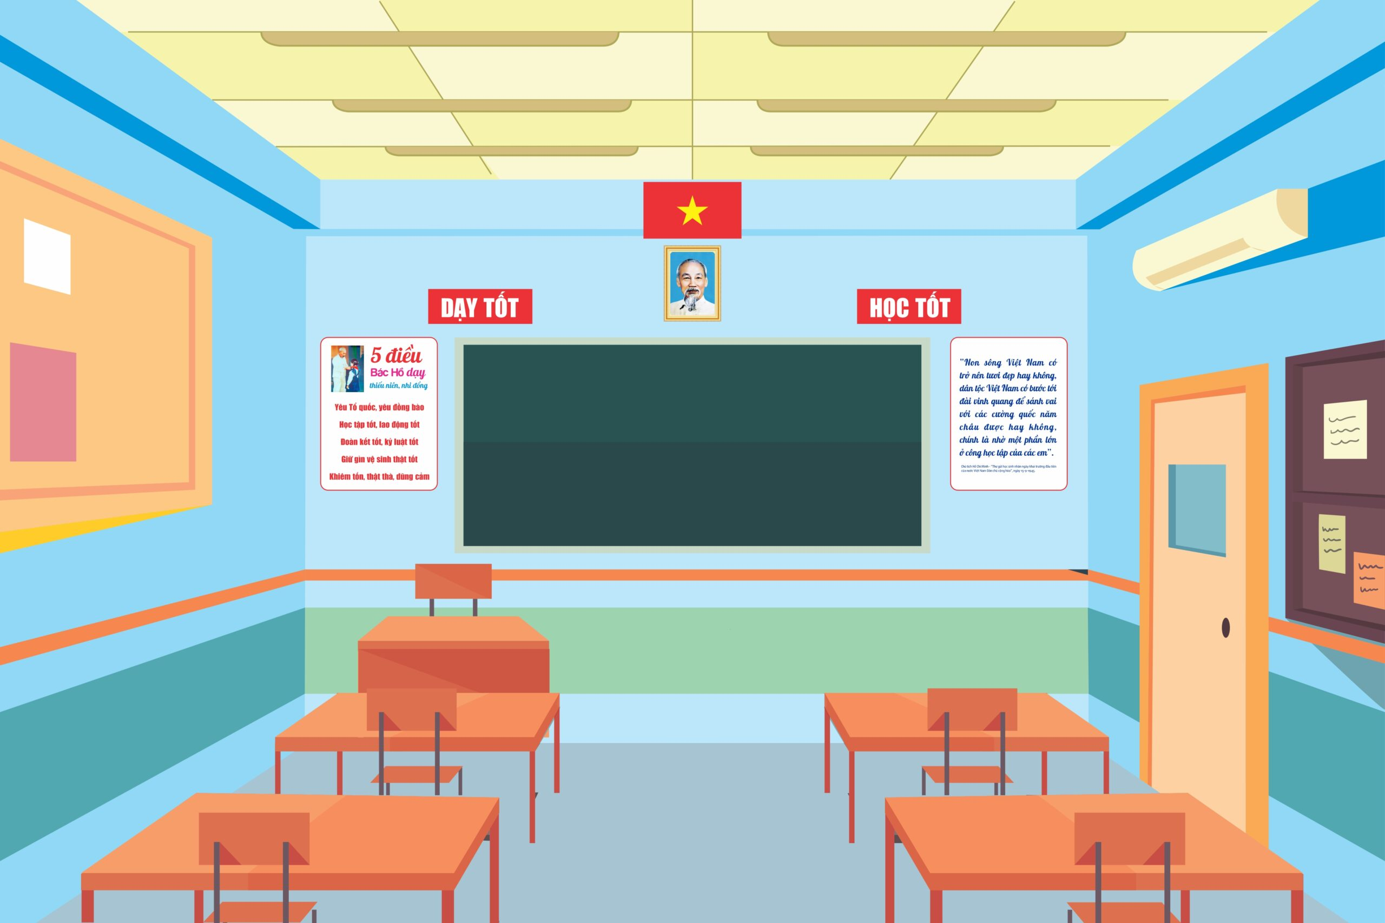
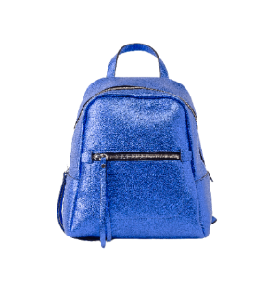

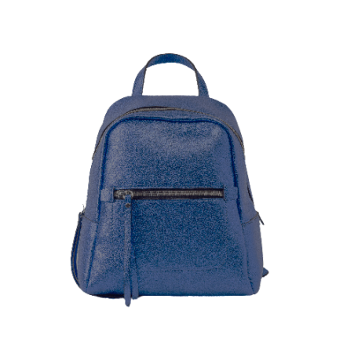
What school things do you see?
Notes:
There’s a classroom with school things everywhere. Ask pupils to look at the pictures carefully and find the school things. Let pupils count the number of items they find to make it more interesting.

Slide 6

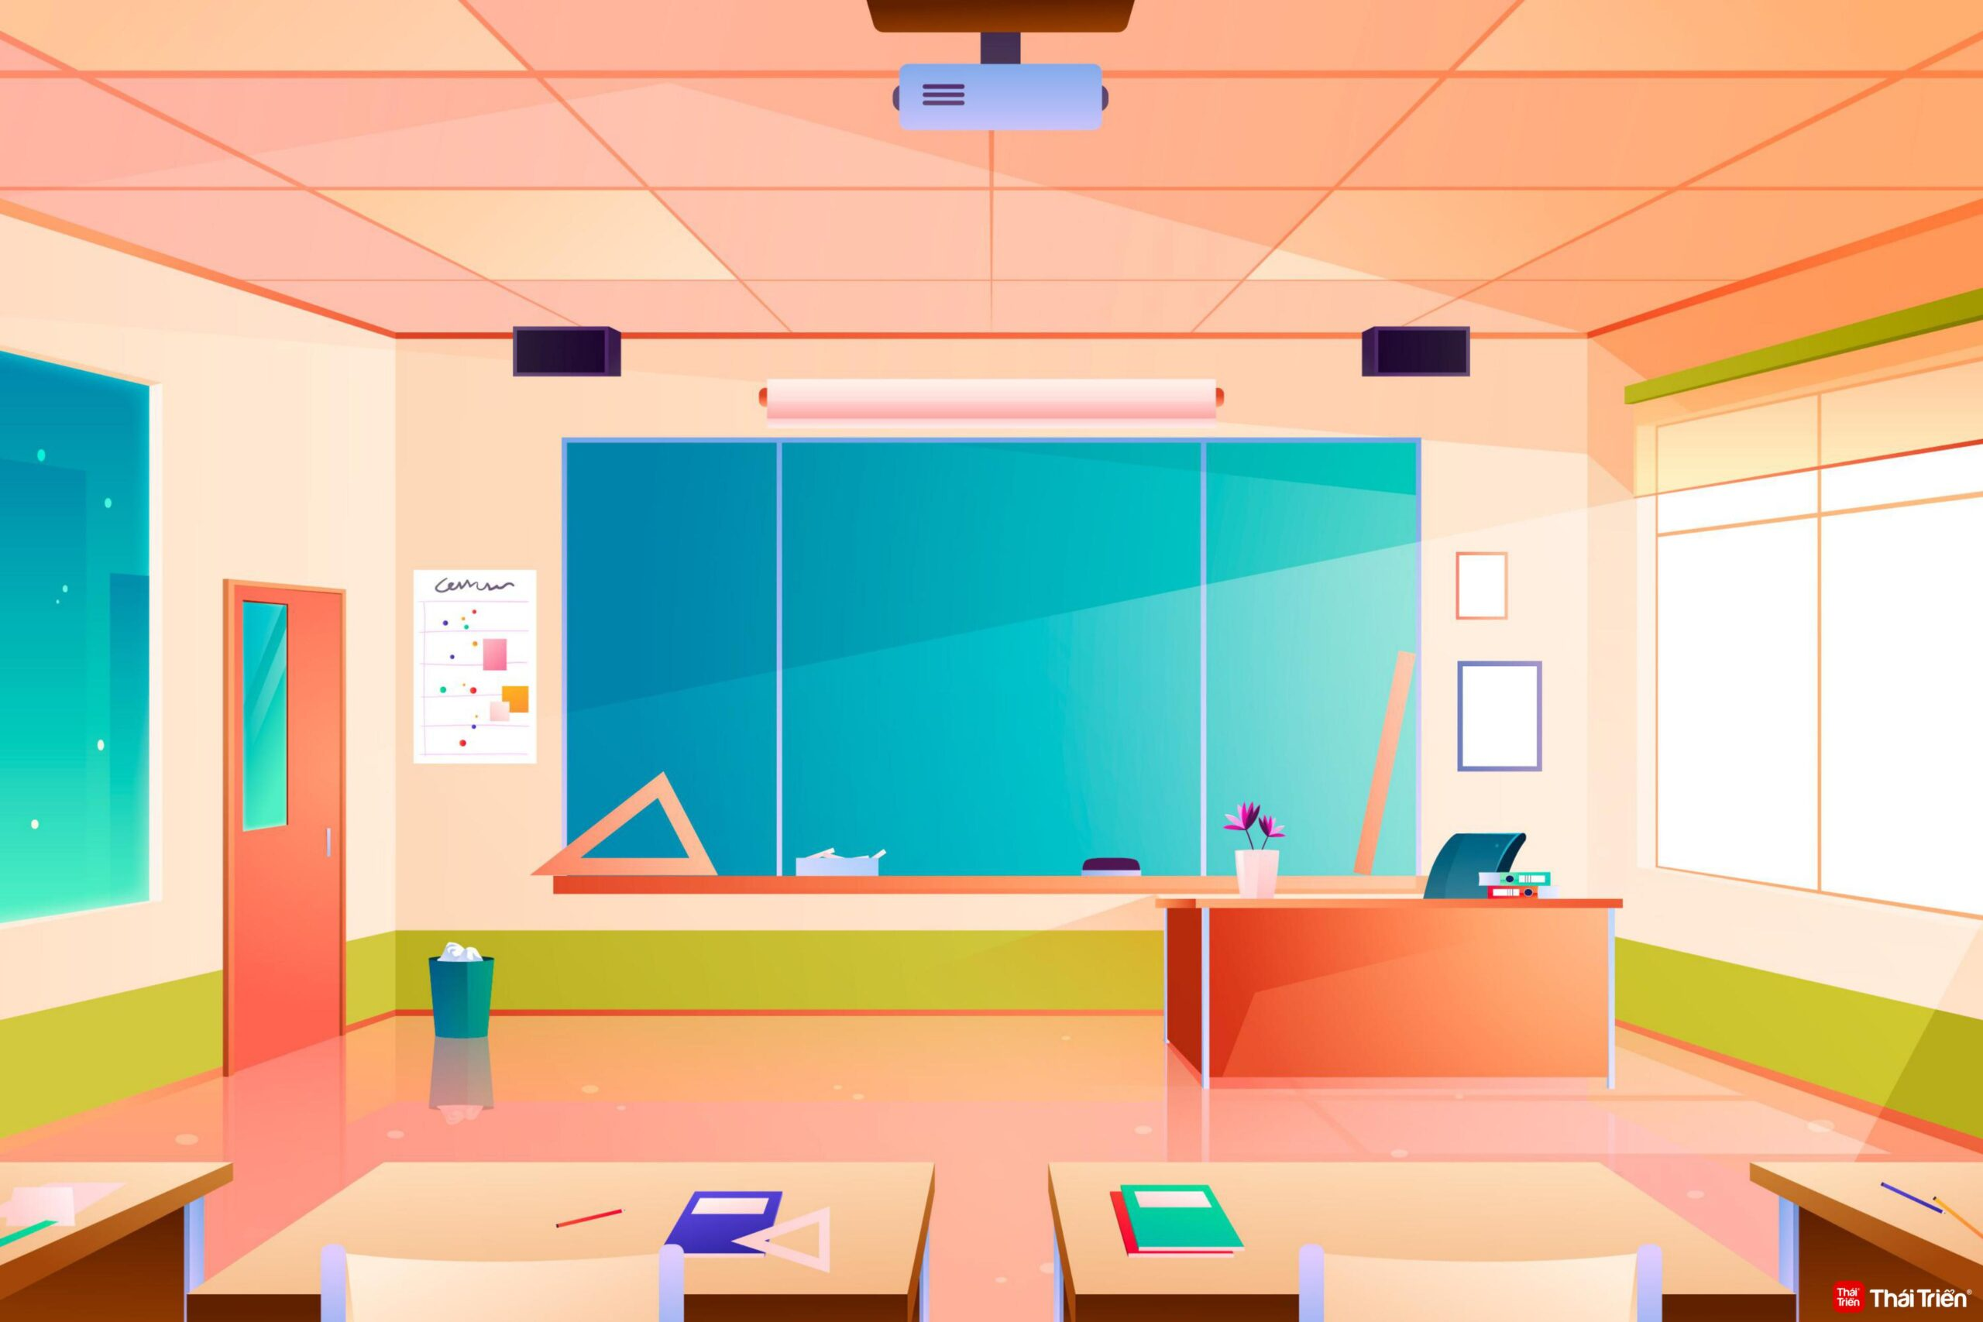
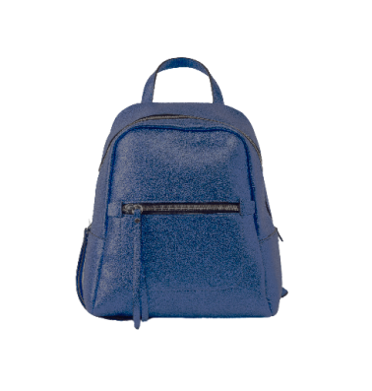
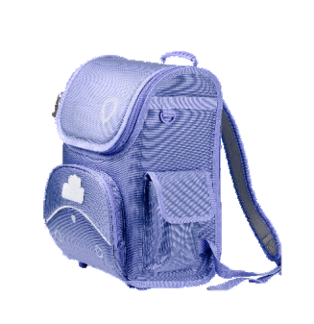
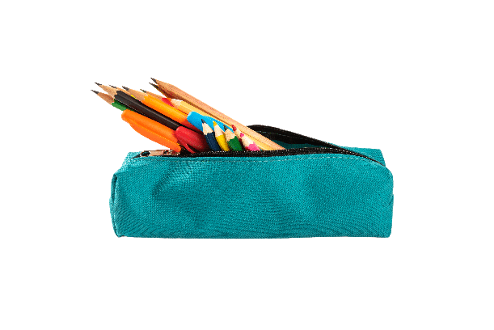
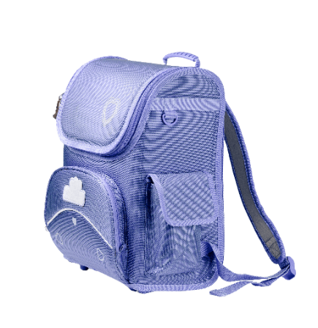
What school things do you see?
Notes:
There’s a classroom with school things everywhere. Ask pupils to look at the pictures carefully and find the school things. Let pupils count the number of items they find to make it more interesting.

Slide 7
②
Listen and number.

Slide 8
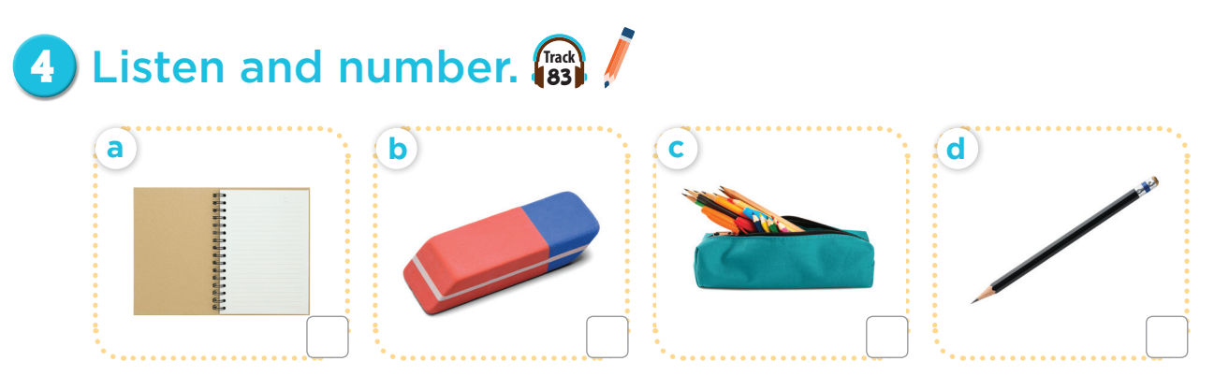

3
4
1
2

Slide 9
③
Read and match.

Slide 10
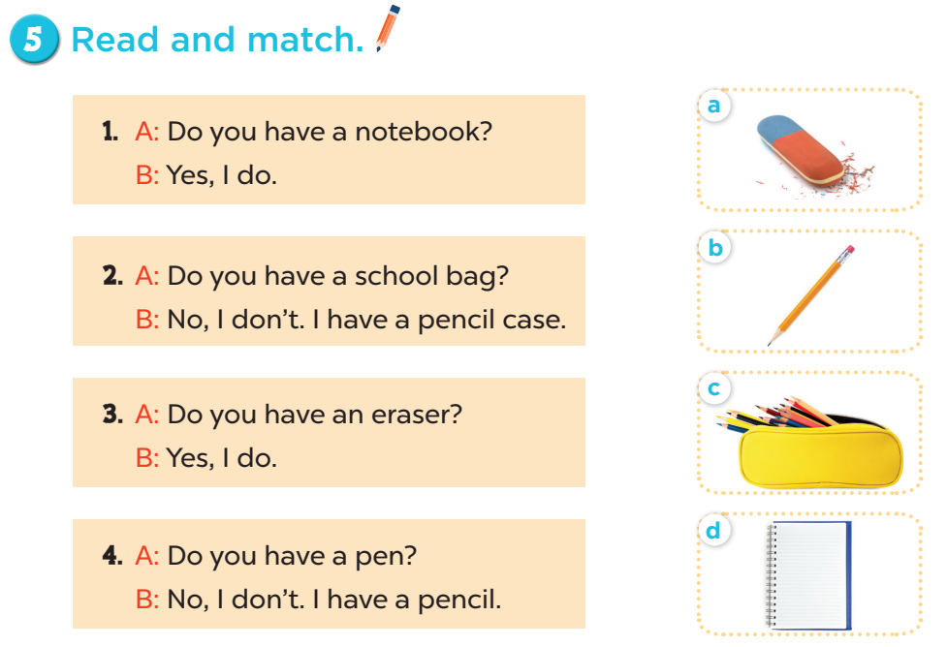

Slide 11

Let’s choose and say!
1
2
3
4
5
6
7
8
Next
Notes:
Let’s choose and say!
Pupils choose a number then choose the correct answer for the question. Who can say it correctly will get points for the team.

Slide 12
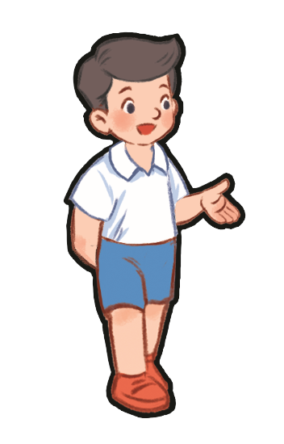


Do you have a pencil?
Yes, I do.
No, I don’t.
Notes:
- Click home to go back.

Slide 13

Do you have a ruler?
Yes, I do.
No, I don’t.
Notes:
- Click home to go back.

Slide 14
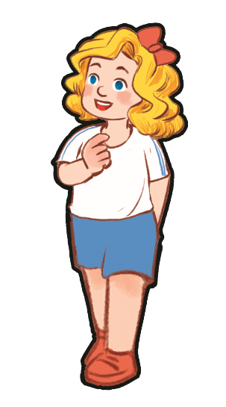
Do you have a book?
Yes, I do.
No, I don’t.
Notes:
- Click home to go back.

Slide 15
Do you have an eraser?
Yes, I do.
No, I don’t.
Notes:
- Click home to go back.

Slide 16
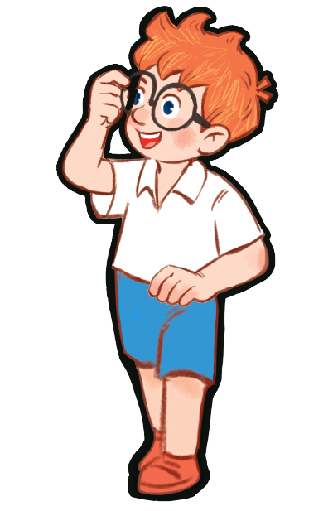
Do you have a pencil case?
Yes, I do.
No, I don’t.
Notes:
- Click home to go back.

Slide 17
Do you have a pencil case?
Yes, I do.
No, I don’t.
Notes:
- Click home to go back.

Slide 18
Do you have a ruler?
Yes, I do.
No, I don’t.
Notes:
- Click home to go back.

Slide 19
Do you have a pen?
Yes, I do.
No, I don’t.
Notes:
- Click home to go back.

Slide 20
④
Let’s play.

Slide 21
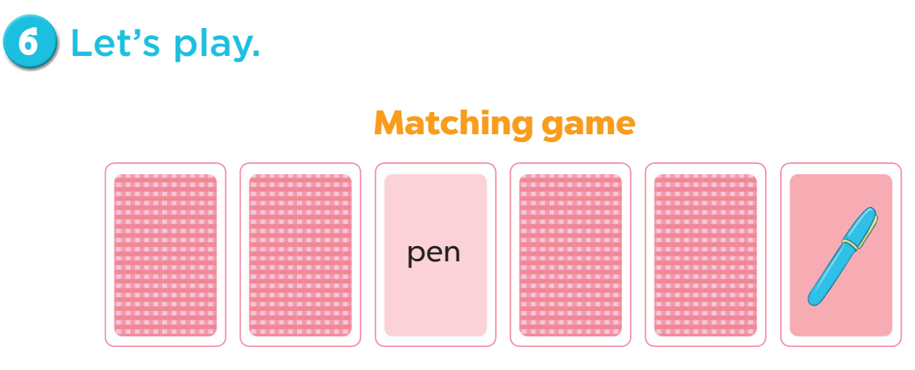

Slide 22

Let’s play.
pencil
pencil case
pen
Notes:
Click the card to show the words/picture. Click again to turn it face down.

Slide 23
Let’s play
pencil case
pencil
pen
Notes:
Click the card to show the words/picture. Click again to turn it face down.

Slide 24
Let’s play
pencil case
pen
pencil
Notes:
Click the card to show the words/picture. Click again to turn it face down.

Slide 25
Let’s play
pencil case
pen
pencil
Notes:
Click the card to show the words/picture. Click again to turn it face down.

Slide 26
⑤
Fun corner and
wrap-up

Slide 27
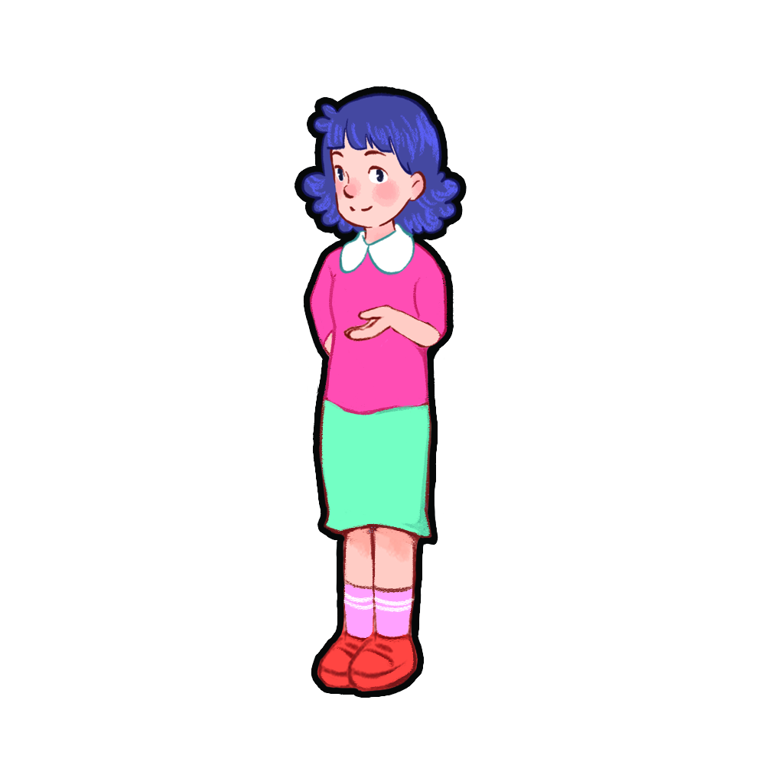
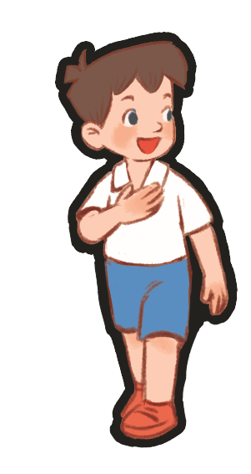
Show me: pencil, eraser, pen!
pencil, eraser, pen!
pencil, eraser, pen!
pencil, eraser, pen!
Notes:
- Teacher asks pupils to put their school things on the desk.
- Ask them to show the school things with the correct order. (example: Show me: pencil, eraser, pen).

