Slide 1


We warmly welcome all the teachers
to join our class 4D!
Teacher: Trịnh Thị Thoa
School: Hung Thang Primary School

Slide 2


Slide 4
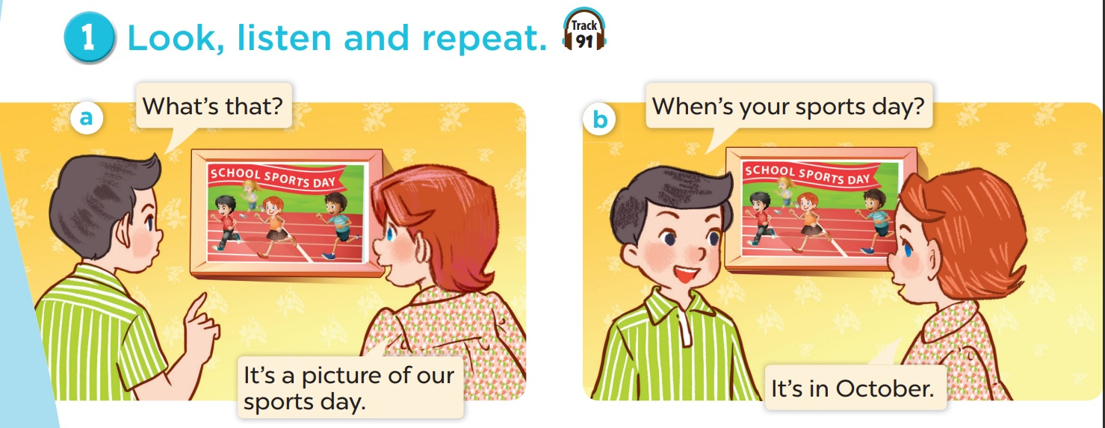

Slide 5


Look, listen and repeat.

Slide 6
Work in pairs. Practise.

Slide 7
Activity 2
Listen, point and say.

Slide 8
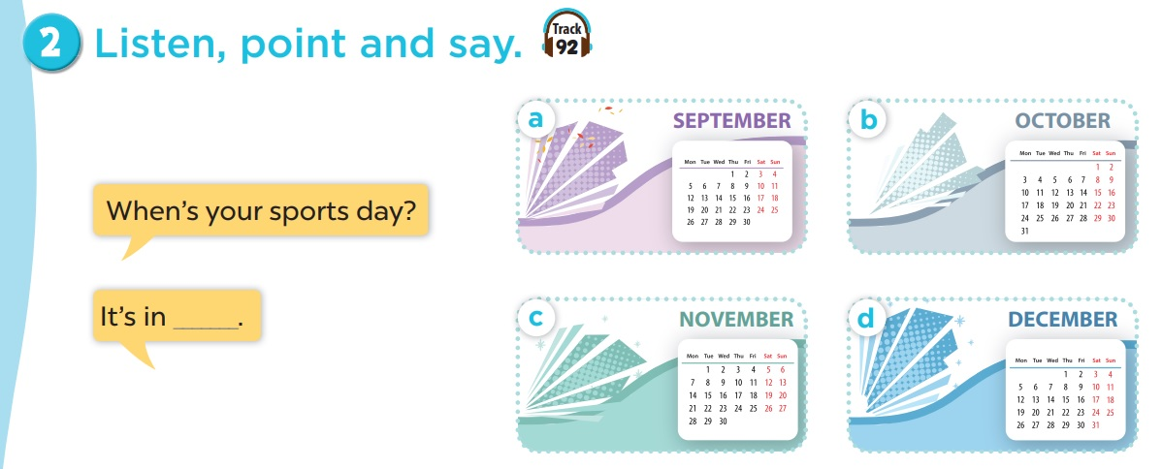
Listen, point and say.
Work in pairs. Practise.
Notes:
Click on the Speaker Icon to play the audio.

Slide 9
Activity 3
Let's talk.

Slide 10


Slide 11

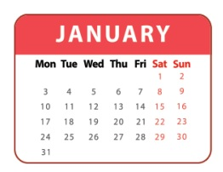


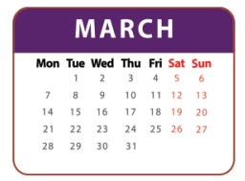

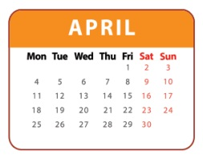
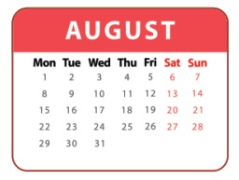
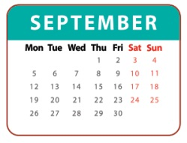
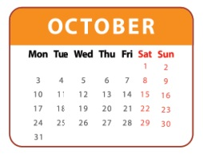
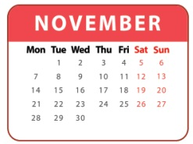
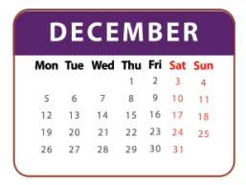
1
2
3
= +1 point
4
5
6
= lose 2 points
= rock, paper, scissors
(winner takes 2 points)
7
8
9
Notes:
- Divide the class into 3 teams.
- Pupils from each team choose a number (or throw sticky ball on the grid to choose the number), then have 2 pupils from each team ask and answer with the picture in that number.
- Pupils or teacher clicks on the month to reveal the icons indicating the points for that team.
- After 9 numbers, the team with the most points is the winner.

Slide 13




Thanks for your participation

