Slide 1


Slide 2
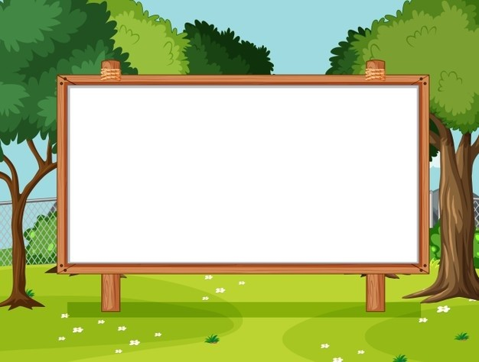
Unit 9 Our outdoor activities
Lesson 3 - Period 5

Slide 3

01
Warm-up and Review

Slide 4
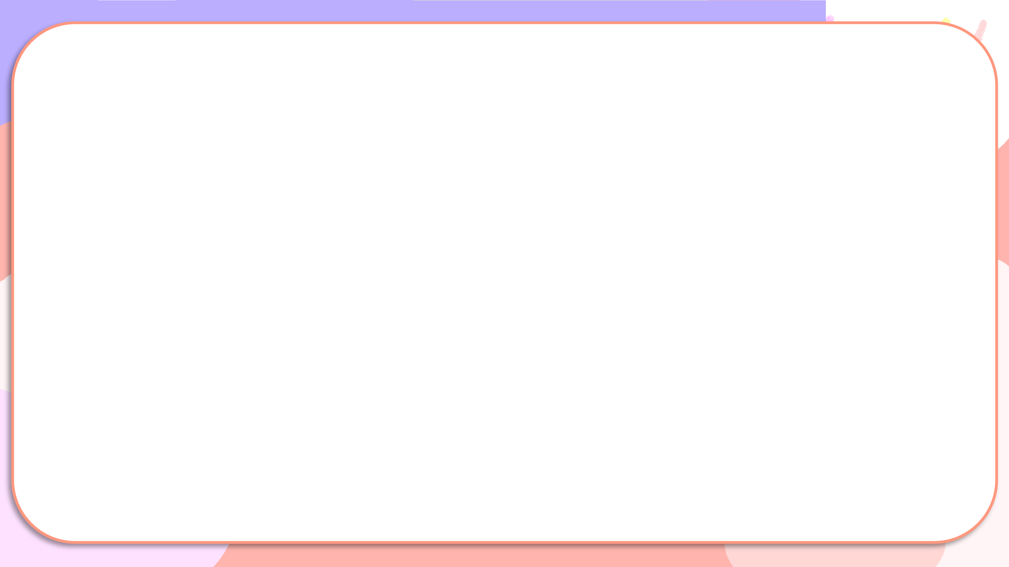

What did you do?
Where were you yesterday?
I was at the campsite.
What did you do there?
I played the guitar.
I played the guitar at the campsite.
Where were you yesterday?
We were at the farm.
What did you do there?
We planted trees.
We planted trees at the farm.

Slide 5
What did you do?
Notes:
HS hát với nhạc

Slide 6
02
Activity 1. Listen and repeat.

Slide 7

Listen and repeat.
'
cinema
I was at the cinema yesterday.
'

Slide 8
Listen and repeat.
'
'
bakery
We were at the bakery yesterday.

Slide 9
Listen and repeat.
'
cinema
I was at the cinema yesterday.
'
'
'
bakery
We were at the bakery yesterday.

Slide 10
03
Activity 2.
Circle, listen and check.

Slide 11
Circle, listen and check.
1.
a. bakery
b. tomorrow
c. pagoda
2.
a. cinema
b. October
c. tomorrow
3.
a. bakery
b. stadium
c. afternoon

Slide 12
Circle, listen and check.
1.
a. bakery
b. tomorrow
c. pagoda

Slide 13
Circle, listen and check.
2.
a. cinema
b. October
c. tomorrow

Slide 14
Circle, listen and check.
3.
a. bakery
b. stadium
c. afternoon

Slide 15
Circle, listen and check.
1.
a. bakery
b. tomorrow
c. pagoda
2.
a. cinema
b. October
c. tomorrow
3.
a. bakery
b. stadium
c. afternoon

Slide 16
04
Activity 3. Let’s chant.

Slide 17
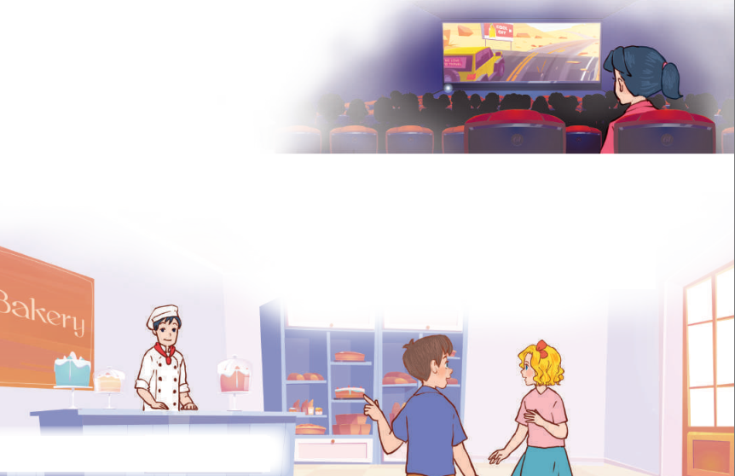
Let’s chant.
Yesterday, I was at the cinema.
I wanted to watch a film.
The film was interesting.
I liked the film.
Yesterday, we were at the bakery.
We wanted to buy some cakes.
The cakes were delicious.
We loved the cakes.

Slide 18
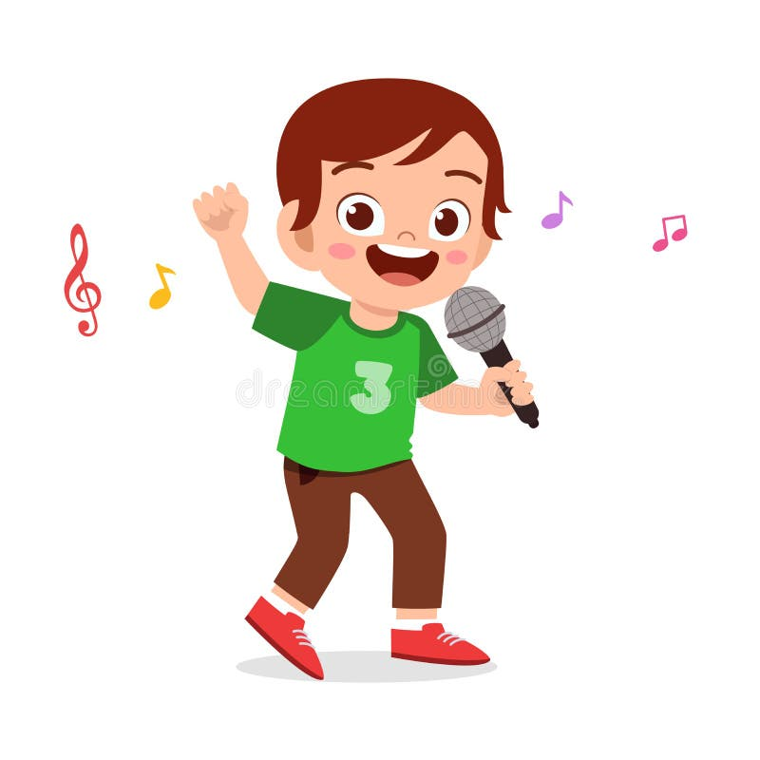

Let’s chant.
Yesterday, I was at the cinema.
I wanted to watch a film.
The film was interesting.
I liked the film.
Yesterday, we were at the bakery.
We wanted to buy some cakes.
The cakes were delicious.
We loved the cakes.

Slide 19
05
Fun corner and Wrap-up

Slide 20

Notes:
Cách chơi: Chia lớp thành 2 đội chơi, Cho phát âm thanh kèm xuất hiện từ.
Đội 1 nếu trọng âm rơi vào âm đầu thì đứng lên không phải thì ngồi
Đội 2 nếu trọng âm rơi vào âm tiết thứ 2 thì đứng lên không phải thì ngồi.
Nếu tất cả HS cùng đúng thì được cộng điểm.

Slide 21
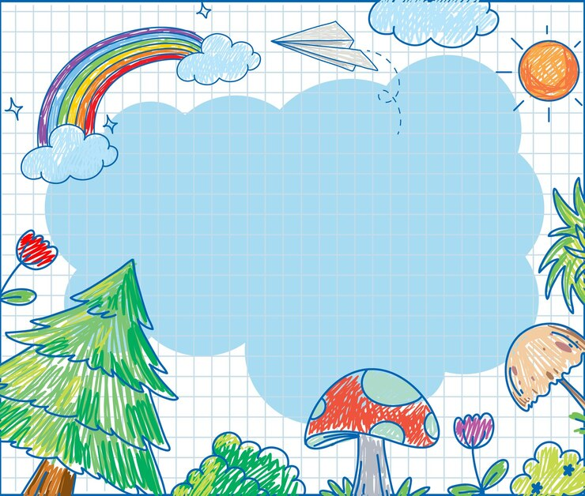
'
bakery

Slide 22
'
delicious

Slide 23
'
guitar

Slide 24
'
interesting

Slide 25
'
yesterday

Slide 26
'
October

Slide 27
'
cinema

Slide 28


Very Good!

