Slide 3


LET’S SING TOGETHER
Notes:
request all pupils to stand up and sing with TPR technique/ read the lesson plan for details

Slide 4
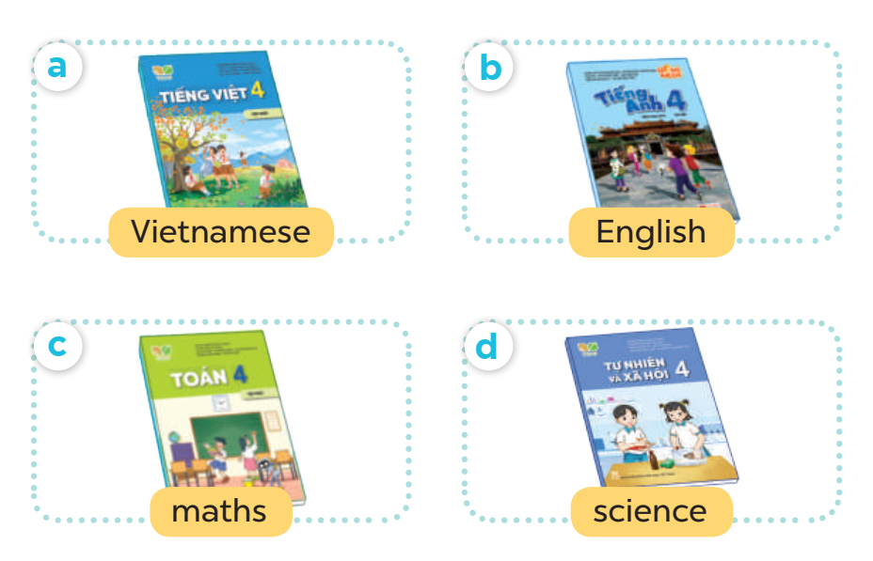
WHAT DO YOU HAVE TODAY?

Slide 5
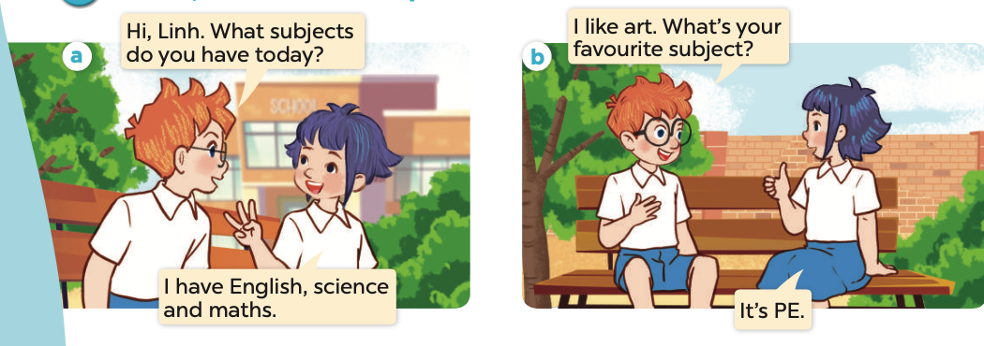

Slide 7
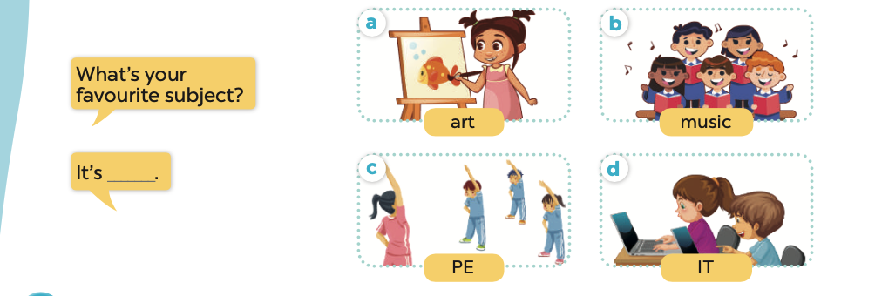

Slide 10


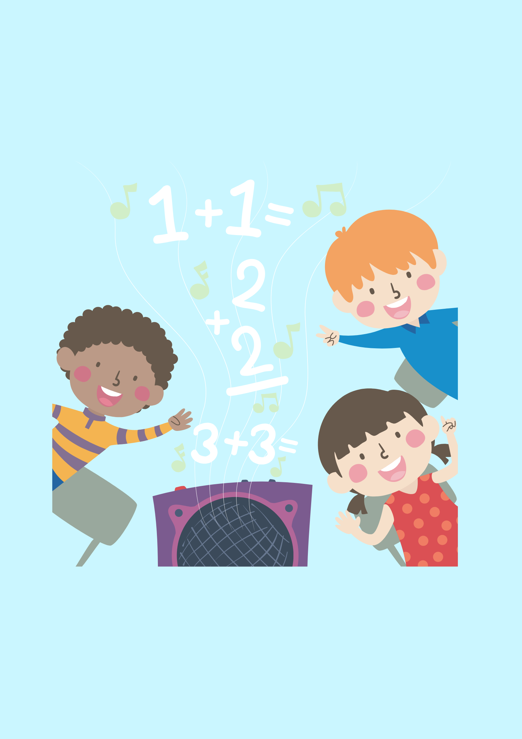

Slide 11




Slide 12
MATCH THE SUBJECT WITH THE PICTURE TO ANSWER THE QUESTION “ WHAT’S YOUR FAVOURITE SUBJECT?”

Slide 13





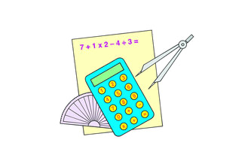


“ WHAT’S YOUR FAVOURITE SUBJECT?”
ART
MATHS
MUSIC
ENGLISH
SCIENCE
IT
PE
ART
Notes:
THIS GAME CAN BE PLAYED IN GROUPS OR TEAMS, FLASH THE CARDS THEN THE WORDS, TIME AND COUNT FOR PUPILS TO MATCH AFTER THE TEACHER SAYS THE SUBJECT IN ORDER,

