Slide 1



Slide 2
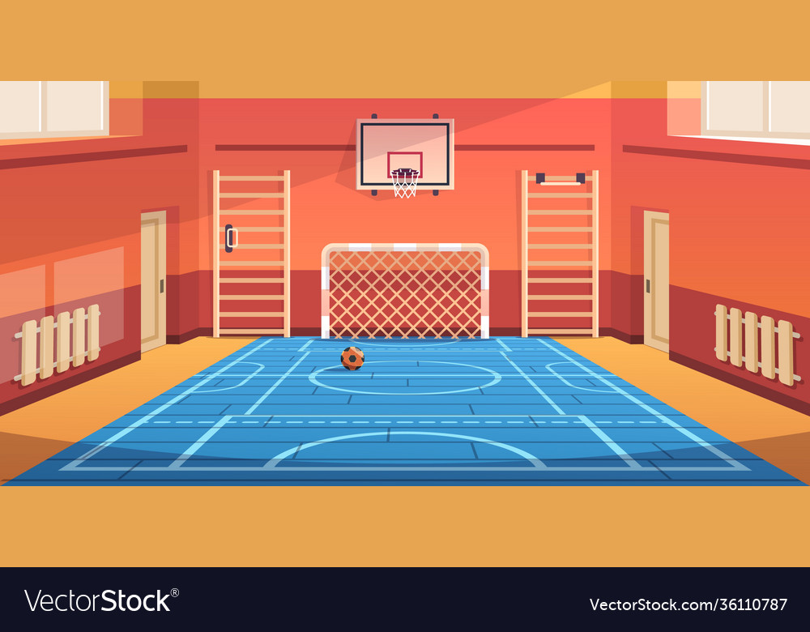

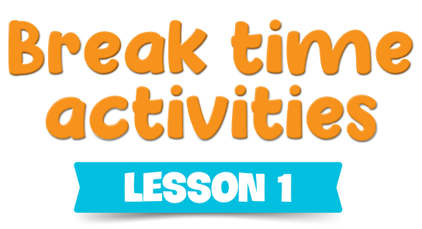

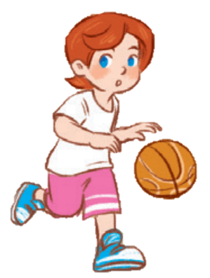
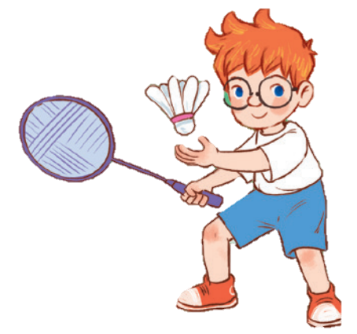
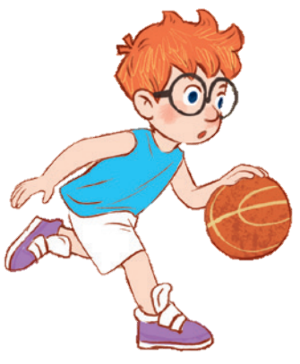
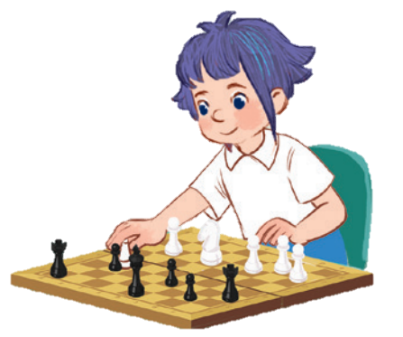
10
Period 1

Slide 3
Contents
1
5
Fun corner and wrap-up
Warm-up and review
4
2
3
Let’s talk.
Look, listen and repeat.
Listen, point and say.

Slide 4
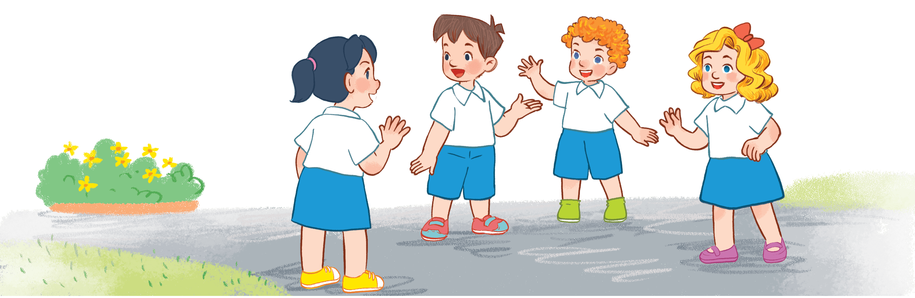
Warm-up AND REVIEW
Notes:
Game: Look and Guess
- Teacher shows 4 pictures numbered 1 to 4 on the board.
- Teacher lets the pupils choose 1 square on the screen and open it.
- Teacher lets the pupils guess the corresponding number of the picture.

Slide 5

Let’s sing a song!

Slide 6
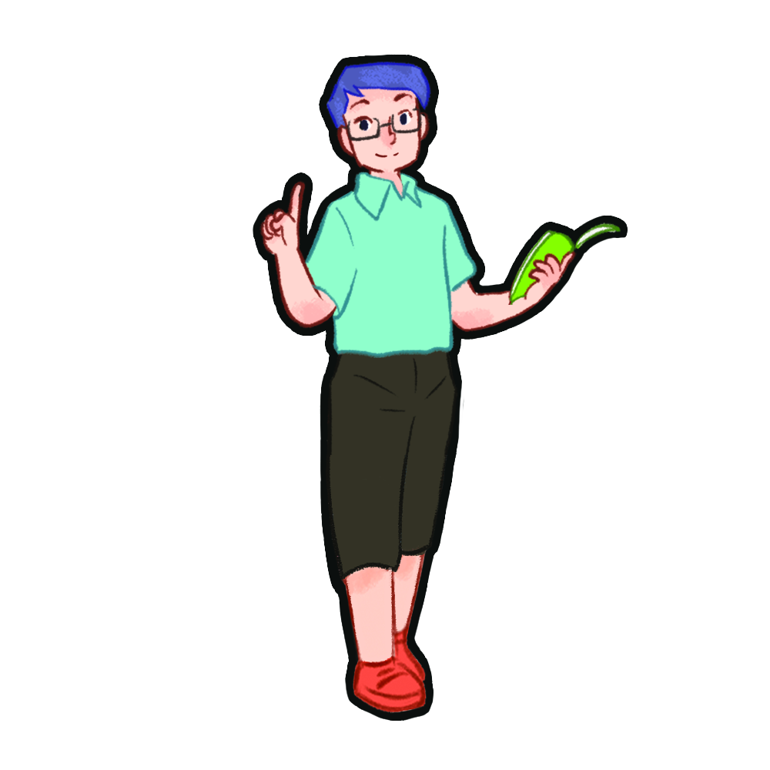
Look, listen and repeat.

Slide 7

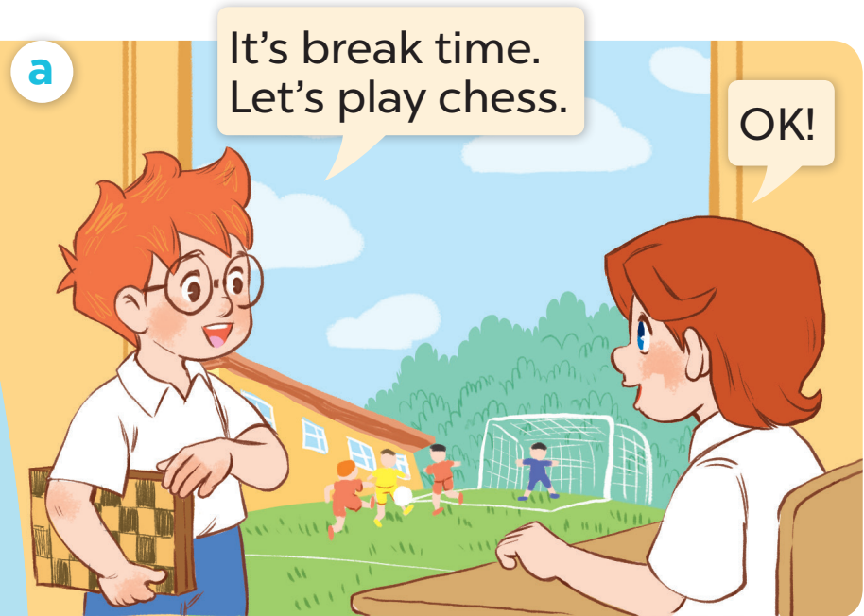
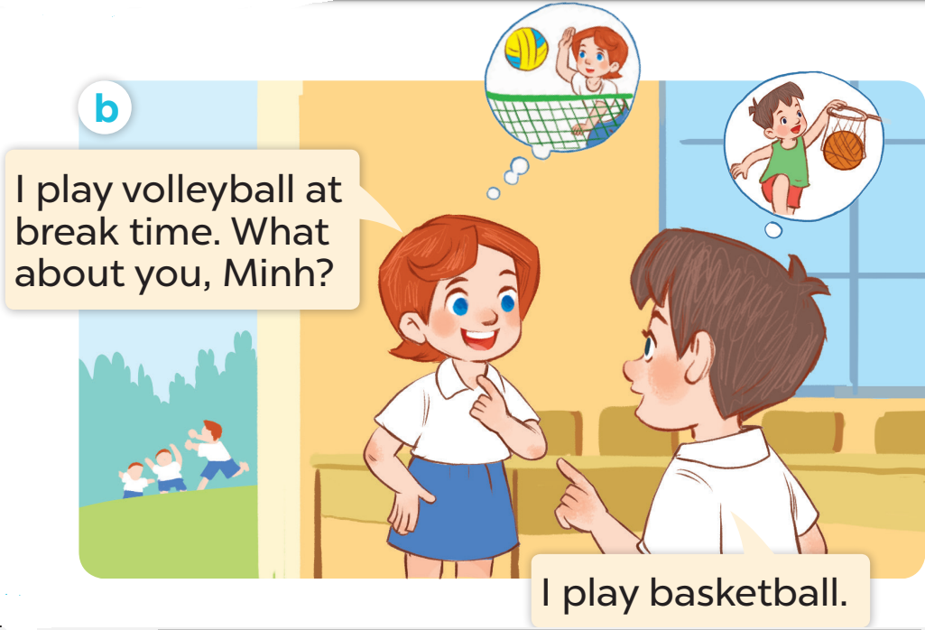

Slide 8
Listen, point and say.

Slide 9
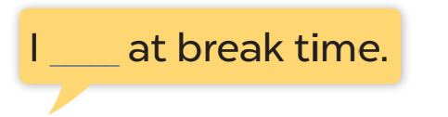
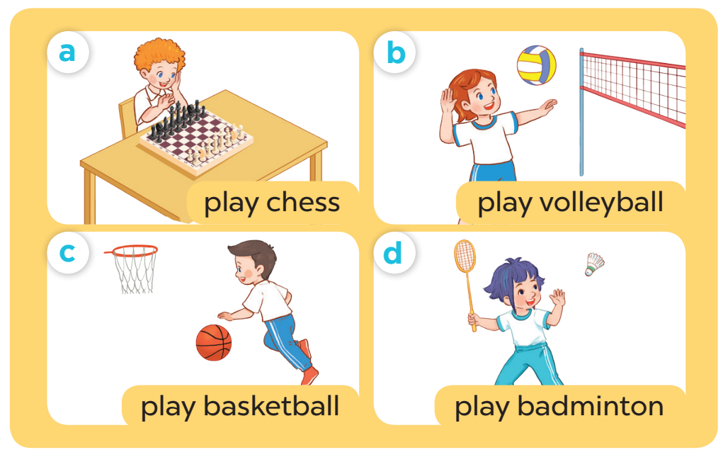

Slide 10
Game time
Notes:
Game: Whisper
- Teacher divides the class into groups of 4.
- Teachers asks 2 groups to get in 2 lines and stand back to the board.
- Teacher asks the first pupil of each line to look at one picture and whisper to the next pupil.
- The last one of each line comes to the board and choose the picture and stick it on the board.
- Change the position of the first pupil and repeat the activities.

Slide 11
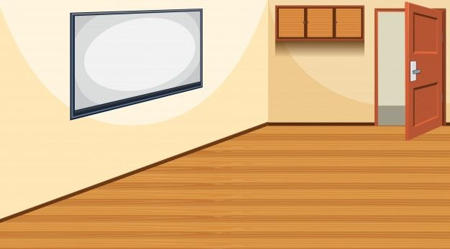


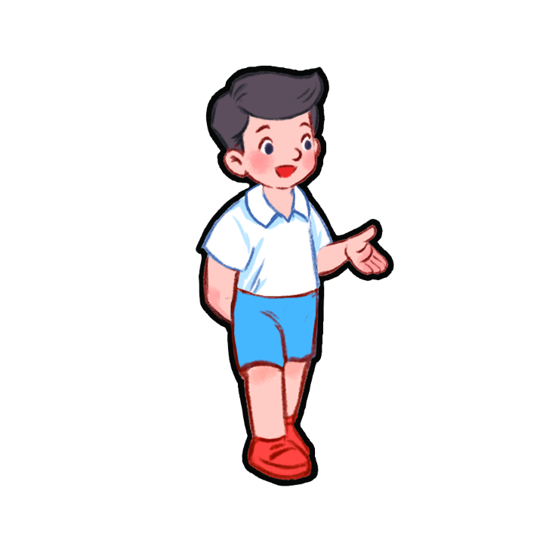

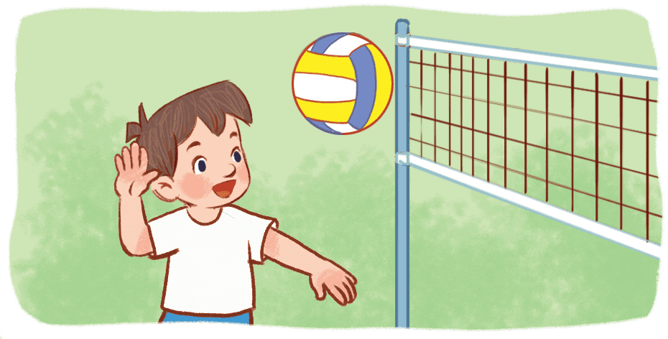
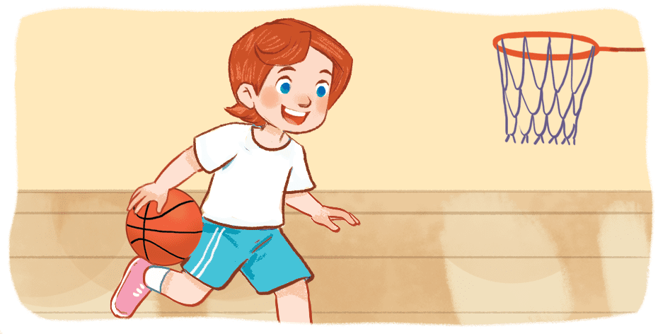

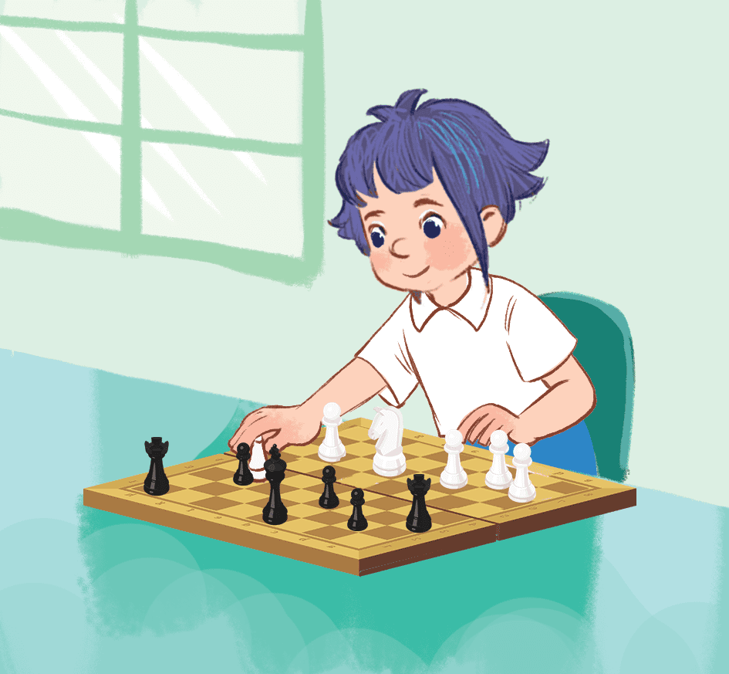
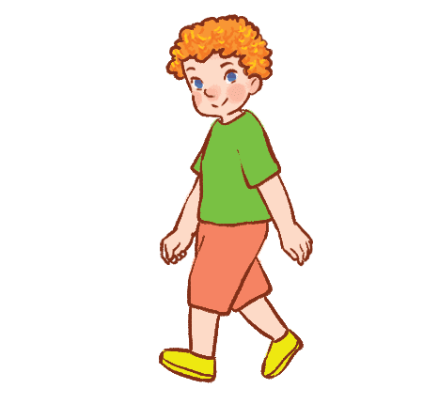


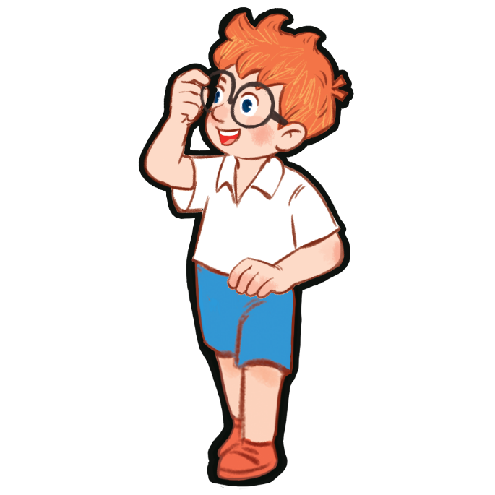
TEAM B
TEAM A

Slide 12
TEAM B
TEAM A

Slide 13



TEAM B
TEAM A

Slide 14
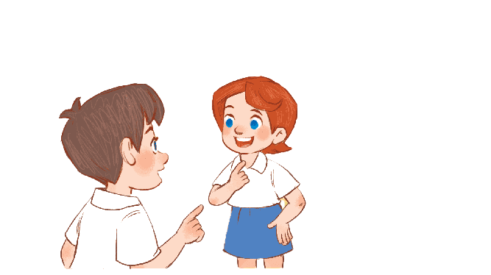
Let’s talk.

Slide 15
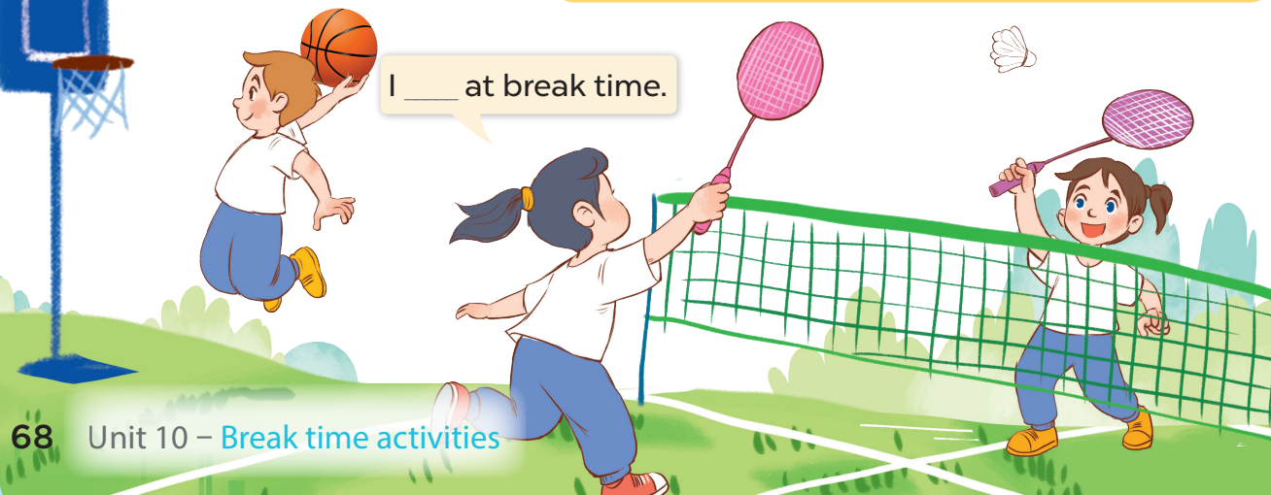

Slide 16

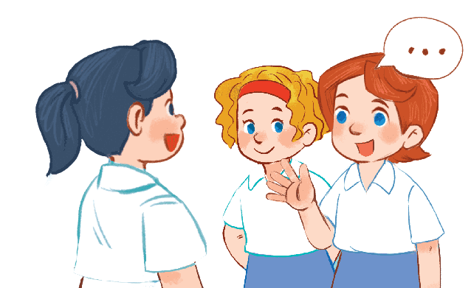
I ……….. at break time
Notes:
-T asks pupils to practise in pairs asking and answering.
-T asks some pairs to present in front of the class.

Slide 17
Fun corner and Wrap-up
Notes:
Game: Act and guess
- Teacher asks 4 pupils to come to the board and act to describe 4 break time activities (play volleyball, play basketball, play chess, play badminton).
- Teacher asks the others to look at the pictures on the board and guess which pupils go with which pictures.

Slide 18
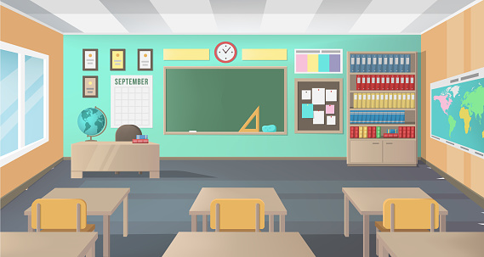
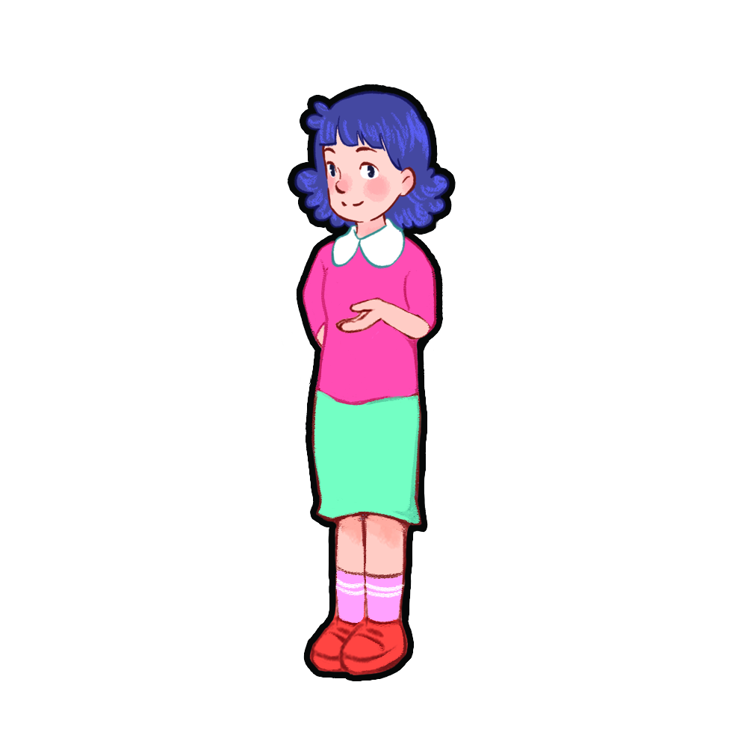




(1)
(2)
(3)
(4)
Notes:
Game: Act and guess
- Teacher asks 4 pupils to come to the board and act to describe 4 break time activities (play volleyball, play basketball, play chess, play badminton).
- Teacher asks the others to look at the pictures on the board and guess which pupils go with which pictures.

Slide 19
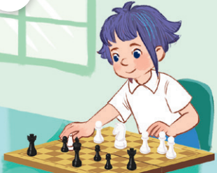
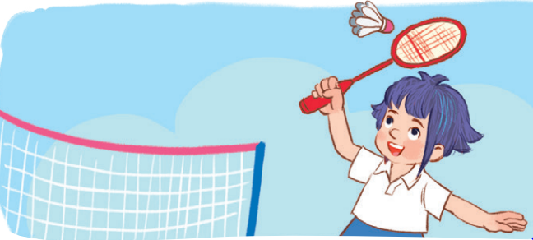
(1)
(3)
(2)
(4)

Slide 20

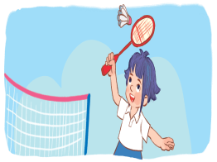
play
basketball
play
chess
play
volleyball
play
badminton
I ………. at break time.
Notes:
Teacher shows 4 pictures of break time activities on the board and asks pupils to practice using the model structure to make sentences.

