Slide 1



Slide 2



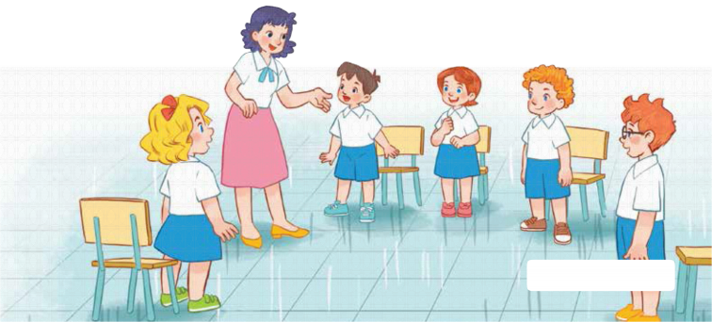
7
Classroom instructions
LESSON 1 – PERIOD 1

Slide 3
CONTENTS
Let’s talk
Look, listen and repeat
Fun corner and wrap up
Warm up & Review
Listen, point and say

Slide 4






Warm up
Notes:
https://www.google.com/search?q=rabbit+cartoon&sxsrf=AOaemvI4GpfofmPqG5NYtRRWAhHG_M37gA:1641483894523&source=lnms&tbm=isch&sa=X&ved=2ahUKEwjPwb-DvJ31AhVTeXAKHeYoA28Q_AUoAXoECAIQAw&biw=1920&bih=937&dpr=1#imgrc=-IJh1Pag2361iM&imgdii=nPvTt9-uBm-XjM
https://www.google.com/search?q=rabbit+cartoon&sxsrf=AOaemvI4GpfofmPqG5NYtRRWAhHG_M37gA:1641483894523&source=lnms&tbm=isch&sa=X&ved=2ahUKEwjPwb-DvJ31AhVTeXAKHeYoA28Q_AUoAXoECAIQAw&biw=1920&bih=937&dpr=1#imgrc=-IJh1Pag2361iM
https://www.google.com/search?q=carrot+with+leaves+cartoon&tbm=isch&ved=https://www.google.com/search?q=carrot+with+leaves+cartoon&tbm=isch&ved=2ahUKEwjHncXRvp31AhURxGEKHQ9vARsQ2-cCegQIABAA&oq=carrot+with+leaves+cartoon&gs_lcp=CgNpbWcQAzoHCCMQ7wMQJzoICAAQCBAHEB46BggAEAgQHlCeD1jVSmD4TmgAcAB4AIABcYgBggqSAQQwLjEymAEAoAEBqgELZ3dzLXdpei1pbWfAAQE&sclient=img&ei=MxHXYYe4A5GIhwOP3oXYAQ&bih=937&biw=1920#imgrc=pApEKpKtTBk_lM&imgdii=gW9vxPI06BP1jM

Slide 5


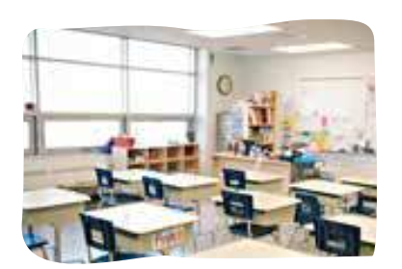
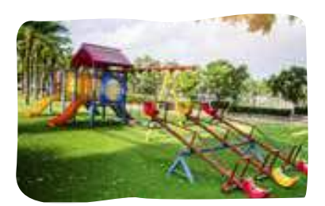
Listen and choose
library
classroom
playground
back
Notes:
Click on Listen and choose

Slide 6
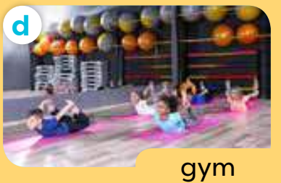
Listen and choose
classroom
gym
Playground
back
Notes:
Click on Listen and choose

Slide 7
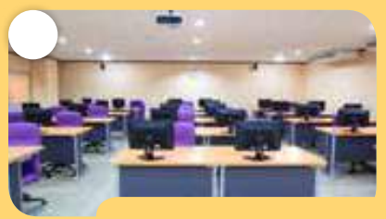
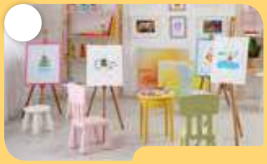
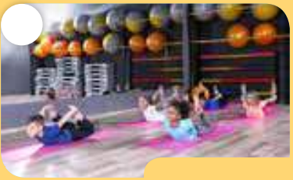
Listen and choose
Let’s go to the _____.
OK, let’s go.
computer room
art room
gym
back
Notes:
Click on Listen and choose

Slide 8
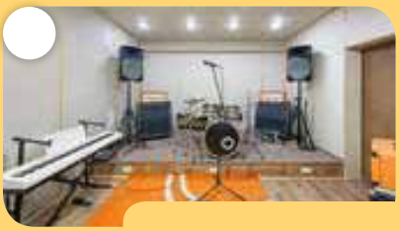
Listen and choose
Let’s go to the _____.
OK, let’s go.
art room
music room
computer room
back
Notes:
Click on Listen and choose

Slide 9
Listen and choose
Let’s go to the _____.
OK, let’s go.
music room
gym
art room
back
Notes:
Click on Listen and choose

Slide 10
Listen and choose
Let’s go to the _____.
OK, let’s go.
music room
computer room
art room
back
Notes:
Click on Listen and choose

Slide 11

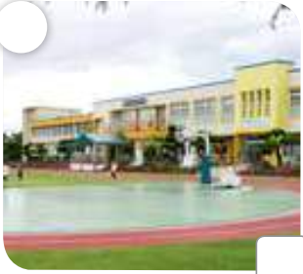
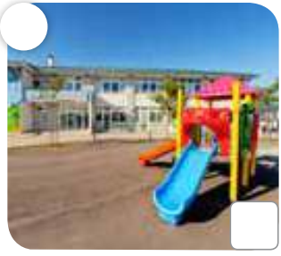
Is this our swimming pool?
Yes, it is./ No, it isn’t.
back

Slide 12
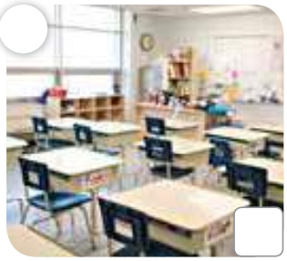
Is this our classroom?
Yes, it is./ No, it isn’t.
back

Slide 13
Is this our library?
Yes, it is./ No, it isn’t.
back

Slide 14
Is this our playground?
Yes, it is./ No, it isn’t.
back

Slide 15

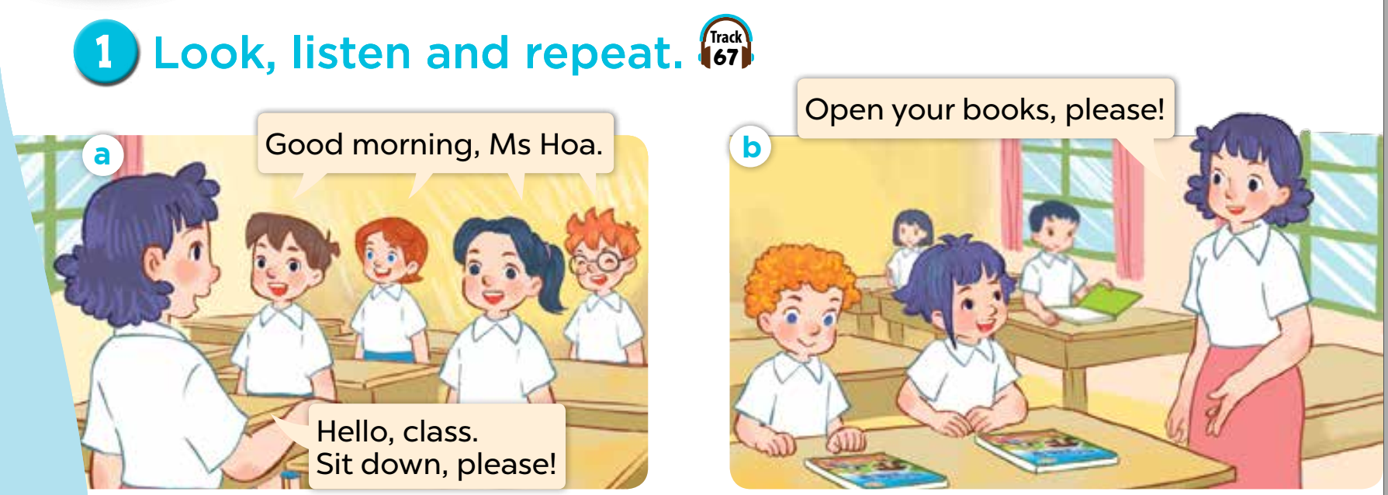

Slide 16
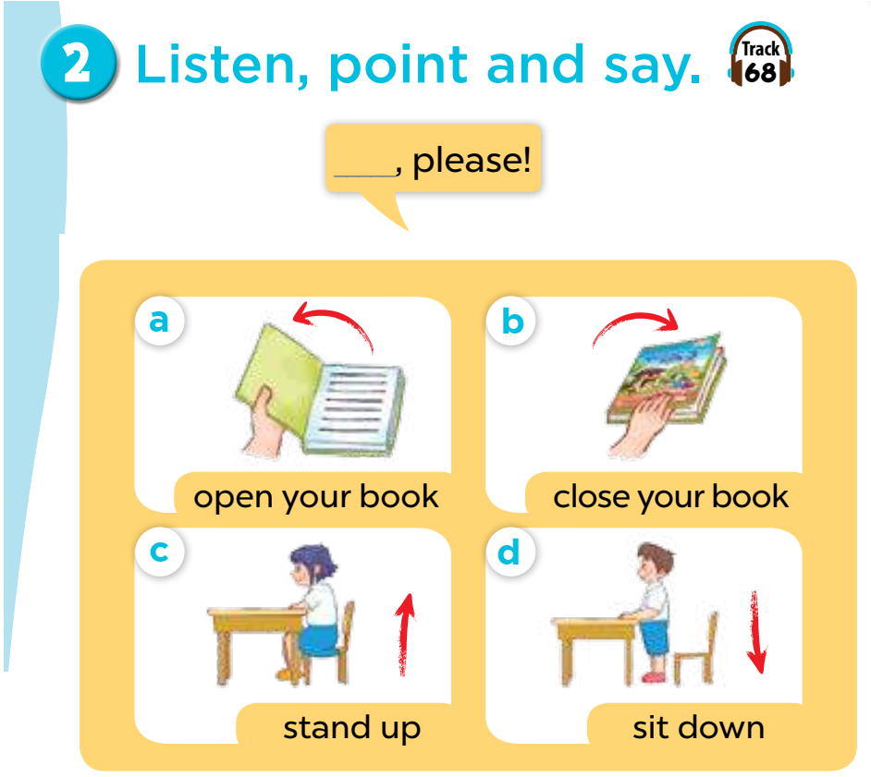

Slide 17
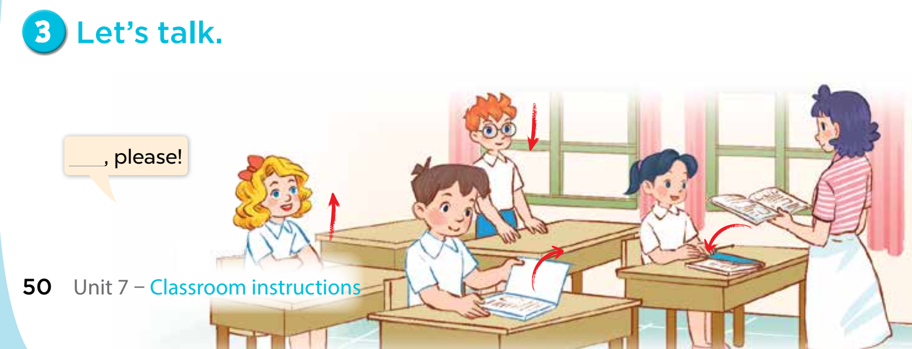


Slide 18
Fun corner and wrap up

Slide 19







A
B
60
10
70
45
90
30
20
100
35
80
40
50
CLICK IN THE WHEEL
Notes:
Hs chọn cây dù mình thích, đi đến câu hỏi, trả lời, sau đó quay lại vòng quay để nhận điểm.

Slide 20

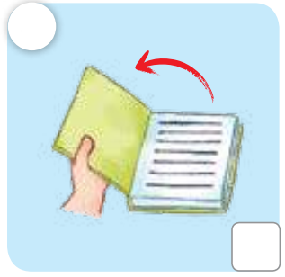


please!
Open your book, please!
Open
your
Book,
CHECK

Slide 21
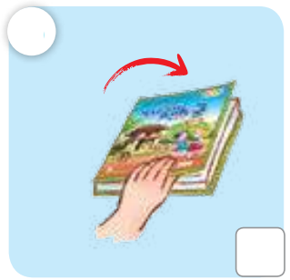
please!
your
book,
Close
Close your book, please!
CHECK

Slide 22
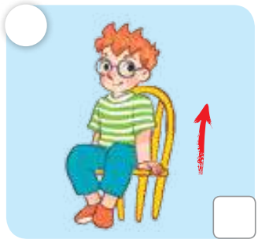
Stand up, please!
Stand
please!
up,
CHECK

Slide 23
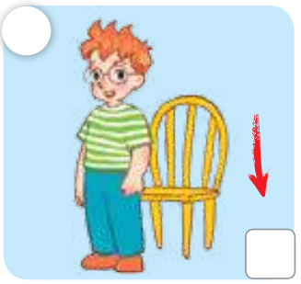
Sit down, please!
Sit
down
please!
CHECK

Slide 24
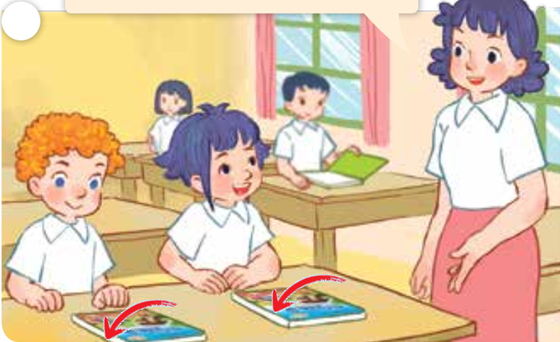
please!
Close your books, please!
Close
your
books,
CHECK

Slide 25
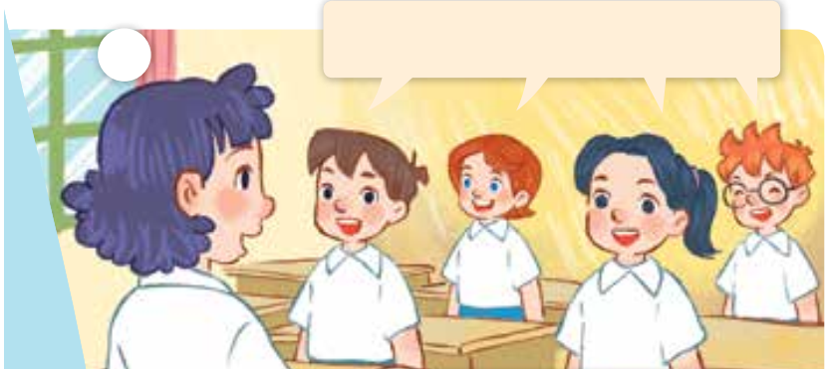
Good morning, Ms Hoa.
Good
morning,
Ms Hoa.
CHECK

Slide 26
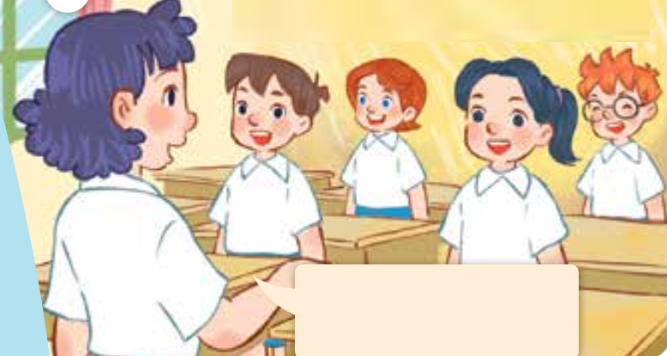
Hello, class.
Sit down, please!
Hello,
class.
Sit down,
please!
CHECK

Slide 27
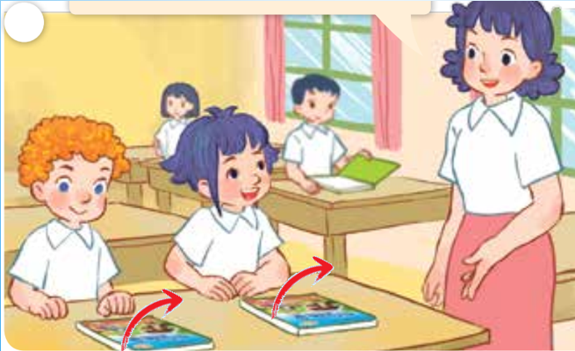
please!
Open your books, please!
Open
your
books,
CHECK

Slide 28
Extra stuffs

Slide 29

Website: sachmem.vn
Fanpage: www.facebook.com/sachmem.vn

