Slide 1






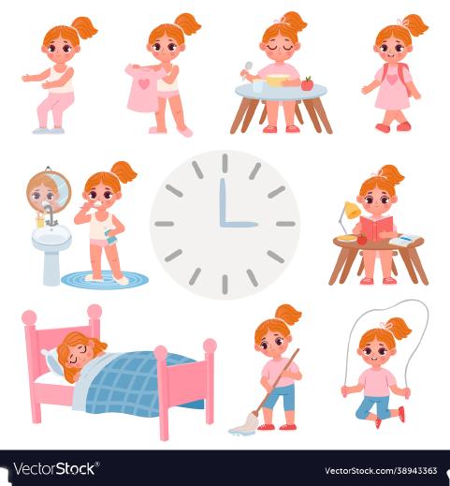


Unit 2
Time and
daily routine
MsPham
0936082789
Lesson 1 – Period 1

Slide 2

Warm up

Slide 3


MsPham
0936082789
MsPham
0936082789
Vocabulary

Slide 4




Vocabulary
MsPham
0936082789
o’clock
/əˈklɒk/
: giờ (đúng)
What time
/wɒt taɪm/
: Mấy giờ
fifteen
/ˌfɪfˈtiːn/
: 15
thirty
/ˈθɜːti/
: 30
forty-five
/fɔːti ˈfaɪv/
: 45

Slide 5
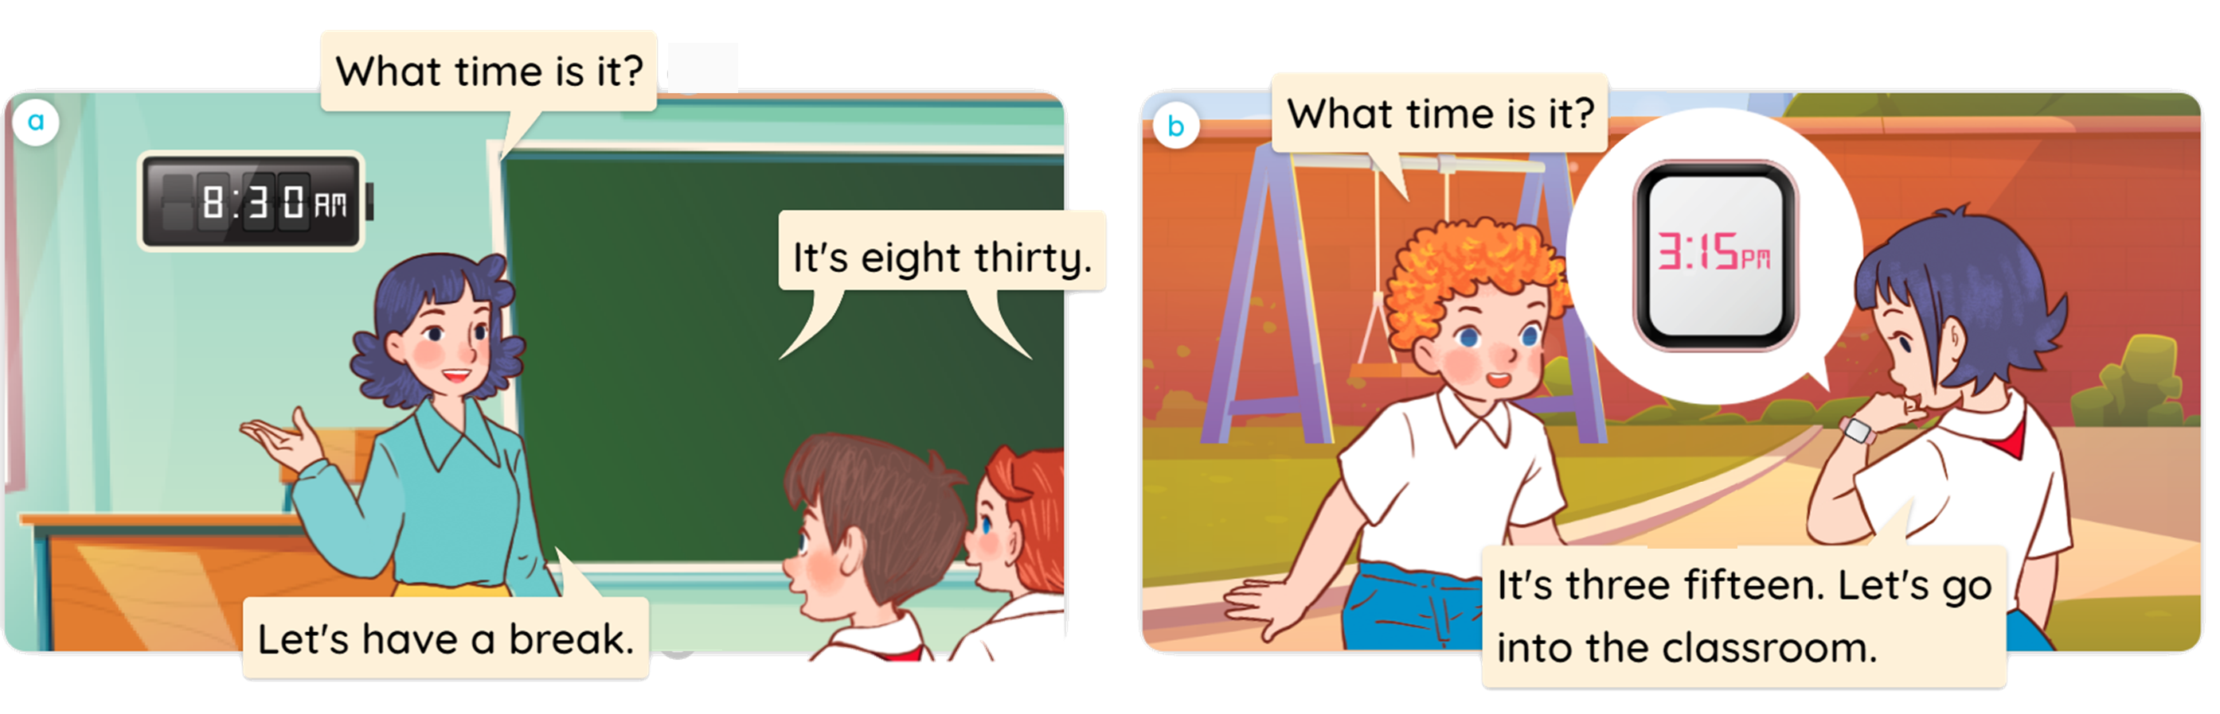


1
Look, listen and read.

Slide 6
MsPham
0936082789
MsPham
0936082789
Structure

Slide 7

1
Cách hỏi giờ:
What time is it?
(Mấy giờ rồi?)
It's + số giờ + o’clock.
It's + số giờ + số phút.
Ex: It’s six o’clock.
Ex: It’s six fifteen.
AM
AM
06 : 00
06 : 15
MsPham
0936082789
MsPham
0936082789
MsPham
0936082789
MsPham
0936082789

Slide 8



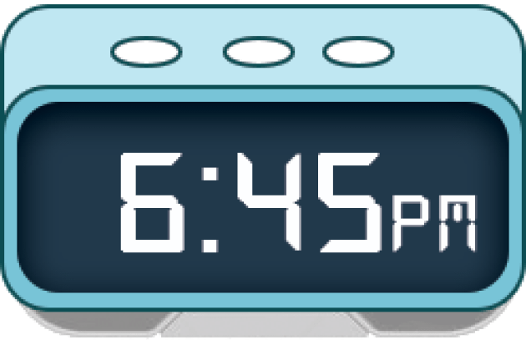
2
Listen, point and say.
a
b
six o’clock
six fifteen
c
d
six thirty
six forty-five

Slide 9
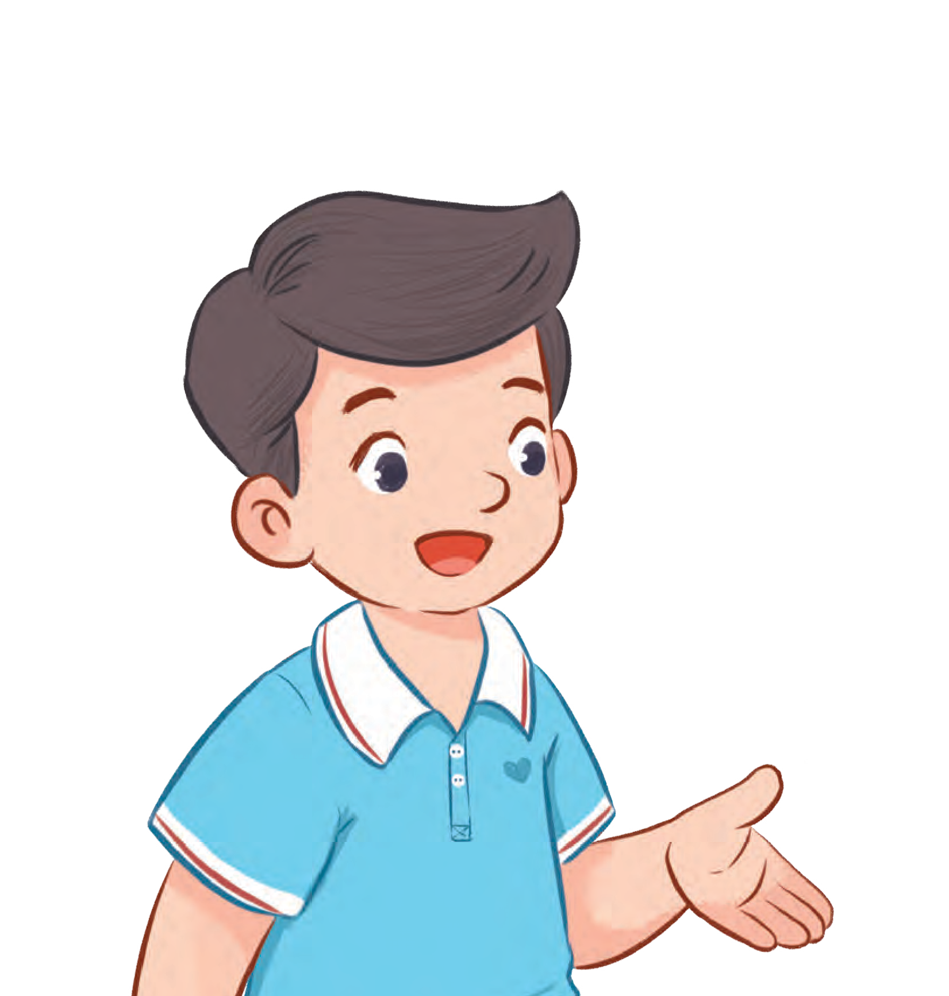

2
Listen, point and say.
a
AM
06 : 00
MsPham
0936082789
MsPham
0936082789
MsPham
0936082789
six o’clock
What time is it?
It’s six o’clock.

Slide 10
2
Listen, point and say.
b
AM
06 : 15
MsPham
0936082789
MsPham
0936082789
MsPham
0936082789
six fifteen
What time is it?
It’s six fifteen.

Slide 11
2
Listen, point and say.
c
AM
06 : 30
MsPham
0936082789
MsPham
0936082789
MsPham
0936082789
six thirty
What time is it?
It’s six thirty.

Slide 12
2
Listen, point and say.
d
AM
06 : 45
MsPham
0936082789
MsPham
0936082789
MsPham
0936082789
six forty-five
What time is it?
It’s six forty-five.

Slide 13
2
Listen, point and say.
a
b
six o’clock
six fifteen
c
d
six thirty
six forty-five

Slide 14







Notes:
Ms Huyền Phạm - 0936.082.789 – YOUTUBE: MsPham. Facebook: Dạy và học cùng công nghệ.

Slide 15




+5
It’s six o’clock.
What time is it?
-1
It’s o’clock six.
AM
06 : 00
-1
It’s six fifteen.
MsPham
0936082789
MsPham
0936082789
Notes:
Ms Huyền Phạm - 0936.082.789 – YOUTUBE: MsPham. Facebook: Dạy và học cùng công nghệ.

Slide 16
-1
It’s six fifteen
o’clock.
What time is it?
+5
It’s six fifteen.
AM
06 : 15
-1
It’s six forty-five.
MsPham
0936082789
MsPham
0936082789
Notes:
Ms Huyền Phạm - 0936.082.789 – YOUTUBE: MsPham. Facebook: Dạy và học cùng công nghệ.

Slide 17
+5
It’s six thirty.
What time is it?
-1
It’s six fifteen.
AM
06 : 30
-1
It’s six forty-five.
MsPham
0936082789
MsPham
0936082789
Notes:
Ms Huyền Phạm - 0936.082.789 – YOUTUBE: MsPham. Facebook: Dạy và học cùng công nghệ.

Slide 18
-1
It’s six fifteen.
What time is it?
+5
It’s six forty-five.
AM
06 : 45
-1
It’s six thirty.
MsPham
0936082789
MsPham
0936082789
Notes:
Ms Huyền Phạm - 0936.082.789 – YOUTUBE: MsPham. Facebook: Dạy và học cùng công nghệ.

Slide 19
+5
It’s eight ten.
What time is it?
-1
It’s ten eight.
PM
08 : 10
-1
It’s eight o’clock.
MsPham
0936082789
MsPham
0936082789
Notes:
Ms Huyền Phạm - 0936.082.789 – YOUTUBE: MsPham. Facebook: Dạy và học cùng công nghệ.

Slide 20
-1
It’s eight fifteen.
What time is it?
It’s eight forty.
-1
PM
08 : 50
+5
It’s eight fifty.
MsPham
0936082789
MsPham
0936082789
Notes:
Ms Huyền Phạm - 0936.082.789 – YOUTUBE: MsPham. Facebook: Dạy và học cùng công nghệ.

Slide 21
+5
It’s eight twenty.
What time is it?
-1
It’s twenty eight.
PM
08 : 20
-1
It’s eight twelve.
MsPham
0936082789
MsPham
0936082789
Notes:
Ms Huyền Phạm - 0936.082.789 – YOUTUBE: MsPham. Facebook: Dạy và học cùng công nghệ.

Slide 22
-1
What time it is?
____________?
It’s nine o’clock.
What is time it?
-1
PM
09 : 00
+5
What time is it?
MsPham
0936082789
MsPham
0936082789
Notes:
Ms Huyền Phạm - 0936.082.789 – YOUTUBE: MsPham. Facebook: Dạy và học cùng công nghệ.

Slide 23


Great job!
Exit
Notes:
Ms Huyền Phạm - 0936.082.789 – YOUTUBE: MsPham. Facebook: Dạy và học cùng công nghệ.

Slide 24

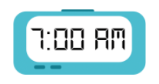

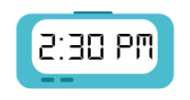




2
Let’s talk.
It’s seven o’clock.
What time is it?

Slide 25
2
Let’s talk.
It’s eight fifteen.
What time is it?

Slide 26
2
Let’s talk.
It’s two thirty.
What time is it?

Slide 27
2
Let’s talk.
It’s four forty-five.
What time is it?

Slide 28
2
Let’s talk.
eight fifteen
four forty-five
It’s _____________.
seven o’clock
two thirty
What time is it?

Slide 29
MsPham
0936082789
MsPham
0936082789
Review

Slide 30
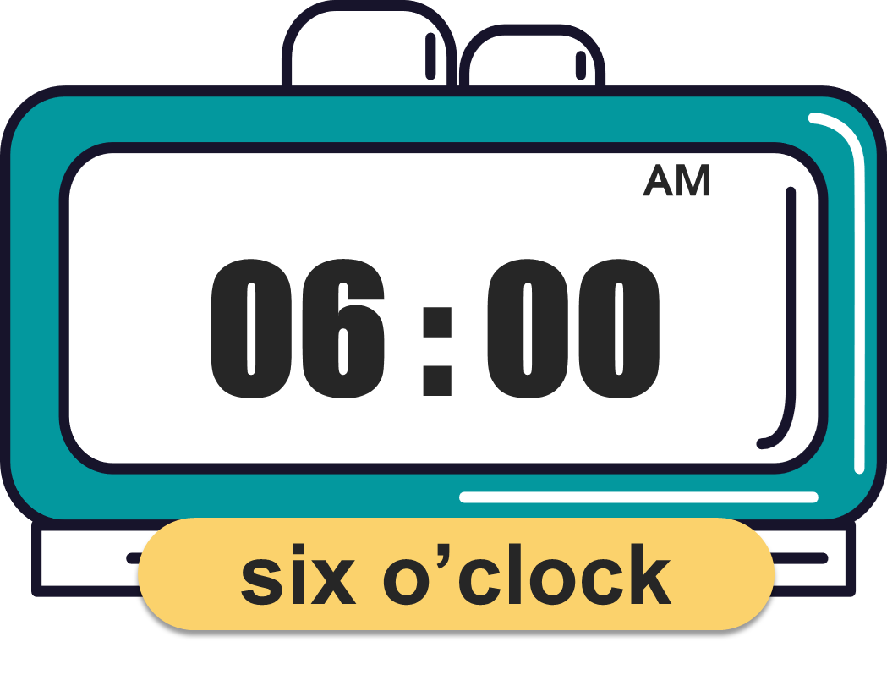
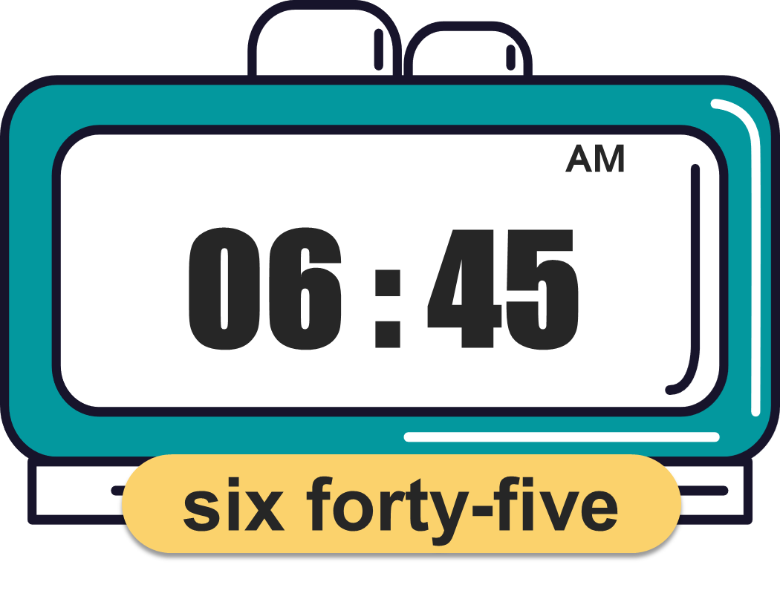
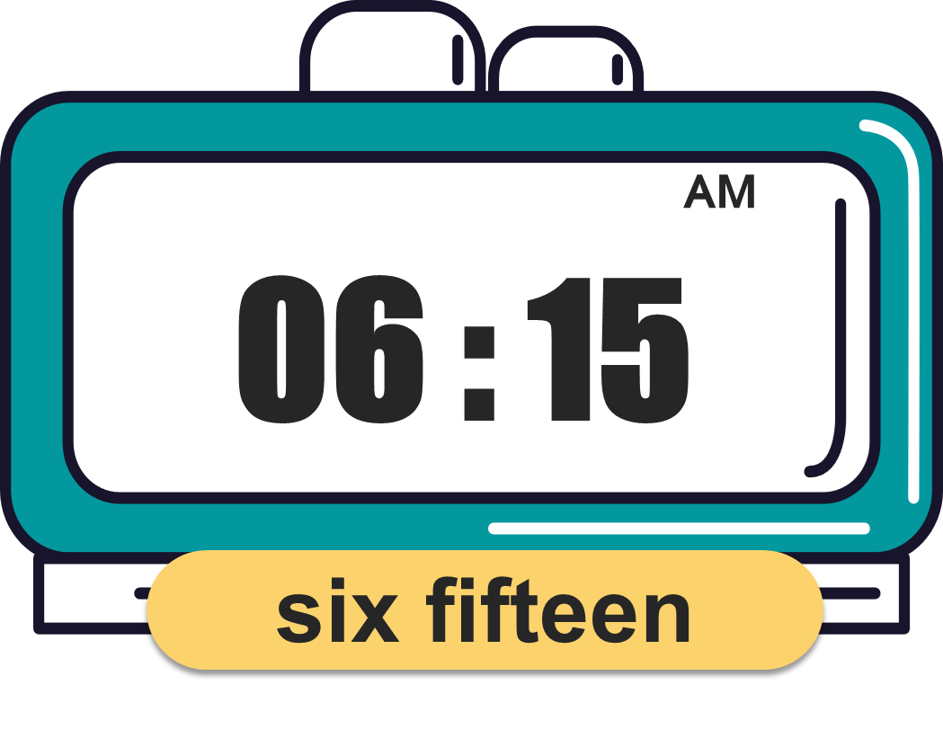
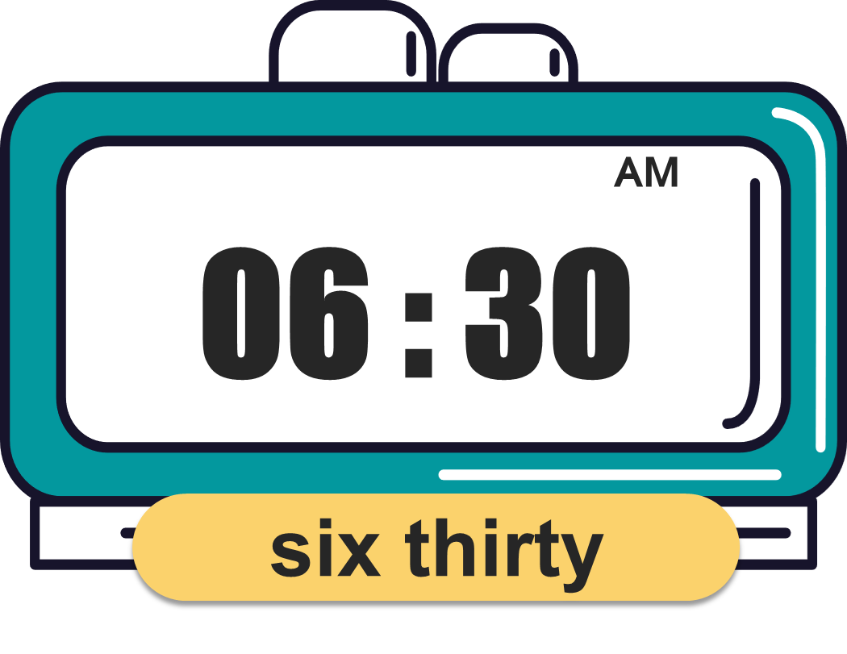
What time is it?
(Mấy giờ rồi?)
MsPham
0936082789
It’s _________.
(____)
MsPham
0936082789

Slide 31
MsPham
0936082789
Thank you!

