Slide 1







Unit 4
My Birthday
Party
Lesson 3 ( 4,5,6)/ p 33

Slide 2


MsPham
0936082789
Warm-up

Slide 3










Luật chơi:
Các đội lần lượt chọn các số từ 1-10.
Trả lời đúng được cộng, trả lời sai bị trừ số điểm đã mở.
Ô chứa ngôi sao xanh được +20 điểm.
Ô chứa sao đen bị -20 điểm.
Lucky number
PLAY
Notes:
Ms Huyền Phạm - 0936.082.789 – YOUTUBE: MsPham. Facebook: Dạy và học cùng công nghệ.

Slide 4


2
10
20
10
3
4
1
-20
10
7
6
+20
20
5
10
8
9
10
20
10
Notes:
Ms Huyền Phạm - 0936.082.789 – YOUTUBE: MsPham. Facebook: Dạy và học cùng công nghệ.

Slide 5


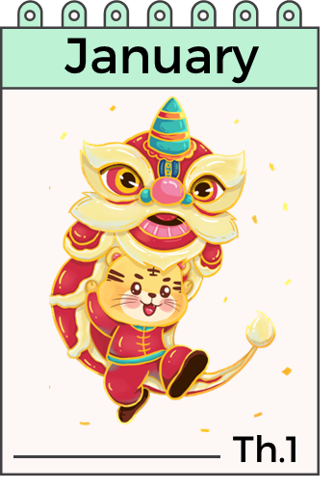


When’s your birthday?
A It’s on January.
B It’s in January.
C It’s at January.
Notes:
Ms Huyền Phạm - 0936.082.789 – YOUTUBE: MsPham. Facebook: Dạy và học cùng công nghệ.

Slide 6

When’s your birthday?
A I’m in April.
B I am in April.
C It’s in April.
Notes:
Ms Huyền Phạm - 0936.082.789 – YOUTUBE: MsPham. Facebook: Dạy và học cùng công nghệ.

Slide 7

It’s in January.
A When’s your birthday?
B When your birthday?
C What’s your birthday?
Notes:
Ms Huyền Phạm - 0936.082.789 – YOUTUBE: MsPham. Facebook: Dạy và học cùng công nghệ.

Slide 8

When’s your birthday?
A It’s in December.
B It’s in February.
C It’s in August.
Notes:
Ms Huyền Phạm - 0936.082.789 – YOUTUBE: MsPham. Facebook: Dạy và học cùng công nghệ.

Slide 9
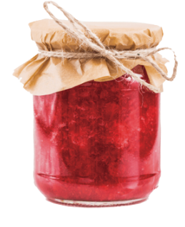
What do you want to eat?
A I want some jelly.
B I want some juce.
C I want some jam.
Notes:
Ms Huyền Phạm - 0936.082.789 – YOUTUBE: MsPham. Facebook: Dạy và học cùng công nghệ.

Slide 10

I want some water.
A What do you want
to eat ?
B What do you want
to drink ?
C What do you want
to do?
Notes:
Ms Huyền Phạm - 0936.082.789 – YOUTUBE: MsPham. Facebook: Dạy và học cùng công nghệ.

Slide 11

What do you want
____ drink?
A with
B in
C to
Notes:
Ms Huyền Phạm - 0936.082.789 – YOUTUBE: MsPham. Facebook: Dạy và học cùng công nghệ.

Slide 12
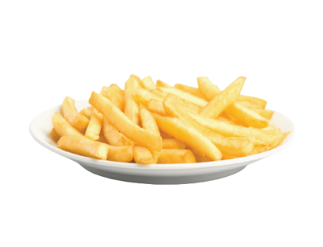
What ____ you want
to eat?
A do
B does
C are
Notes:
Ms Huyền Phạm - 0936.082.789 – YOUTUBE: MsPham. Facebook: Dạy và học cùng công nghệ.

Slide 13
MsPham
0936082789
Review

Slide 14


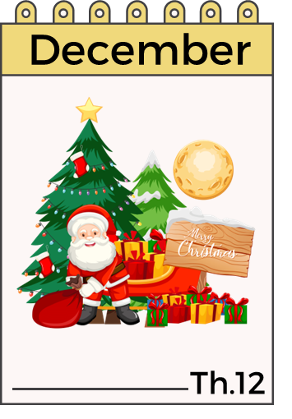


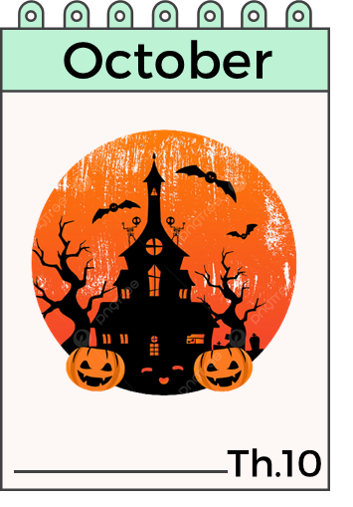
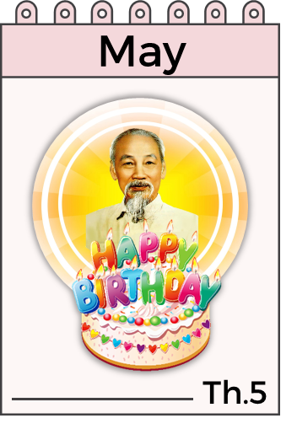

When’s your birthday?
It’s in ___________.
MsPham
0936082789

Slide 15


What do you want to eat/drink?
I want some _________.
MsPham
0936082789
chips
water
grapes
lemonade
jam
juice

Slide 16
MsPham
0936082789
New lesson

Slide 17
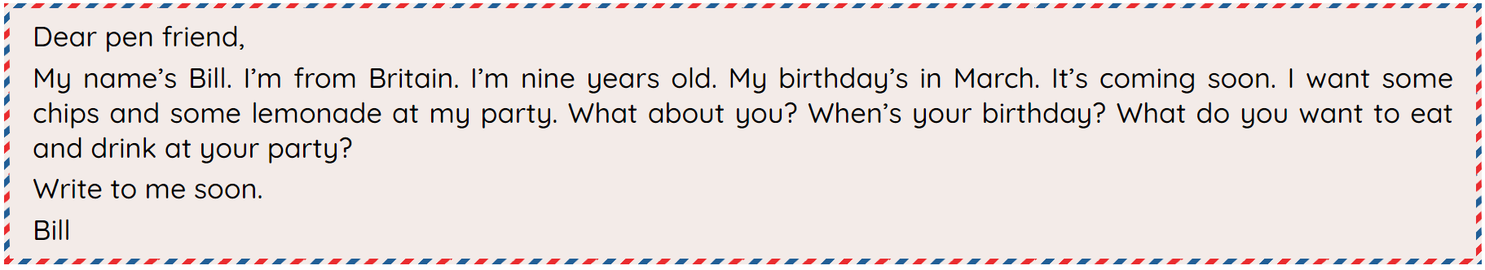
4
Read and circle.
Dear pen friend,
My name's Bill. I'm from Britain. I'm nine years old. My birthday's in March. It's coming soon. I want some chips and some lemonade at my party. What about you? When's your birthday? What do you want to eat and drink at your party?
Write to me soon.
Bill
MsPham
0936082789
1. Bill is from _________.
a. America b. Britain c. Australia
2. His birthday's in _________.
a. March b. January c. April
3. He wants some _________.
a. chips b. grapes c. jam
4. He wants some _________.
a. milk b. lemonade c. water

Slide 18
5
Let’s write.
My name is (1) ……….. I am from (2)…………... My birthday is in (3)……………... I want (4) …………. at my party.
MsPham
0936082789

Slide 19
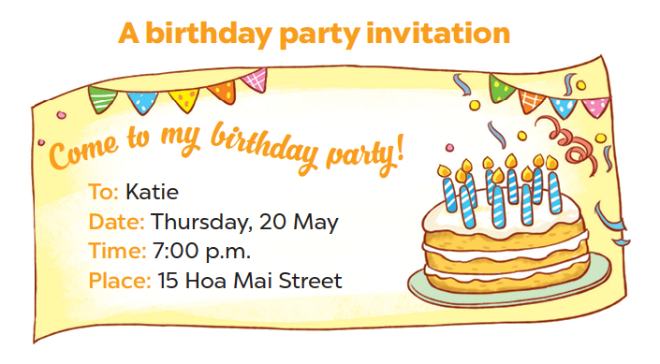
6
Project
MsPham
0936082789

Slide 20
A birthday party invitation card
A birthday party invitation card
Come to my birthday party
To : …………………………….
Date : ……………………………………………..
Time: ……………………………………………
Place : ………………………………………………

Slide 21
5
Let’s write.
A birthday party invitation card
Come to my birthday party
To : Lan Huong
Date : Saturday, 25 October
Time: 7.00 p.m
Place : My house at Kim Cham village

Slide 22
MsPham
0936082789
Extra
Structure

Slide 23
3
Cách hỏi sinh nhật của một người nào đó:

Slide 24
When’s his/her birthday?
It’s in ___________.
(Khi nào là sinh nhật của amh ấy /của cô ấy?)
MsPham
0936082789

Slide 25
4
Cách hỏi của một người nào đó muốn ăn/uống gì:
What does he/she want to eat/drink?
He/She wants some _________.
MsPham
0936082789
chips
water
grapes
lemonade
jam
juice

Slide 26
MsPham
0936082789
Practice

Slide 27
Thank you
for joining!

