Slide 1







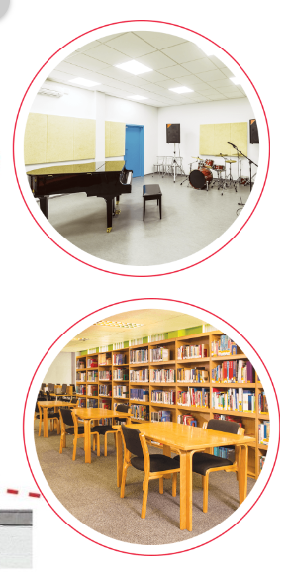
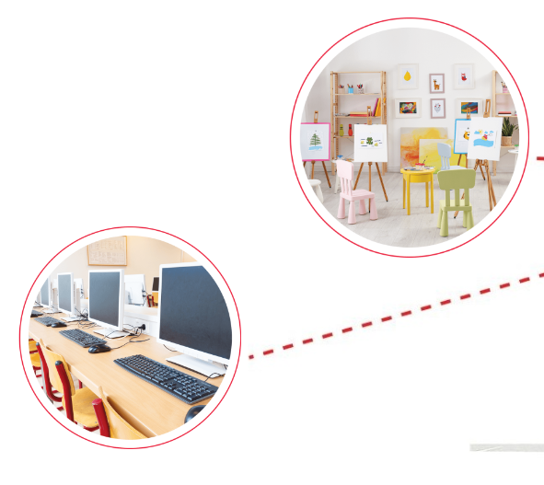





Unit 6
Our school
rooms
Lesson 1
Part: 1, 2, 3
https://www.facebook.com/msphampowerpoint

Slide 2


Structures
Cách hỏi và trả lời xem một phòng (học) nào đó ở đâu?
Where is the ____________?
(+ room)
MsPham
0936082789
(Phòng _______ ở đâu?)
It’s on the ___________.
(+ floor)
(Nó ở tầng _______.)

Slide 3
Vocabulary
MsPham
0936082789
second floor
/ˈsekənd flɔː(r)/
MsPham
0936082789
tầng thứ hai
(tầng 2)

Slide 4
Vocabulary
MsPham
0936082789
third floor
/θɜːd flɔː(r)/
MsPham
0936082789
tầng thứ ba
(tầng 3)

Slide 5
Vocabulary
MsPham
0936082789
third floor
second floor
first floor
MsPham
0936082789
ground floor

Slide 6

Vocabulary check
(Choose the correct answer)
MsPham
0936082789
A
third floor
B
second floor
MsPham
0936082789
C
first floor

Slide 7
Vocabulary check
(Choose the correct answer)
MsPham
0936082789
A
first floor
B
ground floor
MsPham
0936082789
C
second floor

Slide 8
Vocabulary check
(Choose the correct answer)
MsPham
0936082789
A
third floor
B
ground floor
MsPham
0936082789
C
third floor

Slide 9
Vocabulary check
(Choose the correct answer)
MsPham
0936082789
A
ground floor
B
second floor
MsPham
0936082789
C
first floor

Slide 10

Vocabulary check
(Choose the correct answer)
MsPham
0936082789
A
B
C
MsPham
0936082789
second floor

Slide 11
Vocabulary check
(Choose the correct answer)
MsPham
0936082789
A
B
MsPham
0936082789
C
first floor

Slide 12
Vocabulary check
(Choose the correct answer)
MsPham
0936082789
A
B
MsPham
0936082789
C
ground floor

Slide 13
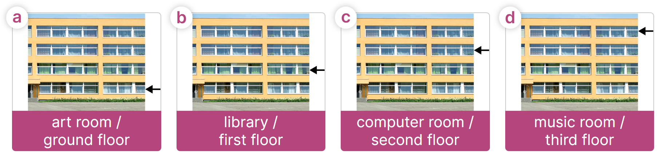
Listen, point and say
Where's the library?
Where's the ________?
MsPham
0936082789
It's on the __________.
It's on the first floor.

Slide 14
Listen, point and say
Where's the computer room?
Where's the ________?
MsPham
0936082789
It's on the __________.
It's on the second floor.

Slide 15
Listen, point and say
Where's the music room?
Where's the ________?
MsPham
0936082789
It's on the __________.
It's on the third floor.

Slide 16
Listen, point and say
Where's the ________?
MsPham
0936082789
It's on the __________.

Slide 17
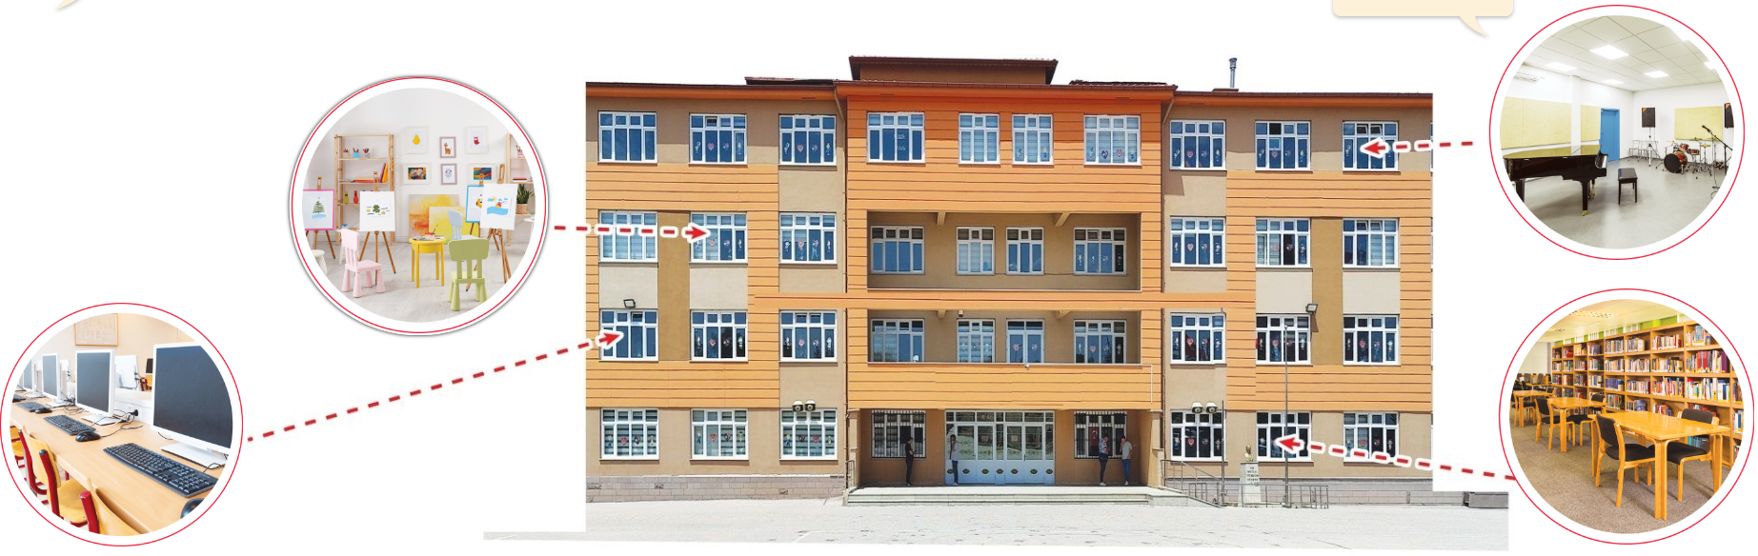
Let’s talk
Where's the ________?
Where's the ____________?
art room
It's on the __________.
second floor
MsPham
0936082789

Slide 18
Let’s talk
Where's the ________?
Where's the ____________?
computer room
It's on the __________.
first floor
MsPham
0936082789

Slide 19
Let’s talk
Where's the ________?
Where's the ____________?
music room
It's on the __________.
third floor
MsPham
0936082789

Slide 20




A
Where's the art room?
It's on the
third floor.
B
It's on the
second floor.
C
It's on the
first floor.
D
They likes sport.
Notes:
Ms Huyền Phạm - 0936.082.789 – YOUTUBE: MsPham. Facebook: Dạy và học cùng công nghệ.

Slide 21


Review
Where's the ______?
It's on the ______.
art room
library
MsPham
0936082789
computer room
music room
third floor
second floor
first floor
ground floor

